Slide 1
CEOS Systems Engineering Tools for Gap Analyses
LSI-VC Meeting (remote presentation)
February 14, 2019
Hanoi, Vietnam
Brian Killough
CEOS Systems Engineering Office
NASA Langley Research Center

Slide 2
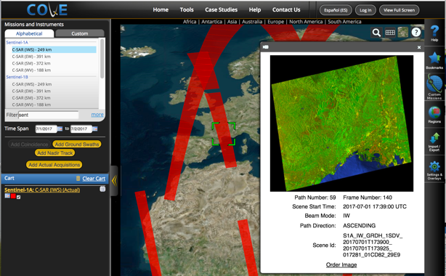
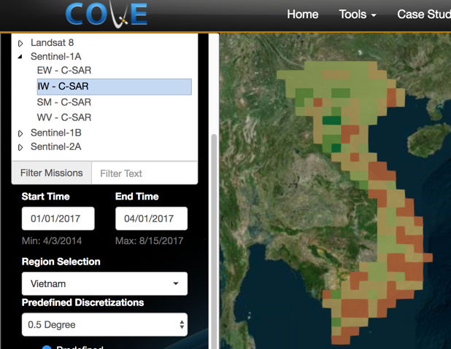
COVE Tool Summary
The CEOS Visualization Environment (COVE) is undergoing development to upgrade its mission database and to add new features
AMA recently hired a programmer to replace Kayla, who left in late 2018.
The new features will allow improved analyses and visualization of instrument coverage and the ability to create custom missions.
Climatological cloud data will also be added to assess cloud coverage for optical missions.
Many of these features will be valuable for LSI gap analyses
www.ceos-cove.org

Slide 3
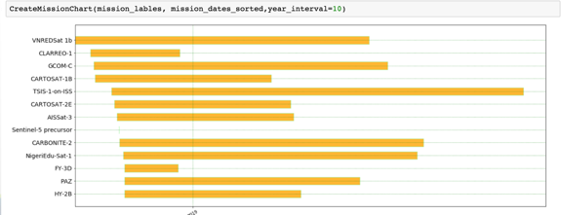
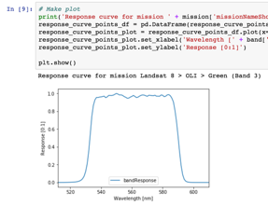
MIM Database Tool
The SEO continues to work with Symbios and ESA to produce annual updates to the MIM database and to add new features.
NASA HQ (Dave Jarrett) has funded the SEO to add capabilities to COVE and the MIM database to support NASA's Sustainable Land Imaging (SLI) Architecture Study and Decadal Survey Studies.
A new API function is being added to the MIM database that will allow custom and powerful queries of the content. In addition, many of the data parameters are bring converted from text format to a database format. These includes: orbits, data policy, resolution, swath and spectral bands.

Slide 4
Future Analyses
The BIG question is what does the community need for gap analyses? What are the questions they might be asking? Here are some examples ...
What missions are being flown now and in the future for a specific measurement type or spectral band window?
What is the coverage provided by two missions at the same time, assuming they have interoperable datasets (e.g. Landsat and Sentinel-2)?
Are there gaps in time for a specific instrument type or measurement type, now and in the future?
Which of the datasets that meet a specific query are openly available?
Broad gap analyses across domains are very difficult as there are too many detailed and subtle constraints that cannot be modeled with the MIM data.
A simple MIM API tool will definitely add a new and powerful capability for systems analyses but we need to be careful that we do not design it too focused on one analysis product.

