Slide 1
Open Data Cube Update
Brian Killough, NASA, SEO
Land Surface Imaging (LSI-VC) Meeting
Session 6
Anchorage, Alaska, USA
4 September 2019

Slide 2
Strategic Direction (for SIT)
What is the goal of the Data Cube initiative?
From the Open Data Cube website ... The ODC seeks to increase the value and impact of global Earth observation satellite data by providing an open and freely accessible exploitation architecture. The ODC project seeks to foster a community to develop, sustain, and grow the technology and the breadth and depth of its applications for societal benefit.
The “ultimate” goal ... foster a regional network of interoperable satellite data cubes (using CEOS ARD) to support a diverse set of global users
Who does the Data Cube support?
Users = Governments, Ministries, Researchers, Statistical Offices, Commercial
What are the key features of the Data Cube?
Free, open source software, cloud computing compatible, analysis-ready datasets, time series analyses, data interoperability, application algorithms focused on SDGs
Lowers “barrier to entry” and significantly increases the use of CEOS satellite data with a focus on non-traditional users in developing countries
What are the alternatives to the Data Cube?
Google Earth Engine, DIAS, Rasdaman ... less control, commercial connections
Traditional downloads ... slow and costly, growing data volumes cause issues

Slide 3
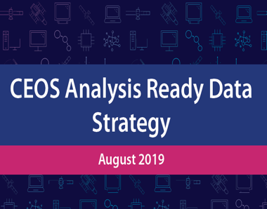
Analysis Ready Data
CEOS, thru the LSI-VC, is coordinating the specifications for analysis ready data (ARD) products. There is great interest in the user community and they recognize CEOS as the lead.
ARD is no longer a desire of global users, but is now becoming a requirement and an expectation!
ARD will help increase the use and impact of satellite data and remove the data workflow burden on less experienced data users.
Most of the ARD is stored on cloud-based systems which allows easy connections to the Open Data Cube (ODC) infrastructure
The combination of CEOS ARD (data) and the ODC (tool) is seen as an end-to-end contribution from CEOS to the user community
We are not just giving the data to the users, but we are making access easier and improving potential outcomes by connecting the data to an open source tool and algorithms
+
=

Slide 4
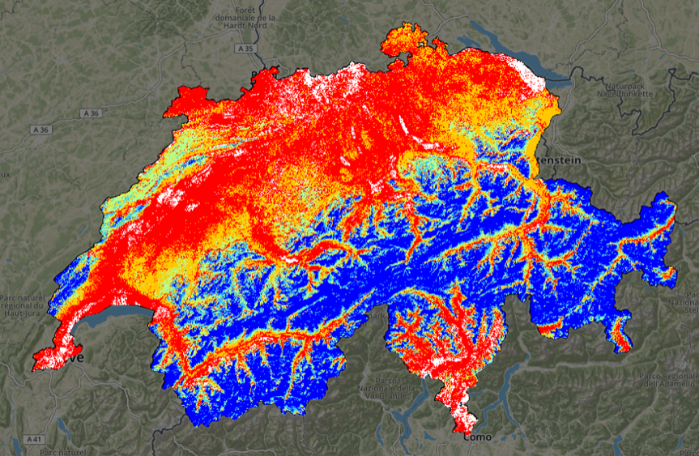
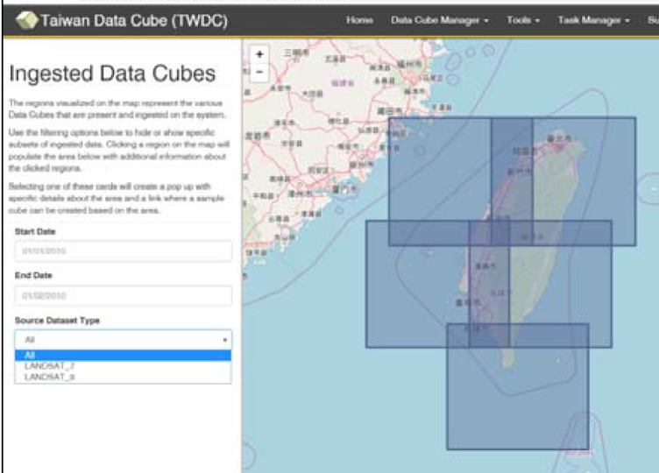
Data Cube Prototypes
Since the start of the Open Data project, there have been many examples of successful adoption of this technology to exploit the use of CEOS ARD and create impactful products.
UNEP and the University of Geneva created the first time series snow cover map of Switzerland
Taiwan used their Data Cube used to study Typhoon damage and recovery and manage their own Formosat ARD

Slide 5
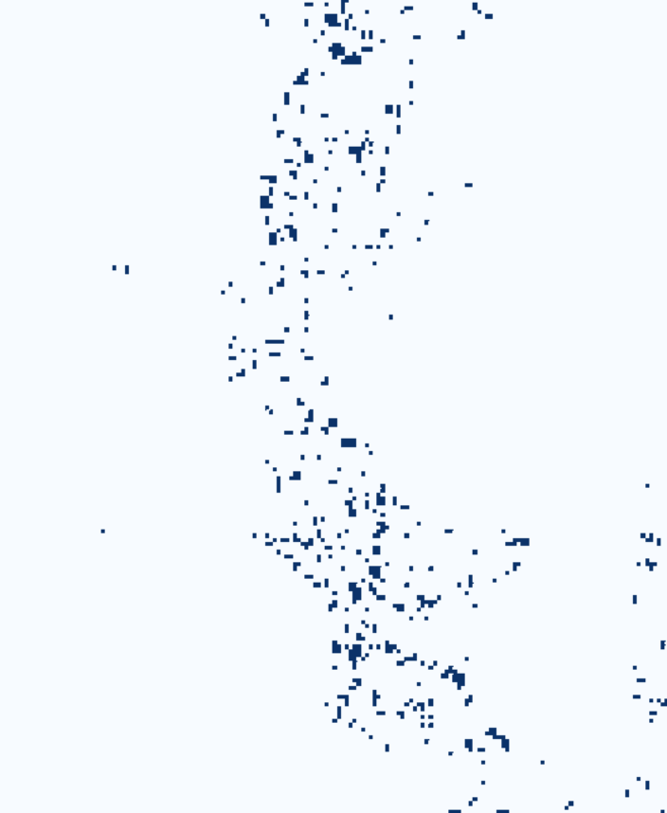
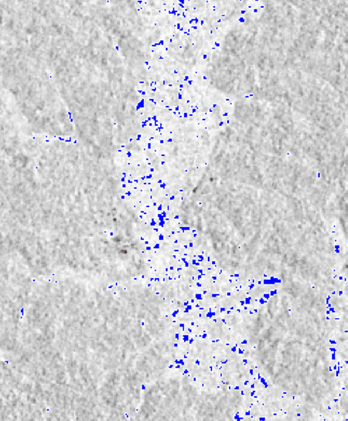
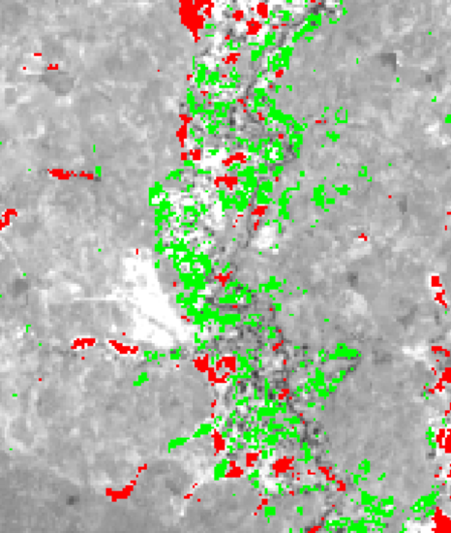
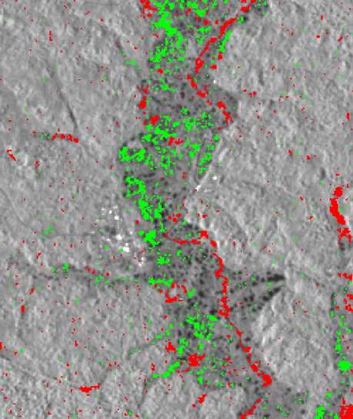
Ghana Mining
The Ghana government is learning how to use interoperable Sentinel-1 ARD and Landsat ARD to search for illegal mining and measure land change impact
Detection of water bodies in May 2017 using Landsat (left) and Sentinel-1 (right)
Detection of vegetation loss (red) and vegetation gain (green) from 2015 to 2018 using Landsat (left) and Sentinel-1 (right)

Slide 6
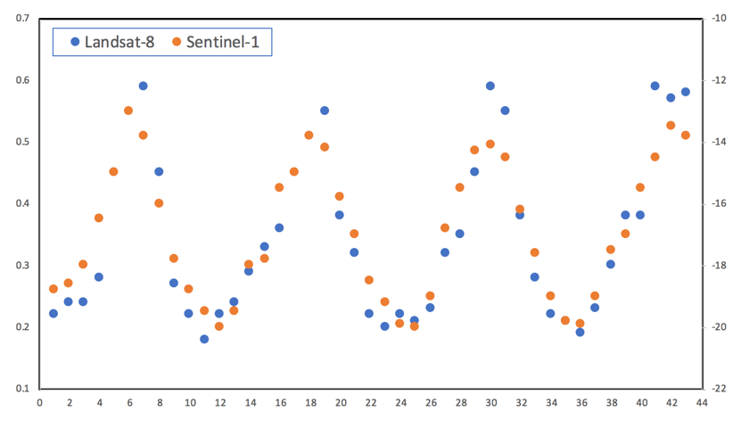
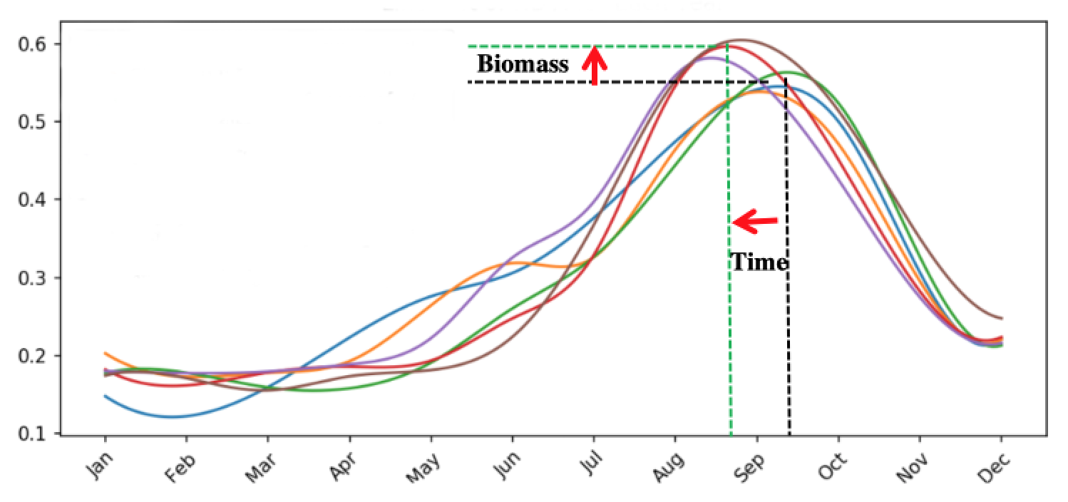
Agriculture Use Cases
Ghana agriculture scientists are studying the impact of new crop varieties and cultivation methods
NDVI Phenology shows increased biomass (yield) and earlier harvest
Landsat and Sentinel-1 phenology curves show similar response supporting the idea they can be used interoperably

Slide 7
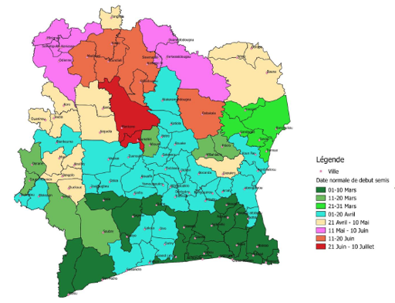
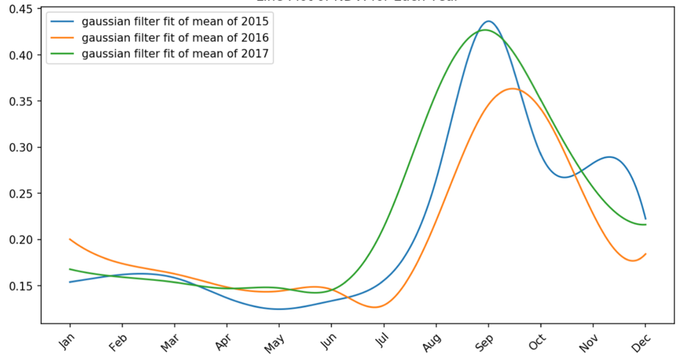
Testimonials
Start of Season variability for Maize in Ghana
NDVI Phenology for Millet Crops Measured yields in 2015 and 2017 were 5% higher than 2016 which is confirmed by the phenology data.
Senegal Government Agriculture Statistician ... This work will enable the ARDC to contribute directly to the estimation of crop yields in Senegal and will enable the government to improve the reliability of agricultural statistics in the calculation of SDG indicator 2.4.1 related to the proportion of land productive and sustainable agricultural
Ghana Government – Head of Geospatial Unit With climate variability a threat to food security and the increasing turn to climate change models and scenarios to support farm level crop production and insurance schemes (parametric), a clear understanding of the duration of crop growth cycles, beginning and end of sowing periods, etc. constitute critical parameter inputs that are currently not available. Existing information is mostly outdated.

Slide 8
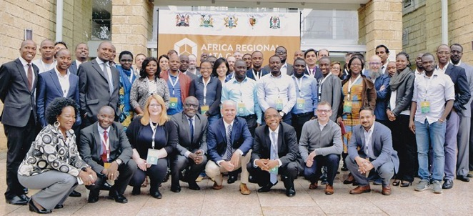
ARDC to DE-Africa
The African Regional Data Cube (ARDC) project was launched in May 2018 for 5 countries (Kenya, Tanzania, Sierra Leone, Senegal, Ghana). Based on Landsat, Sentinel-1 and ALOS data.
Supported by CEOS (lead + technical support), Amazon (donated cloud services) and GPSDD (training + management support).
Multiple web-based remote and face-to-face training sessions since May 2018
Initial country use-cases include agriculture, flooding, urbanization, deforestation and illegal mining.
Focus on Government and Statisical Agencies with growing interest across the countries
The success and use of the ARDC has led to an expansion of the effort to all of continental Africa (Digital Earth Africa) through >$20M of donor funding.

Slide 9
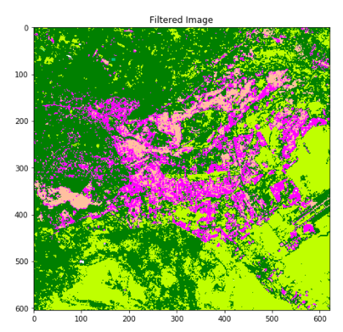
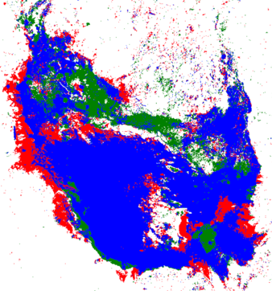
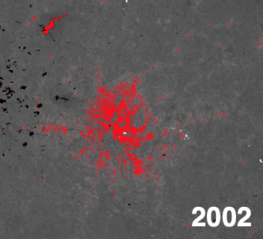
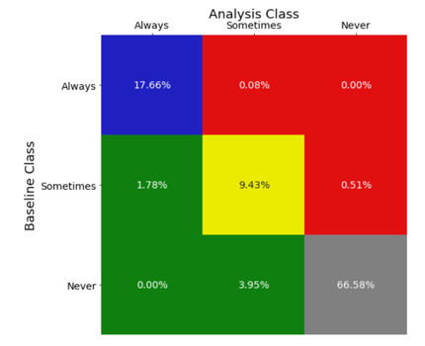
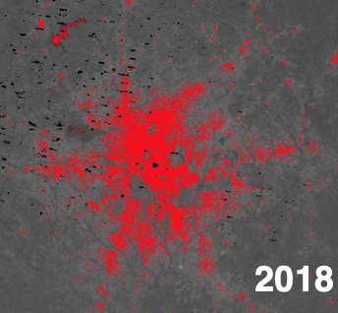
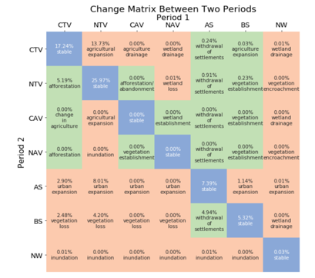
Support to SDGs
SDG 6.6.1
Water Extent
SDG 11.3.1
Urbanization
SDG 15.3.1 Land Degradation
Water Extent = Algorithm based on Landsat time series water detection using the Australian WOFS method. Can be easily used to support SDG reporting and is consistent with UN methodology and the JRC Global Surface Water Explorer.
Urbanization = Evaluating the use of thresholding with NDBI and Fractional Cover (Bare Soil). Also linked to GPWv4 population data. Better urban maps are needed to train and test classification. Working with UN-Habitat and Trends.Earth and evaluating the Impervious Surface Index (ISI).
Land Degradation = Initial testing using an 8-class FAO land classification approach and a change matrix to identify degradation. Evaluating the use of ESA-CCI data for supervised classification training and the UNCCD Good Practice document.
NOTE: Also making progress on SDG: 2.4.1 (Sustainable Agriculture) using Landsat and Sentinel-1 vegetation phenology algorithms

Slide 10
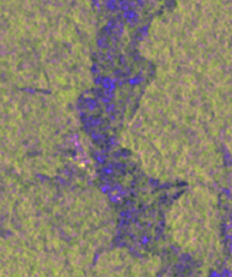
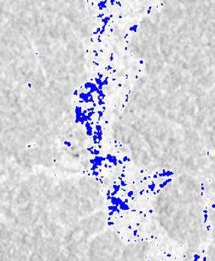
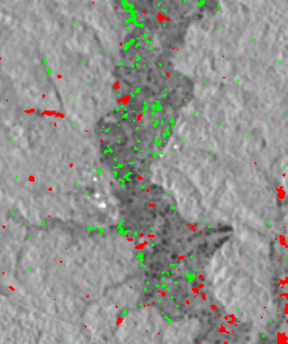
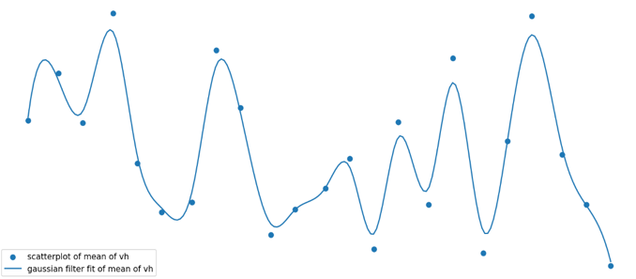
Sentinel-1 ODC Algorithms
Brian and Ake have been working hard on a Jupyter notebook focused on Sentinel-1 radar (on version #9).
Data was prepared by NORCE (Joerg Haarpainter, Norway) over Ghana. The data is monthly mean VV and VH backscatter intensity (likely satisfies most of our ARD requirements)
Some of the features of this notebook include: noise filtering, single date histograms and RGB images (far left), custom RGB (bands and dates, 2nd from left), single date threshold products (3rd from left), time series Gaussian plots (far right), and a multi-date change product (2nd from right).
ESRI has also developed a tool to browse the S1 data over Ghana = https://tinyurl.com/ghana-s1
A similar notebook will be developed for ALOS in time for the GEO meeting.

Slide 11
What is the future?
Work with LSI-VC to develop ARD specifications, promote the use of ARD and demonstrate its value through Data Cube prototypes and projects.
Support to SDGs through the development and sharing of algorithms connected to CEOS ARD
Support to Digital Earth Africa to demonstrate large-scale use of CEOS ARD with a common data analysis infrastructure (data cube).Migrating ARDC data and continental ALOS data.
Work with ESA (Albrecht Schmidt) to improve access to Sentinel ARD for global data cube users
Connect the Data Cube to Google Earth Engine ... huge community of users and algorithms and more datasets. SEO making some progress an talking often with the GEE team.
Connect with SEPAL to support GFOI ... an alternative infrastructure option
Work with GEOGLAM to create a Landsat-based version of the Crop Monitor ... University of Maryland already starting
Explore options to work with the ocean community for land/coastal boundary analyses and water quality and explore connections to new and diverse datasets (e.g. OLCI, Lidar, PACE)

Slide 12
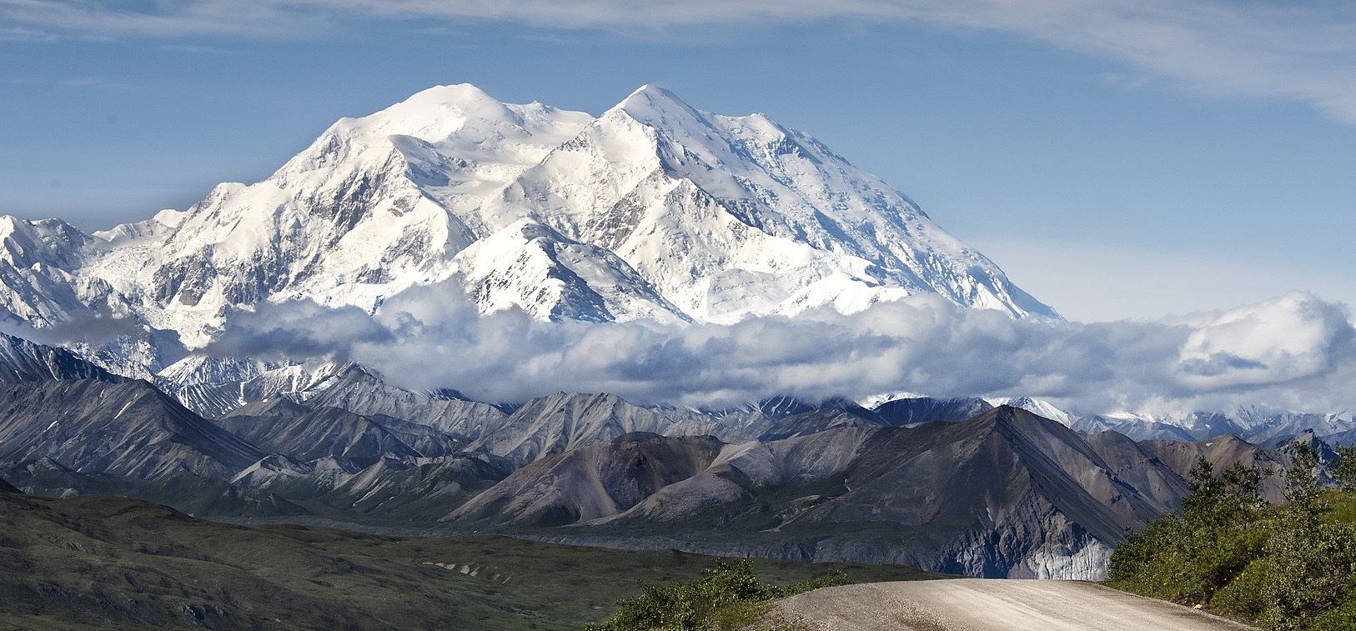
Thanks!

