Slide 1
GFOI Methods & Guidance Documentation Update
Ake Rosenqvist, for JAXA
with material provided by Carly Green
SDCG-16
Session 7, Item#5

Slide 2
Methods & Guidance Doc (MGD)

Slide 3
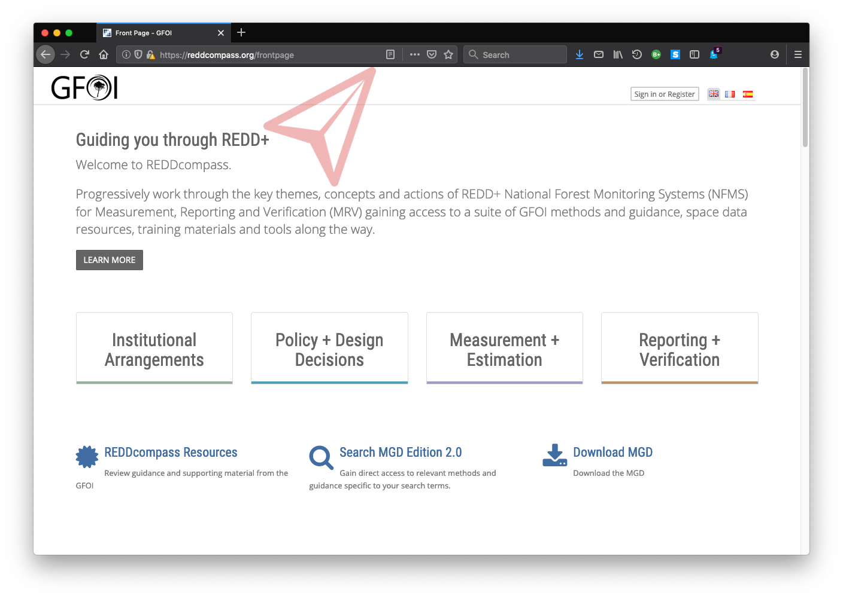
REDDcompass

Slide 4
MGD Work Plan 2019/2020
MGD update (v3.0)
REDDcompass upgrade
GFOI cross component collaboration (incl Repository of Tools)

Slide 5
MGD update process
Countries have significantly matured National Forest Monitoring Systems towards operational reporting of REDD+ results and GHG emissions and removals
To remain relevant MGD methodological guidance should mature to meet countries needs by:
Incorporating and sharing lessons learnt from REDD+ countries since 2016.
Respond to specific methodological requests from REDD+ countries and other GFOI partners
Remain state-of-the-art on National Forest Monitoring methodological advice
The MGD informed the IPCC 2019 refinement text; therefore no substantial edits required in this context

Slide 6
Broad update themes
System Wide
Improve the connection between Measurement and Estimation and Institutional Arrangements
Nesting of sub-national programmes and projects
Guidance on integrating the NFMS with other reporting commitments (eg. NDCs)
Technical
Additional guidance on attribution of land use to land cover
Country examples of how to capture/project impact of REDD+ mitigation actions
Examples of reporting REDD+ activities consistently and their relationship to GHGI categories
Distinguishing and monitoring difficult forest biomes (dryland / mountainous)
Methods/options for reducing uncertainty in activity data and emissions factors
Additional guidance on how to incorporate all carbon pools and other non-CO₂ gases

Slide 7
MGD update process - Timing
MGD leads currently working with authors to clarify writing tasks (← opportunity for CEOS agencies & SDCG)
Aim to have a first draft by Q1/2020
Extensive external review process during Q2/2020
REDDcompass undergoing a parallel update and release process

Slide 8
MGD update – CEOS relevance
EO-related updates necessary – MGD v2 outdated
Key missions now fully operational
New missions in orbit
CEOS Biomass protocol emerging
New global datasets (e.g. Global Mangrove Watch)
CARD4L process – tailored for country users
Cloud computing and Data Cubes...
Revision process “inclusive”. Great opportunity for SDCG to improve visibility of CEOS and EO to UNFCCC & REDD countries
SDCG ACTION#1: Encourage CEOS agencies to contribute to the MGD update

Slide 9
Repository of Tools
Repository of Tools to be hosted on REDDcompass
CALM used to assess status of tools
Self-assessment by tool providers
MGD AG tasked to review CALM assessment (but not the suitability of the tool itself)
Training materials related to Tools can be hosted on REDDcompass
COVE and ODC added to repository (Brian). Forest-TEP (VTT), TerraAmazon (INPE) SEPAL (FAO) + a few more. Currently undergoing CALM assessment review.
SDCG ACTION: Suggest to JAXA or JICA to submit JJ-FAST early warning system to the Repository

