Slide 1
KARI’s Satellites & ARD
Chiho KANG & Daehoon YOO, KARI
CEOS LSI-VC-8
Agenda Session 9
Anchorage, USA
3-5 September 2019

Slide 2
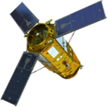
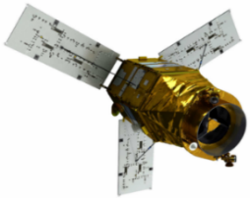
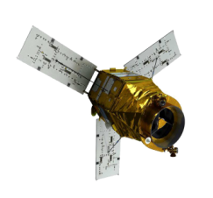
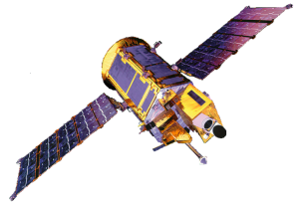
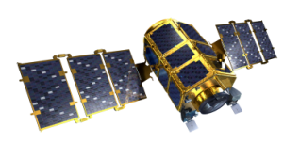
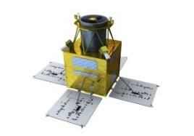
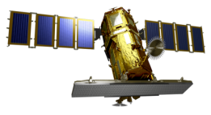
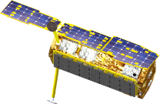
KARI’s LEO Missions
KOMPSAT-1
KOMPSAT-2
KOMPSAT-3
KOMPSAT-3A
KOMPSAT-7
1999
EO, 6.6m
2006
EO, 1m
2012
EO, 0.7m
2015
EO, 0.55m
IR, 5.5m
(2021)
EO < 0.3m
CAS500-1/2
(2019/2020)
EO, 0.5m
Low
Earth
Orbit
Not Working
KOMPSAT-5
KOMPSAT-6
2013
SAR(X), 1m
(2020)
SAR(X), 0.5m
On Orbit
Under Development
CAS500-4/5
KOMPSAT-7A
SmallSat
2022/2025
EO, 1m
SAR(C)
2024
EO < 0.3m
2024~2027
EO, 1m (10)
Planned

Slide 3
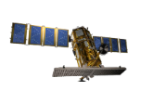
Characteristics & Advantages of KOMPSAT: Fast Revisit
LTAN : 06:00
KOMPSAT-5
COSMO-SkyMed
TerraSAR-X
LTAN : 13:30
KOMPSAT-3
KOMPSAT-3A
EROS-B (Mono)
LTAN : 18:00
KOMPSAT-5
COSMO-SkyMed
TerraSAR-X
LTAN : 11:00
KOMPSAT-2
WorldView-1/2/3
Pleiades-1/2

Slide 4
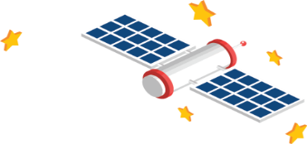
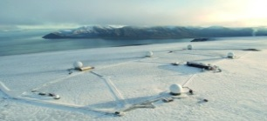
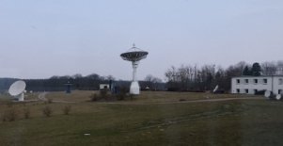
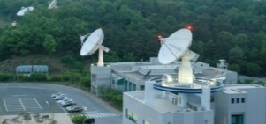
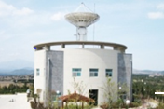
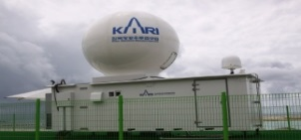
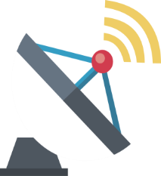
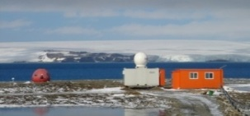
KARI Ground Stations with Global Networks
Svalvard Ground Station
(TT&C/Data Downlink)
S-band: TT&C
X-band: Science Data Downlink
HQ
Neustrelitz Ground Station
(TT&C/Data Downlink)
KARI Ground Station
(TT&C/Data Downlink)
Jeju Ground Station
(TT&C/Data Downlink)
WENO Ground Station
(TT&C)
SEJONG Ground Station
(TT&C)

Slide 5
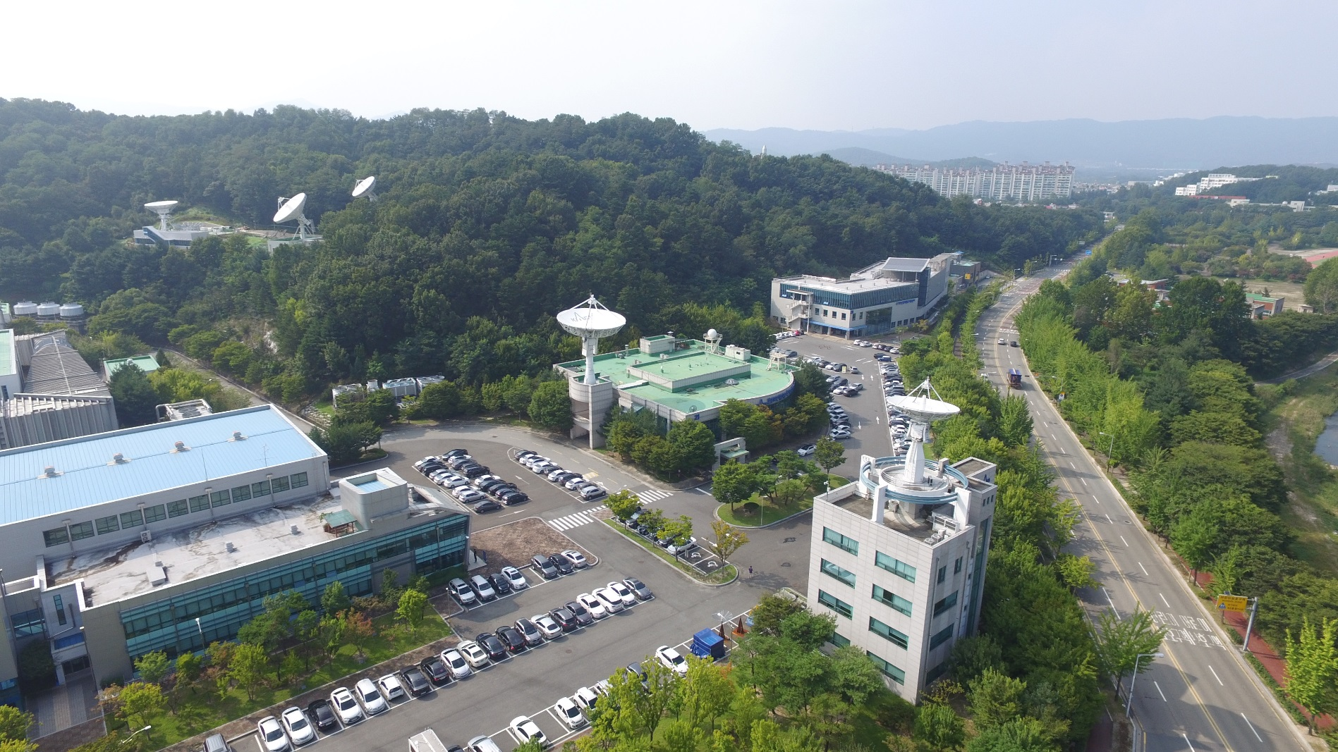
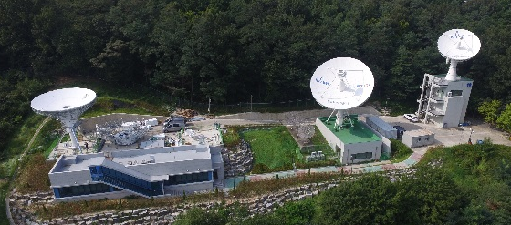
KARI Ground Station & Antenna Systems
9m Antenna
GK-2 Operation
GEO Support
13m Antenna
GEO-K1 Operation
GEO Support
9m Antenna
Backup
13m Antenna
KOMPSAT Operation
LEO Support
7.3m Antenna
KOMPSAT Operation
LEO Support

Slide 6
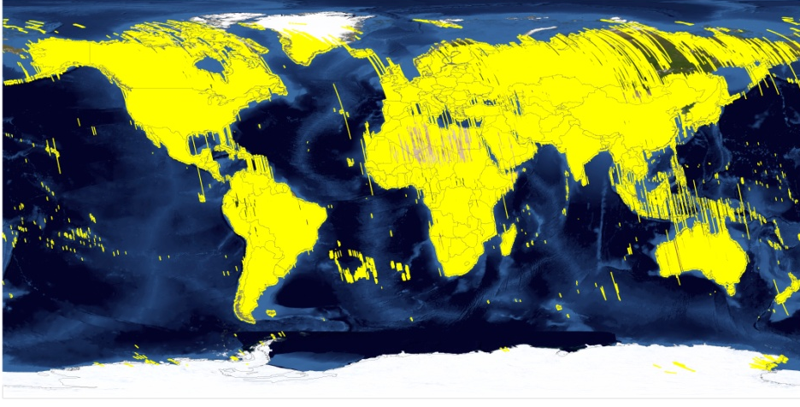
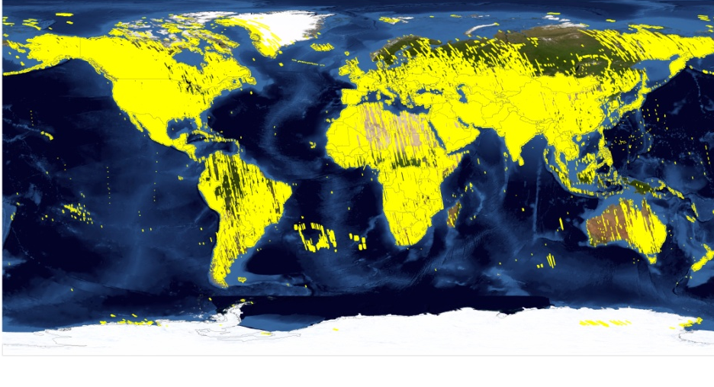
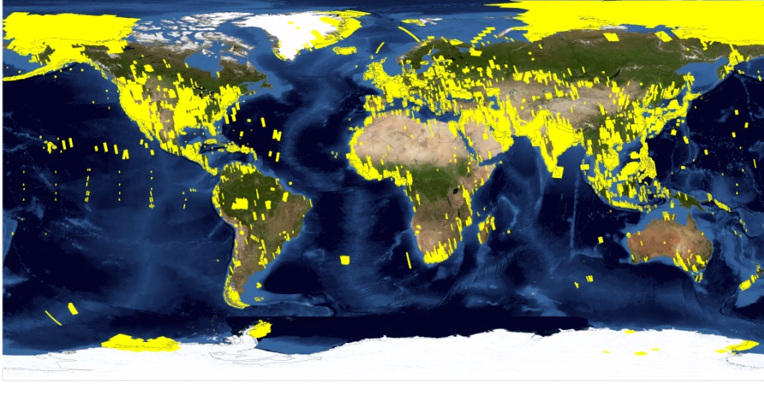
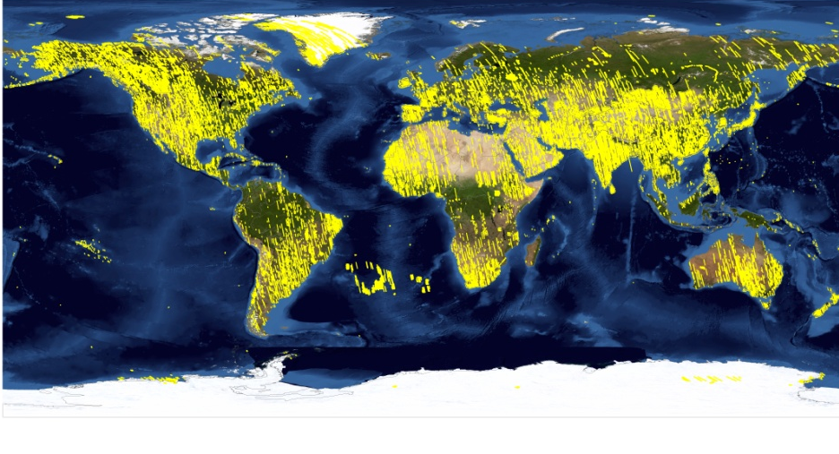
Scene Acquisitions
KOMPSAT-2: ~3.17M Scenes (’06/08~ ’18/12)
KOMPSAT-3: ~1.37M Scenes (’12/05 ~ ’18/12)
KOMPSAT-5 : ~152K Scenes (’13/09 ~ ’18/12)
KOMPSAT-3A: ~400K Scenes(’15/03 ~ ’18/12)

Slide 7
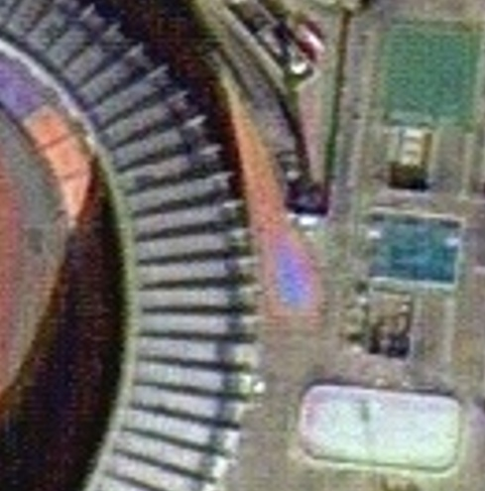
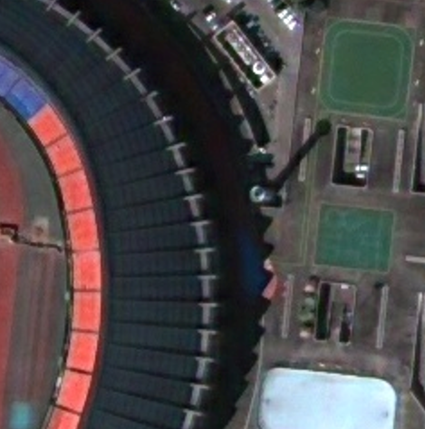
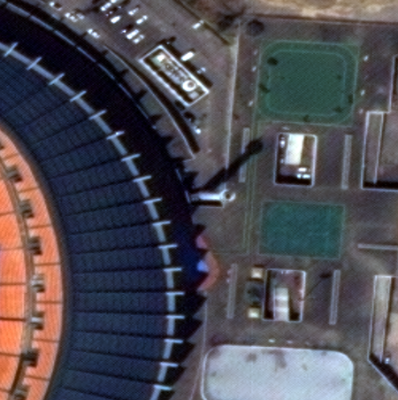
KOMPSAT Images: Spatial Resolution
KOMPSAT-2
KOMPSAT-3
KOMPSAT-3A
Resolution (Pan/MS: 1/4m)
Resolution (Pan/MS: 0.7/2.8m)
Resolution (Pan/MS 0.55/2.2m)

Slide 8
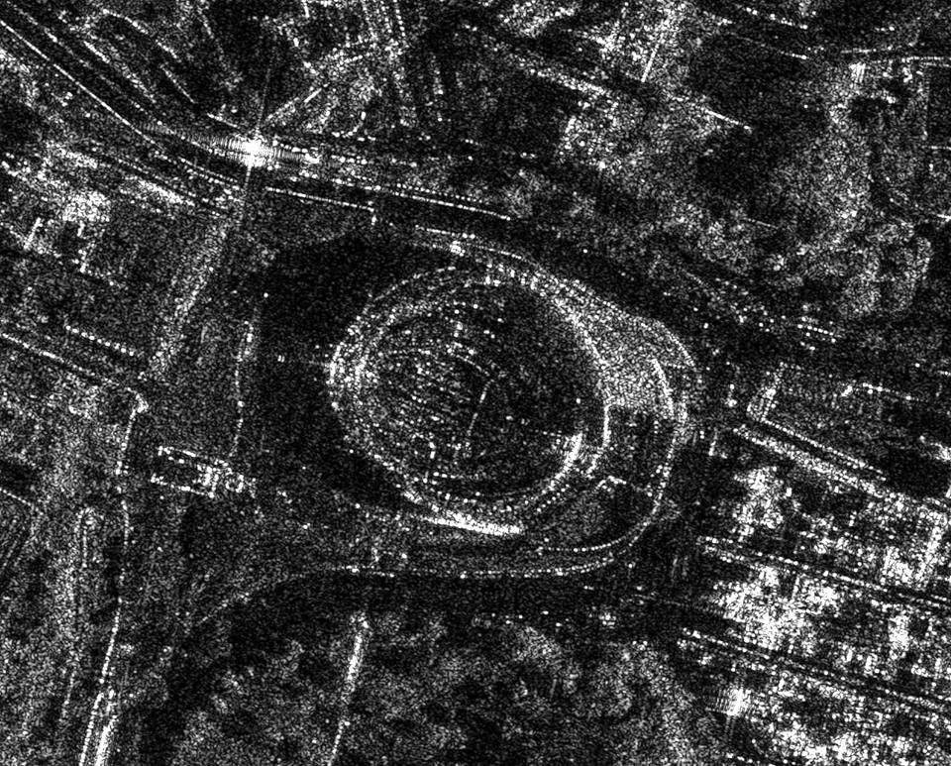
KOMPSAT Images: Integrated Operations
KOMPSAT-3, EO
March, 2013
KOMPSAT-5, SAR
May, 2015
KOMPSAT-3
2014/02/07
KOMPSAT-5
2015/05/11

Slide 9
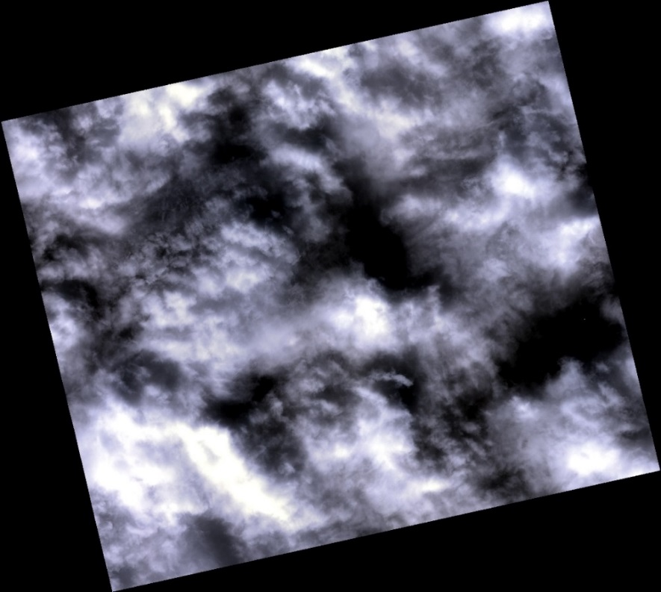
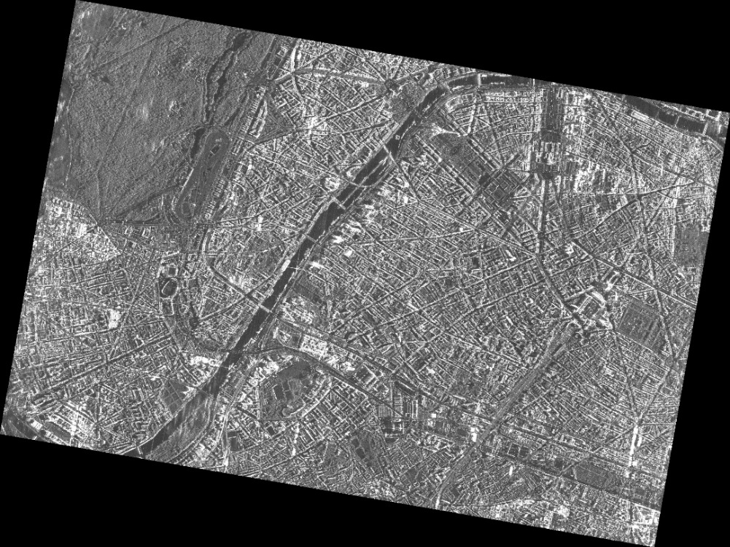
KOMPSAT Images: Optical & SAR Sensors
KOMPSAT-3
Oct. 16th, 2013
KOMPSAT-5
Oct. 16th, 2013
Tour Eiffel
Paris, France
Paris, France

Slide 10
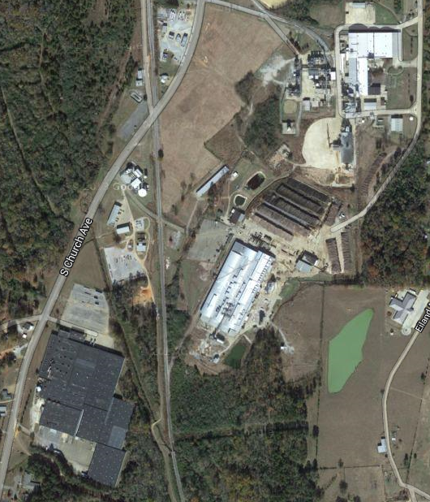
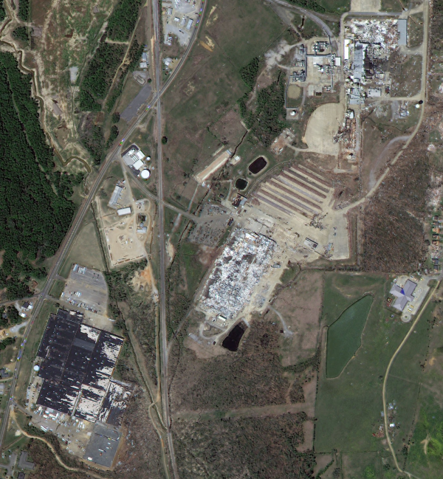
KOMPSAT Images: Change Detections
Google Maps
KOMPSAT-3
Apr. 5, 2014
Tornado, Louisville Mississippi, USA

Slide 11
ARD-Related Activities in KARI
We’ve only just begun!
Works in progress
Review on ARD-related documents
CEOS/LANDSAT/CQC Documents
Check KARI’s status & readiness for ARD product generation
Initial self-assessment on standard products of KOMPSAT-3 system
Level 1R (radiometric corrected) & 1G (geometric corrected) product
Using CARD4L-OSR self-assessment sheet
Inspection & analysis on works to be done for ARD product generation
Driving requirements & specification
Checking additional process & processors
Preparation for sample product generation

Slide 12
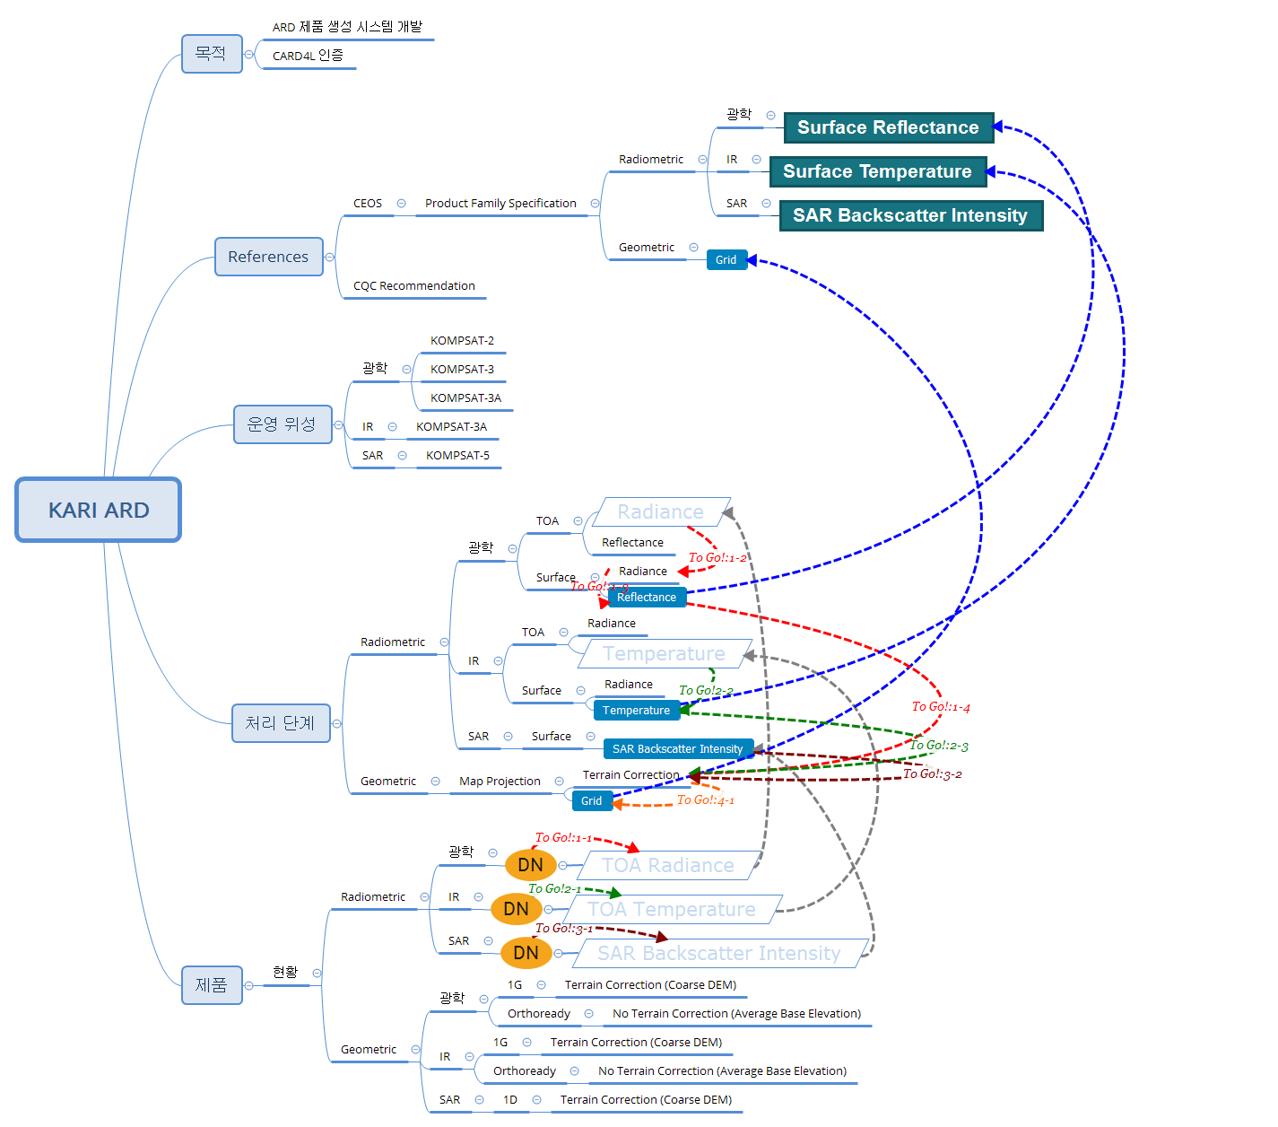
Analysis on Works for ARD

Slide 13
Classification of Works to Be Done (As of Aug. 2019)
Classification | Class | Functions needed | Description
Radiometric | Optical Surface Reflectance | 1-1) TOA Radiance Estimation | From DN of level 1R product DN->radiance conversion DN to radiance considering Gain/Offset
 |  | 1-2) Surface Radiance Estimation | Design of atmospheric correction module Selection of radiative transfer model
 |  | 1-3) Surface Reflectance Estimation | Considering solar irradiance
 | Land Surface Temperature | 2-1) TOA Temperature Estimation | From DN of level 1R product DN->temperature conversion DN to radiance considering Gain/Offset
 |  | 2-2) Surface Temperature Estimation | Design of atmospheric correction module Select of radiative transfer model Considering emissivity
 | Normalised Radar Backscatter | 3-1) SAR Backscatter Intensity Estimation | From DN of level 1D product
Geometric | All | 1-4) Tiling 2-3) Tiling 3-2) Tiling | Selection of map projection Design of grid structure Selection of resampling method

Slide 14
Initial Self-Assessment (As of Aug. 2019, 1/3)
# | General Metadata | Threshold | Target
1.1 | Traceability | Not required | O
1.2 | Metadata Machine Readability | O | O
1.3 | Data Collection Time | O | X
1.4 | Geographical Area | O | X
1.5 | Coordinate Reference System | O | O
1.6 | Map Projection | O | O
1.7 | Geometric Correction Method | Not required | X
1.8 | Geometric Accuracy of the Data | Not required | X
1.9 | Instrument | O | O
1.10 | Spectral Bands | O | O
1.11 | Sensor Calibration | Not required | O
1.12 | Radiometric Accuracy | Not required | X
1.13 | Algorithms | X | X
1.14 | Ancillary Data | O | X
1.15 | Processing Chain Provenance | Not required | X
1.16 | Data Access | X | X
1.17 | Overall Data Quality | Not applicable | X
 | Total | 8/10 | 7/17

Slide 15
Initial Self-Assessment (As of Aug. 2019, 2/3)
# | Per-pixel Metadata | Threshold | Target
2.1 | Metadata Machine Readability | O | O
2.2 | No Data | X | X
2.3 | Incomplete Testing | X | X
2.4 | Saturation | X | X
2.5 | Cloud | X | X
2.6 | Cloud Shadow | X | X
2.7 | Land/Water mask | Not required | X
2.8 | Snow/Ice mask | Not required | X
2.9 | Terrain Shadow Mask | Not required | X
2.10 | Terrain Occlusion | Not required | X
2.11 | Illumination and Viewing Geometry | O | X
2.12 | Aerosol Optical Depth Parameters | Not required | To be determined
 | Total | 2/7 | 1/11

Slide 16
Initial Self-Assessment (As of Aug. 2019, 3/3)
# | Radiometric and Atmospheric Correction | Threshold | Target
3.1 | Measurement | X | X
3.2 | Measurement Uncertainty | X | X
3.3 | Measurement Normalization | Not required | X
3.4 | Directional Atmospheric Scattering | X | X
3.5 | Water Vapour Corrections | X | X
3.6 | Ozone Corrections | Not required | X
 | Total | 0/4 | 0/6
# | Geometric Correction | Threshold | Target
4.1 | Geometric Correction | X | X
 | Total | 0/1 | 0/1
Requirements | Self-Assessment
General Metadata | ∆
Per-Pixel Metadata | X
Radiometric and Atmospheric Corrections | ∆
Geometric Corrections | ∆

Slide 17
Considerations & Questions
Items | Questions
General | Due to various objects and unwanted features (e.g. shadow, off-nadir pointing imaging) shown in high resolution imagery, we expect that it is difficult to estimate each object’s physical value (e.g. surface reflectance) even with coarse accuracy.
General Metadata | N/A
Per-Pixel Metadata | N/A
Radiometric and Atmospheric Corrections | N/A
Geometric Corrections | How to get the sub-pixel accuracy of PFS for high resolution imagery - Optic: 0.5 pixel (rRMSE), SAR: 0.2 pixel (rRMSE)

Slide 18
Questions

