Slide 1
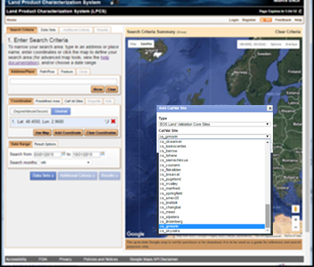
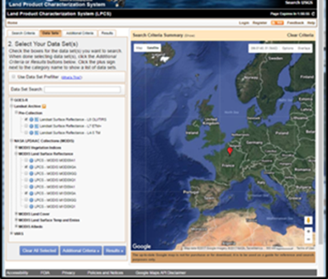
https://landsat.usgs.gov/lpcs
The Land Product Characterization System (LPCS) is a web-based system designed to facilitate characterization and validation of higher-level scientific data products including land products from VIIRS, MODIS, Landsat, and in the future, Sentinel-2 and -3, GOES-16 ABI, and comparable in situ products.
The LPCS includes data inventory, access, processing options, and analysis functions
LPCS data inventory and selection includes numerous pre-defined cal/val locations, as well as options for user-defined selection of locations.
Identify area of interest
Select products within area of interest

Slide 2
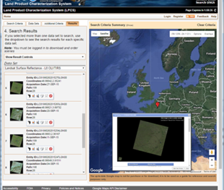
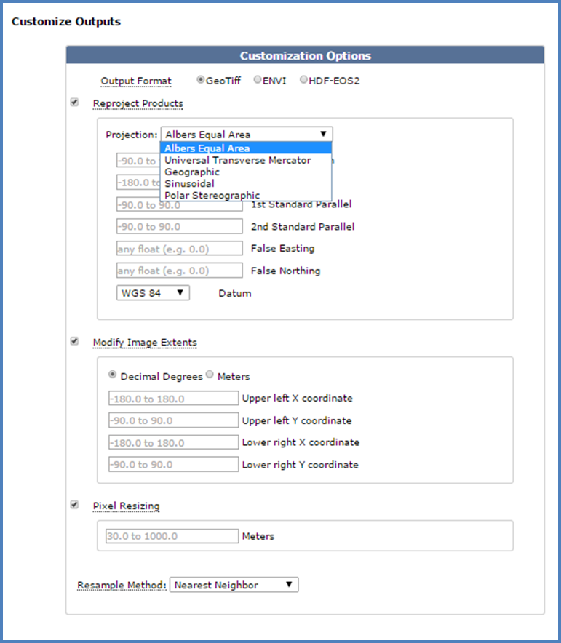
Review and order products
The LPCS permits selection of data to be easily identified, retrieved, co-registered, and compared statistically through a single interface.
Customize products
Sensor data/products from MODIS and Landsat are currently included within the LPCS. Additional land data/products from VIIRS, Sentinel-2, and GOES-16 will be integrated within the LPCS as they become available as higher-level scientific data products .

Slide 3
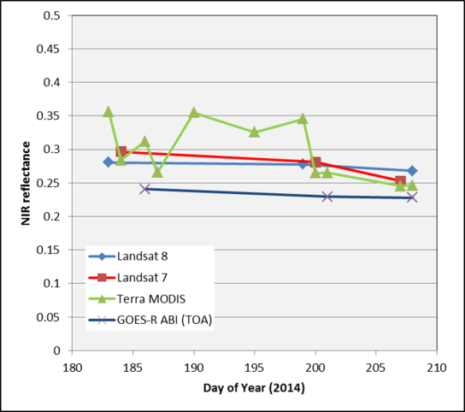
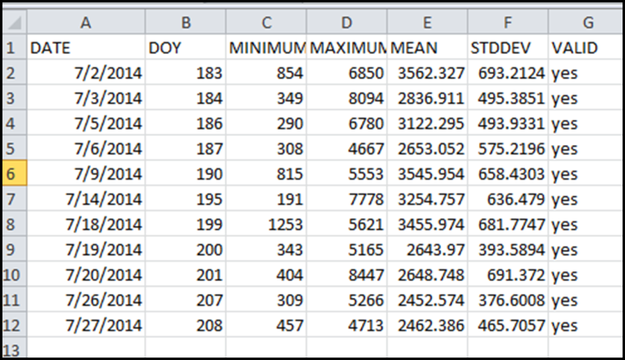
Output includes summarized tables and charts for selected area of interest and geographically registered and resampled image products for additional analysis by system users.
Simulated GOES-16 ABI Landsat MODIS
Contacts:
Kevin Gallo, NOAA/NESDIS
Greg Stensaas, USGS/EROS
John Dwyer, USGS/EROS
Ryan Longhenry, USGS/EROS
Geographically registered and resampled image products.
Near-IR time series inter-comparisons

