Slide 1
Landsat / Sentinel 2a Radiometric and Geometric Comparison
January 10, 2017
Presented by Ron Morfitt, U.S. Geological Survey (USGS)

Slide 2
Topics
Landsat Calibration Team (who really did the work)
Landsat / Sentinel-2a Radiometry
  OLI stability
  Coincident acquisition comparison
  PICS lifetime trending
Landsat / Sentinel-2a Geometry
  Estimated GLS accuracy (post-GCP improvement)
  Predicted and measured L8 OLI – S2A MSI registration accuracy
  GLS global re-triangulation plan and status

Slide 3
Landsat Calibration Team
Comprised of members from USGS/EROS, NASA/GSFC, University of Arizona, South Dakota State University, Rochester Institute of Technology and NASA/JPL
Work performed by:
  Radiometry
    Julia Barsi (NASA/GSFC/SSAI), Obaidul Haque (USGS/EROS/SGT), Morakot Kaewmanee (SDSU)
  Geometry
    Jim Storey, Mike Choate, Raj Rengarajan, Mark Lubke (USGS/EROS/SGT)

Slide 4
Landsat OLI Stability
OLI has been stable to within 1.5% since launch
  Calibration update for CA band (lifetime) and other VNIR bands (short time period) in “Collections” release
    Reprocessed data beginning February 2017
    Completed May 5, 2017
All OLI data included here have been updated for Collections processing.

Slide 5
Monitoring MSI
Desert sites
  Cross Calibration with near-coincident OLI acquisitions
    Libya-4, Algeria-3
  Lifetime trending
    Libya-4, Sudan-1, Algeria-3
Note: only bands common between MSI and OLI included: 1, 2, 3, 4, 8A, 11, 12

Slide 6
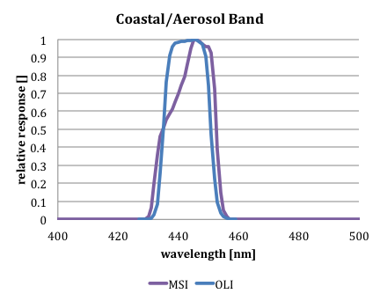
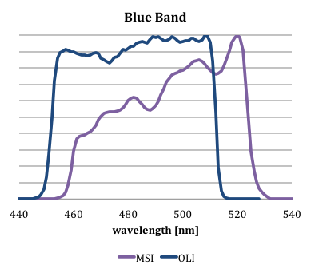
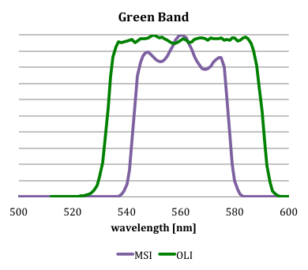
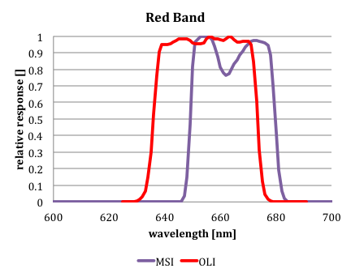
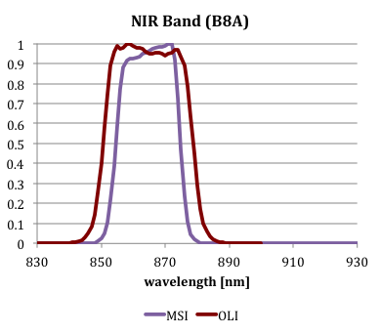
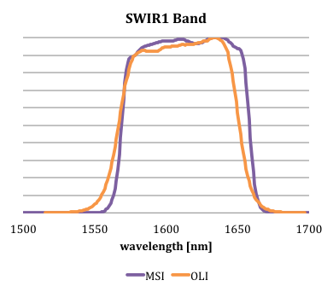
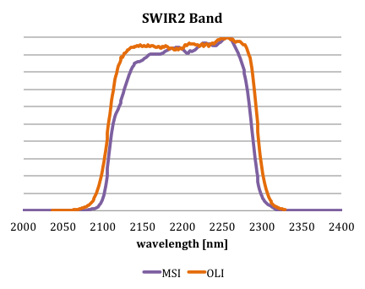
OLI and MSI Spectral Overlap
MSI Bands have significant spectral overlap with OLI bands

Slide 7
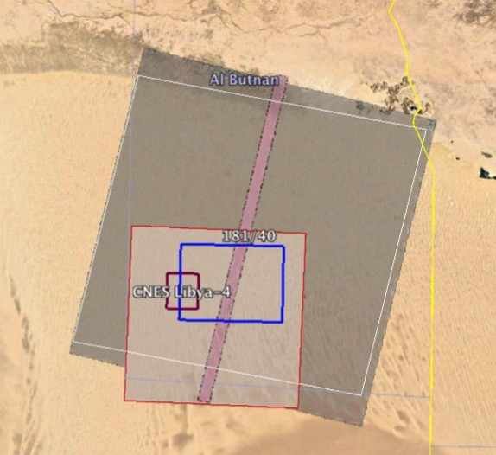
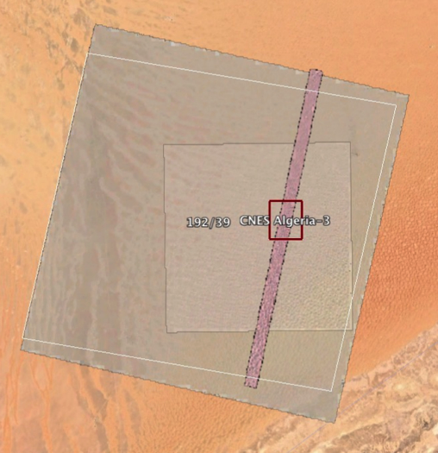
Cross Calibration
Hyperion
OLI
Use MSI and OLI data over Pseudo Invariant Calibration Sites (PICS)
  Libya-4 (GSFC and SDSU)
  Algeria-3 (GSFC only)
Extract Region of Interest from images
  SDSU: ~65x64 km region
  GSFC: CNES defined region, ~20x20km
Compute TOA reflectances for both
Apply Spectral Band Adjustment Factor (SBAF) to make MSI reflectances “OLI-like”
Compare reflectances directly
  Every 80 days, both sites have coincident overpass (NSO) opportunities within 20 minutes with similar viewing geometries
  SDSU also directly compares image pairs acquired within six days
CNES ROI
SDSU ROI
MSI
Hyperion
OLI
CNES ROI
MSI

Slide 8
Reflectance Calculation
OLI TOA reflectance
  Where:
    ρ_{OLI} is top-of-atmosphere reflectance
    M and A are reflectance scaling factors in metadata
    Q_{cal} is image digital count
    θ is solar zenith angle (90-solar elevation angle from metadata or for ROI)
MSI TOA reflectance
  Where:
    ρ_{MSI} is top-of-atmosphere reflectance
    Q_{cal} is image digital count
    QUANTIFICATION_VALUE is provided in the metadata
Convert MSI TOA reflectance to OLI equivalent reflectance

Slide 9
OLI-MSI Cross Calibration Coincident Overpass Results
Agree within 1.5% in most bands, within 4% for coastal aerosol and blue bands
    Within single site, results are agreement within 0.75% (1σ)
GSFC results

Slide 10
PICS Lifetime Trending
For each site, accumulate all cloud-free region-of-interest averages
Correct TOA reflectance for solar zenith angle
  Empirical adjustment to normalize to a standard reference angle. Accounts for some of the seasonal differences.
Normalize all site reflectance data to 1
Calculate slope over time, determine 2-sigma uncertainty of slope
(CA)
(SWIR1)
SDSU results

Slide 11
PICS Lifetime Trending
Trending over almost 2 years indicates very good agreement between the 3 sites, suggests little to no change over time.
More data needed before results conclusive
SDSU results

Slide 12
PICS Lifetime Trending
GSFC results for Libya-4
  OLI, ETM+, MSI. Slopes only since MSI launch
ETM+ updated Nov 2016

Slide 13
Landsat – Sentinel-2 Harmonization
Sentinel-2 will use a set of global reference images (GRI) to ensure multi-temporal registration
  This reference is being established through a series of continental-scale triangulation blocks of MSI data
  High resolution Pleiades imagery is being used as control
    There is no explicit tie to the GLS
  These blocks will be completed during 2016-2017 with operational implementation (and reprocessing) to follow
Given the respective accuracies of the GLS (17 m RMSEr) and GRI (10 m 2-sigma), Landsat / Sentinel misregistration of up to ~26 m 2σ can be expected
  Better registration is required by the science community
  Provides motivation to improve the GLS while making it consistent with the Sentinel-2 GRI framework
Notes:
Sentinel-2 is establishing their own global geometric framework by triangulating large blocks of MSI data. The result will be a set of global reference images (GRI) to which all MSI data will be registered to ensure consistency.
The discrepancies between this GRI framework and the GLS are likely to be larger than the science community will find acceptable.
This gives us “permission” to update the entire GLS to enhance accuracy globally while improving consistency with MSI data.

Slide 14
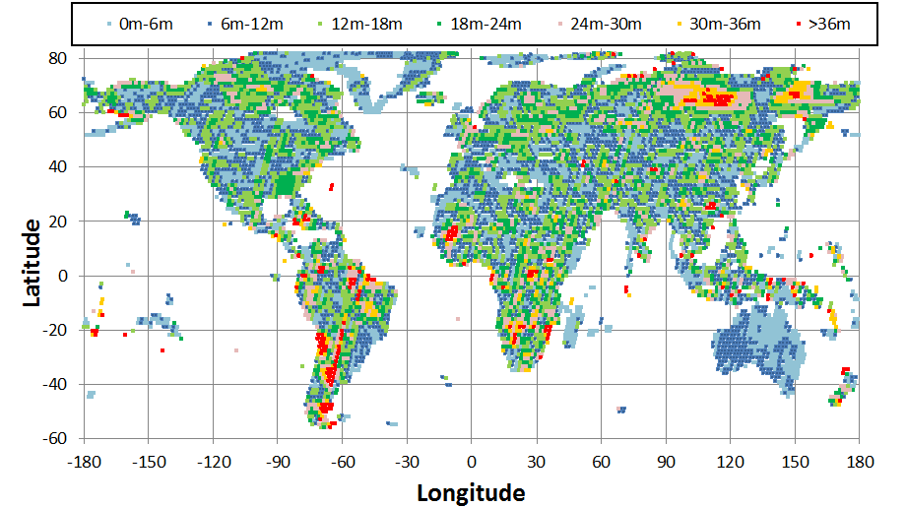
Estimate of GLS Horizontal Error

Slide 15
Phase 4 – Approach and Status
Perform a global readjustment of the GLS using L8 data with sparse ties to Sentinel-2 GRI
Thirteen triangulation blocks have been defined
  Islands will be updated where MSI data are available
Initial (L8 only) triangulations have been performed for all blocks except islands and South America
  New OLI GCPs have been extracted for these blocks
  Solar calibration maneuvers causing minor issue for three paths in South America block
  Islands block in work
Once the GRI is operational, MSI control will be added to support a second, constrained triangulation
Readjusted control will be implemented in Collection 2
Notes:
As a first step, we have identified 13 triangulation blocks (really 12 plus islands) covering all GLS path/rows. These are shown on the next chart.
Australia is one of these blocks. We do not plan to readjust Australia since it is already registered to the Geoscience Australia AGRI framework.
Scene selection and initial unconstrained (with no ties to MSI data) block adjustments have been performed for 3 blocks: South America, Europe, and NW Africa.
As the GRI framework becomes operational we will extract MSI GCPs and use them to constrain a second adjustment of each block.

Slide 16
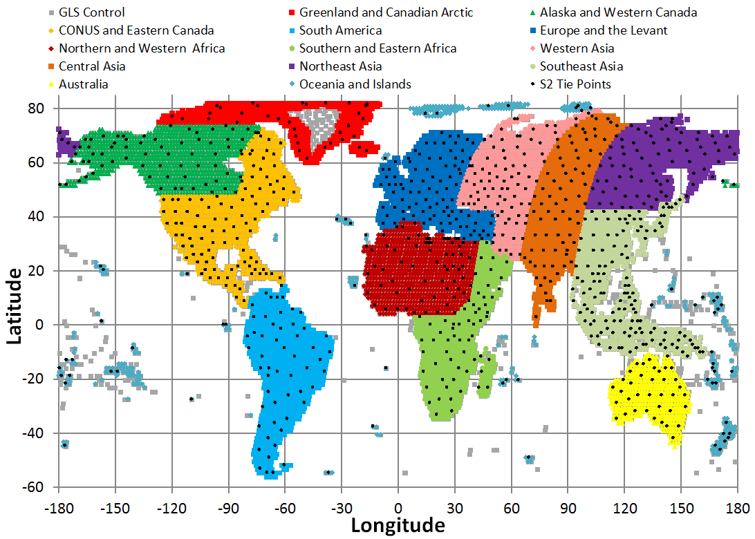
Triangulation Blocks & S2 Tie Sites
Notes:
Continental areas are covered by 12 blocks, 11 of which will be readjusted.
The “13th” block consists of island areas that will be worked as necessary.

Slide 17
Measured Landsat 8 / Sentinel 2 Misregistration
L8/S2 registration accuracy was measured at 255 sites.
Actual results before and after L8-only triangulation:
26m 2σ predicted

Slide 18
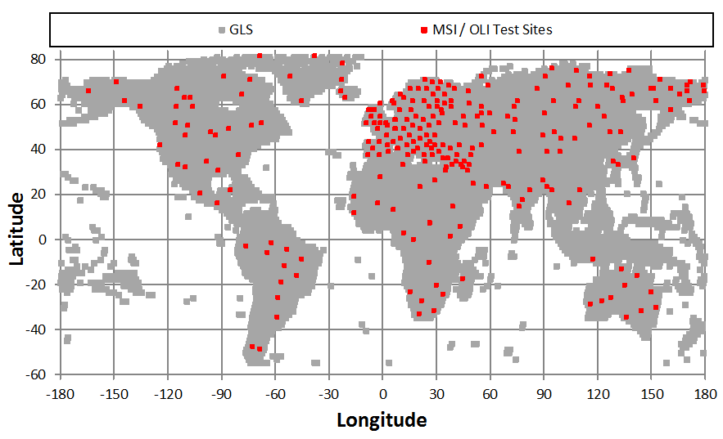
S2 / L8 Comparison Sites

Slide 19
Summary
Coincident PICS indicates Calibration is within 1.5% for most bands, within 4% for CA and Blue
PICS lifetime trending for MSI does not show degradation
Fourth phase of Landsat GCP improvement is underway to improve L8/S2 registration
  Completed L8-only triangulation for 11 of 13 blocks and OLI GCP extraction for 12 of 13 blocks
  Final block adjustment will include GRI tie points to link to Sentinel-2 MSI geometric framework
  Measured OLI to (pre-GRI) MSI registration is slightly better than predicted => 22.3 meters 2σ based upon 255 test sites

