Slide 1
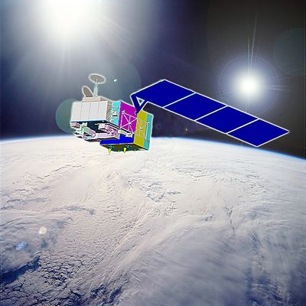
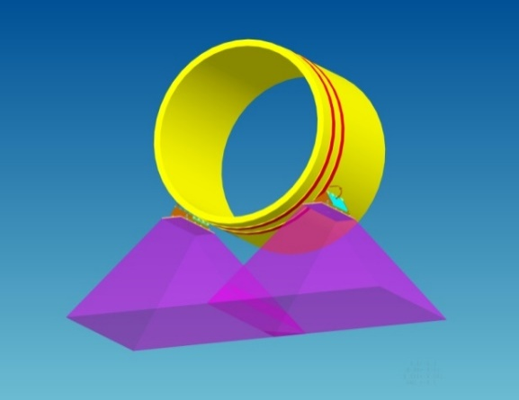
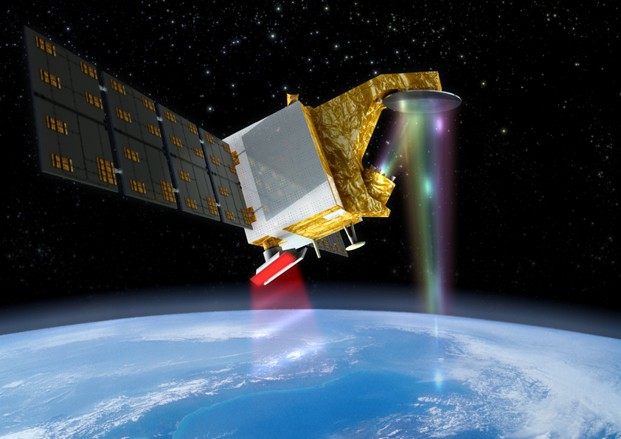
NSSC Update of EO Missions and CAL/VAL
Xiaolong DONG
National Space Science Center
Chinese Academy of Sciences
(NSSC,CAS)
Contributors:
Qifeng LU, NSMC/CMA
Qitao SONG, Wu ZHOU, NSOAS/SOA
Yunhua Zhang, MiRS/NSSC/CAS
CEOS WGCV-42
Sioux Falls, SD, USA
May 16-19, 2017

Slide 2
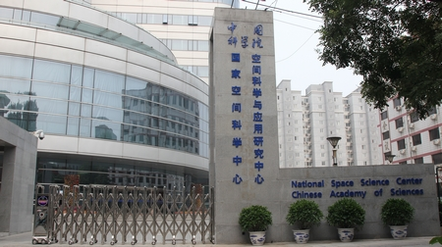

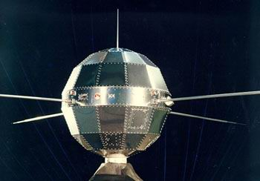
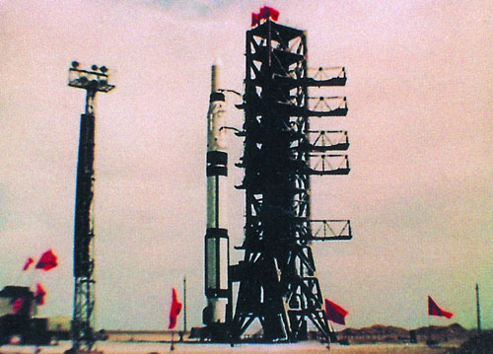
NSSC,CAS
National Space Science Center
Chinese Academy of Sciences
Planning, Development, Management & Operation
of Space Science Missions
(2011~)
Research & Development of
Space Science and Applications （1958~)

Slide 3
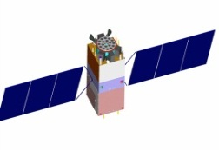
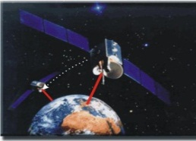
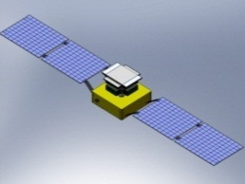
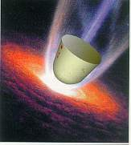
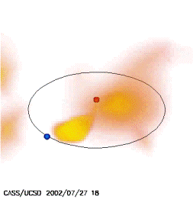
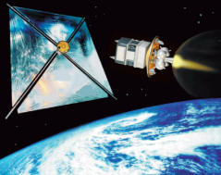
Strategic Priority Program on Space Science
Hard X-ray Modulation Telescope (HXMT)
QUantum Experiments at Space Scale (QUESS)
DArk Matter Particle Explorer
(DAMPE)
SPP on Space Science (I)
2011-2016
ShiJian-10 (SJ-10)
Intensive Study of Future Space Science Missions
Advanced Research of Space Science Missions and Payloads

Slide 4

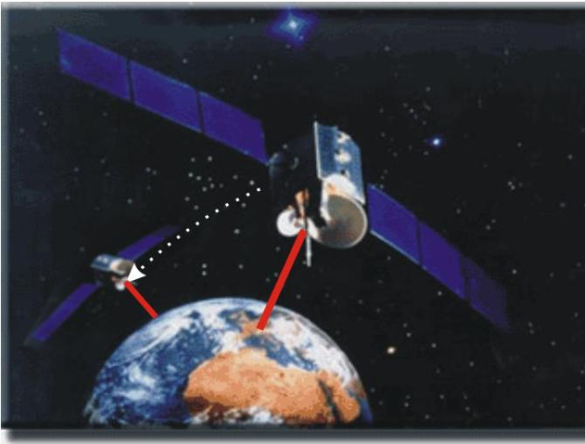
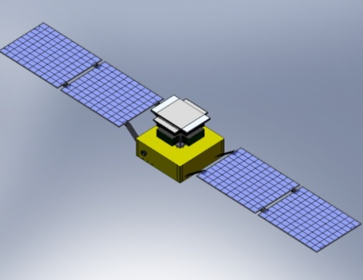
  Update of NSSC: Space Science Missions
Objective
Mission
Black Hole
HXMT
(2017.6)
Microgravity / Life Science
SJ-10
(2016.4)
Quantum
Experiment
QUESS
(2016.8)
Dark Matter
Particle Exploration
DAMPE
(2015.12)

Slide 5
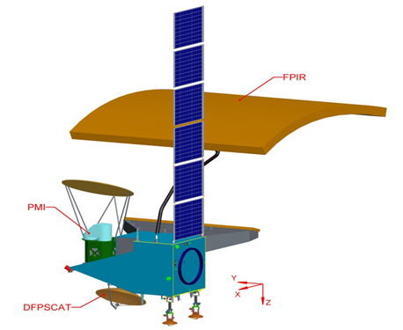
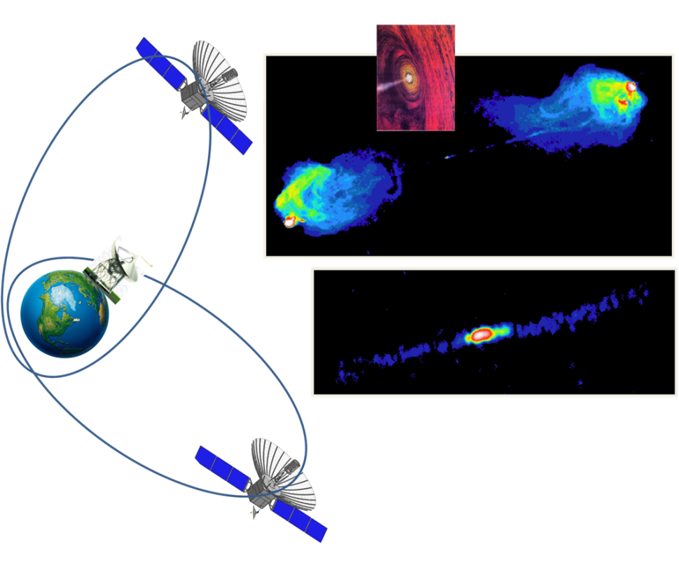
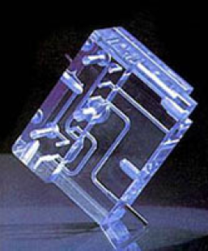
Solar wind Magnetosphere Ionosphere Link Explorer (SMILE)
Einstein Probe (EP)
Advanced Solar Observatory in Space (ASO-S)
SPP on Space Science (II)
2016-2022
Water Cycle Observation Mission (WCOM)
Magnetosphere-Ionosphere-Thermosphere Coupling Constellation (MIT)
Intensive Study of Future Space Science Missions
Advanced Research of Space Science Mission Concepts and Payload Technology

Slide 6
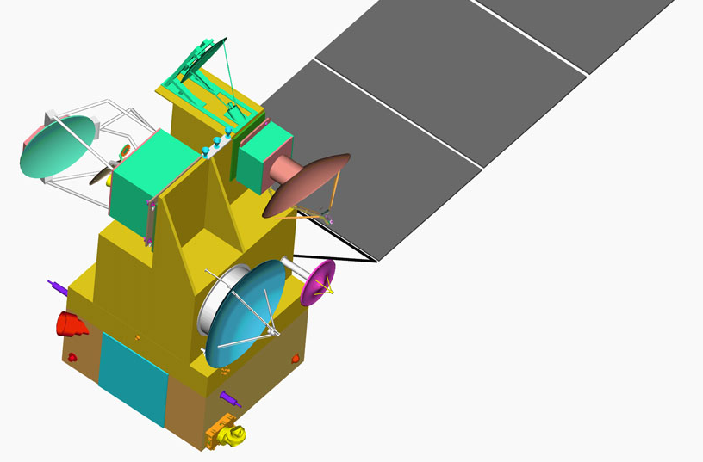
NSSC: Contributions to Oceanographic and Meteorological Satellites
Oceanography and Meteorology
  HY-2 (A, B, C and Follow-on): ALT+ACMR
  COSM: MICAP
  FY-3 and follow-on:
  MWHS/MWHTS(MWHS-II), GNOS
  space environment package
  CFOSAT: radar scatterometer
  FY-4 (optical and microwave):
  Microwave imager, space environment package

Slide 7
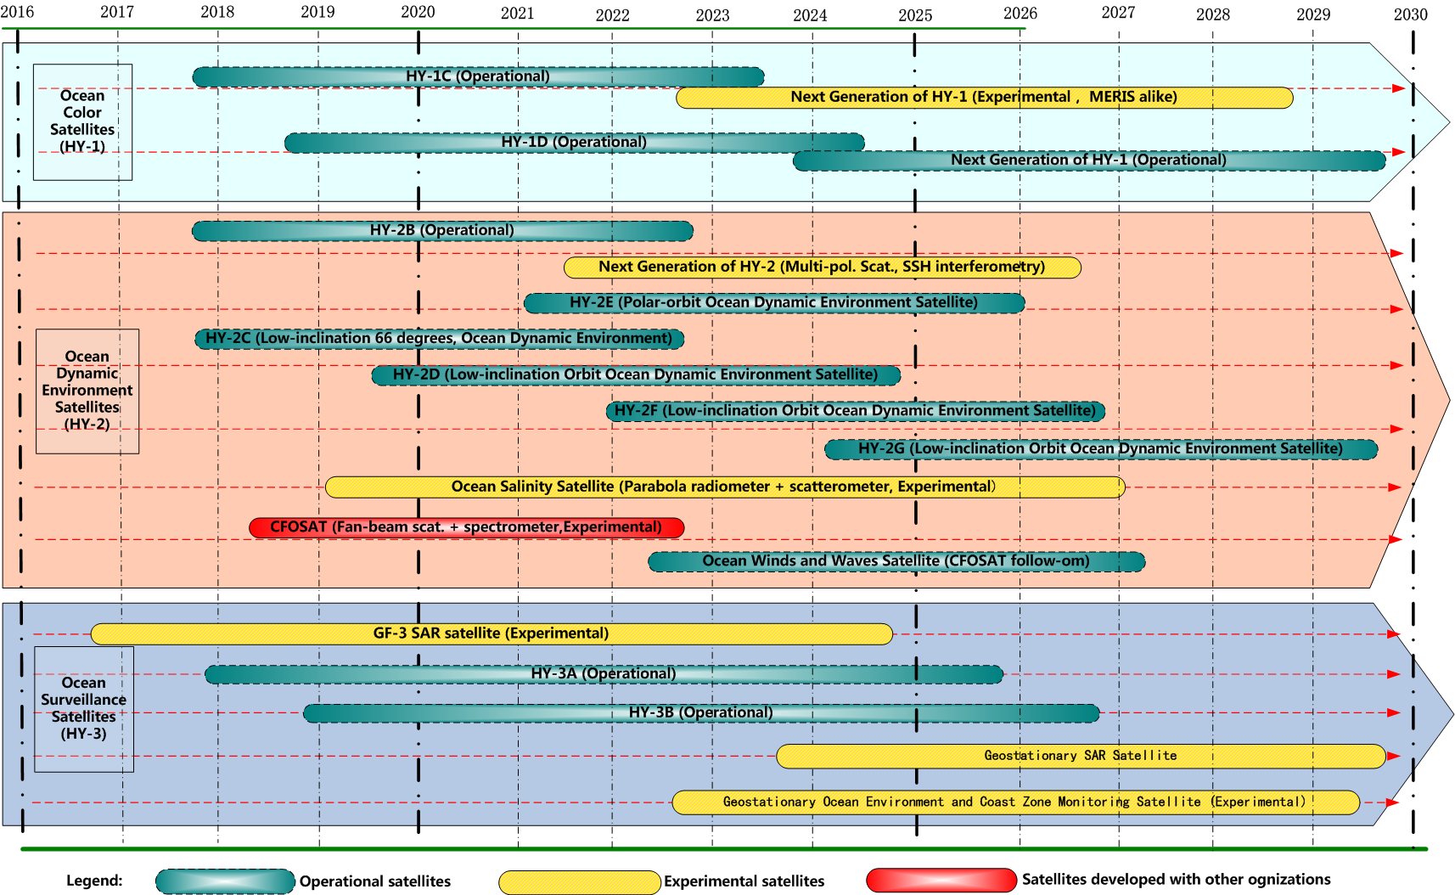
Oceanographic Satellite of China 2016~ (by Q.Song, NSOAS/SOA)

Slide 8
HY-2 update
HY-2A：in orbit >5yrs (2011.08.16)
  New version of ALT data
HY-2B/C：start satellite and payload
  DFRA: dual frequency radar altimeter：Ku (13.58GHz) & C (5.25GHz)
  ACMR: atmospheric correction microwave radiometer: 18.7，23.8，37GHz
  SCAT: radar scatterometer: Ku-band (RF switch network & receiver
  MWRA: microwave imager (6.6-37GHz): L1 data production
  Launch Plan:
    HY-2B: 2nd half of 2018
    HY-2C: 1st half of 2019 (inclined orbit)

Slide 9
CFOSAT update
Payloads:
  SWIM: multiple beam radar for ocean surface wave spectrum (Ku band, by CNES)
  SCAT: rotating fan-beam scatterometer of ocean surface wind vector (ku band, by NSSC)
Schedule
  delivery of flight model: 2017.06-07
  Launch: 2018

Slide 10
COSM update
Chinese Ocean Salinity Mission
Mission requirements:
– 0.1psu, 200km, monthly
– With Simultaneous observation of ocean surface roughness and SST
Schedule
– 2011~2014:grounddemonstration
on different payload technology
– 2015: mission definition, preliminary design, risk mitigation
– 2016: preparation and submission of mission proposal for approval
– Estimated launching: 2019~2020
2 payloads:
MICAP: microwave imager combined active passive (L, C, X, K band) (NSSC)
MiR2D: microwave 2-D interferometric imager (CAST-Xian)

Slide 11
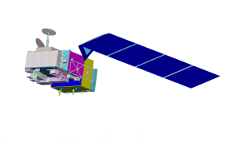
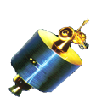

Meteorological Satellite of China 2016~
(by Q. Lu, NSMC/CMA)
National Program for Fengyun Meteorological Satellite from 2016-2021
LEO: AM+PM+Dawn Dusk; GEO: optical+microwave (under development)
2013FY-3C(Op)
2014FY-2G(Op)
2016FY-3D(Op)
2012FY-2F(Op)
2016FY-4A (R&D)
2010FY-3B (R&D)
2017FY-2H(Op)
2018 FY-3E(Op)
2019FY-3F(Op)
2020FY-4C(Op)
2020FY-Rain(Op)
2021 FY-3G(Op)
2018FY-4B (Op)
Up to 2021 there are 9 satellites planned to be launched
Notes:
11

Slide 12
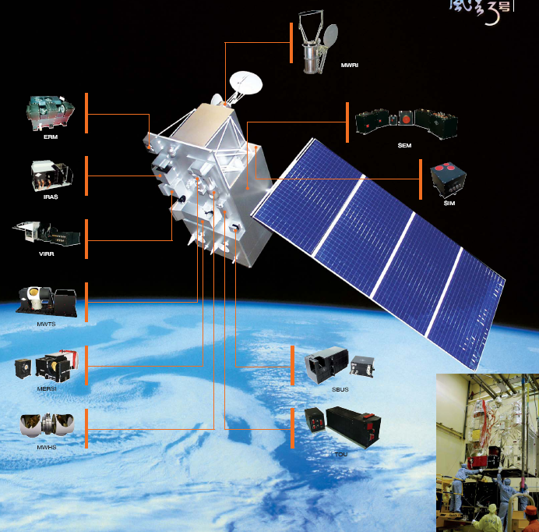
The FY-3A/B/C/D Instrument Suite
Infrared
Atmospheric Sounder
(IRAS)
20 channels
(~HIRS/3)
ok
Microwave
Radiation Imager
10 channels
(~AMSR-E)
Microwave
Temperature
Sounder (MWTS)
4 channel (~MSU)
13 channels
GNSS
Radio-Occultation
Sounder (GNOS)
(~GPS)
Microwave
Humidity
Sounder (MWHS)
5 channel (~MHS)
15channels with channels at
118 GHz
12
Notes:
12
12
12
12

Slide 13
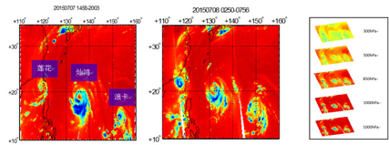
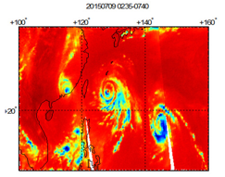
FY-3 update
FY-3A/B
  MWHS: Microwave humidity Sounder
  5 Channels: 150GHz: H, V-pol; 183GHz: 3channels for vapor
  FY-3A ended (launched 2008)
  FY-3B in good status (from 2010)
FY-3C/D
  MWHTS: Microwave Humidity and Temperature Sounders
  15Channels: 90GHz, 150GHz, 118GHz, 183GHz
  FY-3C: MWHTS in good status since 2013
  FY-3D: to be launched in September, 2017

Slide 14
Tiangong -2 Interferometric Imaging Radar Altimeter (InIRA)
Calibration Activities (by Yunhua Zhang)
Calibration of σ⁰ by Amazon Tropical Rain Forest.
Calibration of Antenna Pattern by Amazon Tropical Rain Forest.
Resolution and Height accuracy verified by Conner Reflectors.
Buoy calibration of sea surface height (SSH) measurement.

Slide 15
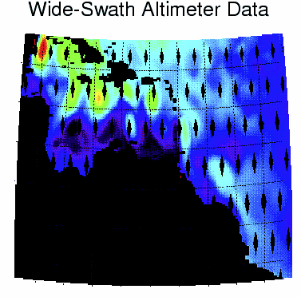
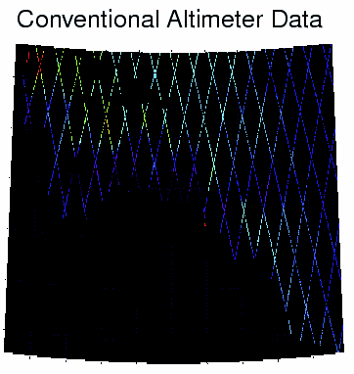
  Tiangong-2 WSRA
  Wide-Swath Radar Altimeter
  2016.10

Slide 16
Calibration of σ⁰ by Amazon Tropical Rain Forest.
Observation of Amzazon Tropical Rain Forest: Mean σ⁰: -6.4500dB, Std σ⁰: 0.2221dB,
Based on TRMM data.

Slide 17
Calibration of Antenna Pattern by Amazon Tropical Rain Forest.
Data 1: The measured boresight deviates 0.5º from the supposed boresight of installation.

Slide 18
Calibration of Antenna Pattern by Amazon Tropical Rain Forest.
Data 2: The measured boresight deviates 0.5º from the supposed boresight of installation.

Slide 19
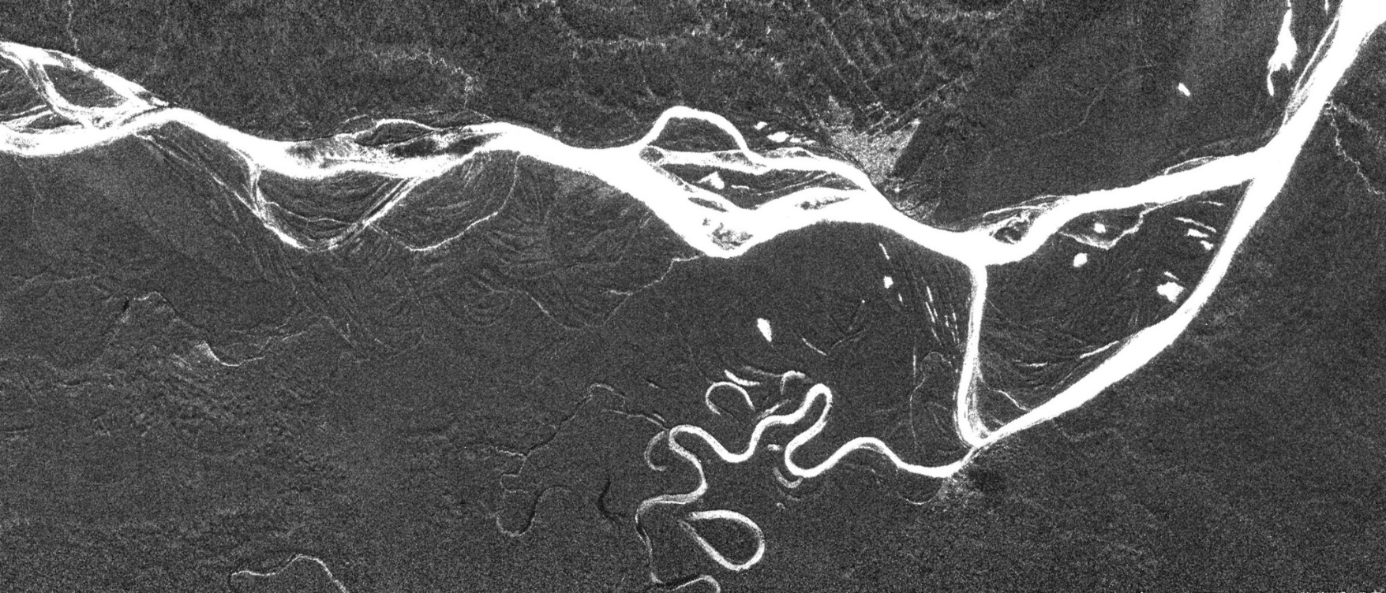
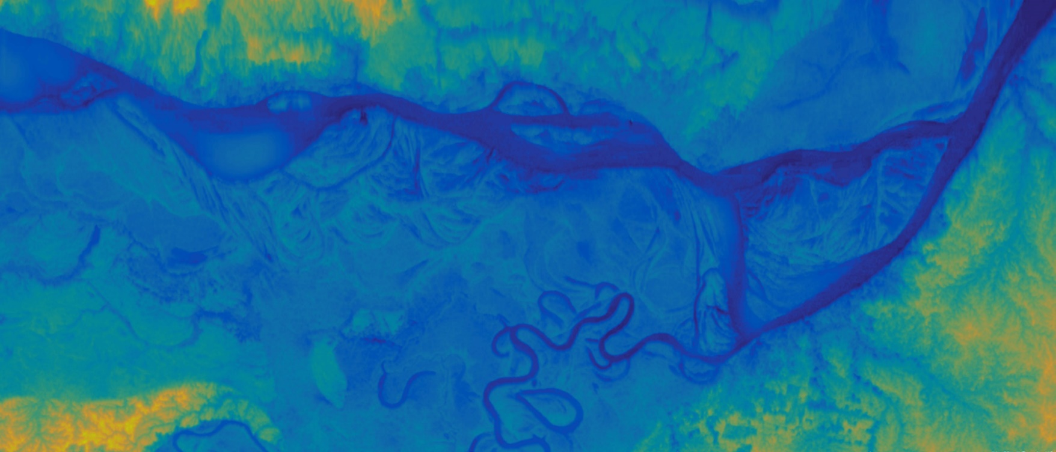
巴西, 秘鲁和哥伦比交界的亚马逊热带雨林地区, 图像大小: 79.3km x 33.6km, 图像中心经纬度: 西经 70.0533 南纬 4.2122,获取时间: 2016.09.23,10:56
亚马逊河
哥伦比亚
巴西
索利蒙伊斯
亚马逊河
亚马逊河
索利蒙伊斯
秘鲁
雅瓦里河
巴西
Notes:
巴西, 秘鲁和哥伦比交界的亚马逊热带雨林地区, 图像大小: 79.3km x 33.6km, 图像中心经纬度: 西经 70.0533 南纬 4.2122,获取时间: 2016.09.23,10:56
20160923105609_000_0MC_ROM_1南美tg1_ampHR(-70.0533 -4.2122)

Slide 20
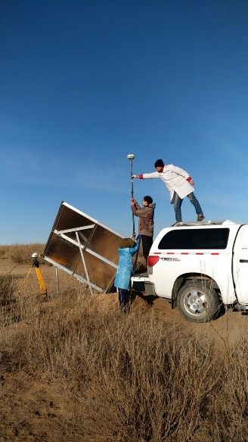
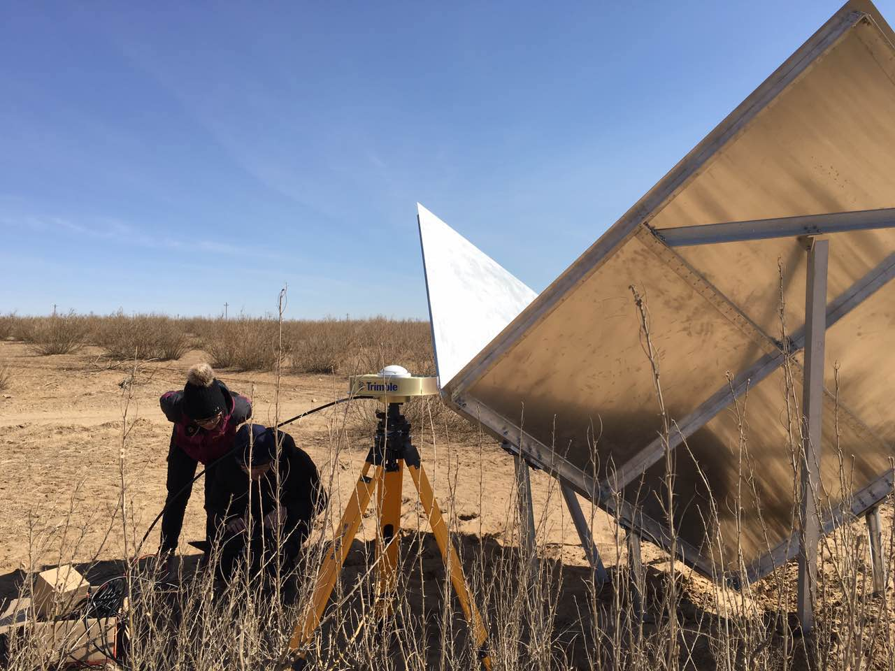
Resolution and Height accuracy verified by Conner Reflectors —2 Square trihedrals of 2m and 5 Triangular trihedrals of 1.5m
Range resolution: 31.85m @ θ = 6.7º,
Azimuthal resolution: 32.98m.

Slide 21
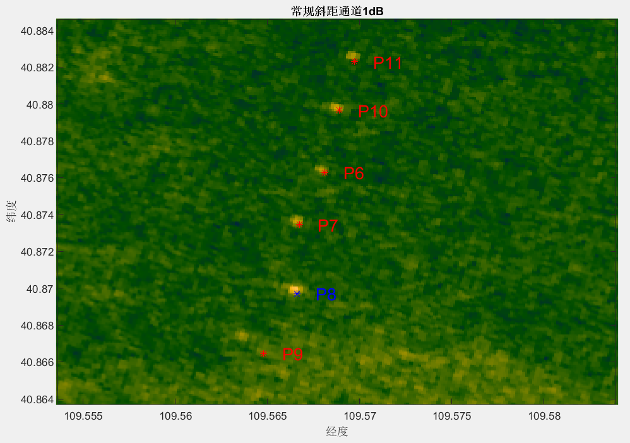
Resolution and Height accuracy verified by Conner Reflectors — 2 Square trihedrals of 2m and 5 Triangular trihedrals of 1.5m
（1）P11 Measured: Lonv = 109.56967593, Latv = 40.88254630，
Height = 1282.58596373m
Ground truth: Lonv = 109.56971520, Latv = 40.88229469， Height = 1284.31870000m
Error: Position = 28.31303714m, Height = -1.73273627m
（2）P10 Measured: Lonv = 109.56875000, Latv = 40.87976852, Height = 1281.12053632m
Ground truth: Lonv = 109.56888970, Latv = 40.87965754, Height = 1280.61470000m
Error: Position = 19.83679609m, Height = 0.50583632m
（3）P6 Measured: Lonv = 109.56791667, Latv = 40.87643519, Height = 1277.25688838m
Ground truth: Lonv = 109.56810350, Latv = 40.87627489, Height = 1276.68870000m
Error: Position = 27.37019857m, Height = 0.56818838m
（4）P7 Measured: Lonv = 109.56652778, Latv = 40.87365741, Height = 1272.83573639m
Ground truth: Lonv = 109.56672650, Latv = 40.87346279, Height = 1272.89070000m
Error: Position = 30.92525972m, Height = -0.05496361m
（5）P6 Measured: Lonv = 109.56652778, Latv = 40.86995370, Height = 1269.87419245m
Ground truth: Lonv = 109.56660090, Latv = 40.86971393, Height = 1269.64370000m
Error: Position = 27.87077518m, Height = 0.23049245m

Slide 22
Buoy calibration of sea level measurement.
B
A
C
A (109.348,18.1356): -10.4m
B (109.2056,18.2484): -11.21m
C (109.2345,18.1012): -10.92m
Absolut error: about 0.3m.
Relative error: about 0.05m.

