Slide 1
Progress on the Implementation of the CEOS Strategy
for Carbon Observations from Space:
CEOS/WGCV/LPV Subgroup Supplement
Miguel Román (NASA)
Miguel.O.Roman@nasa.gov
Fernando Camacho (EOLAB)
Fernando.Camacho@eolab.es
Kurtis Thome (NASA)
Kurtis.Thome@nasa.gov
Hank Margolis (NASA)
Hank.A.Margolis@nasa.gov
Last Updated: (Tuesday, 18 May 2017)

Slide 2
2017-2019 Work Plan
3.2 Progress on the implementation of the CEOS Strategy for Carbon Observations from Space
CARB-19: Land product validation listing and framework | Q4 2017 | Summarize current list of validated land data products relevant to Carbon Strategy. Document validation framework and protocols Provide guidance for online platform for intercomparison of terrestrial carbon products. | WGCV

Slide 3
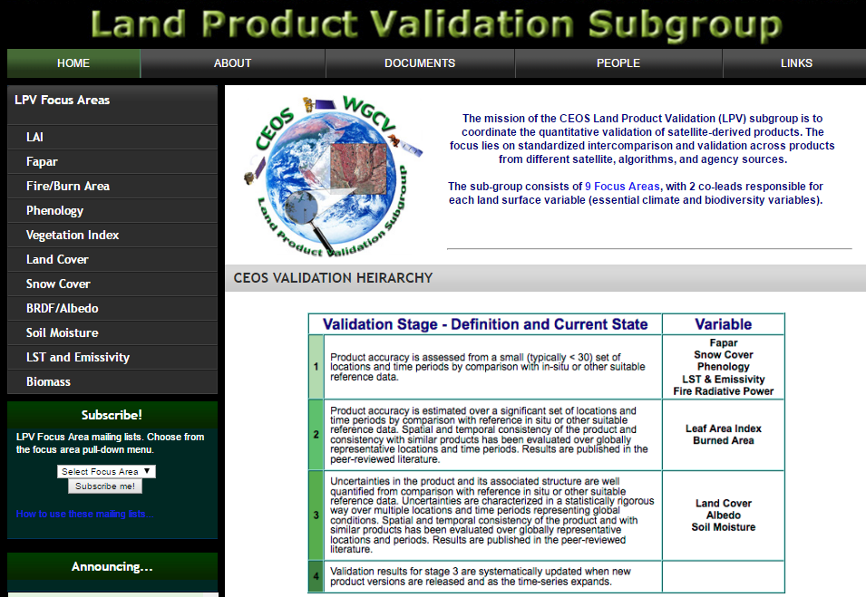
CARB-19: Land product validation listing
CEOS/WGCV/LPV has completed listing of 11 carbon-focused variables, totaling 138 land products from 11 CEOS Agencies.
https://lpvs.gsfc.nasa.gov/
9 product categories are listed as GCOS Essential Climate Variables (ECVs*)
2 product categories are listed as GEOBON Essential Biodiversity Variables (EBVs*).
*
*
*
*
*
*
*
*
*
*
*

Slide 4
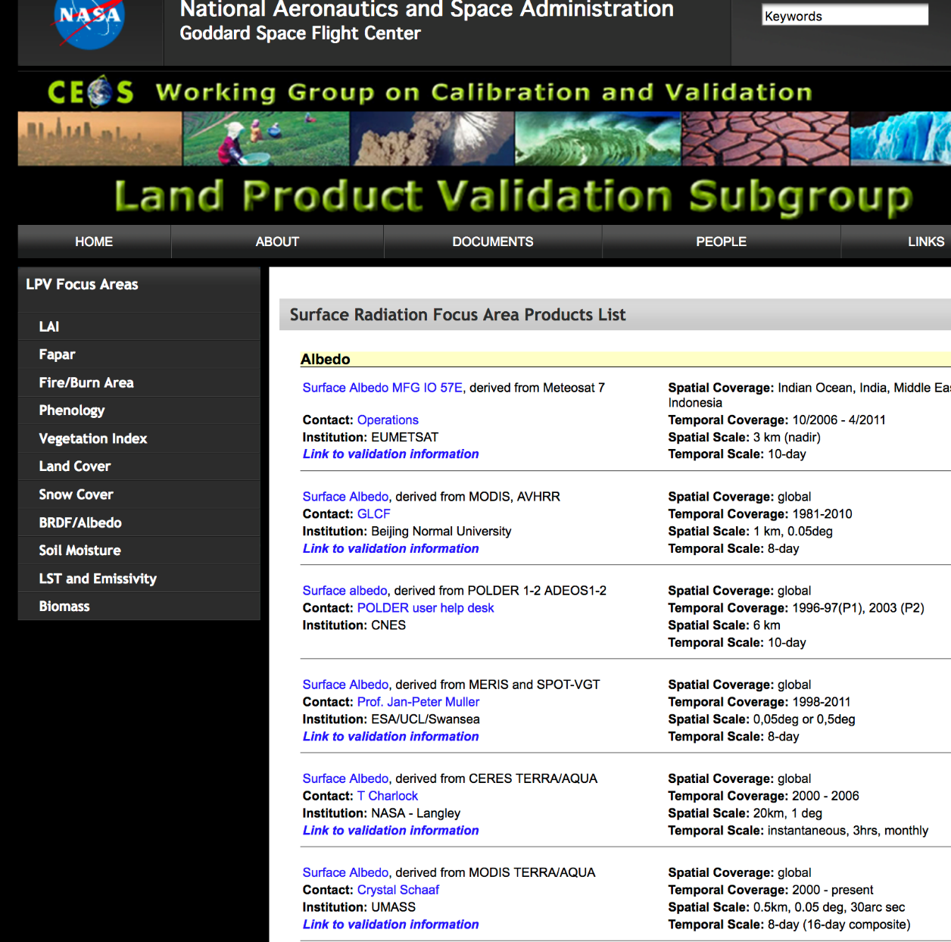

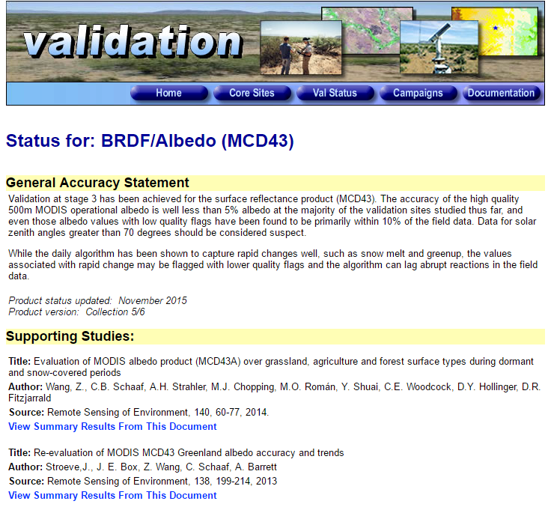
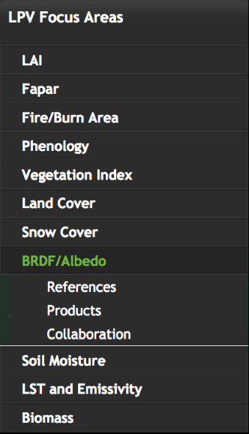
CARB-19: Land product validation listing
(Example #1)
CEOS-LPV Validation Reports – Surface Albedo Focus Area
Provides List of Products with
Meta-data
Contacts
Links to Validation Reports
Links to Data Centers
MODIS Terra/Aqua Surface Albedo

Slide 5

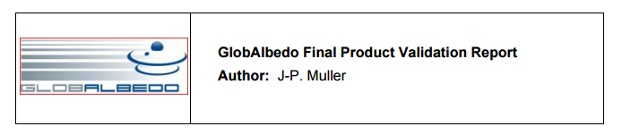
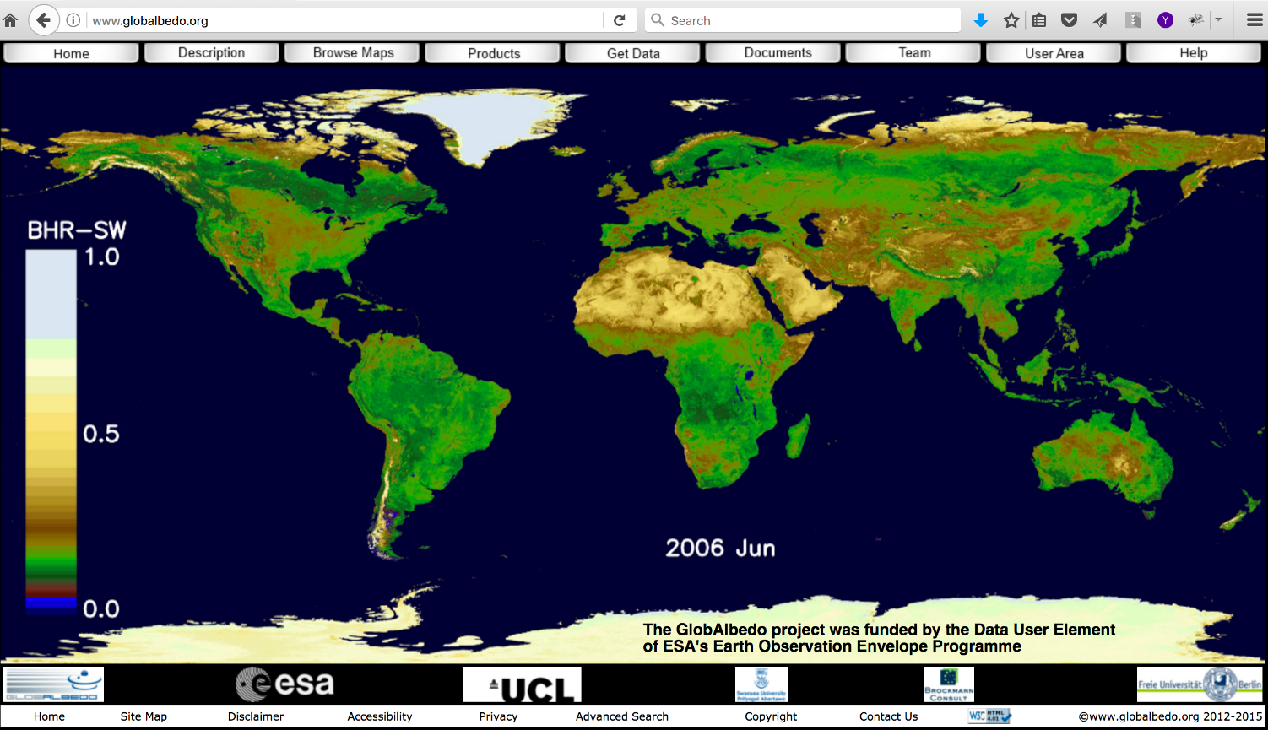
CARB-19: Land product validation listing
(Example #2)
CEOS-LPV Validation Reports – Surface Albedo Focus Area
Provides List of Products with
Meta-data
Contacts
Links to Validation Reports
Links to Data Centers
http://www.globalbedo.org/docs/GlobAlbedo_FVR_V1_2_web.pdf
GlobAlbedo

Slide 6

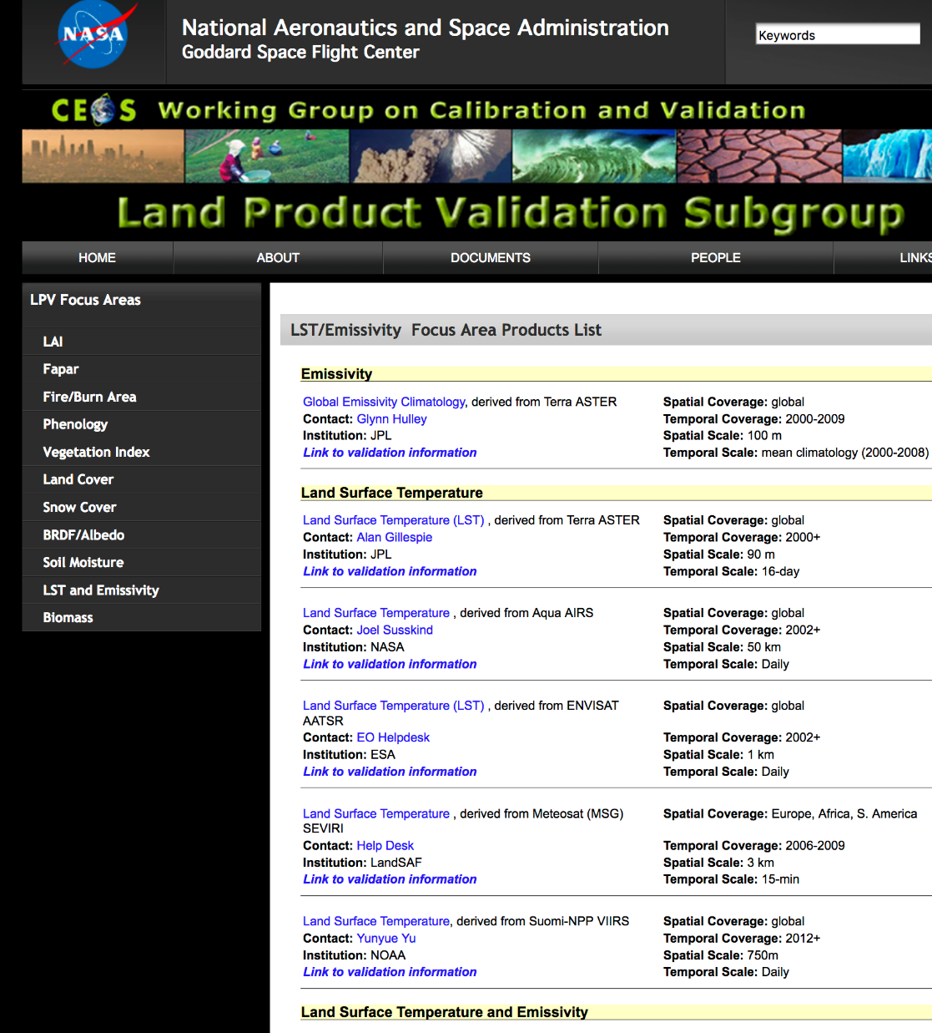
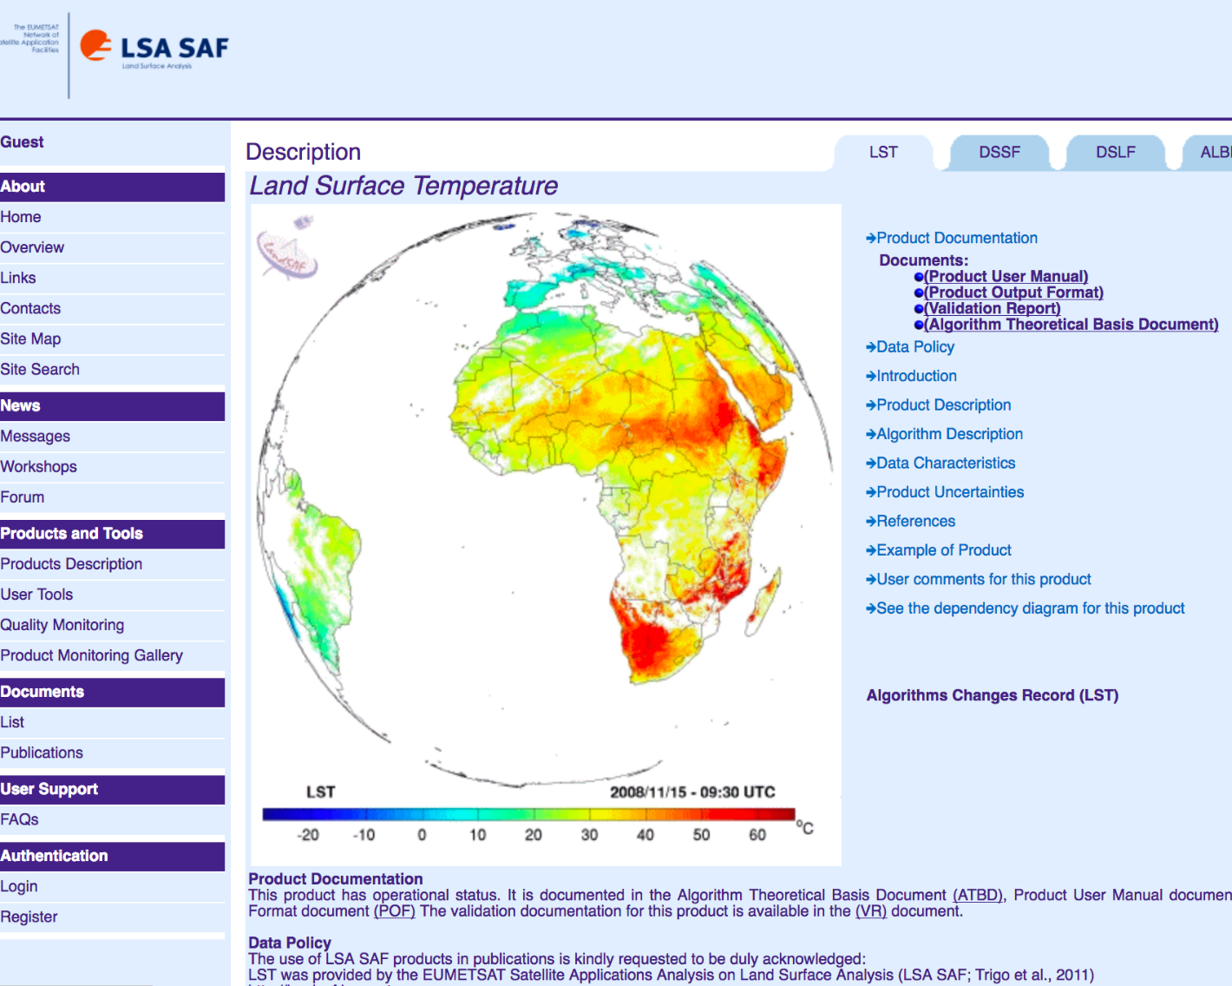
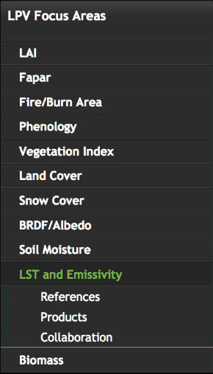
CARB-19: Land product validation listing
(Example #3)
CEOS-LPV Validation Reports – Land Surface Temperature & Emissivity Focus Area
Provides List of Products with
Meta-data
Contacts
Links to Validation Reports
Links to Data Centers
EUMETSAT Land Surface Temperature

Slide 7
2017-2019 Work Plan
3.2 Progress on the implementation of the CEOS Strategy for Carbon Observations from Space
CARB-19: Land product validation listing and framework | Q4 2017 | Summarize current list of validated land data products relevant to Carbon Strategy. Document validation framework and protocols Provide guidance for online platform for intercomparison of terrestrial carbon products. | WGCV

Slide 8
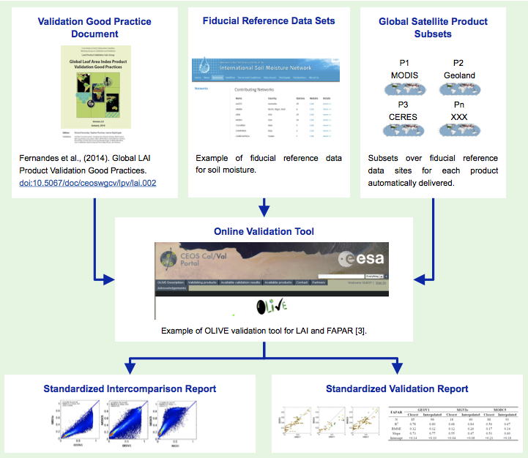




CARB-19: CEOS Land Validation Framework
Schaepman-Strub et al., (2017) submitted
CEOS LPV has established a framework with the aim of independent validation and consistent uncertainty reporting across products as main output.
Multiple agencies are coordinating five actionable tasks:
        [NASA] Developing best practice validation protocols, where validation methods are sent through rigorous peer-review (Q4-2018).
        [NOAA/ESA/EUMETSAT] Ensuring access to processed fiducial reference data (ongoing).
        [USGS/NOAA] Supporting automated subsets of global satellite products (LPCS; Q2-2017.)
        [NASA] Implementing data analysis tools (Q2-2018).
        [NASA/ESA] Delivering standardized intercomparison and validation reports (Q4-2018)
1. 2. 3.
4.
5.

Slide 9
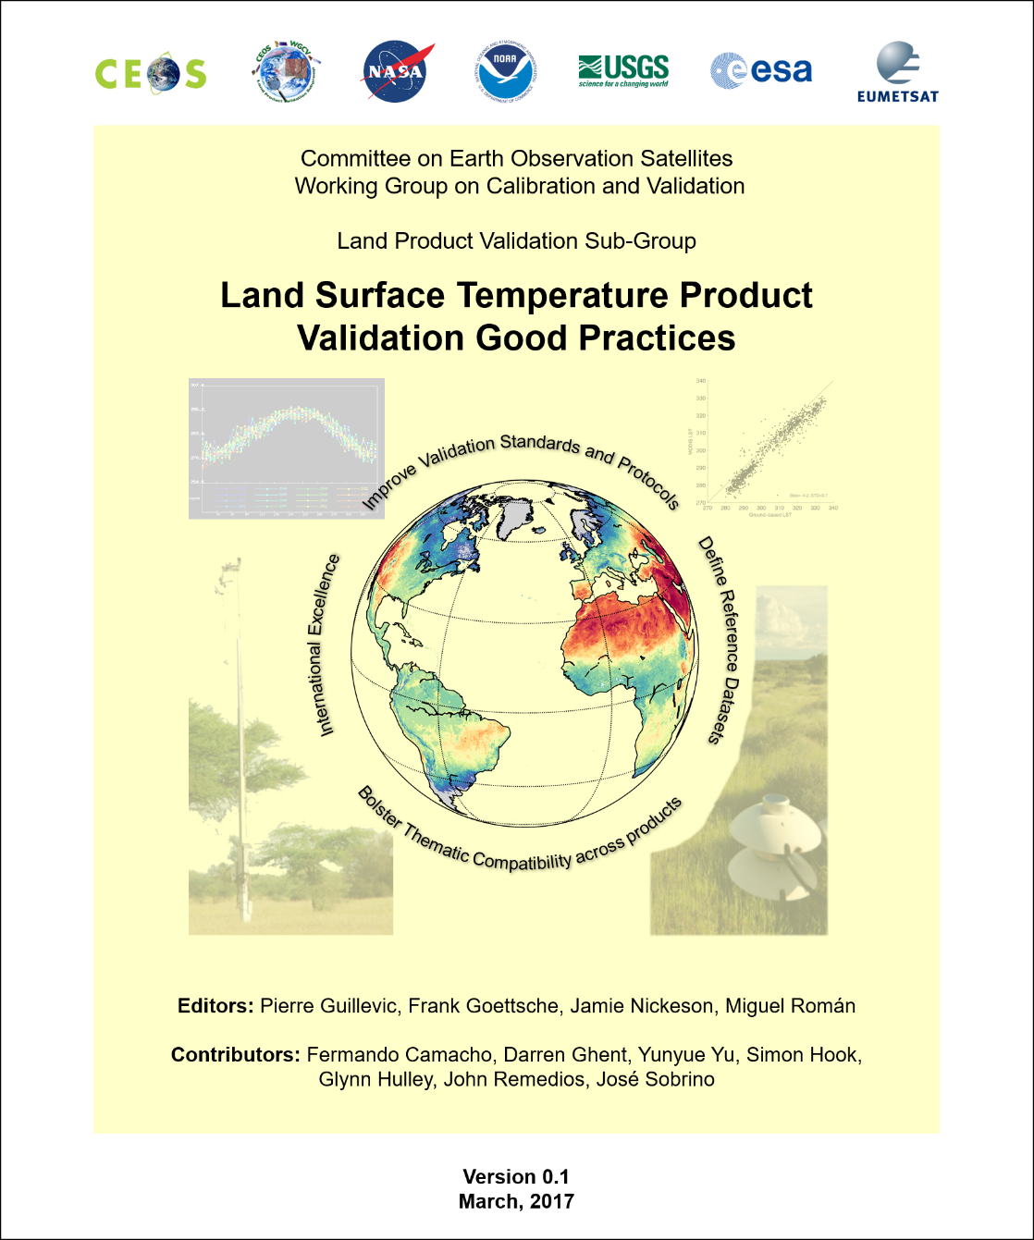
CARB-19: Land Validation Protocol -
Land Surface Temperature (LST) (Q4-2017)
Protocol Status: LST validation protocol document is complete and undergoing peer-review. The protocol will present recommendations on internationally accepted validation good practices.
Overarching Goal: To ensure thematic compatibility across products, reference datasets, and methods. CEOS agency deliverables include:
Support product development, validation, and interconsistency efforts (ROSES, MEaSUREs), maintain the On Line Interactive Validation Exercise (OLIVE) platform to assess global satellite products (LAI, Albedo, LST).
Maintain observational networks in the US (BSRN/SURFRAD, USCRN) used for routine validation of LST.
Develop and maintain the online Land Product Characterization System (https://landsat.usgs.gov/lpcs) to facilitate the characterization and validation of multi-satellite products using in-situ data .
Provide users with multi-mission LST data (GlobTemperature). Engage with the user community through the International LST and Emissivity Working Group (http://ilste-wg.org)
Maintain ground-based LST reference networks in Portugal and Africa for satellite land products validation (Satellite Application Facilities, http://landsaf.ipma.pt)

Slide 10
2017-2019 Work Plan
3.2 Progress on the implementation of the CEOS Strategy for Carbon Observations from Space
CARB-19: Land product validation listing and framework | Q4 2017 | Summarize current list of validated land data products relevant to Carbon Strategy. Document validation framework and protocols Provide guidance for online platform for intercomparison of terrestrial carbon products. | WGCV

Slide 11

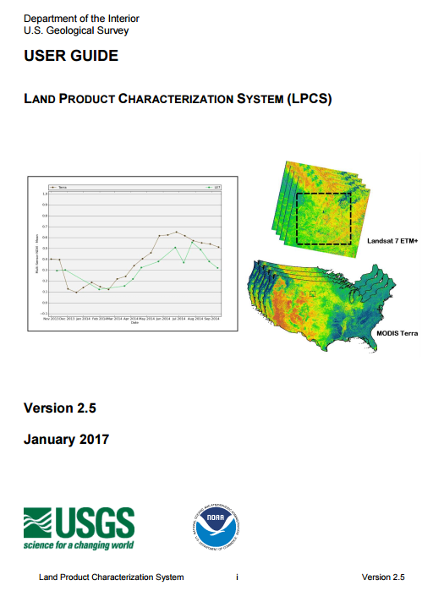
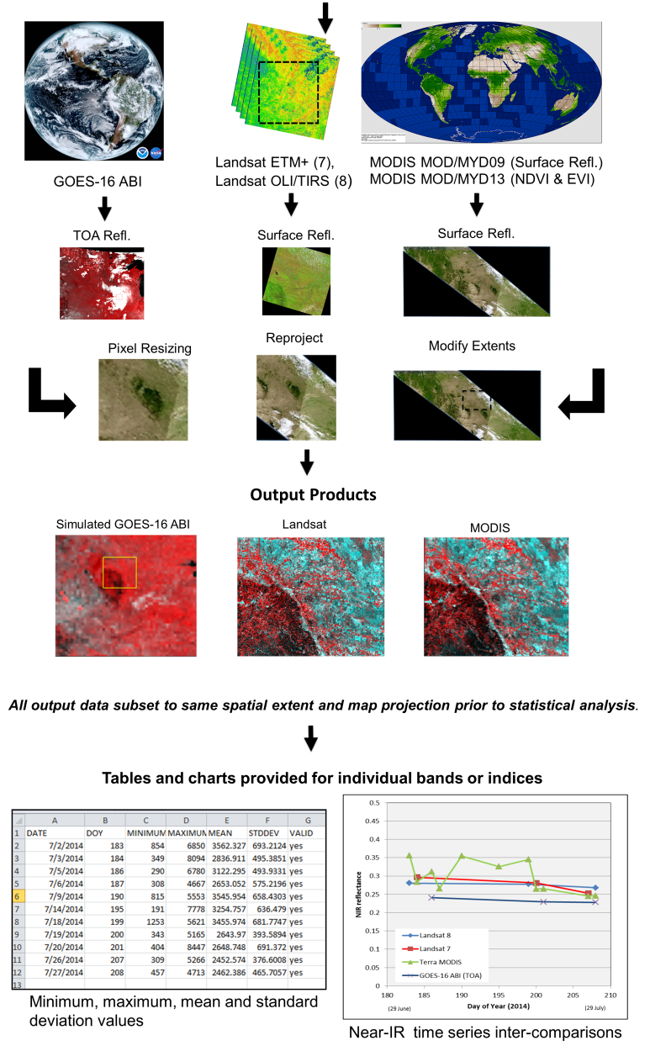
CARB-19: Online Platform for Intercomparison -
Land Product Characterization System (Q2-2017)
In March 2017, USGS and NOAA announced the launch of the Land Product Characterization System (LPCS). LPCS is a web-based system designed to facilitate intercomparison of higher-level, satellite-derived, global land products. Key features include:
Analysis functions that permit data to be identified, retrieved, co-registered, and compared statistically through a single interface.
Access to the latest data collections of Landsat 4 through 8, Terra and Aqua MODIS, Suomi-NPP VIIRS and GOES-16 ABI.
Future products will include ESA Sentinel-2 and -3 series.
LPCS User Guide provides detailed information related to system features and functionality.
https://landsat.usgs.gov/lpcs

Slide 12
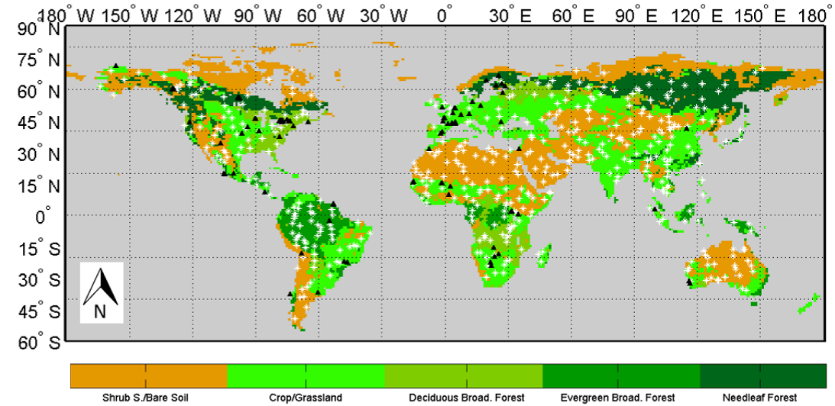
CARB-19: Online Platform for Intercomparison -
OnLine Validation Exercise (OLIVE) (Q2-2018)
The OLiVE platform and source code have been transitioned from ESA to NASA. OLiVE will ingest data from LPCS (USGS/NOAA system) to support the following CEOS carbon strategy actions:
CA-09: Organize and coordinate product intercomparison activities in coordination with the wider carbon cycle science community.
CA-31: Establish validation methodologies, protocols, and benchmark datasets.
CA-34: Ensure that products are intercomparable and can be used synergistically in quantitative analyses.
Spatial distribution of OLiVE sites for validation of FAPAR (Fraction of Absorbed Photosynthetically Active Radiation) (Weiss et al., 2014)

Slide 13
2017-2019 Work Plan
3.2 Progress implementation of the CEOS Strategy for Carbon Observations from Space
CARB-16: Cal/Val and production of biomass products from CEOS missions | Q4 2019 | Development of a coordinated Cal/Val strategy across NASA and ESA biomass missions that rationalizes protocols, data sharing, and the establishment of ground-based carbon super-sites. | NASA and ESA

Slide 14
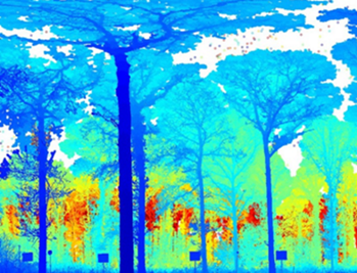
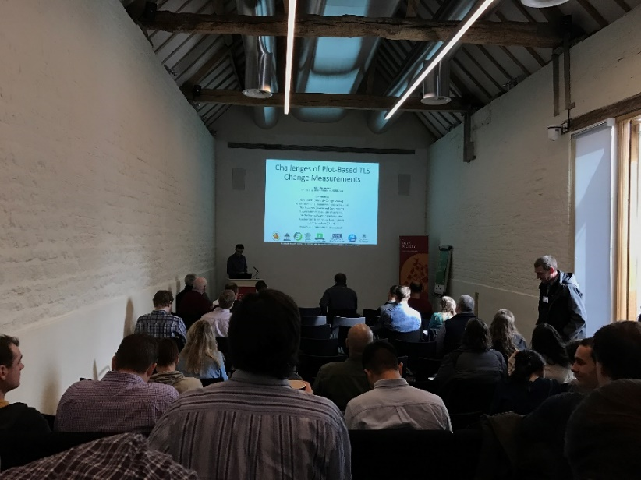
CEOS-LPV Biomass Focus Area Activities
In response to CARB-16, CEOS-LPV has established a new focus area dedicated to the assessment of global aboveground biomass products. 2016-2017 milestones include:
(June, 2016) GEDI, BIOMASS, & NISAR team have agreed on cross-cutting validation activities under the auspices of CEOS/WGCV/LPV. NASA/ESA teams will identify validation sites with coincident field and airborne retrievals (Q2-2018).
(Feb, 2017) The Royal Society supported the international Terrestrial laser scanning (TLS) revolution in forest ecology meeting. TLS data and sampling approaches, which help quantify errors in field and satellite-based estimates, will be used as fiducial reference for aboveground biomass.
https://lpvs.gsfc.nasa.gov/Biomass/AGB_home.html

Slide 15


Multi-Mission Cal/Val Meeting
Nov 6-10, 2017, Bern Switzerland
Follow on to Smithsonian meeting last June
50 person max, invite only, organized by Klaus Scipal at ESA
Several GEDI team members will be attending (list not finalized)
Directly following the meeting (Nov 10) will be a CEOS biomass protocol writing workshop
Goal to circulate rough draft / skeleton of protocol in advance of meeting

Slide 16
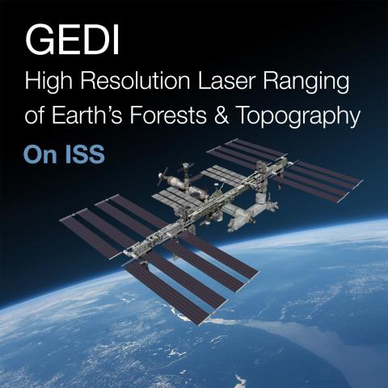


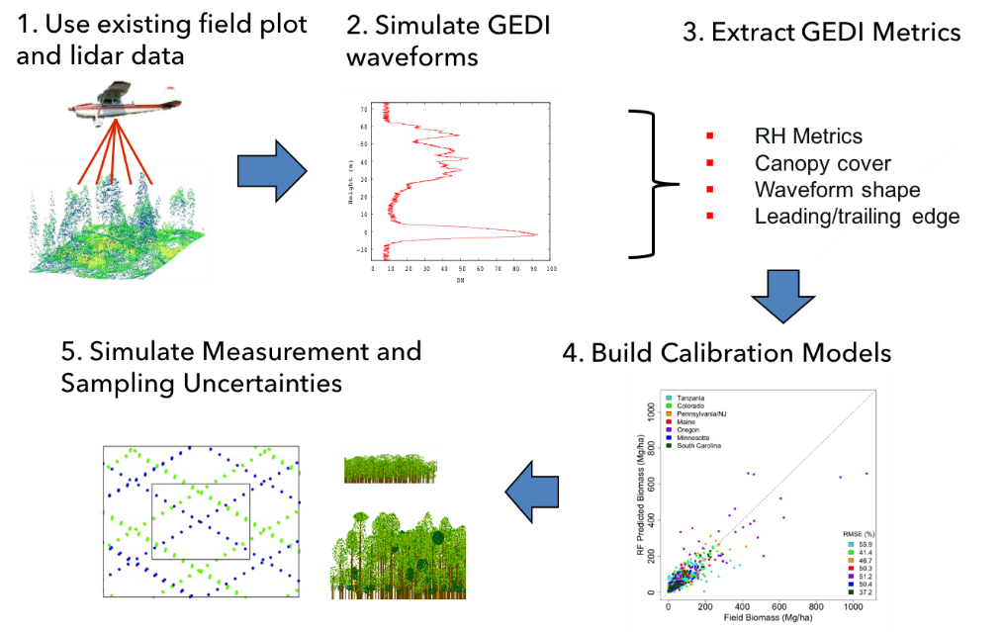
CEOS-LPV Biomass Focus Area Activities
NASA-GEDI science team is compiling a global dataset of coincident field and airborne lidar.
Reference archive includes 3,690 plots (0.0625-0.25 ha), and 17,406 simulated footprints (25m) over ~100 corresponding field sites.
CEOS-LPV Biomass team (NASA/ESA) will work to determine which GEDI reference sites can fill the needs of all missions (including data access) (Q2-2018).
 | Completed | In Progress | Future | Total by Region
Australia | 3 | 13 | 0 | 16
Asia | 0 | 4 | 4 | 8
Europe | 0 | 8 | 9 | 17
North America | 9 | 9 | 3 | 21
Africa | 4 | 5 | 2 | 11
Central America | 5 | 2 | 0 | 7
South America | 11 | 3 | 4 | 18
Total by Status | 32 | 44 | 22 | 98

Slide 17

CEOS/WGCV/LPV
Visit our web site, subscribe to the listserv! lpvs.gsfc.nasa.gov

