Slide 1

WGCV Chair’s Report
K. Thome
NASA
WGCV Plenary # 43
INPE, Sao Jose dos Campos
April 10-13, 2018

Slide 2
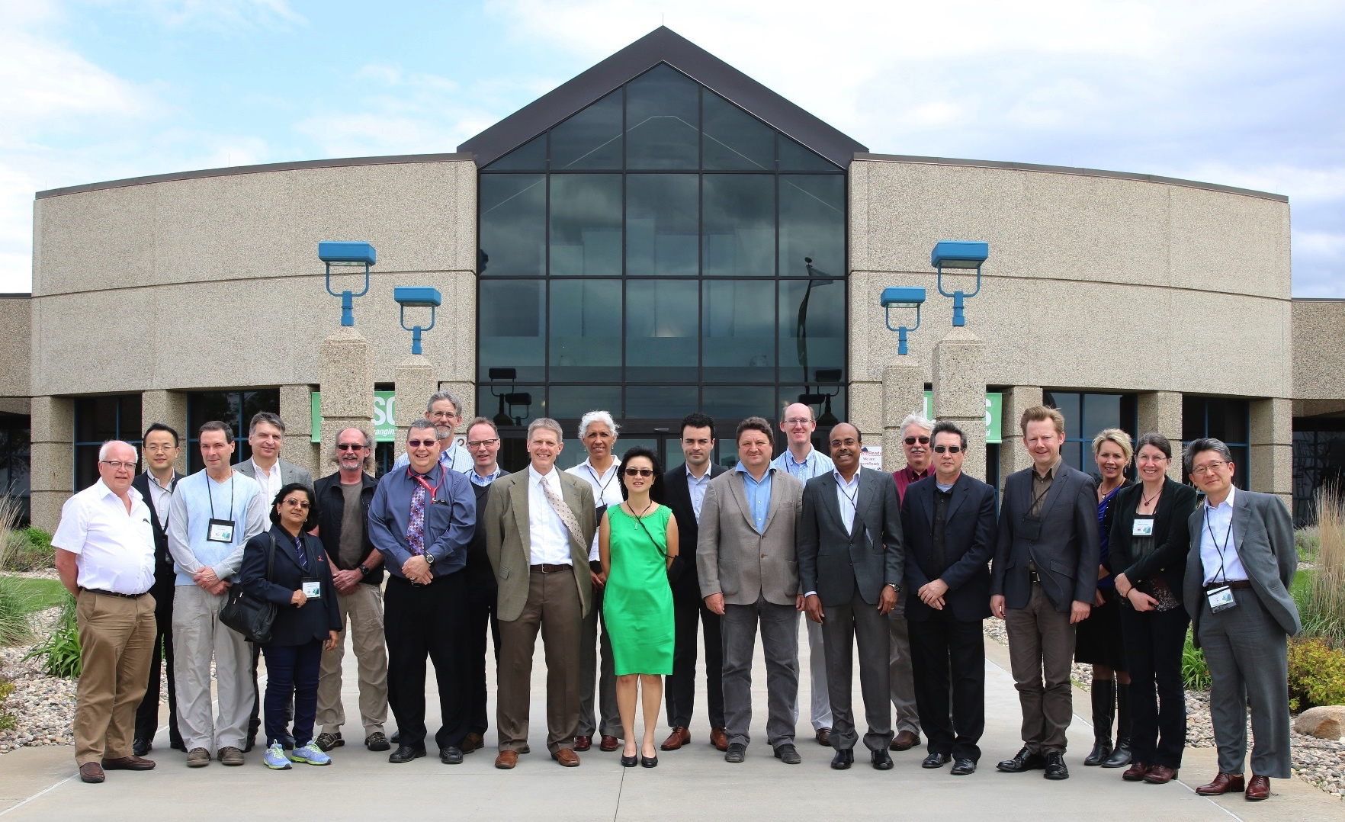
Timeline from WGCV-42
May 2017 WGCV plenary # 42 in Tokyo
September 2017 SIT Technical Workshop in Frascati
Oct. 31 – Nov. 2 CEOS Plenary in Brisbane
November 2017 SAR Sub-group Workshop in Pasadena, California
LPV Subgroup February 2018, Frascati
IVOS Subgroup March 2018, Noordwijk, Netherlands
Other activities
WGCV work plan provided to CEOS Chair
Inputs to monthly CEOS SEC meeting / telecon
July telecon with CEOS SIT
CEOS Newsletter input

Slide 3
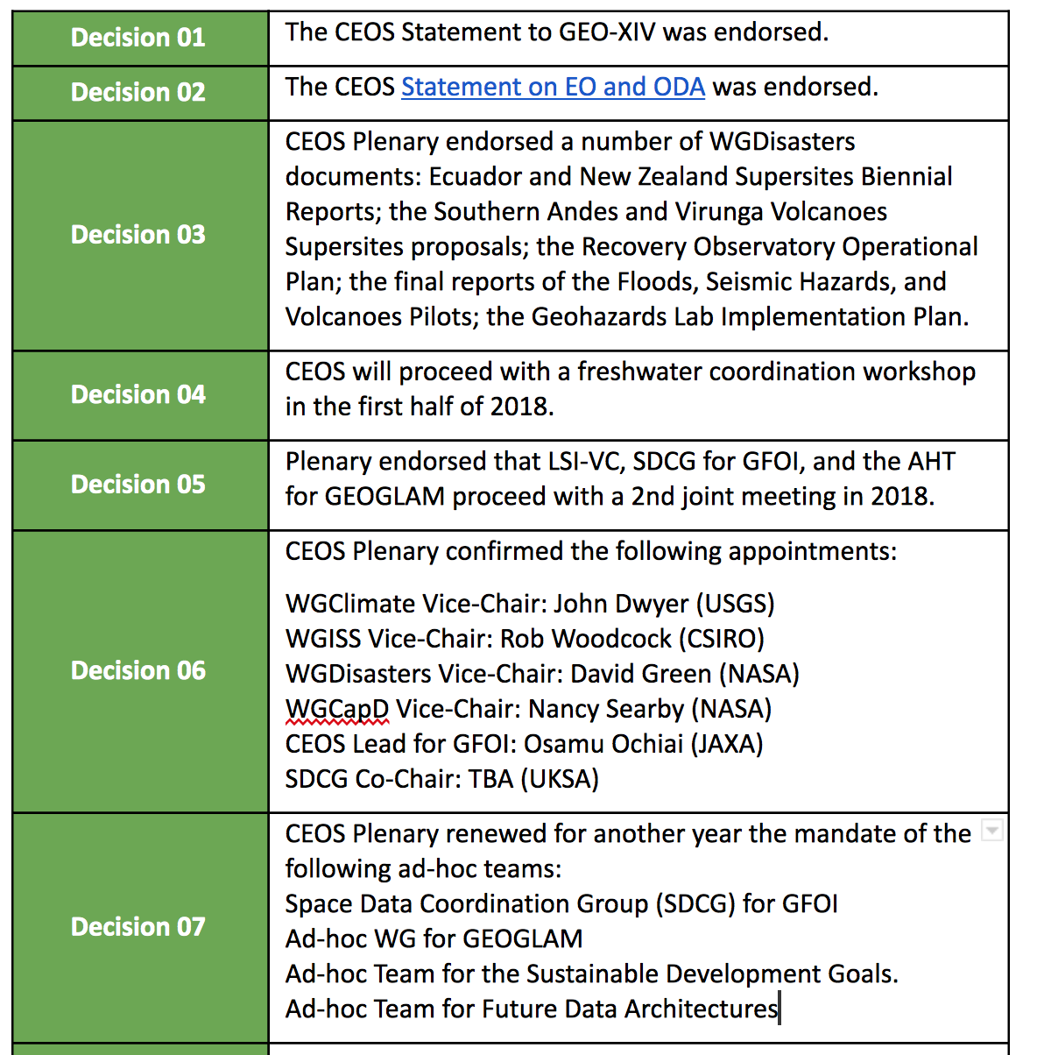
31st CEOS Plenary
18th–20th October 2017
Rapid City, South Dakota, USA
The European Commission (2018 CEOS Chair) will ensure continuity and coherence of CEOS activities by:
Supporting and further developing priorities and themes of previous Chair (USGS)
Understanding and defining common priorities with incoming SIT Chair (NOAA)

Slide 4
European Commission (EC) Priorities
The EC will continue work on past activities such as
  Implementation of the study of future data access and analysis architectures.
  Supporting the ad-hoc team on Sustainable Development Goals (SDGs).
  Moderate Resolution Sensor Interoperability
2018 Chair Priorities
Laying the foundation for an international CO2 and GHG emission monitoring system
Bring the benefits of Future Data Architectures to the present - identify new targets

Slide 5
WGCV and Carbon
WGCV Carbon tasks
All Carbon actions have a path toward completion with specific actions being addressed in preparation for WGCV-43
CARB-19 is to summarize current list of validated land data products relevant to Carbon Strategy
 | 1 | 2 | 3 | 4 | 5 | 6 | 7 | 8 | 9 | 10 | 11 | 12 | 13 | 14 | 15 | 16 | 17 | 18 | 19 | 20 | 21 | 22 | 23 | 24 | 25 | 26 | 27 | 28 | 29 | 30
1
2
3
4
5 |  |  |  |  |  |  |  |  |  |  |  |  |  |  | x |  |  |  |  | x | x |  |  |  | x
6
7 |  |  |  |  |  |  |  |  |  |  | x | x |  |  |  |  |  |  |  |  | x |  |  |  |  | x
8 |  |  |  |  |  |  |  |  |  |  |  |  |  |  |  |  |  | x |  |  |  | x
9 |  |  |  |  |  |  |  |  |  |  | x |  |  |  |  |  |  | x
10
11
12
13
14 |  |  |  |  |  |  |  |  | x | x |  |  |  |  |  |  |  |  |  |  | x
15
16
17
18
19
20 |  |  |  |  |  |  |  |  |  |  |  |  |  |  | x |  |  |  |  |  |  |  |  |  |  |  | x
21
22 |  |  |  |  |  |  |  | x | x |  |  |  |  |  |  |  |  |  |  |  |  |  |  |  |  |  |  | x
23
24
25
26 |  |  |  |  |  |  |  |  |  |  |  |  |  |  |  |  | x | x |  |  | x |  |  |  |  |  |  |  | x
27 | x | x |  |  |  | x | x |  |  |  |  |  |  |  |  |  | x
28
29 |  |  |  |  |  |  |  |  |  |  |  |  |  |  |  |  | x | x |  |  | x |  |  |  |  |  |  |  | x
30
31 |  |  |  |  | x |  |  |  |  |  |  |  |  |  |  |  |  | x
32 |  | x |  |  |  |  |  |  |  |  |  |  | x | x |  | x |  | x |  |  |  |  | x |  |  |  |  |  |  | x
33 |  |  |  |  |  |  |  |  |  |  |  |  |  |  |  |  |  |  |  |  |  |  |  | x |  |  |  | x
34 |  | x |  |  |  |  |  |  |  |  |  |  |  |  |  |  |  | x |  |  | x | x
35 |  | x
36
37
38 |  |  | x | x |  |  |  |  |  |  |  |  |  |  |  |  |  |  | x
39
40
41
42
WGCV lead
SIT 2017
May 2017
CEOS Carbon Action items

Slide 6
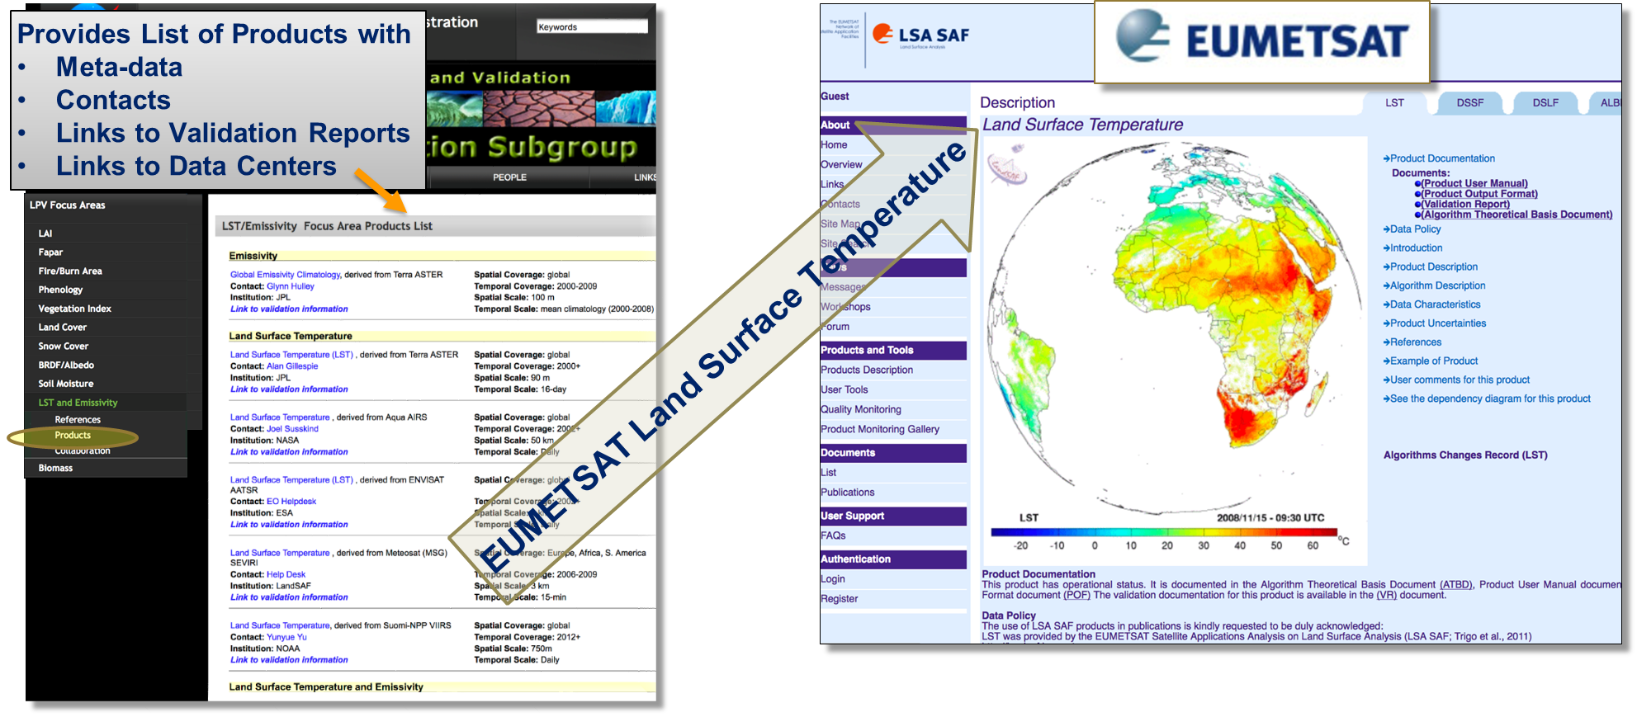
WGCV LPV Validation Reports
Documenting validation framework and protocols
One example - Land Surface Temperature & Emissivity Focus Area

Slide 7
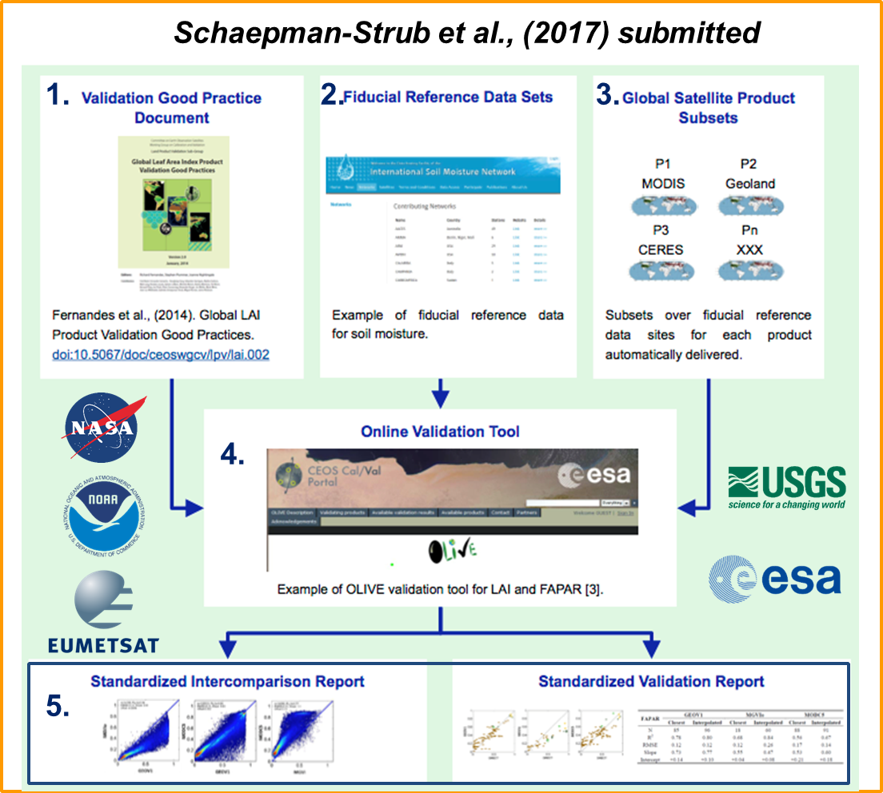
LPV and validation framework
CEOS WGCV LPV has established a framework with the aim of independent validation and consistent uncertainty reporting across products as main output

Slide 8
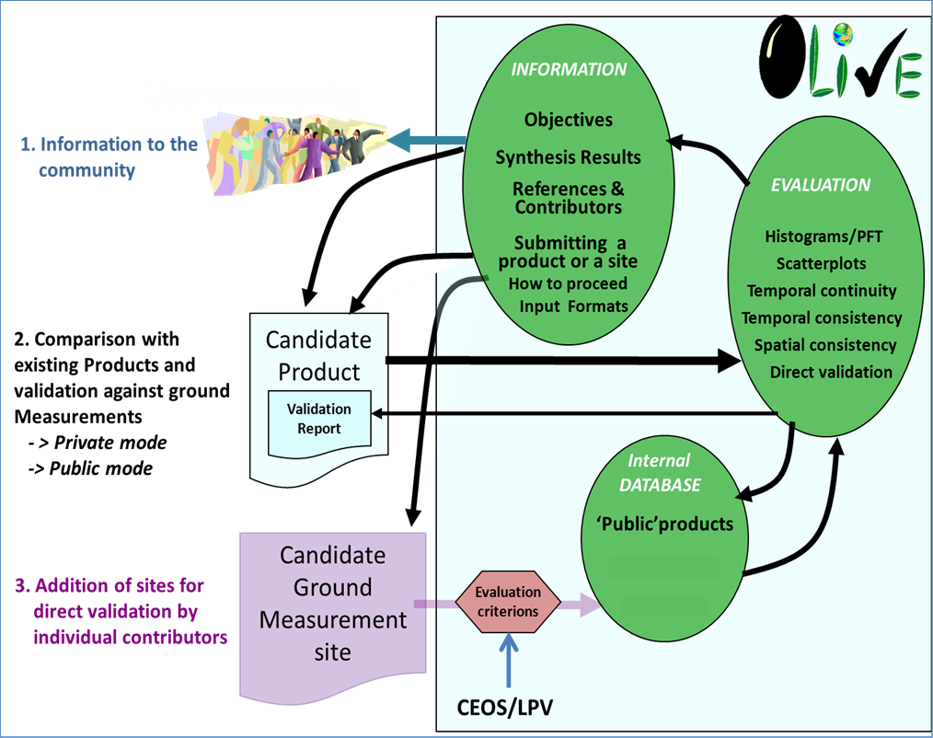
LPV’s OLIVE
Online Platform for Intercomparison - OnLine Validation Exercise (OLIVE)
Guidance for online platform for intercomparison of terrestrial carbon products.
Results of LPV efforts being formalized to allow closure of CARB-19 and likely closure of Carbon Task Force’s Action #08

Slide 9
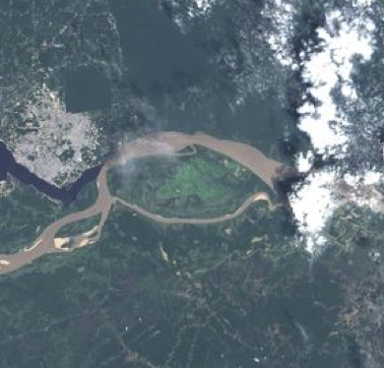
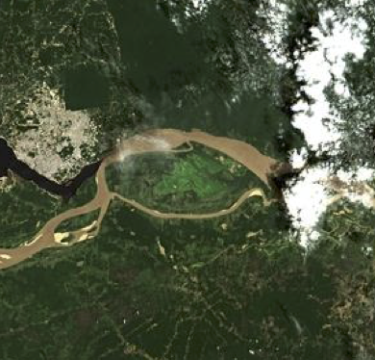
Atmospheric Correction Intercomparison ACIX
Sensors Processors
1 | ACOLITE [Belgium]
2 | ATCOR [Germany]
3 | Brockmann [Germany]
4 | FORCE [Germany]
5 | GA-PABT [Australia]
6 | LaSRC [USA]
7 | LAC [France]
8 | MACCS [France]
9 | OPERA [Belgium]
10 | SCAPE-M [Germany]
11 | SeaDAS [USA]
12 | Sen2Cor [France&Germany]
CV-13: Intercomparison of atmospheric correction models
Better understanding of the different uncertainty contributors and help in improving the AC processors
Definition of the inter-comparison protocol - discussed at first workshop
Application of the AC processors - Participants applied their AC schemes for test sites keeping processing parameters constant
Analysis of the results - ACIX coordinators processed the results submitted by all participants in early 2017

Slide 10
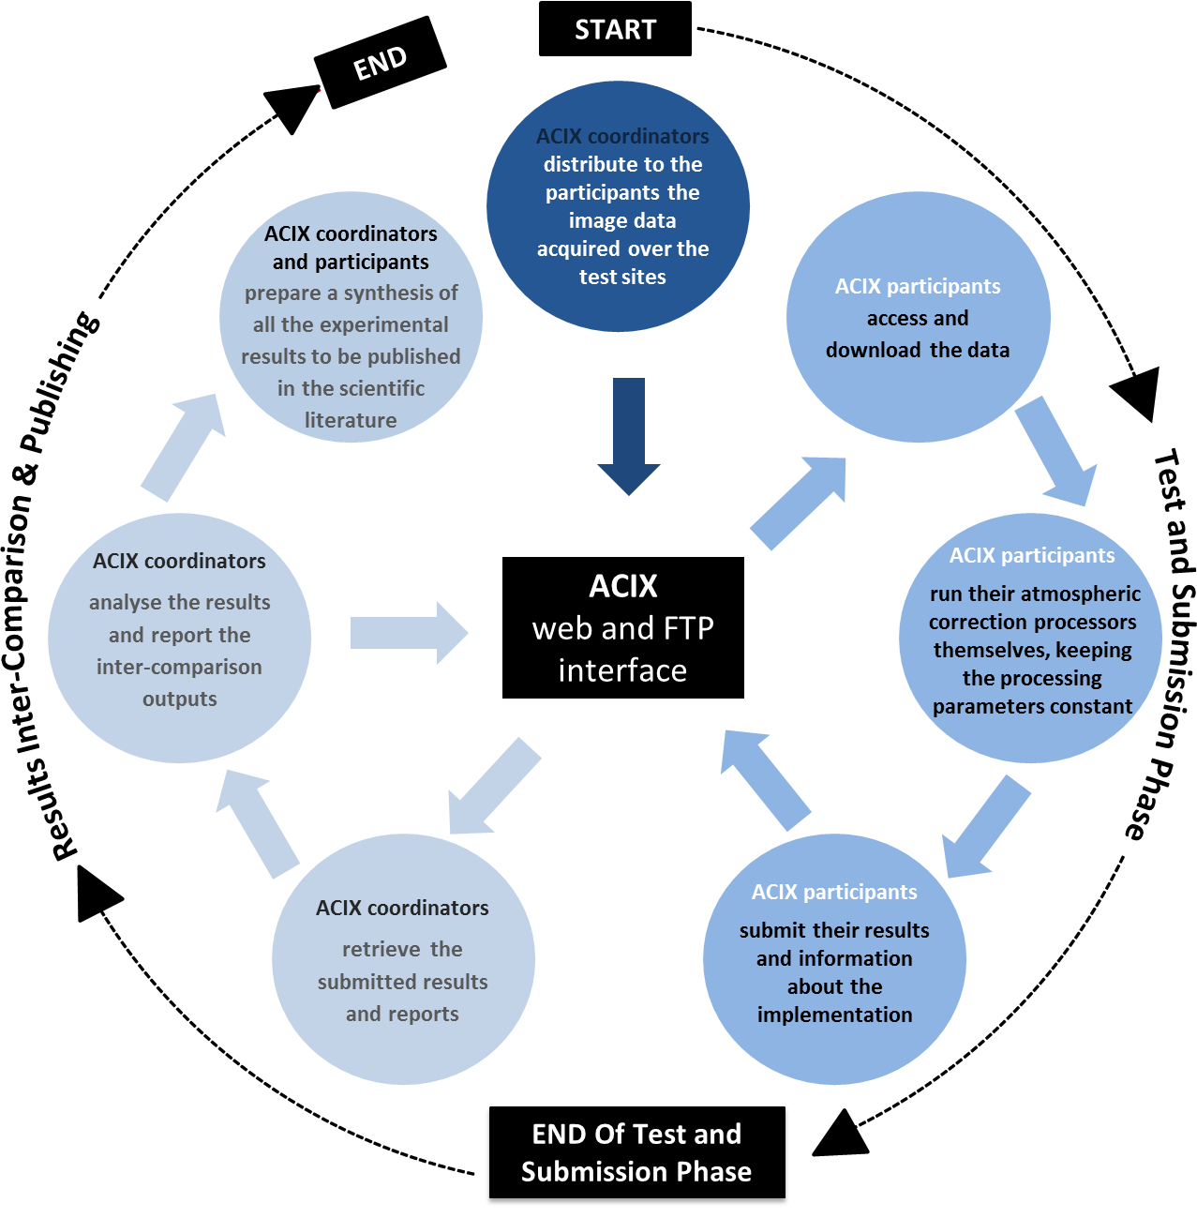
Results presented during 2nd ACIX workshop held in April 2017
Lessons learned on how to improve atmospheric correction schemes
Results pointed to the importance of per-pixel quality flags to ensure accurate atmospheric correction
You are here

Slide 11
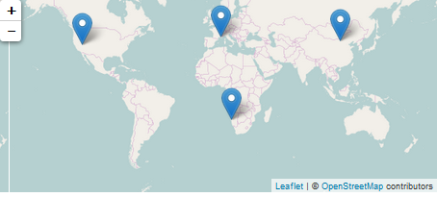
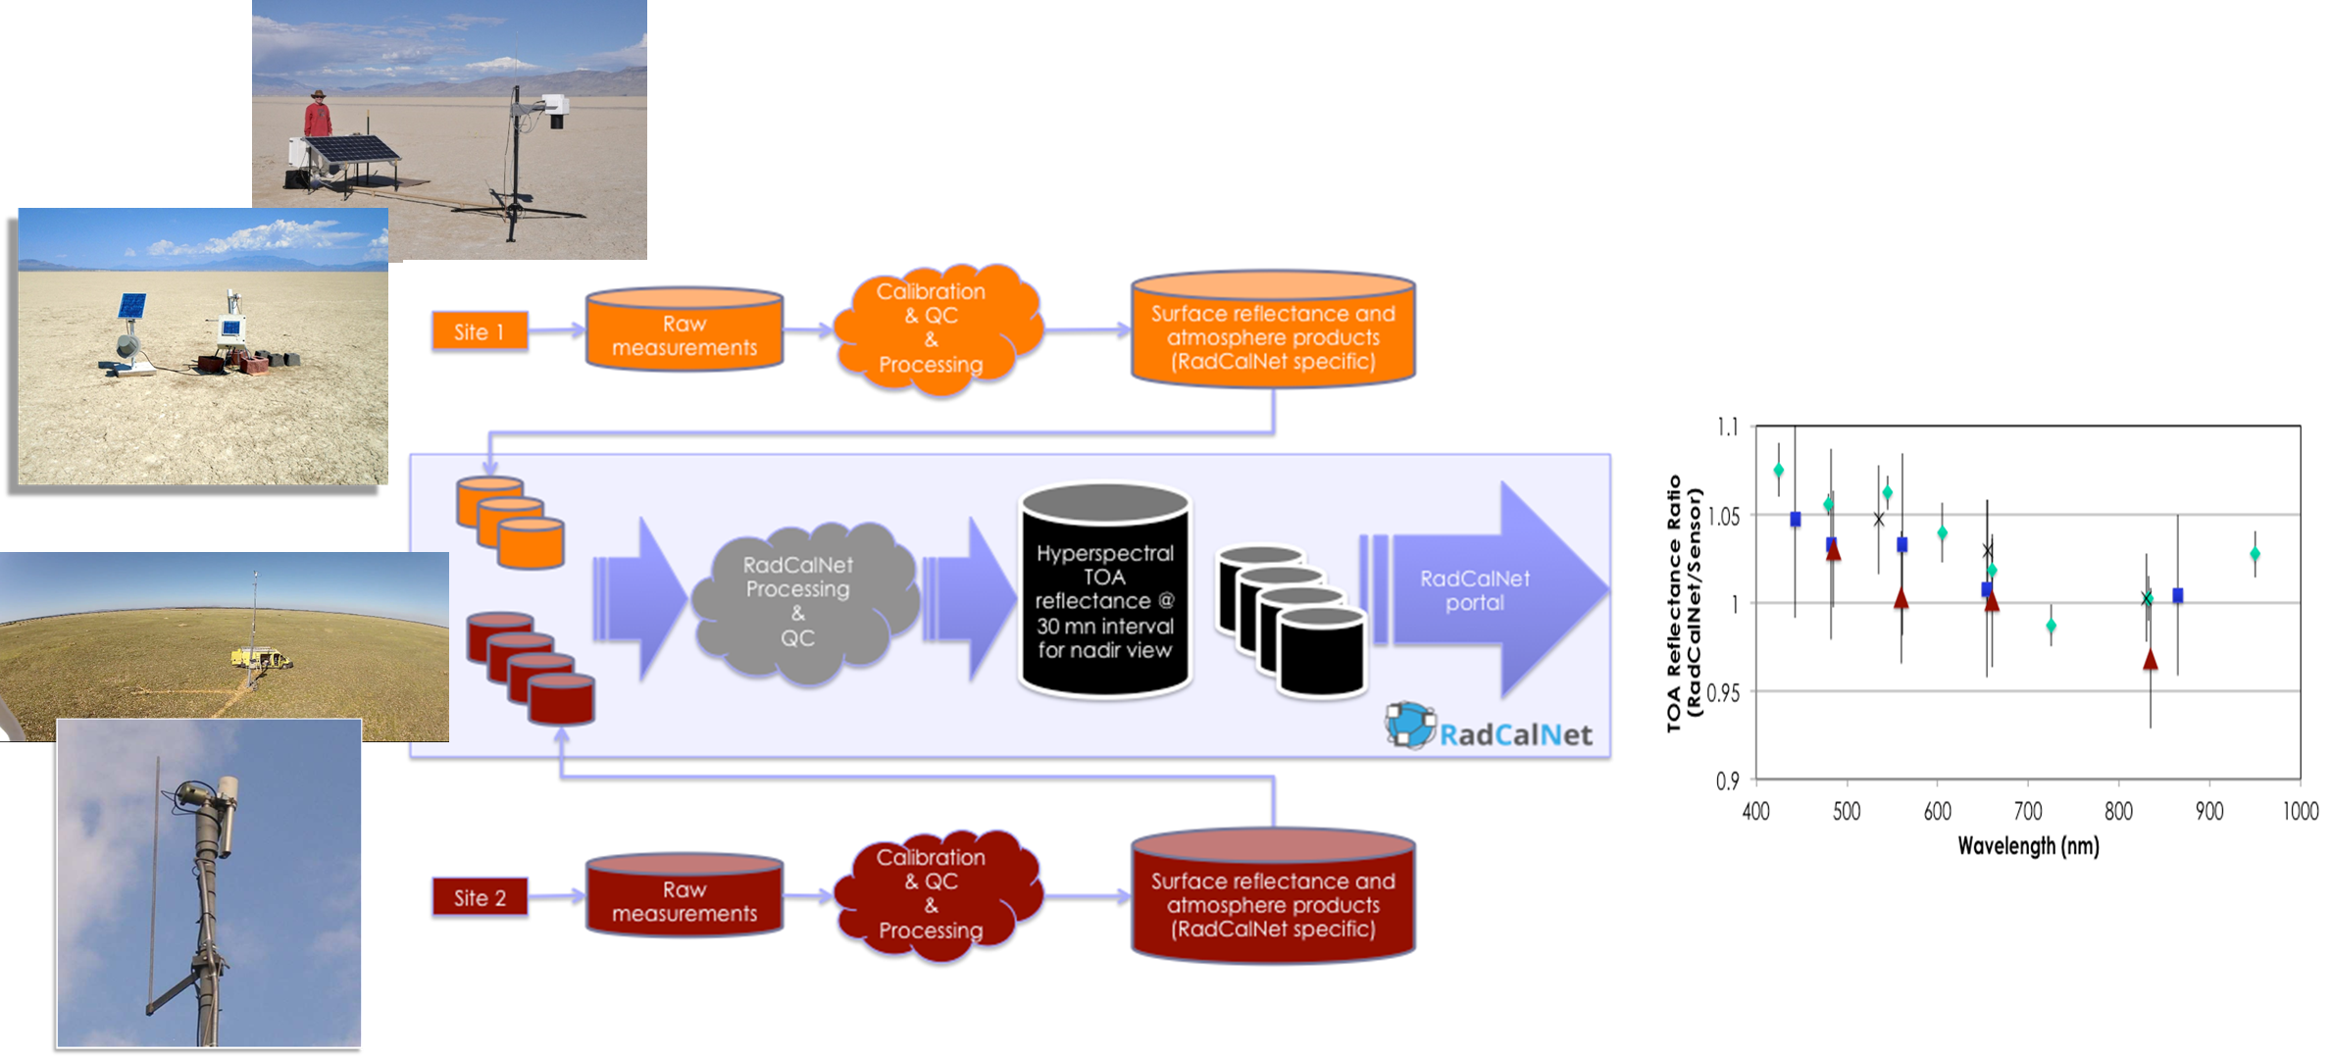
RadCalNet - Radiometric Calibration Network
Network of instrumented sites dedicated to the Radiometric Calibration of EO optical sensors developed in IVOS Subgroup
Automated processing including quality control
Traceability vs. SI standard

Slide 12
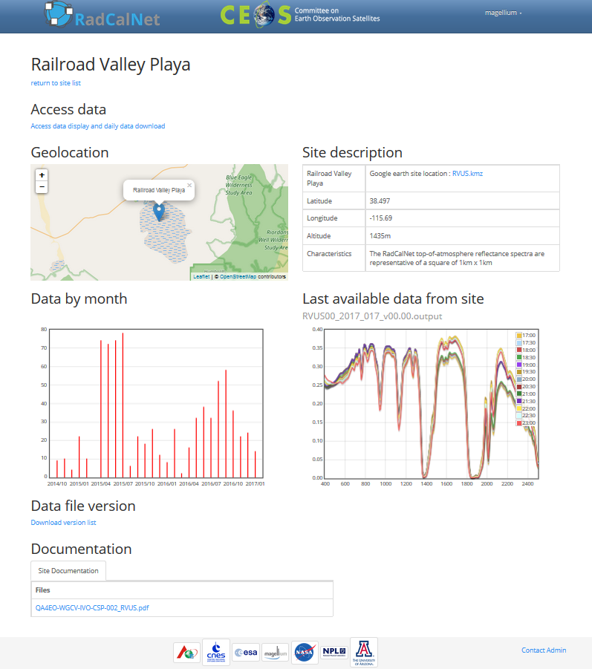
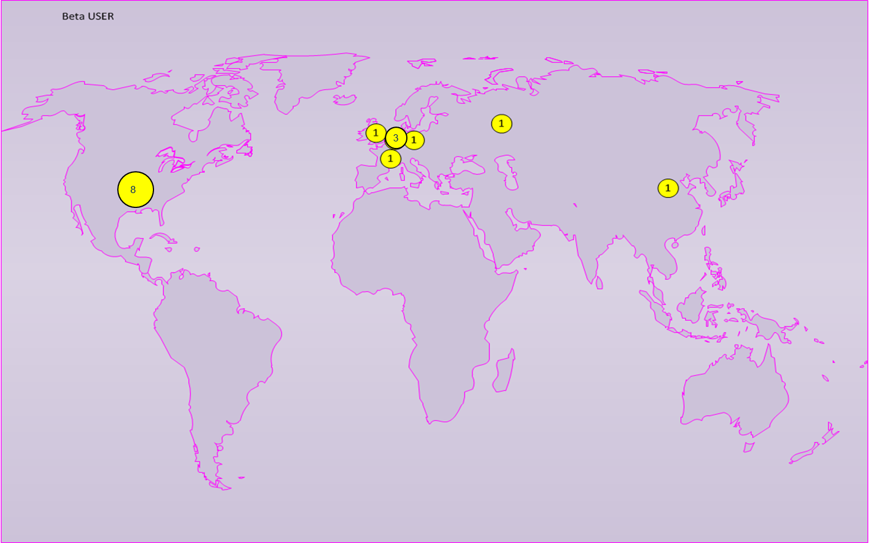
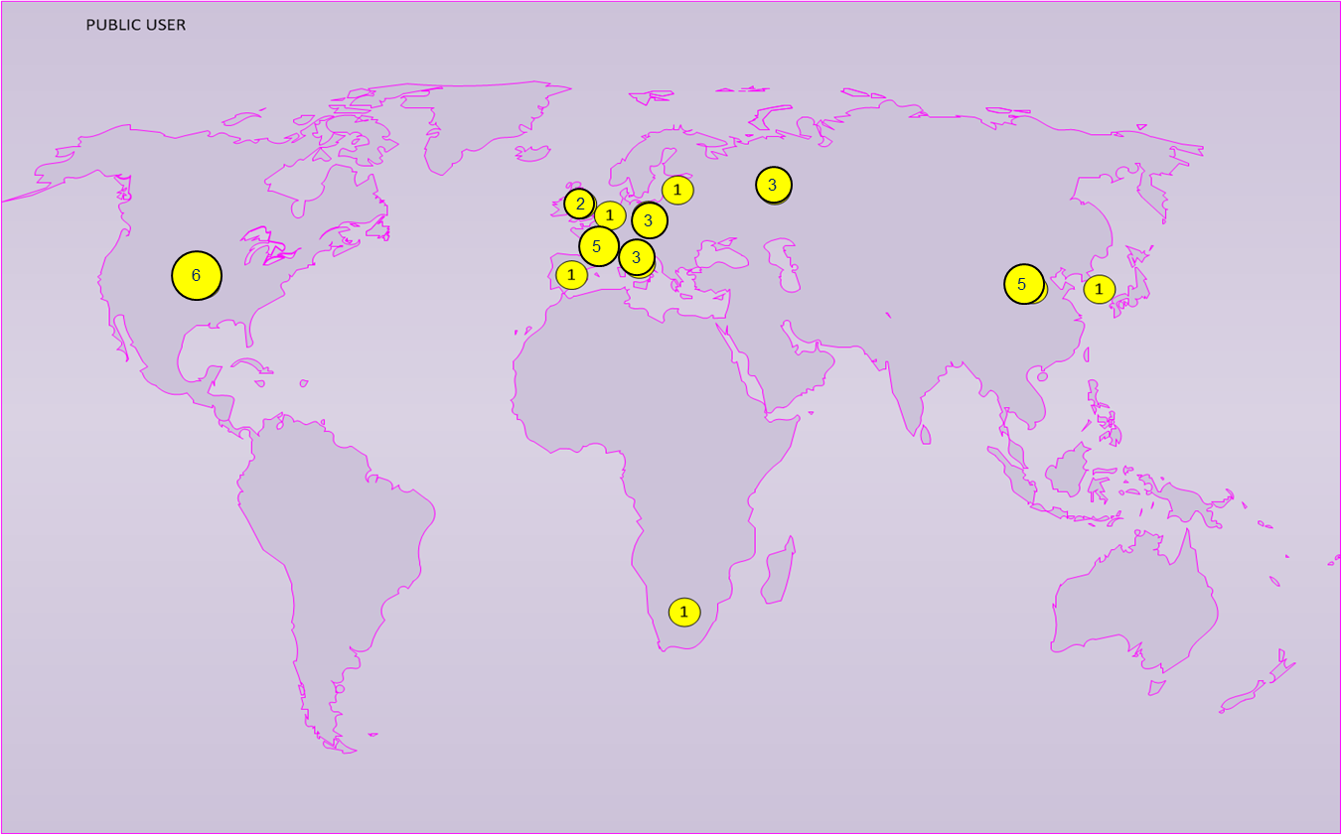
RadCalNet - Radiometric Calibration Network
RadCalNet is in Beta Testing and scheduled for opening of its website to the public in early 2018
WGCV in process of developing process to accept test sites into RadCalNet
The portal
16 Beta Users
32 Registered Users

Slide 13
Crosscutting WGCV activities related to MRI, CARD4L, etc.
WGCV activities cover a range of topics all related to understanding sensor-to-sensor differences
  Fiducial Reference Measurements (FRMs)
  Collaborations with other organizations such as GSICS
  Impacts of cloud masks and DEMs on Level 2 data production
  Solar irradiance spectrum
These activities also relate directly to CEOS Work Plan
  Completion of CV-12 - Evaluation of validation supersites and new validation approaches
  CV-15: L1 top-of-atmosphere interoperability
  VC-30: Interoperability case study for Landsat and Sentinel-2
  VC-29: Framework for moderate resolution land sensor interoperability
  VC-27: Develop a roadmap for the routine production of intercomparable CARD4L

Slide 14
CEOS LPV Supersites
CV-12 WGCV - Evaluation of validation supersites and new validation approaches
Well-characterized supersites with data continuity prospects for validation purposes that allow for testing of products, algorithms, and validation strategies through radiative transfer modeling
A Supersite should be fully characterized (3D canopy structure, plus key land variables) to allow a RT model parameterization, whereas a core site refers typically to the same variable
A Supersite should be useful for the validation of several land products ( > 3 )
Availability of data
Spatial representativeness
Overall, 61 Supersites selected out of:
TERN : 18 nodes in 10 Supersites
ICOS: 71 sites
NEON: 47 sites
LPV : 13 sites

Slide 15
Level 1 Interoperatibility
CV-15 to help define Level 1 top-of-atmosphere interoperability
Develop an initial recommendation of a community reference in collaboration with GSICS
  Introduced at WGCV-42 as a means to provide input to the MRI team
  Develop an initial recommendation of a community reference in collaboration with GSICS
Makes use of ongoing and newly instituted activities
  RadCalNet
  Solar irradiance spectrum
  Fiducial reference measurements
  SI-traceability and good pratices

Slide 16
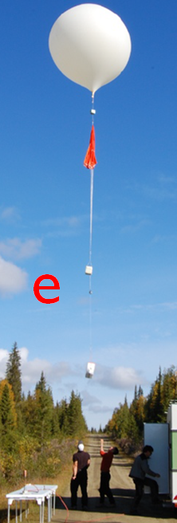
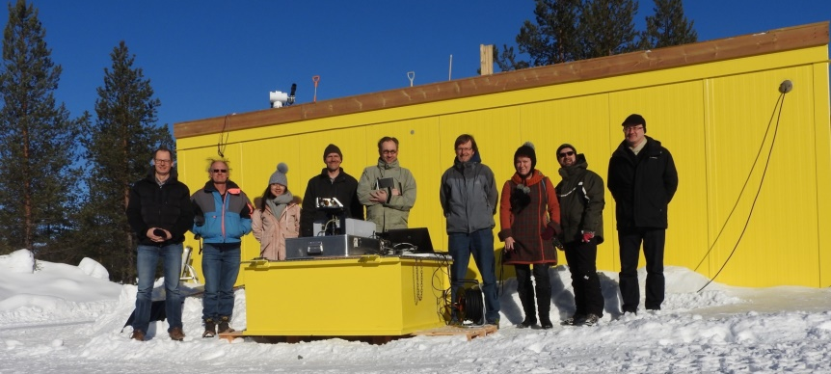
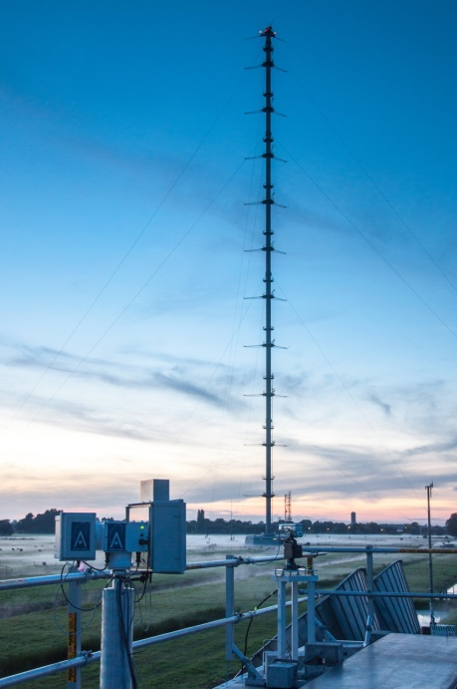

FRMs for atmospheric composition
FRM4GHG Campaign
  CO2, CH4, CO + other GHGs
  S-5p, GOSAT, OCO-2
  Test of new low cost instruments
  ESA, national agencies
CINDI-II Campaign
  OMI, GOME-2A/B
  Validation of NO2, HCHO, SO2…
  NSO, ESA FRM4DOAS, EU QA4ECV

Slide 17
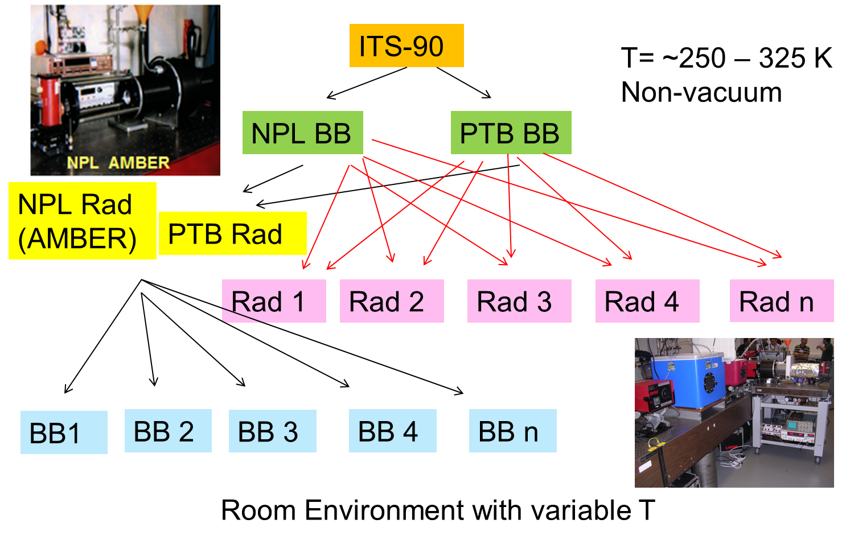
Importance of SI-traceability
Work within all subgroups (AC, IVOS, LPV, Microwave, and SAR) developing good practice approaches to ensure laboratory and field measurements are interoperable
Lead towards Level 1 and higher product agreement

Slide 18
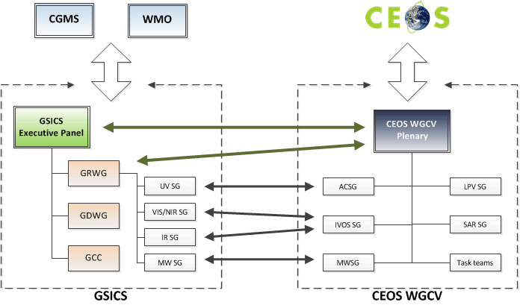
Interaction with other entities
Cooperation with GSICS
Identification of cooperation
priorities and concluded
(cf CV-03 and CV-15)
Cooperation on subgroup level &
working group level which includes
joint meetings of sub-groups
WGCV chair observer @ GSICS-EP
GRWG chair observer @ WGCV
Others
Interaction with IOCCG wrt Cal/Val ocean color
Participation on LSI VC telecons
Combined meeting with WGISS

Slide 19
Solar Irradiance Spectrum
Description of proposed GSICS/WGCV IVOS solar irradiance spectrum is being evaluated by WGCV membership for approval
  Solar spectrum choice can lead to differences in comparisons between sensors
  WGCV accepted solar irradiance spectrum will be distributed on the CEOS Cal/Val Portal
CV-16 - Report on outcomes from GSICS/CEOS reference Solar Spectrum evaluation

Slide 20
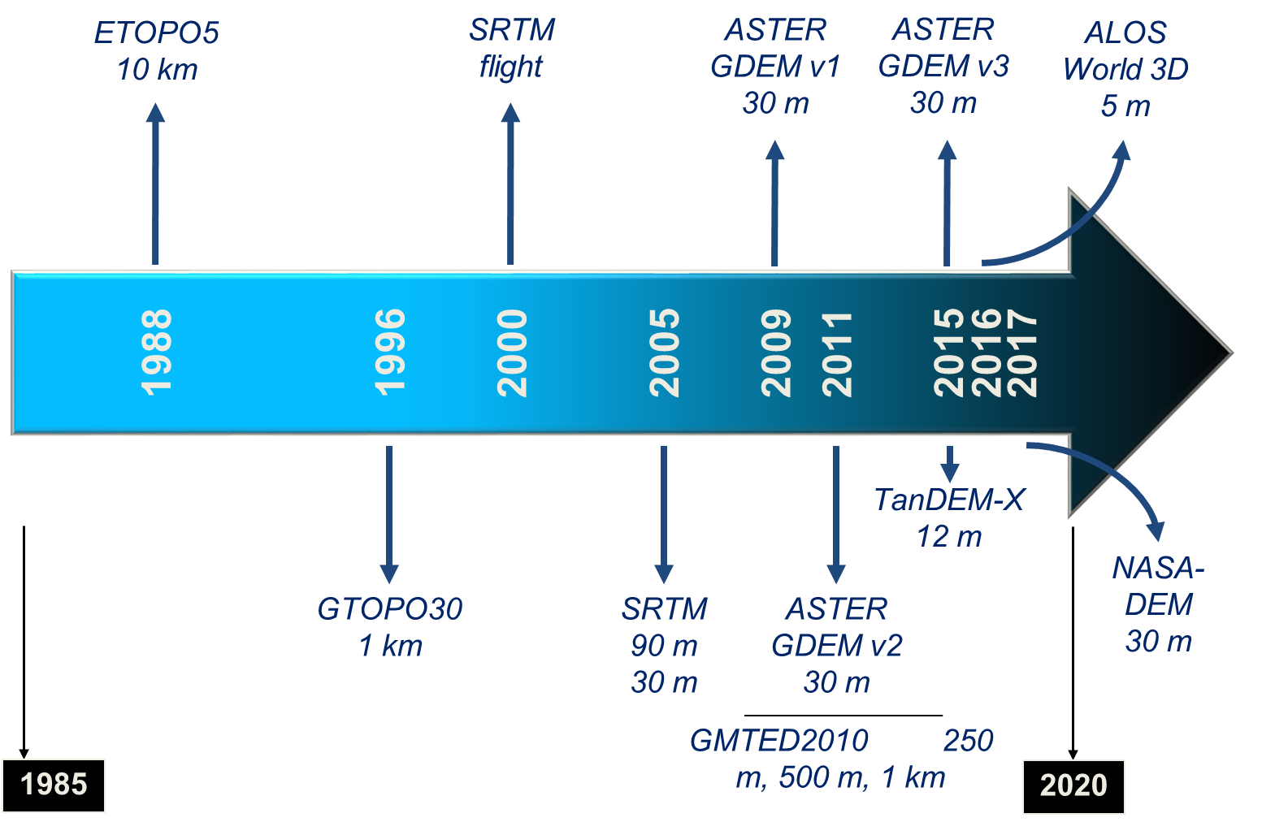
Moving forward on DEM Task Group
WGCV / Terrain Mapping Subgroup
GEO Global DEM Task
ISPRS WG IV/3 – Global DEM Interoperability
Activities:
SRTM workshop / PE&RS special issue
ASTER GDEM evaluation / IGARSS session
ISPRS sessions (2008, 2010, 2012, 2014, 2016)
DEM | Grid spacing (m) | Absolute vertical accuracy specification (m)
 |  | RMSE | LE90 | LE95
SRTM | 30 | 9.7 | 16 | 19.07
ASTER GDEM | 30 | 10.2 | 16.78 | 20
TanDEM-X (WorldDEM) | 12 | 6.08 | 10 | 11.92
PRISM (AW3D) | 5 | 5 | 8.22 | 9.8

Slide 21
Meetings
11/2017 SAR sub-group: CEOS SAR Workshop
01/2018 LPV sub-group meeting
03/2018 IVOS sub-group meeting & workshops
04/2018 WGCV-43 joint with WGISS 11/2015 hosted by INPE
09/2016 SAR sub-group: CEOS SAR workshop

Slide 22
Conclusion
Work Plan progress is proceeding at a good pace
  All actions are proceeding
  Delays in completion in some actions due to personnel availability
  Paths forward to completion are in place for all actions
WGCV interactions with other groups continues to provide challenges and progress
  Interactions with VCs and WGs are advancing WGCV activities
  Cross-cutting activities are creating new links between the subgroups
Attendance and participation by CEOS member agencies at the Working Group and Subgroup levels is strong

Slide 23
SIT-33 Meeting: 24th – 25th April, Boulder (Colorado, USA)
Focus on two of the 2018-2019 SIT Chair Priorities:
Address Working Group (WG) and Virtual Constellation (VC) continuity, sustainability and outputs
  Discuss results of VC and WG Questionnaires
  Identify synergies and cooperation areas between VCs and WGs
Clarify CEOS relationships with CGMS, GEO, and WMO
  Map of CEOS priorities with the 2017-2019 GEO Work Program
  CEOS 2018-19 Work Plan

