Slide 1
Geoscience Australia Report on Cal/Val Activities
Medhavy Thankappan
Geoscience Australia
WGCV Plenary # 43
Sao Jose dos Campos, Brazil
April 10-13, 2018

Slide 2
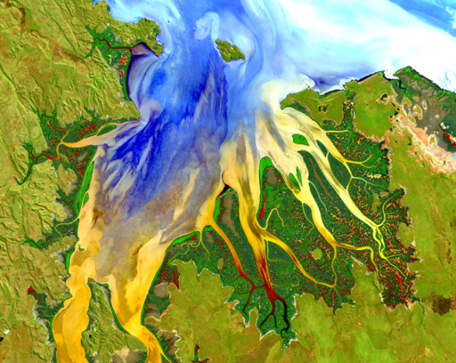
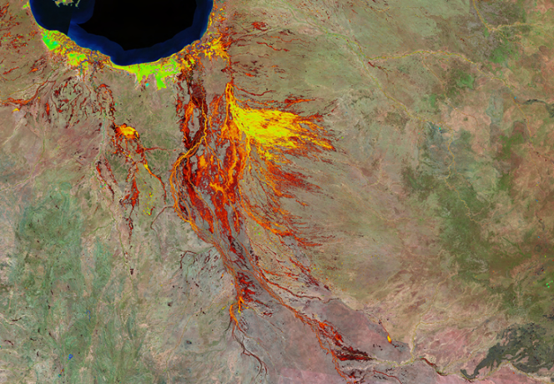
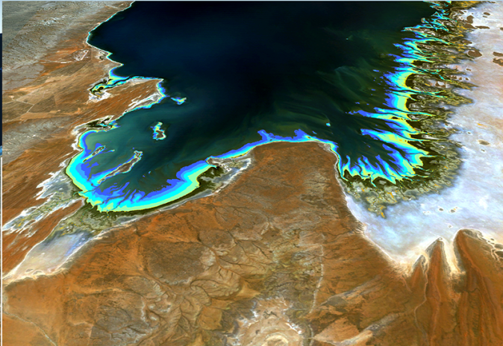
Digital Earth Australia
Geoscience Australia
Report on Cal/Val Activities WGCV Plenary # 43
Australian digital infrastructure for analysis of Earth observations
Operational implementation of the Australian Geoscience Data Cube
Aims to streamline government business and support economic growth
Standardised, analysis ready data for innovative products / services
Australian Government funding of $15.3M over two years
Focus on calibration / validation to support the initiative (QA4EO, WGCV, LPV, GSICS)
http://www.ga.gov.au/about/projects/geographic/digital-earth-australia

Slide 3
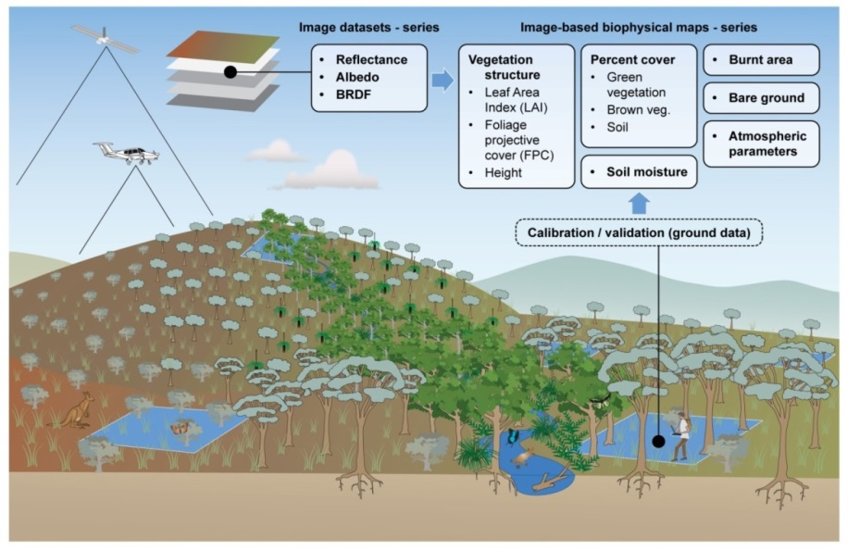
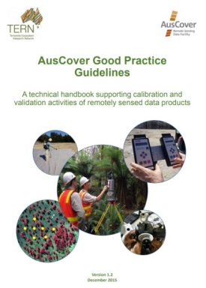
Geoscience Australia
Report on Cal/Val Activities WGCV Plenary # 43
Continental scale validation of surface reflectance
Continental scale validation of surface reflectance
Project Agreement with GA (16 Feb 2018), for CSIRO to coordinate field data collection
Two phases of field data acquisition, near-coincident with satellite overpass (L8,S2)
Good practice protocols for validation
Coordinated multi-temporal data acquisition by team members from multiple organisations

Slide 4
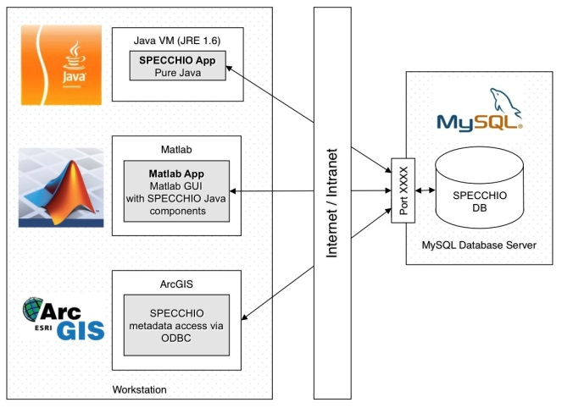
Geoscience Australia
Report on Cal/Val Activities WGCV Plenary # 43
National spectral data repository
Proposal to establish a national spectral library for validation
Host field and reference spectral data obtained by spectroradiometers using SPECCHIO
Community based governance model with open access

Slide 5
Geoscience Australia
Report on Cal/Val Activities WGCV Plenary # 43
Proposed validation system elements
1
Protocols and sampling strategy
3
4
QA4EO protocols, best practice guidelines for EO validation
Validation campaigns
Validation system
Sampling strategy for field measurements
Scheme for airborne measurements
Database sub-system
Coordinated ground airborne and satellite based data collection in line with sampling strategy and protocols
2
Field sites for observing multiple variables (Supersites) and instruments
Scale transform sub-system
Field / airborne measurements at different scales
Upscaling
Accuracy evaluation sub-system
Field instrument calibration / cross calibration

Slide 6
Validation of Land Surface Brightness Temperature
Geoscience Australia
Report on Cal/Val Activities WGCV Plenary # 43
Planning validation of land SBT retrieved from Landsat data
Project agreement for validating SBT being developed with CSIRO
Initial phase of validation for three sites
Historical in situ thermal data (1998-2002) for validating corresponding epoch of Landsat derived SBT

Slide 7
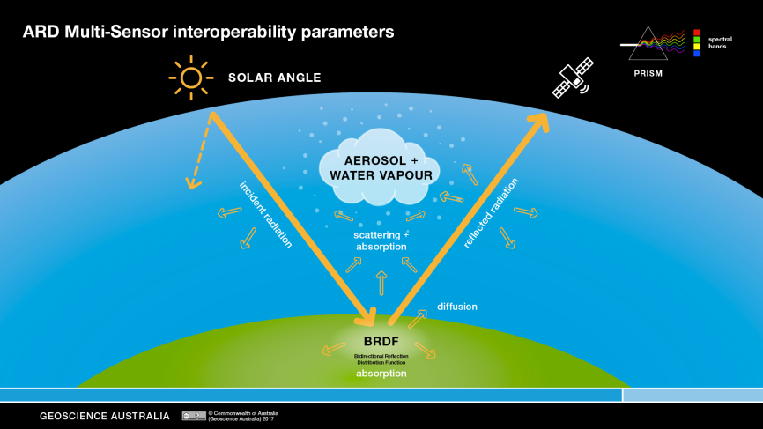
Interoperability of multi-source Analysis Ready Data
Geoscience Australia
Report on Cal/Val Activities WGCV Plenary # 43
Sensitivity Analyses
Solar angle: BRDF normalized to 25, 45 (control) and 70 degrees.
Aerosol change: aerosol optical depth 0.05, 0.15, 0.25. 0.5 (control: best observed)
Water vapour: 0.5, 2, 3.5 (control: NCEP)
BRDF: temporal average (control: MODIS MCD43)
Temporal stability of ARD
Comparison with field data
Tools for ARD intercomparisons

Slide 8
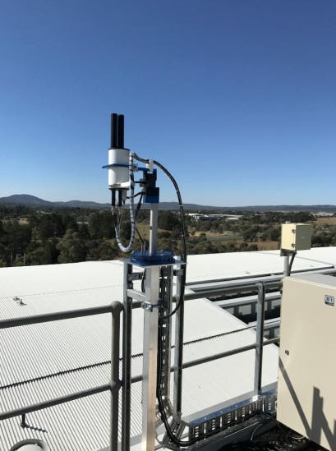
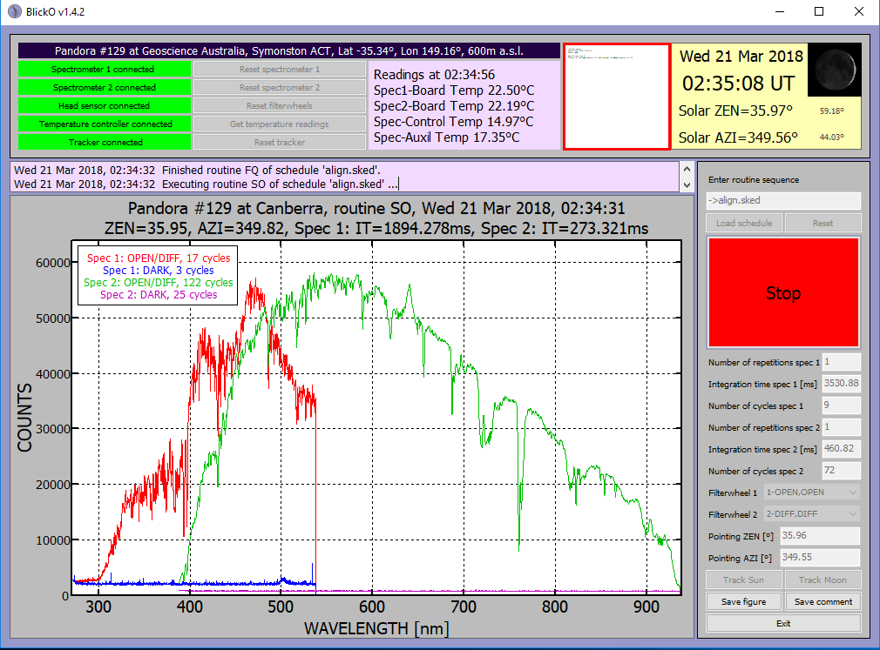
Pandora spectrometers
Geoscience Australia
Report on Cal/Val Activities WGCV Plenary # 43
Collaborative operation of two ESA Pandora spectrometers at Canberra and Alice Springs: Pandora #129 has been installed at Canberra and part of the Pandonia network
The second spectrometer is being prepared for deployment at Alice Springs
Pandora #129 at Geoscience Australia, Canberra

Slide 9
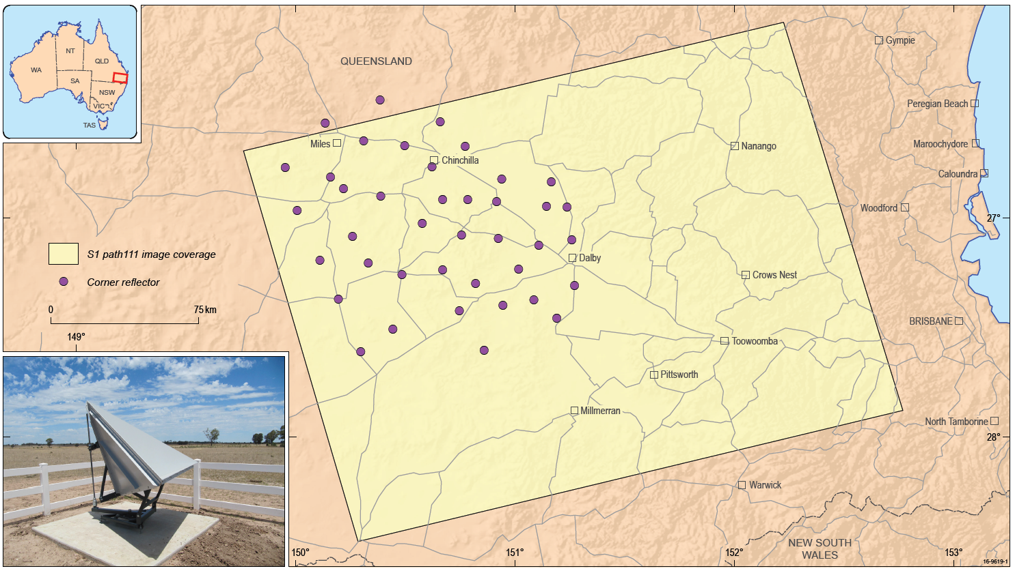
Corner Reflectors for SAR calibration
Geoscience Australia
Report on Cal/Val Activities WGCV Plenary # 43
Surat Basin , Queensland - 40 CRs spread over 100km x 100km
Details of individual CR sites available from the Point and Distributed Targets Database maintained by the CEOS WGCV SAR Subgroup at http://sarcv.ceos.org/targets/target_group/4/

Slide 10
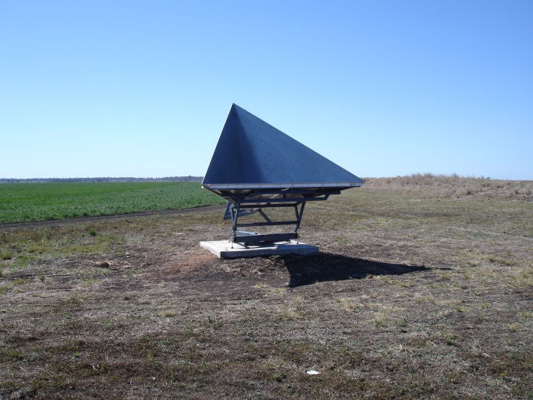
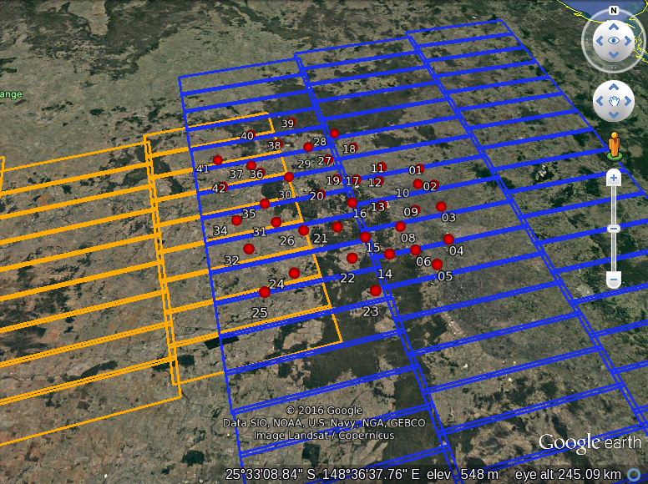
Sentinel-1 Geometric Cal/Val
Geoscience Australia
Report on Cal/Val Activities WGCV Plenary # 43
40 permanently deployed corner reflectors in QLD
Research supporting routine S1 geometric cal/val under ESA “FRM4SAR” project (DLR, University of Zurich, TUM, GA)
Consistent results from independent ALE analysis of S1 data over CR
Compared S1 IWS data and TDX ScanSAR data for the CR array(next slide)
Image courtesy C. Gisinger, TUM

Slide 11
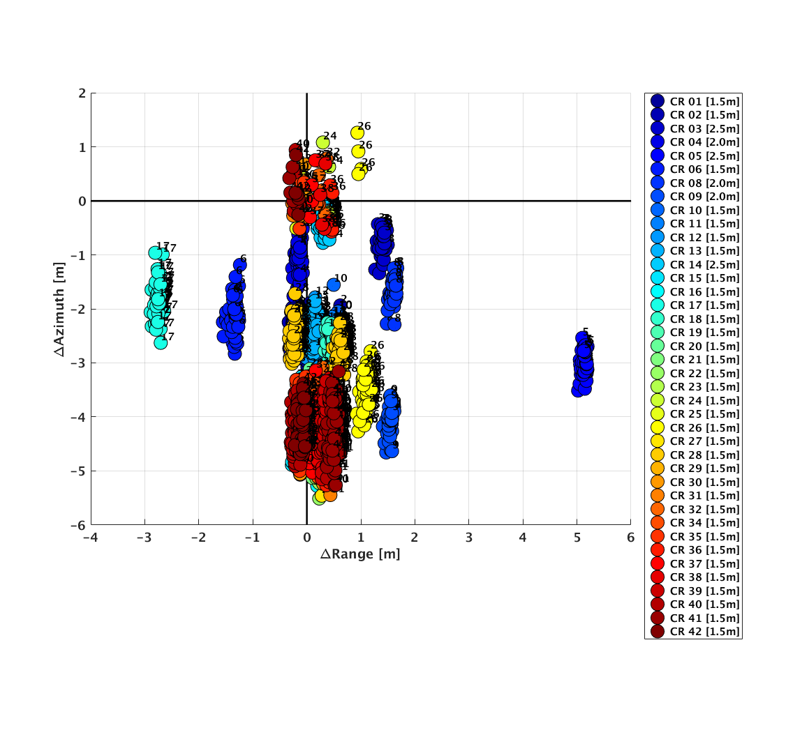
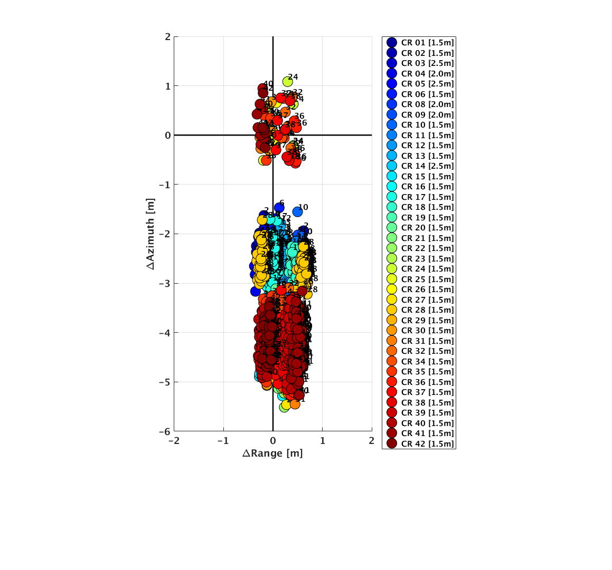
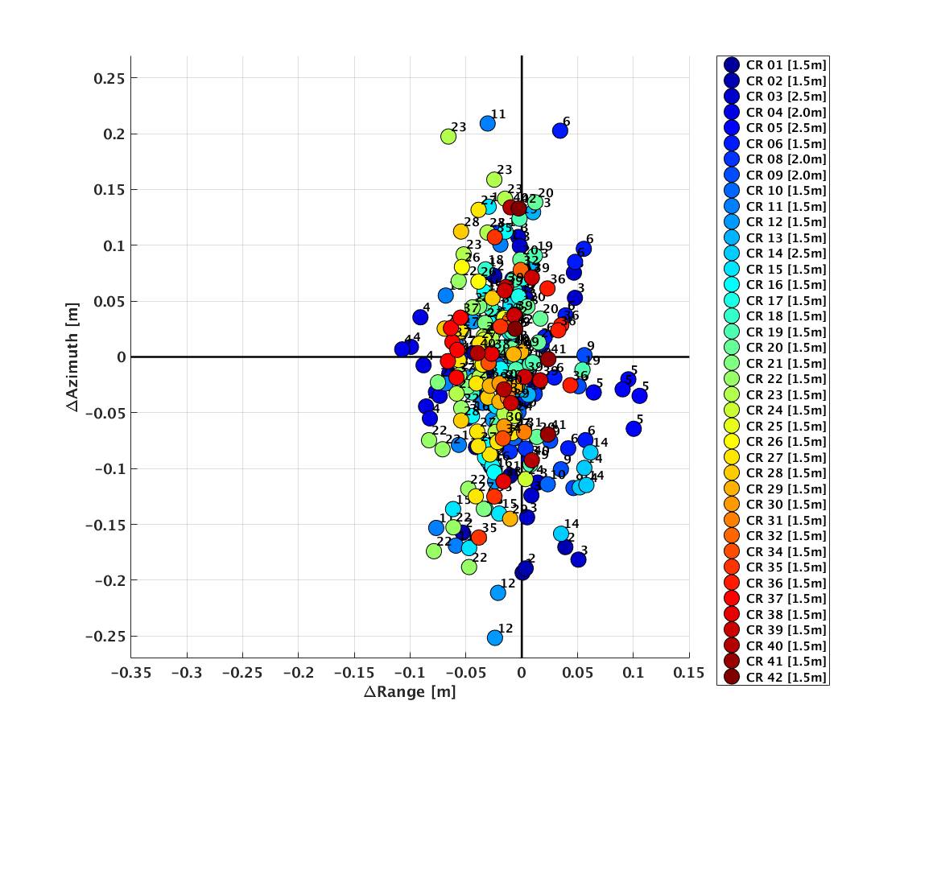
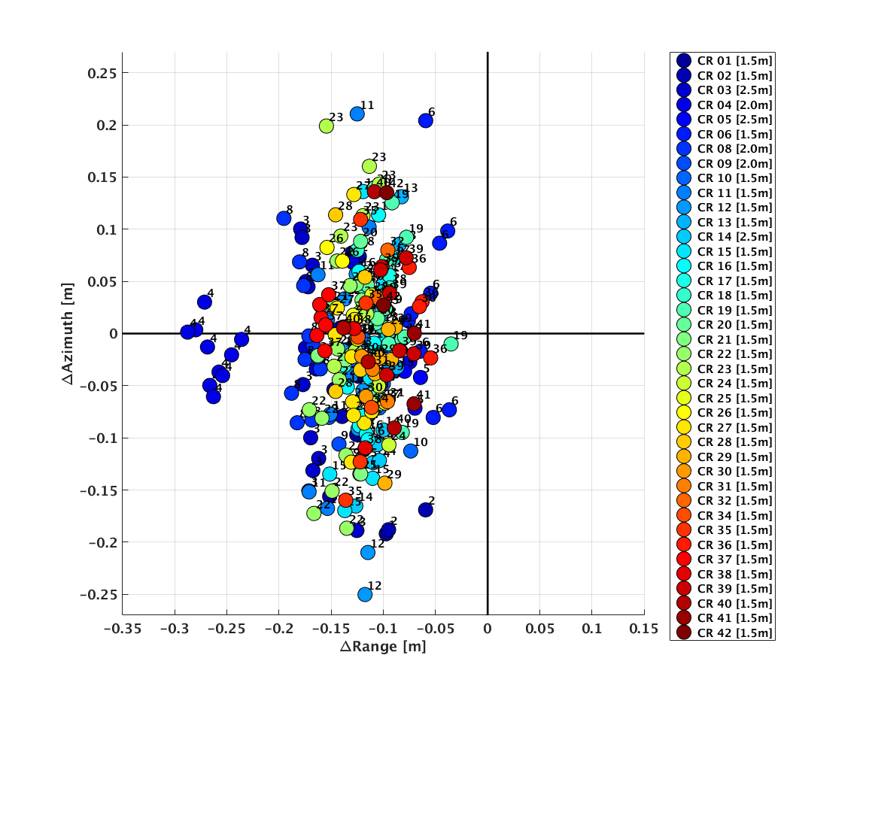
Geoscience Australia
Report on Cal/Val Activities WGCV Plenary # 43
Sentinel-1 / TanDEM-X Absolute Location Error with and w/o correction for CR apex coordinates
Sentinel-1A IWS
TanDEM-X ScanSAR
Images courtesy C. Gisinger, TUM/DLR

Slide 12
New activity supporting SAR calibration
Geoscience Australia
Report on Cal/Val Activities WGCV Plenary # 43
Based on the modelling work with CR apex coordinates, re-surveying of CRs to get apex coordinates will begin next month
Two new 1.5 m corner reflectors are being installed at the Yarragadee geodetic observatory in Western Australia, to co-locate multiple geodetic techniques - VLBI, GPS, SLR, DORIS (cf Metsahovi, Wettzell)
DLR have expressed an interest in regular monitoring of the two new CR to perform geometric calibration of TerraSAR-X
Ongoing discussion with NASA-JPL for supporting NISAR calibration

Slide 13
Geoscience Australia
Report on Cal/Val Activities WGCV Plenary # 43
Open Data Cube
Initiated though a CEOS Data Cube meeting in Canberra in February 2017
Building off active collaborations between GA, CSIRO, NCI, USGS, NASA and CEOS
The foundation of Project participation is openness and transparency
Software developed using tools like github, released under open source license to support local regional national and international capabilities
The community governs itself through:
a Steering Council made up of active contributors (i.e. individuals, not institutions)
engagement in public forums to discuss and debate the direction of the Project
2nd Open Data Cube Conference hosted by GA and CSIRO in Feb 2018

Slide 14
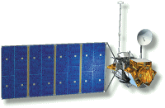
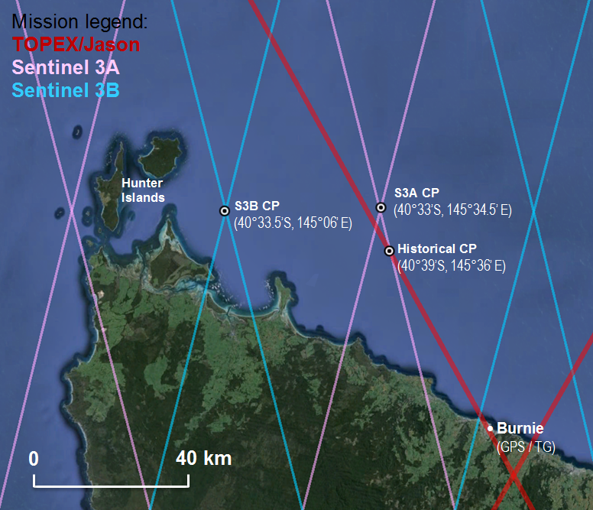
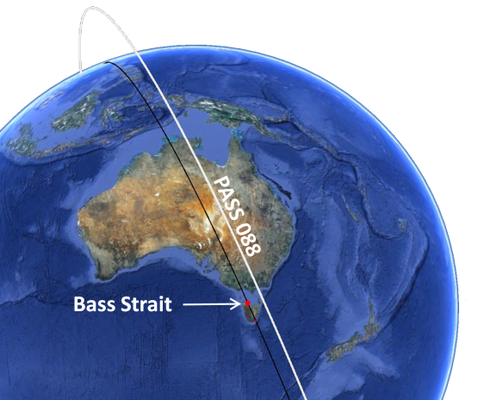
Satellite Altimeter Cal/Val: Bass Strait, Australia
The Bass Strait calibration and validation facility has provided a sustained contribution to satellite altimetry mission science teams for over 25 years.
Primary focus is the ‘Jason-series’ sea level reference missions. Recently added in situ observations in support of the Sentinel-3 missions.
In situ instrumentation includes numerous moored oceanographic instruments at various
TOPEX / Poseidon
Aug 1992 -
Jason-1
Dec 2001 -
(JAS)
OSTM/Jason-2
June 2008 -
comparison points (CPs), high resolution regional ocean modelling, and GNSS equipped buoys.
STLY
(GPS)
We are developing the capability to undertake calibration and validation of the game changing SWOT interferometric mission set to launch in 2021.
RKCP
(GPS)
Jason-3
Jan 2016 -
Sentinel-3A
Feb 2016 -
Effort shifting towards understanding improved noise characteristics of SAR altimeter data in preparation for SWOT in 2021.
Sustained cal/val continues to be essential.
Sentinel-3B
Launching
25 Apr 2018 -

Slide 15
Thank you
Geoscience Australia
Report on Cal/Val Activities WGCV Plenary # 43
medhavy.thankappan@ga.gov.au

