Slide 1
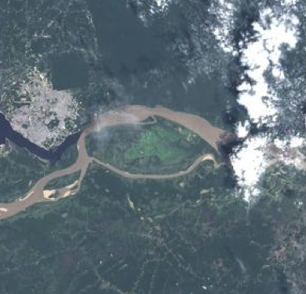
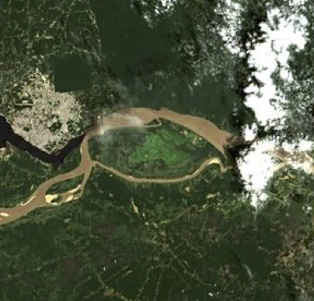
ACIX II
Atmospheric Correction Inter-comparison eXercise
Georgia Doxani | Serco for ESA/ESRIN, Georgia.Doxani@esa.int
Ferran Gascon | ESA/ESRIN, Ferran.Gascon@esa.int
Eric Vermote | NASA, eric.f.vermote@nasa.gov
Jean-Claude Roger | University of Maryland/NASA, jean-claude.roger@nasa.gov
ACIX continuation meeting
1 February 2018 l ESA/ESRIN, Frascati (Italy)

Slide 2
ACIX II -- Way Forward --
ACIX II
ESA
Ferran Gascon
Georgia Doxani
NASA
Eric Vermote
Jean-Claude Roger
Atmospheric Correction
Inter-comparison
Cloud Masks
Inter-comparison
ESA
Brockmann Consult?
NASA
Sergii Skakun
Processors over
Land
Processors over
Water
ESA
Ferran Gascon
Georgia Doxani
NASA
Eric Vermote
Jean-Claude Roger
ESA
Antoine Mangin?
NASA
Nima Pahlevan

Slide 3
ACIX II
Atmospheric Correction
Inter-comparison
Processors over
Land
-- Time period --
At least 1 year period with complete time series from L8/S2A/S2B
From June 2018 and on, we can also have S2-B one year time series (S2 every 5 days)
-- Sites --
All the land AERONET sites, with available measurements in the study time period, in priority order. Some of them will have to be analysed by all the participants, in order to have harmonised results.
The list of the ‘obligatory sites’ will be agreed with the participants.
-- Metrics --
Same as ACIX I +
comparison with RadCalNet
smoothness in time series - Indices from Vermote (2009)
consistency across tiles – Example of one site in two tiles
additional inter-comparison with the individual masks

Slide 4
ACIX II
Atmospheric Correction
Inter-comparison
Processors over
Water
-- Time period --
TBD by the coordinators
-- Sites --
TBD by the coordinators
-- Metrics --
TBD by the coordinators

Slide 5
ACIX II
Cloud Masks
Inter-comparison
-- Time period --
TBD by the coordinators
-- Sites --
TBD by the coordinators
-- Metrics --
TBD by the coordinators

Slide 6
ACIX II -- Timeline (approx.)--
Call for participation to ACIX II
Start ACIX II
1st ACIX II workshop -- Definition of the protocol
2nd ACIX II workshop Presentation of the inter-comparison results
Feb
2018
Apr 2018
July 2018
Sep 2018
Feb 2019
Jun 2019
Sep 2019
Completion of ACIX I
Publication of results – Report & Website
AC & Cloud Masks Results Submission
Inter-comparison protocol
Distribution to the ACIX II participants & request for feedback
Completion of ACIX II
Publication of results – Report & Website

