Slide 1
Cloud mask update
K. . Thome
NASA
WGCV Plenary # 43
INPE, Sao Jose dos Campos
April 10-13, 2018

Slide 2
Original cloud mask task objective
Cloud masking task objectives:
Define the nomenclature, i.e. What is cloud-free? What is a cloud?
Define what “mask” is suitable for what application/user
Original objectives are basic questions that have applicability to a wide range of applications
Atmospheric correction task had similarly basic definitions
Leverage results of upcoming experts workshop for nomenclature guidance

Slide 3
Path forward
Propose a methodology similar to ACIX (see following)
Cloud mask intercomparison exercise (CMIX)
WGCV helps to identify two leads that will detail the process and ensure availability of key support personnel
Guide effort to provide results that will support ACIX II and ARD and interoperability
Allow the CMIX group to
Identify test scenes
Develop the “truth” that is used for evaluation
Collect volunteer groups
Rely on a set of defined test scenes that a set of volunteer groups assess the distribution of clouds within those scenes and the results are compared amongst the participants

Slide 4
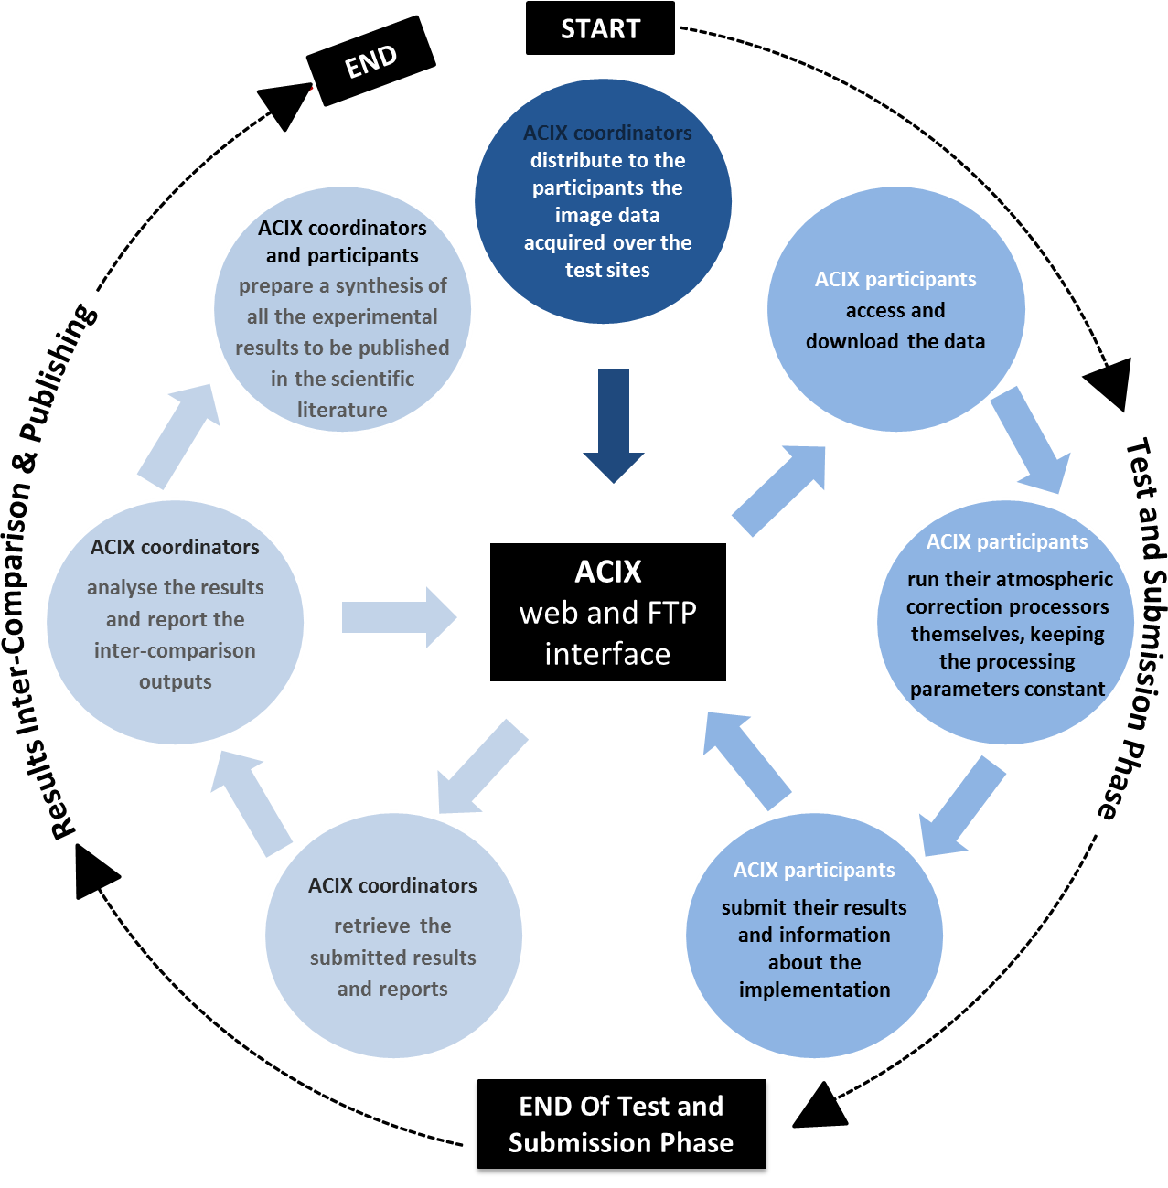
How?
Definition of the inter-comparison protocol
All the proposals will be discussed at an initial workshop where inter-comparison procedure will be agreed upon by all participants.
Application of the Cloud Mask
Participants apply their Cloud Mask schemes to a set of test cases keeping the processing parameters constant.
Analysis of the results
CMIX coordinators process results submitted by all participants and results are presented and discussed during a 2nd workshop.

