Slide 1
Reference Solar Irradiance Spectrum
Nigel Fox
WGCV Plenary # 43

Slide 2
Methods for RadCalNet Data application
Why? Example from RadCalNet Beta Testers
Convert RapidEye Imagery to TOA Reflectance
Extraterrestrial Irradiance (EAI), RapidEye

Slide 3
Update on PMOD/WRC Solar Reference spectrum
Margit Haberreiter, Nigel Fox, Tom Stone, Werner Schmutz
PMOD/WRC
28 March, 2018
Notes:
TO do:
Sonnenbild von Davos, Sonne+haze, Strandbild Kauai....

Slide 4
PMOD/WRC Reference Spectrum
SOLID Composite will be used for the absolute scale
Haberreiter et al. (2017), JGR, Vol. 122, Issue 6, 5910-5930, doi: 10.1002/2016JA023492
In agreement with TSI value as recommended by IAU 2015 Resolution (Prsa et al, 2016)
COSI high-resolution synthetic spectrum
NLTE radiative transfer code
Developed at PMOD/WRC

Slide 5
PMOD/WRC Reference Spectrum
Haberreiter, M., Fox, N. et al., in preparation
Normalization of COSI high-resolution spectrum using SOLID solar minimum spectrum
Careful evaluation of normalization function
Combined uncertainty of datasets
Absolute accuracy of SOLID composite from ATLAS3: 2-3 % (from Thuillier et al., 2003)
high resolution component from COSI calculation: 5% (of the order of the absolute scale, currently under evaluation
Synthetic spectrum will be constrained by SOLID min 2008 spectrum

Slide 6
Details of PMOD/WRC Reference Spectrum
Spectral Coverage
380 - 2000 nm: SSI observational composite
300 - 15000 nm: COSI synthetic spectrum
Spectral Resolution
SSI composite ≤ 623 nm: 1nm
SSI composite > 623 nm: 2nm (and coarser)
COSI: 0.005 nm (or higher)
Solar Activity Level
Solar minimum: annual mean of 2008

Slide 7
Release of PMOD/WRC Reference Spectrum
beta-version is becoming available end of the month
Contact: margit.haberreiter@pmodwrc.ch
final version will be released with acceptance of paper Haberreiter, Fox, et al. (2018) at:
ftp.pmodwrc.ch/pubSolarReferenceSpectrum/
Further information can be found at:
https://www.pmodwrc.ch/en/research- development/solar-physics/solar-spectrum/

Slide 8
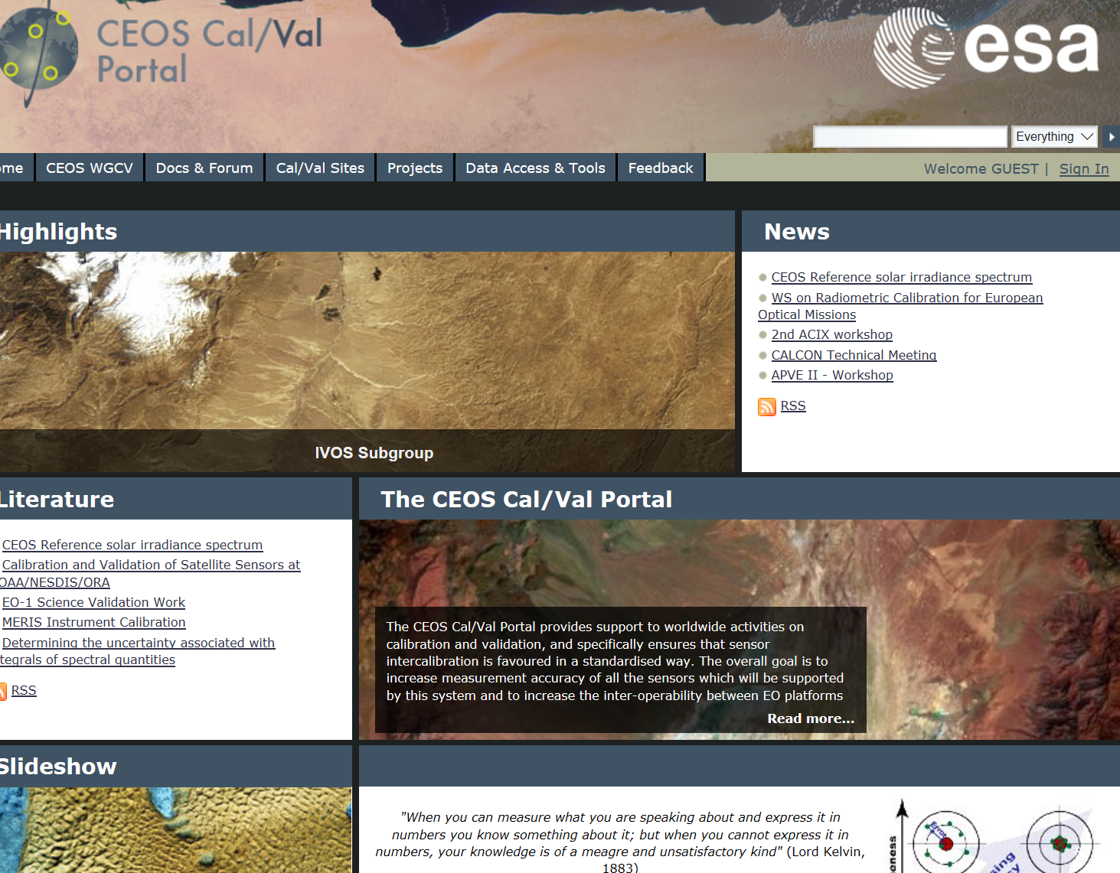
Accessiblility

Slide 9
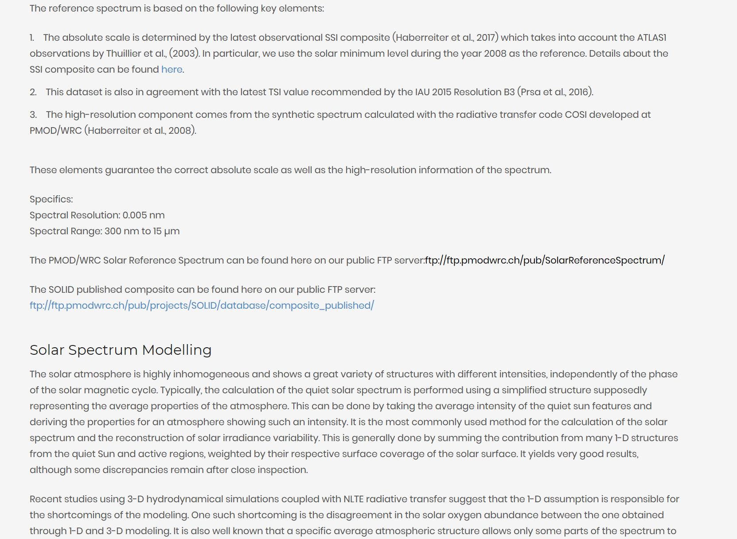
Data set download

