Slide 1

Greenhouse gas reference standards for interoperability
Committee on Earth Observation Satellites
Akihiko KUZE
(Earth Observation Research Center, Japan Aerospace Exploration Agency)
CEOS WGCV 44
Darmstadt, Germany
August, 2018

Slide 2





Why calibration is needed
in GHG differential absorption spectroscopy
<Radiometric Calibration>
The ratio scattering vs. surface reflectance is critical in GHG column averaged density retrieval
>
Retrieved Surface reflectance must be accurate.
<Inter-band Registration>
Light path modification is estimated using O₂-A band
<Non-linearity Correction>
Differential absorption assumes linearity
Under-
Estimated
GHG
Over-estimated GHG
High altitude Cirrus
Dust
Dark Surface
Bright Desert

Slide 3
Specific for Spectrometers
Extremely high requirement of accuracy: to monitor 1 ppm change of 400 ppm XCO₂ from space
Consider Atmospheric absorption in radiometric calibration
Non-linearity correction, stray light, inter band registration matter
Larger foot print to correct photons from narrow spectral band
Vertical profile information
Rapid Instrument technology progress in last 5 years
3

Slide 4
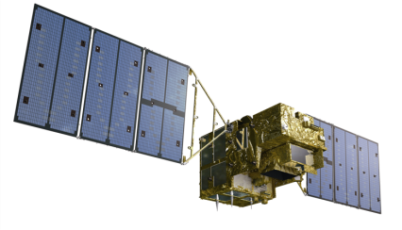
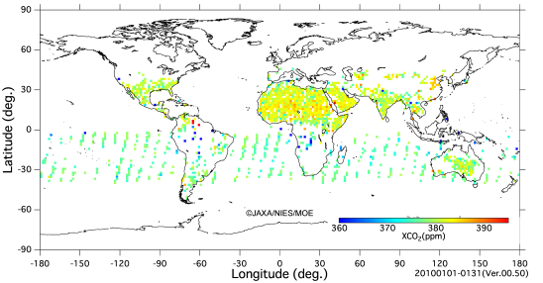
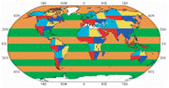
How to validate each product?
Measurement
Optical + Modulation Efficiency
Sudden shutdown during operation
(dead pixels)
Interferogram
Level 1 processing
- processing to radiance spectra
- calibration
Onboard Calibrations are not enough for non-linearity correction
Level 2 and 3 - to produce the global distribution map for CO₂ and CH₄
Aerosol thick, topographically non-flat (LA, central Asia)
Vertical profiles
Validation of flux
Emission sources are known but amounts are uncertain
Wind is the largest uncertainty
Level 4 Processing
Global and local net flux
4

Slide 5
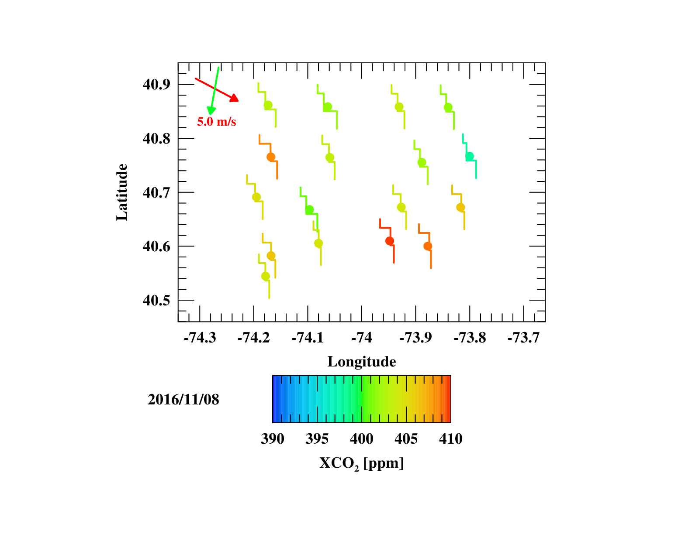
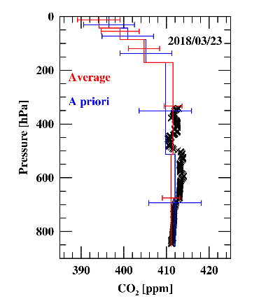
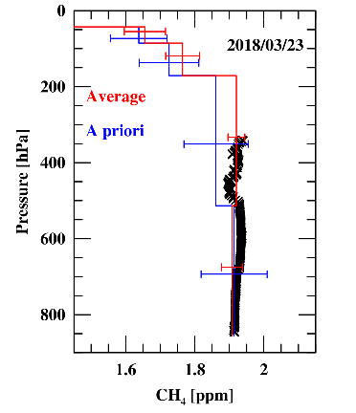
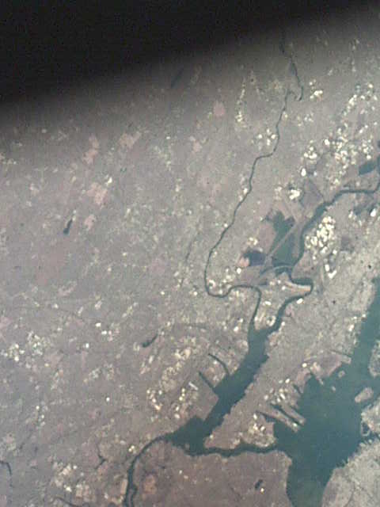
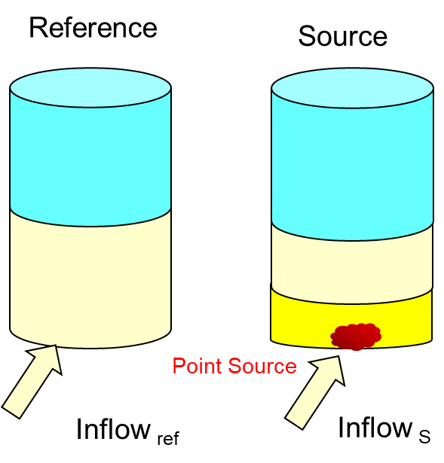
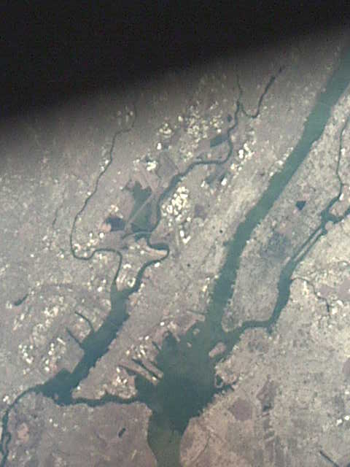
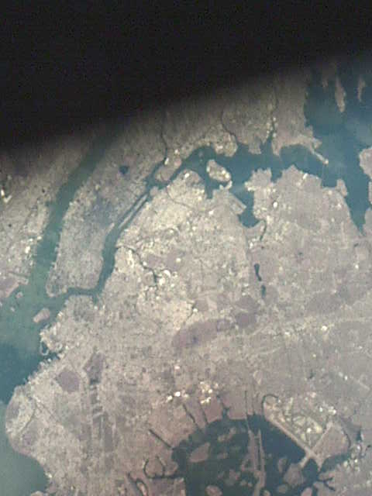
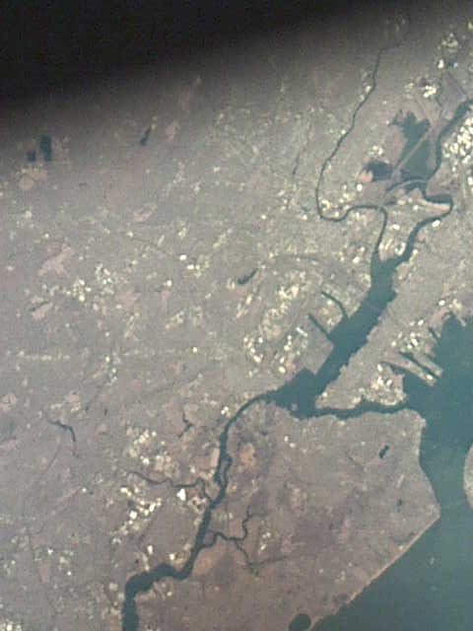
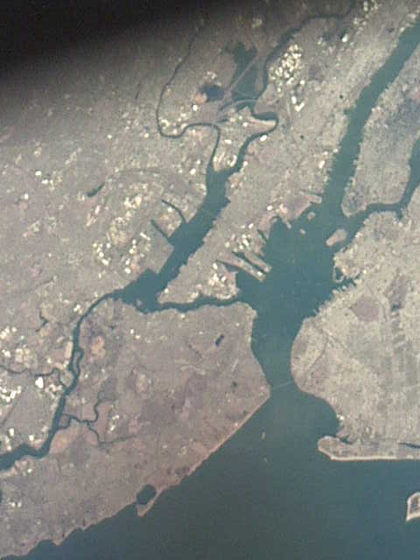
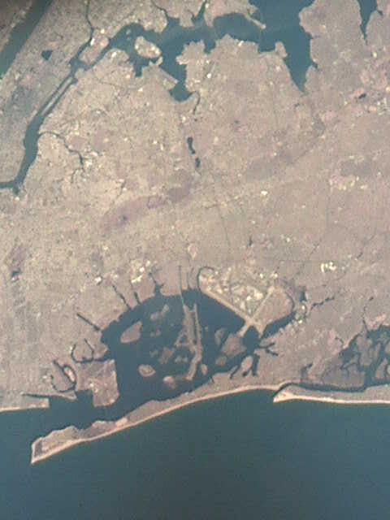
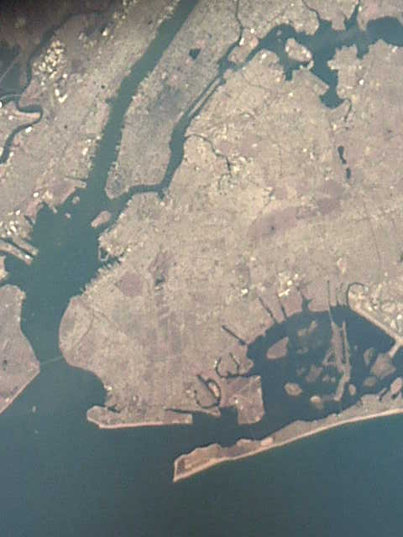
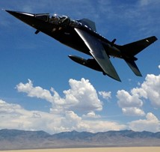
Toward validation for vertical profiles
Partial column product of lower and upper troposphere (LT, UT) from simultaneous use of SWIR and TIR
Now Full use of both SWIR and TIR
Minimizing the retrieved parameter for robustness: only two layers in troposphere
Coincident vertical profile data from about 50 flights over RRV are available but data over megacities are not.
5
GOSAT and NASA AJAX over RRV, NV
Coutesy of Iraci et al.
GOSAT target observations over NYC
5

Slide 6
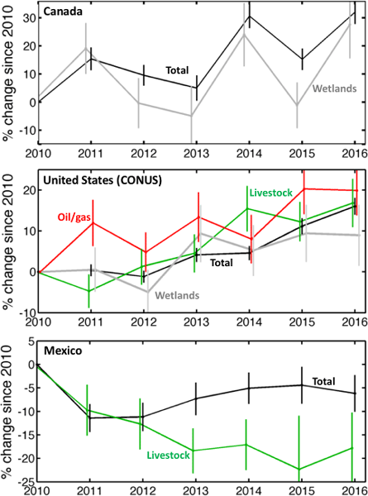
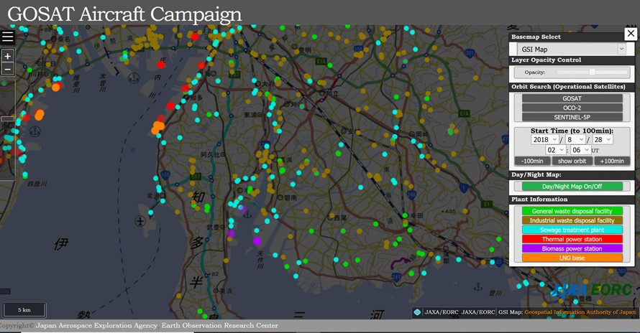
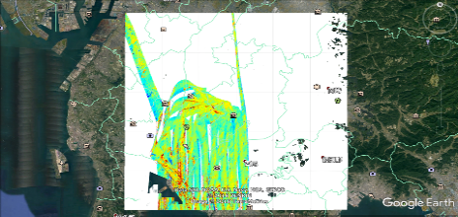
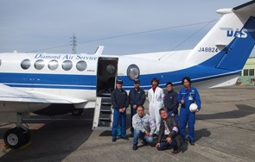
Towards Validation for flux estimation
- Examples -
Regional scale
GOSAT CH₄ enhancements over North America
Trends in CH₄ emissions since 2010 from GOSAT (Canada, US, Mexico)
Jian-Xiong Sheng et al., (Atmos. Mea. Tech. 2018)
2010–2016 changes in CH₄-emitting activities.
City level
WRF
Model
Wind sped & direction
Different GHG source sector location of greater Nagoya
CO₂: Poser plant, traffic, industry
CH₄: Waste water, liver stock, Gas production
6

Slide 7
Calibrations for Spectrometers and their challenges
Prelaunch Calibration: remove O₂, H₂O absorption in the integration room
In orbit Calibration: degradation of optics + temperature dependency (such as modulation efficiency of FTS), Optics high spectral-resolution solar-irradiance
Vicarious Calibration: vertical profiles of temperature and relative humidity for calculating radiance spectra at TOA
Lunar Calibration
Cross calibration: intercomparison of radiance spectra and retrieved results
7

Slide 8
Action Item
<Validation >
FRM (Fiducial Reference Measurement)
https://earth.esa.int/web/sppa/activities/frm, http://frm4ghg.aeronomie.be
TCCON/NDAC and COCON (mobile EM27)
GHG Vertical profile (AirCore)
Commercial airliner monitoring (Japan airline Contrail)
< Cross Calibration >
Intercomparison between GHG spectrometers
http://www.eorc.jaxa.jp/GOSAT/GOSAT_Optimization/index.html
8

Slide 9
What CEOS-WGCV can do?
To be discussed
Upgrade existing CEOS calibration sites to GHG Cal/Val sites
Intercomparison between GHG spectrometers, select comparison sites (Cal/Val sites, ocean, desert, cold target etc.)
Develop list of data base for calibration
Develop list of useful websites for Cal/Val
How to share calibration data that are not listed in the web
How to share the Cal/Val filed and airplane campaign information
Collaboration with CEOS-ACVC (GHG white paper let by David Crisp)
9

Slide 10
Common Standards and Data for
Calibrations and Retrieval (updated)
 |  | Common standards and data | Notes
Calibration | Prelaunch | Cross-calibrated radiometers | Viewing common radiometric standard
 | Onboard | Solar data Lunar
 | Vicarious | CEOS site (RRV etc.) | Annual campaign
Retrieval Algorithm | Parameters | Molecular spectroscopy High resolution solar lines A priori model (Aerosol)
 | Input | Calibrated spectra at 0.76, 1.6, 2.0μm Observation geometry and condition | Level 1
 | Output | Retrieved column amount GHG Simultaneously retrieved parameters (aerosol optical depth, Solar-induced plant chlorophyll fluorescence (SIF)) | Level 2
Validation | Ground Site | High resolution spectrometer mobile spectrometer | TCCON, mobile-FTS
 | Vertical profile | In situ measured data | NDACC, Airplane, Balloon
Intercomparison | Match up | Spectra level Retrieved parameters | Land type and Ocean Viewing Common sites

Slide 11
Cal & VAL for Greenhouse Gases Observation Spectrometers
<Updates>
Committee on Earth Observation Satellites
Akihiko KUZE
(Earth Observation Research Center
Japan Aerospace Exploration Agency
CEOS WGCV 44
Darmstadt, Germany
27 August, 2018

Slide 12
Measured parameters for GHG CAL-VAL
(updated)
Candidates of CEOS sites for GHG Calibration
Dunhuang, Namibia, Libya
To be updated
12

Slide 13
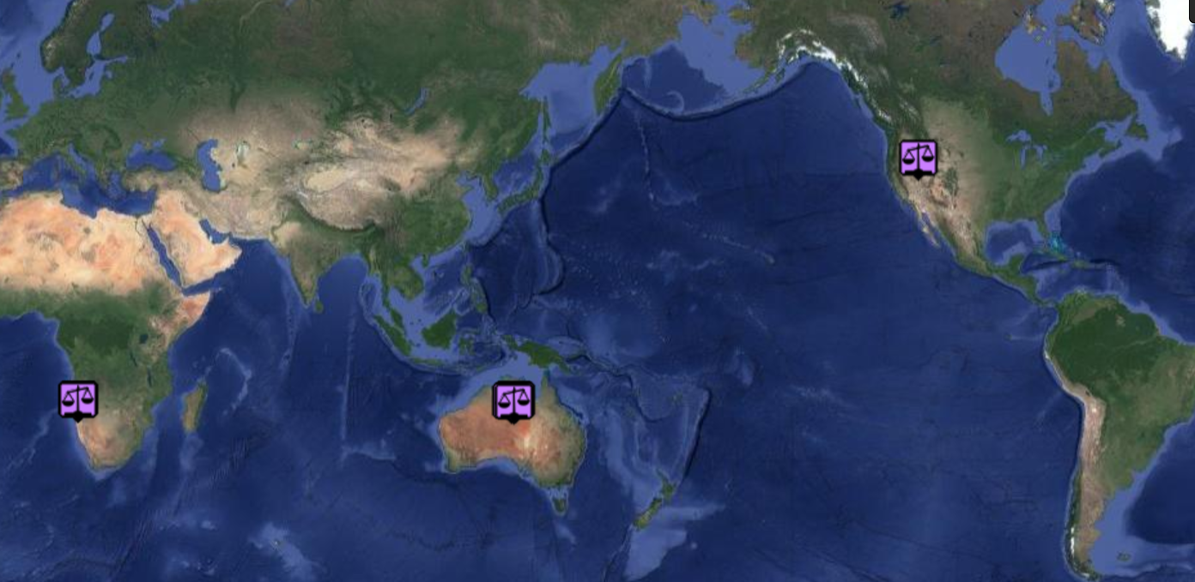

CEOS Calibration Site for GHG Observation Satellites
Baotou
CAS
Artificial
Automatic
Dunhuang
CMA?
GHG balloon
RRV, USA
GOSAT-OCO-2
Annual Calibration
Campaign Site
NASA AJAX
Validation by airplane
Gobabeb
ESA-CNES
Calibration site
GOSAT target
13

Slide 14
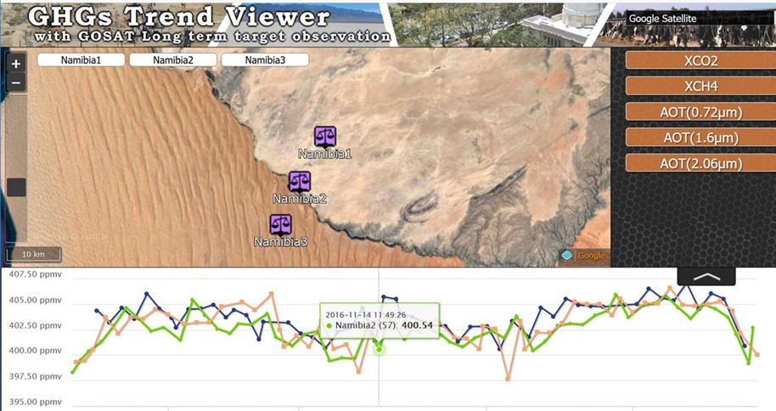
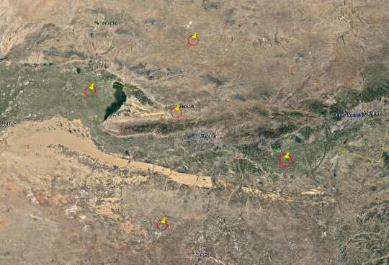
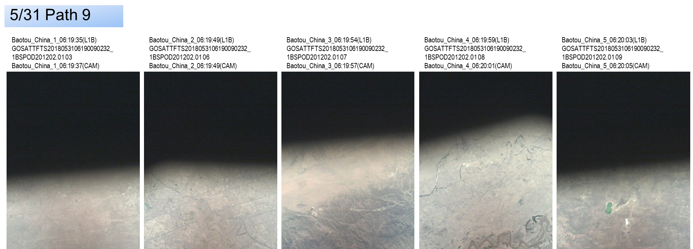
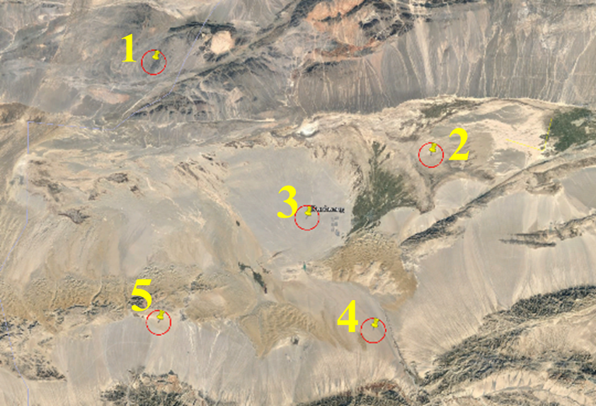
Recent GOSAT observations
Namibia
Two different types of surface
Good clear sky ratio
Baotou China
ID | OBS Point | Lat | Lon
1 | Reference Point 1 | 41.493° | 109.743°
2 | Reference Point 2 | 41.040° | 108.534°
3 | Baotou | 40.855° | 109.543°
4 | Reference Point 3 | 40.427° | 110.813°
5 | Reference Point 4 | 39.857° | 109.383°
China
1
Low clear sky ratio
2
3
Observation path :9 Observation cycle :6
Observation Start :2018/05/01
4
5
Dunhuang
China
Low clear sky ratio
ID | OBS Point | Lat | Lon
1 | Reference Point 1 | 40.733° | 93.559°
2 | Reference Point 2 | 40.375° | 94.972°
3 | Dunhuang | 40.130° | 94.340°
4 | Reference Point 3 | 39.697° | 94.674°
5 | Reference Point 4 | 39.725° | 93.597°
Observation path :11 Observation cycle :6
Observation Start :2018/05/03
14

Slide 15
Tools for Satellite GHG observations
data utilization and exploitation; in addition to regular level 1, 2, .. products
(1) Tools for long term trend data analysis
(2) Measurement and utilization by Multi-satellites, match up data set
(3) Large emission and large cities emission map (emission location
15

Slide 16
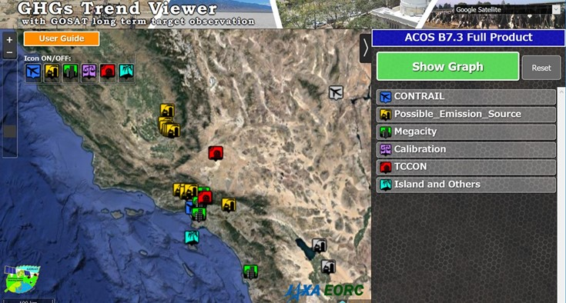
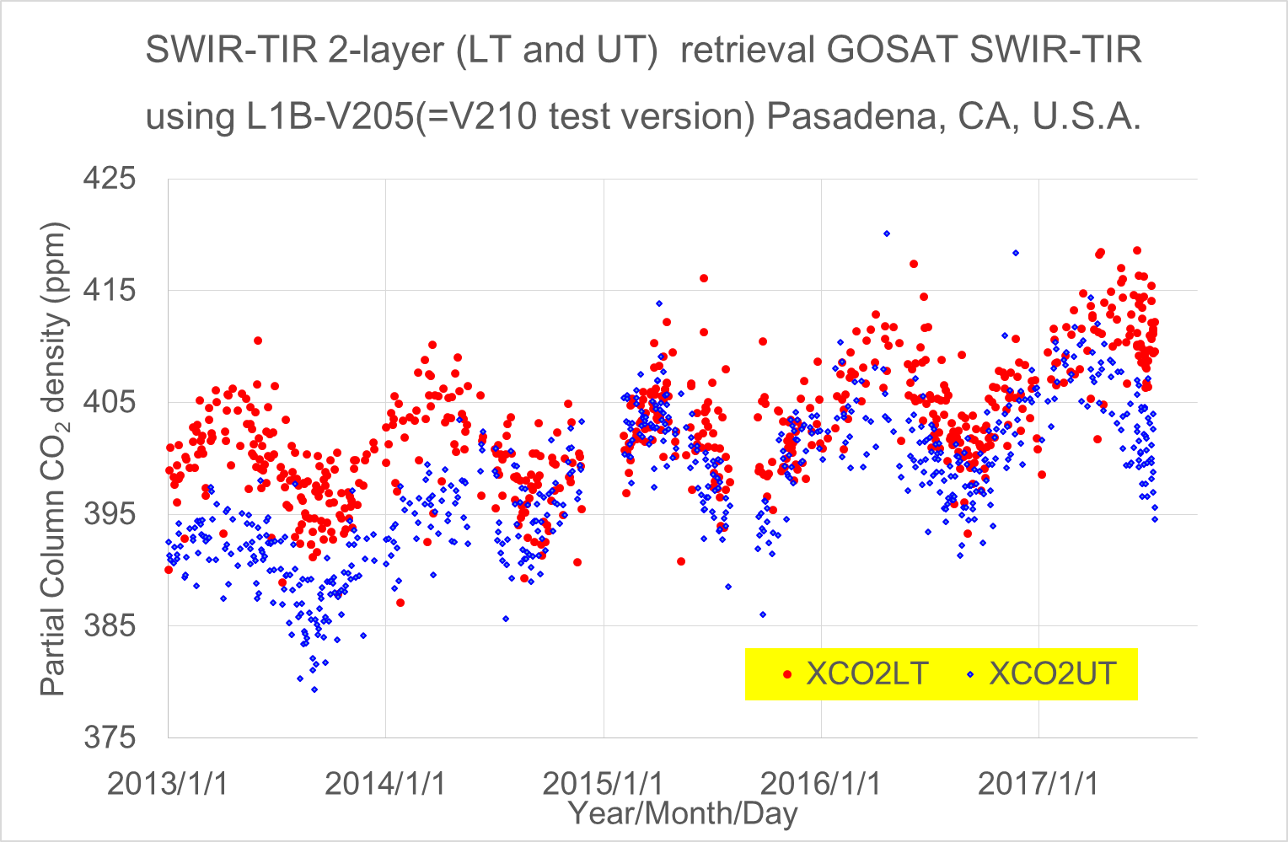
A decade long dataset and new research products http://www.eorc.jaxa.jp/GOSAT/product.html#trendviewer
long-term trend data of the selected targets, including the large point sources of methane (CH₄) and intensive observations of selected mega cites.
Contents: Long term CO₂, CH₄, SIF, AOD by GOSAT
3 produces : NIES V02.72, ACOS B7.3 FULL, RemoTeC V2.3.8
Trend figure & can be downloaded in csv format
Solar-Induced chlorophyll Fluorescence (SIF), Aerosol Optical Depth (AOD), Population density
http://www.eorc.jaxa.jp/GOSAT/CO2_moitor/index.html
Preliminary version
Plan for 2018
Long term research product of partial column and SIF of selected targets: Mega cities, CAL&VAL, point source
16

Slide 17
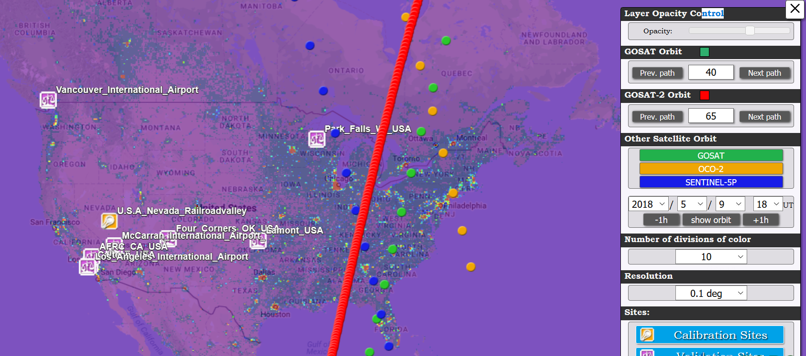
GHG Satellites Constellation
Match-up point check tool
http://www.eorc.jaxa.jp/GOSAT/GOSAT_Optimization/index.html
9 May 2018, UT18 & ODIAC
together with GOSAT, GOSAT-2, OCO-2 orbits (=TanSat), Sentinel 5P
Plan for 2018
Matched-up data set
Common database for GHG observation instruments from space:
Match up database of radiance spectra that include data quality, uncertainty, time, location of each instrument (GOSAT-OCO-2, GOSAT-AIRS, ……) will be provided.
17

Slide 18
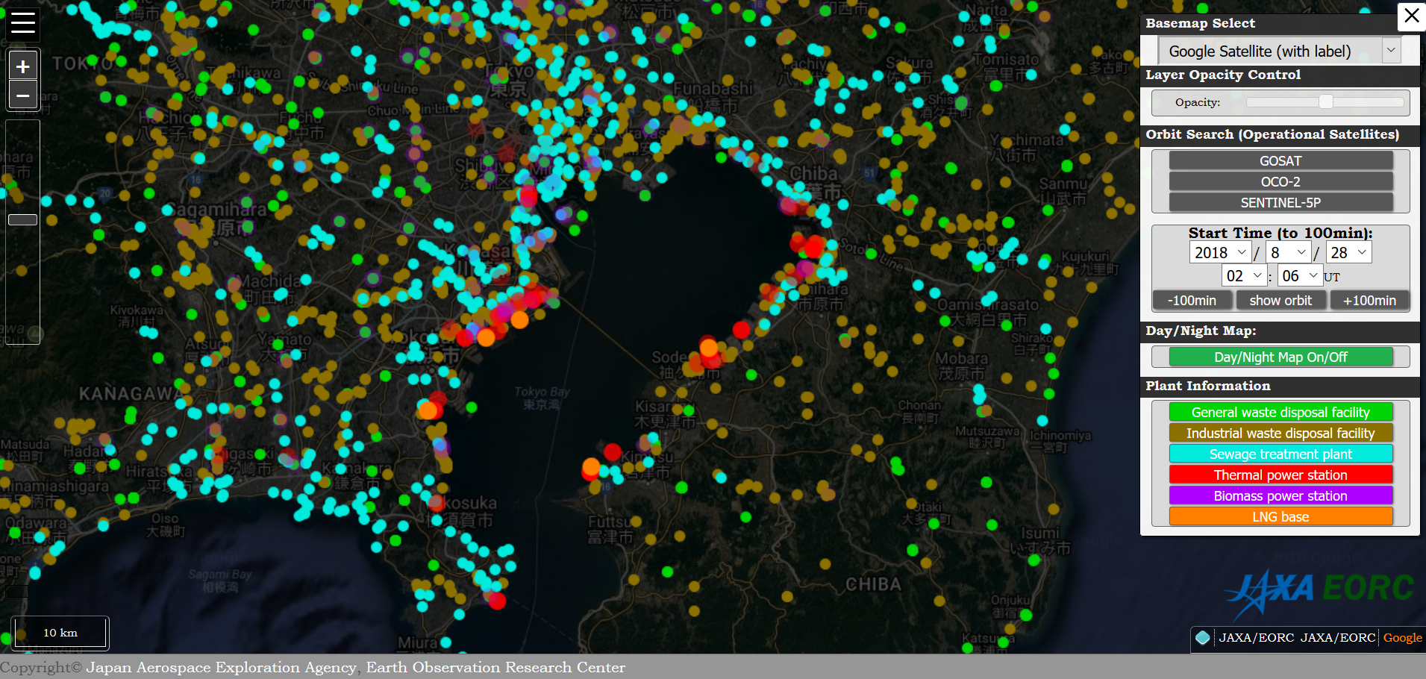
Flux estimation
GOSAT observation
Frequent and long term observation can detect the trend of the CH₄.
Estimation of CH₄ flux has large errors: both column density enhancement and wind speed. Higher spatial resolution improves enhancement and imaging capability provide proper reference.
(1) Optimized observation pattern to detect various emission sectors of CO₂ and CH₄.
(2) Adding 420-490 nm NO₂ spectrometer to the present configuration
18

