Slide 1
Proposed WGCV CARD4L assessment process
K. Thome
NASA
WGCV Plenary # 44
EUMETSAT, Darmstadt, Germany
August 28-31, 2018

Slide 2
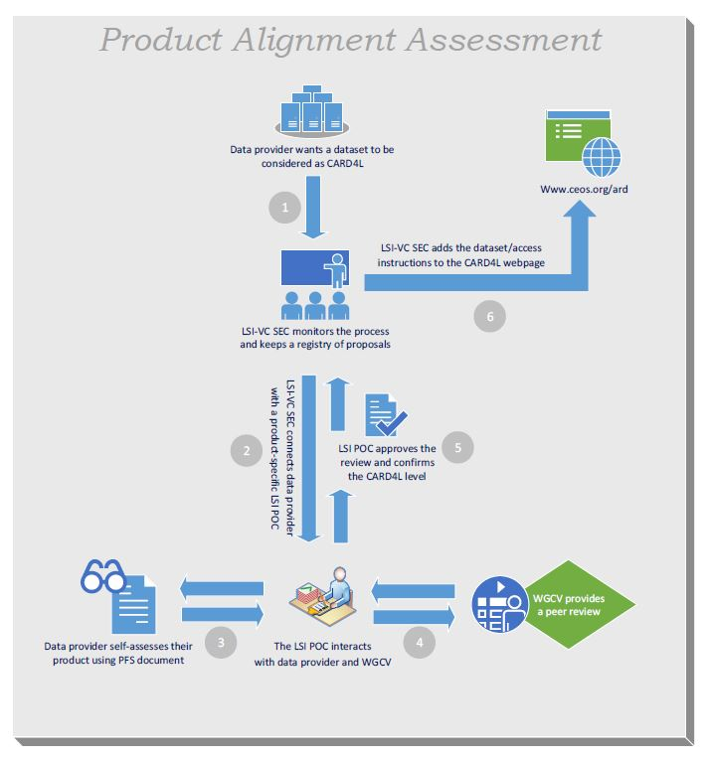
PFS POC interacts with Data Provider and WGCalVal to
Verify Data Provider’s Product Self-Assessment
Obtain the feedback of WGCV on the Product’s Cal/Val process
What does “a peer review” entail?

Slide 3
Try to avoid bogging down in definition of ARD, MRI, data cube
Identify key questions to answer that lead to the assessment of uncertainties in surface reflectance
Identify key questions to answer that lead to assessment of surface reflectance validation
This can be a large effort
Make this more manageable by determining a set of starting points
CARD4L as the definition of what an ARD is and what is needed to develop a “suitable” ARD
Provide guidance on how CARD4L products can be evaluated against their requirements
Incorporate the Level 1 interoperability discussion because the next step in ARD is to allow an ARD from multiple sensors to be developed

Slide 4
WGCV assessment role
Goal of LSI-VC is to ensure that
Recognised CalVal process is being employed
CalVal “good practice” is being applied
WGCV needs to define the right level of detail for the review
Define “good practice”
Includes how to assess the PFS metrics
Boundary between doing the validation and relying on the product provider’s results
WGCV’s role is also to provide feedback to LSI-VC on their product family specifications
Review process will help guide this feedback
Review process will provide key WGCV POCs for LSI-VC to work with on PFS
RadCalNet process could provide an example that is suitable here

Slide 5
RadCalNet process follows a similar path as that proposed by LSI-VC for CARD4L

Slide 7
Reminder of approval process for RadCalNet site
Prospective site manager documents that they meet requirements for membership with advice and guidance from RadCalNet Working Group
Submission of documentation to a RadCalNet Admission Review Panel made up of five members with Panel Lead from RadCalNet WG; two members from IVOS; two members from WGCV at large
Panel formulates recommendation to be carried forward to the WGCV membership – recommendation of approval requires concurrence by majority of panel
WGCV plenary acts on recommendation either via email or WGCV meeting
Recommendation accepted at a WGCV meeting unless three members that are present indicate disapproval
Recommendation accepted outside of WGCV meeting after one month evaluation period leads to fewer than five members registering disapproval
Much of the evaluation process can take place via telecon/email

Slide 8
Proposed approach for CARD4L for discussion
Data provider expresses
interest to LSI-VC for
product review
LSI sends
requests to
WGCV POC
WGCV POC puts Data Provider into contact with WGCV evaluator
WGCV interacts with Data Provider on their documentation
LSI-VC informed
by WGCV
POC of vote
outcome
CARD4L Acceptance
Review Panel provides
recommendation to WGCV
for vote
Summary of Data Provider’s
documentation provided to
WGCV CARD4L Acceptance
Review Panel
Assumes that concept of RadCalNet process is applicable

Slide 9
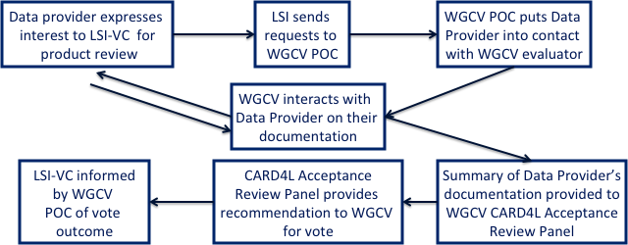
Proposed approach for
CARD4L for discussion
WGCV POC would be similar to the RadCalNet WG lead
Propose CARD4L evaluation lead (Label is placeholder)
CARD4L evaluation lead would be a WGCV member who is approved to a two-year term at a WGCV plenary meeting but there would be no service limits
Does not imply the formation of a CARD4L evaluation working group, simply that this person acts as a
Point of Contact with LSI-VC
Initial point of contact with data provider
Determines best subgroup or contact point within WGCV for evaluation of data provider’s documentation

Slide 10
Proposed approach for
CARD4L for discussion
CARD4L evaluation lead determines the best contact point within WGCV for the Data Provider to interact during the evaluation process
Multiple options are possible for this step
Contact list of volunteers provided by subgroup leads
Subgroup leads themselves
WGCV member
Other?
Need for technical expertise points to using subgroup membership

Slide 11
Proposed approach for
CARD4L for discussion
Evaluation process is an interaction between the WGCV representative and the Data Provider
Collaborative process much like in the RadCalNet case
Help ensure documentation follows accepted nomenclature
Clear demonstration of necessary quality
Goal is to help Data Provider move toward documentation leading to acceptance
Ultimately, it is the Data Provider’s choice whether to move forward with documentation to the WGCV’s CARD4L Acceptance Review Panel
Documentation can move forward without the WGCV representative’s approval

Slide 12
Proposed approach for
CARD4L for discussion
WGCV representative supplies their summary evaluation of the Data Provider’s documentation to the CARD4L Acceptance Review Panel
WGCV will assemble a CARD4L Acceptance Review Panel
Lead would be the CARD4L Evaluation Lead
Suggest that we four others as part of the panel
One representative that is a WGCV member
Three other volunteers that are either a WGCV member or a subgroup member nominated by their subgroup chair
Not more than one volunteer from a given subgroup
Two-year terms

Slide 13
Proposed approach for
CARD4L for discussion
CARD4L Acceptance Review Panel evaluates the summary from the WGCV evaluator and formulates a recommendation
Recommendation of approval requires concurrence by majority of panel
Evaluation process can be done via telecons and email
Evaluation should take place within 6 weeks from receiving the evaluator’s summary
Recommendation is carried forward to the WGCV membership
Note that even a recommendation of disapproval will be carried forward

Slide 14
Proposed approach for
CARD4L for discussion
WGCV membership votes on the Data Provider’s documentation not the panel recommendation
WGCV vote can take place either via email or at a WGCV meeting
Documentation is accepted at a WGCV meeting unless three present members indicate disapproval
Default is to wait until next WGCV meeting unless Data Provider requests the process be done via email
Documentation and panel recommendation forwarded to full WGCV membership for at least a one month
Documentation is accepted unless five members register disapproval by email

Slide 15
Preceding will be presented to LSI-VC next week during their meeting
LSI-VC has also asked for a WGCV representative as a POC for CARD4L activities
WGCV is being asked to evaluate product format specifications in addition to providing peer review of the CARD4L products
PFS already exist for many of the products but iterations are expected as we learn more from the review process
Updates are expected to be needed as users begin to use the ARDs for applications
New products will need PFS development

