Slide 1

CNES Activity Report
Aimé MEYGRET, Patrice HENRY - CNES
WGCV Plenary # 44
Darmstadt
August 28-31, 2018

Slide 2

CNES
Report on Cal/Val Activities
WGCV Plenary # 44
SUMMARY
Calibration Monitoring of in-Flight Missions
Preparation of future Missions
Involvement in CEOS/WGCV activities

Slide 3
CNES
Report on Cal/Val Activities
WGCV Plenary # 44
Calibration Monitoring of CNES in-Flight Missions
PLEIADES 1A & 1B (Very High Resolution Imaging)
          • Accurate geometric and MTF calibration monitoring
          • Radiometric calibration monitoring (moon, PICS, test sites)
IASI A & B (IR Atmospheric Sounding)
          • Spectral and radiometric calibration
          • Intercalibration activities : IASI-A/IASI-B ; IASI/AIRS ; IASI/CRIS
Megha-Tropiques: Saphir (MW Sounder), Scarab (optical scanning radiometer) calibration monitoring
IIR (3 band IR Radiometer) on-board Calipso calibration monitoring (cross-calibrated with MODIS)
          SMOS – Calibration and performances monitoring

Slide 4
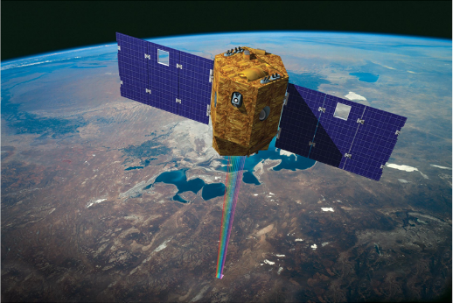
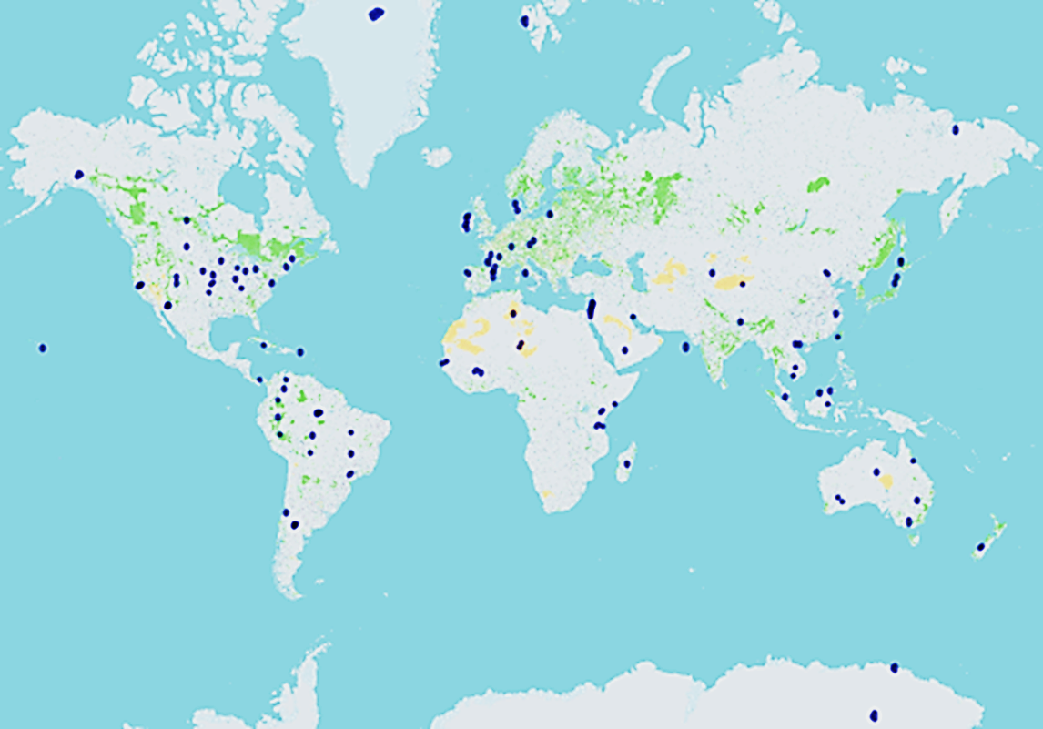
CNES
Report on Cal/Val Activities
WGCV Plenary # 44
VENμS– Vegetation and Environment monitoring on a New μ Satellite
Mission goal
          High revisit (2 days) and high spatial resolution (5-10 m) for vegetation monitoring
Instrument
          • Camera with 12 narrow spectral bands in the VNIR
          • Swath 27 km
          • Stereoscopic imaging
          Tilting capability: +/- 30 deg
          Israel/France partnership
          • ISA: microsatellite with Hall Effect Thruster
          • CNES: high resolution camera
          110 selected scientific sites
Successfully launched Aug. 1, 2017
Hand over March 1, 2018

Slide 5
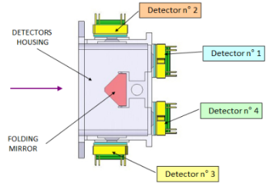
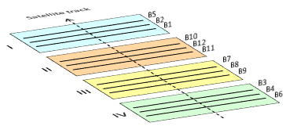
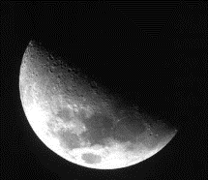
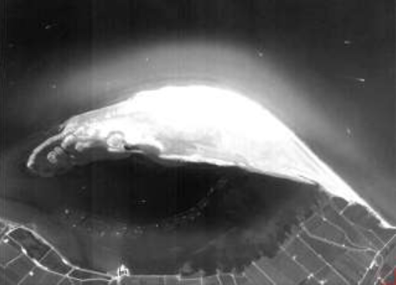
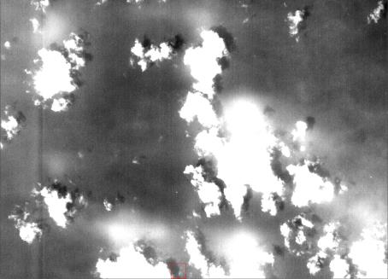


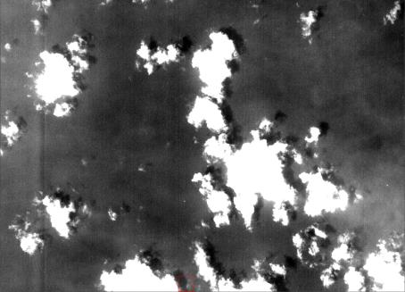
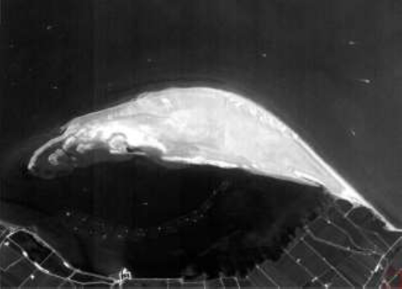
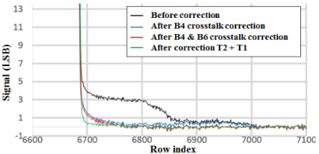
CNES
Report on Cal/Val Activities
WGCV Plenary # 44
Calibration Monitoring of CNES in-Flight Missions
VENµS straylight in-flight correction
B1 image of the Ebro delta, Sept. 8, 2017
B3 Moon transition, Dec 5, 2017
B2 image over North Atlantic, Aug. 18, 2017

Slide 6
CNES
Report on Cal/Val Activities
WGCV Plenary # 44
Calibration Monitoring of CNES in-Flight Missions
VENµS: Calibration and performances monitoring
Outcome from the IOCR:
Overall image quality is good, and the products match scientific expectations, except for some « difficult » sites
Geometric performance
  Attitude refined by image processing: some tunings and reprocessings are scheduled
  geometric performances are OK for 10-meter resolution L2 products
Stray-light correction performance is highly satisfactory
Radiometric calibration
  good performance (3%) for spectral bands B3 to B12
  not accurate enough (5%, as anticipated) for deep blue bands (B1 and B2)
Reprocessings
  Summer 2018 with the current configuration
  Autumn 2018 with updated configuration (enhanced geometric performance and B12 calibration update)
  ☞ Products on www.theia-land.fr

Slide 7
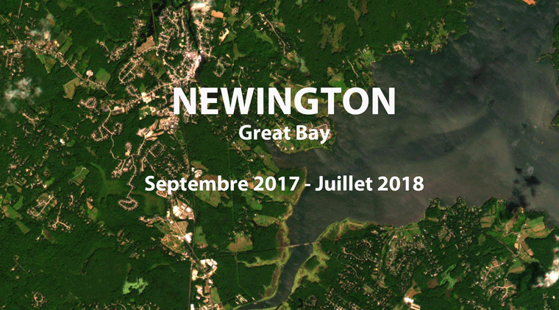
CNES
Report on Cal/Val Activities
WGCV Plenary # 44
VENμS time serieS

Slide 8
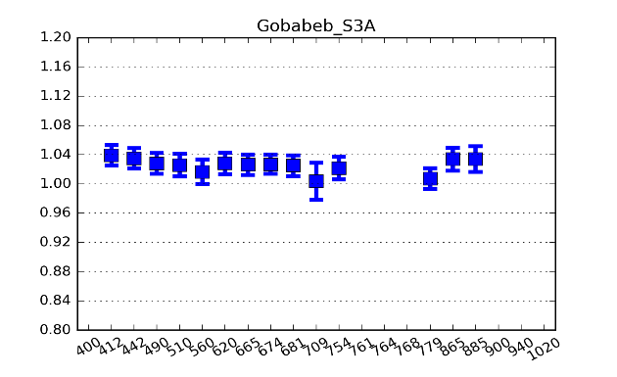
CNES
Report on Cal/Val Activities
WGCV Plenary # 44
Participation in other Missions Calibration Monitoring
Airbus D&S SPOT-6&7 satellites
          • Calibration monitoring using PICS and test sites (La Crau and Gobabeb)
Support to ESA for SENTINEL-2 and SENTINEL-3 calibration
          • In-orbit tests and routine monitoring
          • All calibration methods: La Crau (S2) and Gobabeb (S2&S3),
          deserts (S2&S3), Rayleigh scattering (S2&S3), sun glint (S3),
          clouds (S2&S3), Antarctica (S3)
Support to GISTDA for THEOS calibration
          • Calibration monitoring using PICS
Exchanges with NASA for LANDSAT-8 and MODIS calibration
          • PICS and moon calibration monitoring
Support to EUMETSAT for 3MI (Multi-channel Multi-viewing Multi-polarisation Imager) ground characterization and future in-flight calibration

Slide 9
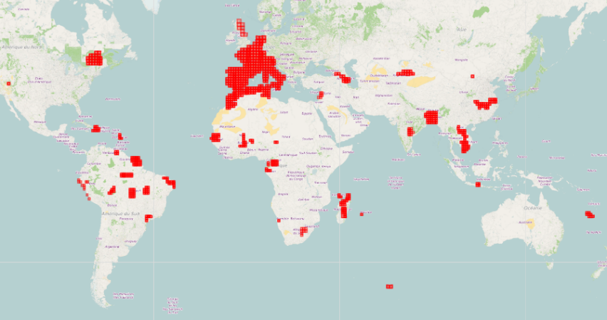
CNES
Report on Cal/Val Activities
WGCV Plenary # 44
THEIA: L2A operational production
    Atmospheric Correction software: MAJA (CNES/DLR partnership), freely available as stand alone version at https://logiciels.cnes.fr/en/content/maja
⇒ MAJA 1.0 operationally used within THEIA's ground segment in CNES (MUSCATE)
    SENTINEL 2A & 2B L2A THEIA products are available at https://theia.cnes.fr
    on 7 M.km² with MAJA V1.0 (processed in real time)
    VENµS L2A products available at
    https://theia.cnes.fr
    LANDSAT 5-7-8 L2A products available at
    https://theia-landsat.cnes.fr
  Next reprocessing with MAJA 3.1 using CAMS data (autumn 2018):
  - Sentinel 2A&2B
  - LANDSAT 8 projected on SENTINEL-2 grid over France
  On demand SENTINEL-2 L2A processing development on going
S2A & 2B L2A tiles produced byTHEIA

Slide 10
CNES
Report on Cal/Val Activities
WGCV Plenary # 44
Spot World Heritage
Retrieval of images scattered in the different receiving stations all over the world (≈ 50%) : around 15 millions of images available at CNES
Systematic processing of the images at level 1A for long term storage:
⇒ end of processing: october 2019
Plan for level 1C processing. 2 options:
          • automatic processing: quick access but storage cost and
          predefined products
          • on-demand processing: possibility for customized products but not suitable for
          large areas coverage or long time series
Study the capability to process suitable ARD products (how to apply relevant atmospheric correction to data acquired in 1986?)

Slide 11
CNES
Report on Cal/Val Activities
WGCV Plenary # 44
SUMMARY
Calibration Monitoring of in-Flight Missions
Preparation of future Missions
Involvement in CEOS/WGCV activities

Slide 12
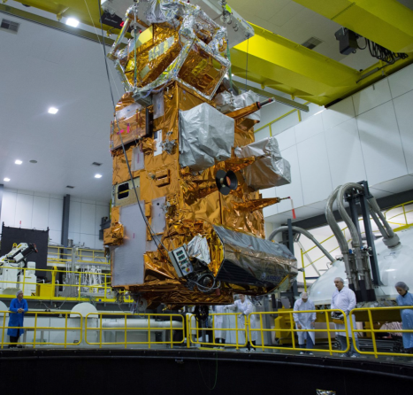
CNES
Report on Cal/Val Activities
WGCV Plenary # 44
IASI-C on Metop-C
3 bands for continuous spectral coverage: 3.62-15.5 µm,
8461 channels, spectral resolution: 12 to 0.66 nm,
2x2 pixels (12km)
CNES/EUMETSAT partnership
Launch planned 6th november 2018
            Satellite FAR successful in march 2018
            Satellite arrived in Kourou in June 2018
Cal/val planned from december 2018 to may 2019
Rehearsal of cal/val activities at CNES in spring 2018
➔ Cal/val key point in June 2018 : everything is ready!

Slide 13
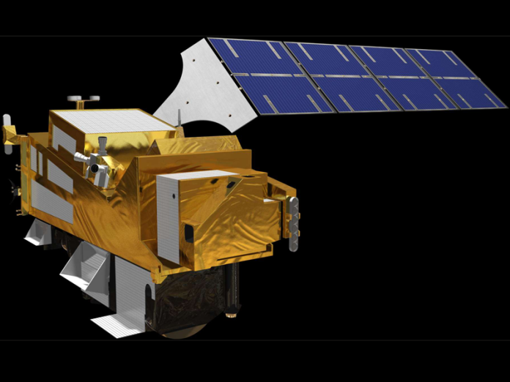
CNES
Report on Cal/Val Activities
WGCV Plenary # 44
IASI-NG – New Generation of InfraRed Sounder on-Board METOP-SG
Mission goal
          Continuity of IASI mission for meteorology, atmosphere chemistry and climate
          Improvement of measurement precision: 1 K for temperature,10% for humidity
Instrument Concept
          Fabry-Perot interferometer
          Many technical innovations
          Spectral resolution and signal-to-noise ratio improved by a factor of two
          CNES/EUMETSAT partnership
          Launch: 2022
          3 models continuity up to 2040

Slide 14
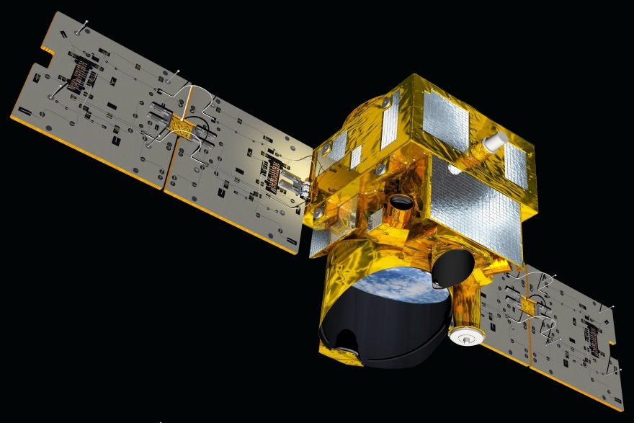
CNES
Report on Cal/Val Activities
WGCV Plenary # 44
MERLIN - Methane Remote Sensing Lidar Mission
Mission goal
          Global information on atmospheric Methane concentration (CH4 column density)
          with accuracy better than 1% (random error) and 0.2% (systematic error) and with a spatial resolution of 50 km along track
Instrument Concept
          First spaceborn integrated path differential absorption LIDAR instrument (laser
          wavelength around 1.645 μm)
French/German partnership
          • CNES platform : Myriade
          • DLR instrument
          Launch: 2024
          Phase C/D on going

Slide 15
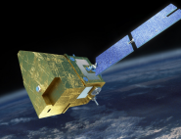
CNES
Report on Cal/Val Activities
WGCV Plenary # 44
MicroCarb – Measuring CO₂ from a Microsatellite
Mission goal
          Mapping of sources and sinks of carbon dioxide (CO₂) on a global scale
Instrument Concept
          Infrared passive spectrometer operating in 4 bands with high spectral and
          radiometric performances
          Measure the total column concentration of CO₂ with a precision of 1 ppm and
          a pixel size of 4.5 km x 9 km.
Partnership with UKSA
+ discussions with EUMETSAT in progress
          Launch: planned for 2021
          Phase C/D in progress

Slide 16
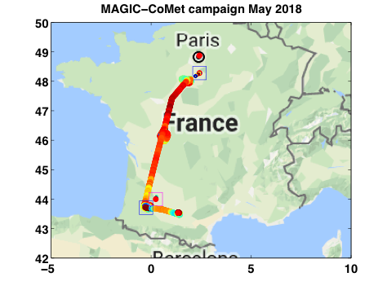
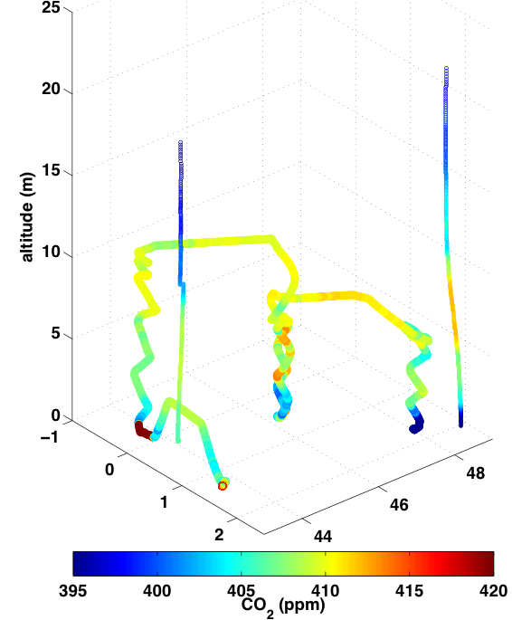
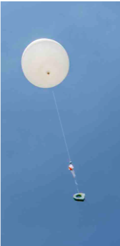








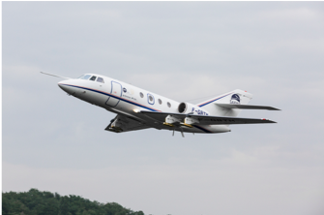
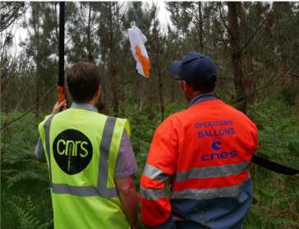
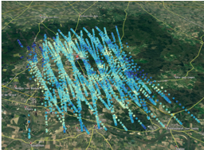
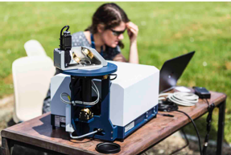
CNES
Report on Cal/Val Activities
WGCV Plenary # 44
MAGIC campaigns : Monitoring of Atmospheric composition and Greenhouse gases through multi-Instruments Campaign
To prepare the validation of GHG products from MicroCarb, IASI-NG, MERLIN missions
First campaign in may 2018, in synergy with DLR COMET campaign
40 scientists + CNES teams + SAFIRE planes
2 planes, 19 balloons (Aircore, Amulse, radiosoundings), 4 ground spectrometer, OCO-2 and IASI/METOP satellites

Slide 17
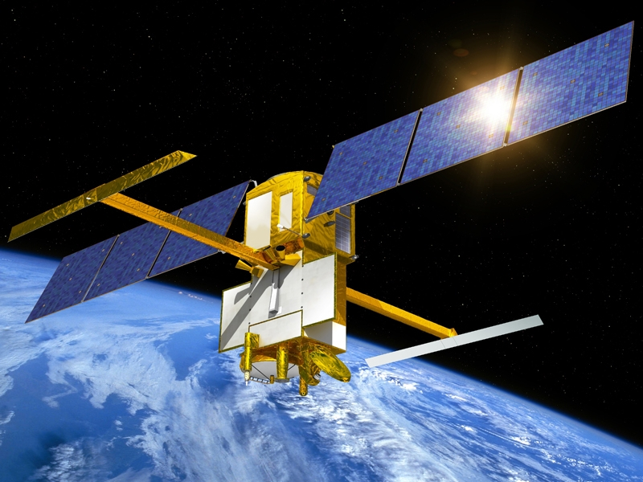
CNES
Report on Cal/Val Activities
WGCV Plenary # 44
SWOT – Surface Water and Ocean Topography Mission
Mission goal
          Complete coverage of the world's oceans and freshwater bodies with repeated
          high-resolution elevation measurements
          Oceanography: mesoscale and sub-mesoscale circulation patterns
          Hydrology: surface water monitoring - rivers (width>100m) - lakes, reservoirs and wetlands larger than 250x250 m²
Instruments
          • Wide-swath Ka-band radar interferometer
          • Nadir radar altimeter
          • Microwave radiometer
          US/French partnership
          • NASA-CNES + CSA & UKSA
          Launch: 2021
          ➔ CAL/VAL : dedicated one-day repeat pass orbit (during 6 months) for calibration purposes

Slide 18
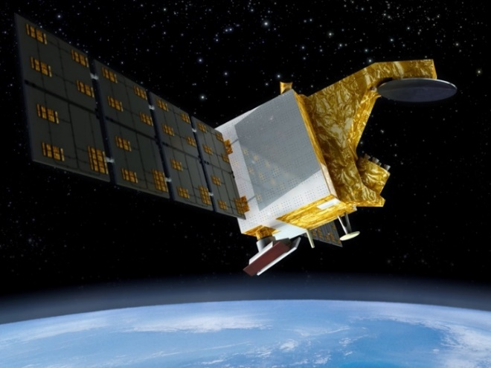
CNES
Report on Cal/Val Activities
WGCV Plenary # 44
CFOSAT – China-France Oceanography SATelitte
Mission goal
          Study of the characteristics of ocean surface winds and waves
Two Radar instruments
          • SWIM ‘Surface Waves Investigation and Monitoring’, a wave scatterometer
          (6 rotating beams enable to measure wave properties: direction, wavelength, etc.)
          • SCAT, a wind-field scatterometer
          (wind intensity and direction measures)
          Chinese/French partnership
          • CNSA: SCAT instrument
          • CNES: SWIM instrument
          Launch: 29/10/2018
          ➔ CAL/VAL : 5 expertise centers coordinated by CNES (CNES, LATMOS, LOPS, Météo France and CLS with the support of a ScienceTeam), numerous intrument modes to be validated, in-situ combined airborne/marine campaigns (2 orbital cycles)

Slide 19


CNES
Report on Cal/Val Activities
WGCV Plenary # 44
TRISHNA – Thermal infraRed Imaging Satellite for High resolution Natural resource Assessment
Mission goal :
- Ecosystem stress and water use monitoring
- Coastal zone monitoring and management
Optical instruments VNIR, SWIR and TIR
          • High spatial scale (∼50m)
          • High revisit (3 for 8 days cycle)
          India/France partnership
          • ISRO: VNIR-SWIR instrument, accommodation on a main frame
          • CNES: TIR instrument
          Launch: 2025
          Phase A on going

Slide 20
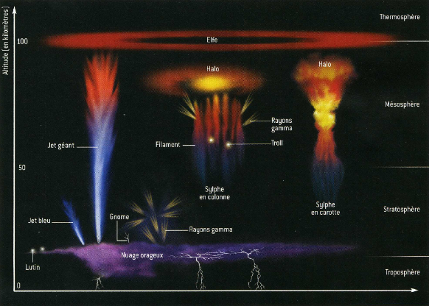
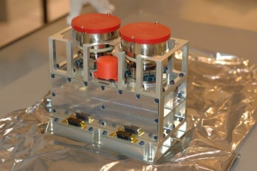
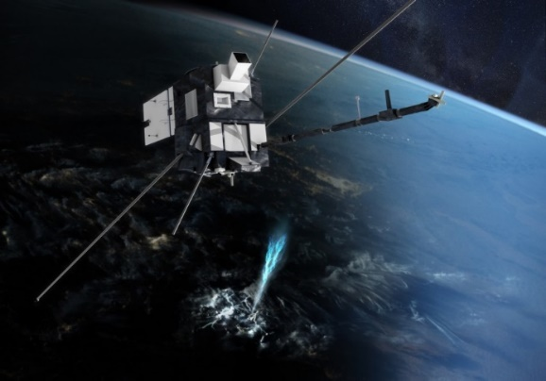
CNES
Report on Cal/Val Activities
WGCV Plenary # 44
TARANIS
Mission goal :
To study Transient Luminous Events (TLEs)
and Terrestrial Gamma ray Flashes (TGFs)
8 instruments (X-ray, Gamma-ray, Electric field,…)
including 2 optical instruments:
- MCP-MC: 2 MicroCameras dedicated to lightnings
and sprites observation (762 & 777 nm)
- MCP-PH: 4 Photometers for irradiance measurement
(220, 337, 762, 750 nm)
          France/Czech Republic (University of Prague)/USA (Stanford University and GSFC) partnership
          Launch: dec. 2019
          Phase C/D on going
          Big challenge for in-flight calibration (mission dedicated
          to the observation of stealthy events by night)

Slide 21
CNES
Report on Cal/Val Activities
WGCV Plenary # 44
SUMMARY
Calibration Monitoring of in-Flight Missions
Preparation of future Missions
Involvement in CEOS/WGCV activities

Slide 22
CNES
Report on Cal/Val Activities
WGCV Plenary # 44
CNES Calibration Activities
Forthcoming priorities for CNES: Sounding and Altimetry missions, but also Thermal Infra Red and Hyperspectral imagery
Gap period for CNES Imagery Missions
• Need to adapt/enforce our calibration activities to new missions (MicroCarb, TIR, Hyperspectral,…)
• While continuing the effort in radiometric calibration database
and methods development mainly in support to our partners:
          . CNES involvement in Sentinel 2A and B calibration and performance assessment
              . CNES support to ESA for Sentinel 3A and B in-flight calibration monitoring
              . CNES support to EUMETSAT for 3MI calibration activities
              . CNES support to ADS for SPOT6&7 and soon PLEIADES-NEO (2020) in-flight calibration monitoring

Slide 23
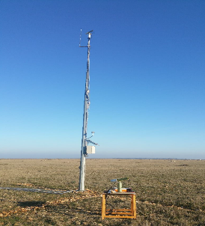
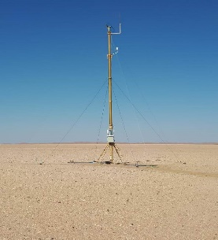
CNES
Report on Cal/Val Activities
WGCV Plenary # 44
CNES Involvement in CEOS/WGCV Activities
CEOS activity managed as a ‘project’ in CNES
          • Clear budget line established
          • Human resource identified (more or less!)
Internal Review Board recommendations:
          • Strong involvement in RadCalNet with 2 calibration sites:
          La Crau and Gobabeb (cooperation agreement with ESA for the Namibian site)
          • Leadership of the PICSCAR Task Group and associated studies
          • Participation to GSICS/GRWG for IASI intercalibration, lunar calibration
          and ‘geo-deserts’ database populating
          • Next ACWG participation to promote IASI, MERLIN and MicroCarb Missions
          • Development of new generation tools for SADE/MUSCLE (MUSCLE-NEO): more operational and open to external partners

Slide 24
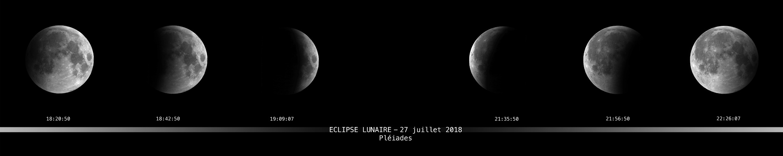
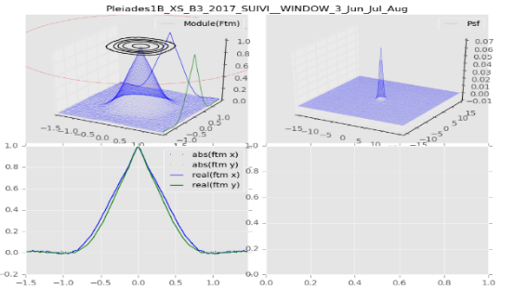
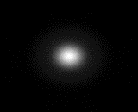
CNES
Report on Cal/Val Activities
WGCV Plenary # 44
CNES Involvement in CEOS/WGCV Activities
Continuous feedback towards WGCV/IVOS community for new calibration methods developped at CNES
              - ROLO lunar albedo model improvement
              ⇒ phase angle and spectral correction
              - High resolution optical sensors calibration based on stars
              ⇒ simultaneous MTF and absolute calibration retrieval
Calibration data exchange

