Slide 1
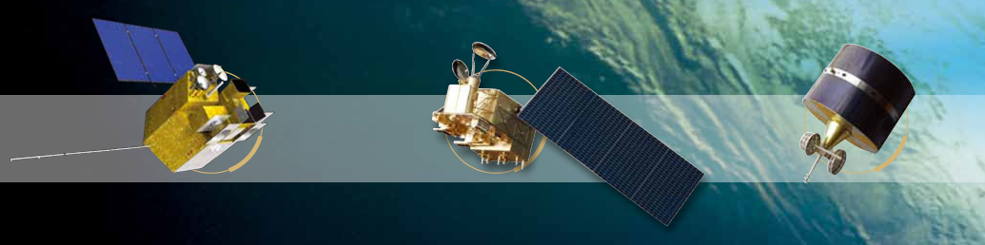


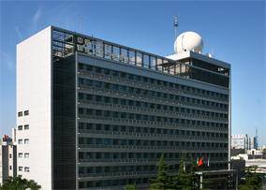


FY-3D Commissioning Test Overview
Xiuqing Hu
National Satellite Meteorological Center,
China Meteorological Administration
(NSMC/CMA)
CEOS/WGCV meeting August 28-31, 2018

Slide 2

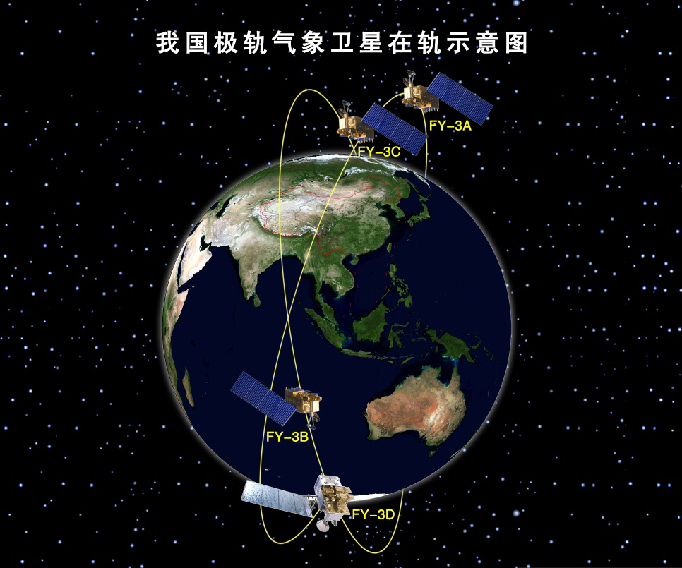
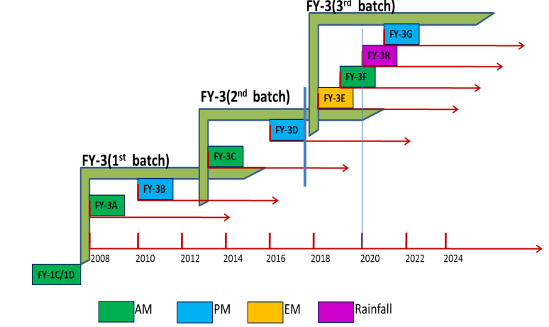
Background of FY-3X serial satellite
FY-3 is the Chinese second generation LEO meteorological satellite.
Four Satellites has already been on orbit and four more satellite will be lunched.
2008.05.27 | FY-3A | AM
2010.11.05 | FY-3B | PM
2013.09.23 | FY-3C | AM
2017.11.15 | FY-3D | PM

Slide 3
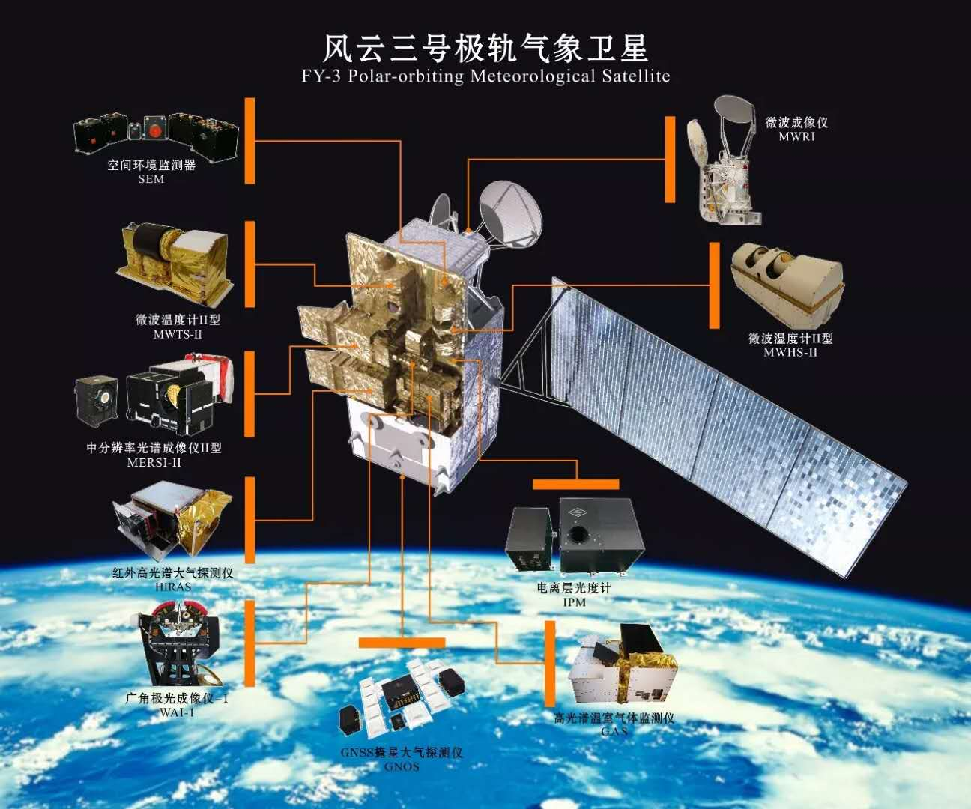
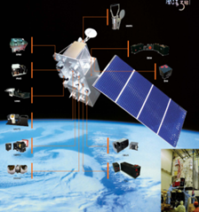
FY-3D Instrument configuration
-- Launched on 15, Nov. 2017 and commissioning almost finished
10 instruments on board FY-3D:
5 Successive instruments:
MWTS-II: Microwave Temperature sounder
MWHS-II: Microwave Humidity sounder
MWRI: Microwave Radiation Imager
GNOS: Global Navigation Occultation Sounder
SEM: Space Environment Monitor
2 Improved instruments：
MERSI-II：Improved from MERSI
HIRAS: Upgraded from filter-type sounder IRAS
3 New Instruments:
GAS: Greenhouse gases Absorption Spectrometer
WAI: Wide-angle Aurora Imager
IPM: Ionospheric Photometer
FY-3D
FY-3A/B/C

Slide 4
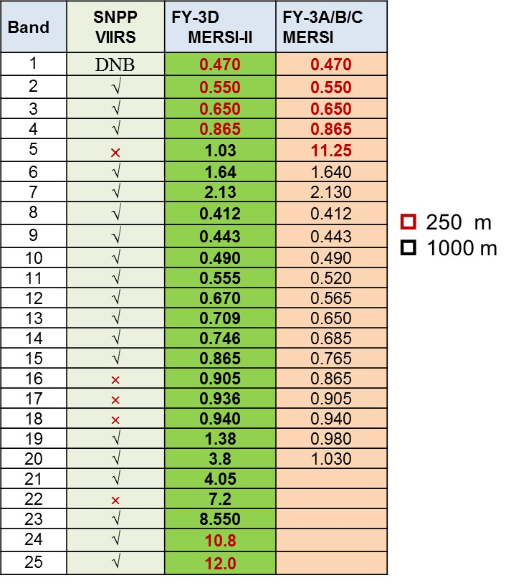
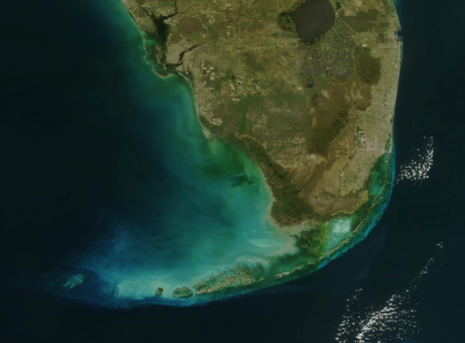
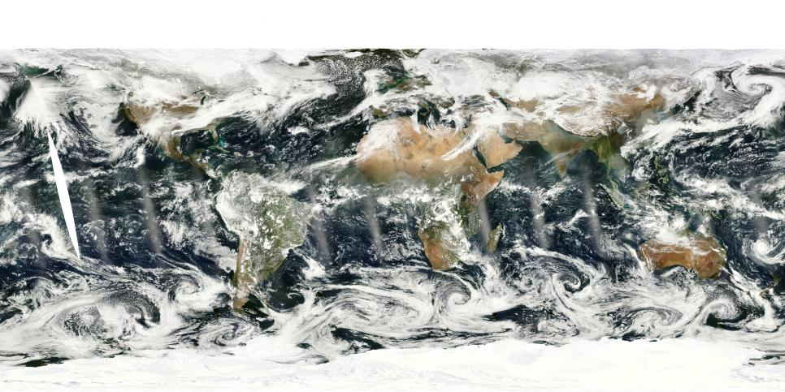
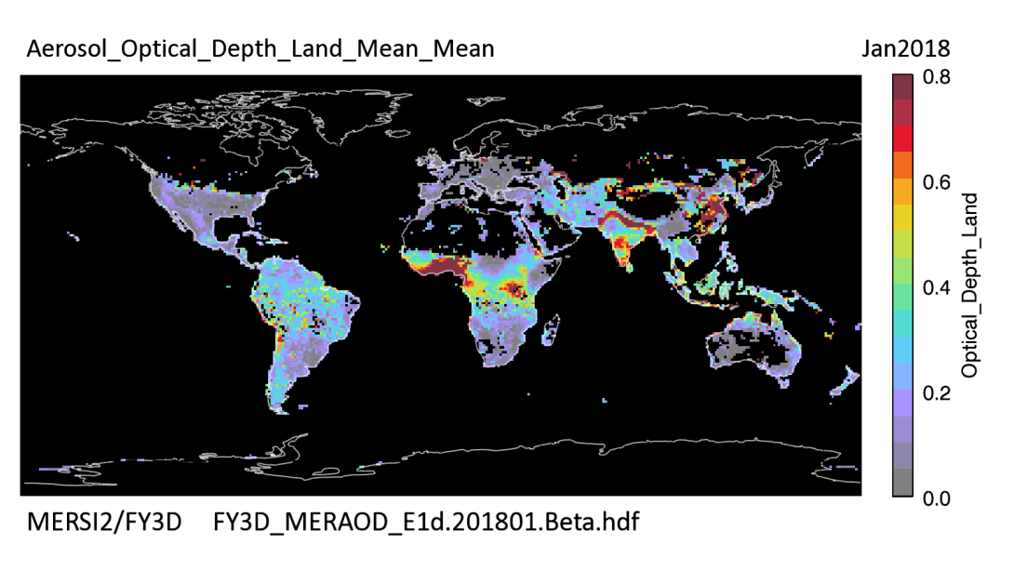
Imager of FY-3D: MERSI→MERSI-II continuity and Evolution
MERSI-II Improvement:
  Cover all bands in FY-3A/B/C MERSI
  Five more IR bands with 2 split windows with 250m spatial resolution
  Add Circurrus cloud band 1.38um
  Water vapor bands In NIR and 7.2um
  Higher accuracy using onboard calibrator
  Lunar Calibration capability
MERSI-II global Mosaic image
MERSI-II global AOD over land

Slide 5
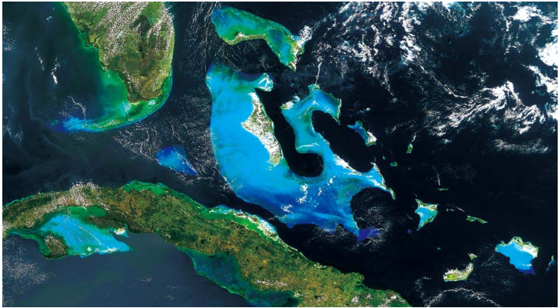
MERSI-II image

Slide 6
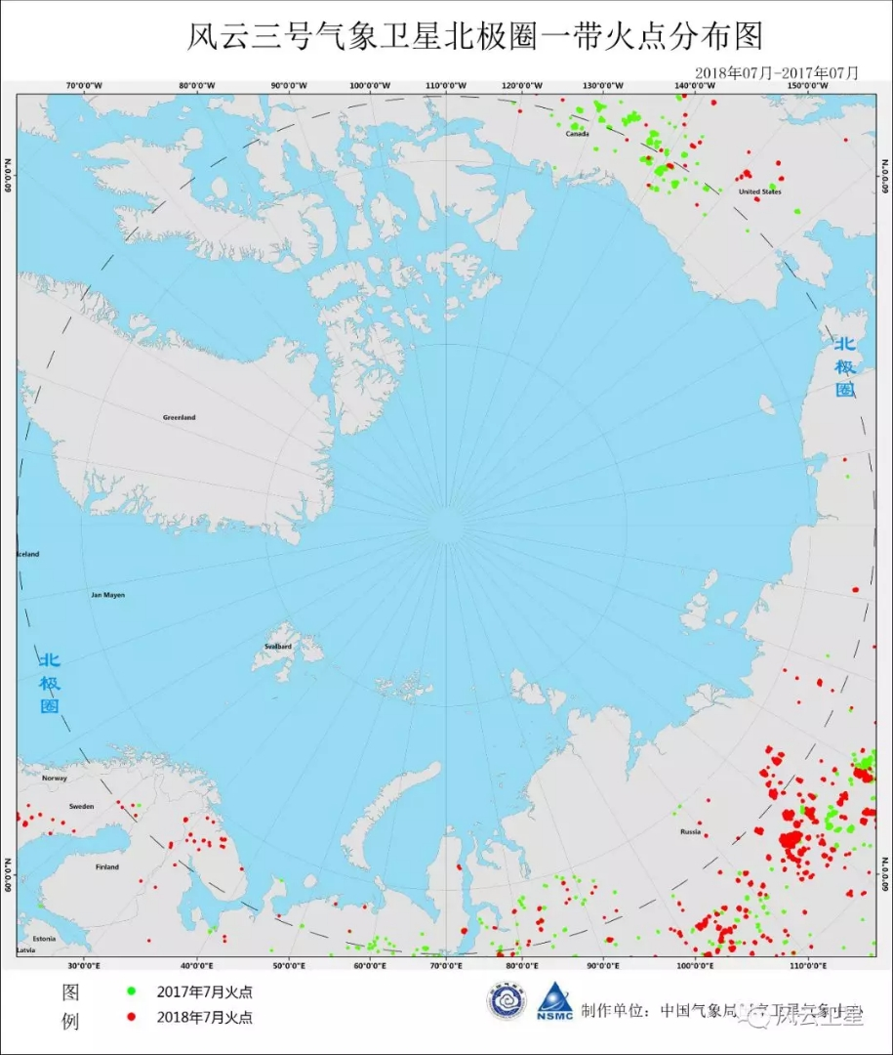
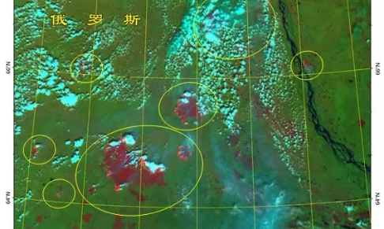
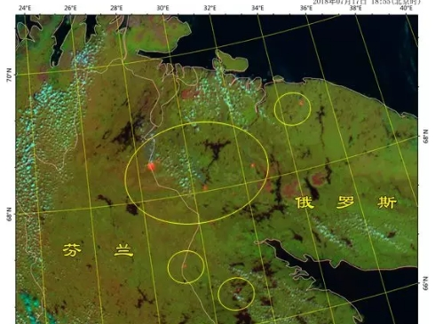
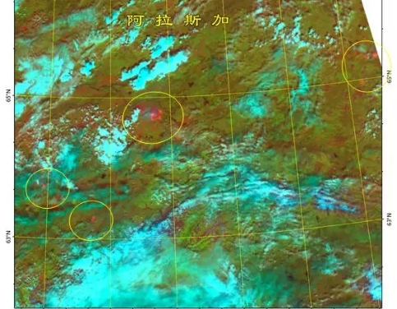
Active Fire monitoring around Arctic
Russia
Fenland and Russia
Alasika, UAS

Slide 7
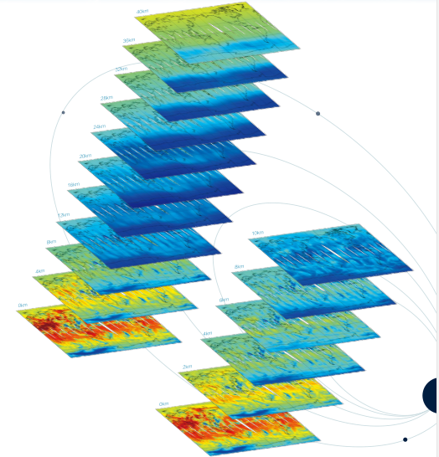
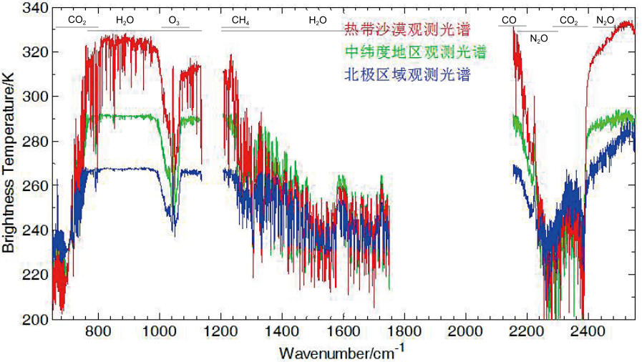
HIRAS
Band | Spectral range (cm-1) | Resolution (cm-1) | NEΔT @250K | chs
Longwave | 650 *– 1136 （15.38 μm-8.8 μm） | 0.625 | 0.15K | 778
Midwave1 | 1210 – 1750 （8.26μm-5.71 μm） | 1.25 | 0.1K | 433
Midwave2 | 2155-2550 （4.64μm-3.92 μm） | 2.5 | 0.3K | 159

Slide 8
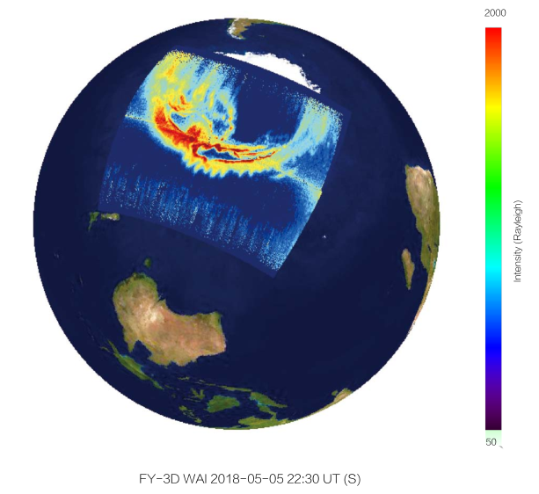
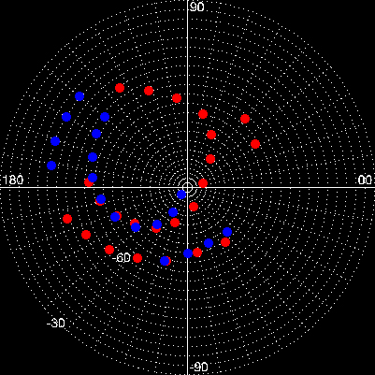
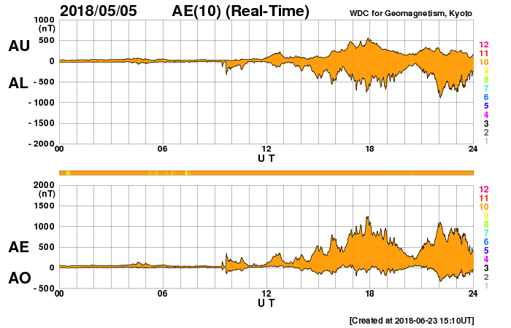
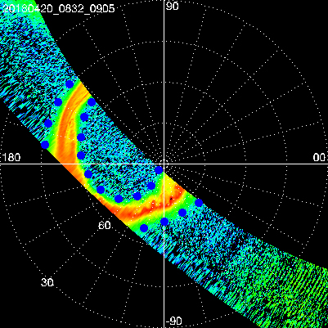
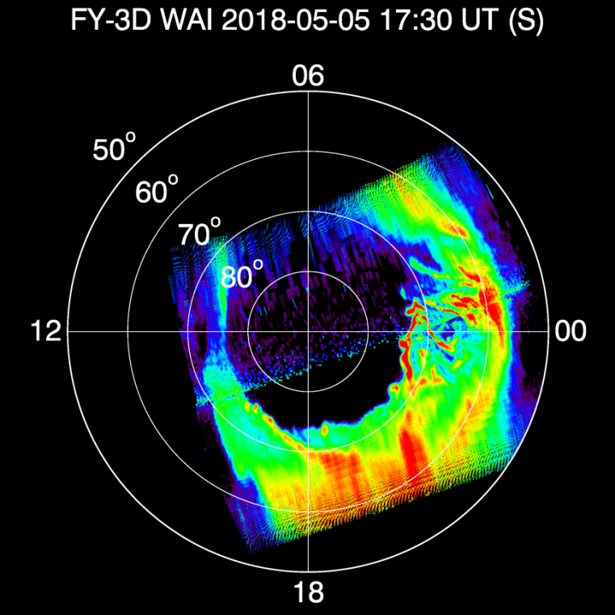
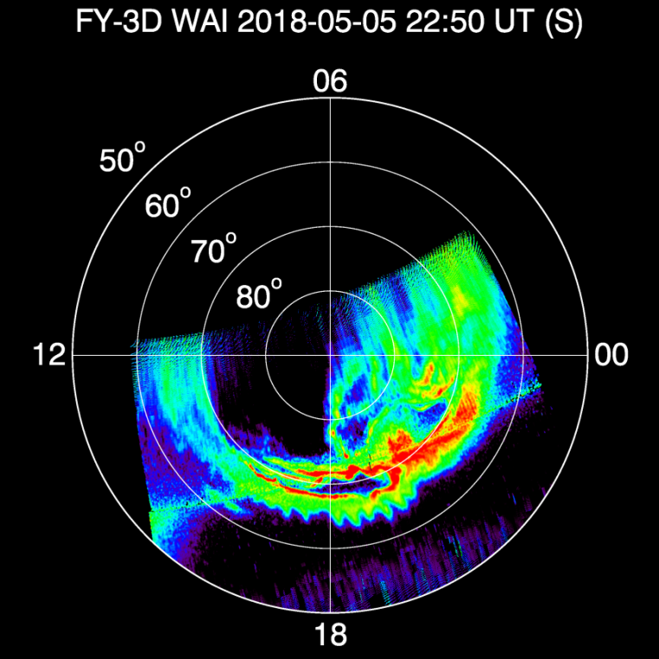
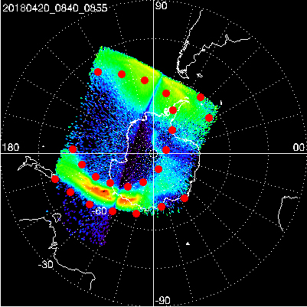
The New from FY-3D
Auroral oval
WAI: Wide-angle Aurora Imager
Polar magnetic substorm

Slide 9
FY-3D Commissioning Phase
15 November
2017
lunched successfully
31st June
2018
Complete the orbital check out
Complete summary and review of the orbit test
July
2018
Oct.
2018
August
2018
Turn into formal operation and data release
In-orbit delivery for trial operation

Slide 10
Latest Update of FY-3D status
Tests for satellite platform have been finished, the results show the functions and performances meet the requirements;
Field campaigns for FY-3D Vicarious calibration and validation were conducted at Simao rainforest in March 2018, Dunhuang desert in April 2018, and Qinghu Lake in August 2018.
All 10 instruments onboard FY-3D have finished the three-round tests for evaluating the key performances which all meet with specification.
8 instrument payloads, i.e. MERSI-II, HIRAS, GNOS, MWTS, MWHS, MWRI, SEM, and IPM have begun with L1 data application test and trial operation.
Trial data of Sounding instruments （ HIRAS, GNOS, MWTS, MWHS, MWRI）were delivered to outsides such as ECWMF, EMETSAT, Metoffice, Wisconsin University and CAS for L1 quality evaluation and data assimilation test

Slide 11
FY-3D Cal/Val Continuity
Operational Instrument Performance Monitoring for long term based on OBC complete telemetry parameters
GSICS SNO or SNOx monitoring using reference instruments (IASI, CrIS, MODIS,VIIRS) and Intercomparison with EUMETSAT sensors such as Sentinel 3 OLCI/+SLSTR, GOME-2.
MERSI-II Calibration trend monitoring using PICS sites and ground-based automatic measurements at Dunhuang site
Integrated calibration system which combines earth targets, moon, DCC and RT simulation
Overview of FY-3D commissioning test X. Hu
Cal/Val for FY-3D Microwave sensors (MWTS/MWHS/MWRI) Q. Lu
FY-3D/HIRAS calibration and validation C. Qi
FY-3D/MERSI-II commission test N. Xu

Slide 12
  TANSAT
  -- Data has been opened to world users
A joint mission: by MOST(Ministry Of Science and Technology), CAS(Chinese Academy of Science), and CMA.
Mission objective: to retrieve the atmosphere column-averaged CO2 dry air mole fraction (XCO2).
Instruments：
ACGS(Atmospheric CO2 Grating Spectrometer) is mainly used to measure atmospheric CO2. It has three spectral bands. One is the oxygen A-band with a centroid wavelength of 760nm. The other two are weak and strong carbon dioxide absorbing bands with centroid of 1610nm and 2060nm.
CAPI(Cloud and Aerosol Polarization Instrument) is a 5-channel UV/VIS/ NIR/SWIR radiometer with three polarizations in two channels

Slide 13
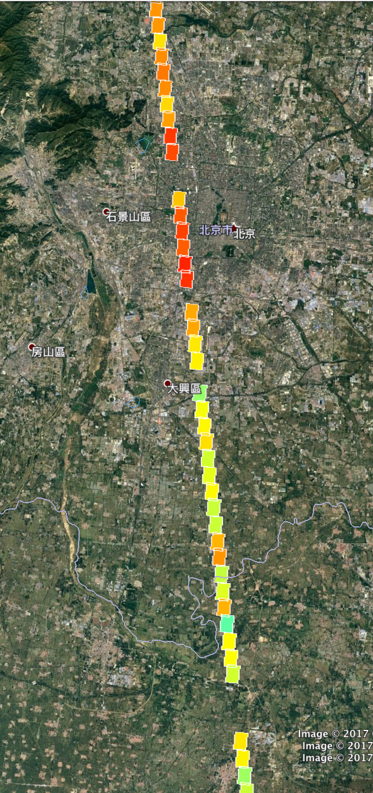
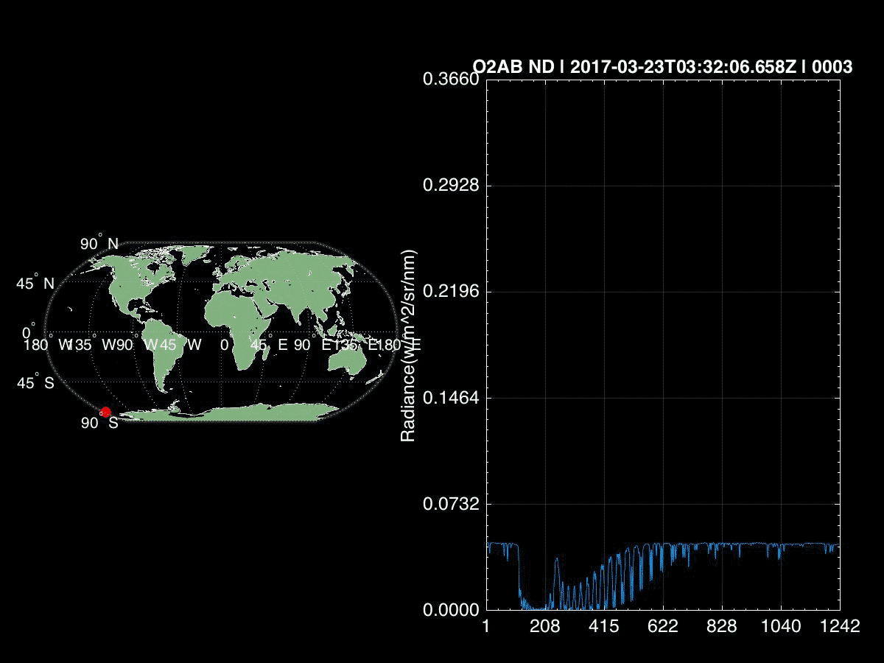
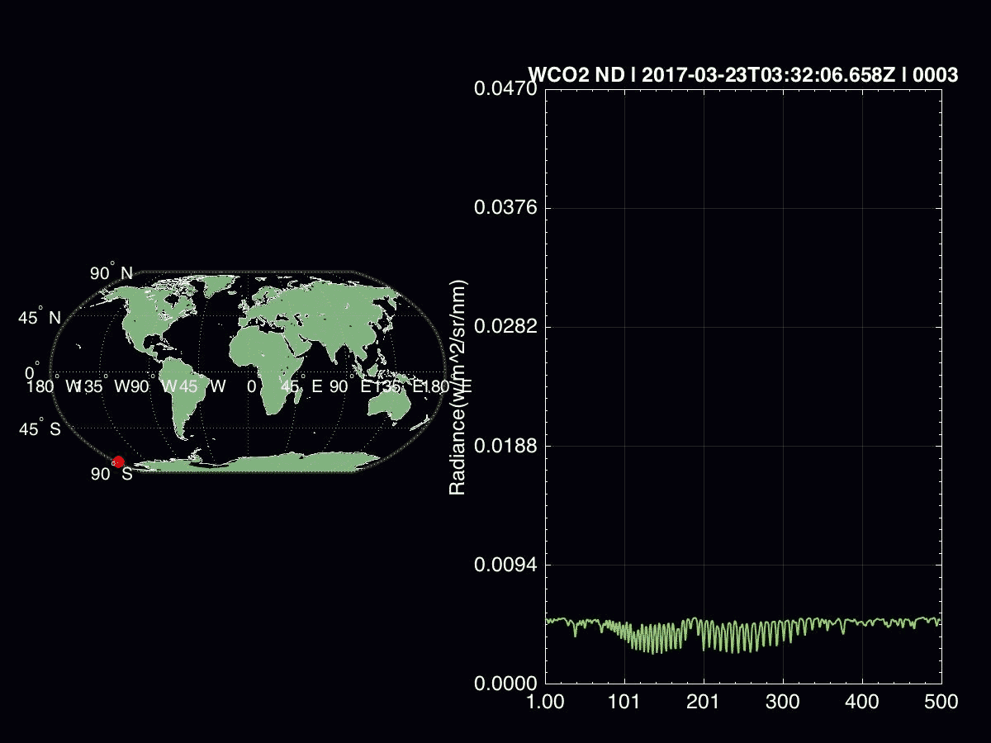

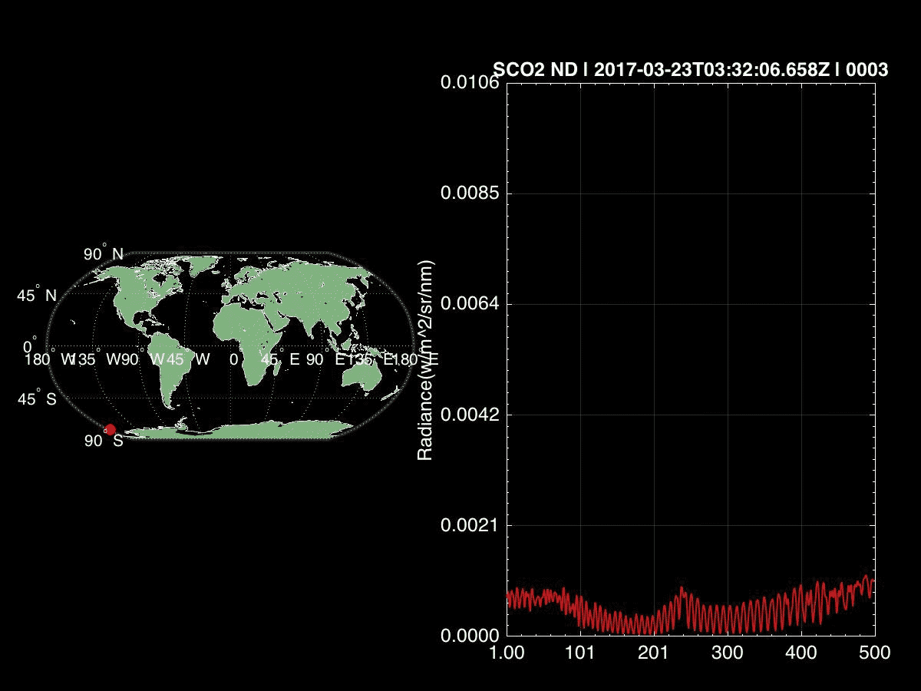
Current Status of TANSAT
TANSAT was successfully launched on Dec. 22,2016.
Commissioning test has been finished by June 30,2017, and the Satellite was handed over to NSMC/CMA for operation in Oct. 2017
Data are available for world-wide users .
Rural
Urban
Rural
XCO₂

Slide 14
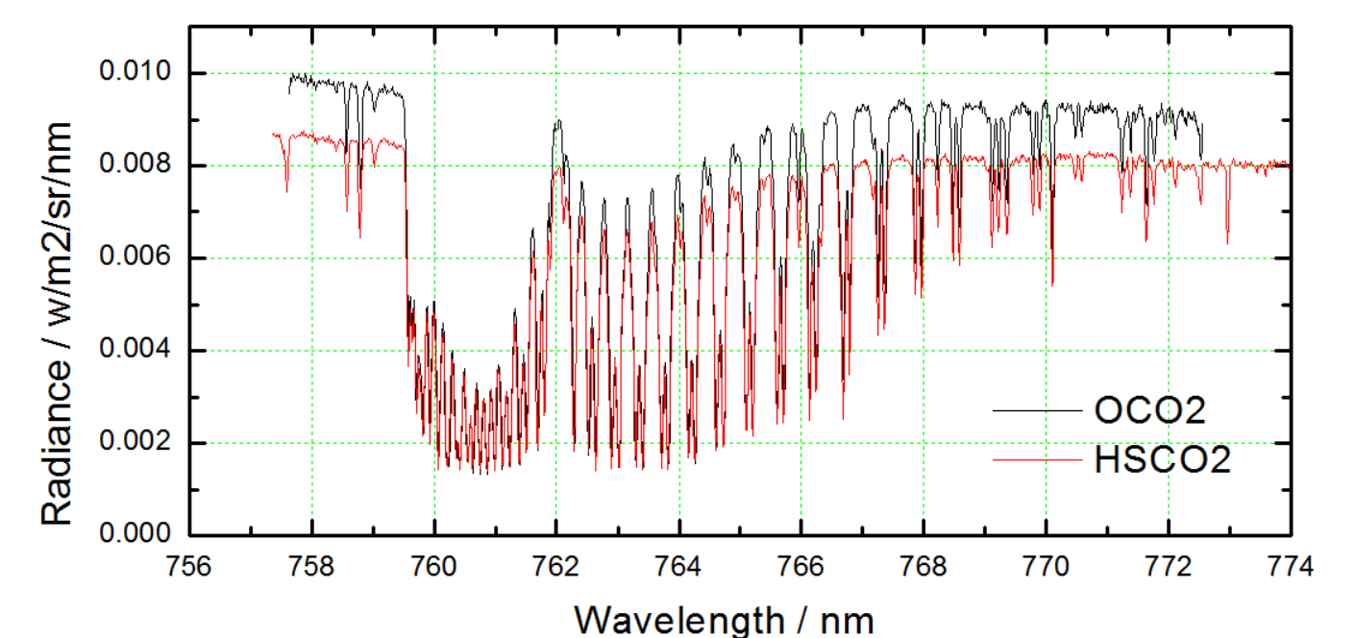
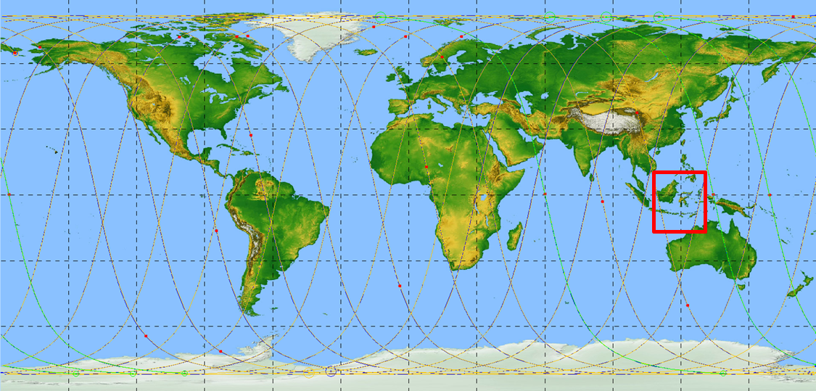
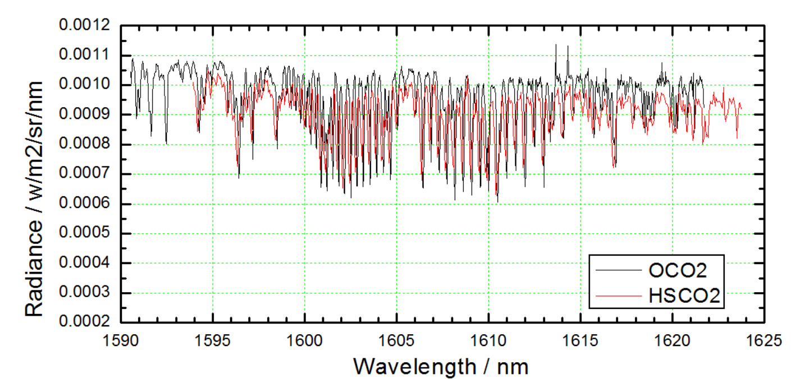
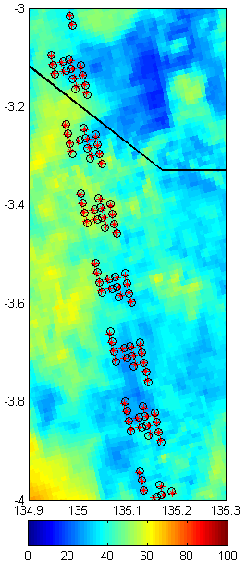
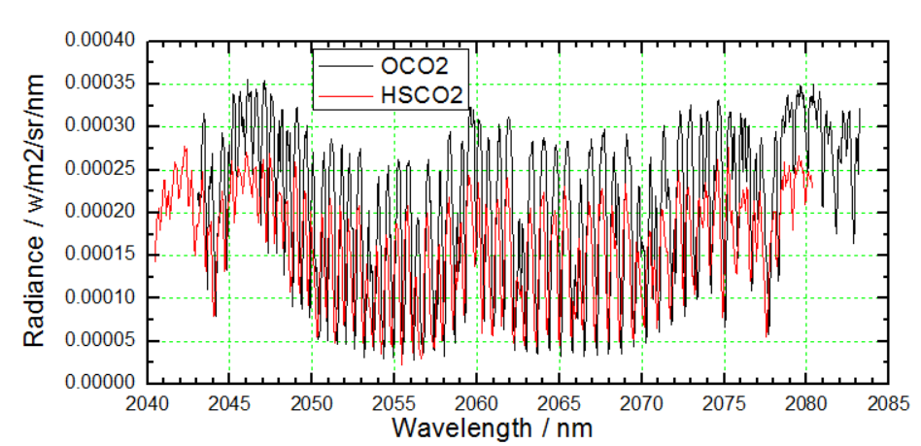
CO2 and O2 Absorption Spectra
Comparison with OCO-2

Slide 15
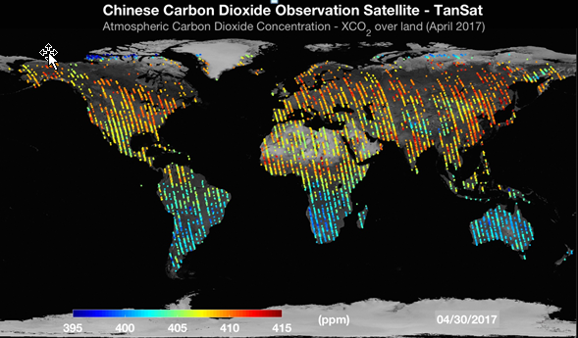

Slide 16

Email：huxq@cma.cn
Tel: 68407463
Cell phone: 17710267179
National Satellite Meteorological Center, CMA
Thanks！

