Slide 1


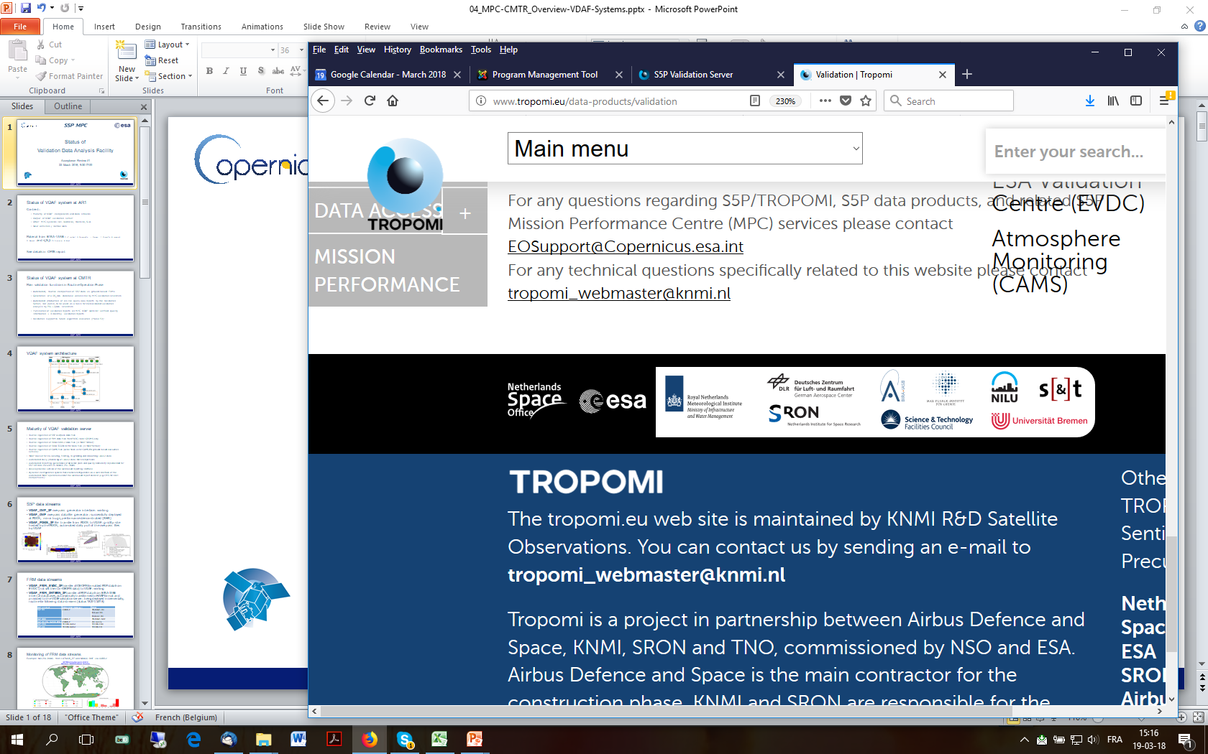

Sentinel-5p Mission Performance Centre
Operational Validation Facility
  J.-C. Lambert, B. Langerock, S. Compernolle, Y. Geunes, J. Granville, D. Hubert,
  A. Keppens, O. Rasson, and T. Verhoelst / BIRA-IASB, Brussels, BE
  S. Niemeijer and B. Rino / s[&]t, Delft, NL
  A. Dehn (ESA), K.-U. Eichmann (IUP-UB), G. Jaross (NASA/GSFC), M. Sneep (KNMI), T. Wagner (MPI-C), C. Zehner (ESA)
  + many others from BIRA-IASB, DLR, ESA, IUP-UB, KNMI, MPI-C, NILU, RAL, SRON

Slide 2
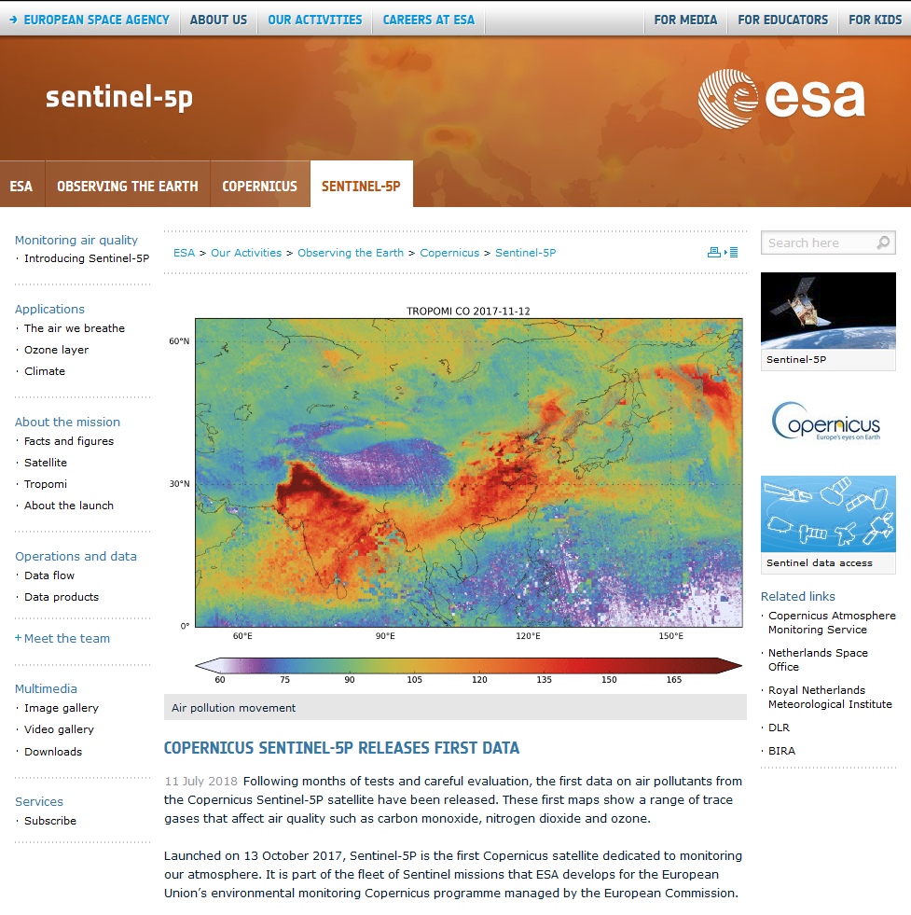
S5P operational data production since July 13
This talk:
1. S5P TROPOMI Validation Plan
2. Automated Validation Facility
- Architecture
- Data streams
- Output
3. Initial validation results
4. Conclusion

Slide 3
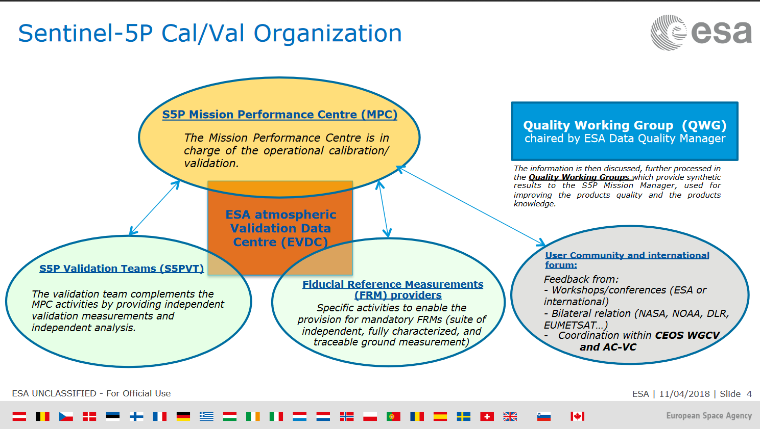

Slide 4
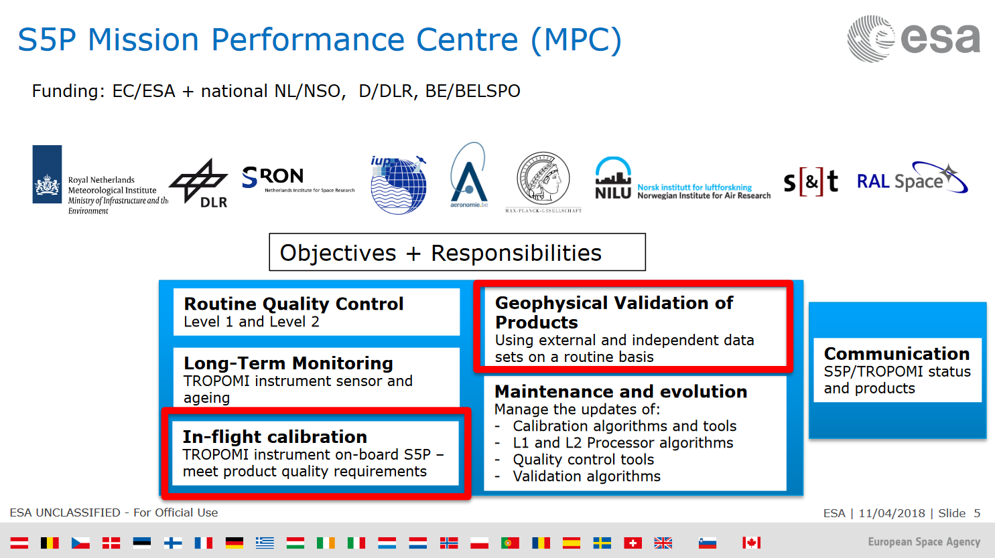

Slide 5


S5P Mission Performance Centre - Validation
S5P Mission Performance Centre (MPC) to provide operational validation service during Copernicus S5P Routine Operation Phase
Machine based ⇨ VDAF
Automated, routine comparison of S5P data vs. FRMs
Generation of S5P validation database for MPC Teams
Automated generation of on-line quick-look reports
Validation-based monitoring of L2 products health
Generation of quarterly consolidated validation reports
Generation of quality info articles on validation website
Validation support to Level-1-to-2 algorithm QA & evolution
Human based
⇨ MPC VAL Team

Slide 6
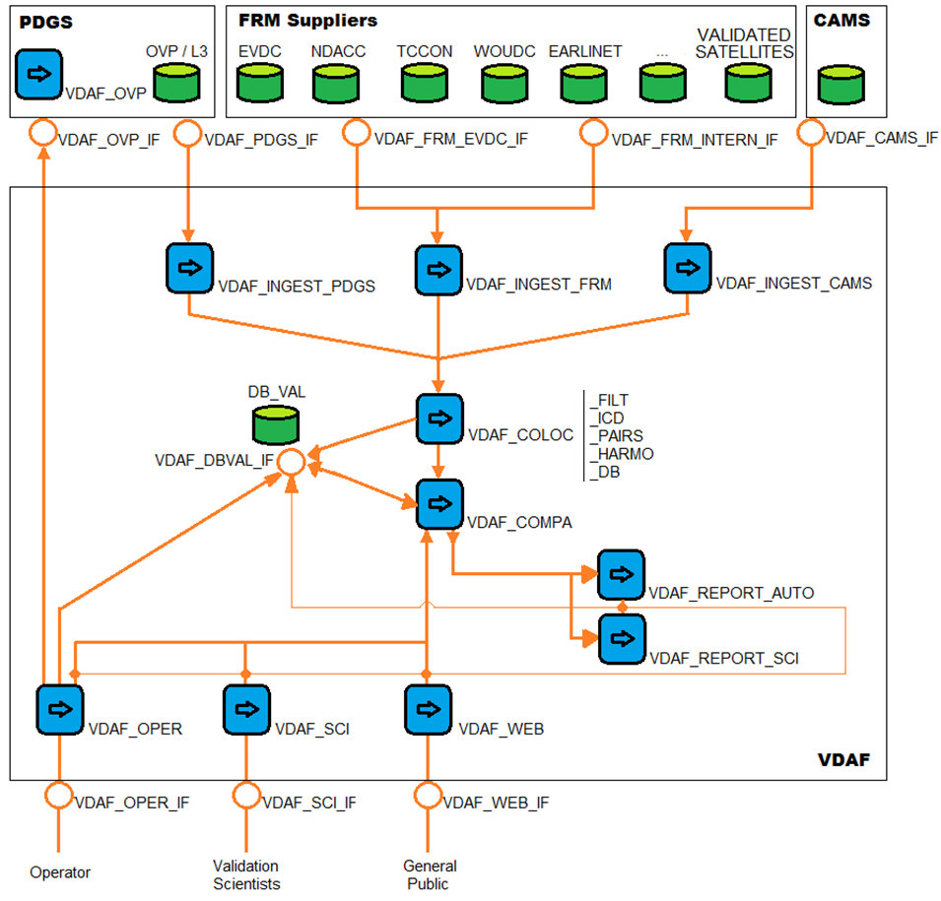
S5P MPC Validation Data Analysis Facility (VDAF)
System
Architecture
FRMs + Other Validation Data

Slide 7
S5P VDAF
S5P TROPOMI and
Validation Data
Streams
FRMs + Other Validation Data

Slide 8
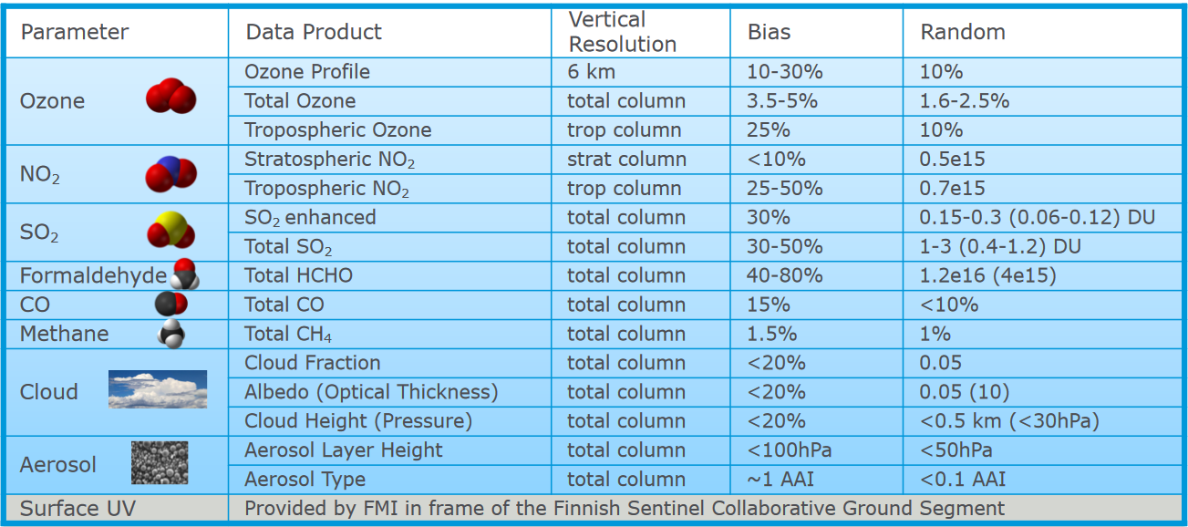
S5P L2 Product Requirements
Sentinel-5 Precursor Cal/Val Plan for Operational Phase - ESA-EOPG-CSCOP-PL-0073 (11/2017)

Slide 9










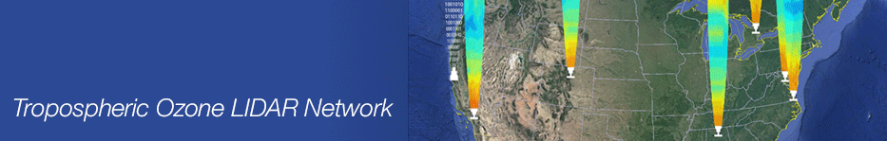









Validation Data Streams into S5P VDAF
ESA FRM programme + WMO GAW contributing networks
ID | S5P Data Product | Validation Measurements
A | O₃ total column | Brewer, Dobson, ZSL-DOAS, MAX-DOAS, Pandonia
B | O₃ profile (incl. troposphere) | ozonesonde, stratospheric DIAL, tropospheric DIAL
C | O₃ tropospheric column | ozonesonde
D | NO₂ stratospheric column | ZSL-DOAS
 | NO₂ tropospheric column | MAX-DOAS
 | NO₂ total column | Pandonia (PGN)
E | SO₂ total column | Pandonia (PGN)
F | HCHO total column | MAX-DOAS, Pandonia
G | CO total column | TCCON FTIR (NIR), NDACC FTIR (MIR)
H | CH₄ total column | TCCON FTIR (NIR), NDACC FTIR (MIR)
I | Cloud Fraction | not available
 | Cloud Height (pressure) | Cloudnet lidar/radar
 | Cloud Optical Thickness | not available
J | Aerosol Absorbing Index | not available
 | Aerosol Layer Height | EARLINET aerosol lidar
Tropospheric Ozone LIDAR Network

Slide 10
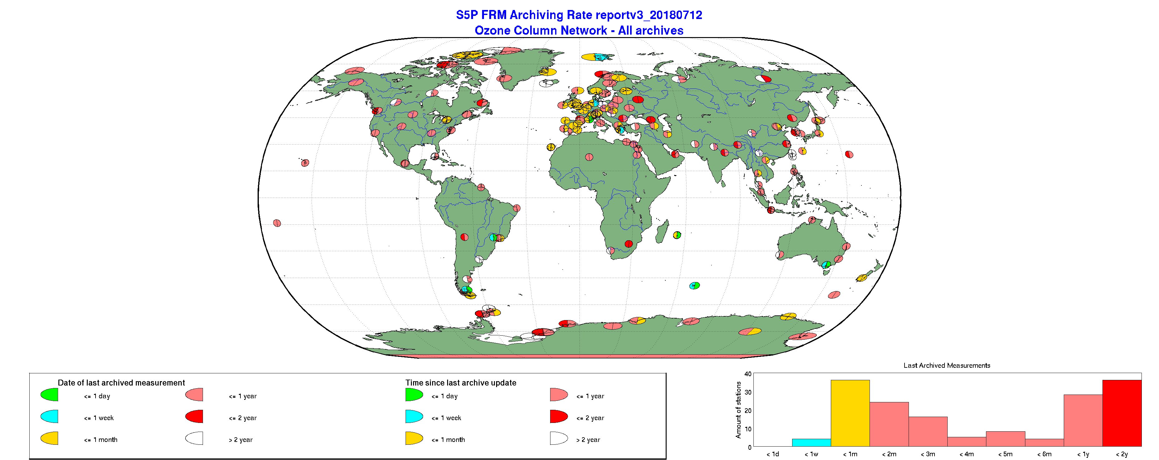

Status of Validation Data Streams into VDAF
O3 column data from NDACC and WMO GAW (WOUDC)

Slide 11
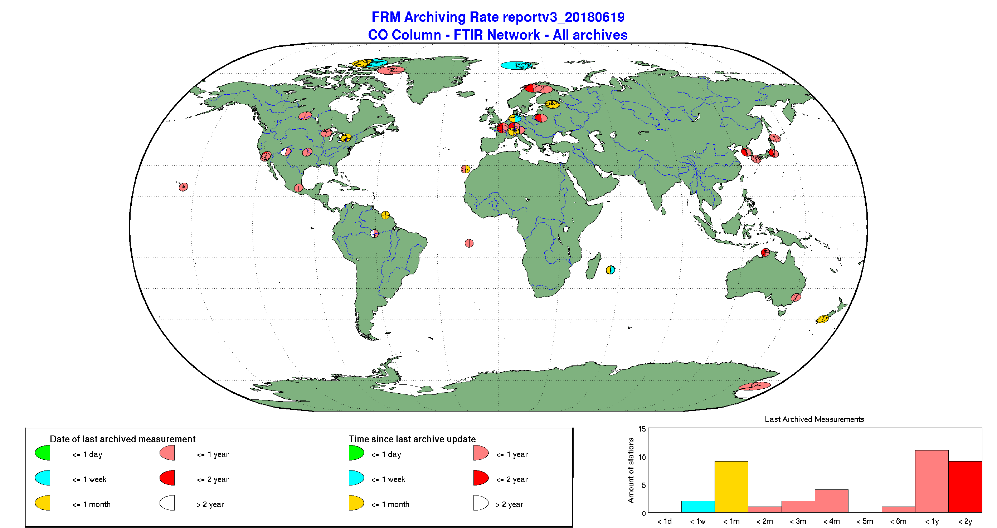

Status of Validation Data Streams into VDAF
CO column (FTIR) from NDACC and TCCON
NDACC and TCCON
standard archiving rate < 1-2 years
Faster delivery organised through CAMS-27/84
Waiting for future ESA FRM4GHG data streams

Slide 12
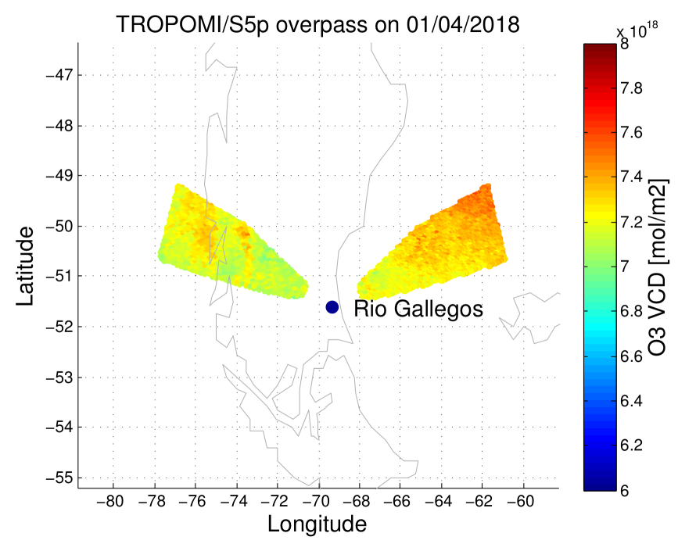
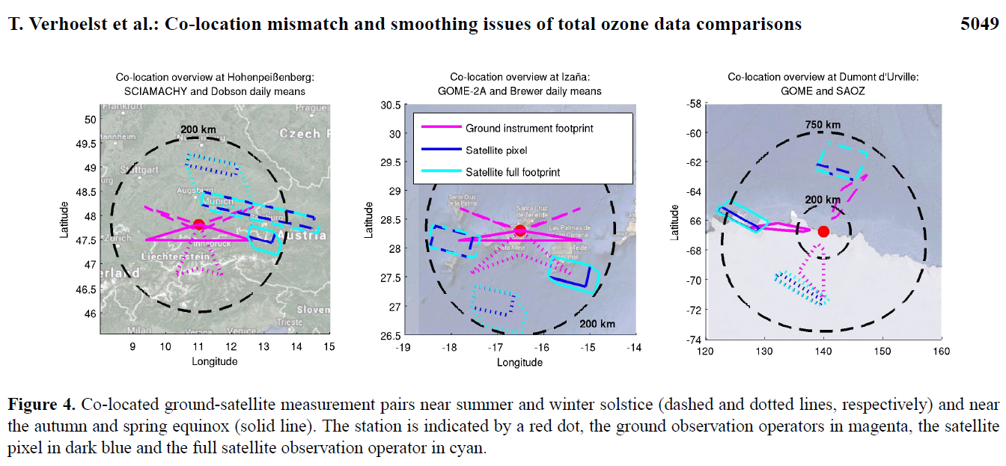
S5P Data Streams into MPC VDAF
Overpass data extractor in S5P PDGS
Generic approach, specific parameters
Optimization of data volumes !
AMT 2015

Slide 13
S5P MPC Validation Data Analysis Facility (VDAF)
Core System
FRMs + Other Validation Data

Slide 14
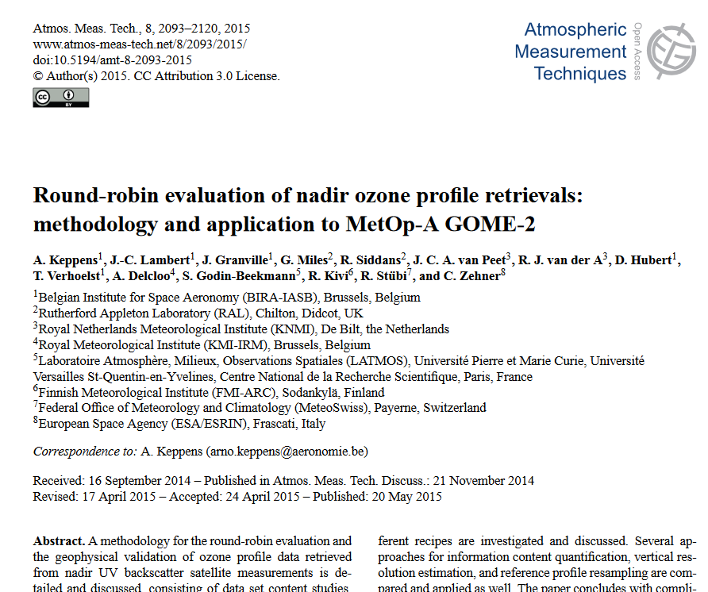
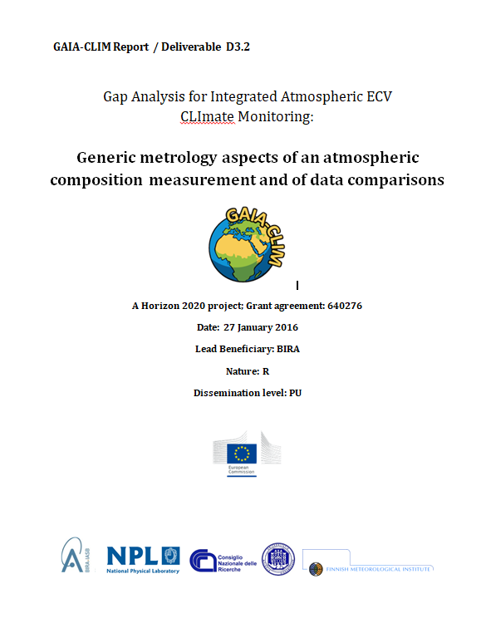

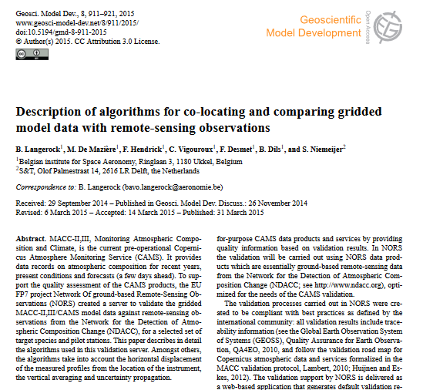
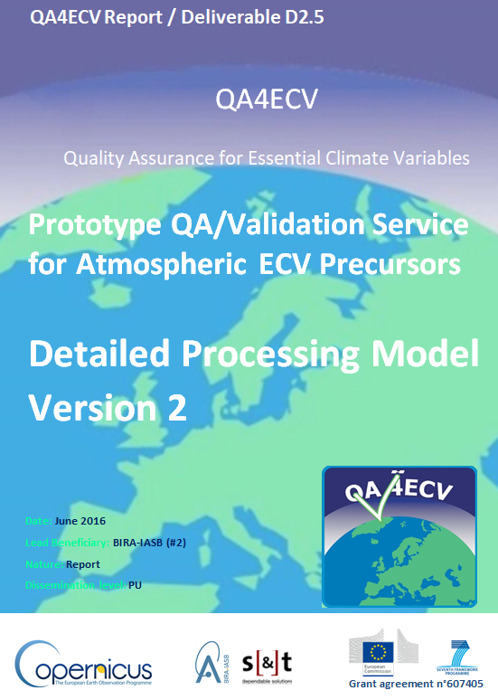


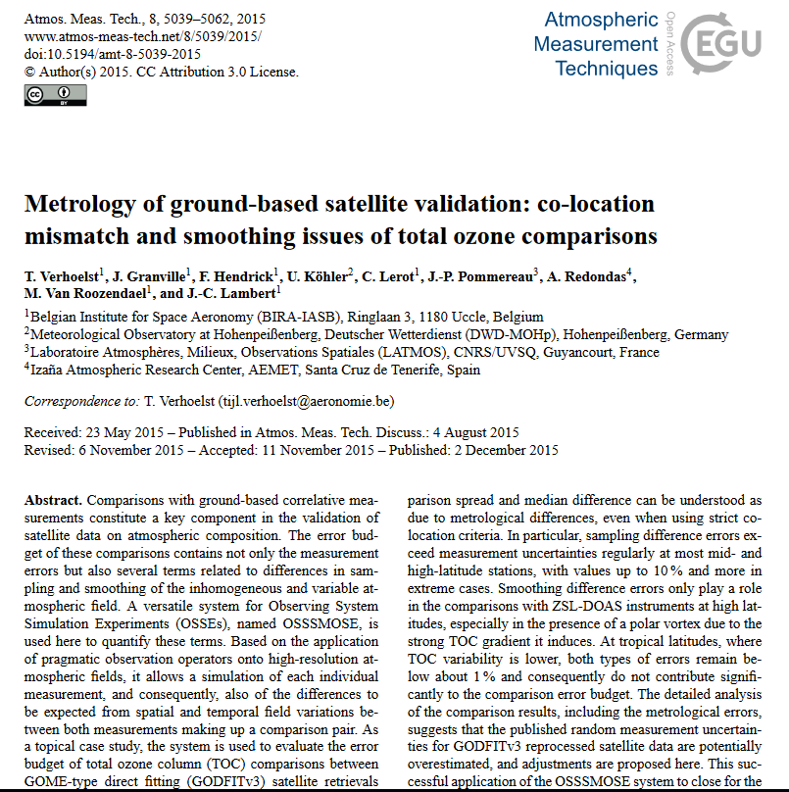






State-of-the-Art Validation Chain, Co-locators, Comparators…
Cross GEOSS
EO Cal/Val
Prototyping ESA Multi-TASTE and CCI_Ozone
Community feedback / endorsement
Implemention in FP7 QA4ECV-AVS, H2020 GAIA-CLIM, C3S_312a#ozone,
S5P MPC/VDAF, CAMS-84/27, CCI+
WGCV-28/…/31
cci
ozone
ACC-8/…/11

Slide 15

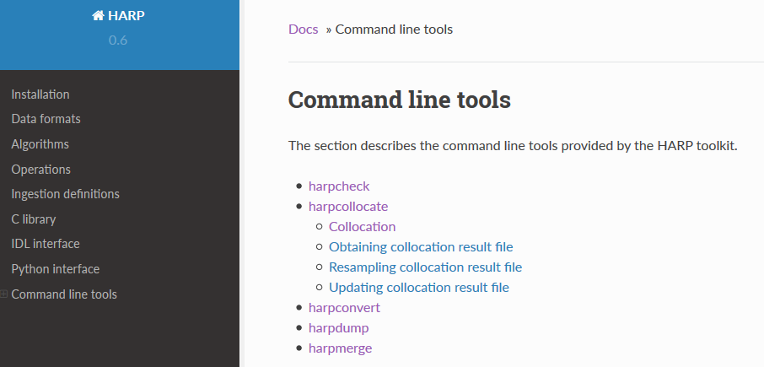
Data Handling, Co-location and Comparison Toolset
HARP
harp documentation
https://cdn.rawgit.com/stcorp/harp/master/doc/html/index.html

Slide 16
S5P VDAF
MPC dedicated Automated Validation
Server and
Public
Validation Website
FRMs + Other Validation Data
Synergies with similar developments for
AC-SAF, QA4ECV and CAMS-84/27

Slide 17
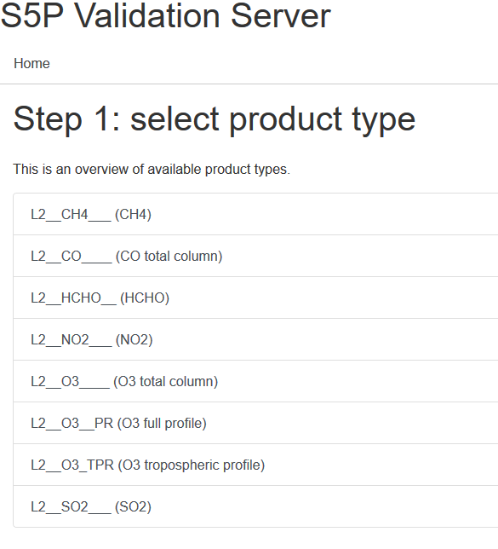
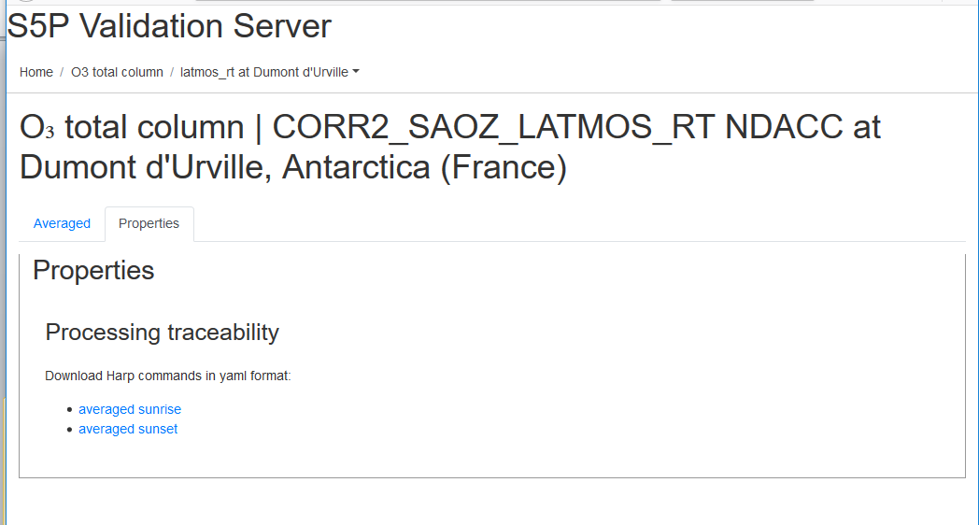
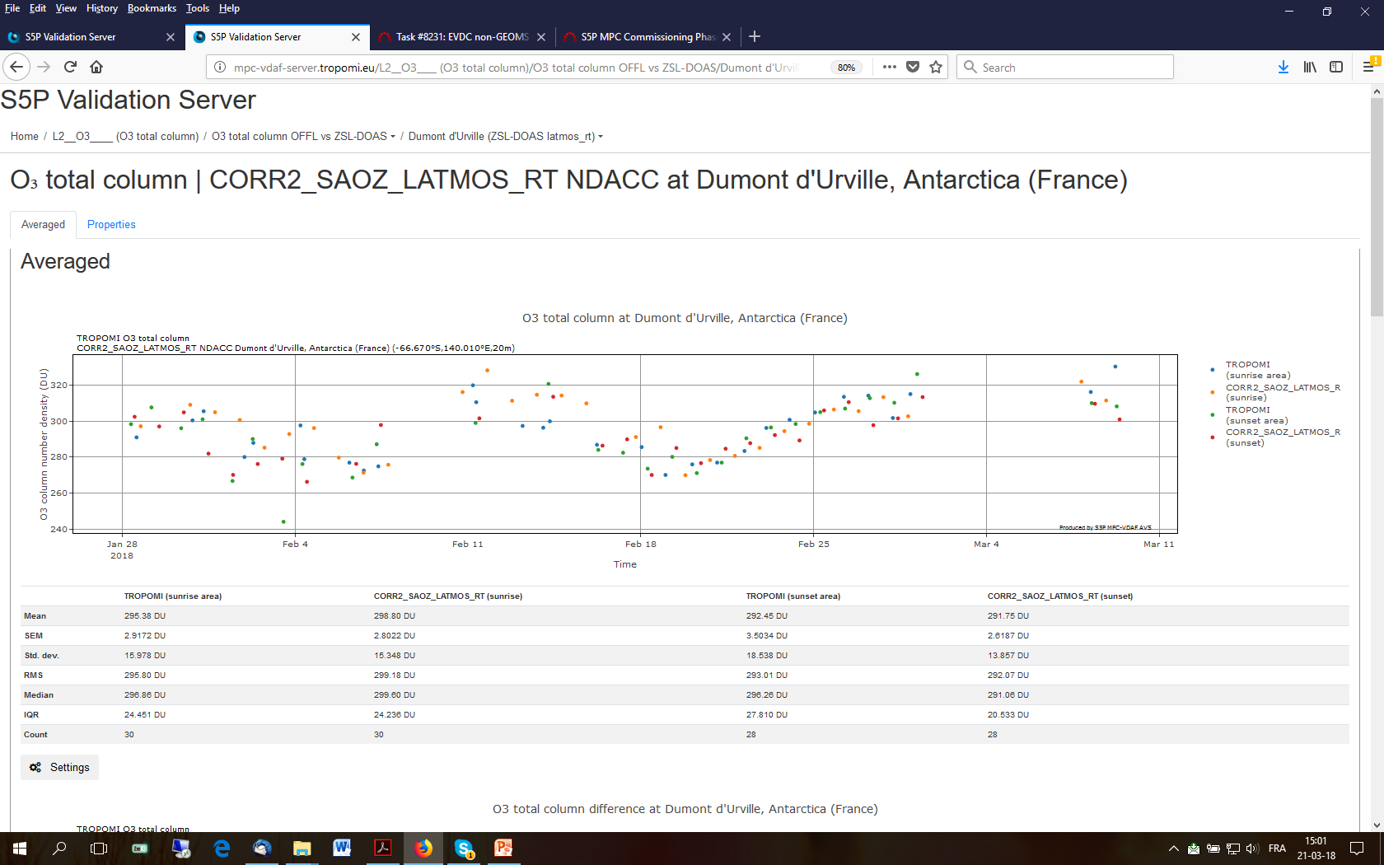
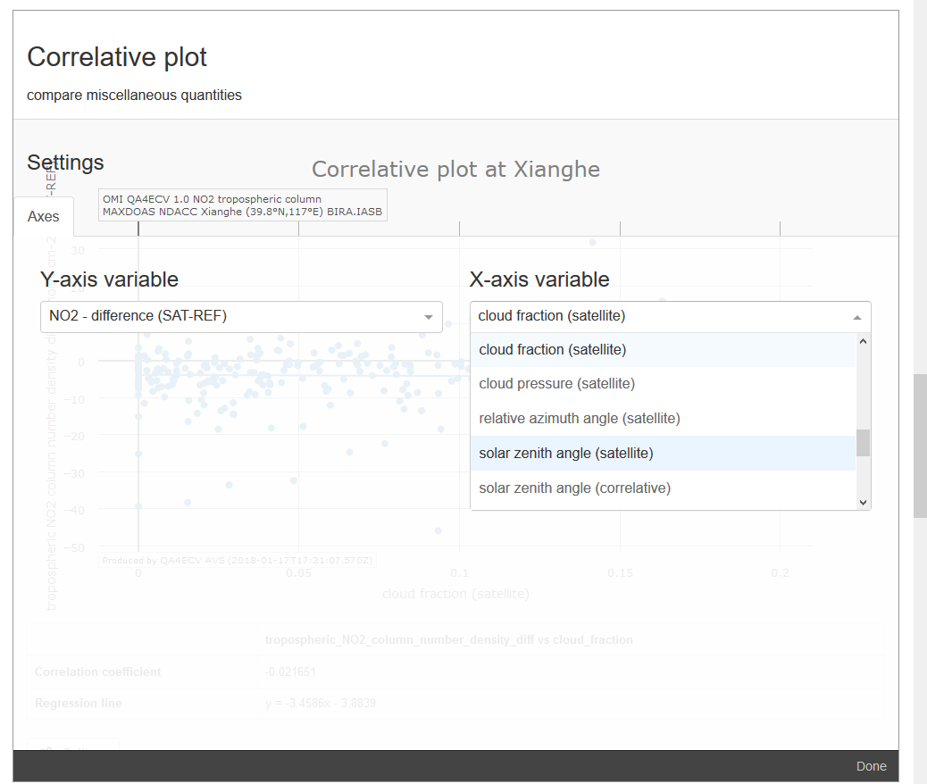
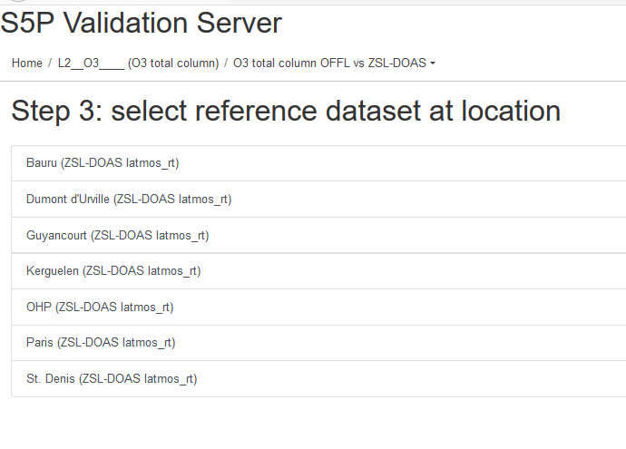
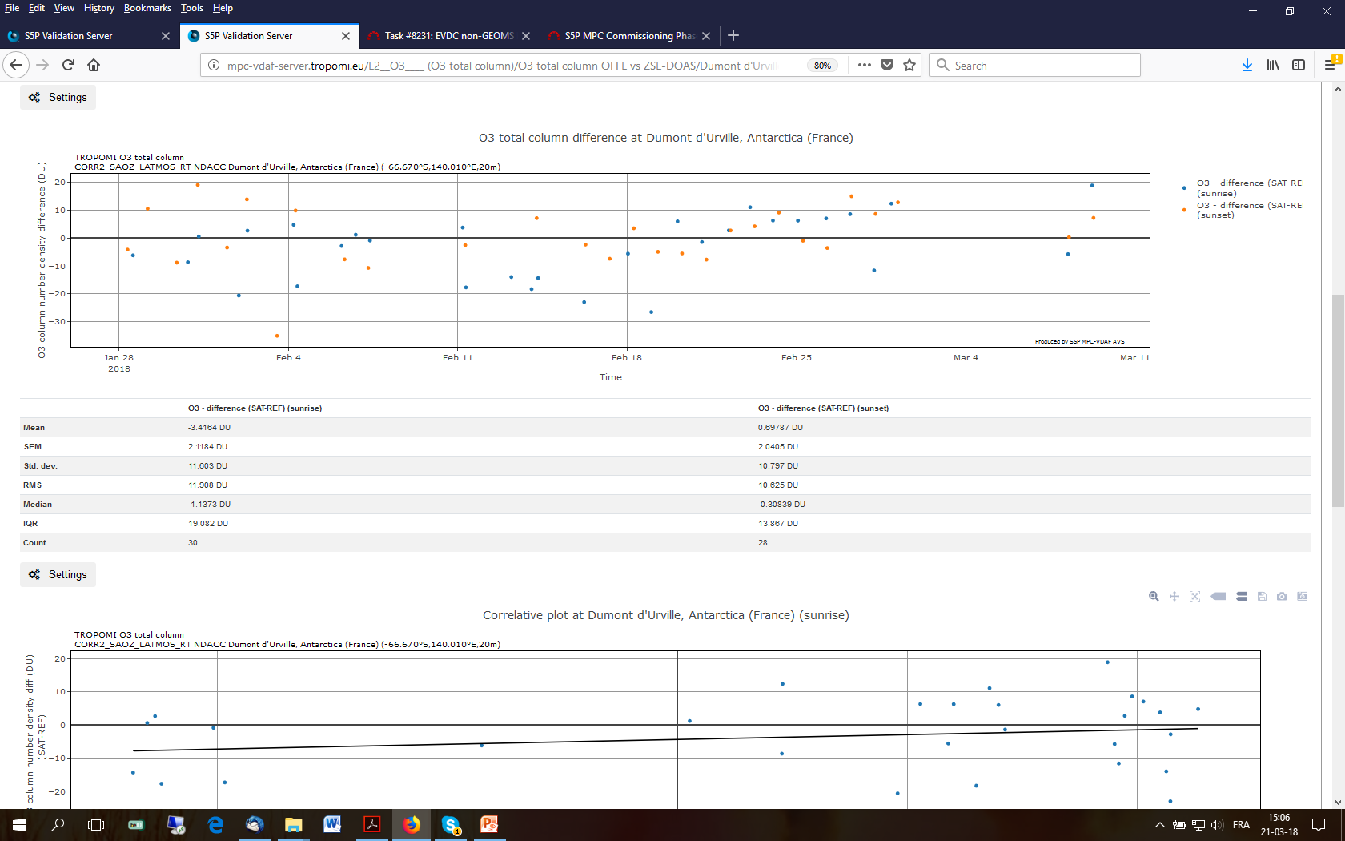
S5P VDAF Automated Validation Server

Slide 18
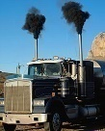
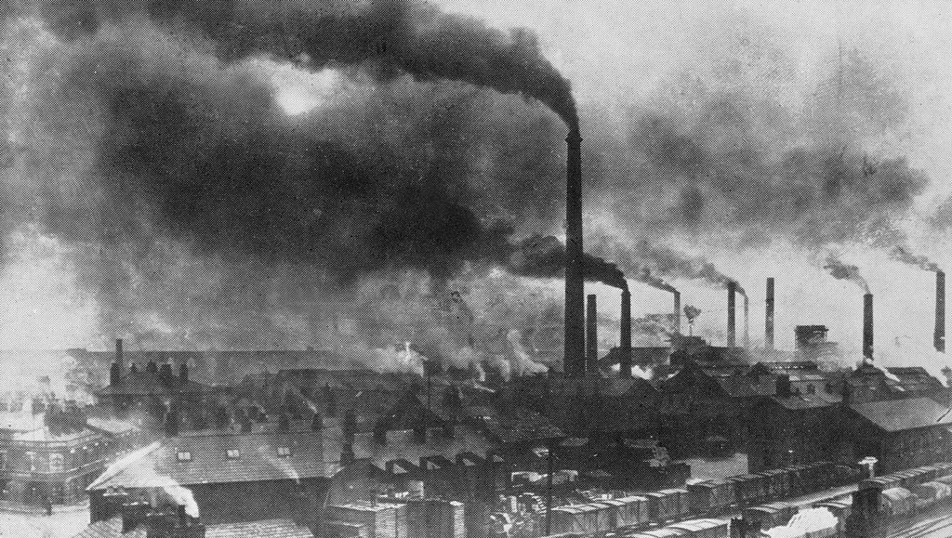


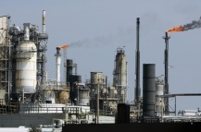
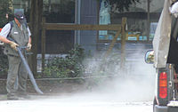
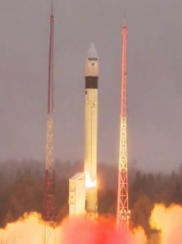

S5P MPC L2 Validation Planning
WGCV-44
COPERNICUS, PUBLIC SERVICES, POLICY MAKING
13 OCT 2017
JUL 2018
SEP 2018
OCT 2018
DEC 2018
COMMISSIONING PHASE RAMP-UP
AIR QUALITY, CLIMATE, OZONE, UV RESEARCH
…
Launch
Prototype
Validation
Prototype
Validation
Prototype
Validation
Prototype
Provisional planning for S5P L2 products public release
O3 NO2 CO AAI CLOUD
HCHO SO2 O3-TRC
CO CH4
ALH UV
O3P
Lot #1
Lot #2
Lot #3
Lot #4
Lot #5

Slide 19
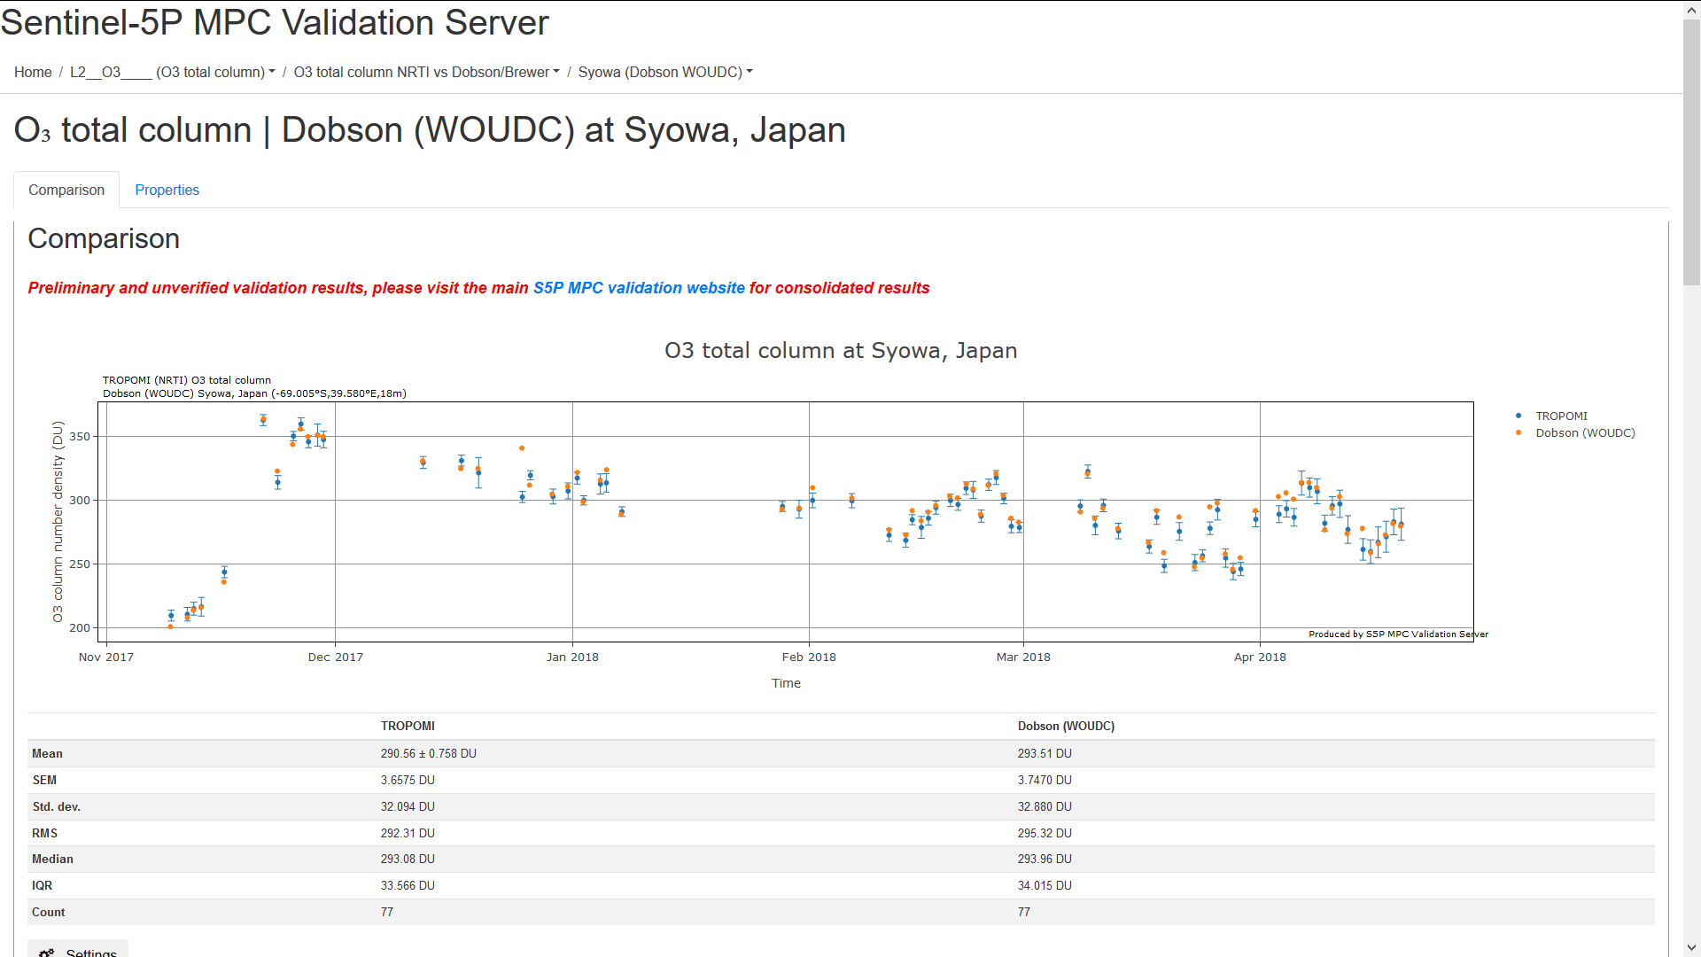

First release of S5P Ozone column data
Initial validation w.r.t. NDACC DOAS/SAOZ, MAX-DOAS and Pandora qa_value > 0.75 (without clouds) / qa_value > 0.5 (including clouds and snow/ice)

Slide 20
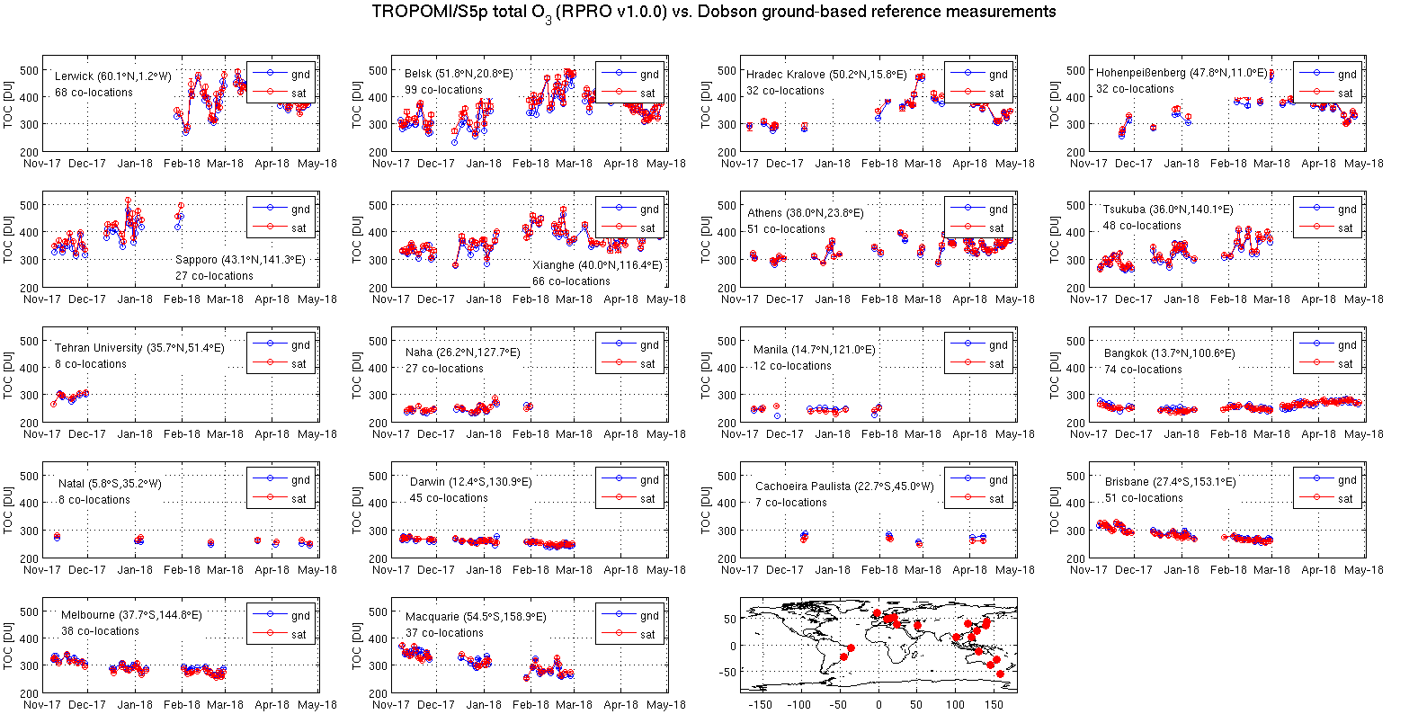
Courtesy T. Verhoelst, BIRA-IASB

Slide 21
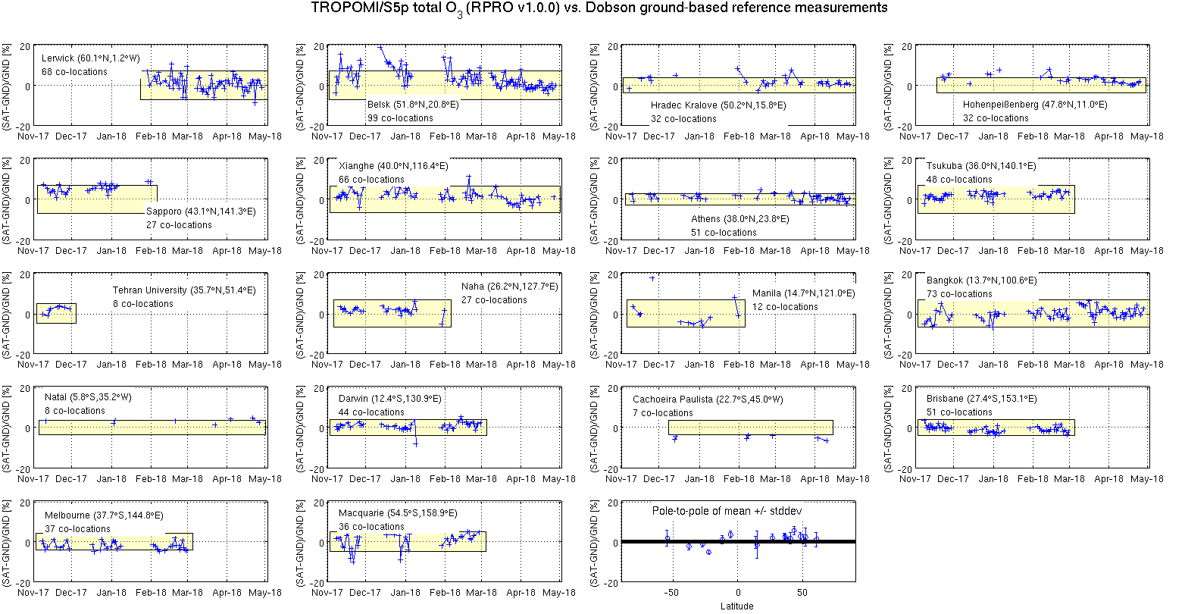
2-sigma combined ex-ante uncertainty
Courtesy T. Verhoelst, BIRA-IASB

Slide 22
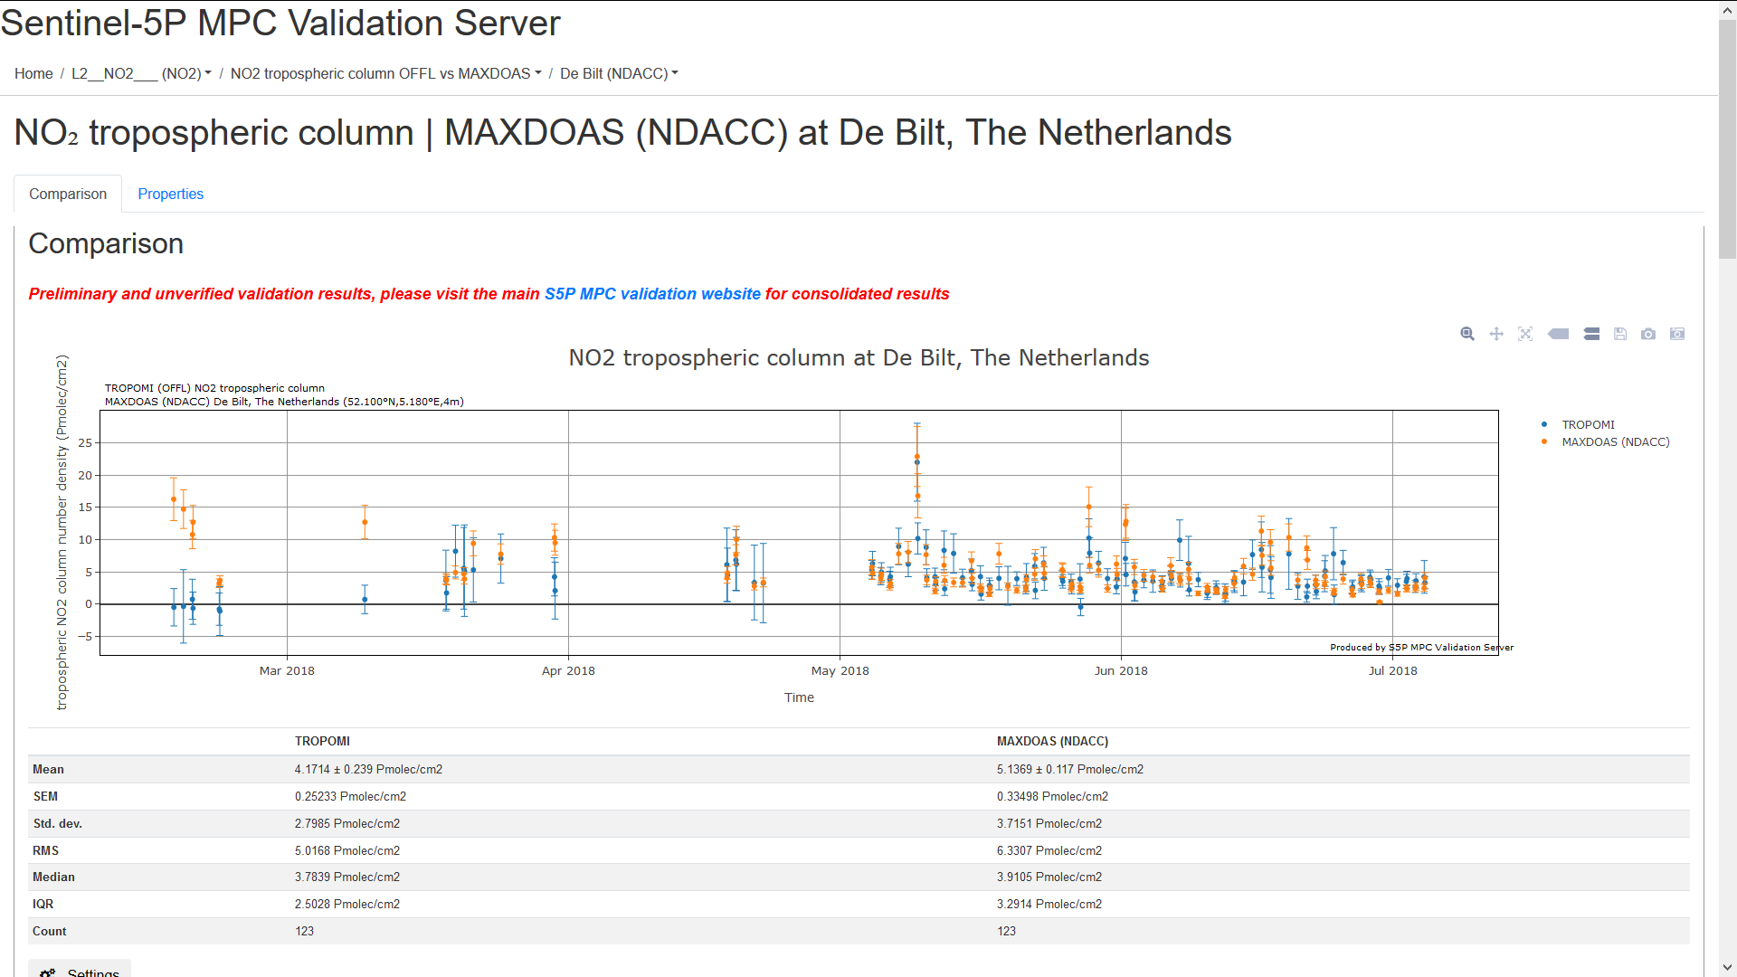

First release of S5P NO2 column data
Initial validation w.r.t. NDACC DOAS/SAOZ, MAX-DOAS and Pandora qa_value > 0.75 (without clouds) / qa_value > 0.5 (including clouds and snow/ice)

Slide 23
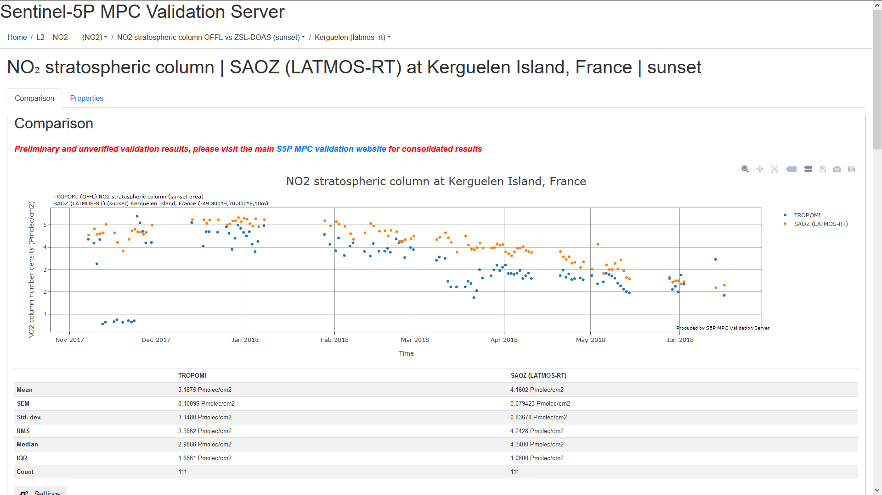
First release of S5P NO2 column data
Initial validation w.r.t. NDACC DOAS/SAOZ, MAX-DOAS and Pandora qa_value > 0.75 (without clouds) / qa_value > 0.5 (including clouds and snow/ice)

Slide 24

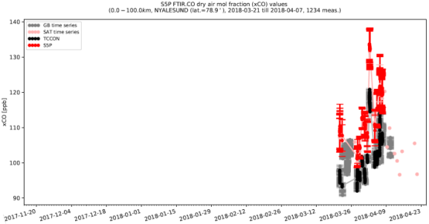
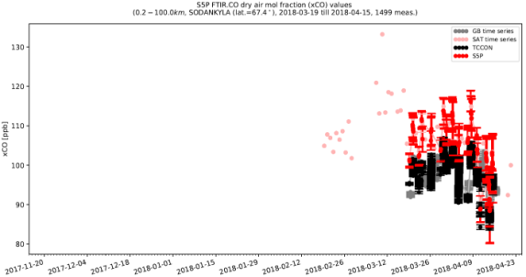
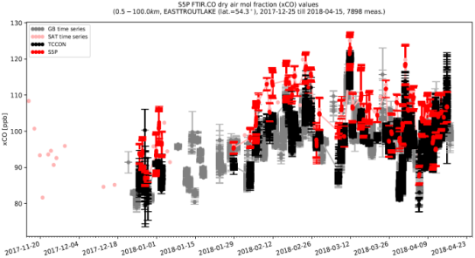
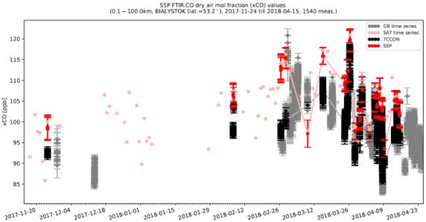
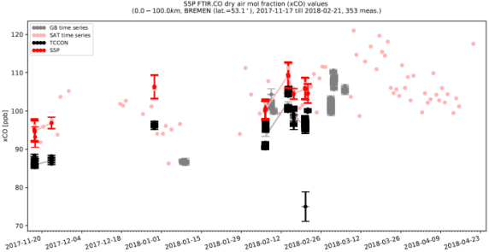
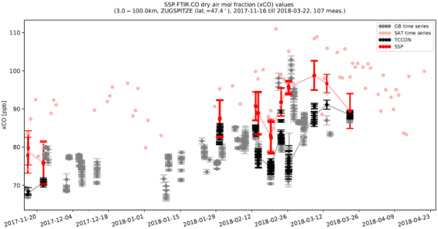
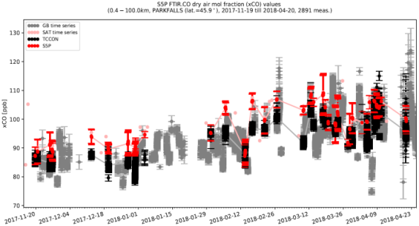
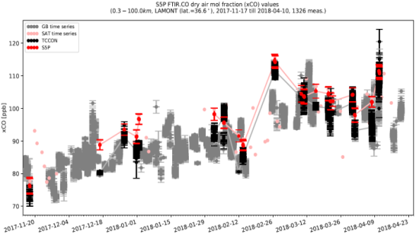
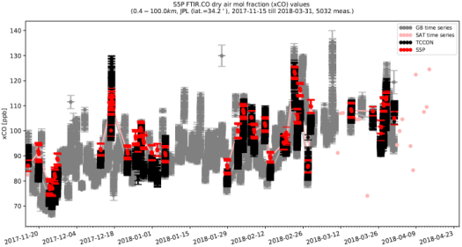
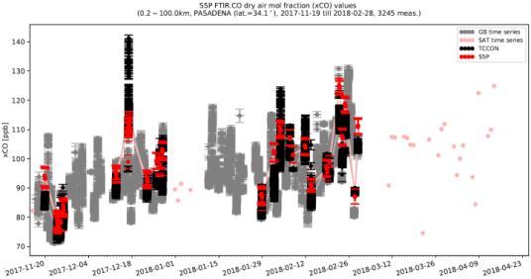
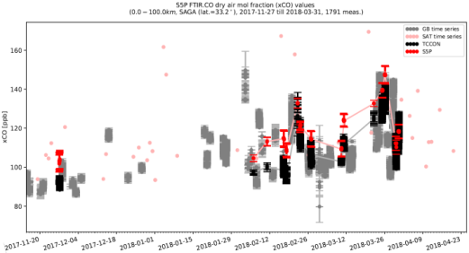
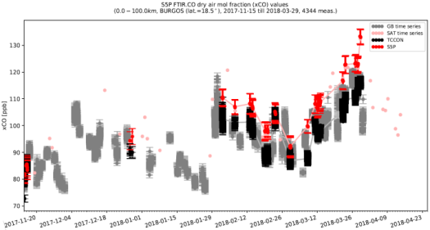
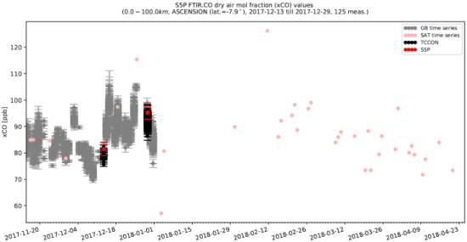
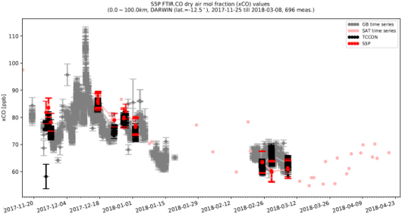
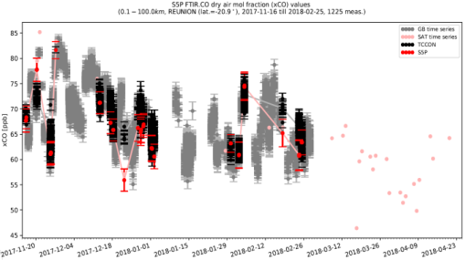
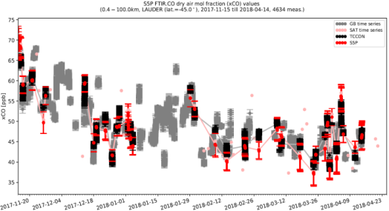
First release of S5P CO column data w.r.t. TCCON qa_value > 0.5 / cloud OD < 0.5 / cloud height < 5000 m
NYALESUND
SODANKYLA
EASTTROUTLAKE
BIALYSTOCK
BREMEN
ZUGSPITZE
PARKFALLS
LAMONT
JPL
PASADENA
SAGA
BURGOS
ASCENSION
DARWIN
REUNION
LAUDER
Courtesy M. Kumar Sha, BIRA-IASB, AO Project TCCON4S5P

Slide 25
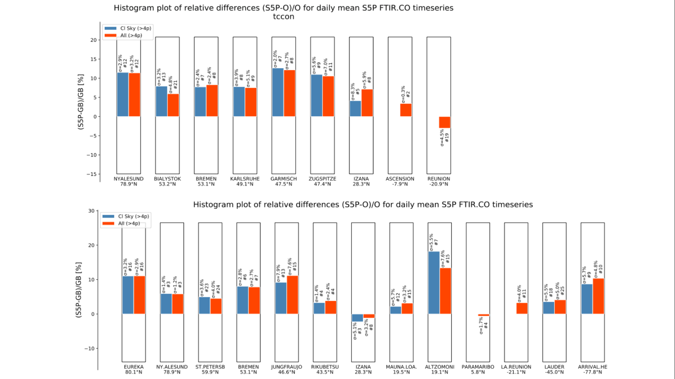

First release of S5P Carbon Monoxide column data
Initial validation w.r.t. TCCON and NDACC
Courtesy M. Kumar Sha, BIRA-IASB, AO Project TCCON4S5P

Slide 26

First release of S5P Carbon Monoxide column data
Stripes in L2_CO
From S5P CO Product Readme File, July 2018

Slide 27

S5P MPC Validation Website

Slide 28



Where to find S5P Product Details and Quality Information
Product Readme File
PRF
All available on http://sentinels.copernicus.eu and http://www.tropomi.eu
Product User Manual Algorithm Theroretical Basis
PUM ATBD

Slide 29


Conclusion (1/2)
S5P MPC operates an Automated Validation Server built upon heritage validation systems (long-term support from BELSPO, EC, ESA, EUMETSAT, ECMWF)
VDAF-AVS = core of S5P MPC routine validation service
    implemented in MPC environment, dependent on external data streams
    initially Envisat products, now expanding to all S5P products (UV to SWIR)
    tailored to S5P and Copernicus needs
    developed in synergy with other Copernicus elements
Started on July 13, 2018, routine validation service with first release of S5P data, incl. continuous survey of L2 health and quarterly consolidated validation reporting

Slide 30
Conclusion (2/2)
Approach combining MPC VAL and S5PVT AO activities successful
Valuable synergies between Copernicus space, CAMS/C3S data procurement and CAMS/C3S service components
Underlying systems (e.g. Multi-TASTE) are mature, however, ad hoc support required for:
  operationalization of scientific validation systems
  service set-up
  tools and methods for new validation paradigms and challenges
  harmonization of uncertainties, closure of comparison error budget…
  FRM/validation data availability (and timeliness)
Automated or not, EO (L1/L2/L3/L4) data validation always requires substantial interpretation by (human) scientific experts.

Slide 31
Thank you !

