Slide 1
USGS Agency Update
CEOS WGCV 44, EUMETSAT, Darmstadt, Germany
Date: August 30, 2018
Presented by: Greg Stensaas, USGS Earth Resources Observation and Science (EROS) Center
stensaas@usgs.gov, Phone #: +1 (605) 594-2569

Slide 2
Outline
Landsat Operations and Development
USGS Data Archive
ARD/Interoperability
ECCOE
  Landsat Cal/Val
  Landsat-9 development and Landsat 9 Follow-on
  Joint Agency Commercial Imagery Evaluation (JACIE) / System Characterization
  Product validation and LPCS
Moderate-Resolution Land Imagery Requirements

Slide 3
Landsat and Archive Operations
USGS is responsible for the archival, production and distribution of Landsat data (L1 – L5 MSS, L4 – L5 TM, L7 ETM+, and L8 OLI/TIRS)
Many other dataset available via long term archive
  ResourceSat-2 over US; Looking at enhancing w/ ResourceSat-2A
  Sentinel-2
  Some commercial satellite data and much aerial photography
NARA affiliate archive, Sunset clause for licensed data and important vendor collections

Slide 4
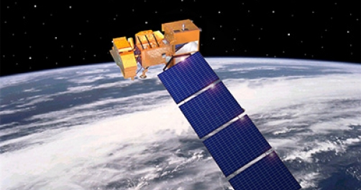
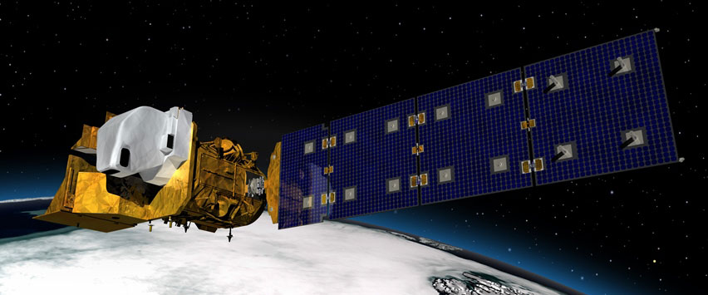
Landsat Mission Status
Landsat 7
  Landsat 7 has been on orbit 19+ years
  Acquiring at a rate of ~470 scenes per day with continental acquisition strategy
    105% duty cycle operations for ETM+ performing smoothly
    Data acquisition in support of Northern Hemisphere growing season imaging
    Landsat 7 on-orbit performance continues to be outstanding
  End of Mission Plan (EOMP) – Parallel science operations with Landsat 9 launch & ascent
    Extended science mission life potential to as late as July 2021
  Relocated to Building 25 on Goddard Space Flight Center (GSFC) to accommodate multi-satellite Mission Operations Center (MOC) 4 May 2018
  Flight Operations Team (FOT) exceeded 6 years without operator error (and counting)
Landsat 8
  Acquiring at a rate of ~740 scenes per day with continental acquisition strategy
  On-orbit performance of Landsat 8 observatory continues to be solid
    Solar Array Drive Assembly (SADA) associated sensor variation investigation on-going
    No spacecraft or instrument anomalies since September 2015
  Comprehensive planning for eventual transition to Landsat Multi-Satellite Mission Operations Center (LMOC) underway
  Frequent night and off-nadir imaging of volcano activity (Kilauea and Guatemala) continue, along with fire season imaging of U.S. west coast
Notes:
Final

Slide 5
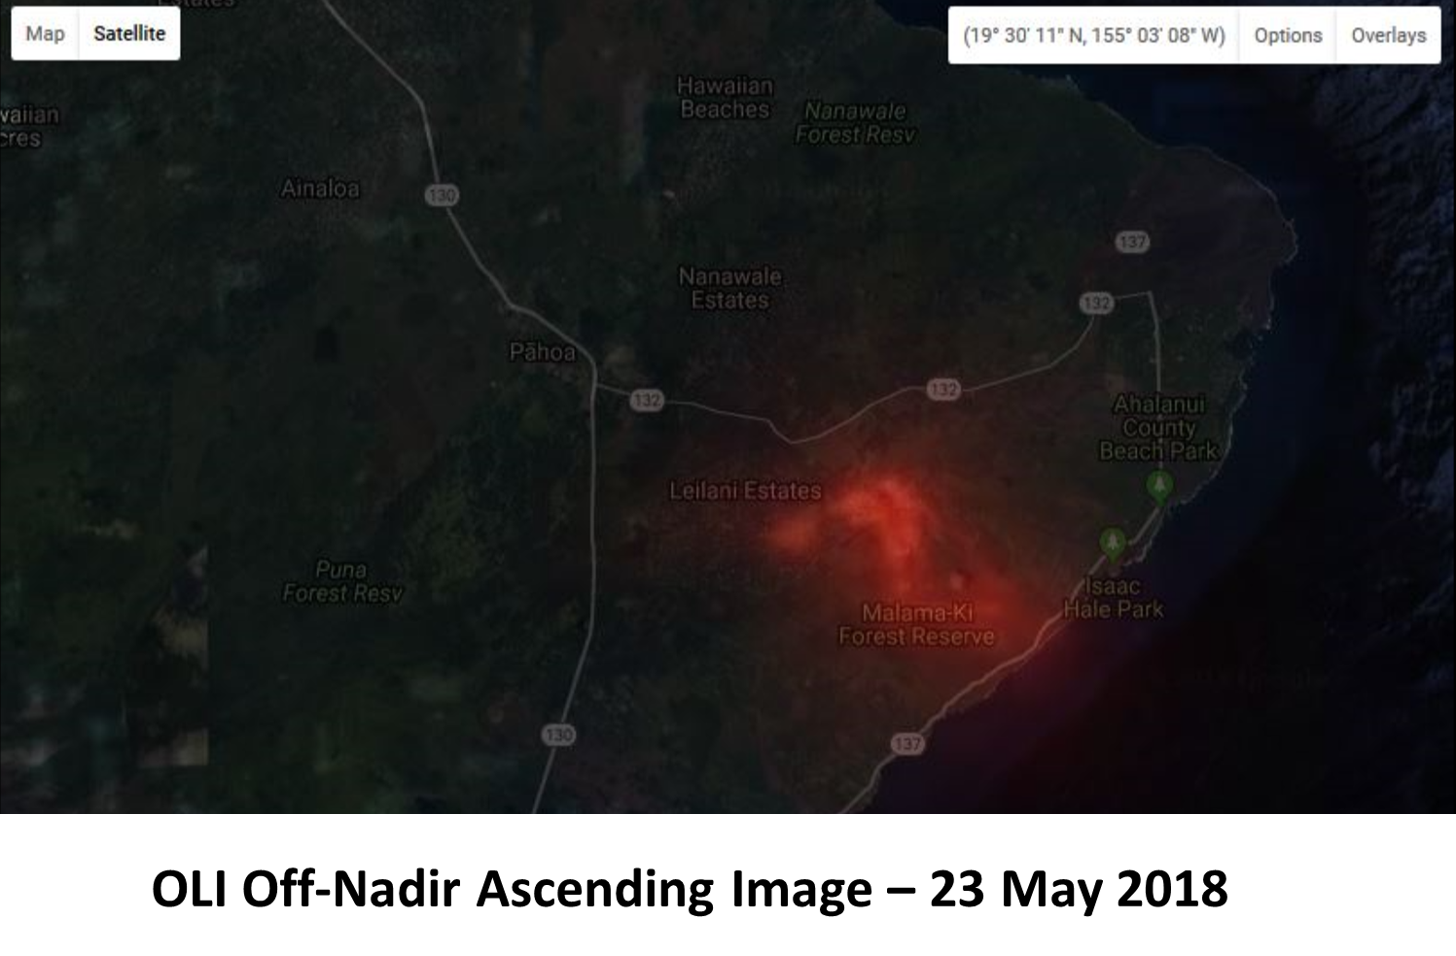
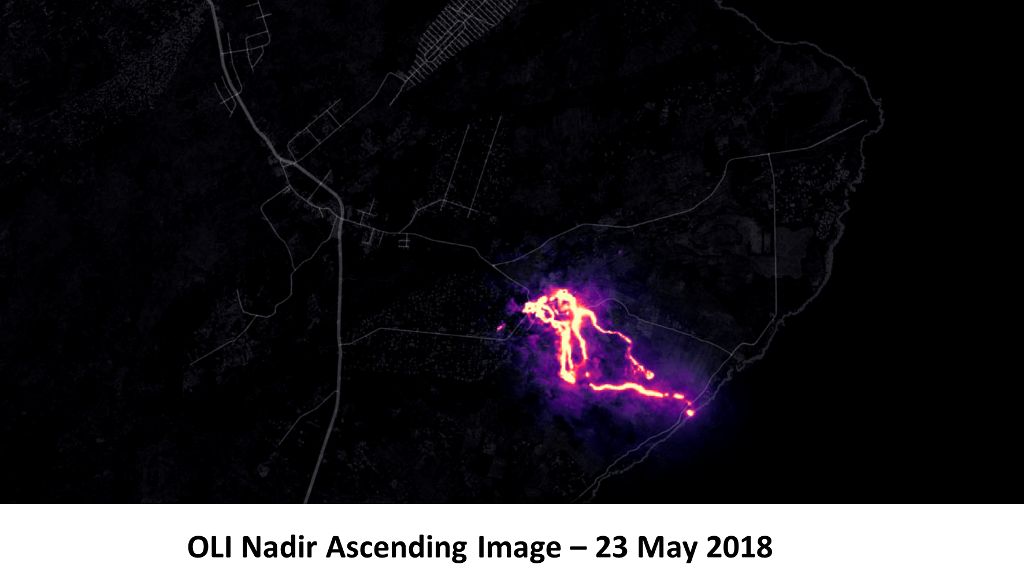
Landsat 8 Comparison Examples – Kilauea Hawaii

Slide 6
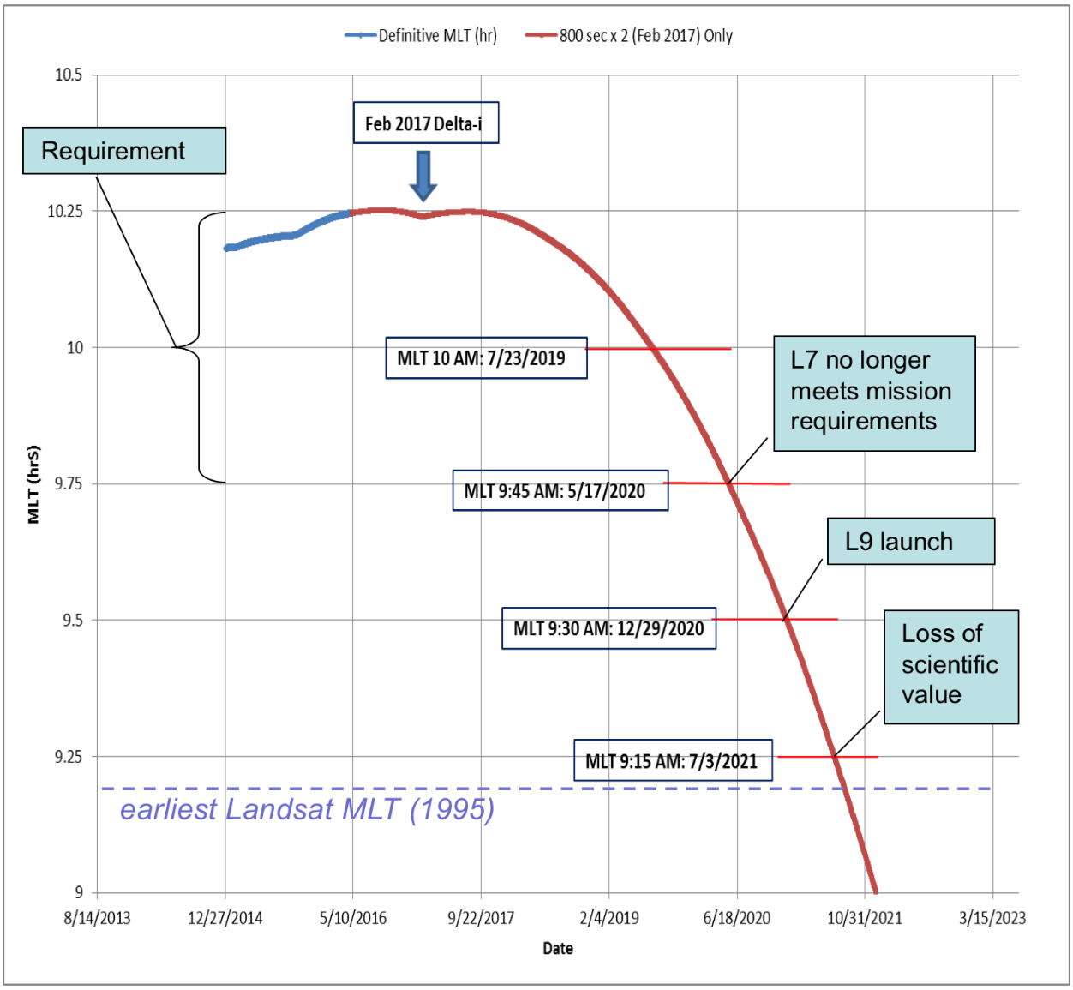
L-7 Mission Schedule Challenge
Important Landsat community to maintain two healthy Landsat satellites on-orbit for 8-day coverage
  Landsat 7 and 8 currently operating
Landsat 7 End of Mission planning – goal is to align with launch of Landsat 9
Landsat 7 science data degrades once outside mission equatorial crossing requirement of 10:00 AM +/- 15 min MLT in May 2020
  Science data retains value until 9:15 AM Mean Local Time
December 2020 Landsat 9 LRD with 3-month commissioning period completed in March 2021 supports 2021 northern hemisphere growing season with Landsat 9
Congressional direction to launch Landsat 9 in 2020
Landsat 9 KDP-C NASA Agency direction in December 2017 recognized this challenge and provided schedule and budget resources to achieve objective
  Management Agreement LRD: December 2020
Landsat 7 Equatorial Crossing Time
Impact on End of Mission
Planning

Slide 7
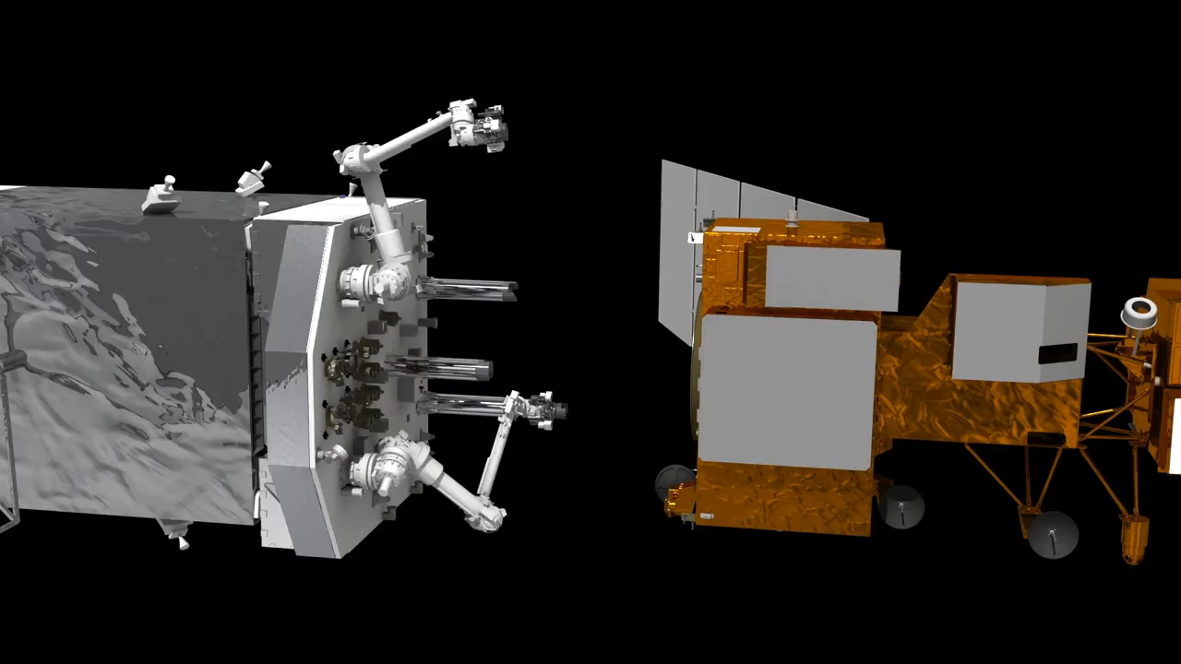
Landsat 7 and Restore-L
USGS continues support of NASA’s Restore-L technology demonstration
  Landsat 7 is principle client for NASA Restore-L
The Landsat 7 End-of-Mission Plan to dovetail into Restore-L mission timeline
Restore-L Mission Objectives
  Launch Restore-L Servicing Vehicle (RSV)
  RSV approach Landsat 7 and perform inspection using on-board cameras
  RSV capture and secure Landsat 7 to create combined “stack”
  Transfer between 10-110 kg of fuel from RSV to Landsat 7
  Relocate combined stack to new orbit
  Release Landsat 7 and retreat to safe orbit
Courtesy NASA GSFC - https://sspd.gsfc.nasa.gov/restore-l.html

Slide 8
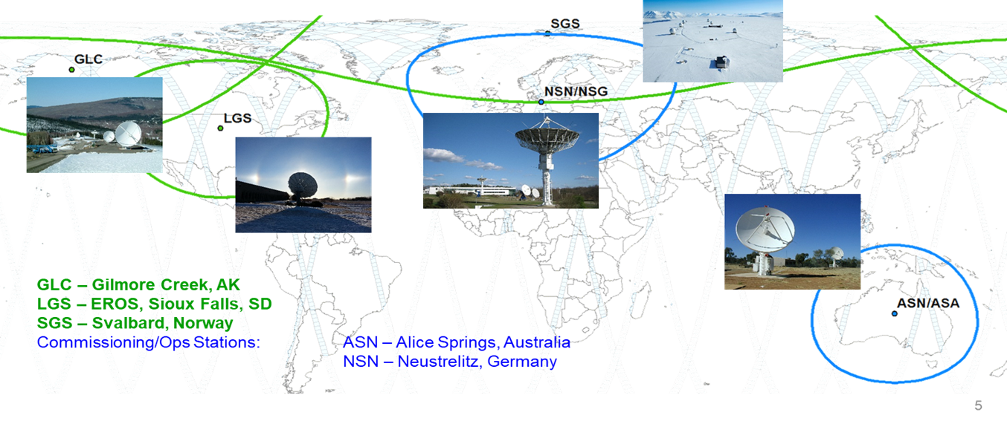
Landsat Ground Network (LGN) Status
L7 LGN (GREEN):
  LGS (Sioux Falls, SD)
  NP3 & NP4 (North Pole, AK)
  NSN (Neustrelitz, Germany)
  ASN (Alice Springs, Australia)
  SG1 (Svalbard, Norway)
L8 LGN (GREEN):
  LGS (Sioux Falls, SD)
  GLC (Gilmore Creek, AK)
  NSN (Neustrelitz, Germany)
  ASN (Alice Springs, Australia)
  SGS (Svalbard, Norway)
Landsat 9 LGN – Leveraging Landsat 8 LGN

Slide 9
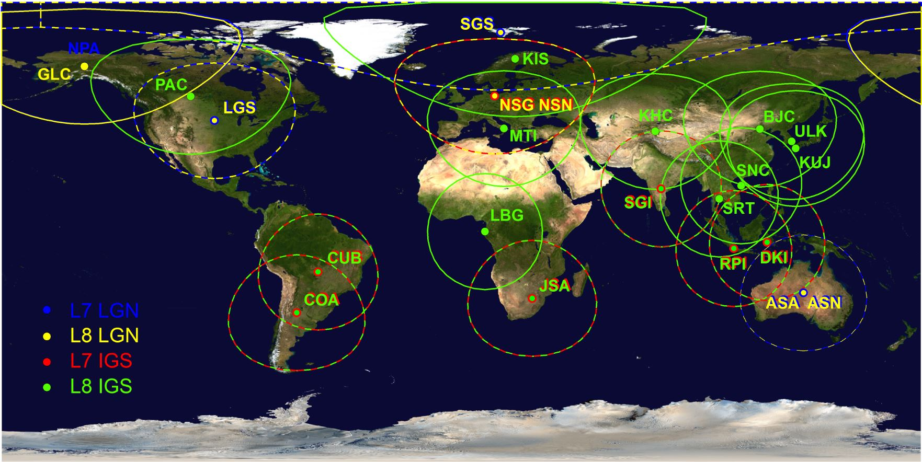
Active Landsat Ground Stations
10 Active L7 Stations 23 Active L8 Stations

Slide 10
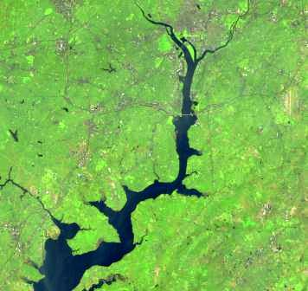
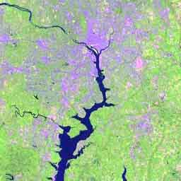
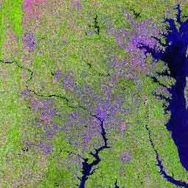
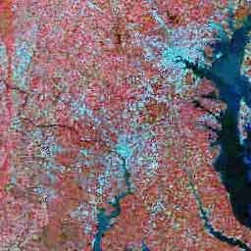
U.S. Landsat Archive Overview - June 28, 2018
OLI-TIRS: Landsat 8
  1,271,164 scenes
    ~ 4,395 TB Raw and L0Ra Data
    average scene size 1813 MB
ETM+: Landsat 7
  2,525,487 scenes
    ~ 2,345 TB Raw and L0Ra Data
    average scene size 487 MB
TM: Landsat 4 & Landsat 5
  2,841,794 scenes
    ~ 1,425 TB Raw and L0Ra Data
    average scene size 263 MB
MSS: Landsat 1 through 5
  1,307,902 scenes
    ~ 79 TB Raw and L0Ra Data
    average scene size 32 MB
Total:
  7,946,347 scenes
    ~ 8,244 TB Raw and L0Ra Data

Slide 11
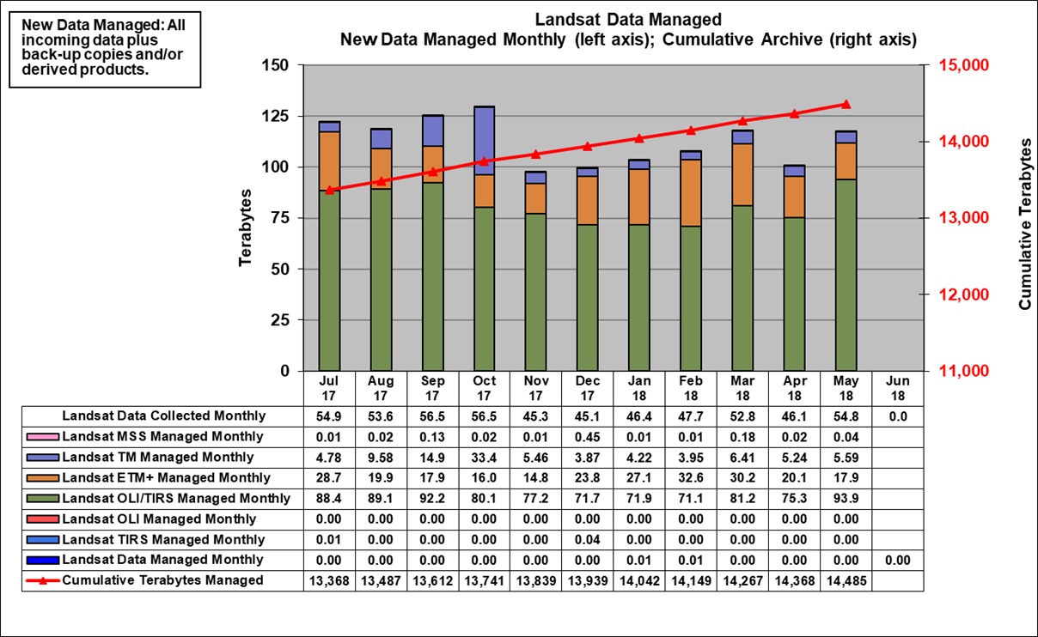
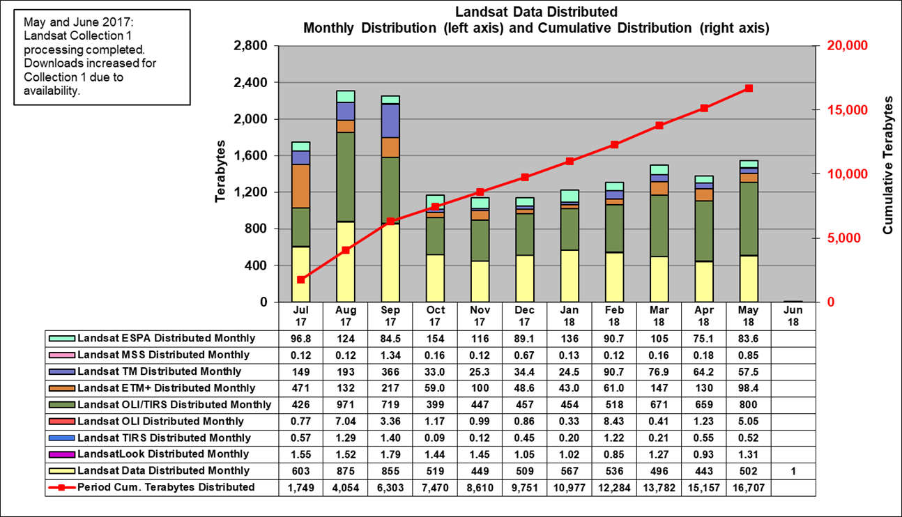
Landsat Inventory & Download Statistics - June 28, 2018

Slide 12
Landsat Data Products & ARD
For the last 10 years, USGS has distributed “Level 1T” as the standard Landsat product
  precision registered and terrain corrected (orthorectified)
  at-sensor radiance / top-of-atmosphere reflectance
USGS now adopting Analysis Ready Data (ARD) as the standard product for L9
Gridded, tiled “stackable” images
Processed to surface reflectance and temperature (Level 2)
Aligned with CEOS recommendations to ease burden of preprocessing for users

Slide 14
Planet Interoperability Workshop
We held a short CEOS side meetings to support the LSI-VC ARD/MRI with goals of:
  1) providing recommendations back to workshop planning team,
  2) providing recommendations for CEOS ARD and MRI,
  3) providing potential actions required for CEOS, both LSI-VC and other CEOS groups, and
  4) developing a short out brief for LSI-VC to CEOS and CEOS appropriate groups.
The CEOS group discussion covered multiple areas:
  1) industry is moving very quickly in terms of interoperability and integrating Landsat and Sentinel with their products to create science products and assessments.
  2) Sentiel-2 data is being used more due to higher resolution and greater temporal coverage,
  3) calibration and uncertainty information is very important, some tools are being developed by ESA,
  4) the ARD/MRI effort within CEOS needs to include a common set of references and definitions related to: common DEMs, geopositional accuracy including pixel referencing, traceability to international standards, processing uncertainty, and metadata,
  5) cloud storage and processing are becoming the norm with in industry and the availability of machine usable information and metadata related to the surface reflectance products is a must,
  6) the discussion included potential for a CEOS common DEM and image georeferenced information, and
  7) the need for enhanced CEOS recommended test sites and product validation were discussed.
Notes:
Recommendations/Actions:
1) We need to evaluate the feasibility of using ESA’s tool to generate GRI L1C and look at the overall process of documenting uncertainty.
2) Planet showed interest in getting 15m/10m global GCP image chips (after GRI integration). Geometry team will need to discuss and decide the possibility and use of generating Landsat GCPs at higher resolution (15m).
3) The recommendation is to use GRI reference dataset for Collection 2.
4) We need to pursue the CEOS ARD recommendations and determine the best solutions for USGS and for CEOS.
5) The ARD and MRI teams need to be involved in the user views of the data.
6) We need to maintain an awareness of the industry/commercial use and integration of Landsat and Sentinel, and make sure we are moving in the right direction in comparison to ESA and other remote sensing organizations.
7) We need to stay directly tied to future ARD interoperability follow-on workshops.
8) Integrated products science validation perspective needed as a new paradigm for creating faster, high resolution, and greater temporal repeat.

Slide 15
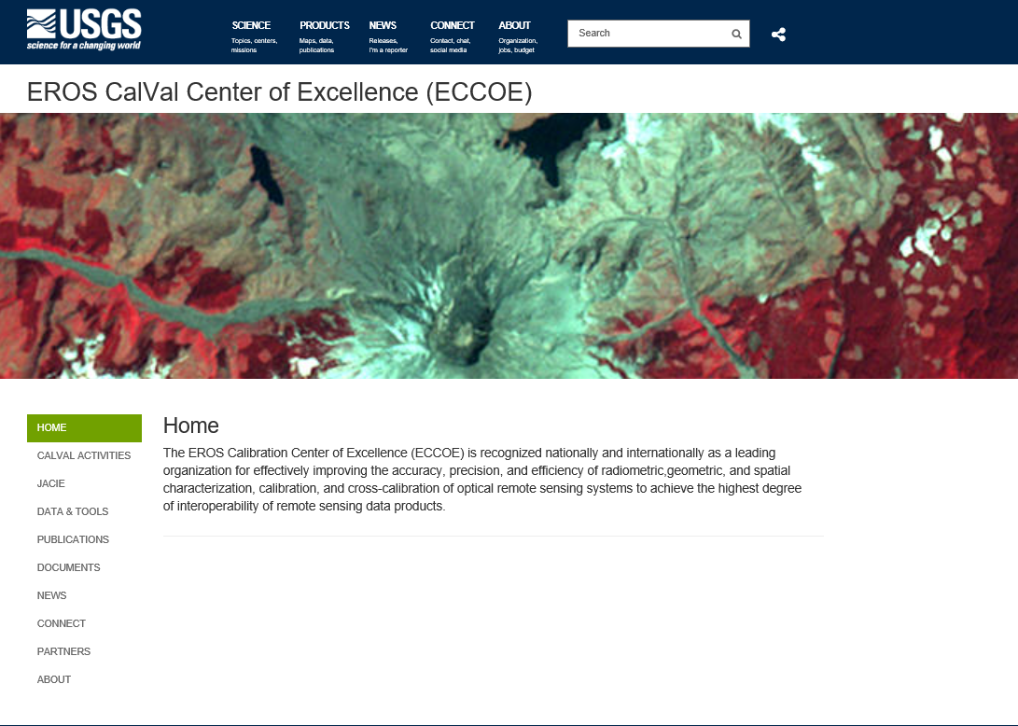
ECCOE https://www.usgs.gov/land-resources/eros/calval
ECCOE Goals:
Ensure continued excellence with Landsat 1-9 calibration
Emphasize Landsat/Sentinel 2 cross-calibration for data interoperability
Support Post L-9 capabilities assessments and advocate for Post L-9 calibration requirements
Develop standard procedures for the commercial and government community for Landsat calibration and quality comparisons
System characterization and comparison of land imaging sensors
Surface Reflectance and LST Validation

Slide 16
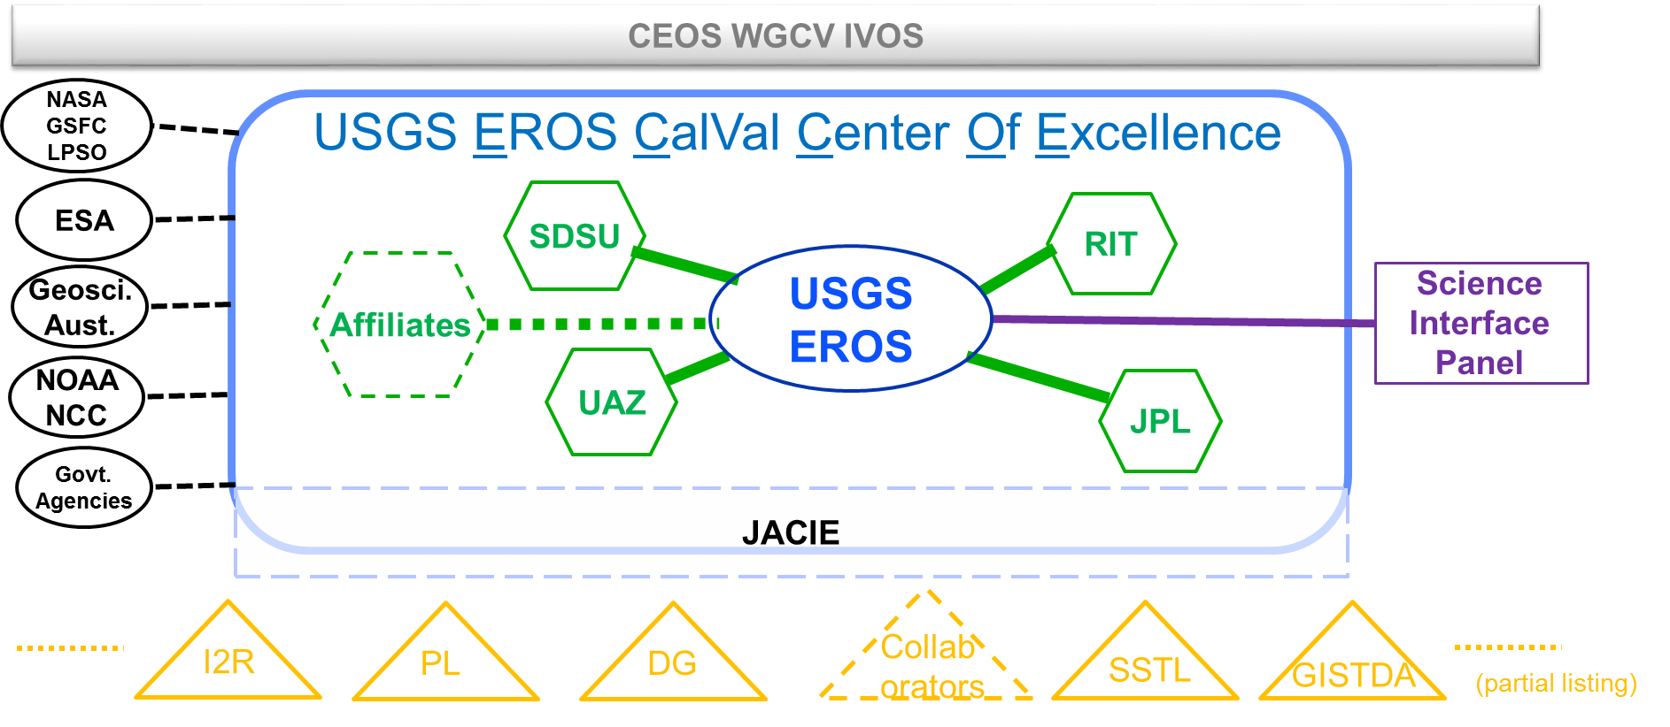
ECCOE Structure* – Current
* Not all inclusive

Slide 17
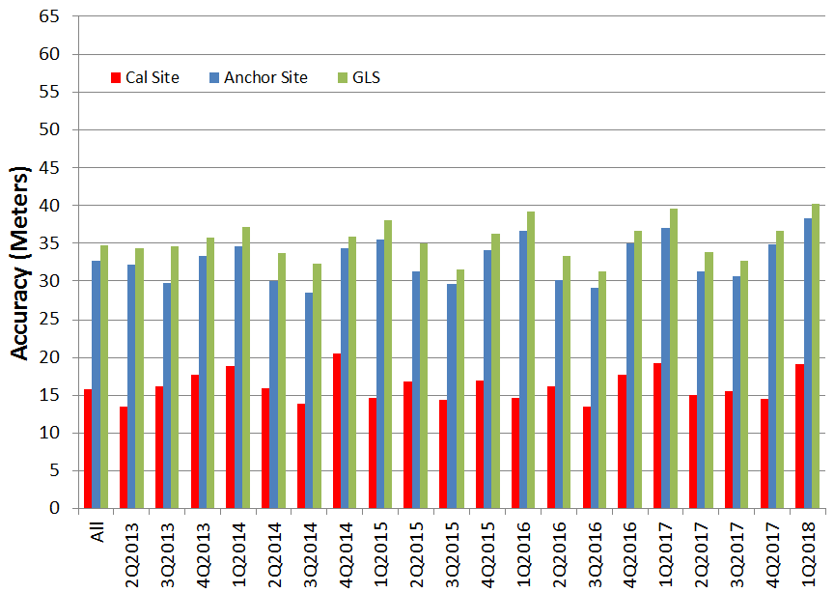
Landsat Geodetic Accuracy Characterization
OLI Geodetic Accuracy by Quarter
Spec
GCP accuracy limits the ability to measure absolute geodetic accuracy.
Notes:
Note: Results are in comparison to GLS 2000 data set.
GCP Phase 3 implemented during 3rd Quarter 2016.
Appears to be a slow increase in the across track mean offset.

Slide 18
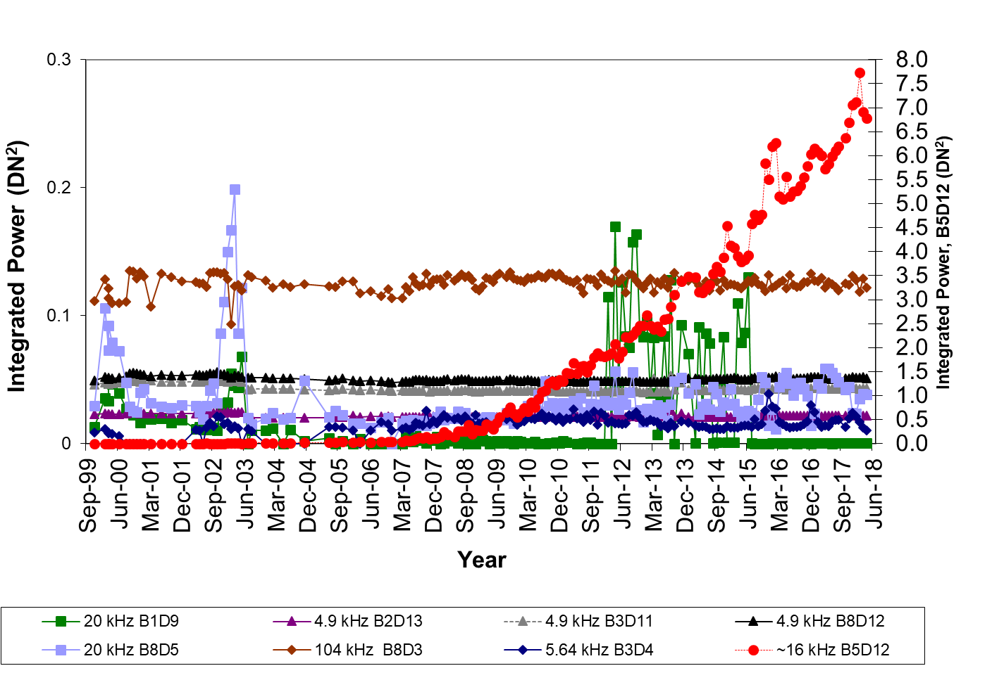
L7 ETM+ Radiometry
IAS radiometric trends suggest nominal operation of ETM+, in general. They also indicate slight degradation of few detectors in Band 5.
The overall CN noise levels of B5 D10 and D12 have increased over the years
  All Band 5 images are believed to be affected by CN to some degree, whether visibly or not by naked eye

Slide 19
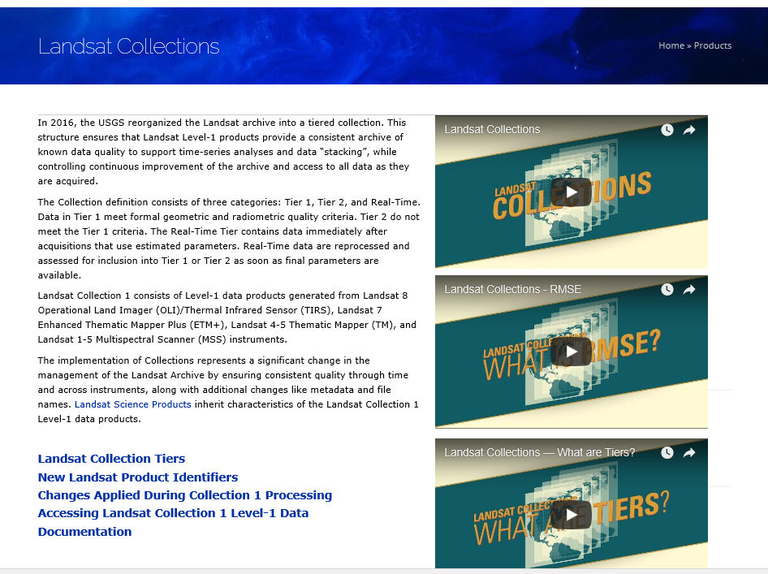
Landsat MSS Collection 1 complete
1,307,902 MSS products generated by LPGS
  7,895 L1TP Tier 1 products
  633,416 L1TP Tier 2 products
  483,466 L1GS Fallback products
  183,125 L1GS products
TM no-PCD and MSS are now in collection.
MSS - Establish consistent calibration among different formats of MSS data
    Update current radiance calibration
    Transfer L8 OLI reflectance calibration to L1-5 MSS
  GCP Outlier Rejection Improvement
  Fill Scan Additions
https://landsat.usgs.gov/landsat-collections
Notes:
TM no-PCD and MSS are now in collection 1.
TM no-PCD (Payload Correction Data)
Lifetime Look-Up-Tables (LUTs) of blackbody and shutter temperatures are used for thermal band processing
No-PCD scenes without DE (Definitive Ephemeris) will use TLEs (Two Line Elements) modeled from PCD scenes from the same time period
MSS
Establish consistent calibration among different formats of MSS data
Update current radiance calibration
Transfer L8 OLI reflectance calibration to L1-5 MSS
GCP Outlier Rejection Improvement
Fill Scan Additions

Slide 20
Landsat Cal/val Activities
Continue investigation of IAS database trending of Landsat sensors
Collection1 related documents update
  MSS radiometric ADD (in review)
  TM radiometric ADD for TM no-PCD thermal band (in review)
  MSS CPF Definition document
Radiometric characterization of Sentinel 2 data
  Co-authored with Julia on Journal paper titled “Sentinel-2A MSI and Landsat-8 OLI Radiometric Cross Comparison Over Desert Sites” -submitted for publication
Present/Publish calibration updates and instrument status
  Couple presentations at JACIE: Collection1 update and L8/S2 cross calibration (SDSU)
L7 ETM+ CPF update

Slide 21
Landsat-8 Radiometry
Landsat 8 is continuously exceeding expectations in terms of data quality
All OLI bands continue to be stable on-orbit
  At most ~1.2% change in band average response (Band 1)
  Most of the calibration techniques provide consistent results
    Characteristics of the working lamp are changing
      Working lamp removed from combined gain model
      Correction of CA and Blue band trends was implemented on April 1, 2018
  Small detector to detector variations (generally within 0.1%) that are well corrected
  SNR performance 2-3 times better than required
TIRS has been extremely stable on-orbit
  At most 0.5% change in band average response
  Noise performance ~8 times better than requirements
  Stray light correction algorithm substantially improves image uniformity and absolute calibration in typical scenes

Slide 22
OLI Radiometric Performance Summary
On-orbit characterization has confirmed that all requirements have been met
* Band 7 compliance depends on solar spectrum used
** Nearly all the cross comparisons show OLI within 3% of MODIS, MERIS, and MSI
*** Few intermittently streaky detectors above requirement level placed in out-of-spec bin as allowed

Slide 23
TIRS Radiometric Performance Summary
* Improved with stray light correction – analyses underway to characterize
** When two values are shown with commas between them, they represent Band 10 and Band 11 separately

Slide 24
L8/S2 Registration Improvement Plan
Perform global readjustment of the GLS control using L8 data with sparse ties to the Sentinel-2 Global Reference Image (GRI).
  Six triangulation blocks are being used to perform this global readjustment.
L8-only triangulations are complete for all blocks.
  New OLI GCPs were also extracted for all blocks.
  The adjusted control is available for testing but is not yet being used for product generation.
When the S2 GRI L1C data become available, we will re-run the triangulation solution with MSI control added to a subset of scenes.
  Some MSI control will be withheld to test the triangulation.
  Validate using OLI-MSI image registration measurements.

Slide 25
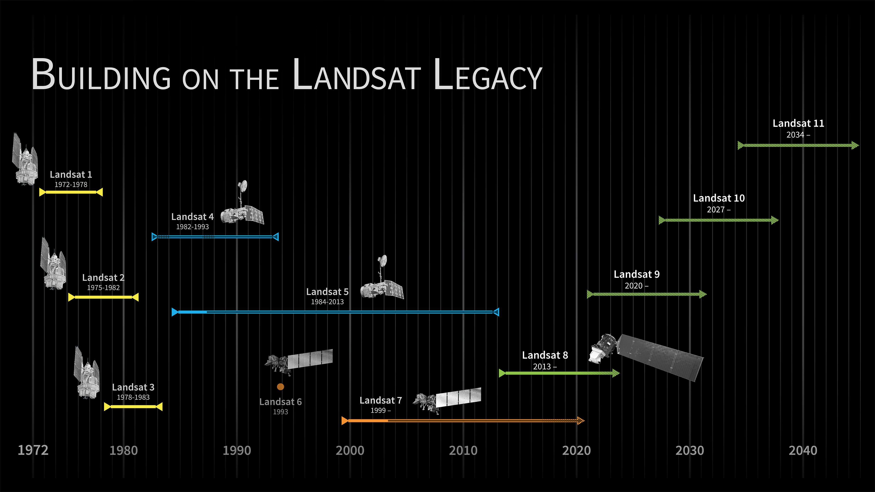

Slide 26
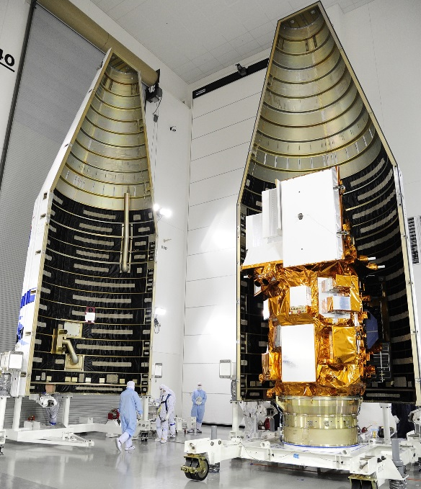
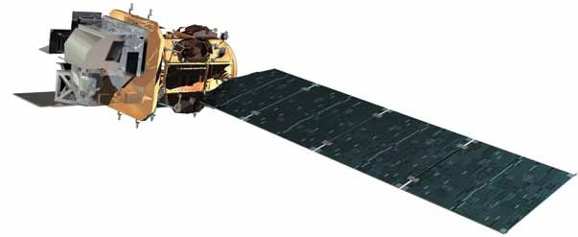
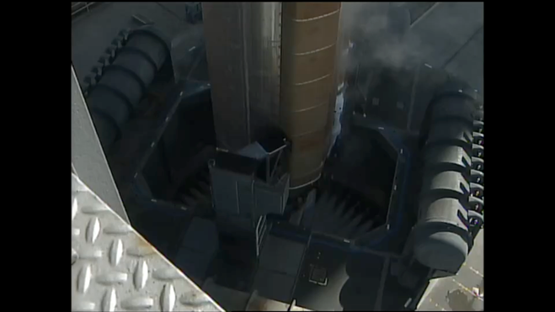
From Landsat 8 to Landsat 9
Landsat Data Continuity Mission (LDCM) launch Feb. 11, 2013
Completed on-orbit commissioning and handover to USGS May 30, 2013
(named Landsat 8)
Sustainable Land Imaging (SLI) Architecture Study Team (AST) Oct. ‘13 – Aug. ’14
Landsat 9 included in President’s budget request Feb. 2015
A “fully Class-B rebuild of Landsat 8”
GSFC received HQ authorization to initiate Landsat 9 project March 4, 2015

Slide 27
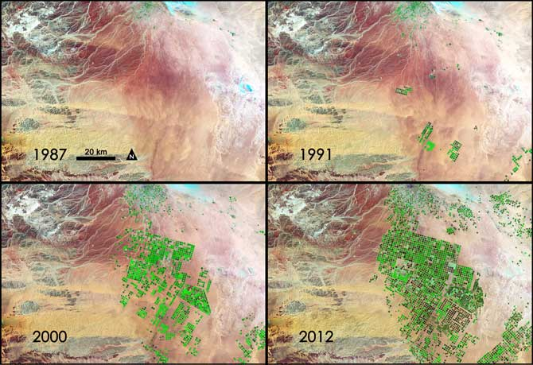
Landsat 9 Mission Overview
  Mission Objectives
Provide continuity in multi-decadal Landsat land surface observations to study, predict, and understand the consequences of land surface dynamics
Core Component of Sustainable Land Imaging program
  Mission Parameters
Single Satellite, Mission Category 1, Risk Class B
  5-year design life after on-orbit checkout, At least 10 years of consumables
Sun-synchronous orbit, 705 km at equator, 98°inclination
16-day global land revisit
Partnership: NASA & USGS
  NASA: Flight segment & checkout; USGS: Ground system and operations
Category 3 Launch Vehicle
Launch: Management Agreement - December 2020; Agency Baseline Commitment – November 2021
  Mission Team
NASA Goddard Space Flight Center (GSFC)
USGS Earth Resources Observation & Science (EROS) Center
NASA Kennedy Space Center (KSC)
Instruments
Operational Land Imager 2 (OLI-2; Ball Aerospace)
    Reflective-band push-broom imager (15-30m res), 9 spectral bands at 15 - 30m resolution
    Retrieves data on surface properties, land cover, and vegetation condition
Thermal Infrared Sensor 2 (TIRS-2; NASA GSFC)
  Thermal infrared (TIR) push-broom imager
  2 TIR bands at 100m resolution
  Retrieves surface temperature, supporting agricultural and climate applications, including monitoring evapotranspiration
Spacecraft (S/C) & Observatory Integration & Test (I&T)
Northrop Grumman Innovation Systems (NGIS), formerly Orbital ATK (OA)
Launch Services
United Launch Alliance (ULA) Atlas V 401
Mission Operations Center (MOC) and Mission Operations
General Dynamics Mission Systems (GDMS)
Increase in pivot irrigation in Saudi Arabia from 1987 to 2012 as recorded by Landsat. The increase in irrigated land correlates with declining groundwater levels measured from GRACE (courtesy M. Rodell, GSFC)
27

Slide 28
Ground System Architecture
Landsat Multi-Satellite Operations Center (LMOC)
  The facility, functional capability, and personnel needed to operate the Landsat 9 observatory
Ground Network Element (GNE)
  Provides highly reliable S-Band and X-Band communication services with the observatory and routes the data appropriately within the Ground System (GS)
  Substantial use of heritage – Landsat 8 equipment compatible with spacecraft
  Leverages current operational LGN
Data Processing and Archive System (DPAS)
  Ingest, archive, catalog, process, and distribute Landsat 9 data (through Level 2) to the public
  Leverages mature, multi-mission system

Slide 29
Ground System Major Milestones
Ground System nearing critical design completion; hardware acquisition and subsystem development underway
GSRR December 2016
GPDR March 2018
GCDR September 2018
GNE CDR June 2018
DPAS CDR July 2018
LMOC CDR August 2018
MOC equipment in place in Sept 2018
Ground Readiness Tests Begin February 2019
Mission Operations Readiness June 2019
Flight Operations Readiness May 2020
Launch December 2020
Mission Transition & Handover March 2021

Slide 30

JACIE Annual Civil Commercial Imagery Evaluation Workshop
  September 17 - 19, 2018 @ NOAA College Park, MD
    JACIE Information Page – Everything back to 2001 including Workshop Information
    http://calval.cr.usgs.gov/jacie/
Excellent program – US Govt. Agency Leads and CRS Industry CEO/CTO Panels
EROS Calibration Center of Excellence (ECCOE) @ Annual Workshop September 20, 2018 @ NOAA College Park
    Last year S-2 and Landsat-8 Cross calibration /Harmonization
    This year “Cross calibration/characterization of small satellites to Landsat/Sentinel” Co-Chaired by Planet

Slide 31
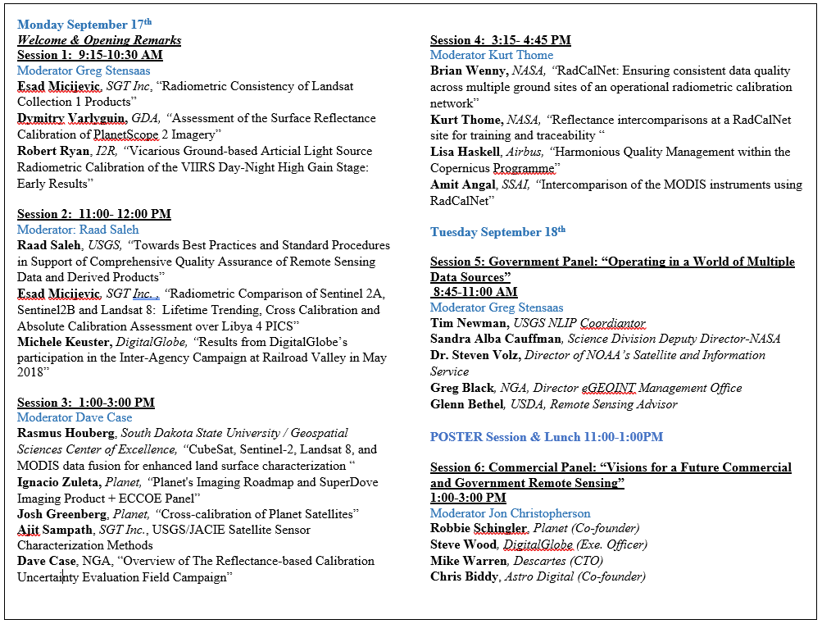

Slide 32


Slide 33
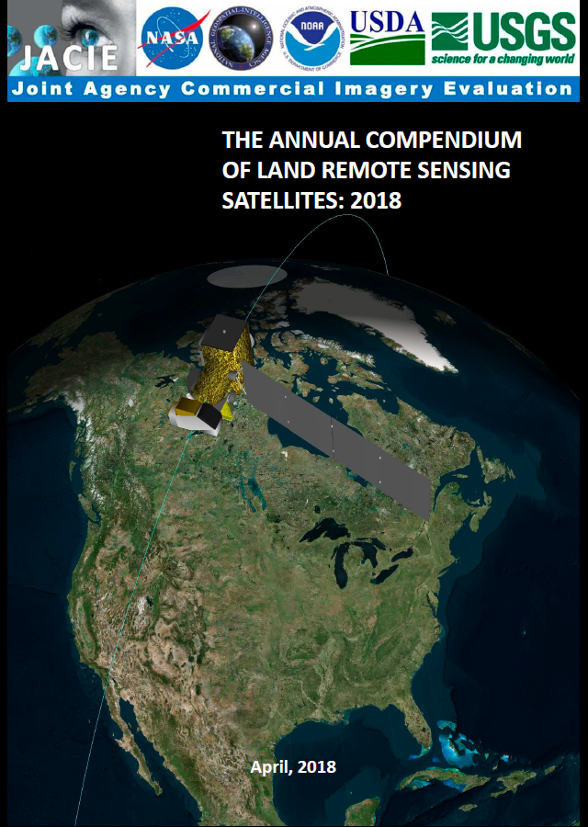
Interagency System Compendium
Using RCA-EO to publish
Published by USGS under JACIE partnership
  Page 1: Factory Specs
  Page 2: JACIE Assessment Results

Slide 34
JACIE Characterization Best Practices and Guidelines
Best Practices and Standard Procedures in Support of Comprehensive Quality Assurance of Remote Sensing Data and Derived Products
Provide Draft Document describing recommend JACIE Process
  Build Consensus on Definitions and Terms, e.g., Interoperability.
  Describe Standards, Methods and Best Practices, and Uniform Reporting
Obtain Feedback and Input from Partners
Enlist Stakeholders and Collaborators to Evaluate Draft
Encourage Adoption by JACIE, other Groups/Organizations, and Users
Revise and Enhance as Needed
Key components:
Define Sensor Characterization Process
Provide System Specifications
Use Uniform Reporting of System Specifications and Sensor Characteristics Performance Measures
Follow Common Calibration Techniques
Adopt Standardized Validation Protocols
Conduct Usability and Application-specific Requirements Assessment
Utilize Common Cal/Val Test Datasets and Test Sites
Document available tools and processes
Interested in CEOS WGCV as collaborator and reviewer

Slide 35
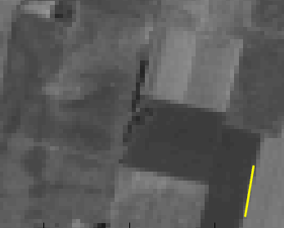
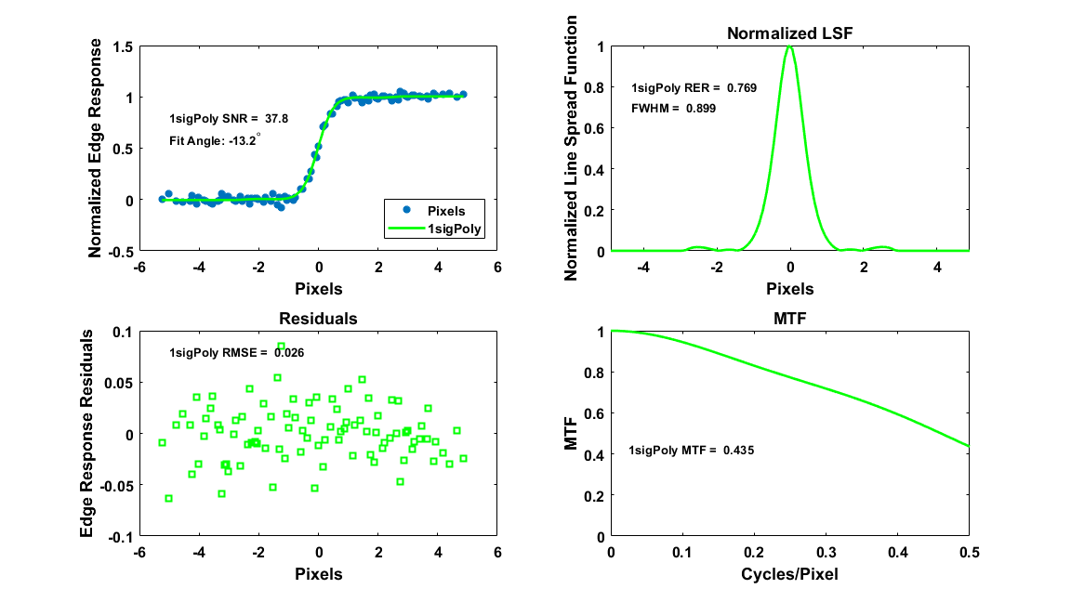
Image Quality Evaluation Tool
Spatial Resolution Calculation
Image Edge
The IQE Tool, provided by Innovative Imaging and Research (I2R) under USGS TSSC contract, enables automated assessment of imager spatial resolution
Provides estimates of image sharpness parameters, including Relative Edge Response (RER), Edge Slope, Edge Extent and Modulation Transfer Function (MTF) @ Nyquist
Finds uniform, high-contrast edges that normally occur in acquired imagery
IQE benefits include the ability to:
Measure image sharpness across the entire image and report results as a function of field angle
Automate image quality assessment using “standard” images (engineered targets not required)
Perform trending analysis of imager performance
Landsat 8 OLI, Band 5, SCA 9
Parameter Calculation
Example of a naturally occurring image edge (left), and the spatial resolution parameter calculations performed by the IQE (right)

Slide 36
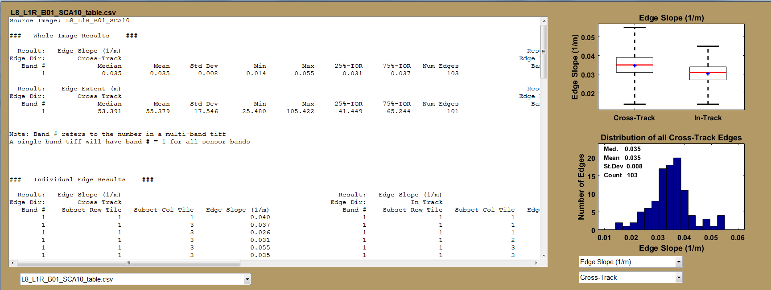
IQE Summary Statistics
Landsat 8 OLI, Band 1, SCA 10
Summary statistics table and figures compiled by the IQE for an entire image or subset

Slide 37
Digital Imagery Guideline
The Digital Imagery Guideline is an interactive tool that describes how spatial resolution is specified and provides a catalog of images to relate specifications to image products
  Defines commonly used spatial resolution metrics, such as Ground Sample Distance (GSD), RER, and MTF @ Nyquist, and describes how they are measured
    Discusses concepts that affect image quality, such as aliasing
  Simulated data sets show how varying image sharpness parameters and GSD affect spatial resolution using multiple features
Guideline is intended to assist the remote sensing community acquire data or define sensor specifications appropriate for various applications

Slide 38
Digital Imagery Guideline Examples
Blurry
Balanced
Aliased
Simulated image example from the Digital Imagery Guideline
10-m RGB images simulated from GeoEye-1 (1.9-m input)
Images simulated at 3 image sharpness levels
  Blurry: MTF @ Nyquist = 0.03
  Balanced: MTF @ Nyquist = 0.15
  Aliased: MTF @ Nyquist = 0.8

Slide 39
Digital Imagery Guideline Examples
Blurry
Balanced
Aliased
Simulated image example from the Digital Imagery Guideline
1-m RGB images simulated from Leica DMCIII aerial (0.03-m input)
Images simulated at 3 image sharpness levels
  Blurry: MTF @ Nyquist = 0.03
  Balanced: MTF @ Nyquist = 0.15
  Aliased: MTF @ Nyquist = 0.8
39

Slide 40
System Characterization Plan
Landsat-8/Sentinel-2 Harmonization – being done in conjunction with NASA GSFC
Planet Surface Reflectance Product
  Planet recently announced surface reflectance and mosaick capability
  Will compare to current Landsat SR products
Ongoing assessments of Planet
  Planning to get new sensor data/ new products in 2019
WorldView-3 IR Assessment
  Multiple bands in SWIR-1 & 2
Astro Digital Landmapper BC
  Much delayed due to launch failures; Successful launch finally in January; Just talking to them now
Future Systems (always changing environment)?
  Hyperspectral DESIS, Satellogic, BlackSky Global, Earth-I, etc., …
Provide Support to Sustainable Land Imaging Architecture Study Team (AST)

Slide 41
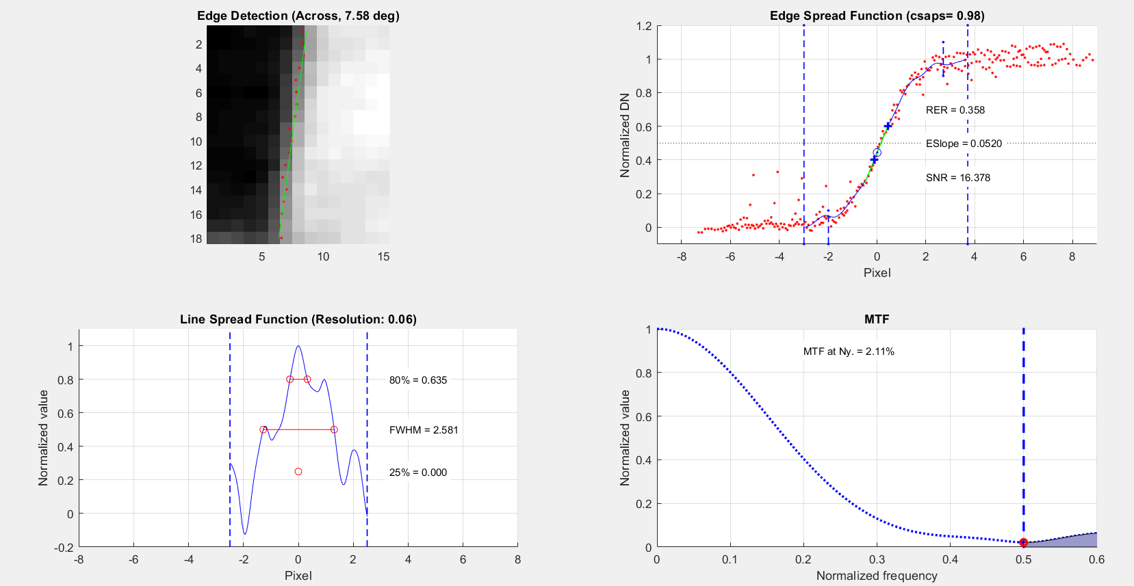
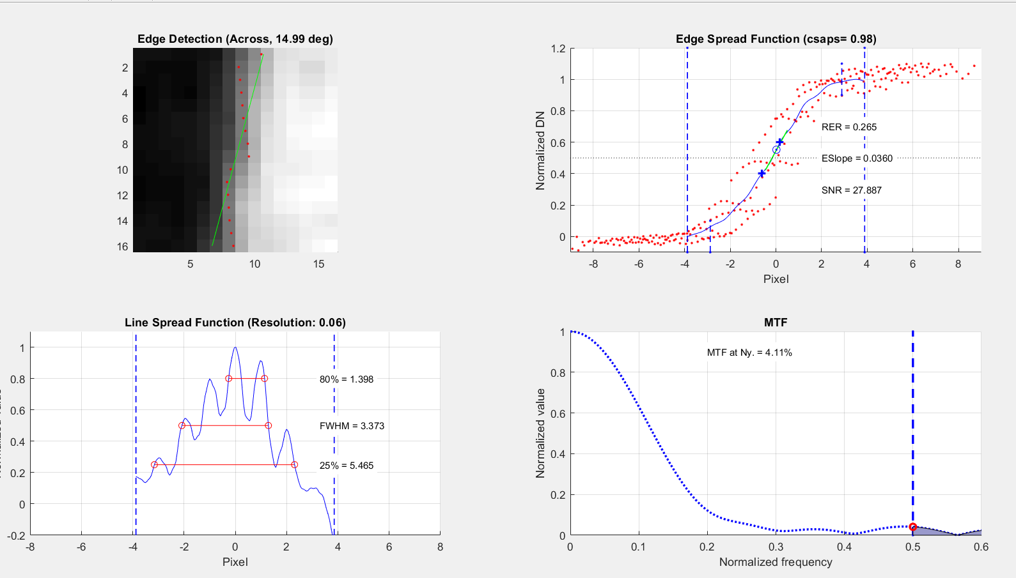
Planet Geometry and MTF
Geometry - Sub pixel consistency/accuracy in Sioux Falls test range
The two MTF plots below (Red and NIR, respectively) are representative of the flock of Doves analyzed
NIR MTF is always worse than RGB
SNR seems larger for NIR (than for RGB), but that could be for many reasons, including gaussian filtering
Red NIR

Slide 42
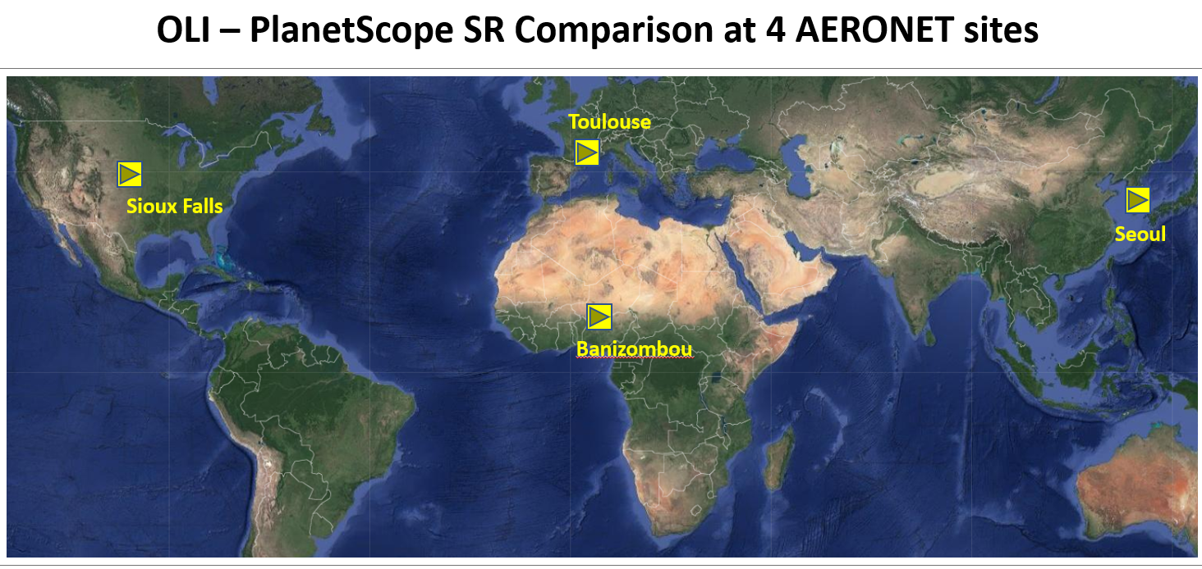
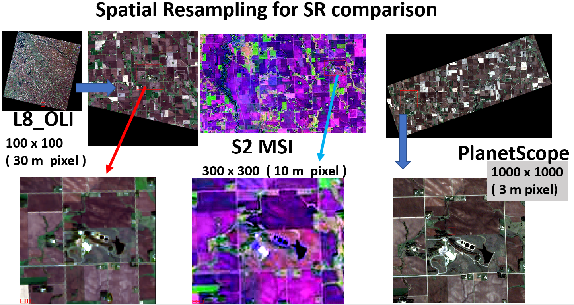
SR products
Notes:
The small satellite community has expanded satellite imagery applications. Thus, USGS was interested in radiometric and geometric data quality. We compared surface reflectance between L8 OLI and PlanetScope. An important consideration in the selection of the comparison site is the AERONET site, because AERONET provides ground truth aerosol optical thickness and column water vapor. We selected 4 sites around the globe. Each dataset consists of (1) L8 OLI (2) Sentinel2 MSI (3) PlanetScope, and (4) AERONET data. All three dataset has different spatial resolution (30m OLI, 10m MSI, and 3m PlanetSope). Thus, it is necessary to resample higher spatial resolution data to OLI resolution. After resampling, the scatterplot between sensors reveals relative georeferencing error between sensors. We used optimization procedure to identify relative georeferencing error. The correction of the georeferencing error will minimize the added uncertainty in the surface reflectance comparison. In most cases the error was less than 1 OLI pixel.

Slide 43
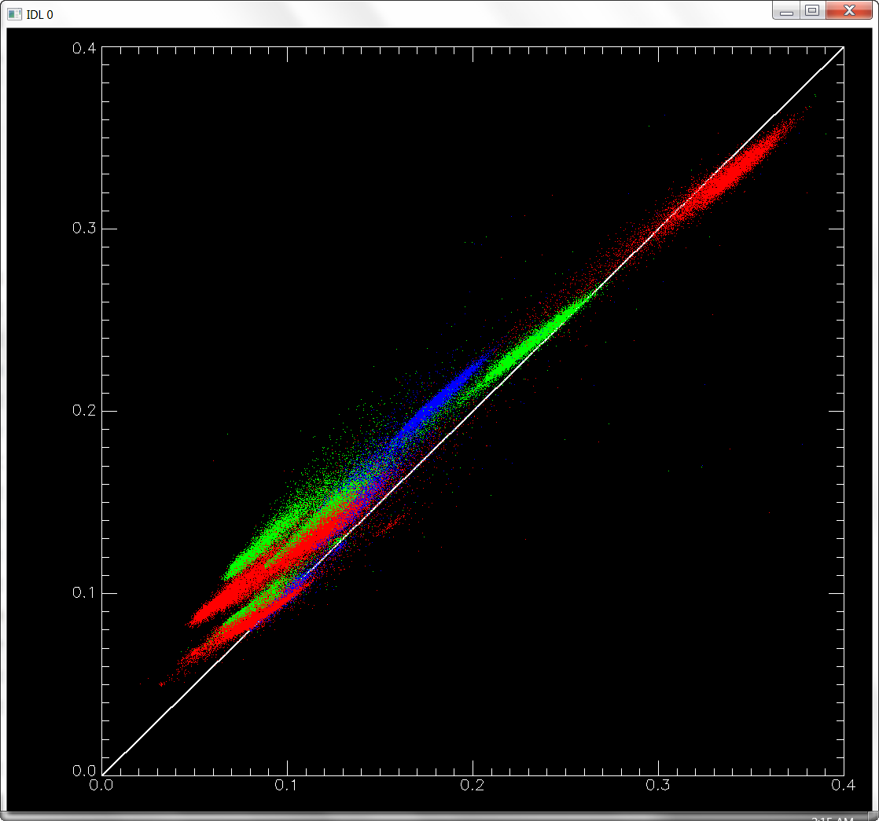
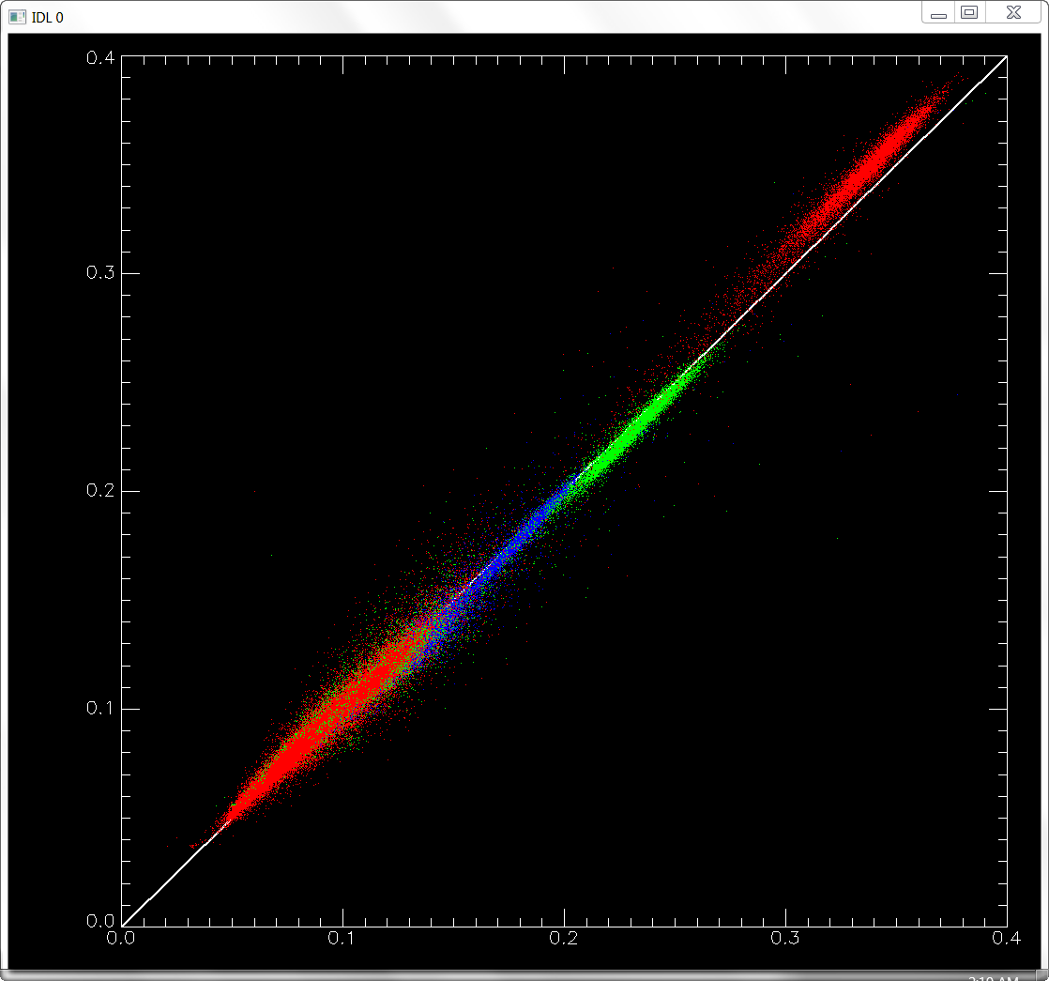

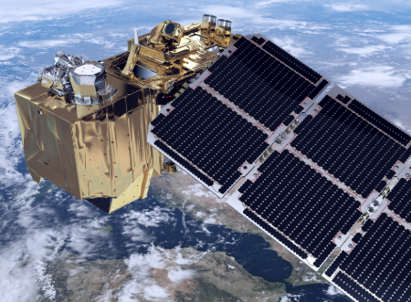

Plant vs. L-8 OLI TOAR
TOAR
TOAR
Notes:
TOA Reflectance

Slide 44
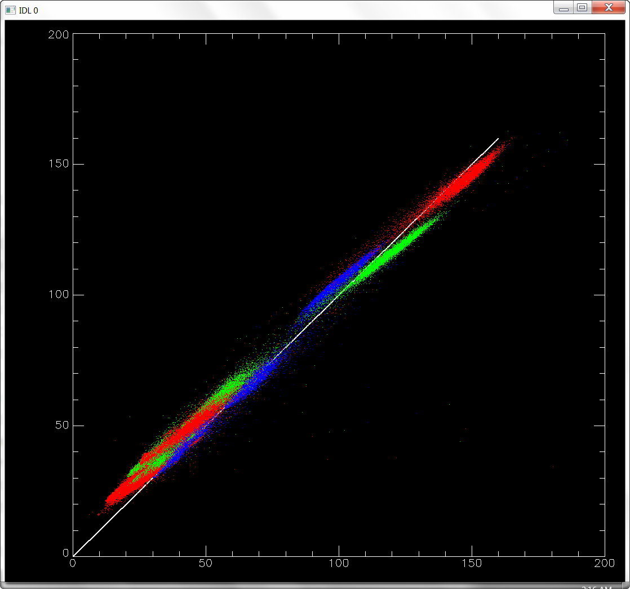
Radiance to Reflectance
TOA Radiance
TOAR
Pre-launch calibration
On-orbit monitoring, correction
Straylight correction, …
Earth-Sun distance
Solar zenith angle
Solar Flux (irradiance)
all, precisely known
~ no uncertainty
Notes:
We compared L8 OLI and PlanetScope. The plot shows R,G,B comparison from 4 different sites around the globe. The mismatch in radiance shows the quality control issue with PlanetScope data. When TOA (Top of the Atmosphere) radiance is converted to TOA reflectance, it is a straightforward conversion. It seems the error became enhanced after the conversion, but virtually no additional error is introduced. The root-cause of the error is due to the radiance error.

Slide 45
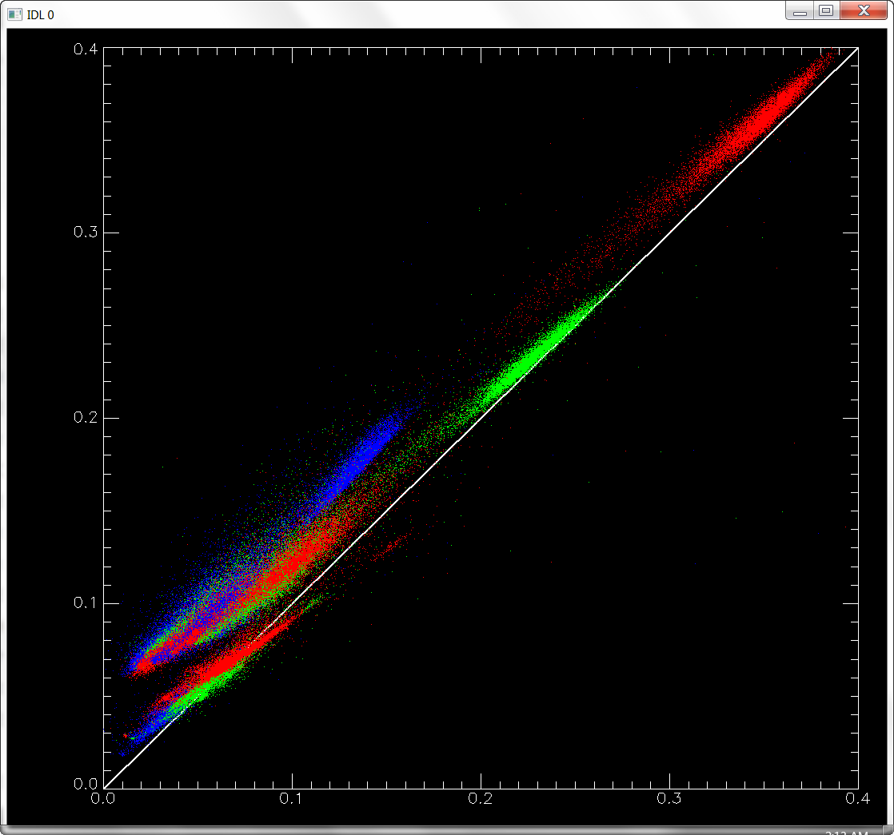
TOA Reflectance to SR
TOAR
SR
Atm. Corr.
Overall spectral pattern looks decent.
It is not easy to really screw up AC !!!
Notes:
We compared L8 OLI and PlanetScope. The plot shows R,G,B comparison from 4 different sites around the globe. The mismatch in radiance shows the quality control issue with PlanetScope data. When TOA (Top of the Atmosphere) radiance is converted to TOA reflectance, it is a straightforward conversion. It seems the error became enhanced after the conversion, but virtually no additional error is introduced. The root-cause of the error is due to the radiance error.

Slide 46

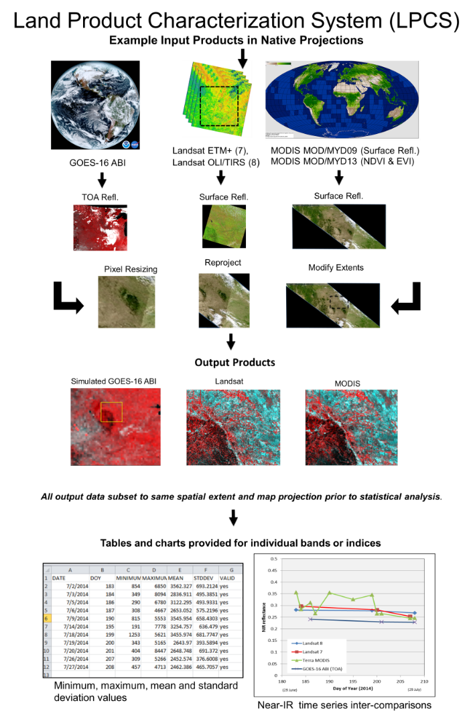
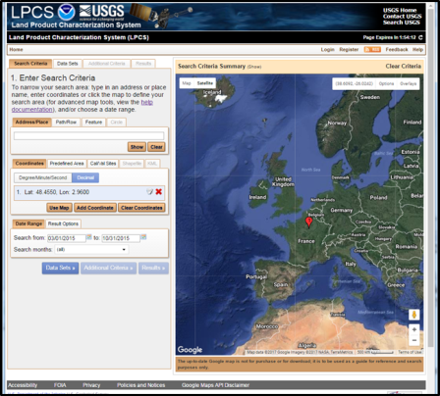
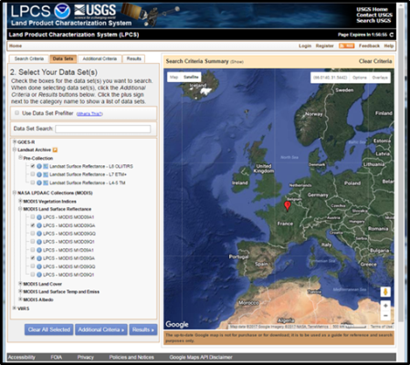
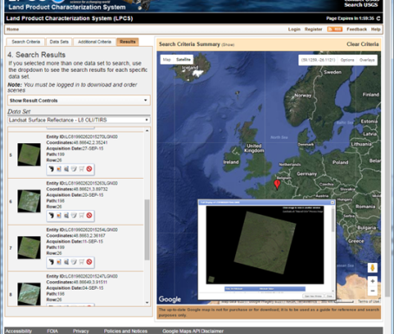
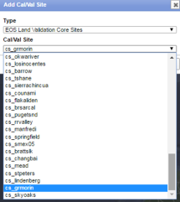
LPCS joint effort – NOAA, USGS, NASA https://landsat.cr.usgs.gov/lpcs
The Land Product Characterization System (LPCS) is a web-based system designed to facilitate characterization and validation of higher-level scientific data products including land products from ASTER, VIIRS, MODIS, Landsat, and in the future, Sentinel-2 and-3, GOES-16 ABI, and comparable in situ products.
The LPCS includes:
data inventory,
access, processing options, and
analysis functions,
that will permit selection of data to be easily identified, retrieved, co-registered, and compared statistically through a single interface. Data inventory and selection includes numerous pre-defined cal/val locations as well as options for user-defined selection of locations.

Slide 47
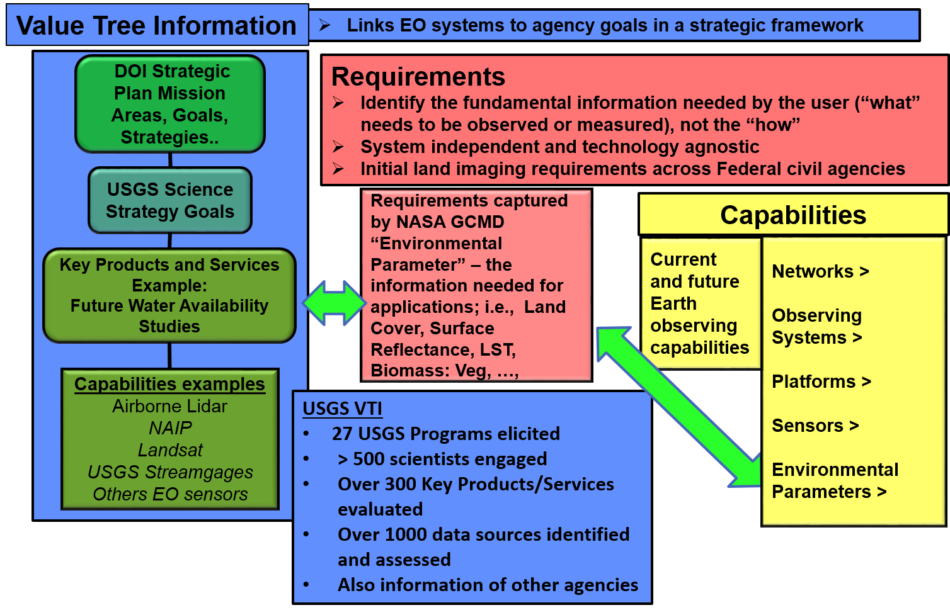
User Information and Requirements
Primary attributes of an Environmental Parameter
  Spectral characteristics
  Horizontal Resolution
  Sampling Interval
  Also collect attribute “needs” for: geographic coverage, data latency, conditions for sampling, length of the data record, etc.
US Earth Observation Assessment 2016
All EO products and services used by the US Federal Civil Government

Slide 48
Distribution of Applications by Societal Benefit Area (SBA)
Adopts the OSTP framework of societal benefit areas (SBAs) used in the National Earth Observation Assessment 2016 (EOA 2016).
n = 176
As of 1/8/2018

Slide 49
Requirements Capabilities and Analysis for Earth Observation (RCA-EO) - First Detailed Moderate Resolution User Requirements database model
RCA-EO Components
EORES
Value Tree Information (VTI)
        Earth observing input and capabilities (products and services) mapped to the organization’s goals and objectives
Requirements
Capabilities
User Requirements
        Database of system-independent user needs
Analysis
Observing Systems Capabilities
        Database of current and future Earth observing systems
Value
Tree
Earth Observation Requirements Evaluation System (EORES) and Analysis
Using EOA VTI to elicit User Requirements
        Across all Civil Federal Agencies
RCA-EO is driving toward a user needs driven business management process to address mission priorities, and incorporate evolving Earth observing technology
https://remotesensing.usgs.gov/rca-eo/
Notes:
RCA-EO is a USGS Land Remote Sensing (LRS) Program activity that collects and interprets Federal Earth Observation (EO) needs and capabilities to:
Provide a detailed view of user requirements & EO capabilities
Match EO user needs to a range of potential system and data solutions
Assess the relative value of EO systems, products, and services to agencies and societal interests
Enable user and data-driven decision making for Earth Observing programs to inform the development of systems, products and services
Inform future investments in EO systems and their design characteristics
Partnership between USGS and the National Oceanic and Atmospheric Administration (NOAA) for developing next generation system and analytical toolsets
Leverages NOAA’s excellent legacy efforts (12+ years)

Slide 50

Landsat-9 Follow-on User Requirements
Main User Needs Findings
At minimum, users needed continuity of Landsat data and derived products with free and open data access
To better perform their work, users need weekly clear observations, 10m spatial resolution for (VNIR – SWIR) and 30-60m for thermal, and additional red edge bands and narrower bands in VNIR and SWIR regions
Ideally, users want clear imagery every 3 days at 5-10m spatial resolution, and contiguous 10nm-wide VNIR – SWIR band and more 5-8 thermal bands
Federal and non-Federal needs were similar (more to come)

Slide 51
Landsat-9 Follow-on User Requirements
Summary of other attributes
Free and Open!
Data latency: less than 1 day for standard and higher level products
Geolocation accuracy: less than ½ pixel
Radiometric accuracy: within 5%, SNR ranging from 800:1 to 250:1 (water quality, cryosphere, minerals), 12/14-bit
Thermal accuracy: 1-3K for surface temperature
Geographic coverage: Global land (95%), Global land and ocean (5%)
Nighttime thermal imaging: Volcanic activity, underground coal fires, urban heat islands, etc.
Landsat data products (surface reflectance, cloud mask, native thermal data), global ARD
Data access and cloud computing

Slide 52
International Requirements Elicitation Opportunity
Being used today with international partners, and through Landsat WGs
Uses the RCA-EO Requirements Elicitation Process as baseline
  Significantly optimized the detailed attribute elicitation process and created as easy to use template
  template was set-up as to allow import into database
  Created training documents
  Training tested with GSA, as well as, process used for groups with the U.S.
Process retains compatibility with other collected requirements data
Identifies from subject matter experts (SMEs) for elicitation and follow-up as needed
  Involves interviews and data capture from SMEs
  Need someone to coordinate and identify SMEs to join training session
If interested in more information, contact
  Steve Labahn - labahn@usgs.gov, Greg Snyder – gsnyder@usgs.gov, or Greg Stensaas – stensaas@usgs.gov
Elicitation process is available for international use

Slide 53
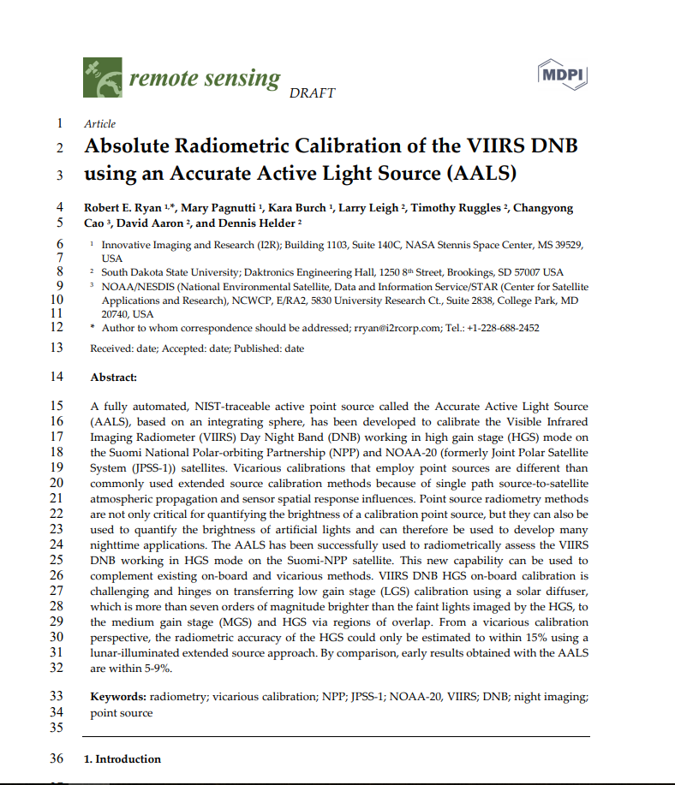
Questions
VIRSS Day Night Band
  SDSU/I2R work
  NOAA Sponsored
  Draft publication coming out soon
  NIST traceable light source
  light source is currently being installed in a modified cargo trailer and that the new unit will be operated in SD in the summer and MS in the winter

Slide 54
Summary of Others Studies
The Request for Information (all land imaging community), AmericaView (US state and local), Geoscience Australia (international), and Landsat Advisory Group (non-Fed) surveys included governmental and non-governmental, domestic and international users
  Spatial resolution – 10m for VNIR/SWIR bands; 30 – 60m or even 5 – 10m for thermal data
  Observation frequency – Weekly to sub-weekly usable observations
  Spectral enhancement – Red edge bands, several narrow bands in the UV, VIS, SWIR, and TIR regions, and hyperspectral capabilities
  Priority – Improvements in observation frequency, followed by increasing spatial and spectral resolution
Non-Federal studies largely mirrored the user needs collected by USGS
Have compared to LST findings and results of the Value of Landsat Study

Slide 55
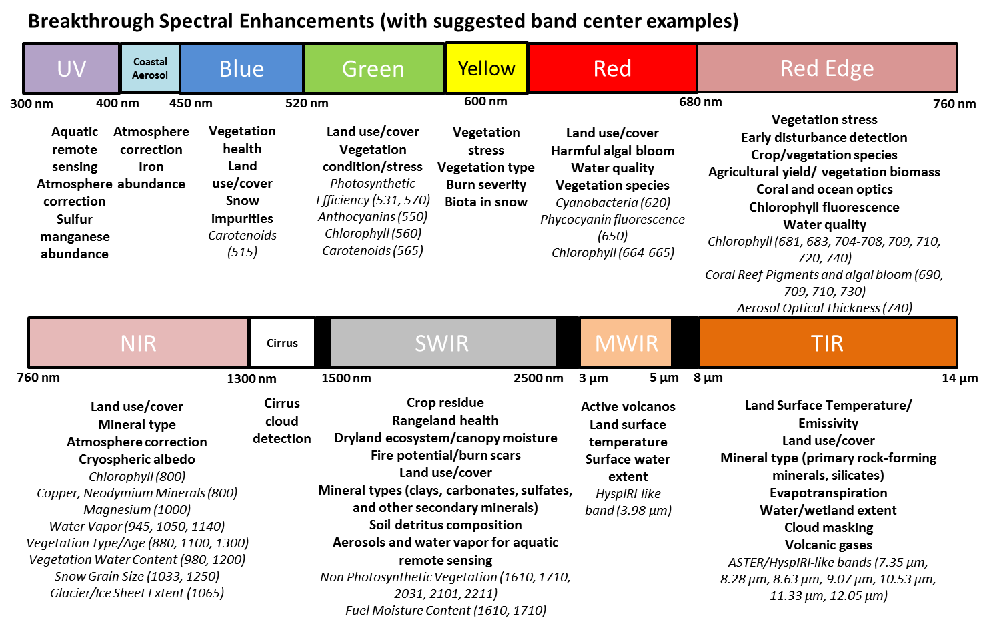
Breakthrough spectral improvements

Slide 56
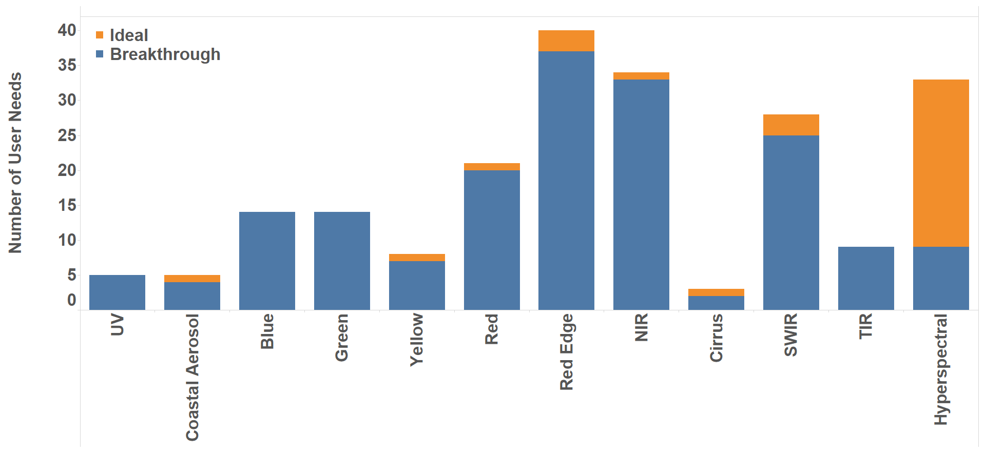
Spectral improvement needs
As of 1/8/2018

Slide 57
Strong USGS Elevation Program
Lidar Scanner, Survey Team, Trimble Total Station and GPS Rovers and Receivers
Sensor and technology assessment / Lidar point and imagery cloud assessment
2 - ASPRS Lidar Data Quality Guidelines
  Published in ASPRS PE&RS Magazine March and April 2018
Collecting National Lidar Point Cloud, creating Elevation Products
Members available to support CEOS Terrain Mapping Subgroup

Slide 58
User Requirements
What are user requirements?
  The specification of the characteristics of an Earth observation, product, or service to meet a user need
  Identifies the fundamental information needed by the user
    Stated in the form of an “Environmental Parameter” along with the relevant attributes
    Using the NASA Global Change Master Directory (GCMD) taxonomy conventions as a starting point
  Not system-dependent; technology agnostic
    Not constrained by any specific type of observing platform
    Captures the “what” is needed and not the “how”

Slide 59
RCA-EO’s Requirements Elicitation
Defining the Landsat “User” Community
  USGS and DOI (National Park Service, Fish and Wildlife Service, Bureau of Land Management, Bureau of Reclamation, etc.)
  Other Federal Agencies (USDA, NASA, DOC, DOE, DOD, EPA, etc.)
  Academia
  International Community
  Industry
  Non Governmental Organizations
  Private Citizens
Landsat data provided free of charge since 2008
  Dramatically increased the number of users in all categories
    Landsat User Surveys - 2009 & 2012 and Case Studies
      https://www.fort.usgs.gov/sites/landsat-imagery-unique-resource/surveys-landsat-users
    Users and uses of Landsat 8 satellite imagery—2014 survey results
      https://www.fort.usgs.gov/products/sb/13655
    Future Landsat Value Study (2018)
Impossible to engage everyone – needed a strategy

Slide 60
User Engagement Strategy
Starting point for elicitation – Federal (+ academic + other)
  Used data from Federal use-case studies to identify current users of Landsat and other moderate resolution imagery (Office of Science and Technology Policy (OSTP) Earth Observation Assessment (EOA))
    Core group for initial engagement - traditional users
      National Plan for Civil Earth Observations (EOA 2012) ---- New EOA 2016 – coming soon https://remotesensing.usgs.gov/2014_national_plan_for_civil_earth_observations.pdf
  Use cases also pointed to lower spatial resolution users (e.g. MODIS/VIIRS), and users who want higher resolution
  Used download registration information from EROS
  Targeted specific user communities (e.g., HyspIRI science community (hyperspectral needs), water quality, cryosphere, other – non-traditional Landsat users
  US Group on Earth Observations (GEO) Satellite Needs Working Group (Federal)
  Above users also gave us referrals – widened the circle

Slide 61
Other Requirements Sources
AmericaView (State and Local)
  Optimized elicitation process used to collect requirements
  Completed
USGS Request For Information
  Asked for community input to Landsat follow-on needs
Geoscience Australia (International) Assessment
  Completed
Landsat Advisory Group
  Provided list of requirements from non-governmental organizations
Landsat Science Team
  Report on Science completed
Landsat User and Value Studies
  Study and report being finished by end 2018
US GEO Satellite Needs Working Group

Slide 62
User need example:
Application: USDA Foreign Agriculture Service (FAS) Crop Yields
User need parameter: Non Photosynthetic Vegetation
User need level | Spatial resolution | Usable observation frequency | Spectral characteristics | Data latency | Other comments
Minimum | 30m (reflective), 100m (thermal) | 2 weeks | Reflective shortwave and thermal infrared | 2 day | Orthorectified global surface reflectance mosaic
Breakthrough | 30m (reflective), 100m (thermal) | 1 week | 10-50nm bands centered near 2030, 2100 and 2200nm; thermal infrared | 2 day | Orthorectified global surface reflectance mosaic
Ideal | 10m (reflective), 30m (thermal) | 1 week | Hyperspectral shortwave infrared; thermal infrared | 2 day | Orthorectified global surface reflectance mosaic

Slide 63
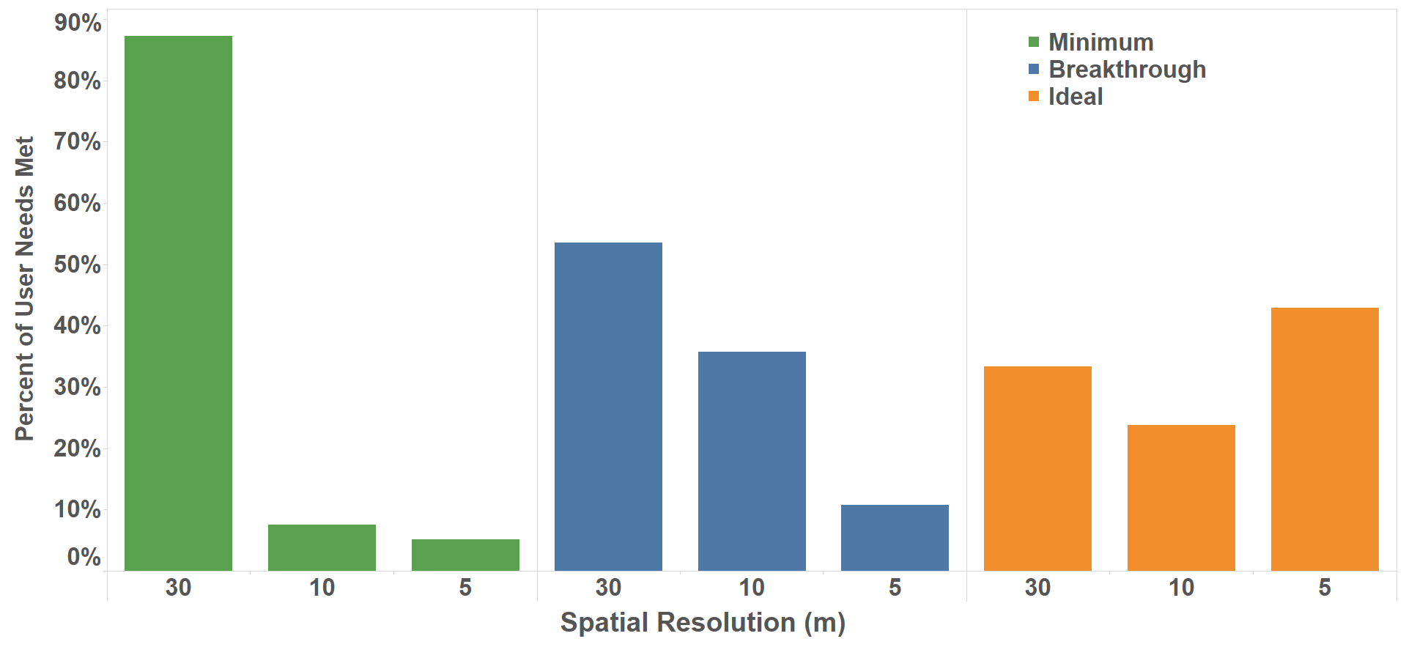
Spatial resolution (reflective)
As of 1/8/2018

Slide 64
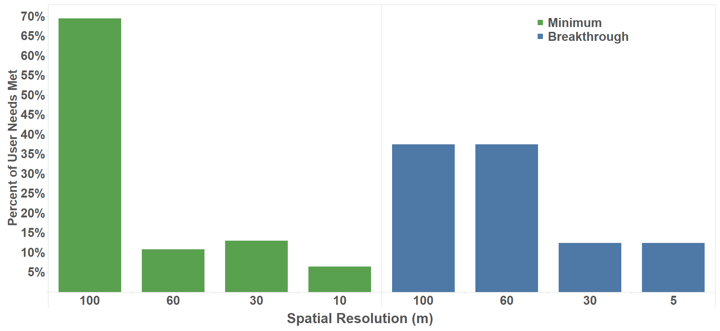
Spatial Resolution (thermal)
As of 1/8/2018

Slide 65
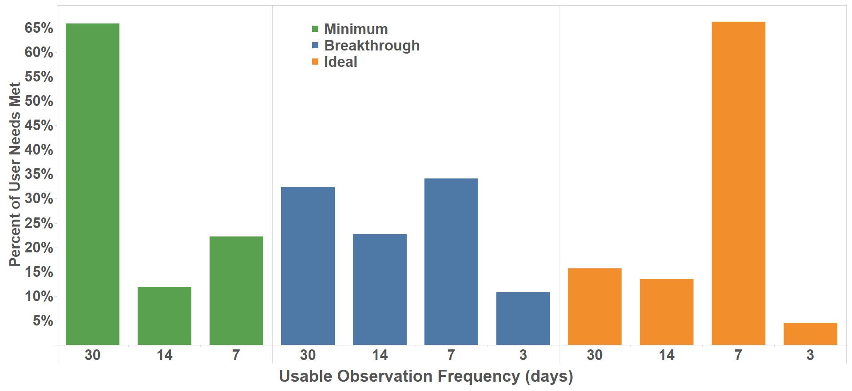
Observation Frequency
As of 1/8/2018

