Slide 1
WGCV CARD4L Peer Review
Medhavy Thankappan
WGCV-45
July 15-19, 2019

Slide 2
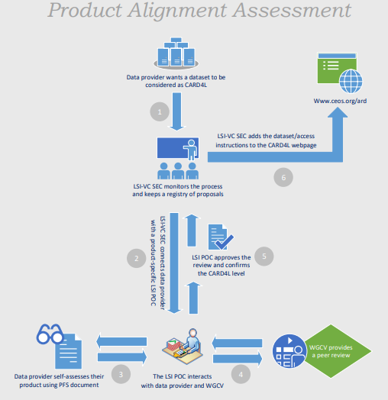
CARD4L product alignment assessment
A process to assess products that are CARD4L compliant has been defined
Data providers proposing products for CARD4L assessment would do a self-assessment of products against the CARD4L specs as the first step
Data providers would then approach LSI-VC for endorsement of a product as CARD4L compliant
LSI-VC would work with WGCV to assess the product against CARD4L specifications

Slide 3
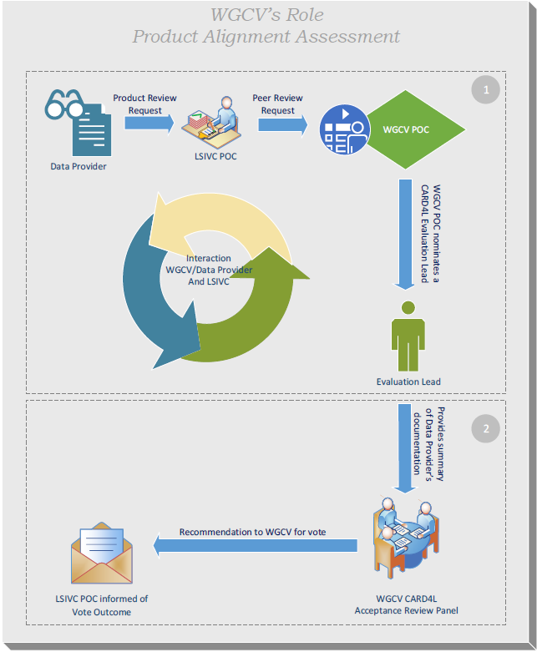
Steps in the peer review process
CARD4L peer review request from LSI-VC to WGCV PoC
WGCV Evaluation Lead nominated
Evaluation Lead verifies data provider's documentation and makes it available to the WGCV CARD4L Acceptance Review Panel
Acceptance Review Panel considers documentation and provides the final recommendation for vote to the WGCV membership
Outcome of the vote communicated to the LSI-VC PoC

Slide 4
Discussion
Pool for Review Panel
Evaluation Lead (M Thankappan)
WGCV member at large (N Fox)
IVOS subgroup member (J Czapla-Meyers, C Anderson, L Ma)
LPV subgroup member (F Gascon, F Camacho)
SAR expertise (B Chapman, D Guedtner, N Miranda, T Tadono)
Land Surface Temperature expertise (D Ghent, F Goettsche)

Slide 5
Discussion
Actions
Arrangements for setting up the WGCV Acceptance Review Panel – Done at WGCV-45
Sub group leads to confirm members
Communication to the LSI-VC – at LSI-VC / SIT TW

