Slide 1

IVOS/LPV Surface Reflectance Task
Working Group on Calibration and Validation
Fernando Camacho (LPV) , Niguel Fox (IVOS)
Notes:
LPV established as subgroup in 2000.

Slide 2
Background
Working Group on Calibration and Validation
Field based validation is critical to ensure consistency in generation of ARD products such as Surface Reflectance (SR) from multiple sensors
Quantifying measurement uncertainty will help define ‘fit for purpose’ SR products
Surface Reflectance is input for many terrestrial land products, understanding uncertainty in both field and satellite products is essential.
Community consensus protocols (CEOS) on SR still to be written
Several on-going activities (GA Australia, ESA FRM4Veg,..) on SR open a window of opportunity to agree on SR validation protocols, before starting a global SR validation exercise.

Slide 3
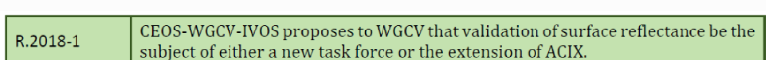
Background
Working Group on Calibration and Validation
IVOS recommendation
LPV recommendation
LPV R-2019-1: To promote ESA FRMVeg protocols under CEOS WGCV, to involve other agencies to get the needed international consensus on the surface reflectance and FAPAR validation protocols.
LPV R-2019-4: In collaboration with IVOS, propose a new CEOS WGCV surface reflectance validation and intercomparison exercise lead by ESA and NPL (UK) in the framework of FRM4Veg.

Slide 4
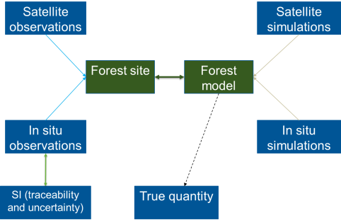
Ideal scenario
End – to – End Traceability (how the product was produced and how the product was validated)
Uncertainty characterisation and propagation (sources and extent of error)
Fully documented with use case examples
Algorithm Traceability Chain
ECV Data Product
In situ Traceability Chain
Validation

Slide 5
Fiducial Reference Measurements
Direct translation of QA4EO to in situ / reference data
In situ measurements / campaigns specifically designed for satellite data/product validation:
  That are rigorous on traceability and uncertainty characterisation
  May provide a means to bridge potential data gaps
  Facilitate interoperability between sensors
Funded by ESA, but is being adopted more widely by other space agencies in the context of CEOS

Slide 6

FRM4Veg
Support the initial validation of Copernicus Surface Reflectance(SR), FAPAR and CCC products from:
Sentinel-3 (FAPAR, OTCI and SYN)
Sentinel-2 (L2A) and PROBA-V (S1 TOC 100m)
Proposing the methodologies for Fiducial Reference Measurements (FRM) and Product Validation for vegetated targets and perform FRM campaigns.
Phase 1 (2019-2020):
FRM protocols and Validation concept
2 field campaigns (Barrax, Wytham)
Phase 2 (2020-2021) (under preparation)
Consolidate FRM protocols for SR, FAPAR and CCC
New campaigns, round-robin intercomparison, workshops, write and review community endorsed protocols
+ European supersites

Slide 7
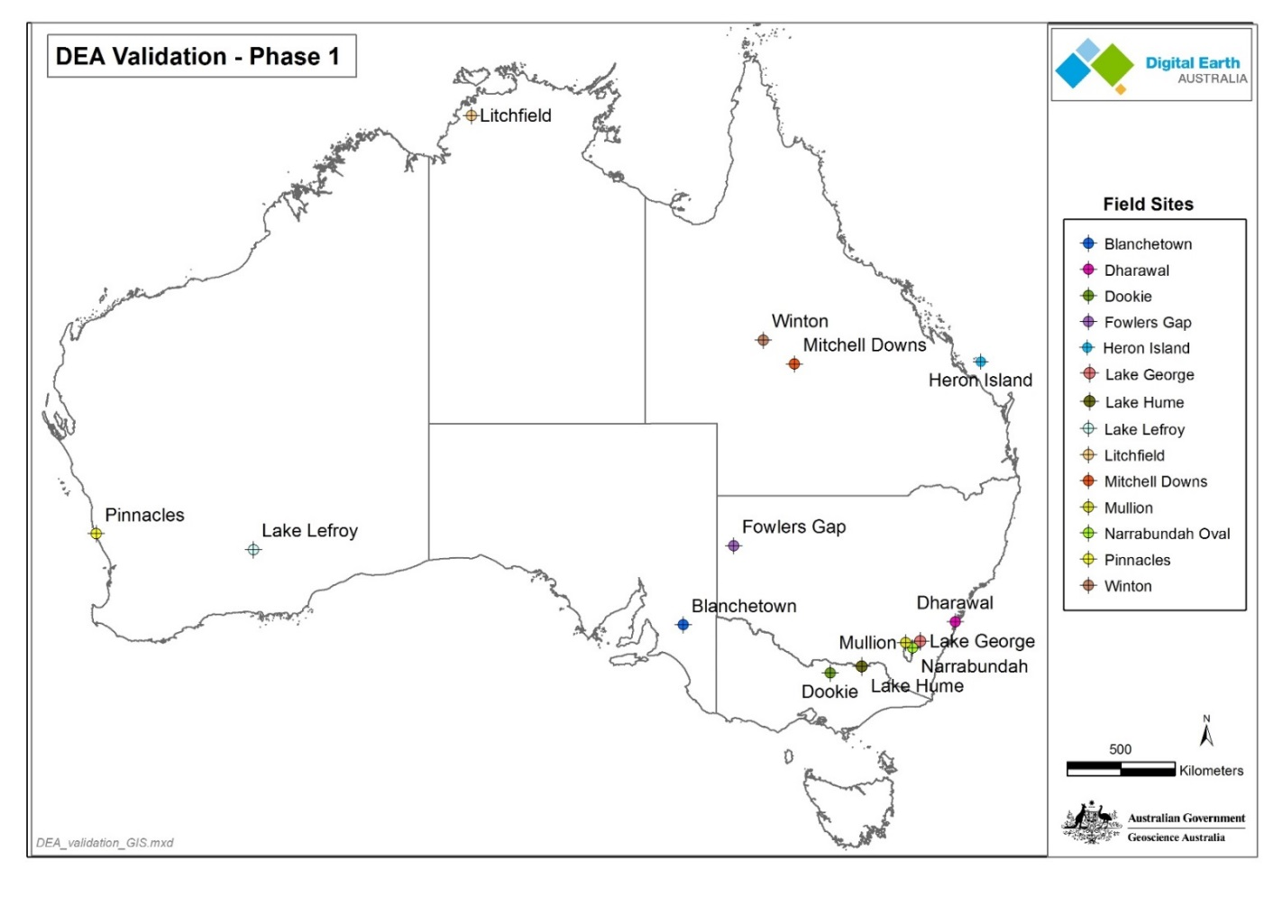
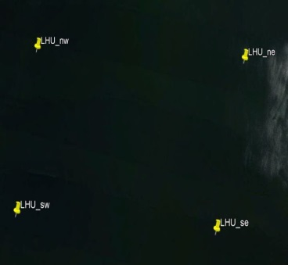
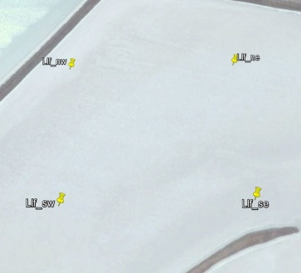
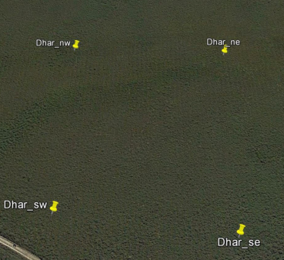
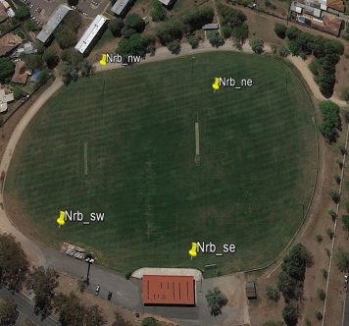
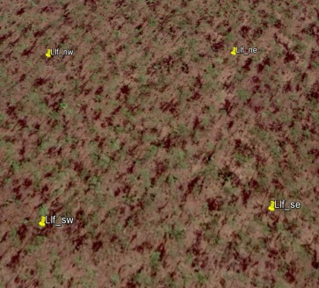
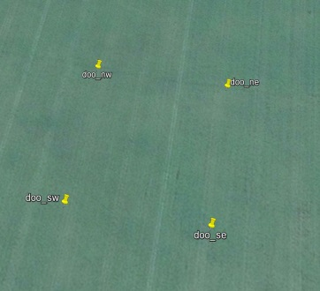
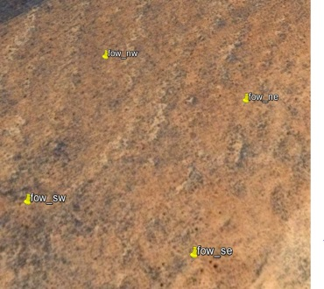
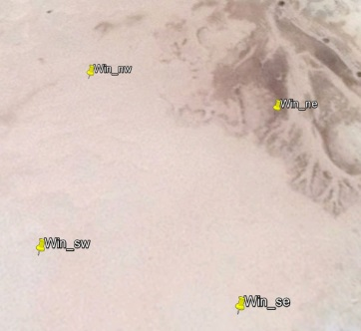
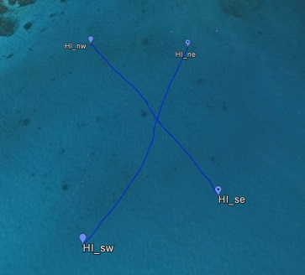
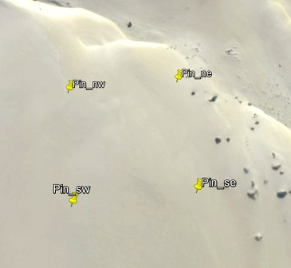
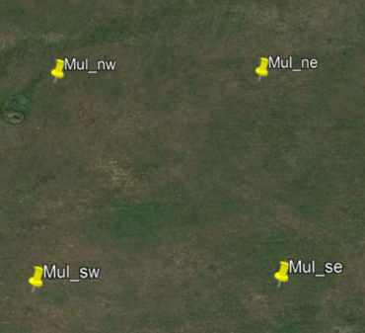
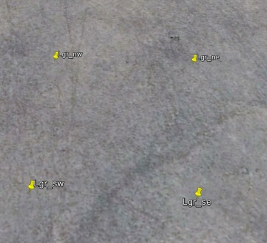
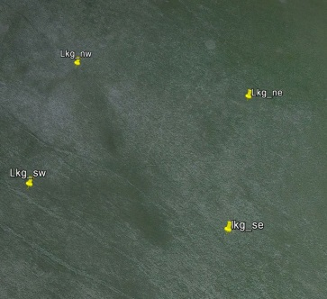
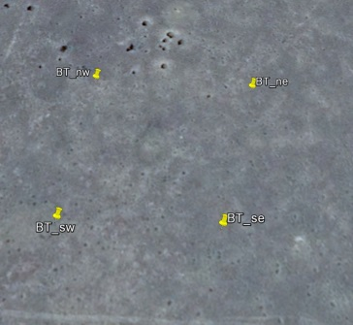













Continental scale SR validation (CV-17)
Surface Reflectance Validation Sites
Surface types
‘mostly’ flat
bare or low vegetation
homogeneous
spectrally diverse

Slide 8

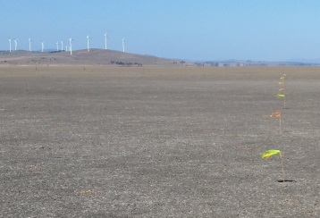
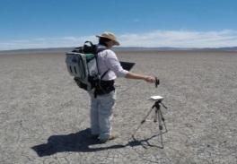
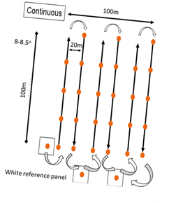
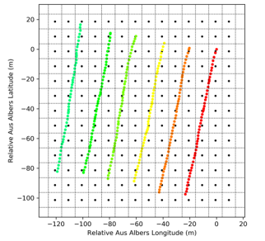
Field data collection for continental scale validation of surface reflectance
Coordinated by CSIRO
All instruments / panels were characterised by CSIRO
100x100m sites
6 transects in each site oriented on the solar azimuth
Atmospheric readings coincident with overpass using either MicroTops or ASD
Transects bookended by panel readings
SR field validation protocols documented
The National Spectral Database will provide free access to field data

Slide 9
LPV - IVOS new SR Task (proposition)
Working Group on Calibration and Validation
Field Surface Reflectance “Round-Robin” inter-comparison exercise, and development of community endorsed SR validation protocols
Lead Agency: ESA (FRM4Veg project), Funding support (ESA Earthnet)
IVOS supporting calibration / traceability of field radiometry,…
LPV supporting consensus validation protocols for SR global
Objectives:
Agree on fiducial reference measurements protocols with full traceability for surface reflectance (SR) characterization (inputs: GA, FRM4Veg,..)
Develop protocols for global SR validation (field radiometry, airborne, models) (LPV type)
Perform RR inter comparison of SR, to learn and refine FRM protocols
Organize two workshops before and after RR for discussion on protocols, field experiment and outcomes
Publish RR inter-comparison results
Outcome: Endorse FRM4Veg SR protocols under CEOS WGCV (LPV-IVOS)
Period: 2020 - 2021 (RR exercise in June-July 2021, Europe)
On the horizon: Validation of SR products using community endorsed protocols

Slide 10
If Agree ?
Working Group on Calibration and Validation
Establish a small task group to define CEOS wide strategy in terms of consolidating and agreeing consensus protocols
Prepare and distribute initial indicative invite for inter-comparison exercise
  Identify number of likely participants
  Scope and scale of task etc
  Single end to end validation exercise
Develop strategy for potential CEOS (network) building on RadCalNet
Develop strategy and plan for a validation exercise as part of an ACIX 3

Slide 11

Time for discussion

