Slide 1

Towards a (joint?) DEM Quality Framework
P. Strobl
European Commission
WGCV Plenary # 45
CSIRO, Perth, Australia
July 16-19, 2019

Slide 2
Rational – Why DEMs are important
The Earth is not flat! (we’ll come to that later)
No validated DEM → no correct geometry.
No validated DEM → no correct radiometry.
No correct geometry or radiometry → no ‘interoperability’!
DEMs usually are NOT proprietary to an EO mission (unless they are its target).
DEMs usually are NOT considered upon the outset of most EO missions, but are added as kind of commodity later in the ground segment.

Slide 3
DEMs in Copernicus
2010-2012 as part of the GMES Initial Operations (GIO) the EU-DEM was procured to serve as a reference data set throughout the 39 EEA member states (EEA39).
It was produced by an industrial consortium as a merger of the SRTM v4.1 (CGIAR-CSI) and the ASTER-GDEM V1.0 on a 1” lat/lon ETRS89/EVRS2000 grid later resampled to 25m ETRS89-LAEA (EPSG:3035)
Quality was highly disputed (ASTER GDEM V2 became available end 2011). Overall accuracy was confirmed in 2014 at around 3m (RMSE), but varies with location, terrain, and land cover between 2 and 10m (RMSE) or 2-20m (LE95).
Since 2014 the EU-DEM continuously ranked among the 3 most downloaded datasets on EEA portal.
IN 2017 an initiative started to procure a global reference dataset: Copernicus-DEM.

Slide 4
Copernicus-DEM
Objective → To procure a global high-resolution Digital Elevation Model (DEM) with sufficient accuracy and resolution for usage across the whole Copernicus Programme
Key need → a consistent global world coverage over all areas
Key use case → Sentinel-2 orthorectification (@10m)
Key constraint → procurement envelope
Only a global DEM derived from space data allows to meet the key points

Slide 5
Copernicus-DEM instances
DEM instance | Geographical coverage | Horizontal sampling | DEM licence
Global (GLO-90-F) | Global | 90 m | Full, free and open
Global (GLO-30-R) | Global | 30 m | Restricted
Europe (EEA-10-R) | EEA39 | 10 m | Restricted
https://ec.europa.eu/growth/content/copernicus-digital-elevation-model-dem_en
GLO-90-F license allows its unrestricted usage in full, free and open conditions
GLO-30-R and EEA-10-R licenses allow usage for:
  Sentinels data processing within CSC ground segment
  Copernicus Contributing Missions data processing within contributing ground segments
  Usage by Copernicus Services, Copernicus Entrusted Entities and EU Institutions/Bodies

Slide 6
… and then?
A reference data set for a program the size of Copernicus will be scrutinized
In anticipation of user demands a benchmarking against well known and established data sets was envisaged
How is this best done?
On search for expert advice Geomorphometry.org was contacted
Idea for a Workshop on Global DEM Benchmarking was borne, hosted by EC-JRC and co-organized with Geomorphometry.org

Slide 7

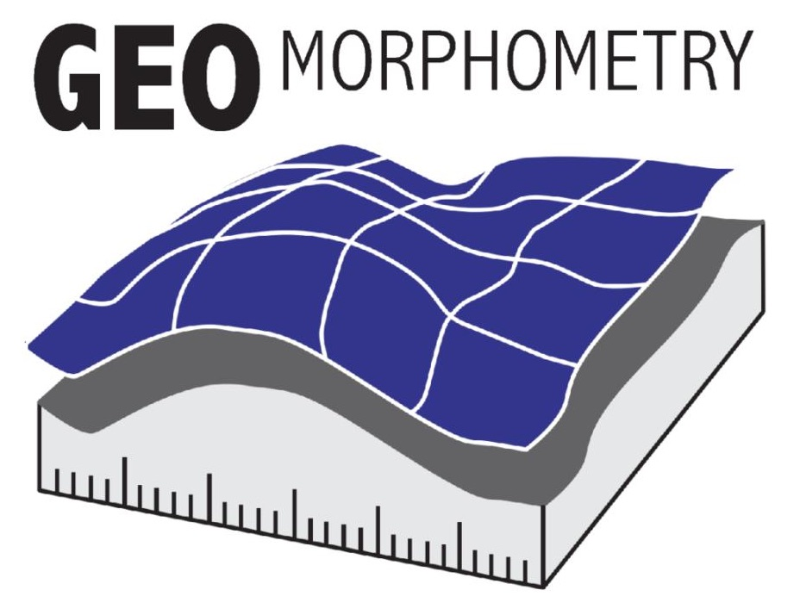
JRC Workshop on Global DEM Benchmarking
Took place at JRC Jan 16-19 2019.
22 DEM experts from around the world attended
Agreement to issue a white paper on the state of the art of DEM products and their quality assessment
Recommendations:
  Revival of the CEOS TMSG
  - link with Gemorphometry.org
  - work towards a ‘DEMIX’
  Guidelines for shoreline Bathymetry
  Guidelines for DEM-Fusion
  Create communication platform,
  ‘one stop shop’
Executive summary
I. Terminology
II. Review of Global DEM+Validation surfaces/points
Analytical basis
Quality Metrics and relation to application domains
V. Opportunities & Challenges
(ensemble, photon, data architecture, future IT, global grids, CalVal, submarine, further to be added)

Slide 8
What is a DEM? … and what not?
Unambiguous and shared terminology is a prerequisite of any joint endeavor (since Babylonian times)
Definition: DEM (digital elevation model): general term for a georectified grid-based digital representation for a topographic surface, composed of elevations on the Earth.
  Consequently, DEMs are commonly referred to as having 2.5 dimensions (2.5D) and not three dimensions (3D). Alternative structures for digital topography, like triangulated irregular networks (TINs), contours, and point clouds are not DEMs because they are not grids. Digital bathymetry is a DEM, as the collection method with sonar is not fundamentally different from the lidar, optical, or radar collections on land, which themselves have different characteristics, and the gridded representations are similar and must increasingly be integrated for coastal models.

Slide 9
What are the most important features of a DEM?
Before talking about quality we must fix the metrics which characterize our subject. Three main groups were identified:
Linear differences (or error) statistics such as RMSE, LE90, CE90, Median and normalized median absolute difference (NMAD), separately for horizontal and vertical directions, by e.g. slope, land cover, and not generalized over more than 10⁶-10⁷ values.
Morphological descriptors, e.g. differences in slope, aspect, roughness and in their distribution. Complex morphological metrics like number of peaks and pits, length of ridges and troughs, number of outliers (spikes), consistency of stream networks.
Other: Autocorrelation length, SNR,
Non quantitative: Completeness and reliability of Metadata

Slide 10
What is consistency or coherence?
So far these are rather qualitative terms which are however frequently and interchangeably used as quality criteria.
Need for a (better) definition!
and if possible quantification!

Slide 11
What is a ‘good’ DEM?
Once we agreed on the metrics to describe a DEM we can set threshold and target values, which however will depend on the application!
For orthorectification:
  Most important is maximum observation angle and then GSD
  DEM must share same Reference Geometry as imagery
For terrain correction:
  Slope and Aspect must be realistic, to better 10º
  DEM and imagery must be co-registered at (sub-?)pixel level

Slide 12
Which is the better DEM?
Assessment of DEMs requires either to establish their absolute accuracy or to compare them with each other (relative)
Validation requires a reference which is considerably higher in accuracy than the validated data set
Benchmarking can be performed between any compatible data set
If multiple data sets are to be benchmarked against each other it might however be desirable to use one as reference

Slide 13
Towards “DEMIX” a global DEM Intercomparison Exercise
P. Strobl
European Commission
WGCV Plenary # 45
CSIRO, Perth, Australia
July 16-19, 2019

Slide 14
Towards “DEMIX” a global DEM Intercomparison Exercise
P. Strobl
European Commission
WGCV Plenary # 45
CSIRO, Perth, Australia
July 16-19, 2019

Slide 15
Organisational Prerequisites
Commitment of at least all (quasi) global free&open DEM providers
Invitation to all commercial providers of at least continental DEMs
Agreement of all participants on technical baseline
Realistic estimate of effort
Resources for coordination and logistics (meetings etc.)
ACIXS, CMIX, other-IX of any help?

Slide 16
Approach
Call for expression of interest to all CEOS partners (plus Industry?)
Condition:
  Access to at least continental scale DEM
  Commitment to release benchmarking results
Select one global DEM as reference (by consensus, majority?)
Criteria:
  global coverage
  validated accuracy (x, y, z)
  grid spacing (as proxy for spatial resolution)
  accessibility

Slide 17
Approach cont’d
Determine a suitable sub-tiling of the reference DEM
Perform (correlation?) matching between the reference DEM and the S2-GRI (using shaded relief technique) and analyse eventual co-registration issues
Calculate the agreed comparison metrics for each candidate with the reference
Publish results

Slide 18
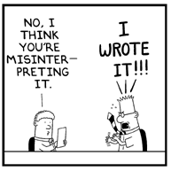
Open issues
Do we need a multiscale approach (30”, 3”, 1”, 0.33”)
Do we need a global grid, if so, which is the most suitable?
other?
… and after all: Does that fit with WGCV?

Slide 19
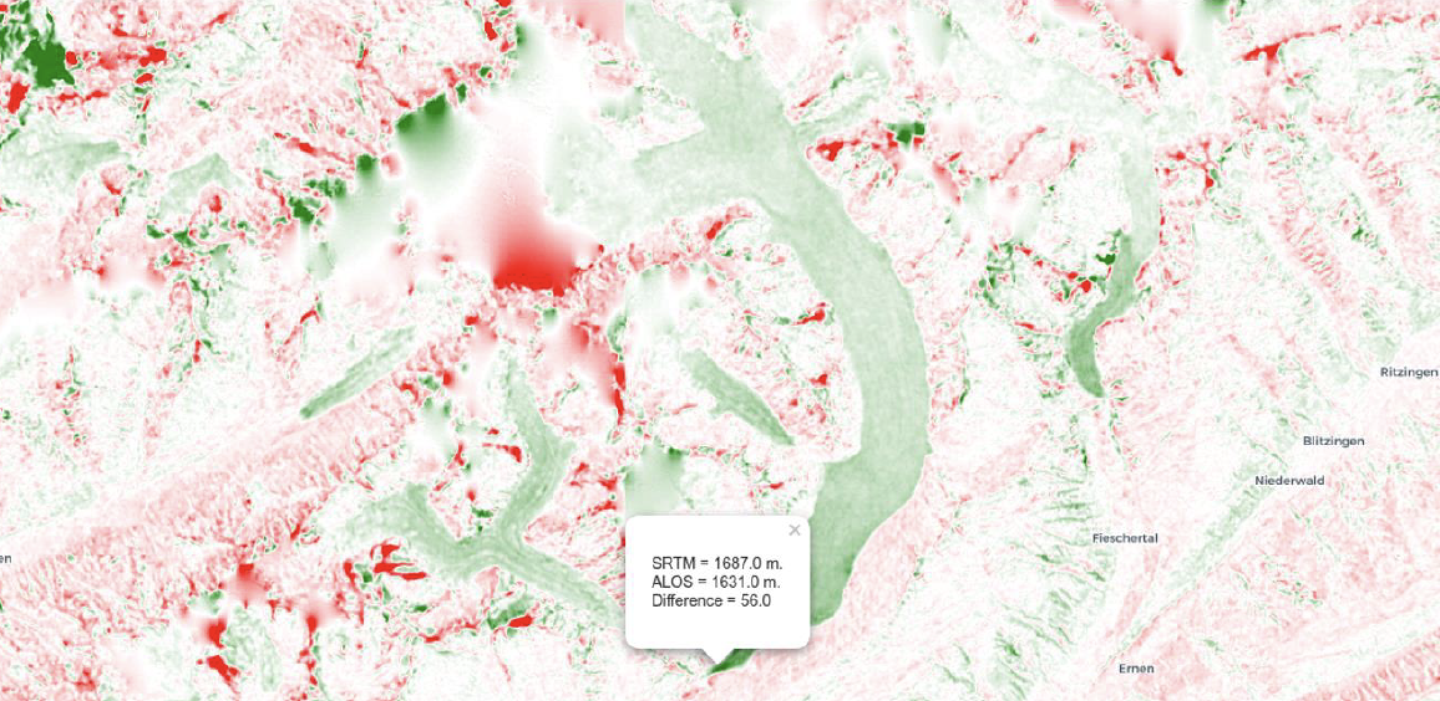
Questions?
Thanks!

