Slide 1



Agency Report
Academy of Opto-Electronics(AOE),Chinese Academy of Sciences(CAS)
WGCV-45 Plenary
Ning Wang, Lingling Ma, Chuanrong Li, Lingli Tang
Key Laboratory of Quantitative Remote Sensing Information Technology, Chinese Academy of Sciences, Beijing, China
Department of Earth Observation Technology Application,
Academy of Opto-Electronics, Chinese Academy of Sciences, Beijing, China
July 2019

Slide 2
Outline
Activities on Baotou site
Airborne transfer calibration campaign
Advances in spaceborne radiometric transfer calibration research
Consideration of atmospheric & eco-environment comprehensive monitoring scientific platform
Future plans

Slide 3
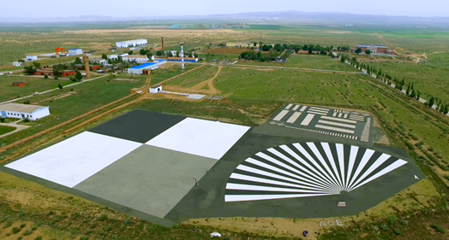
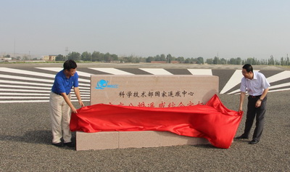
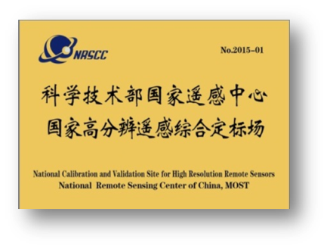
Activities on Baotou site
The Baotou site
Located in Inner Mongolia, China. 50km away from the Baotou city.
It is designated as “National calibration and validation site for high resolution remote sensors” by NRSCC,MOST, and is also one of the demonstration sites of the RadCalNet.

Slide 4













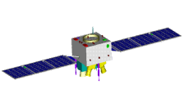


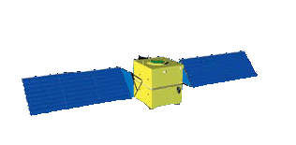
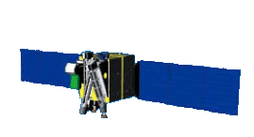


Activities on Baotou site
Support for the Cal&Val of HR satellites.
GF-series
GF-1 01/02/03/04 2m Pan/8m Mux
GF-2 1m Pan/4m Mux
GF-5 HSI 30m
GF-6 2m Pan/8m Mux
ZY-1 02C/ 04a
5m Pan/10m MUX
Land resources satellite series of China
ZY-102C/ CBERs-04
GF-1/2/3/5/6
National major project of high resolution EO system
ZY-3 01/02
2.1m Pan/5.8m MUX
Mapping satellite DEM
production
High Res.
SATELLITE
ZY-3
01/02
SJ-9 A/B
2.5m PAN/10m MUX
Civil new technology experiment satellites
SJ-9a/B
SV-1 01/02/03/04
0.5m Pan/2m MUX
China's commercial HR satellite constellation
BJ-2
SV-1
Micro sat.
CX-1
HSI(128 bands) 30m
OHS-series
HSI (32 bands) 10m

Slide 5
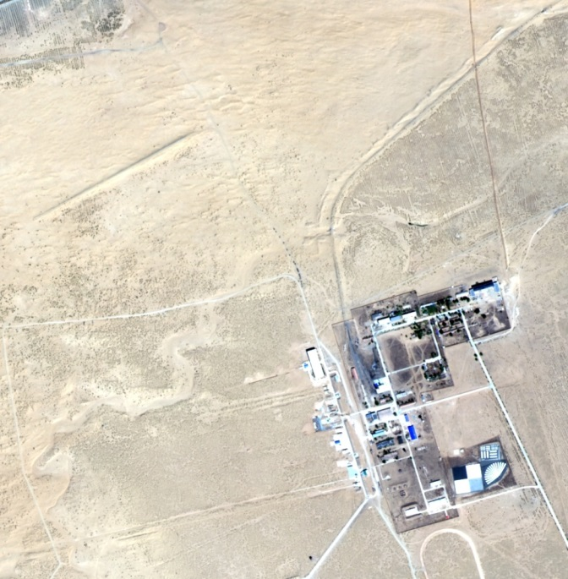
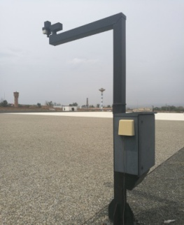
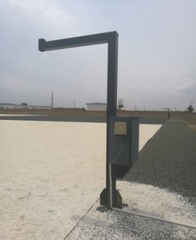
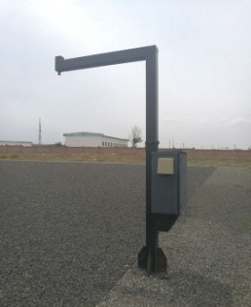
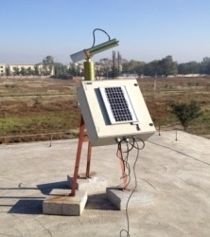
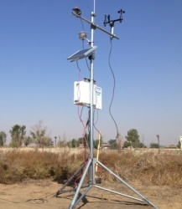
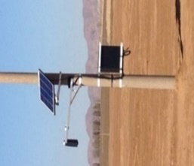
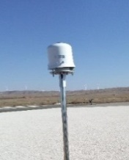
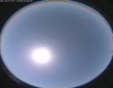

Activities on Baotou site
Surface spectral reflectance measurements: there are now five suit of automatic observation systems employed spectroradiometers for surface reflected spectral radiance in Baotou site.
Sun-photometer, meteo station and all-sky imager are used to observe the atmospheric and cloud.
Sandy site
1.8km
Meteorological station
Cimel CE318
Permanent targets
SV-01 MUX (2018/5/2 12:03:54)

Slide 6
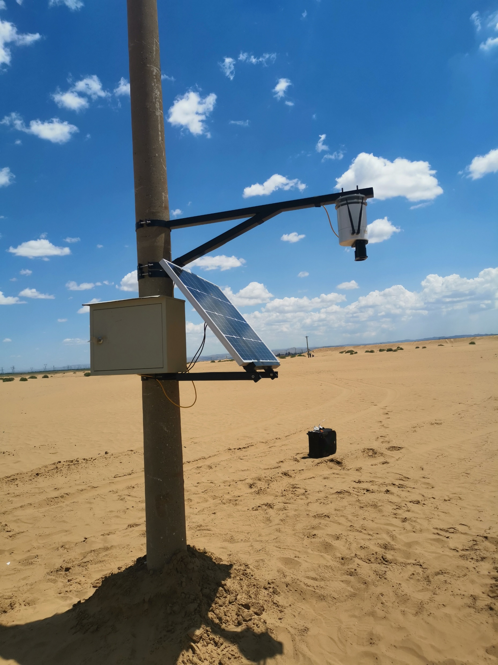
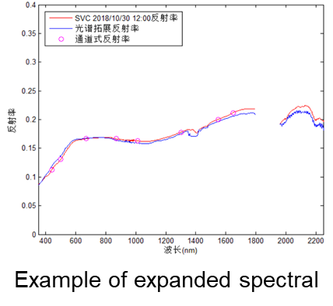
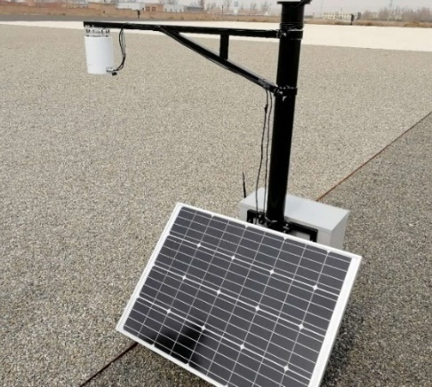
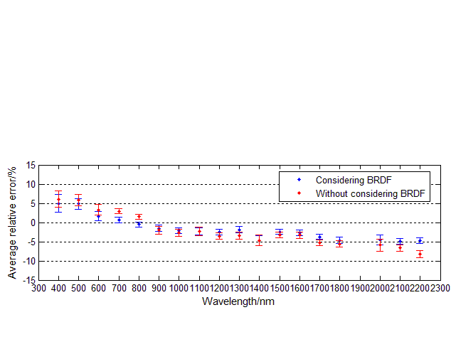
Activities on Baotou site
Improvement -- Increase of multi-channel radiometers
High-stability low-cost multi-channel radiometers are developed. Up to now, one radiometer has been deployed on gray target and three ones have been installed on sandy site.
Towards the spectral expansion problem for multi-channel observations, a reflectivity spectral expansion method considering BRDF effect is developed to take the consideration of variation of Solar zenith angle.

Slide 7
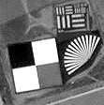
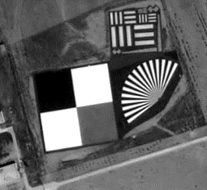
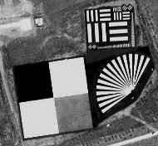
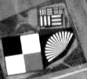
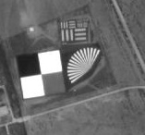

Activities on Baotou site
Comparison of predicted and observed TOA reflectance over gray target on 2018 for Chinese high-resolution satellite sensors
Satellite | GSD | 2018
GF-1 | Pan：2 m MUX：8 m | 3/29, 4/23, 4/27, 10/4, 10/12, 10/16, 12/29
GF-2 | Pan：1 m MUX：4 m | 8/8, 9/21
ZY3 | Pan：2.36 m MUX：5.8 m | 5/27, 6/1, 6/6,7.25, 9/22
ZY-02C | Pan：5 m MUX：10 m | 9/22
SV-1 | Pan：0.5 m MUX：2 m | 4/20, 4/28, 5/2, 5/2, 5/15, 5/17, 5/17, 8/5, 8/9, 8/9, 8/15, 9/20, 9/22, 9/23, 9/23, 9/29
GF-1 Pan 2018/10/12
GF-2 Pan 2018/8/8
SV-1 Pan 2018/9/20
SV-1 Pan 2018/9/22
ZY-3 Pan 2018/9/22
ZY-02C Pan 2018/9/22

Slide 8
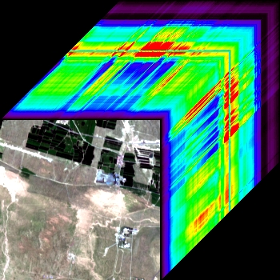
Activities on Baotou site
China’s hyperspectral satellites comparison over sandy site
GF-5 was launched on May 9 2018. The Advanced Hyper Spectrum Imager (AHSI) is one of GF-5’s main sensor for terrestrial high resolution remote sensing.
GSD | 30 m
Spectral range | 0.4-2.5 μm
Spectral resolution | VNIR ≦ 5 nm; SWIR ≦ 10 nm
radiometric calibration accuracy (SD & SDSM) | Absolute:5%; Relative:3%
Spectral calibration accuracy (LED) | VNIR：≦0.5nm；SWIR：≦1.0nm
Swath | 60 km
Bands | 330 (VNIR:150，SWIR: 180)
Revisit period | 51 days (no side-looking) 5 days (with 25°side-looking)
Sandy site
GF5/AHSI cube (WVC=1.78, AOT=0.074 @ 2018/8/8 13:46:18)

Slide 9
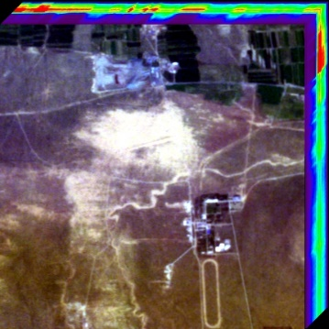
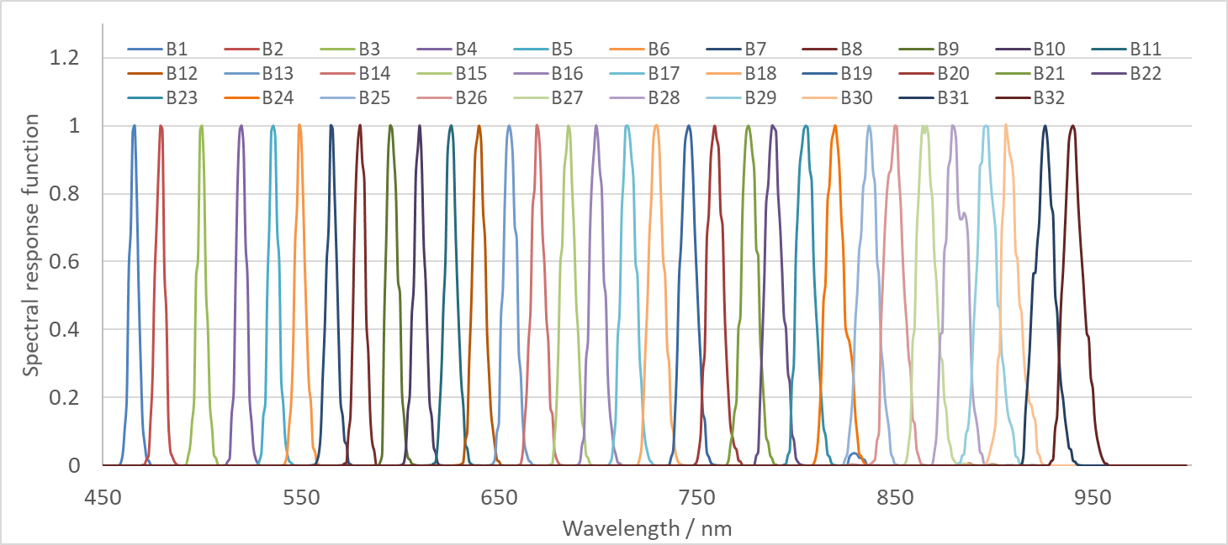
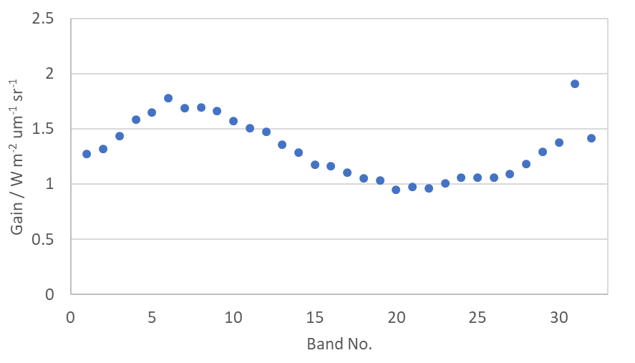
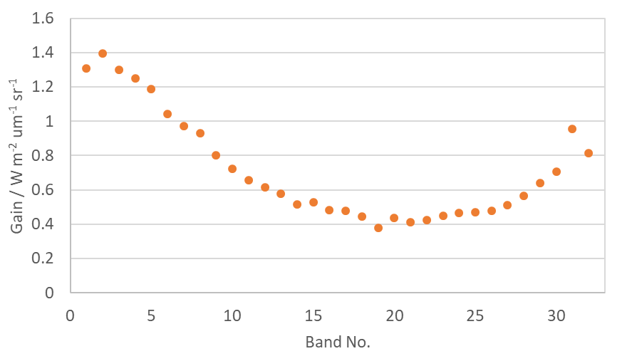
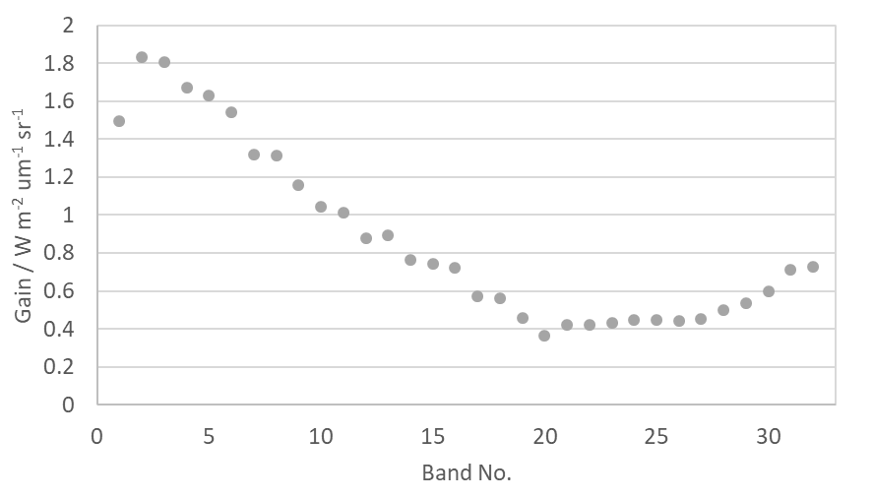
Activities on Baotou site
China’s hyperspectral satellites comparison over sandy site
OHS commercial constellation (OHS2A, OHS2C, OHS2D) (Orbita Aerospace Ltd.) was launched on Apr 26 2018.
The hyperspectral imagers aboard: 10m GSD, spectral range 400nm~1000nm, 32 bands, mean spectral resolution 2.5nm.
No pre-launch laboratory calibration data available. No internal calibrator onboard the satellites.
Twelve times of automatic radiometric calibration were carried out during Aug to Oct 2018, base on the sandy site.
OHS2A image (2018/9/22)
OHS2C (2018/9/12)
OHS2D (2018/8/22)
OHS2A（2018/9/22）
Radiometric calibration coefficient of OHS hyperspectral imagers

Slide 10
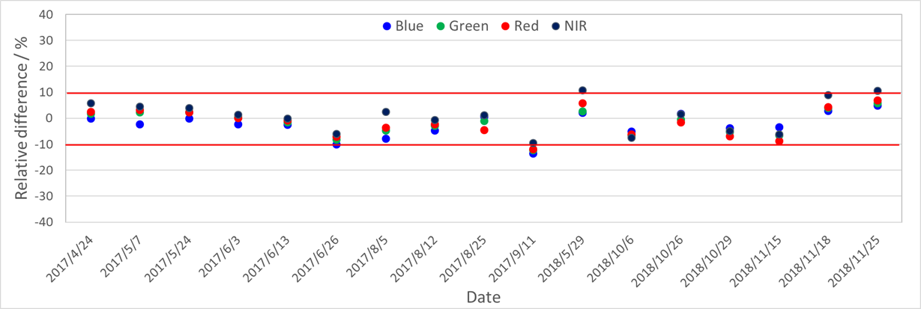
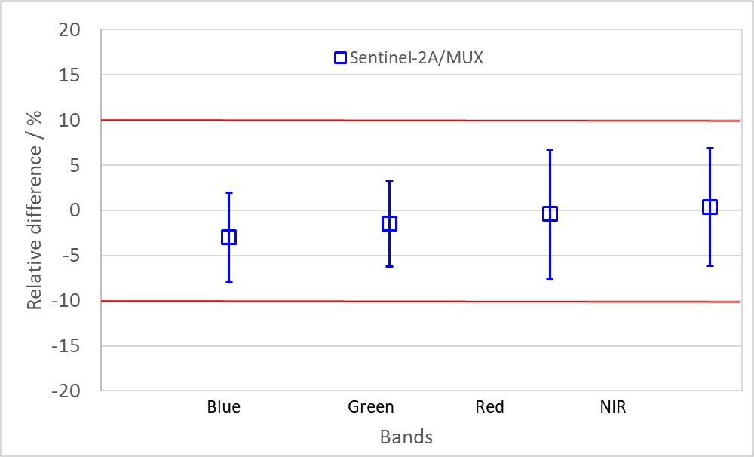
Activities on Baotou site
Comparison of predicted and observed TOA reflectance of Sentinel-2A/MSI
Results show that the averaged relative error for the blue, green, red and NIR between predicted and observed TOA reflectance are -3.0%, -1.5%, -0.4%, 0.4%, respectively.

Slide 11
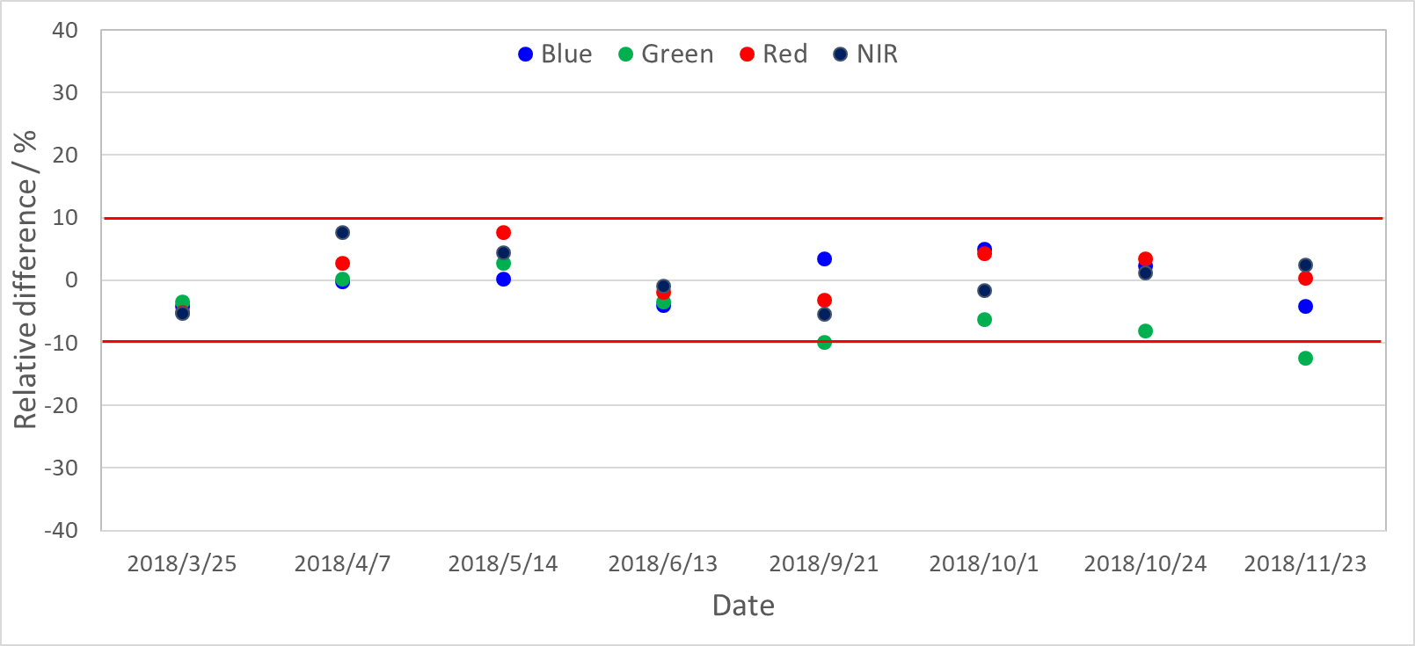
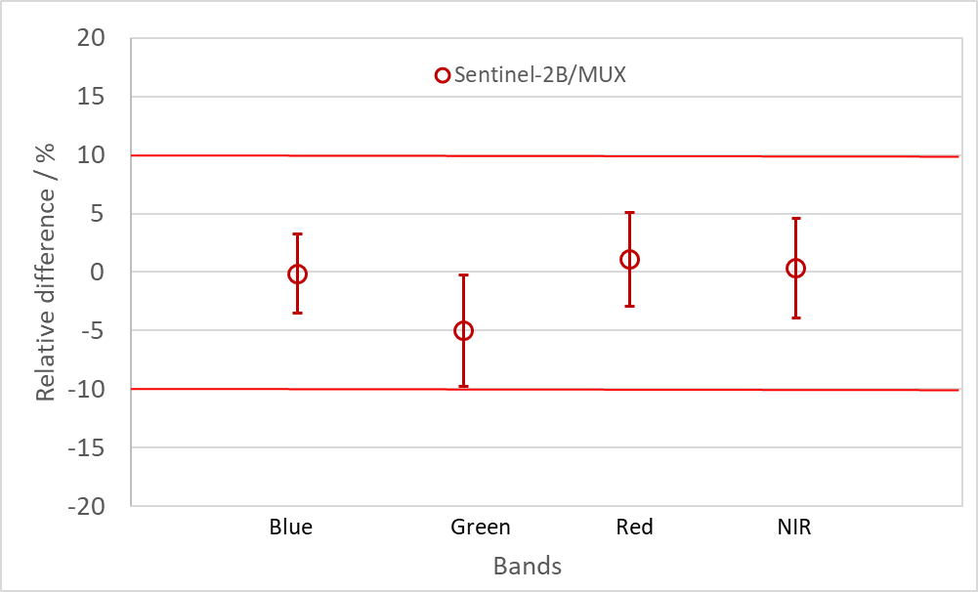
Activities on Baotou site
Comparison of predicted and observed TOA reflectance of Sentinel-2B/MSI
Results show that the averaged relative error for the blue, green, red and NIR between predicted and observed TOA reflectance are -0.2%, -5.0%, -1.1%, -0.4%, respectively.

Slide 12
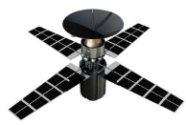



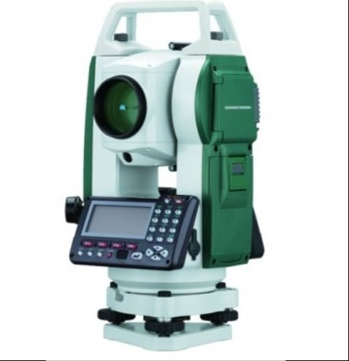
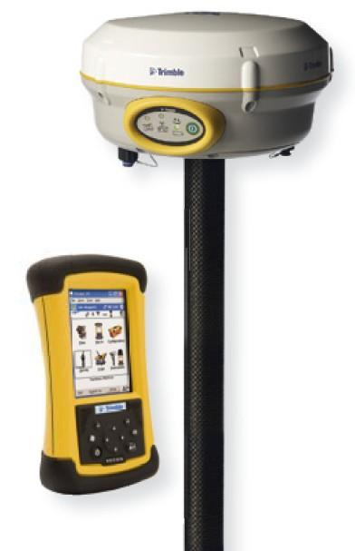
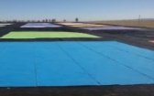
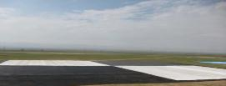



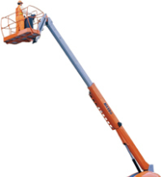
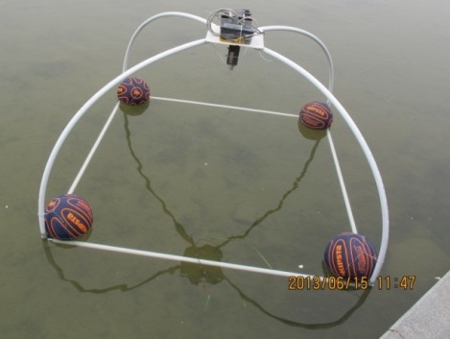

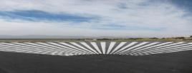
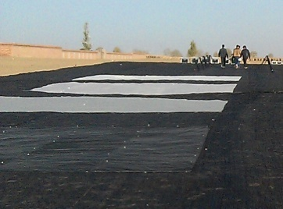

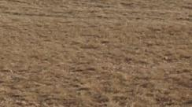
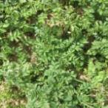

Airborne transfer calibration campaign
Consistency transfer calibration is an efficient approach to improve the quality of satellite remotely sensed data. In this system, the measurement benchmark is obtained with ground-based and airborne standard instrument and then transferred to satellite sensors.
3 Key components
Benchmark transfer method
Different types of artificial targets and natural scenes
benchmark
Standard ground instrument and airborne payloads traced to SI
benchmark
benchmark
SI
Ground measurement system
Artificial standard targets
Natural ground scenes

Slide 13
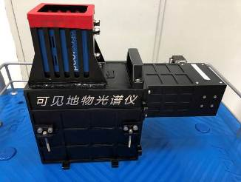
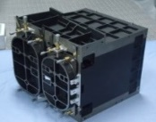
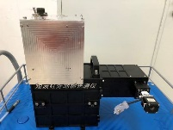
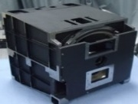
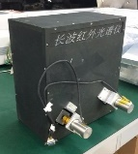

Airborne transfer calibration campaign
Ground-based and airborne hyperspectral imagers which have the consistent design parameters with self-calibrators are developed.
Ground hyperspectral imager
Airborne hyperspectral imager
Covering the same spectral range
More channels and higher resolution for ground imagers
Self-calibration units
Lab calibration traced to SI
VNIR
VNIR
400-1050nm
650 channels
0.002m@1m
400-1050nm
300 channels
0.5m@1km
SWIR
SWIR
1000-2500nm
300 channels
0.002m@1m
1000-2500nm
170 channels
0.5m@1km
LWIR
LWIR
8-12.5μm
150 channels
0.01m@1m
8-12.5μm
75 channels
0.5m@1km
Calibration accuracy at actual working condition
Factors | VNIR | SWIR | LWIR
Uniformity of self-calibrator | 2.00% | 2.00% | 0.2K
Stability | 1.0% | 1.0% | 0.1k
Transfer uncertainty | 1.0% | 1.0% | 0.2K
Total Uncertainty(k=1) | 2.45% | 2.45% | 0.3K

Slide 14








Airborne transfer calibration campaign
Date：13th, Sep – 1st, Oct, 2018
Location：Baotou, Inner Mongolia

Slide 15




Airborne transfer calibration campaign
Air-flight system
Airplane：Cessna 208
Payload：VNIR and SWIR hyperspectral imager
Flight height：2000m (relative altitude)
GSD：1m(VNIR-SWIR)
Ground system
Ground platform：Aerial working platform
Payload：VNIR and SWIR hyperspectral imager. The imagers mounted on a two-dimensional turntable
Height：20m；
GSD：0.04m(VNIR); 0.04m (SWIR)
Reflectance of targets：50%、40%、30%、20%

Slide 16





Airborne transfer calibration campaign
2.2TB hyperspectral data acquired
Portable target
Crop
Sand
Permanent target
Mosaic image

Slide 17





Airborne transfer calibration campaign
Satellite data acquisition
2018.9.23 SV1-02 MS（2m）/Pan（0.5m）
2018.9.21 Sentinel-2B MS（10m）
可见-近红外合成图
短波红外
2018.9.23 SV1-04 MS（2m）/Pan（0.5m）
2018.10.4 Landsat 8

Slide 18





Airborne transfer calibration campaign
Surface auxiliary data acquisition
Within half an hour before and after the satellite overpass, the reflectance of permanent targets, portal targets, sand and cropland were measured with field spectrometer to validate our models and approaches.
固定靶标反射率
高空作业车移动靶标反射率
彩色移动靶标反射率
沙地自然场景反射率
植被自然场景反射率

Slide 19







Airborne transfer calibration campaign
Surface auxiliary data acquisition
Atmospheric profiles

Slide 20







Airborne transfer calibration campaign
Transfer calibration result between ground and airborne imager
Bold blue line：Airborne observation over 40% reflected target
Thin blue lines：Airborne observation ±5.8%（k=2）
Self calibration uncertainty 2.73%（k=1）
Imager stability 1.0% (k=1)
Red line: At-airplane radiance simulation with ground measurement
Ground image
Airborne image
Portable target #1
Portable target #2
Permanent target-grey
Permanent target-white
Permanent target-black

Slide 21






Airborne transfer calibration campaign
Transfer calibration result between airborne and satellite imager
VNIR
SV1-02
Acquisition time： 9.23 12:08
SV1-04
Acquisition time： 9.23 11:51
沙地
Acquisition time：9.23 11:51
Sentinel 2B Acquisition time： 9.21 11:25
SWIR
Acquisition time： 9.29 13:14
LandSat 8 OLI Acquisition time： 10.4 11:24

Slide 22
Airborne transfer calibration campaign
Transfer calibration result between airborne and satellite imager
Simulated TOA radiance over sandy region
Sentinel-2b observed radiance
Simulated TOA radiance
Landsat-8 observed radiance

Slide 23
Advances in spaceborne radiometric transfer calibration research
As a follow-up project, AOE has been in charge of “Space-borne radiometric benchmark transfer calibration and field validation”, which supported by National Key R&D Project of China. The main idea is to bring the radiometric benchmark from lab to space platform to reduce the traceability uncertainties.
Space-borne radiometric benchmark systems
Prototype system for benchmark transfer calibration
Accurately transferring of spaceborne radiometric benchmark to various satellites(2%, 0.2K)
1%, 0.2K
Solar reflected spectrum
SI①
Calibration
Database
Infrared spectrum
SI②
Models and software
SI②
International metrology benchmark
Comprehensive validation site network
NPL
SI②
consistently tracing of the data radiometric quality
Multi-approach benchmark transfer calibration and field validation system
Validation
NIM
Aerostat platform at stratosphere
System integration testing and application demonstration
Standard’s specification
Application
Multi-series optical satellites
Land satellites
Meteorological satellites
Ocean satellites

Slide 24













Advances in spaceborne radiometric transfer calibration research
Cross-calibration for Chinese high-resolution satellite missions
Towards requirement of cross-calibration for HR satellite, we have selected 11 stable target sites with satellite images and in-situ investigation.
With in-situ measurement and satellite products, the characteristics for these sites are obtained.
BRDF measurement with UAVs
Preliminary filter results in Northwest China
Global stable target (e.g. PICS)
Characteristics database
Historical images
BRDF
reflectance
Atmosphere
Location of standard site
Main surface types
Sand
Gobi

Slide 25




Advances in spaceborne radiometric transfer calibration research
Cross-calibration for Chinese high-resolution satellite missions
Multi-observation-parameter coupling transform technical is being studied.
TOA reflectance model for stable target sites is build, to realize the normalization processing between the space benchmark satellite and calibrated satellites.
Time series of MODIS TOA reflectance(Libya4)
Cross-calibration for HR satellite
SI-traceable reference instruments
Calibrated
instruments
The SI-traceable reference instruments could be first used to calibrate the RadCalNet TOA reflectance.
Benchmark
transfer
The calibrated RadCalNet TOA reflectance will be used to calibrate the sensors onboard other satellites.
TOA ref. model
Band 7
Average relative error: 1%-2%；
RadCalNet sites

Slide 26




Advances in spaceborne radiometric transfer calibration research
Cross-calibration for Chinese meteorological and ocean satellites
Spectral compensation technology is explored to compensate for the influence of spectral gap of hyperspectral sensor on transfer calibration.
This method have been validated using CrIS、IASI and gap-filled HIRAS spectra. Results show good agreement.
SNO Intercalibration Regression based on CrIS and HIRAS for MERSI Band 8.55μm
CrIS Gap
HIRAS Gap
HIRAS Radiance Spectra after gapfilling
Blue：Orignal Spectra
Red ：Gap filling Spectra

Slide 27


Advances in spaceborne radiometric transfer calibration research
Cross-calibration for Chinese meteorological and ocean satellites
Cross calibration technique for ocean data with low signal level is being studied. Strict data quality control standard and rigorous constraints have been proposed, and this have been validated with MERSI II/FY-3 and VIIRS data.
Constraints |  | Conditions
Geometric observation | θ_{s} | 18°<θ_{s}<50°
 | △θ_{s} | 0°<△θ_{s}<2.5°
 | θ_{v} | 20°<θ_{v}<38°
 | △θ_{v} | |△θ_{v}|<5.7°
 | φ_{r} | 110°<|φ_{r} | <150°
 | △φ_{r} | |△φ_{r} | <15°
weather conditions | U₁₀ | U₁₀<7.8 m s⁻¹
 | P | 100.5 kPa <P<102.5 kPa
 | CV | CV<0.1
Overpass time | △t | 2 min<△t <20 min

Slide 28







Advances in spaceborne radiometric transfer calibration research
Ground validation networks technology
Large-area uniform natural scenes in China have been selected as candidate validation sites, covering different surface type, including farmland, grassland, Gobi, sand, baresoil and waterbody
Jingyuetan
Hulun Buir
Golmud
Baotou
Minqin
Huailai
Farmland
125.35E
44.45N
167m
Grassland
120.00E
49.34N
632m
Gobi
94.28E
36.42N
2840m
Bare soil
109.62E
40.85N
1311m
Sand
103.22E
38.50N
1398m
Waterbody
115.77E
40.37N
474m
28

Slide 29










Advances in spaceborne radiometric transfer calibration research
Ground validation networks technology
Towards each candidate site, the spatial heterogeneity has been assessed with high resolution satellite images (GF-1, 2m) in 10m, 50m, 100m, 500m, 1km and 5km scales
10m
50m
100m
500m
1km
E.G. Jingyuetan

Slide 30

Advances in spaceborne radiometric transfer calibration research
Ground validation networks technology

Slide 31

Atmospheric & Eco-environment Comprehensive Monitoring Scientific Platform

Slide 32











Atmospheric & Eco-environment Comprehensive Monitoring Scientific Platform
Planned additional atmospheric sounding and component analysis instruments, including Bruker Fourier Transform Spectrometer (FTS)
In-site investigation
Existing facilities in Dinghushan site
Brewer Spectrophotometer MKII
Flux Observing Tower
Growth Rules Observation
Bruker IFS 125 HR
Agilent GC-MS 7010B
Dinghushan site
Canopy Rainfall Observation
Automatic weather station
Cimel CE-318
Radiometrics MP
Sigma MPL

Slide 33
Future plans
1. Spaceborne radiometric transfer calibration research will be a major part of our work:
  Cross-calibration techniques for land, meteorological and marine satellites, include spatial and spectral match, angular normalization, and temporal correction between two satellites;
  Ground-based validation techniques, include ground truth acquisition at pixel scale, local atmospheric radiative transfer calculation, and so on;
  Promote related work on system software development, stratospheric demonstration system design and develop based on high-altitude-balloon platform.
2. Improvement of ground automatic calibration system
  Operational maintenance of current system
  Improve the capability on thermal infrared calibration or validation

Slide 34

Thank you !

