Slide 1
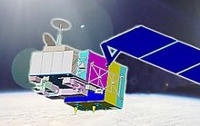
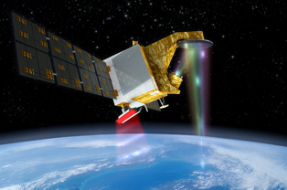
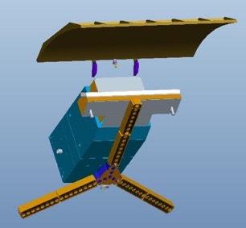
NSSC Update of EO Missions and CAL/VAL
Xiaolong DONG
Heguang Liu
Yongmei Wang, etal
National Space Science Center
Chinese Academy of Sciences
(NSSC,CAS)
CEOS WGCV-45 Perth
July 16-19, 2019

Slide 2

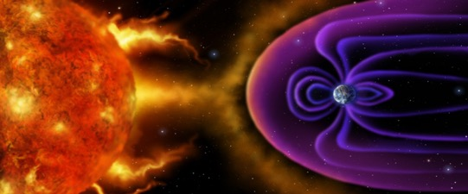
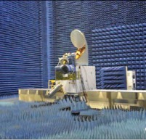
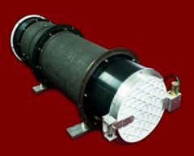
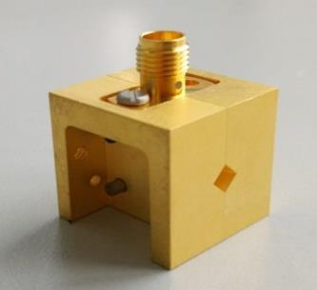
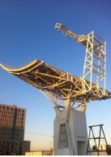
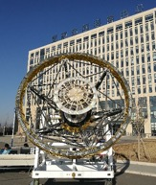
A Snapshot
National Space Science Center, CAS
A Comprehensive institution for Science, Technology, and Engineering
Planning, Development, Implementation and Operation
of Space Science Programs
Research and Development of
Space Science and
Frontier Technologies

Slide 3
Remote Sensing Activities at NSSC
Oceanic Remote Sensing
Atmospheric Remote Sensing
Radar altimetry for ocean surface topography
Radar scatterometry for ocean surface vector wind and current
Microwave radiometry for ocean surface temperature, salinity, wind and pressure
GNSS-R for ocean surface wind and waves
Microwave radiometry for atmospheric humidity/temperature profiling
GNSS-Occultation for atmospheric sounding
UV-Visible spectrometer for atmospheric trace gases and aerosols
Microwave/Millimeter wave radar for cloud, precipitation and atmospheric wind

Slide 4
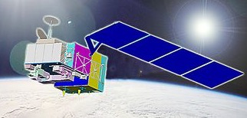
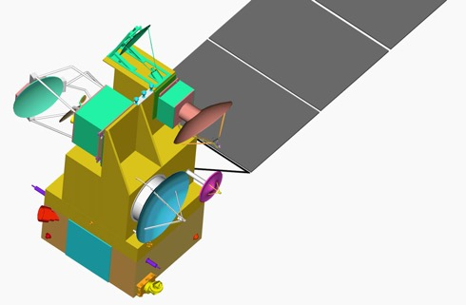

NSSC contributions to Oceanographic
and Meteorological Satellites
HY-2 (Ocean Dynamic Environment Missions)
  Dual-frequency radar altimeter
  Atmospheric Correction MW Radiometer
  Radar scatterometer
TG-2 (Manned Space Flight Mission/Skylab)
  InIRA (Interferometric Imaging Radar Altimeter)
CFOSAT (China-France Oceanographic Satellite)
  Radar scatterometer
COSM (Chinese Ocean Salinity Mission)
  MICAP (Microwave Imager Combined Active Passive)
FY-3 (LEO meteorological Satellite)
  Microwave Humidity/Temprature Sounder
  GNSS Occultation/Reflectrometry Sounder
  Ozone total amount imager
  Atmospheric pollutant and aerosol imager (UV and visible spectrometer)

Slide 5
Update of CAL/VAL Activities at NSSC
Oceanic Remote Sensing
Atmospheric Remote Sensing
CFOSAT Radar Scatterometer
HY-2B Radar Altimeter
FY-3D Microwave Humidity Temperature Sounder
FY-3C/D GNSS Occultation Sounder
FY-3C Total Ozone Unit

Slide 6
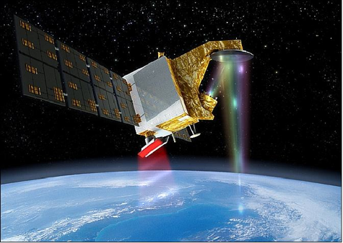
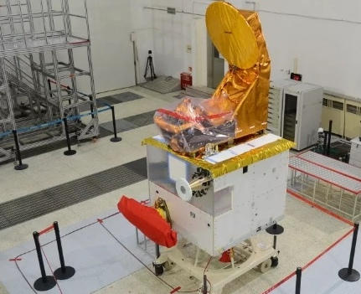
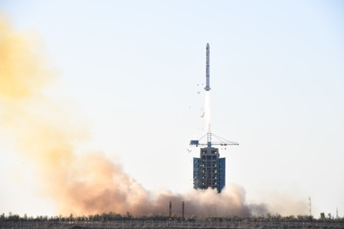
CFOSAT Scatterometer
CFOSAT (Chinese-French Oceanic SATellite) is a China-France jointly developed oceanography satellite
CFOSAT has two radar payload
  SCAT: a Ku-band rotating fan-beam radar scattermeter (SCAT) for ocean surface wind vector measurement;
  SWIM: a Ku-band real aperture radar for measurement of directional
  ocean surface wave spectrum
Launched on October 29, 2018

Slide 7
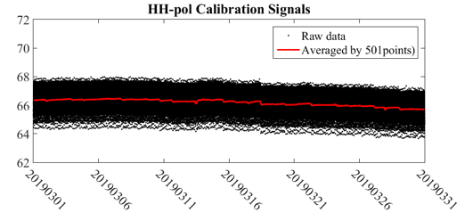
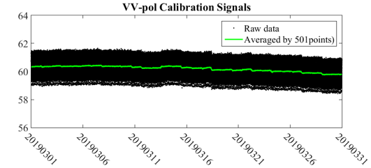
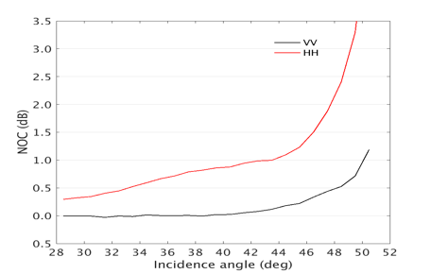
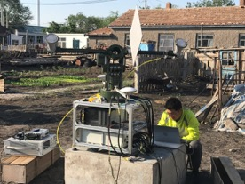
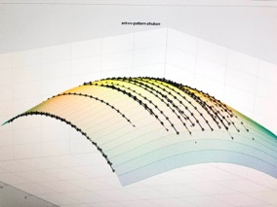
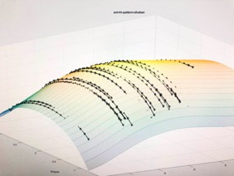
CFOSAT Scatterometer
Calibration activities
  Internal calibration for signals and noises
  NWP ocean calibration for L1B/L2A sigma 0 product
  Transponder calibration for antenna pattern and geoposition

Slide 8
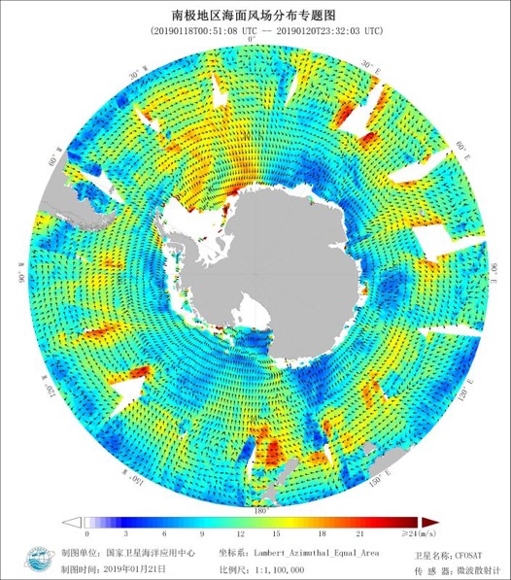
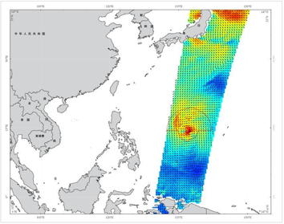
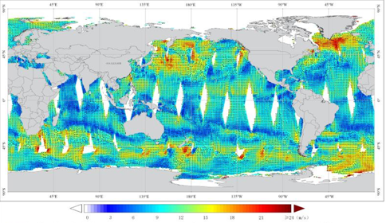
Wind retrieval Results
The wind speed accuracy of CFOSAT SCAT is better than 2m/s.
The wind direction accuracy is better than 20°.
Wind speed accuracy | Better than 2m/s
Wind direction accuracy | Better than 20°
Swath width | >1000km
Surface resolutions | 12.5km/25km

Slide 9
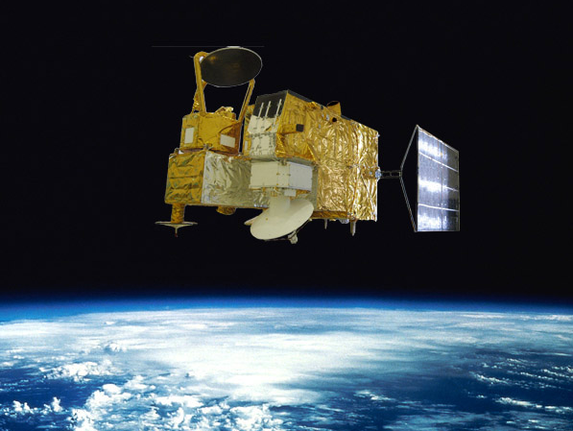
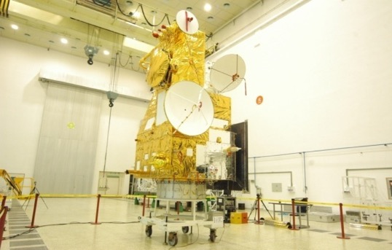
HY-2B Radar Altimeter
HY-2 is oceanic dynamic environment measurement mission
HY-2A and 2B, were launched on August 16th, 2011 and October 25th, 2018 respectively.
The main payloads of HY-2 include:
  Dual frequency radar altimeter
  atmospheric correction microwave radiometer
  Radar scatterometer
  Microwave radiometer (Imager)

Slide 10
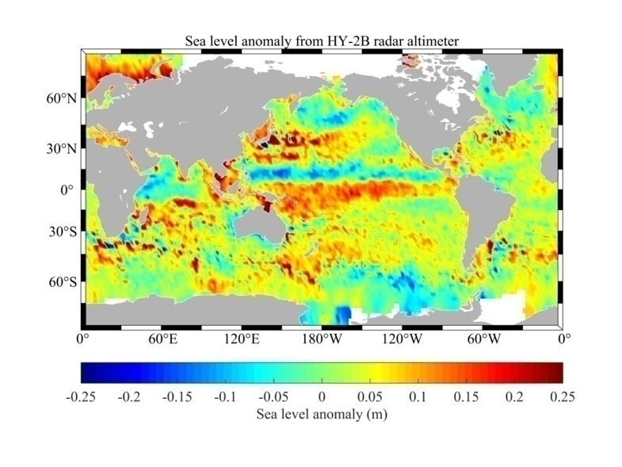
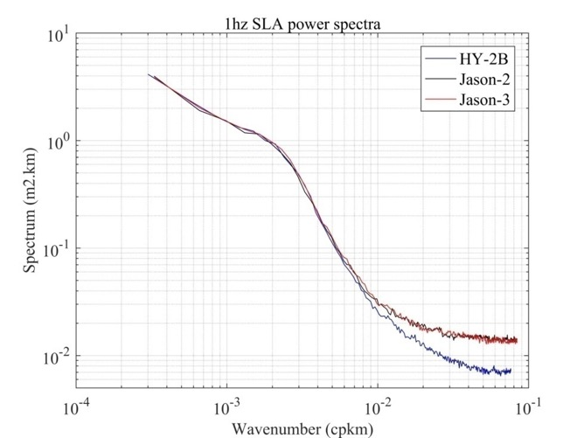
Sea level anomaly for HY-2B altimeter
(2018.12.10～2018.12.24)
Upgrade of HY-2B Altimeter
Using atomic clock as main frequency reference
Sea surface level product: 10cm➔5cm
SLA power spectrum for HY-2B altimeter

Slide 11
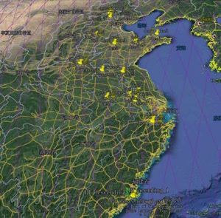
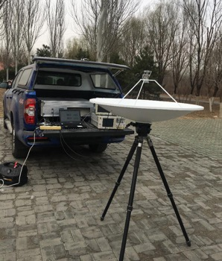
Transponder Calibration for HY-2B Altimeter
Data | Site | Height (m) | Trops (m) | Ionos (m) | Tide (m) | Bias of Clock(m)
2019-04-14 | Putian | 117.43408 | 2.55732 | 0.0664 | 0.106647 | 4.1156e-9
2019-04-23 | Nanjing | 11.28426 | 2.53546 | 0.0221 | 0.072112 | 4.1090e-9
2019-04-27 | Penglai | 102.73701 | 2.40098 | 0.0243 | 0.089858 | 4.0757e-9
2019-04-29 | Weifang | 24.68911 | 2.45455 | 0.0015 | -0.028883 | 4.2098e-9
2019-05-21 | Beijing | 27.95623 | 2.34155 | 0.0223 | 0.003537
Absolute Calibration Accuracy of Elevation | ≤2cm

Slide 12
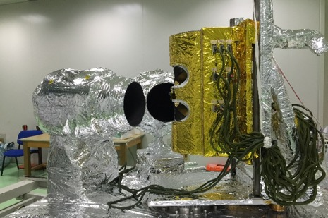
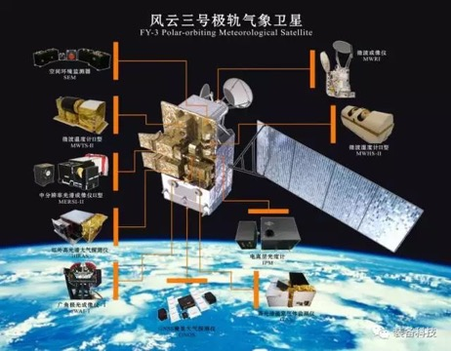
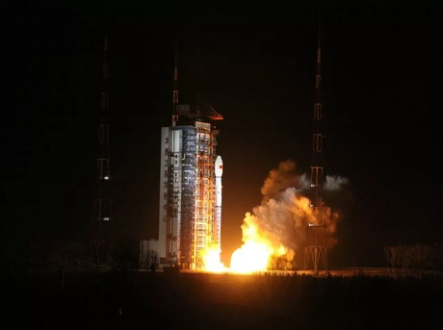
FY-3D Microwave Humidity/Temperature Sounder
channel | Freq(GHz) | FY-3D ON-board NE△T（K）
1 | 89.0 | 0.21
2 | 118.75±0.08 | 1.22
3 | 118.75±0.2 | 0.48
4 | 118.75±0.3 | 0.38
5 | 118.75±0.8 | 0.37
6 | 118.75±1.1 | 0.36
7 | 118.75±2.5 | 0.36
8 | 118.75±3.0 | 0.20
9 | 118.75±5.0 | 0.18
10 | 150.0 | 0.22
11 | 183.31±1 | 0.39
12 | 183.31±1.8 | 0.29
13 | 183.31±3 | 0.29
14 | 183.31±4.5 | 0.28
15 | 183.31±7 | 0.25
FY-3D Satellite Launch Time:
Nov 15, 2017.

Slide 13
O-B results
Emissivity model by FASTEM5, and atmospheric absorption model by MPM93 with water vapor continuum
1. Good results with O-B error distribution
2. Larger error window frequency due to surface emission

Slide 14
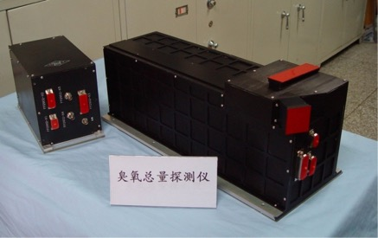
FY-3 Total Ozone Unit (TOU)
Total Ozone Unit (TOU): Total ozone mapping
on FY-3A (May, 2008 --- 2015) , FY-3B (Nov. , 2010 --- )
and FY-3C (Sept. 2013----)
Parameter | Value
Science Objects | Total column ozone, Aerosol (Absorbing aerosol index, AAI), volcanic SO₂
Wavelength range/Spectral resolution | 300-360nm/1.0nm(six channels)
FOV | 3.6°×3.6°
Spatial Resolution | 50km at Nadir
Swath width | 2908km
Number of samples/scan | 31 points in 8.16s
Operation modes | 1. Normal scan 2. Wavelength monitoring 3. Radiometric Calibration
It is the first instrument for daily global coverage of total ozone monitoring in China
User: China Meteorological Administration(CMA)

Slide 15
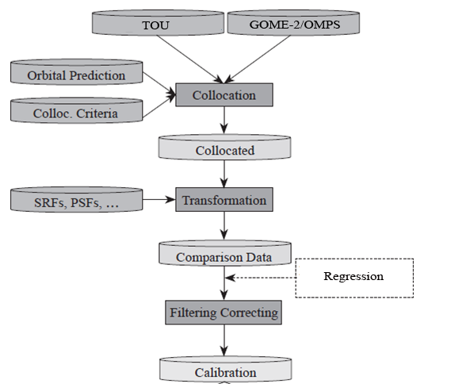
In-orbit Calibration
Methods
(1) Orbit Forecast (SGP): < 5 min
Satellite
(2) Temporally Concurrent: <5 min
Pixel observation time
(3) Location Matching: <3 km
Pixel center
(4) Geometrically Aligned
Viewing geometry
(5) Spatial Collocated (Uniformity estimation)
Inter-calibration includes several steps, including (1)-(6).
(6) Spectral Consistent
Convolution

Slide 16
In-orbit Calibration
FY-3A/TOU vs NPP/OMPS L1B (2013.10.1-13）

Slide 17
In-orbit Calibration
Inter-comparison of FY-3C/TOU vs Metop-B/GOME-2 L1B (2016.11.1-5)

Slide 18
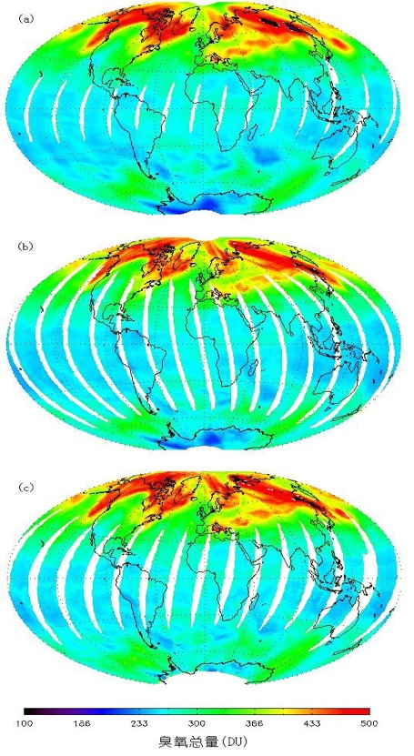
Validation
2009-03-21
FY-3A/TOU
Comparisons amoung FY-3A/TOU、AURA/OMI and Ground-based stations(74): Averaged Bias
AURA/OMI
The average biases of daily ozone were -0.18%, -0.38%, and -0.59% between TOU and OMI, TOU and ground-based measurements, and OMI and ground-based measurements, respectively.
By :
Lawrence E Flynn
（NOAA/NESDIS）
METOP/GOME2
Averaged Bias :< 3%

Slide 19
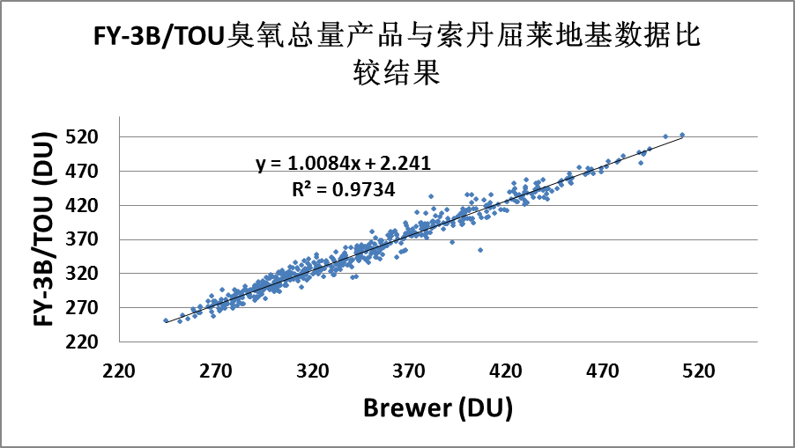
Validation
Comparison of total ozone between FY-3B/TOU and Brewer (Finland).
Mean deviation: 1.45%，RMS Deviation: 2.65%，
R²: 0.9734
Comparison of total ozone between FY-3B/TOU and Metop-B/GOME-2.
R²:0.9937
(Results by Wang Weihe,CMA)

Slide 20
Validation
Comparison result of FY-3C/TOU total ozone amount after calibration and KAUNAS site data (WOUDC station)
Comparison result of FY-3C/TOU total ozone amount after calibration and VALENTIA site data (WOUDC station)
(Results by Wang Weihe from CMA)

Slide 21
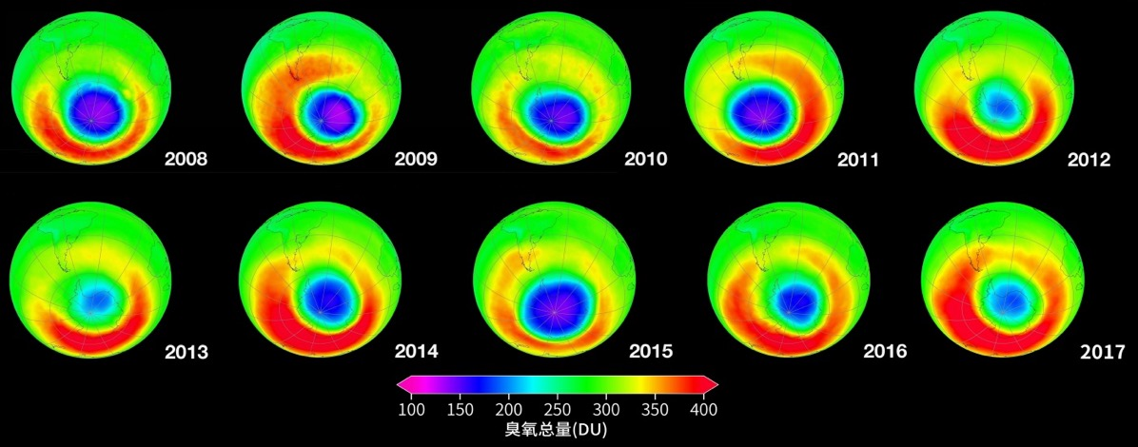
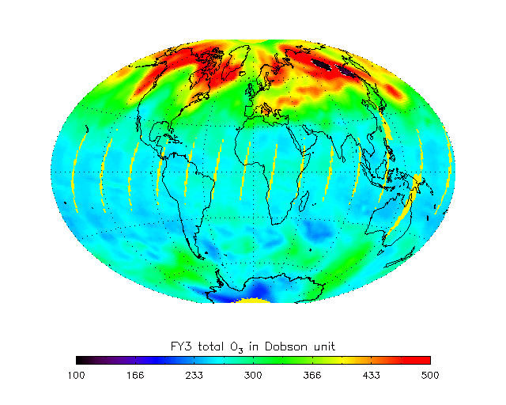
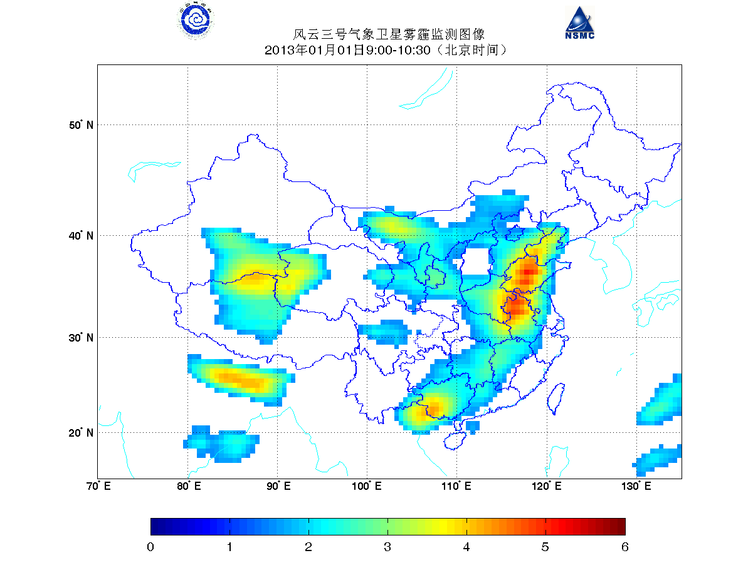
Products
Ozone Hole
2018,2019,
………
http://data.wis.cma.cn/DCPC_NSMC_CMA/open/fy3b/p_touxx_gbal_l2_toz_mlt_gll_poad_110km_ms_txt/bawx/
WMO/WOUDC
Daily global total ozone mapping
The Products By: Wang Weihe,CMA
Dust Monitoring by AAI

Slide 22
Next generation development
FY-3F/HRTOU (High-Resolution Total of Ozone Unit )
  Objects:
  Continue to FY-3/TOU ozone mapping record
  To related trace gases for ozone layer prediction
  Hyper-spectral imaging
  Wide swath telescope yields daily global maps
  High spatial resolution
FY-3F will be launched in 2022
Charactristics | VALUE
Science Object | O3、NO2、SO2、HCHO、BrO、OClO、aerosol、O3 Profile（Nadir）
Wavelength Range | 250~500nm
Channel×Spectral Resolution | UV1:250~300nm×1nm; UV2:300~320nm×0.5nm VIS:320~500nm×0.55nm
FOV | 112°
Spatial Resolution | UV1:21km*28km UV2&VIS: 7×7km
SNR | UV:100-1000 VIS: >1000

Slide 23
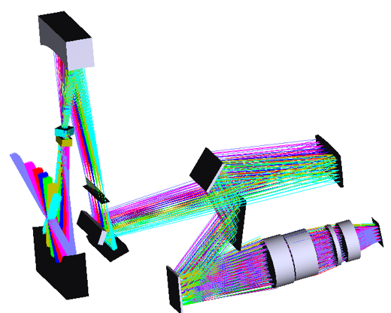
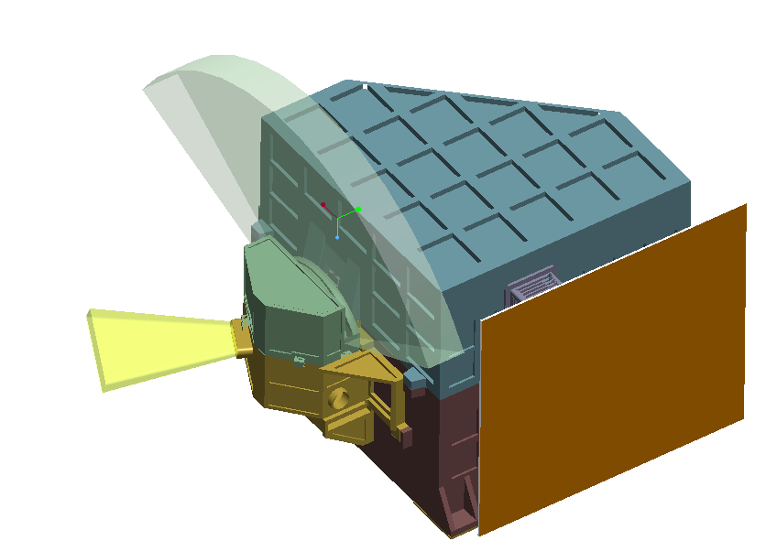
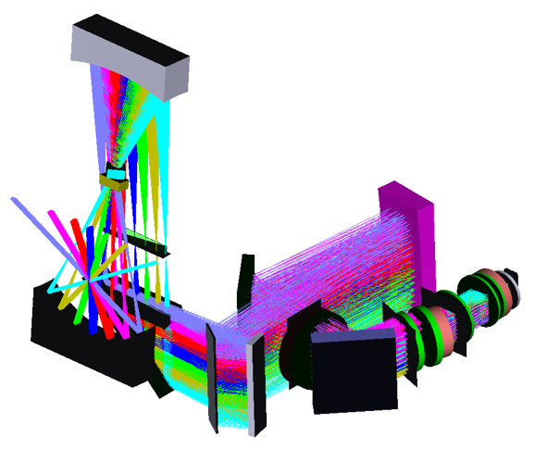
Optical Layout View of HRTOU
UV Channel
VIS Channel
Layout

Slide 24
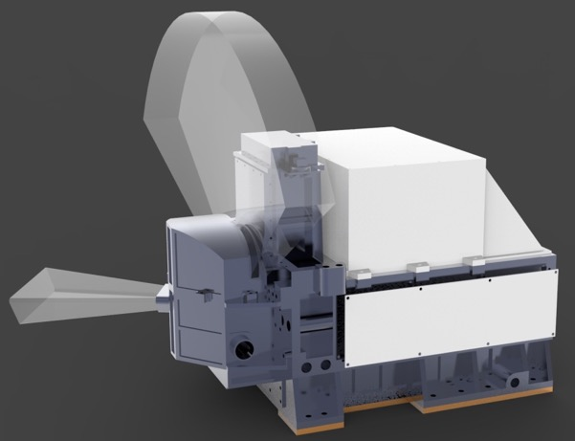
Next generation development
AAS (Absorbing Aerosol Sensor on Gao-Fen 5B Satellite
Index | Characteristics
Science Objects | absorbing aerosol
Spectral range/nm | 340-550nm
Spectral resolution/nm | ～2nm
Field of View | ±57°
Spatial resolution | 4km×4km（at nadir）
SNR | ＞1000（10.89μW/cm² .sr.nm）
Wavelength calibration accuracy | 0.1nm
Dynamic range | 10³
Stray light | 10⁻³
Working mode | Nadir radiance measurement Radiometric Calibration
The AAS is a UV/VIS spectrograph that combines high spatial resolution and lower spectral resolution together with daily global coverage
AAS will be launched aboard GaoFen-5B satellite in 2020.

Slide 25
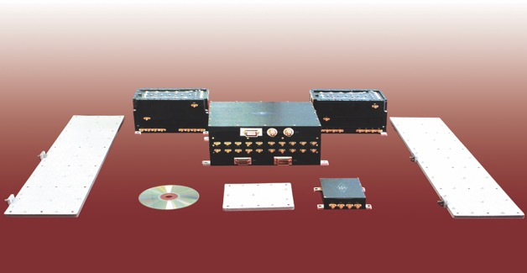
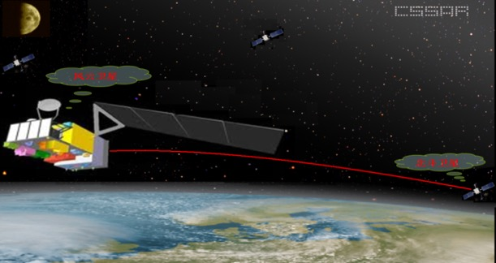
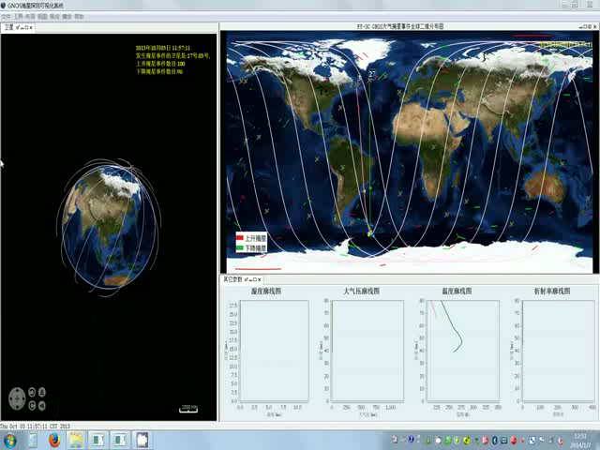
FY-3C/D GNOS RO data products
GNOS (GNSS Occultation Sounder)
FengYun
GNSS
FY-3C/-3D GNOS:
Signals: GPS&BDS;
RO events:
>500 GPS RO events/day
~200 BDS RO events/day
Main atm&ion RO retrievals:
Bending angle (alpha),
Refractivity (N), Density(ρ ),
Pressure (p), Temperature (T), Humidity (q), Ionospheric electron density (Ne) etc.
It is the first GPS/BDS compatible RO receiver all over the world

Slide 26
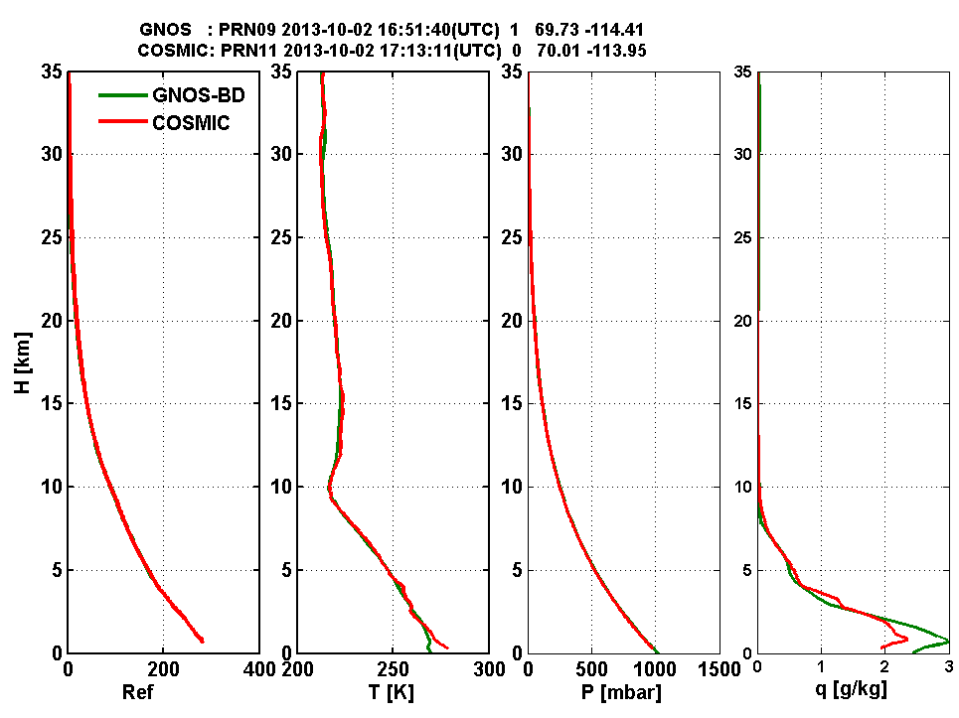
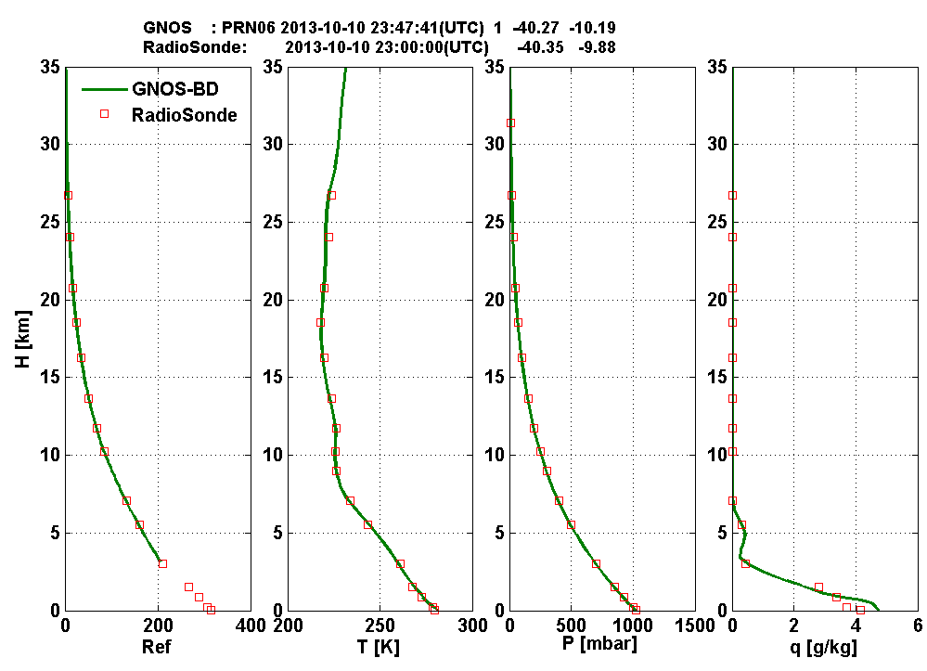


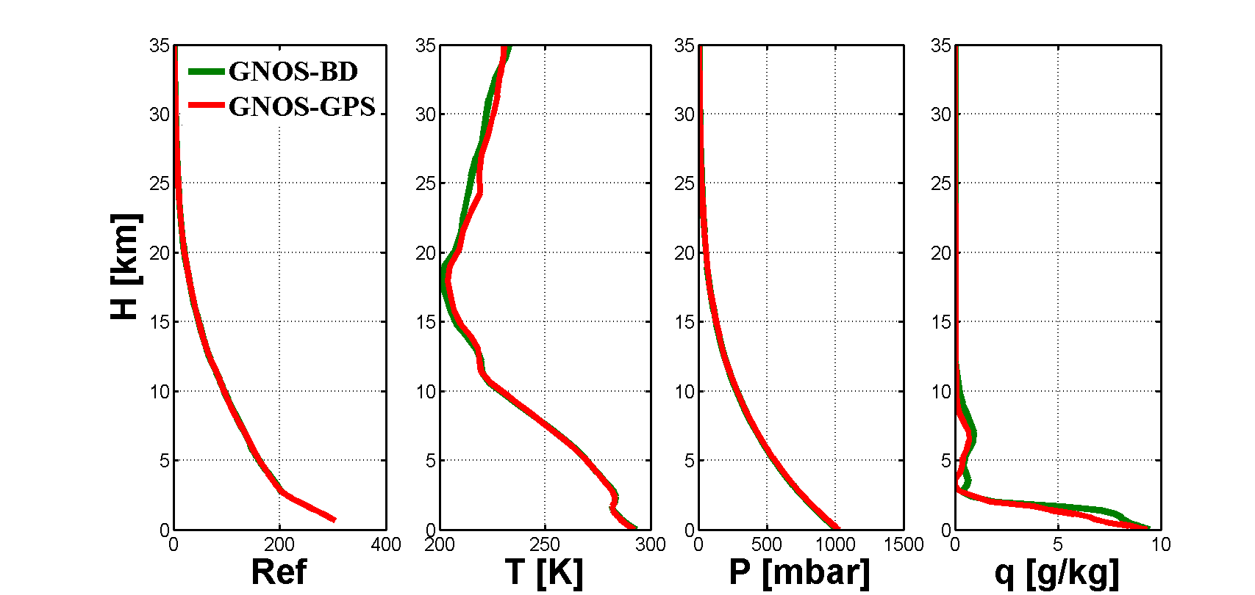

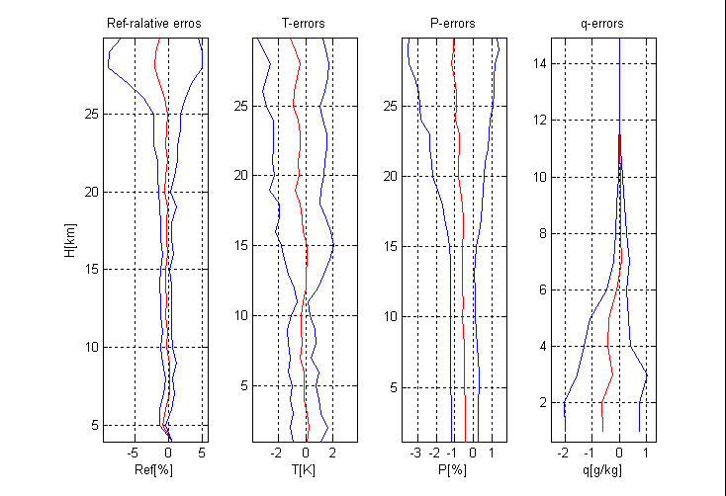

FY-3C/-D GNOS RO data validation
Product validation (Atmospheric products)
Comparison with COSMIC observation data and radio sonde data
Comparison between GNOS/BDS
and GNOS/GPS
RO data
For the first time validated the consistence of GPS & BDS RO Data.
The quality of FY-3C GNOS RO data were consistent with other RO missions and other atmospheric observations .

Slide 27



FY-3C/-D GNOS RO data validation
Product validation (Atmospheric products )
Ref. FY3C GNOS GPS
Ref. FY3C GNOS BDS
Red：bias
blue：std
within 200km，±1 h(time)
5-25km | Ref（%）
 | Bias | std
GNOS-GPS vs ECMWF | -0.09 | 0.75
GNOS-BDS vs ECMWF | -0.04 | 0.53
COSMIC vs ECMWF | -0.12 | 0.71
from
Mi Lao
Liao Mi,et al. Preliminary validation of the refractivity from the new radio occultation sounder GNOS/FY-3C. Atmos. Meas. Tech, 9,781-792,2016
FY-3D preliminary results of in-orbit testing
are consistent with those of FY-3C

Slide 28
Thank you for your attention!
谢 谢！

