Slide 1
NOAA Satellite Cal/Val Progress Update
Jason Choi on behalf of
Changyong Cao (WGCV NOAA Rep.)
With contributions from GOES and JPSS teams
NOAA/NESDIS/STAR
45th CEOS Working Group on Calibration and Validation (WGCV-45)
Perth, Australia, July 15-20, 2019 hoted by CSIRO

Slide 3
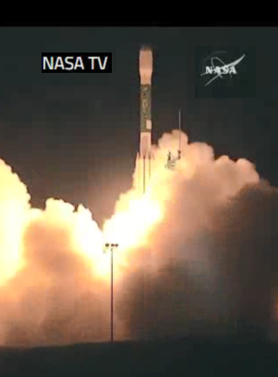
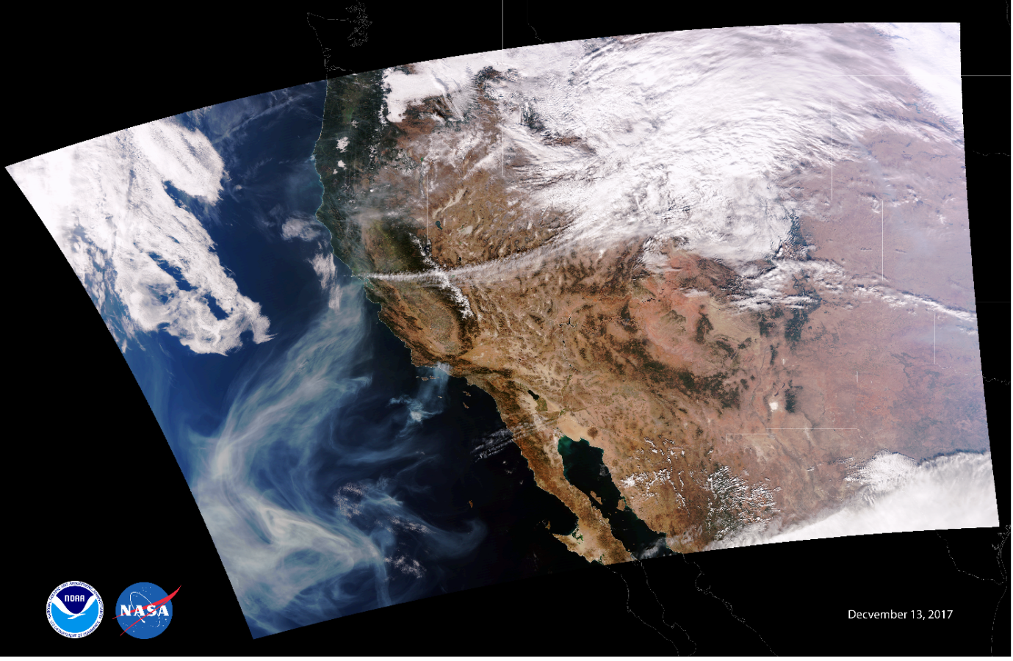
VIIRS Update
NOAA-20 VIIRS was launched on 11/18/2017.
After the Post Launch Tests (PLTs), NOAA-20 VIIRS has been performing very well.
First light image on 12/13/2017
Notes:
A United Launch Alliance Delta II rocket carrying JPSS-1 (now NOAA-20) lifts off from Space Launch Complex 2 at Vandenberg Air Force Base in California on November 18, 2017, at 1:47 a.m. PST (4:47 a.m. EST).

Slide 4
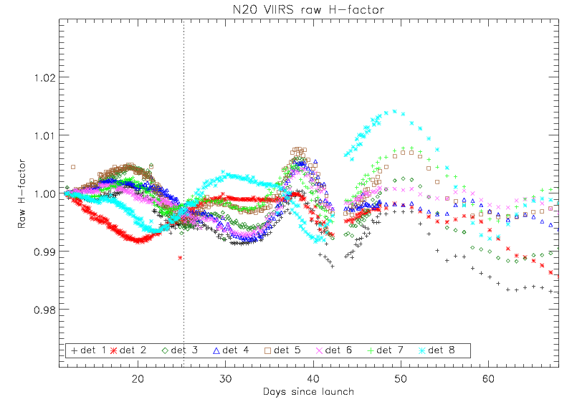
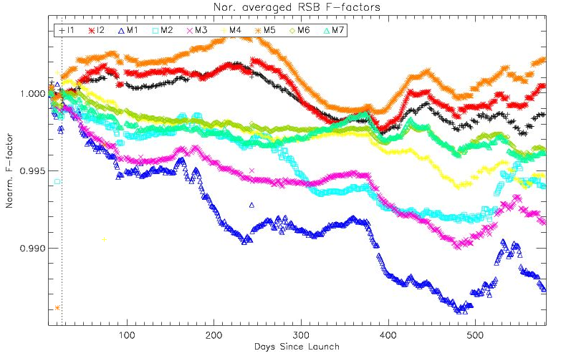
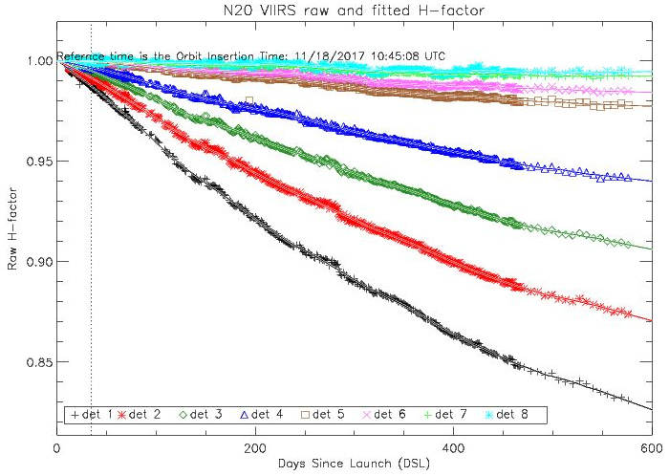
VIIRS RSB Update
NOAA 20 Reflective Solar Band
Initial calculations of the SD-degradation (H factors) indicated potential problems with prelaunch transmission and BRDF LUTs.
The H-factor oscillation problem was fixed with the re-derived SD/SDSM LUTS.
Using yaw maneuver and on-orbit SDSM data sets.
F-factors are very stable.
Up to 1.5% oscillations
Using prelaunch LUTs
Offline NOAA-20 VIIRS Radiometric Cal. Coeffs.
Using updated LUTs

Slide 5
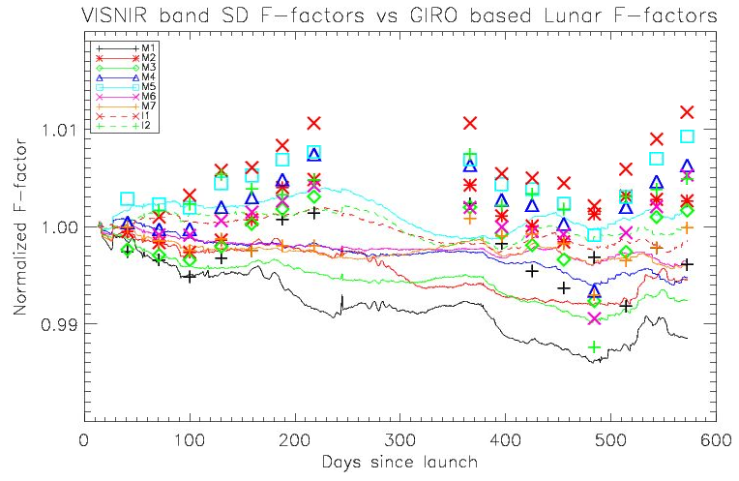
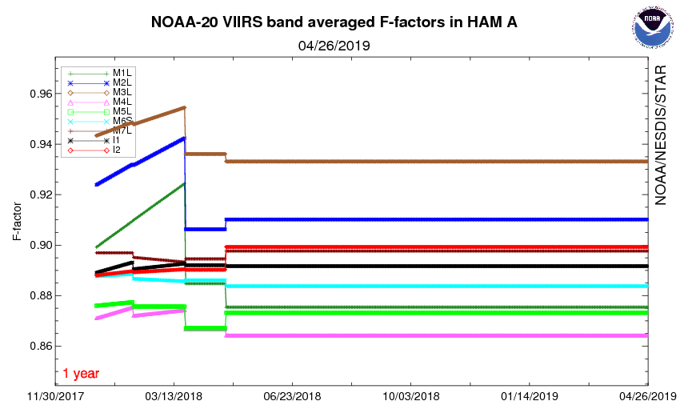
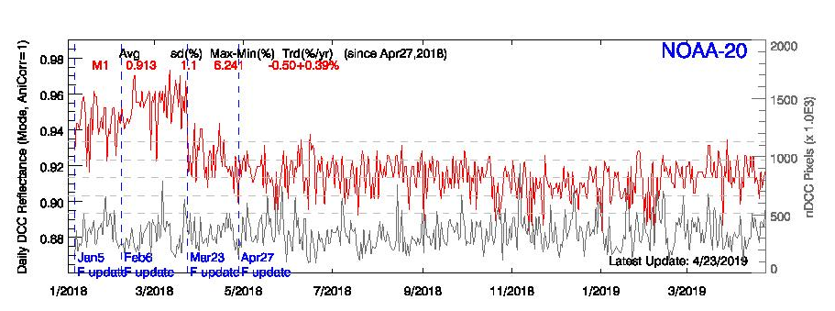
VIIRS RSB Update
NOAA-20 Reflective Solar Band Update
To validate the SD F-factors (lines), lunar F-factors (symbols) are compared using GSICS Implementation of ROLO (GIRO) model.
Operational LUTs are fixed since April 2018 because the SD F-factors changes doesn’t represent true gain.
Deep Convective Cloud and X-cal results doesn’t show strong evidence to add slope in F-factors yet.
S-NPP RSB is also very stable.
April, 2018

Slide 6
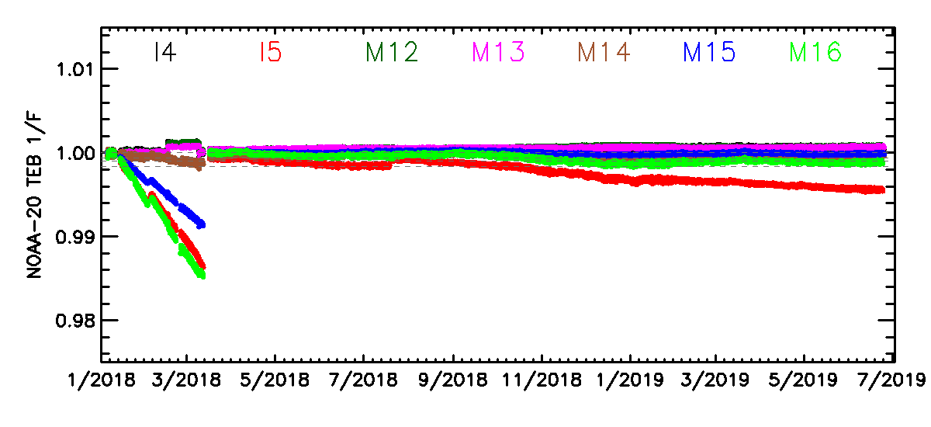
VIIRS TEB Update
NOAA-20 Thermal Emissive Band (TEB) gains were degraded fast.
Approximately 0.5% per week.
Water vapor accumulation in the optics can cause degradations.
Performed Mid Mission Out Gassing (MMOG) to remove water vapor from 3/12 ~ 24/2018.

Slide 7
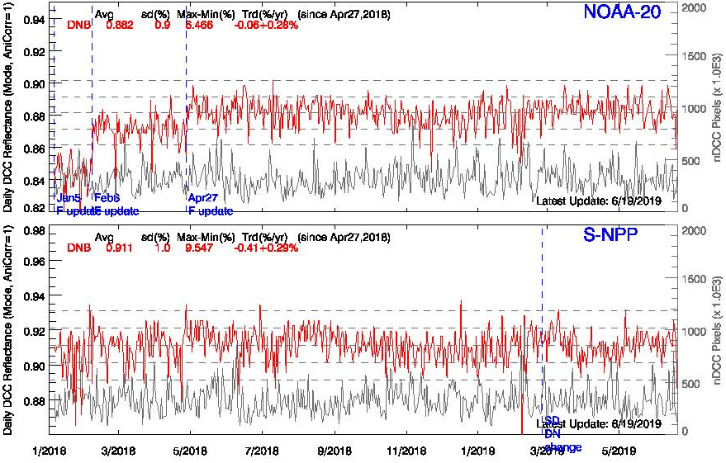
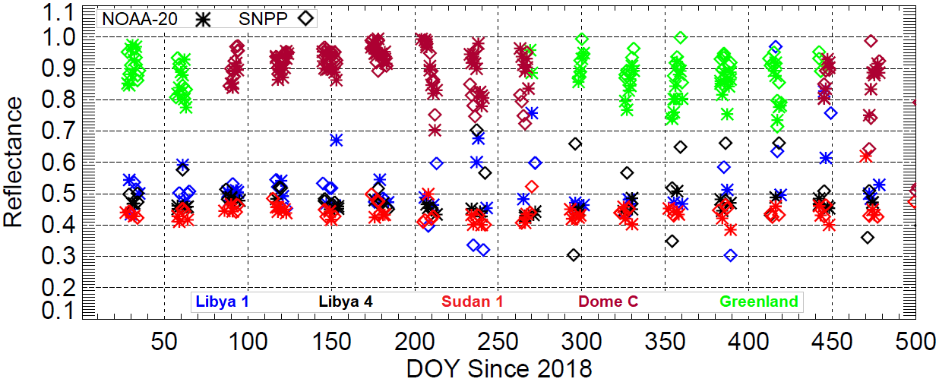
VIIRS DNB Update
Both SNPP and NOAA-20 VIIRS DNB are performing well within specification.
SNPP and NOAA-20 DNB suggest good radiometric consistency
Daytime reflectance compared over DCC (<4%)
Nighttime reflectance (using MT model) compared over lunar illuminated vicarious sites is <4%.
Operational LGS gain (based on SD) and Gain ratio (based on EV during new moon) trends are stable
Operational calibration dark offsets for both the instruments are based on deep space view for HGS.
Daytime Comparison over DCC
Nighttime Comparison over radiometric sites

Slide 8
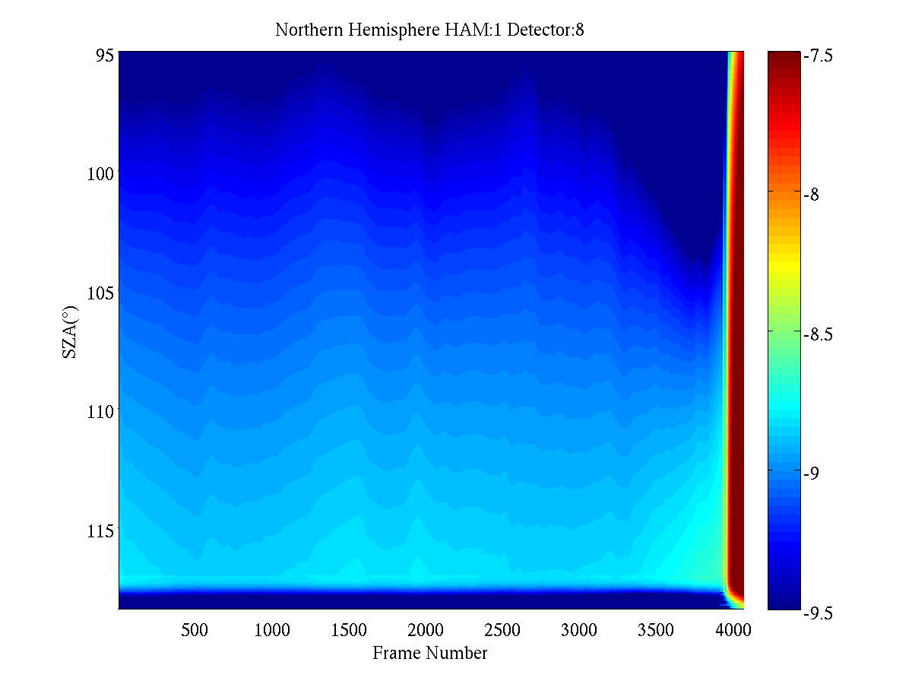
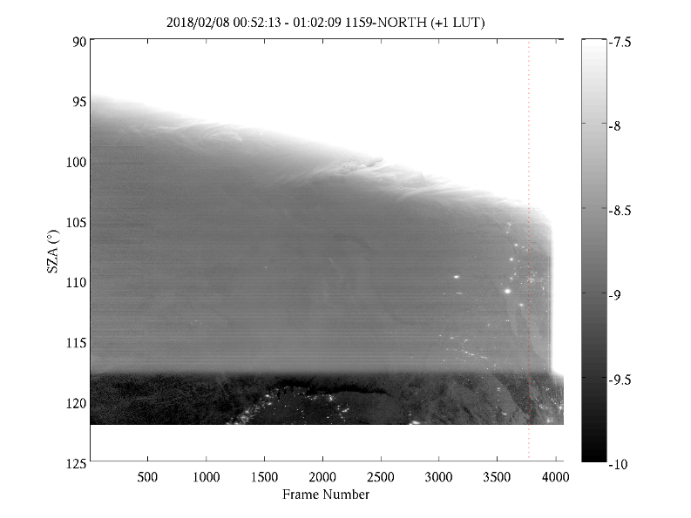
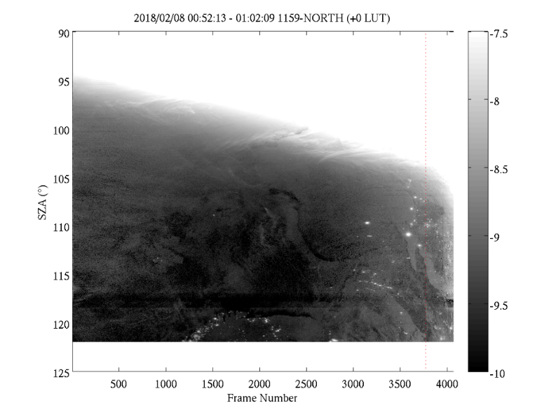
VIIRS DNB Update
NOAA-20 DNB Stray Light Correction
Overall stray light pattern of NOAA-20 DNB is similar to SNPP DNB with additional strong stray light (as large as ~10⁻⁷ W/cm²-sr) in the extended zone
NOAA/STAR DNB stray light correction code has been adapted to extend the correction into the extended zone
First stray light correction LUT was developed using new moon data around Jan. 17, 2018 and in operation at IDPS since Feb. 6, 2018 (Orbit #1139)
Monthly stray light correction LUT generation is performed routinely to support SLC in IDPS.
Stray Light Correction LUT
(Northern Hemisphere)
With Stray Light
After Stray Light Correction
Strong SL in extended zone
EV SL
S/C SZA= 118.4º

Slide 9
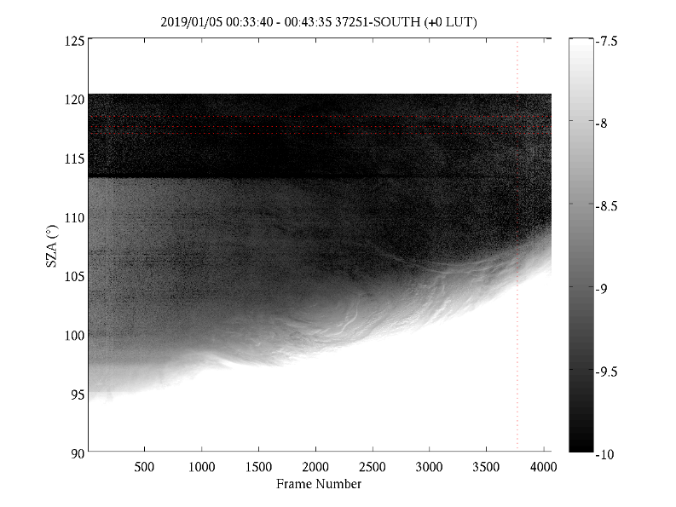
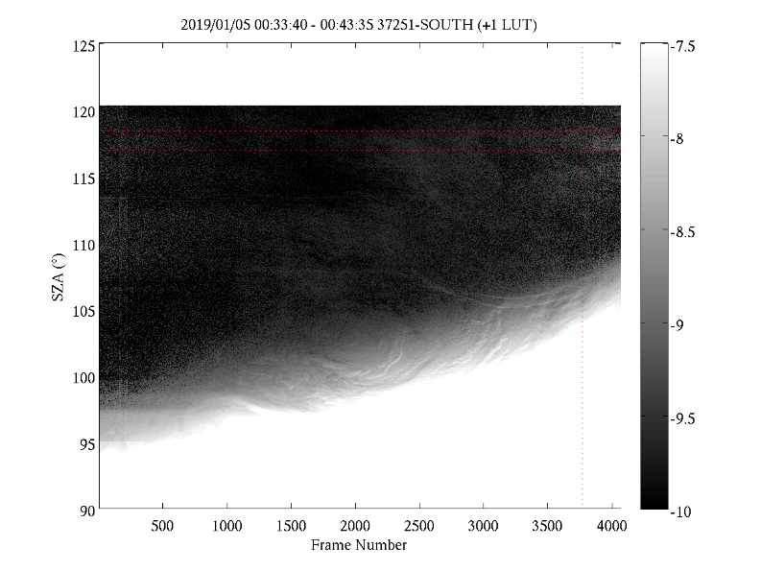
VIIRS DNB Update
With Stray Light
(Southern Hemisphere)
SNPP DNB Stray Light Correction improved.
SNPP DNB SLC in IDPS data was implemented with recycled monthly LUTs before May, 2019.
Significant remnant stray light (~10⁻⁹ W/cm²-sr) over southern hemisphere in regions affected by stray light coming from EV+SD port.
Over northern hemisphere, remnant stray light appears near the 118.4 degree boundary with striping
Since May 2019, SNPP DNB SLC uses most recent DNB data around new moon day to generate LUT and make correction in IDPS.
Corrected with Recycled LUT
EV SL
Corrected with New LUT
EV+SD SL
Remnant SL

Slide 10
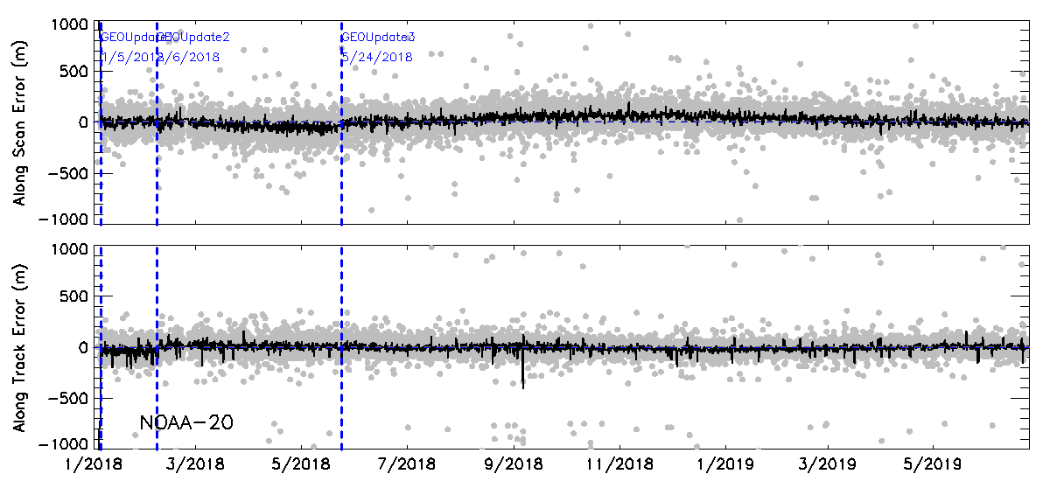
NOAA-20 VIIRS Geolocation
NOAA-20 VIIRS geolocation errors are less than 200 meters.
Small biases (~ 50 meters) were observed during Aug. 2018 – Feb 2019.

Slide 11
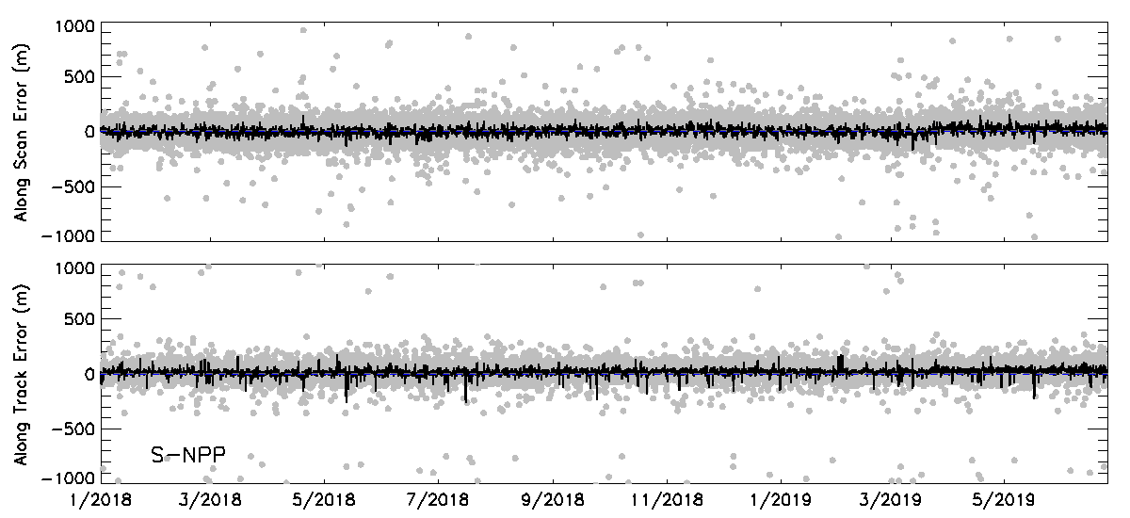
S-NPP VIIRS Geolocation
S-NPP VIIRS Provides very stable geolocations.

Slide 12
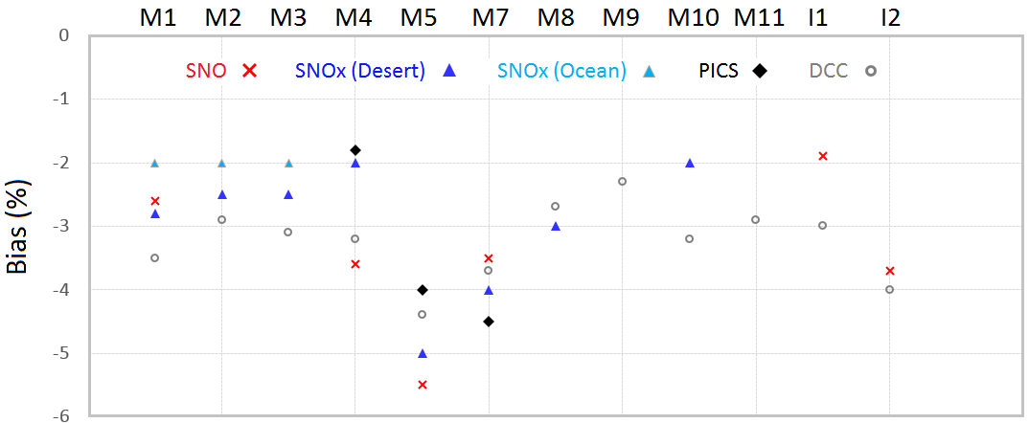
VIIRS Radiometric Bias
SNPP VIIRS performs well with radiometric bias mostly within 2% relative to AQUA MODIS using PICS, DCC and SNOs (double differencing with MODIS).
NOAA-20 VIIRS observed reflectance is consistently lower than S-NPP for all RSB by 2-3%.
Larger bias exists for M5 (~-4.5%) and M7 (~-4%) because S-NPP VIIRS M5 and M7 absolute calibration are biased high by ~2%.
Root cause of NOAA-20 VIIRS bias is most possibly attributed to prelaunch calibration and the investigation ongoing.

Slide 13
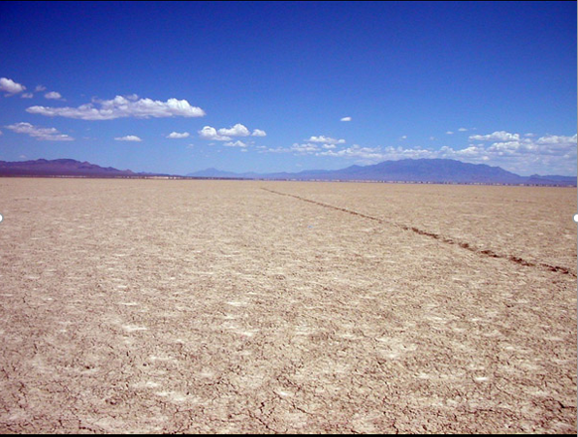
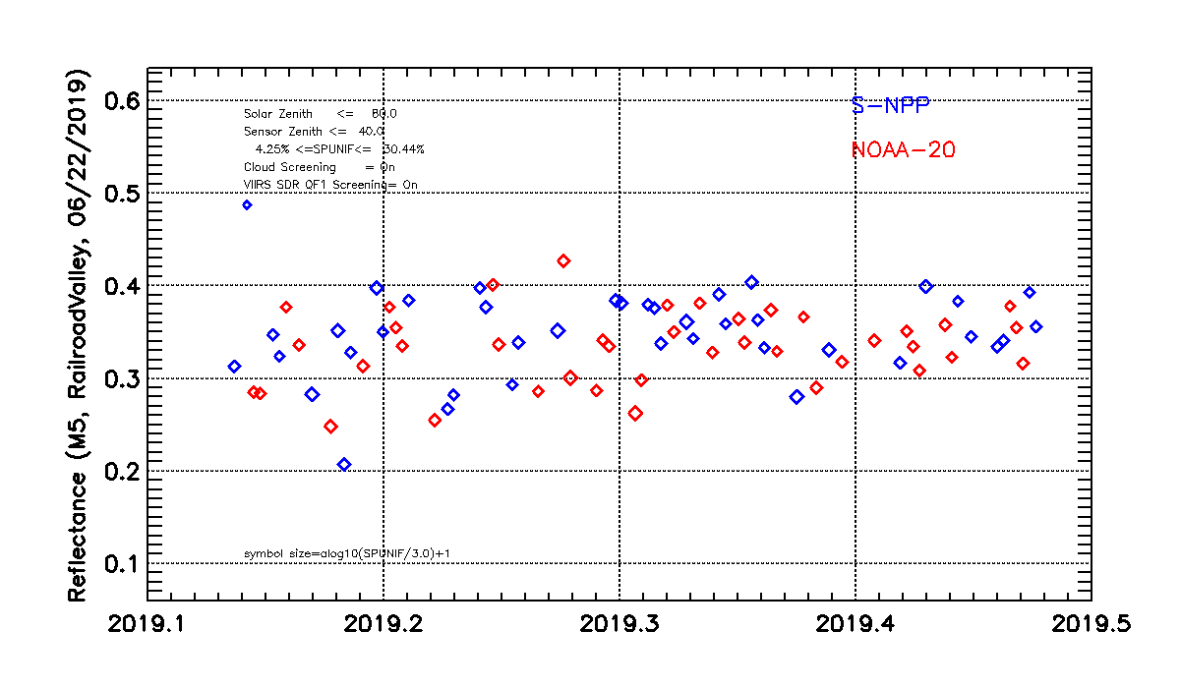
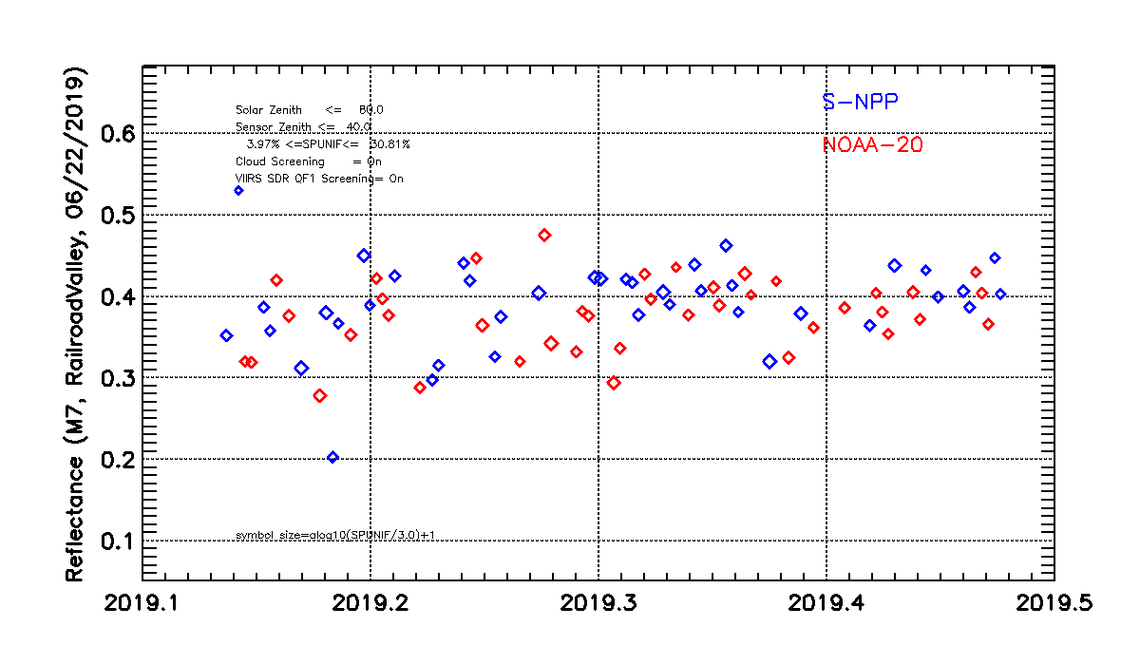
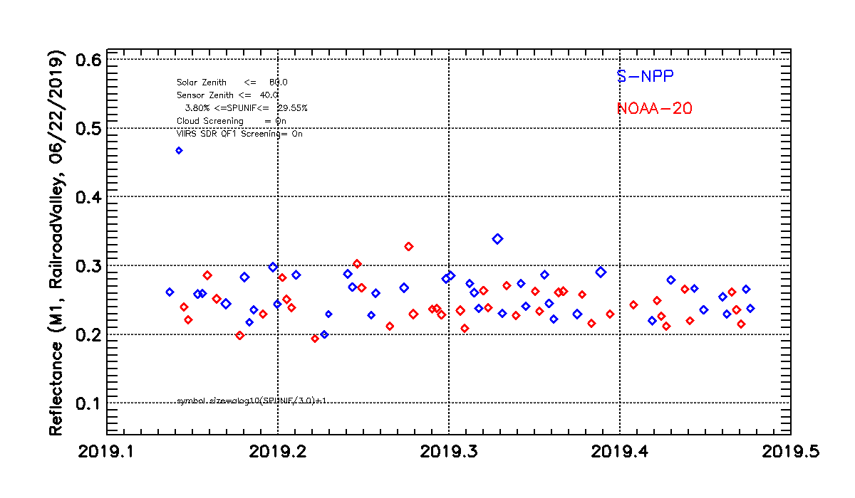
Validation Site - Railroad Valley Playa
Lat: 38.504°N Lon: 115.692°W
Nevada, USA
Elevation: 1350 m
Size: ~ 15 x 15 Km
Desert site with no vegetation
M5
Image courtesy of USGS
M7
M1

Slide 14
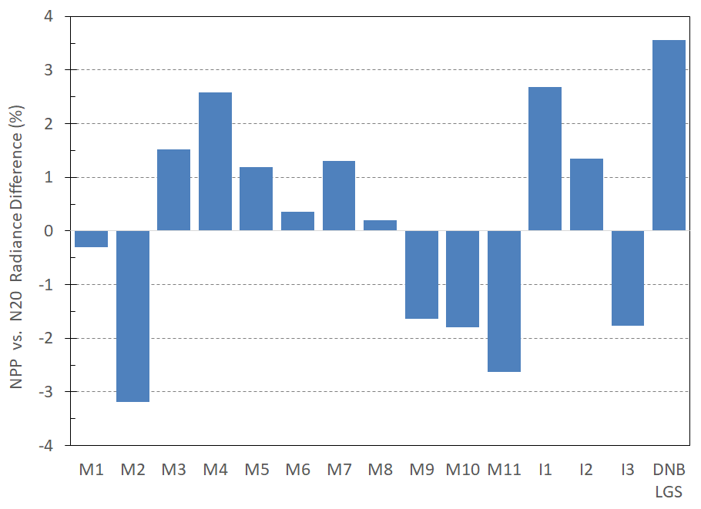
VIIRS Radiometric Bias
NOAA-20 and S-NPP VIIRS uses different solar models
S-NPP uses Kurucz spectrum (MODTRAN 4.0)
NOAA-20 uses Thuillier solar model.
Comparing radiance can result in bias due to differences in solar irradiance model.
Figure indicates bias for most of the bands; M2 suggests large bias of more than 3%.
CEOS Solar Irradiance Model will be considered for J2 VIIRS product.
http://calvalportal.ceos.org/ or https://www.pmodwrc.ch/en/research-development/solar-physics/solar-spectrum/

Slide 15
JPSS-2 VIIRS and Beyond
JPSS-2
VIIRS instrument passed PSR (pre-shipment review) and is in storage until shipment for spacecraft integration in 2020
Eliminated M6 rollover at high radiance
Eliminated low-radiance nonlinearity in DNB and the SWIR bands (return to the near-constant DNB pixel size across full scan)
Eliminated DNB stray light (based on prelaunch tests)
Reduced polarization sensitivity to within requirements (except for M1)
Improved co-registration between VNIR and SWIR/MWIR/LWIR bands
Spacecraft launch is planned for March 2022
JPSS-3
VIIRS instrument integration and testing started in 2019
Spacecraft launch is planned for 2027
JPSS-4
Manufacturing of VIIRS instrument components has started
Spacecraft launch is notionally planned for 2032

Slide 16
S-NPP VIIRS V2 Reprocessing & Improvements
RSB Bands
Using consistent RSBAutocal F-factors with MODTRAN/Kurucz solar spectrum (V1)
OC F-factor based bias correction; Constant bias correction M5/M7 (V1/V2)
RSBAUTOCAL F-factors based on re-analyzed SD/SDSM screen and BRDF LUTs annual oscillation removed + further smoothed (V2)
Using Thuillier (2002) solar spectrum, consistent with NOAA-20 (V2); makes difference in radiance
Updated NOAA Ocean Color F-factor based bias correction (V2)
STAR Kalman Filter based bias correction factors based on LunarCal/DCC/SNO (V2) for VNIR bands
STAR Surface Roughness-induced Rayleigh Scattering (SRRS) Model for SWIR bands (V2)
TEB Bands
Preliminary WUCD bias correction applied to M15/M16 (V1)
Improved EBBT LUT, radiance limit mismatch resolved + better BT limits (V1/V2)
Improved WUCD bias correction (corrected DELTA-C-LUT error), applied to all TEBs (V2)
DNB
Time dependent DNB RSRs (50+ RSR LUTs) (V1/V2) with improved RSBAUTOCAL LGS gains (V1/V2)
Airglow free pitch maneuver based deep space data for dark offset, significant reduction in negative radiances (V1/V2)
Reprocessed using on-orbit based offset and gain ratio (V1/V2)
Reprocessing implements stray light correction for the entire record (V1/V2)
Terrain corrected geolocation is generated for the entire data record(V1/V2)
Improved calibration offsets with striping correction for Agg29-32 (V2)

Slide 18
GOES-16 as GOES-East
GOES-16, the first NOAA GOES-R series geostationary satellite was launched on 11/19/2016.
After intensive post-launch tests (PLT) and post-launch product tests (PLPT) at the check-out point at ~89.5ºW, it drifted eastward and operates as the GOES-East at 75.2W since 12/18/2017
The IR radiance is very stable and well calibrated.
Calibration accuracy of all the ABI Visible and Near-infrared (NVIR) bands is within 5%, after the recent update of solar diffusor calibration look-up table (LUT) at B02 (0.64$µ$m).
More details on GOES-16/17 performances are available at: https://www.star.nesdis.noaa.gov/GOESCal

Slide 19
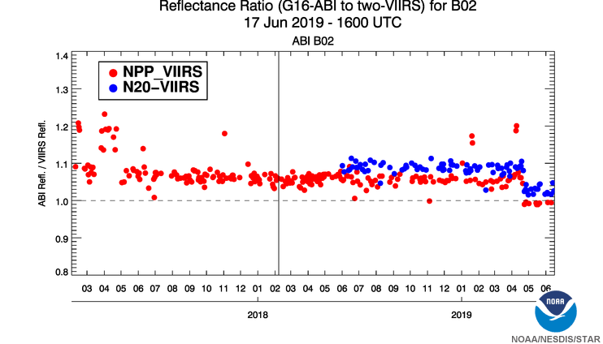
GOES-16 B02 (0.64µm) Solar Cal. LUT Update
Update of B02 solar diffuser calibration look-up table
Time-series of daily GEO-LEO inter-calibration results for G16 B02 (0.64µm). The G16 B02 radiance after the solar cal. LUT update agrees well with the SNPP/VIIRS and N20/VIIRS observations.

Slide 20
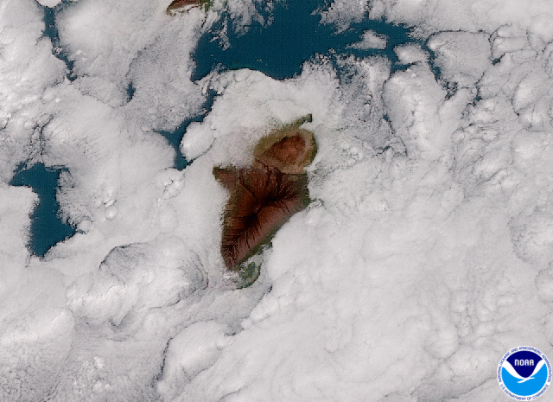
GOES-17 as GOES-West
GOES-17 was successfully launched on March 1, 2018.
After the PLT/PLPT tests at the checkout point, it drifted to the 137.2ºW position and became GOES-West on February 12, 2019.
Despite the loop heat pipe (LHP) anomaly discovered in the early PLT period, GOES-17 ABI is optimized to greatly improve its performance and joins GOES-16 to provide the visible and infrared imagery with high spatial, temporal and spectral, radiometric and geometric quality in the Western Hemisphere.
GOES-17 image of clouds around Hawaii’s Big Island on Jan. 15, 2019 (https://www.nesdis.noaa.gov/content/goes-17-now-operational-here%E2%80%99s-what-it-means-weather-forecasts-western-us)

Slide 21
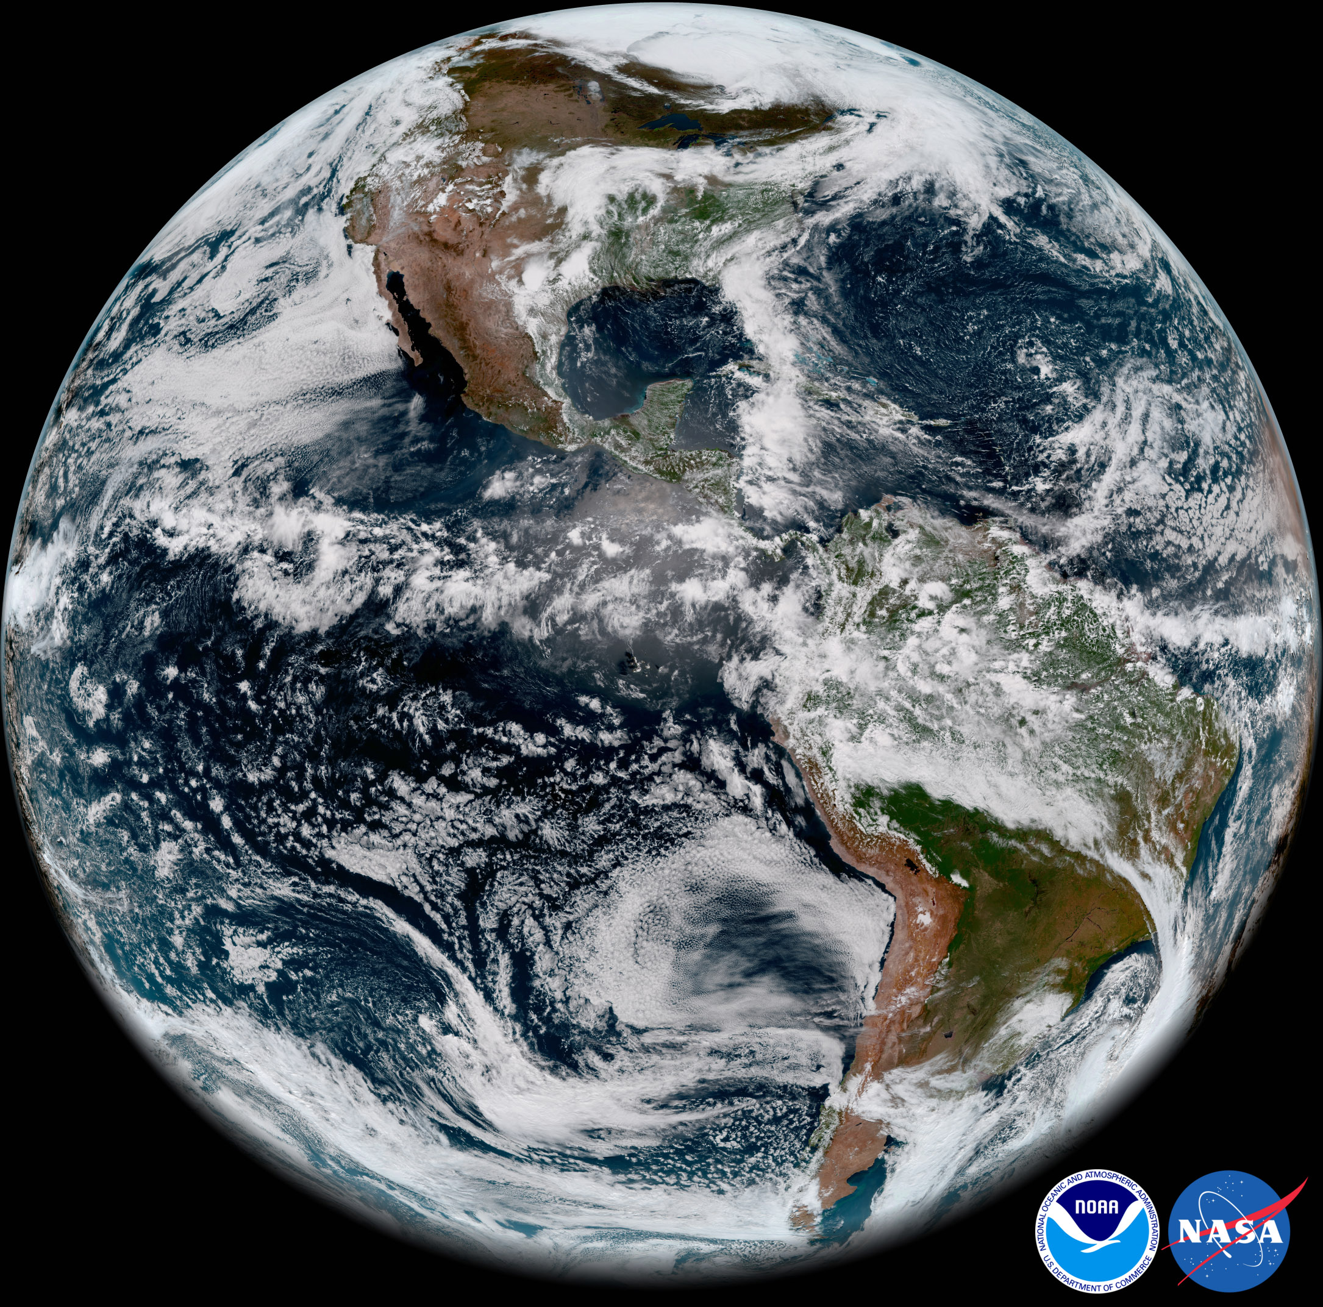
GOES-17 First Image
GOES-17 ABI “First Light” Full Disk Image (2018-05-20 at 12:00pm)
https://www.nesdis.noaa.gov/content/goes-17-releases-%E2%80%98first-light%E2%80%99-imagery-its-advanced-baseline-imager-abi

Slide 22
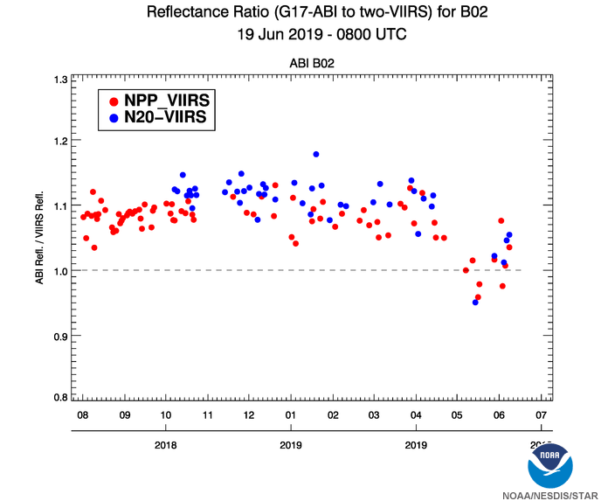
GOES-17 Radiance Quality and Major VNIR Update
During the time when the IR focal plane temperature is controlled, IR radiance is stable and well calibrated.
The overall calibration accuracy of the G17 VNIR bands is less than 5% for all the six VNIR bands except for B02. B02 (0.64µm) was brighter than the reference by ~8%.
On April 27, 2019, the solar calibration look-up table was updated for G17 B02 which reduced the calibrated radiance by about 6.9%.
Efforts are still ongoing to improve the G17 ABI radiance quality.
Solar diffusor LUT update
Daily monitoring of GEO-LEO inter-calibration result for G17 B02 (0.64µm). The G17 B02 radiance after the solar cal. LUT update overall agrees well with the SNPP/VIIRS and N20/VIIRS observations.

Slide 23
Summary
NOAA-20
Launched on 11/18/2017
VIIRS RSB, TEB and DNB are performing very stable within the specifications.
S-NPP
VIIRS RSB, TEB and DNB bands are in nominal status and providing stable observations.
GOES-16
Became GOES-East at 75.2ºW on 12/18/2017.
ABI is performing well.
VNIR calibration accuracy is less than 5% after the recent solar calibration LUT update.
GOES-17
Launched on 3/1/2018
Became GOES-West at 137.2ºW on 2/12/2019.
Despite the LUT anomaly, GOES-17 ABI is optimized to provide high quality data.
Efforts are still ongoing to improve the GOES-17 ABI performance.

Slide 24
Backup Slides

Slide 25
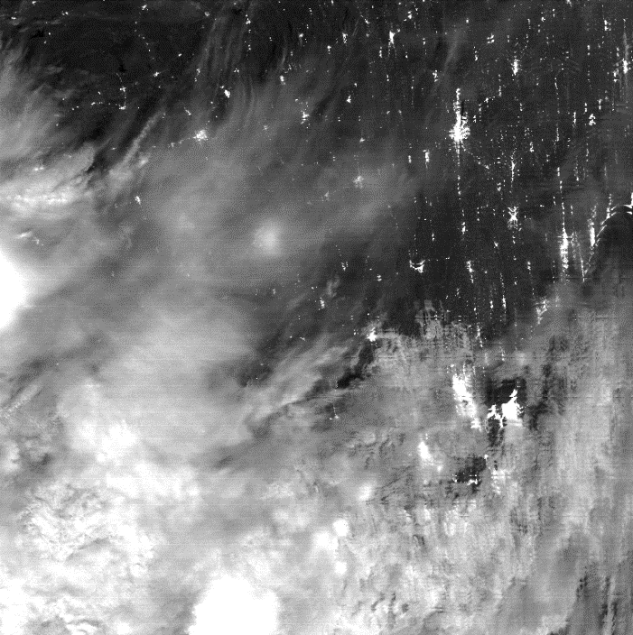
NOAA-20 VIIRS DNB Striping Correction
Gain ratio LUT deriving algorithm updated since Nov. 2018
mitigates striping in nighttime imagery resulting from non-linearity.
California
Oct 24, 2018
striping
destriping
with new LUT

Slide 26
S-NPP Reprocessing
Kalman Filter (V2) for VNIR Bands
Correcting long term degradation
Future plan
For F-Factor
RSBAutoCal F Factor
(Solar diffuser cal)
Kalman
AI based Forecasting
DCC Time Series
Estimated F-Factor Time Series
Lunar F Time Series
SNOx Time Series
Features:
Predict up to two weeks ahead of time for correction (used as a scaling factor);
Different time resolutions (some at irregular interval)
Combine input observations from different sources (subject to measurement uncertainty and noise)
After using Kalman Filter, excellent stability in VNIR bands, <0.3% change in 5 years.

Slide 27
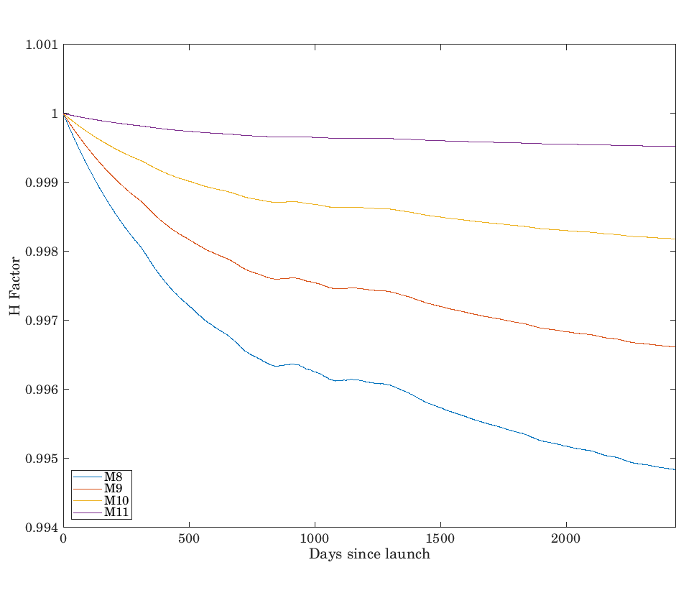
SRRS Model For VIIRS SWIR Band Correction
S-NPP Reprocessing
NOAA STAR Surface Roughness-induced Rayleigh Scattering (SRRS) Model
Ref: Shao, X.; Cao, Changyong; Liu, T.-C. Remote Sensing 2016, 8, 254
After using SRRS model, excellent stability in SWIR bands, <0.15% change in 5 years.

Slide 28
S-NPP VIIRS V2 Reprocessing Data Distribution
S-NPP Reprocessing
Data server
FTP or/and HTTP
Both servers are located at Bamboo CICS/UMD due to large volume of dataset
FTP push service highly recommended for bulk transfer (part of Reprocessing on-Demand using scp/sftp)
Direct access to all available granules can be obtained through web browser but slow.
Investigating a SIPS -like web interface
Driven by SQL DBMS server and geospatial search (leveraging NASA Atmosphere and Land SIPS technology)
Web Interface design
Subcategory for each sensor/data type (GMTCO GITCO GDNBO SVI SVM SVDNB)
Provide bash scripts to users for easy downloading
Other options for very large volume datasets request (>1TB)
provide large tar balls for easy downloading (e.g., ATMS tar ball files are available at ftp://jlrdata.umd.edu/pub/ATMS/)
Automate control data flow for specific user (generate tar files, remove tar files after downloading, currently performing it for CrIS FSR data month by month ftp://jlrdata.umd.edu/pub/ATMS/CrIS/)

Slide 29
GOES-NOP(GOES-13/14/15)
GOES-13, the previous GOES-East at 75ºW, was deactivated and relocated to 60ºW on January 8, 2018. It is recently activated to prepare for the drift over the Indian Ocean (GOES-IO).
GOES-14, as the primary back-up satellite at 105ºW. Routinely pulled out of storage for the annual healthy check-out.
GOES-15, as operational West Backup at 128W on 11/7/2018. GOES-15 (128ºW) and GOES-17 (137.2ºW) operate in tandem through early July 2019.

