Slide 1
CEOS Cal/Val Portal
Philippe Goryl^{1,} Paolo Castracane²,
1) ESA ESRIN
2) RHEA c/o ESA ESRIN
WGCV#45
15 - 29 July 2019 CSIRO, Perth, Australia

Slide 2
CEOS Cal/Val Portal
Table of Contents:
CEOS Cal/Val Portal overview – the current portal
Why a new portal?
The New CEOS Cal/Val Portal
Conclusions

Slide 3
Outreach of CEOS WGCV
Outreach of CEOS working group CalVal (WGCV) is divided in two websites:
http://calvalportal.ceos.org/
http://ceos.org/ourwork/workinggroups/wgcv/
Hosted by ESA
Include mainly technical content, tools, data access and literature.
Hosted by NASA
Contains mainly current activities, objectives, organizational, and other content-related matter

Slide 4
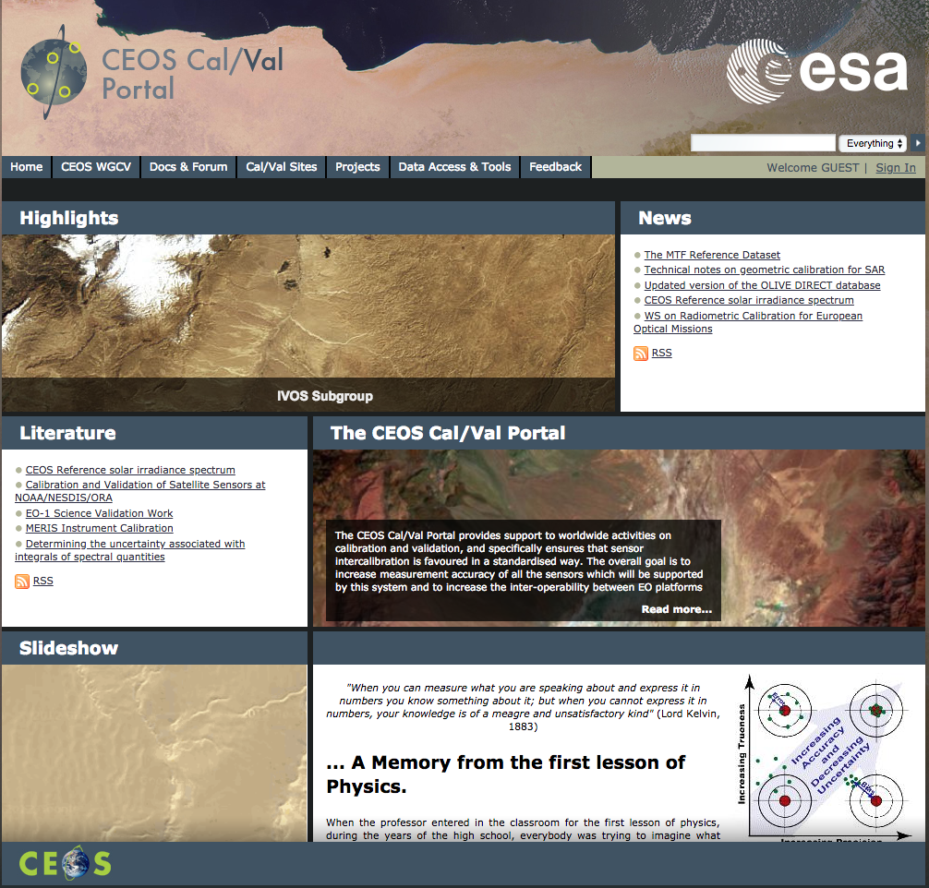
CEOS Cal/Val Portal Overview
The CEOS Cal/Val portal is a web portal hosted by ESA and made available to the CEOS WGCV community as a reference point to share, store, publish Cal/Val related data and information.
The Portal is technically managed by Brockmann Consult GmbH
Two years contract for Maintenance and Evolution

Slide 5
Why a new CEOS Cal/Val Portal?
The aim of the portal is:
To be a window through the WGCV worldwide activities.
To support the user community in Cal/Val tasks, providing access to relevant materials,
documentation, tools and services.
To promote sharing of information: members are encouraged to actively contribute with
documents, materials, publications, links etc.
To support communication and collaboration, providing room for news, announcements,
workshops, conferences and meetings.
To acts as an effective enabler to encourage interactions between and within organisations
and project teams.
Web reshaping led by access simplification, upgrade of materials, new features.

Slide 6
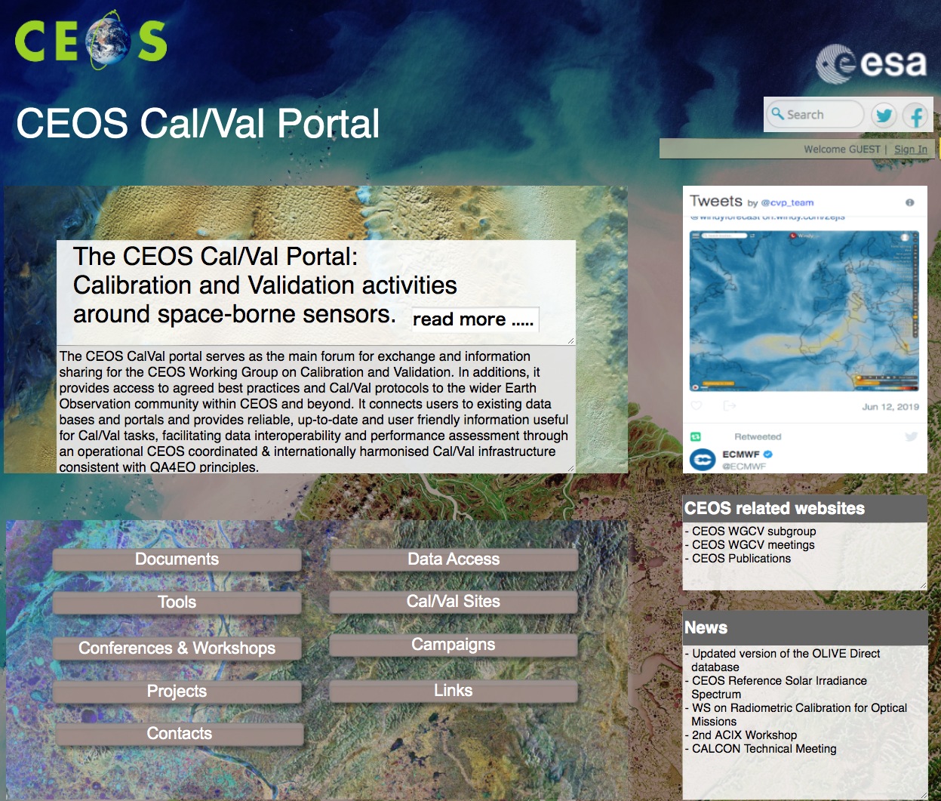
The new CEOS Cal/Val Portal Home Page
Mission Statement and “read-more”
Buttons Menu to access main pages
Hidden navigation menu
Twitter Iframe
News panel
Forum – post titles placeholder

Slide 7
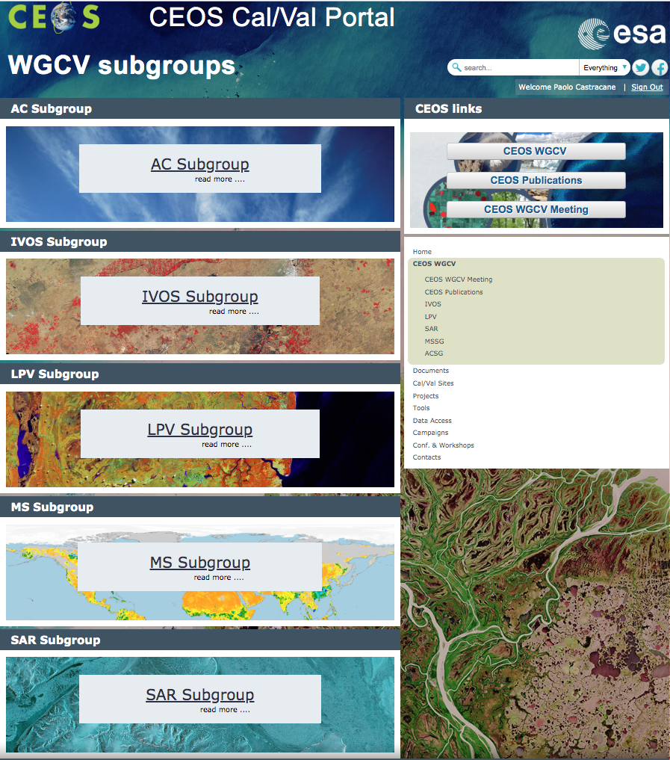
The new CEOS Cal/Val Portal WGCV subgroups
The CEOS WGCV page.
It includes:
All Subgroups: info, relevant materials etc.
CEOS WGCV, Publications and Meetings links

Slide 8
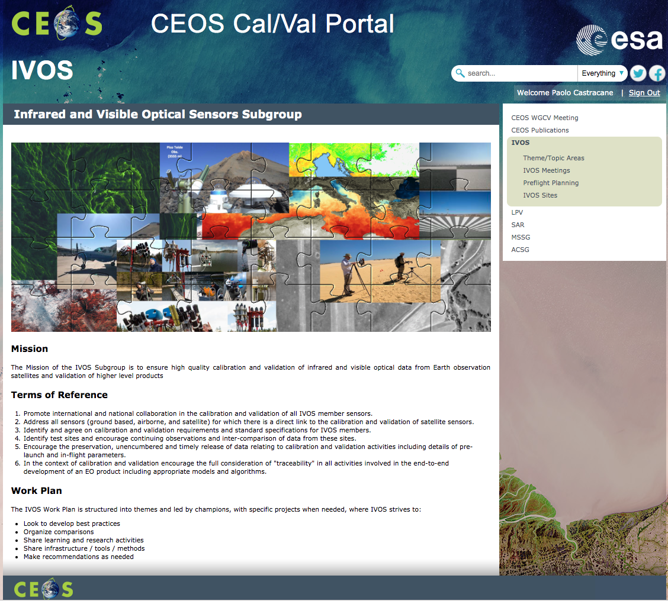
The new CEOS Cal/Val Portal IVOS subgroup
The IVOS Subgroup page includes:
Theme/Topic Areas: Land Surface Reflectance, Ocean Colour, Surface Temperature, Geo-Spatial Image quality; Solar Irradiance Spectrum, Sensor Intercomparison, Vicarious Calibration.
IVOS Meetings (with presentations)
Preflight Planning
IVOS Sites

Slide 9
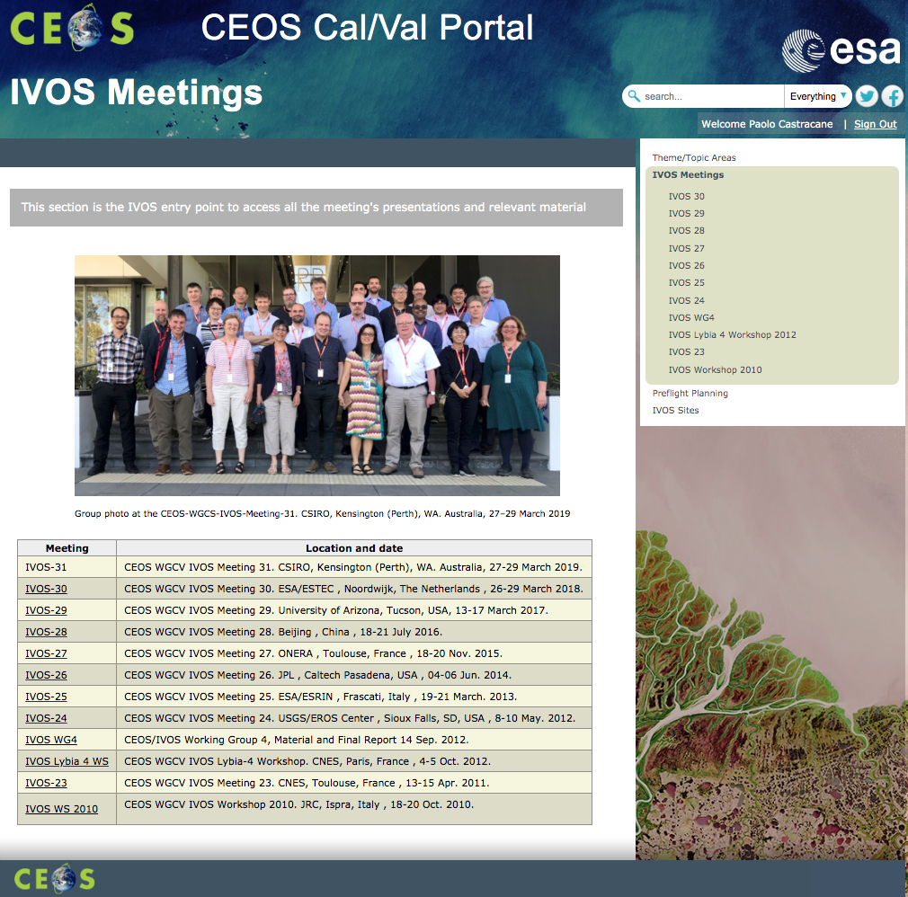
The new CEOS Cal/Val Portal IVOS subgroup: Meetings
Repository of all the IVOS Meetings presentations from 2010 to 2019

Slide 10
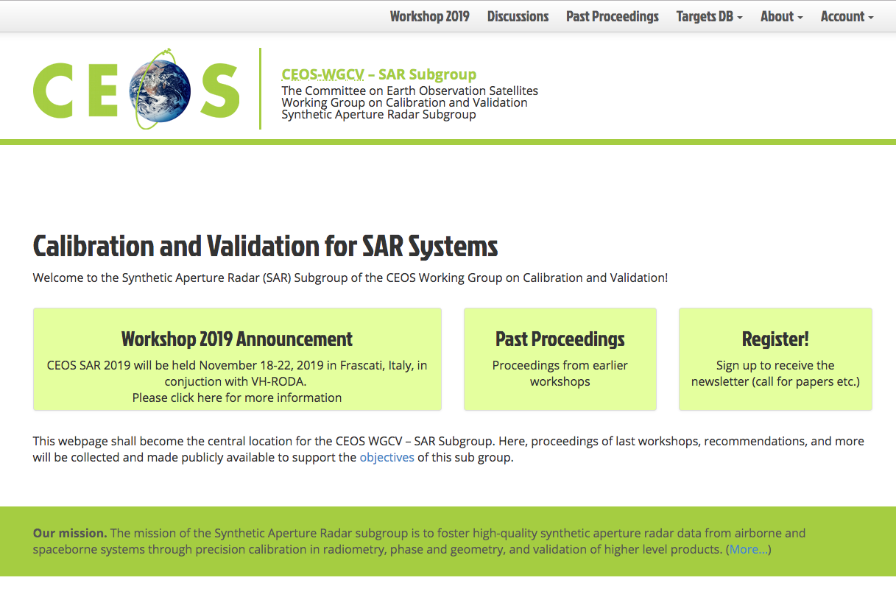
The new CEOS Cal/Val Portal SAR subgroup
Roadmap to transfer the SAR subgroup website (http://sarcv.ceos.org/)
to the Cal/Val Portal
Past Proceedings
An introductory page for each past workshop, transferring of the presentations to the Cal/Val Portal.
Discussion
this section can be maintained including a dedicated blog within
the Cal/Val Portal
Targets DB
It will be maintained including conversion of polygons to KML format
Registration and members
SAR subgroup members can be registered on the Cal/Val Portal,
The subgroup chair will have rights/privilege to handle memberships
and add/change content on the dedicated page for SAR Subgroup
Workshops
The new dedicated web content shall be used for notices and for the user registration of new workshops. Next Workshop will be on November 2019

Slide 11
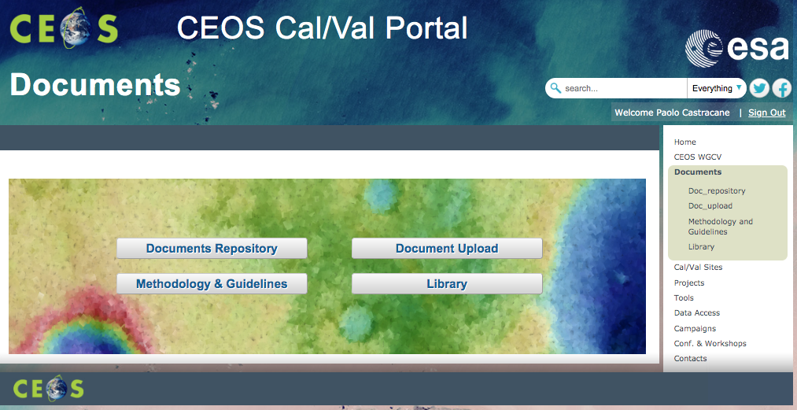
The new CEOS Cal/Val Portal Documents
Document repository
for query, download and
upload documents
Methodology & Guidelines
Library
to collect relevant links to
the latest publications

Slide 12
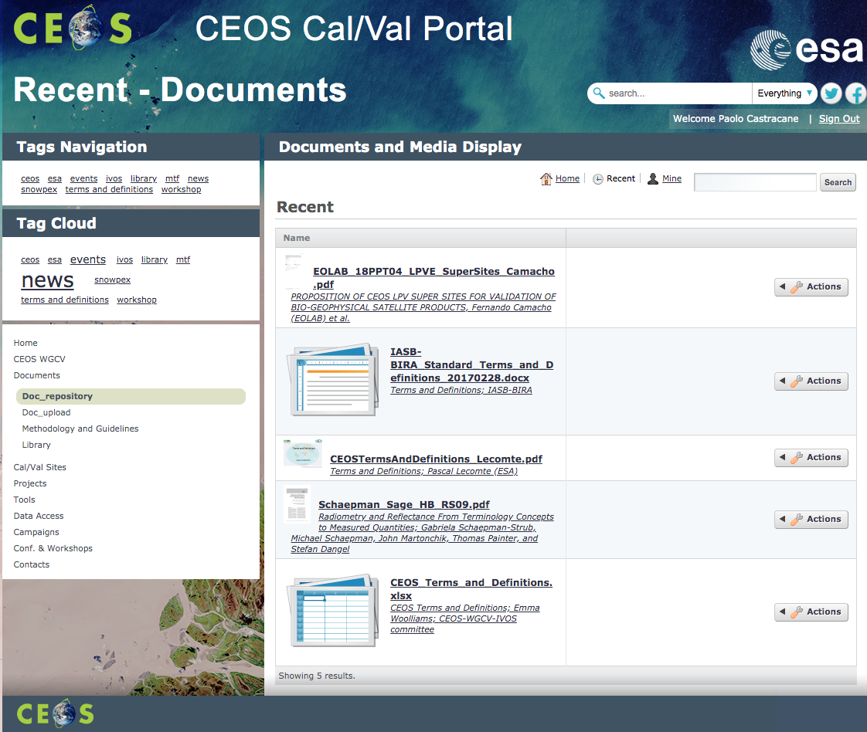
The new CEOS Cal/Val Portal Documents
Document repository
Query: search an tags
overview and download

Slide 13
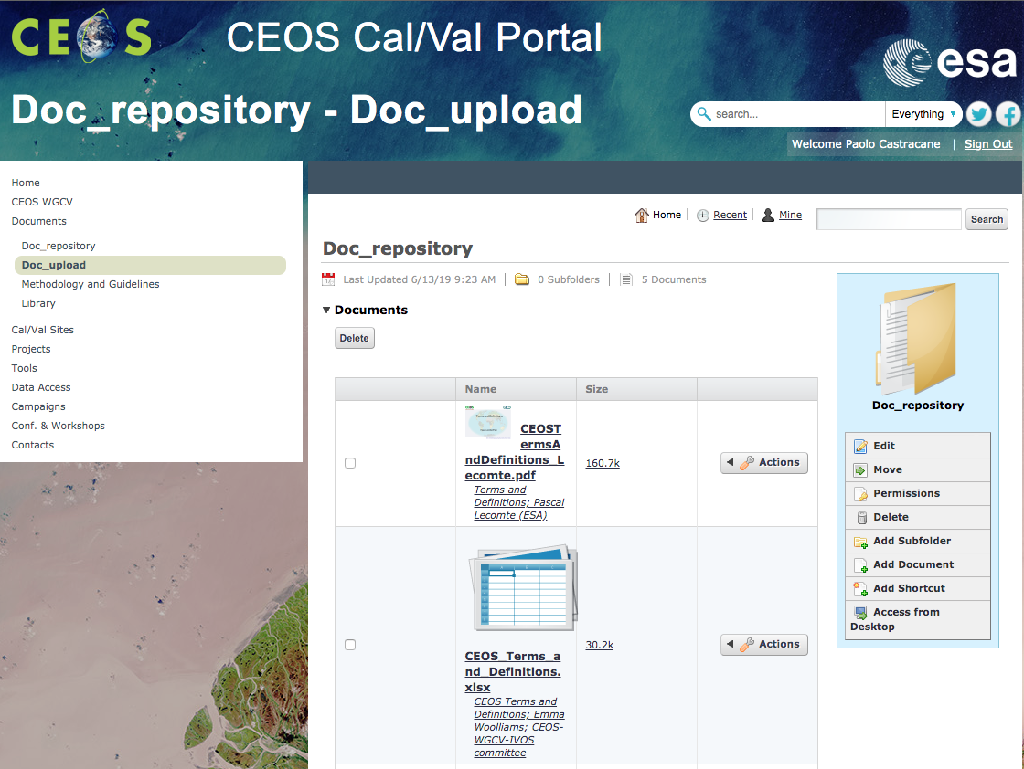
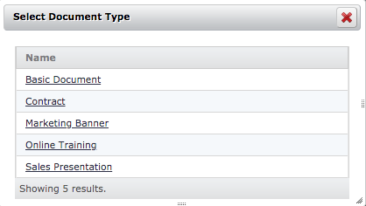
The new CEOS Cal/Val Portal Documents
Document uplaod
Add document

Slide 14
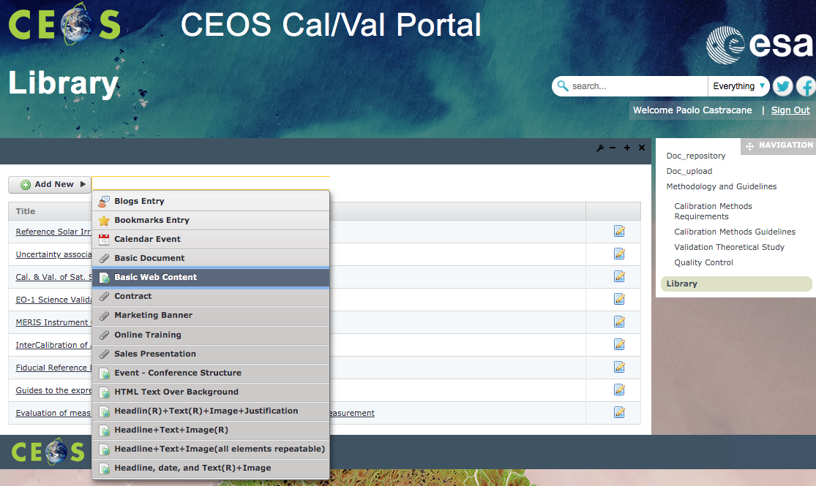
The new CEOS Cal/Val Portal Documents
In “Library” users are allowed to include contents: e.g. links to the latest publications or references.

Slide 15
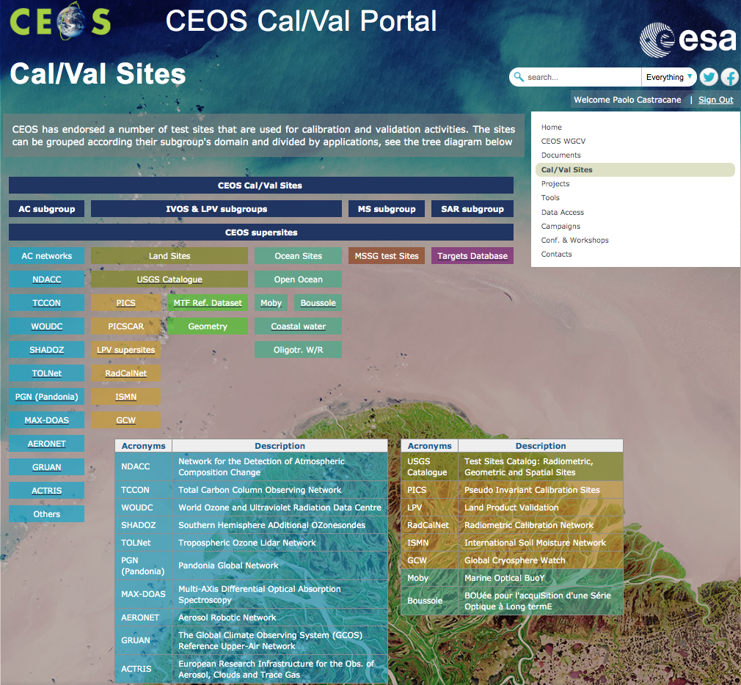
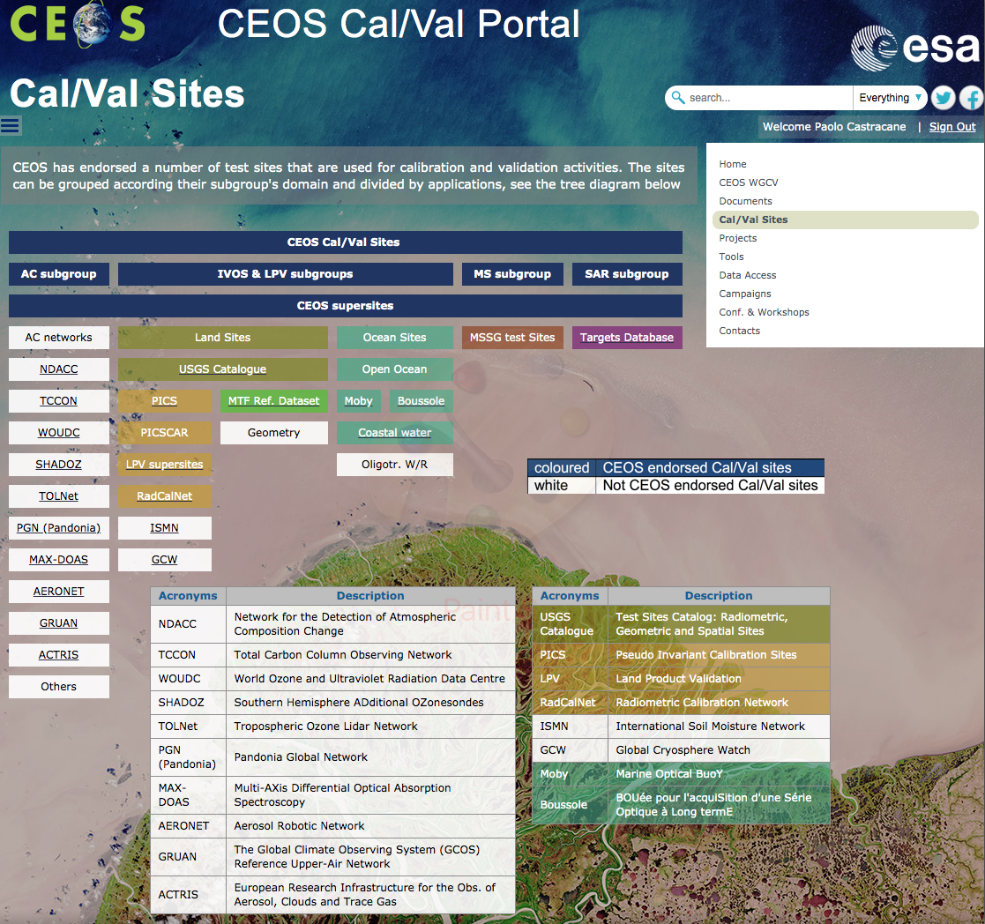
The new CEOS Cal/Val Portal Cal/Val Sites
The Cal/Val sites page aims to host the references of the CEOS endorsed test sites and networks according to subgroup’s domain

Slide 16
The new CEOS Cal/Val Portal Cal/Val Sites
The Cal/Val sites page aims to host the references of the CEOS endorsed test sites and networks according to subgroup’s domain

Slide 17
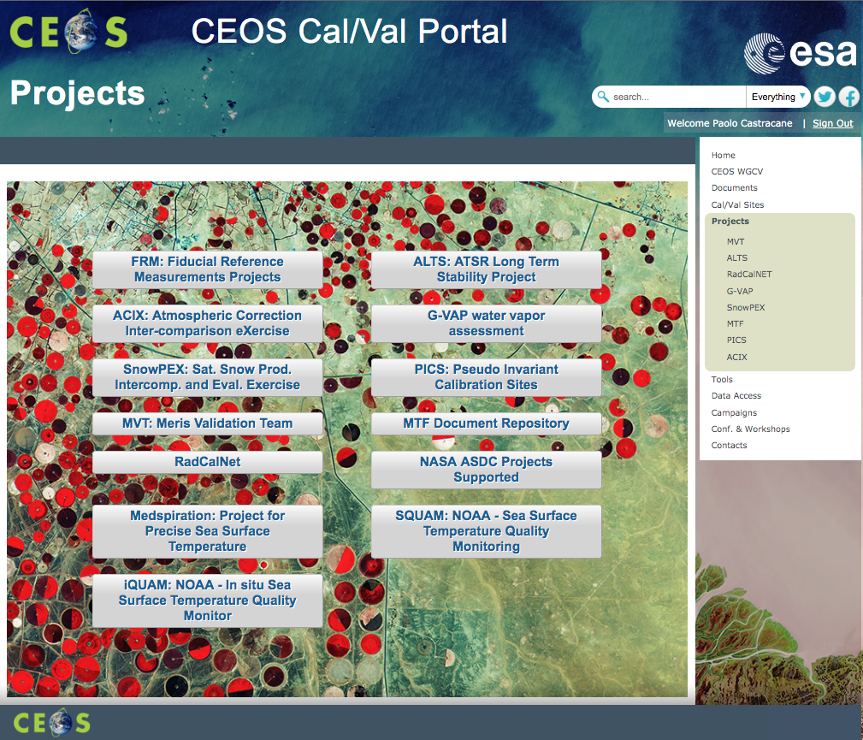
The new CEOS Cal/Val Portal Projects and Campaigns pages
Projects and Campaigns pages includes relevant activities:
Fiducial Reference Measurement (FRM) projects
PICS, MTF and ACIX are maintained, links
Campaign page: relevant links

Slide 18
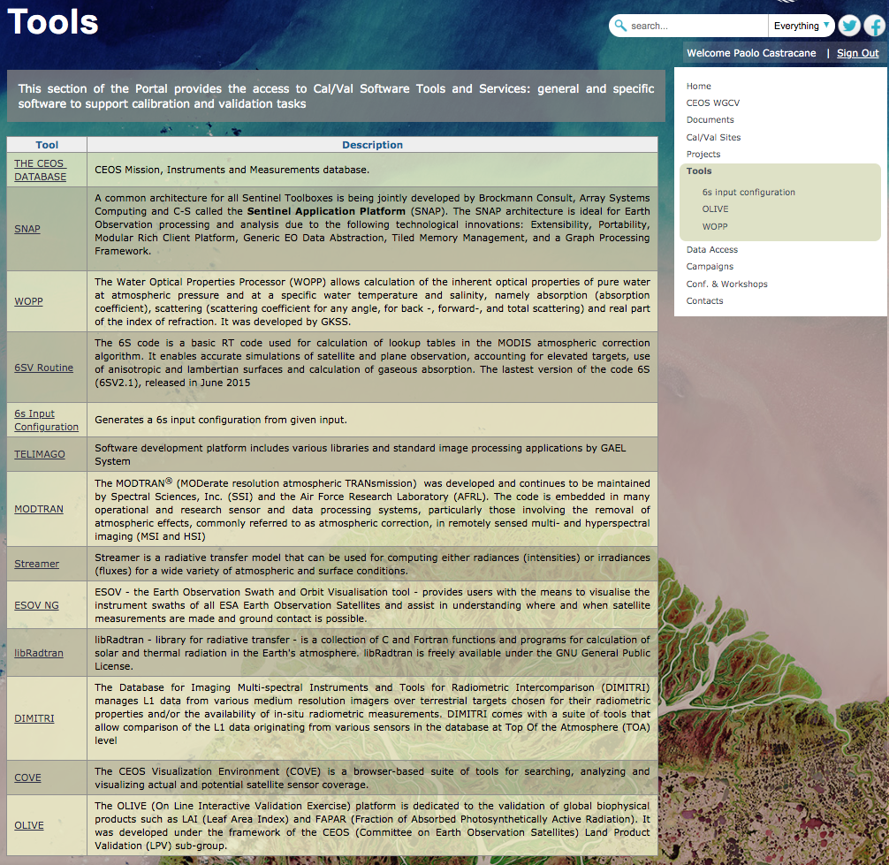
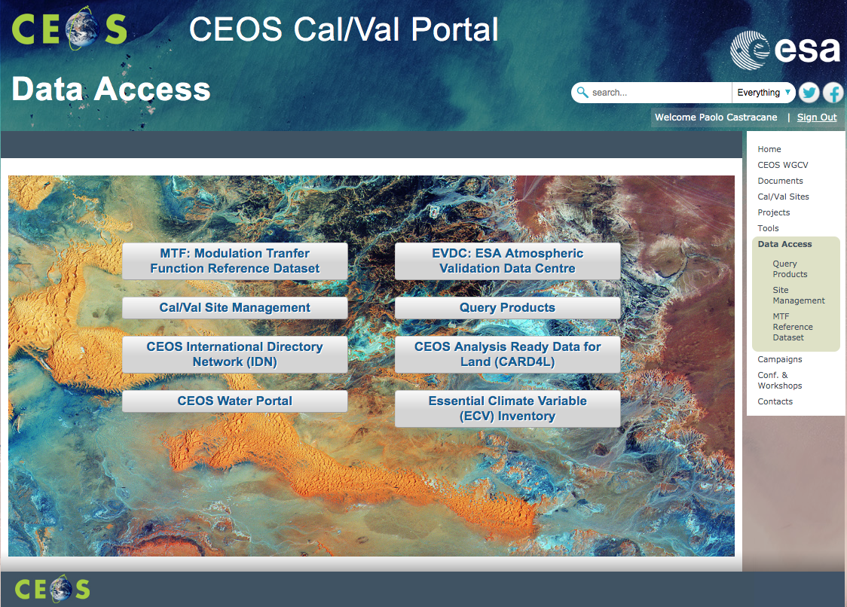
The new CEOS Cal/Val Portal Tools and Data Access pages
Data Access is dedicated to the significant Cal/Val data providers.
The page “Tools” hosts: OLIVE, WAPP and include several links with the possibility to include new ones.

Slide 19
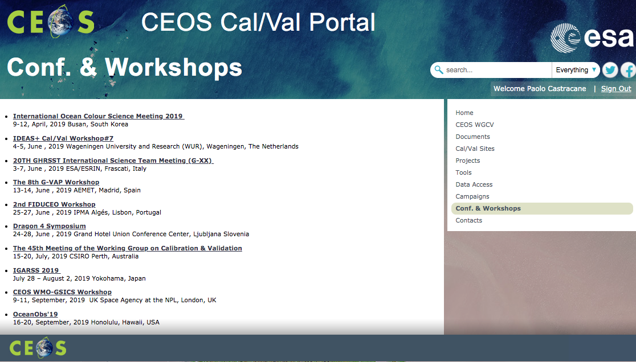
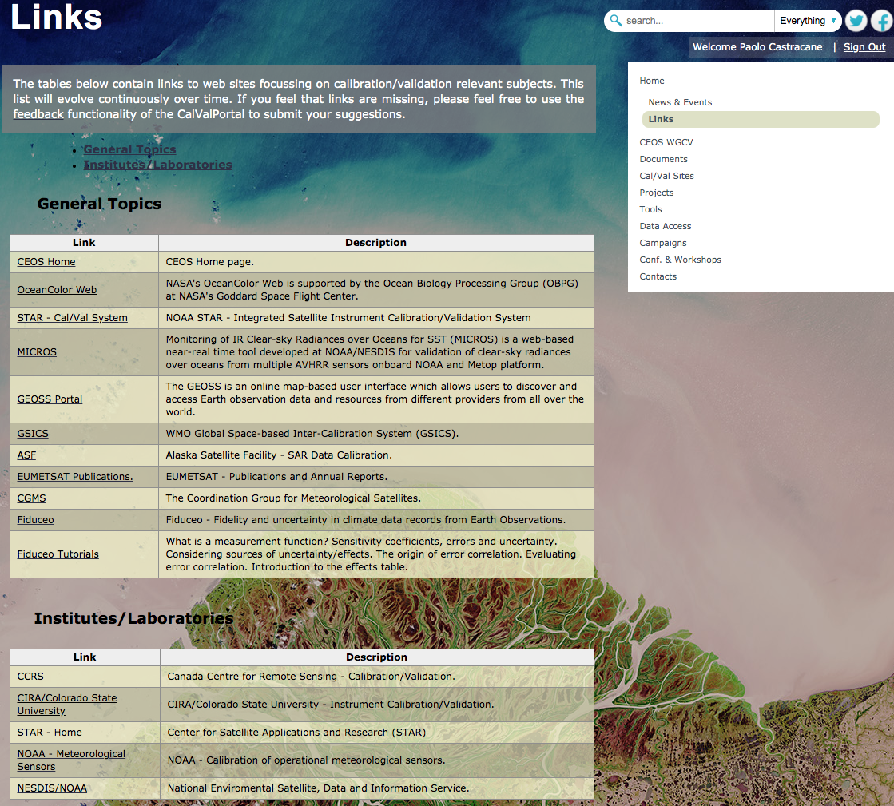
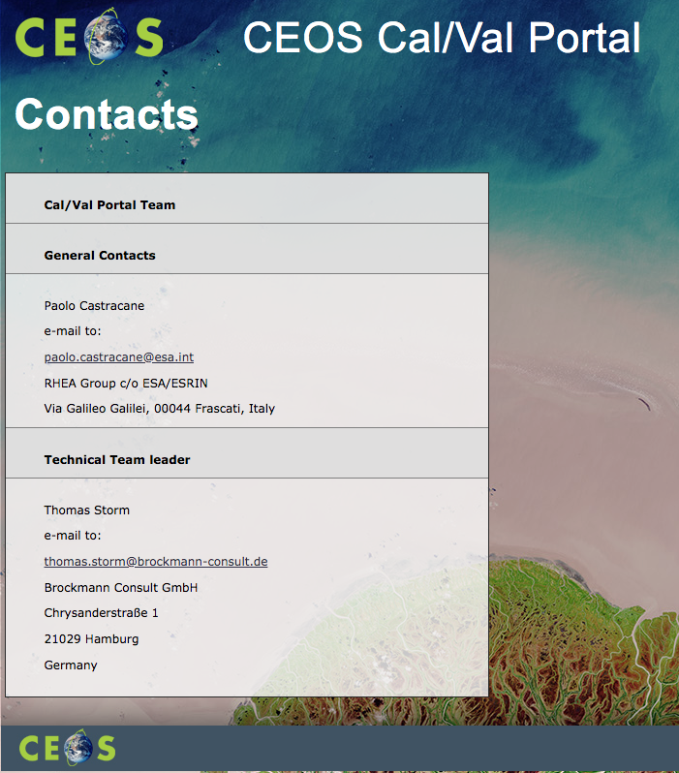
The new CEOS Cal/Val Portal Conf. & Workshops, Links
Conferences & Workshops provides a time ordered list for the relevant events with links to the official websites for conferences and workshops.
The Links page will offers a substantial list of relevant links subdivided by topics.
Contacts will include information on the web administrators for general and technical issues.

Slide 20
Conclusions
A new CEOS Cal/Val portal is proposed – it is currently password protected and available.
General comments from the CEOS WGCV community is welcome
Further feedback from Subgroup Chair is expected
The portal is conceptually dynamic, it will evolve according to the users needs and proposals.
The signed-in users are allowed to directly upload documents and materials that can by fully public or shared within defined groups and sub-groups.

