Slide 1

MTF (IVOS spatial quality task grp)
Committee on Earth Observation Satellites
F Viallefont ONERA
D Helder SDSU

Slide 2
CONTEXT
The geo spatial activity was set up in 2011.
It started with presentations entitled
  Definition and importance of geo-spatial quality
  Overview of in-flight MTF measurement methods and corresponding basic theory
The IVOS was seen as a good place to help the small community working in the geo spatial quality field to
  meet
  exchange
  share their experience
  establish recommendations to ensure good qeo spatial quality.

Slide 3
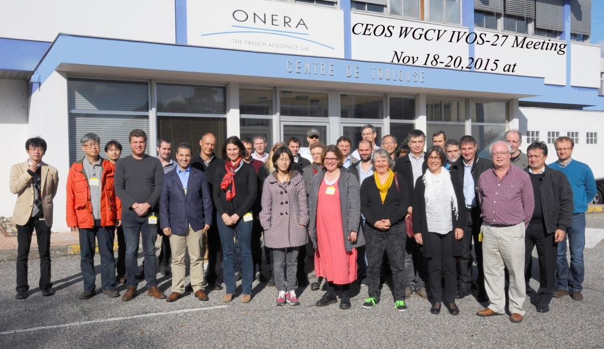
CONTEXT
In the 2012-2014 period, letters were sent to collect information about targets, methods and expectations.
In 2015, a geo spatial quality workshop was organized.
  It was an opportunity to have a large set of presentations about MTF assessment from various entities and various sensors
  A roadmap was discussed

Slide 4
Proposed Framework
On-orbit Estimation (substantial portion of document)
Field Methods Survey
Targets
  Artificial/Man-made
    Points
    Lines
    Edges
    Pulses
  Image feature-based
    Linear (‘Rich’) features
    Bridges
    Moon
  Matrix of Targets
    Type vs. GSD
    Availability/Maintenance
    Point of Contact
    Recommended for operational acquisition
  Database of ‘Standard’ Imagery for PSF/MTF estimation
Data Analysis, PSF/MTF Estimation
  Image data format
  Models
  Parametric/Nonparametric Methods
  Database of ‘Standard’ estimation methods
Proposed Actions
(from IVOS 24)

Slide 5
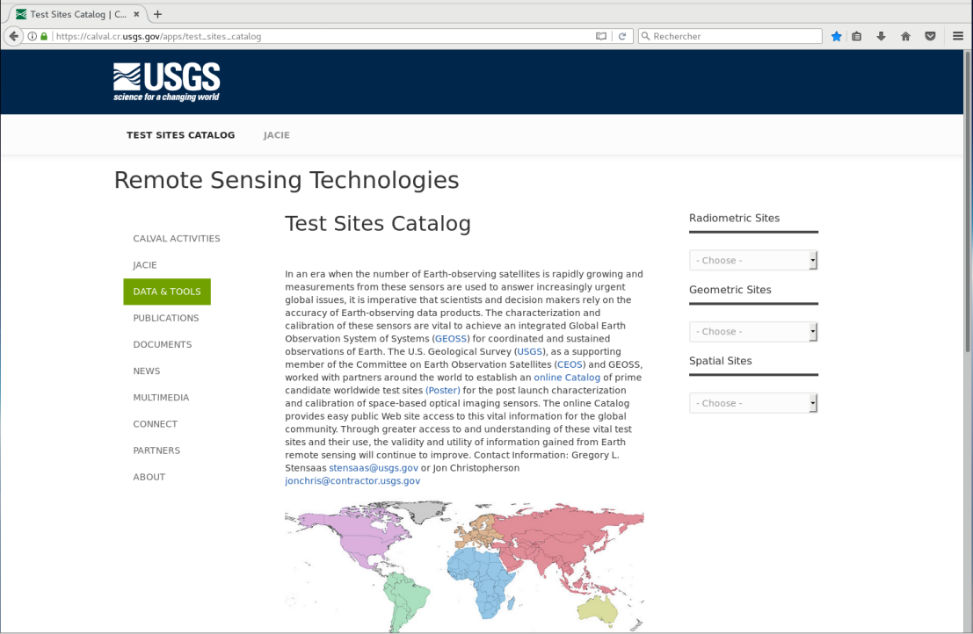
THE FRAMEWORK
D. Helder led the field methods survey: answers to letters about targets and methods were used to complete a catalog of targets suited for MTF measurement.
Field Methods Survey Test sites catalog
https://calval.cr.usgs.gov/apps/test_sites_catalog

Slide 6
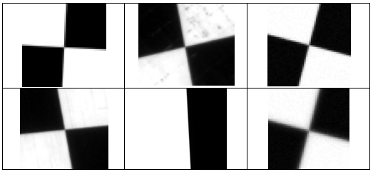
THE FRAMEWORK
In 2015, a team was created to work on the MTF measurement methods beginning with the edge method. Three participants provided edge images.
Shared data for MTF measurement Initiate reference dataset

Slide 7
THE FRAMEWORK
From 2016 to 2017, processing of the reference edge images and MTF comparisons
2018: paper writing and reference dataset preparation
MTF measurement comparison Reference dataset preparation

Slide 8
RESULTS
2018: paper published and reference dataset created
MTF measurement comparison paper published
Comparison of MTF measurements using the edge method: towards a reference dataset
Françoise Viallefont-Robinet, Dennis Helder, Renaud Fraisse, Amy Newbury, Frans van den Bergh, DongHan Lee, and Sébastien Saunier
Optics Express Vol 26, Issue 26, 33625-33648, 2018
https://doi.org/10.1364/OE.26.033625

Slide 9
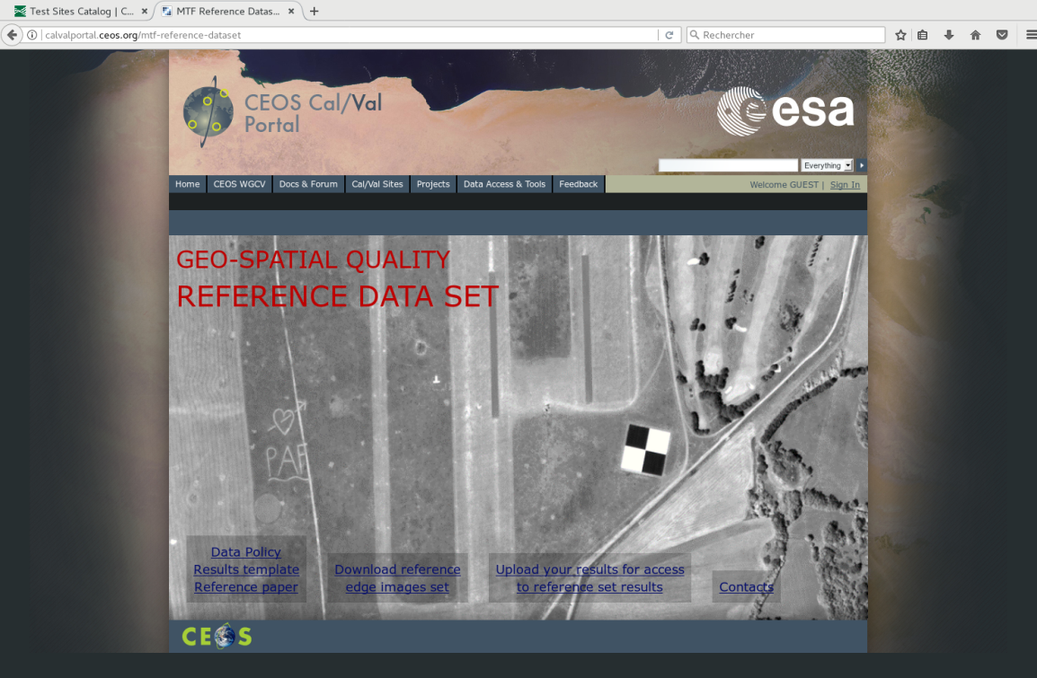
Available for users to compare on CalVal portal
2018: paper published and reference dataset created
MTF measurement comparison
+ Reference dataset
Shared data for MTF measurement

Slide 10
Test Site Catalog
Test site catalog hosted by USGS EROS at http://calval.cr.usgs.gov/rst-resources/sites_catalog/spatial-sites/
Essentially no change in test site catalog since our meeting in November 2015.
  Checkerboards: Baotou, Big Spring, FGI Sjokulla, Peng-Hu, Salon de Provence, Stennis
  Bridges: Chesapeake Bay, Jiaozhou Bay, King Fahd, Lake Ponchartrain, San Mateo
  Migrate catalogue to CalVal portal (Done!)
Goal from last meeting to have exhaustive list of checkerboards and bridges
  From the viewpoint of the participants on Monday, this list seems to be exhaustive.
Concern: how many of these sites are being maintained?
  Maintenance is first requirement to be CEOS recommended

Slide 11
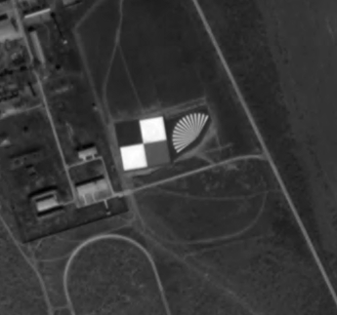
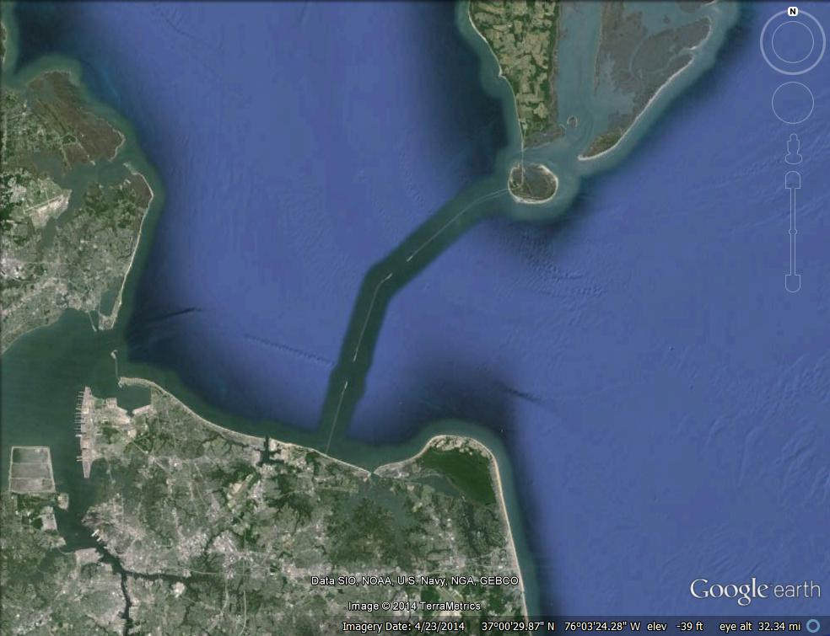
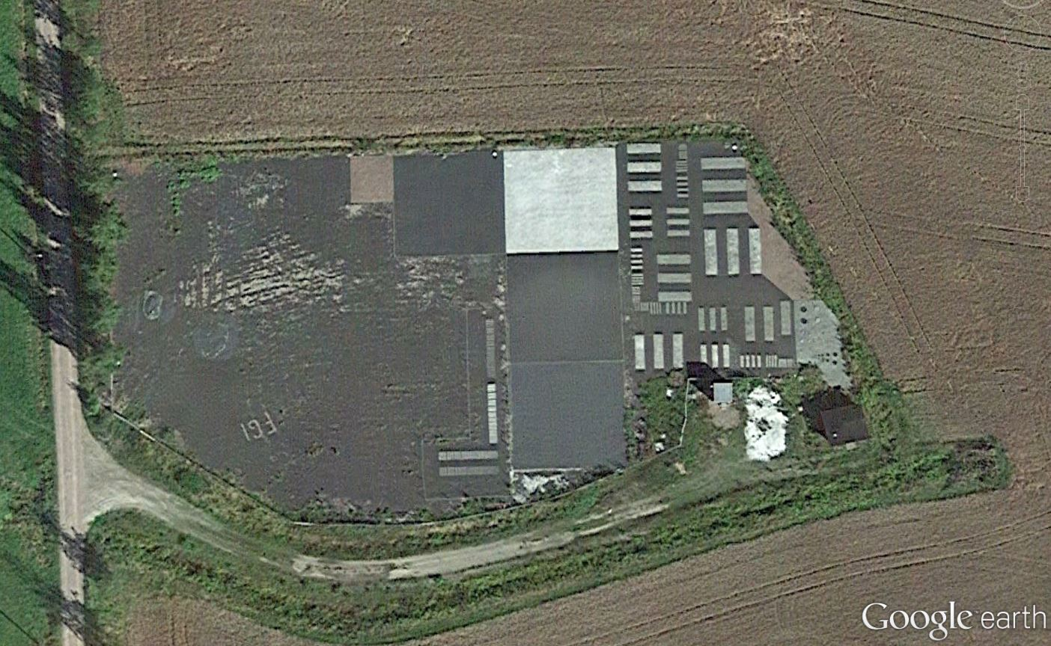
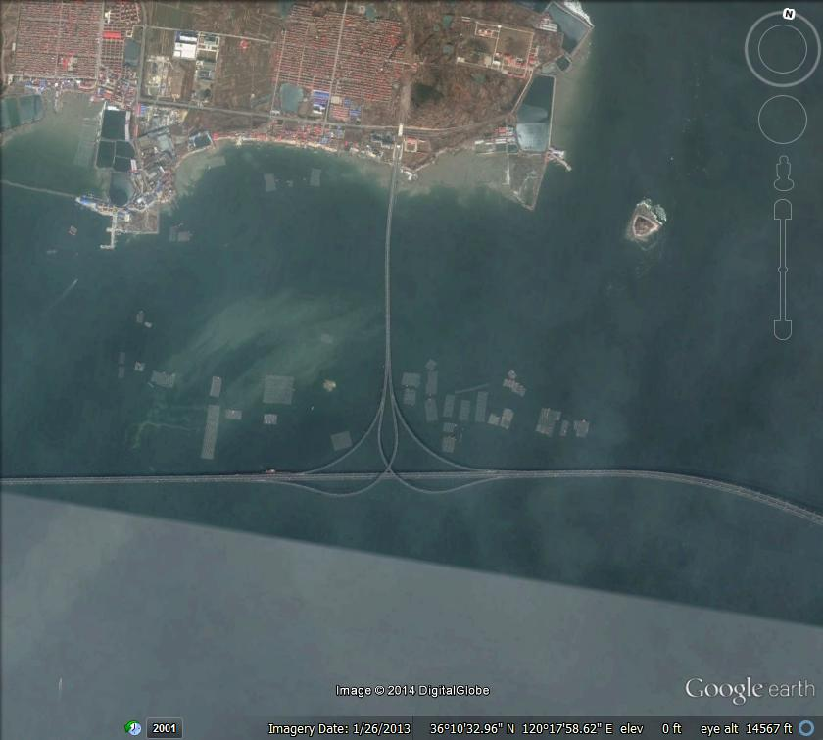
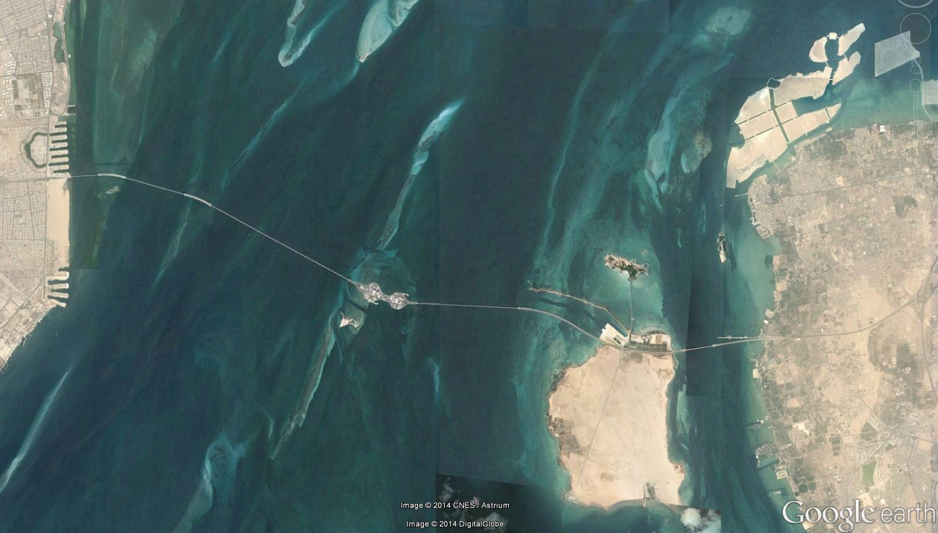
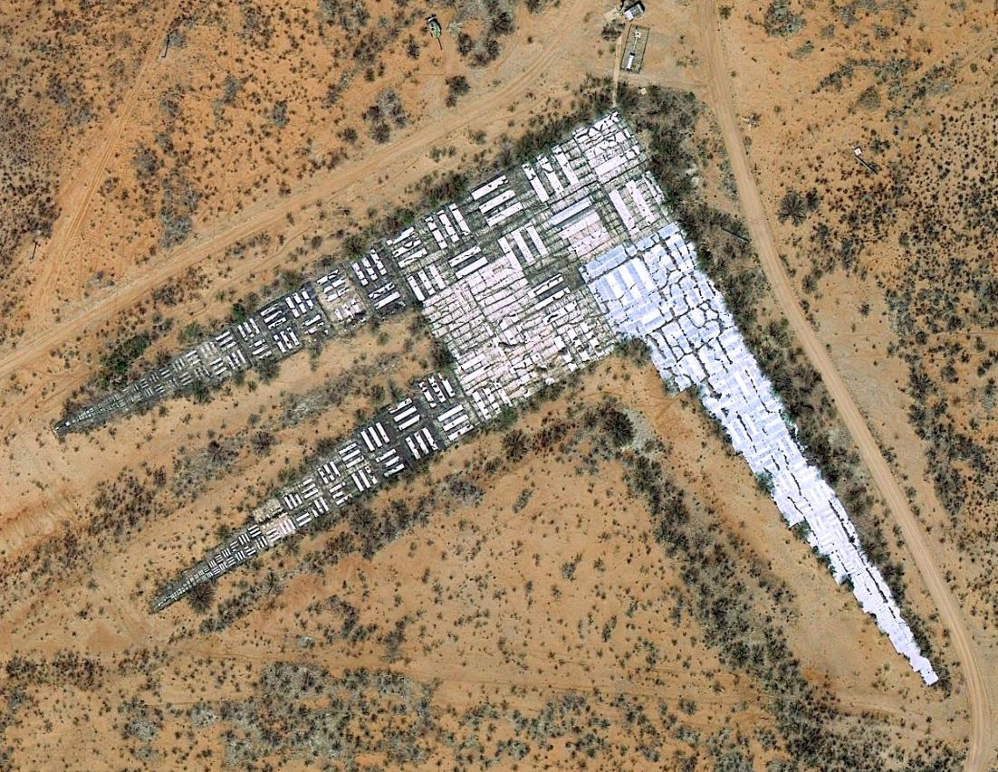
Current Website Status
Baotou, China
Chesapeake Bay Bridge, USA
FGI Sjokulla Aerial Test Range, Finland
Ft. Huachuca MTF Site, USA
Jiaozhou Bay Bridge, China
King Fahd Causeway, Bahrain

Slide 12
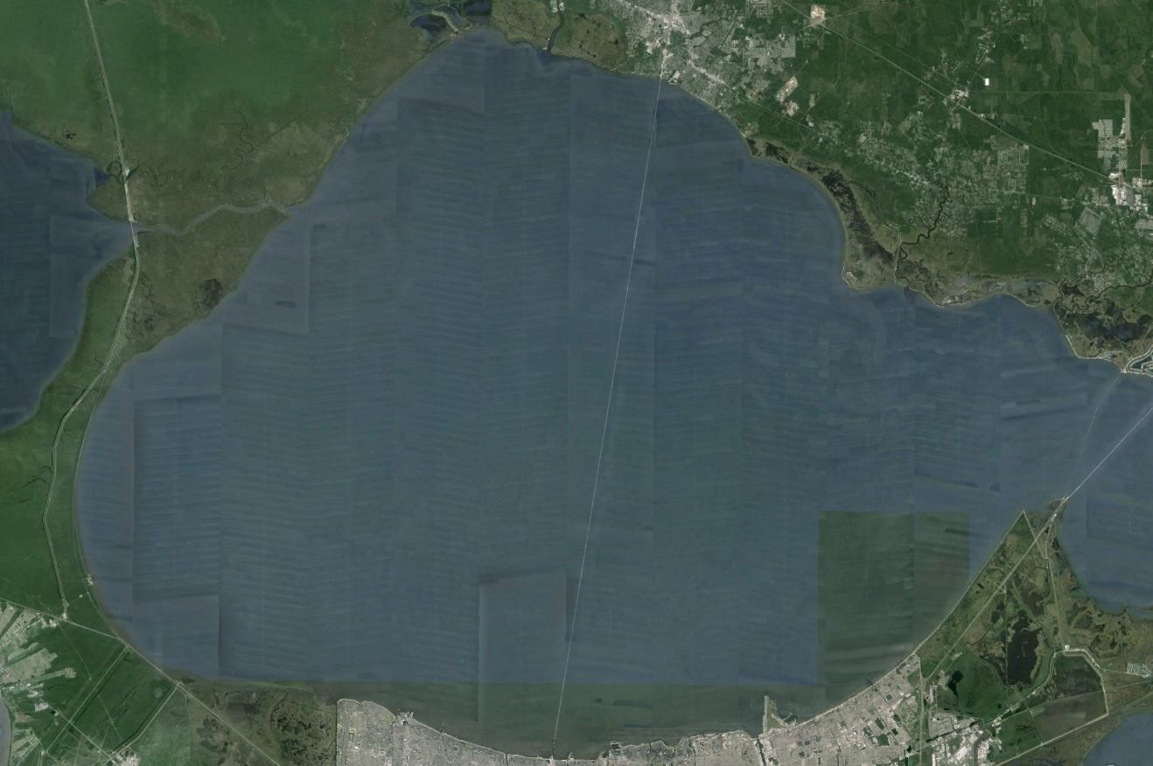
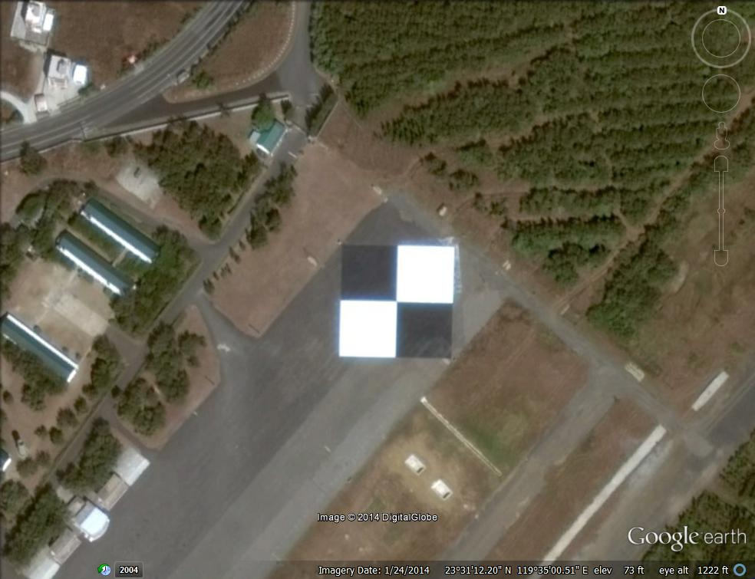
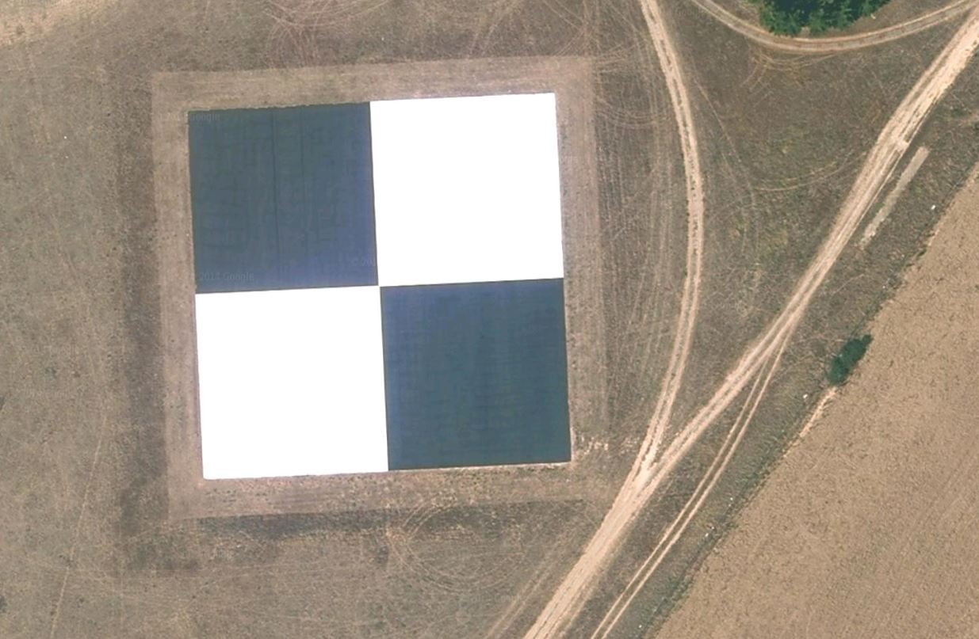
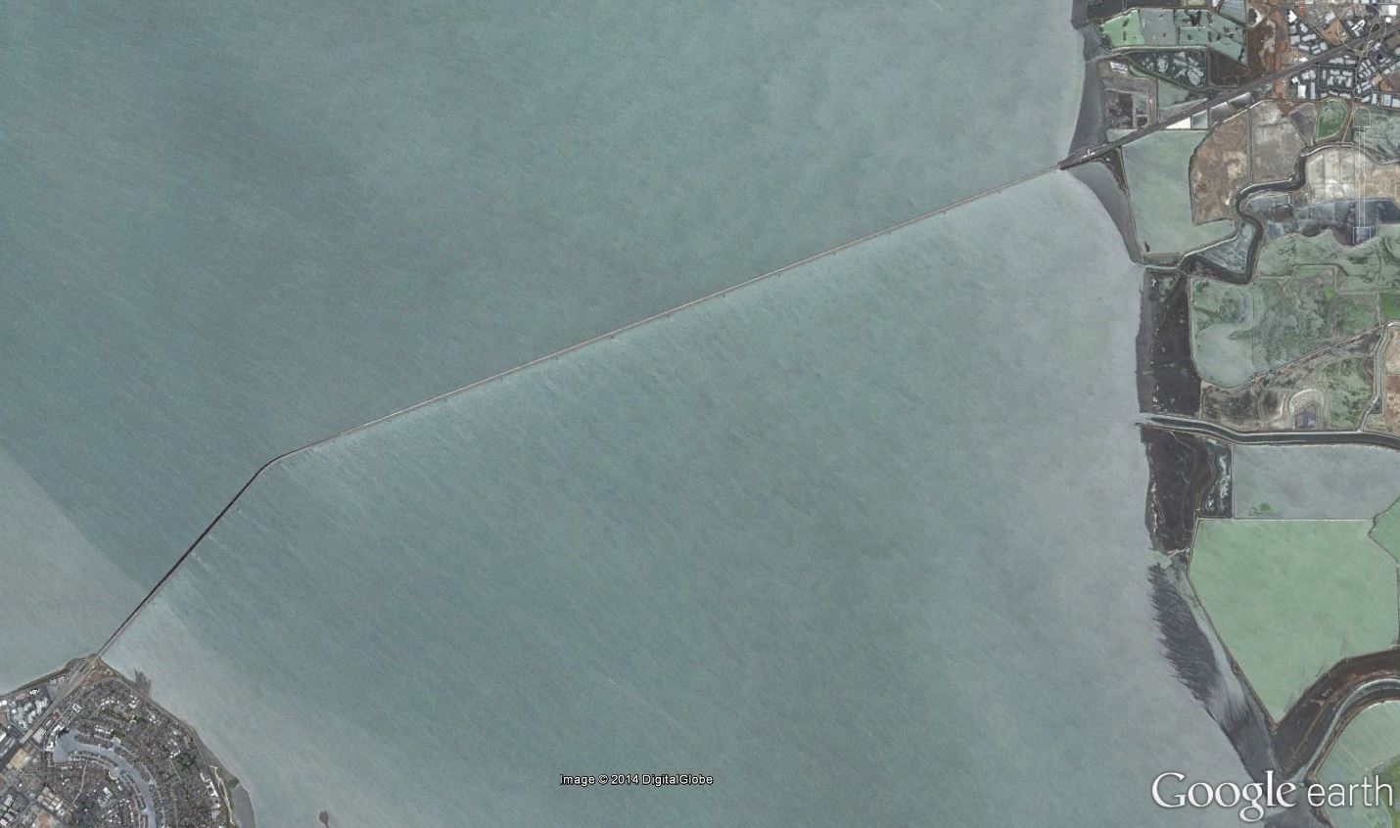
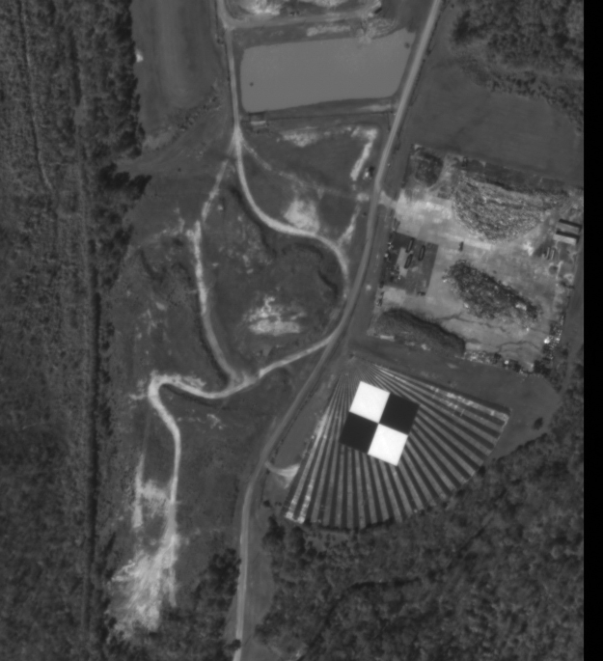
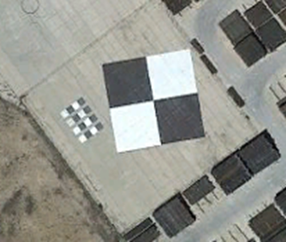
Current Website Status
Lake Ponchartrain Causeway, USA
Peng-Hu, Taiwan
Salon de Provence, France
Stennis, Mississippi, USA
Big Spring, USA
San Mateo Bridge, USA

Slide 13
Need to Do
What are the requirements to be a CEOS recommended site?
Characteristics
What other test sites should be included?
  Stars
  Moon
  Urban sites

