Slide 1

WG Climate
Observations for Climate
Committee on Earth Observation Satellites
Jörg Schulz, EUMETSAT, WGClimate Chair
John Dwyer, USGS, WGClimate Vice Chair
Albecht von Bargen, DLR; WGClimate Vice Chair
CEOS WGCV 45
Observations for End Users, Item 4.2
Perth, Australia
15-19 July 2019

Slide 2
Content
Reflection on joint meetings with GCOS and WCRP Data Advisory Council;
WGClimate #10:
  WGClimate leadership;
  GHG Monitoring (CEOS-32-05);
  ECV Inventory, gap analysis and coordinated action plan
UNFCCC;
Miscellaneous items
Comment: Presentation is based on SIT-34 reporting

Slide 3
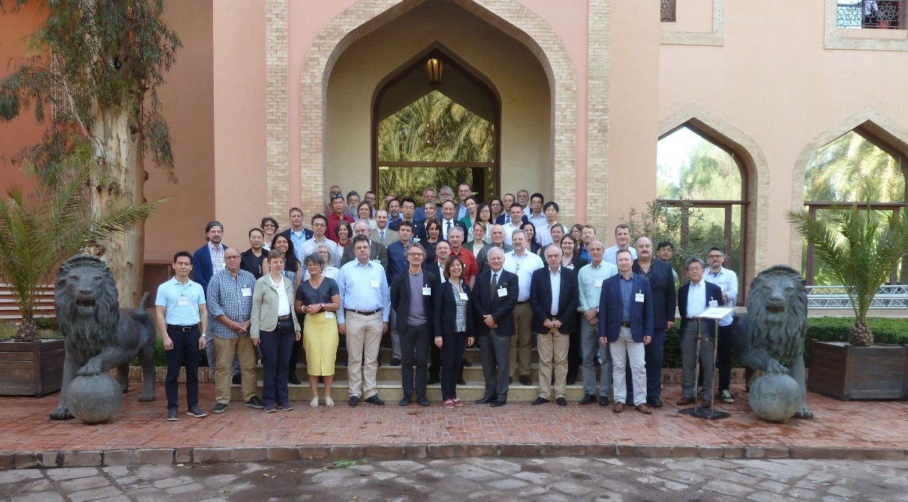
Joint Meetings with GCOS and WCRP DAC
CMRS-23 and 24
Marrakech, 18-19 March 2019
Well attended by ~80 people;
Need further discussion with GCOS on requirements setting for various applications;
WCRP:
Has new strategic priorities and works on an implementation plan to be ready in one year. We try to install an effective entry for space agencies via WCRP DAC and joint planning staff at WMO;
WGClimate is promoting that GCOS remains “the single voice” for requirements towards space agencies including those for WCRP applications;
Joint meeting with WDAC proposed to consider establishment of joint GCOS/WCRP panels instead of single organisation panels.

Slide 4
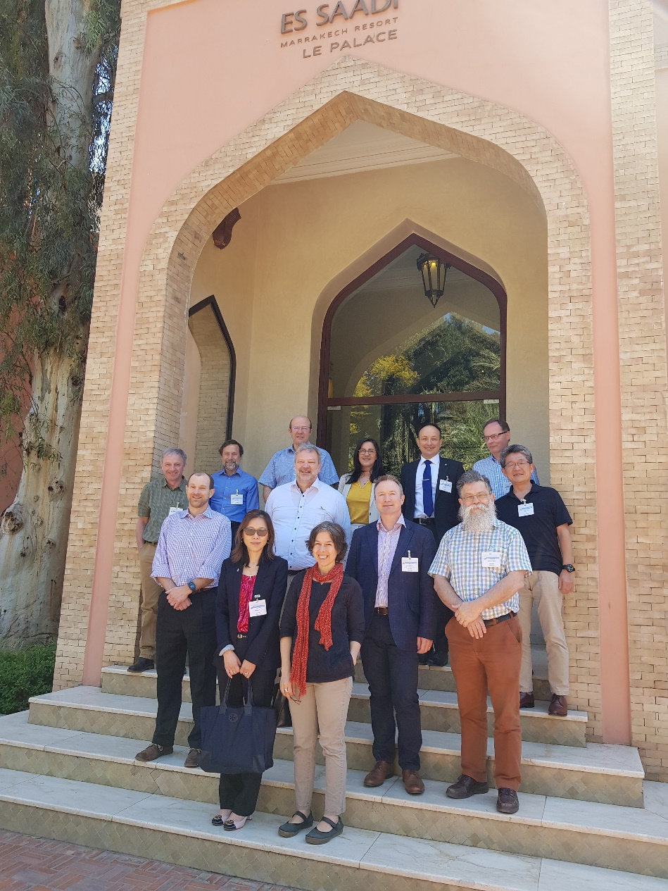
WGClimate #10
Marrakech, 19-22 March 2019
Well attended by 11 agencies (CNES, DLR, EC, ESA, EUMETSAT, JAXA, KMA, NASA, NOAA, UKSA, WMO);
Cross representation from CEOS (WGCV, WGISS, AC-VC, and CEO), UNFCCC, C3S, WCRP
Major items:
  Leadership;
  GHG Monitoring (CEOS-32-05);
  WMO Congress;
  ECV Inventory, gap analysis, coordinated action plan (several work plan actions);
Next meeting(s) Sep 2019 (4-6, 10) alongside CEOS SIT-TW, Alaska.

Slide 5
Leadership
WGClimate was in need for a new Vice-Chair in October 2019;
John Dwyer stepped down because of health reasons
WGClimate did highly appreciate his continuous support of the WG since the very early times. He brought in the expertise in terrestrial and was very well recognized by all members. Much to WG’s regret it must accept that John is not able to further chair.
After nomination by WGClimate and approval by CEOS and CGMS, Albrecht von Bargen (DLR) became vice-chair from June 1st, 2019 onwards with moving into the chair role duing the CEOS plenary in 2020.
The search for new vice-chair from 2020 onwards is now opened.

Slide 6
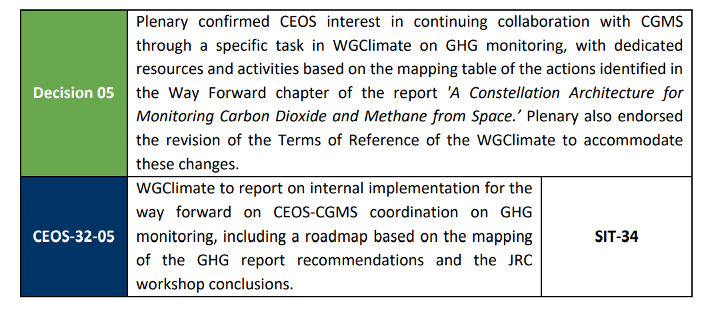
GHG Monitoring

Slide 7
GHG Monitoring – Internal Implementation Rationale
Both CEOS and CGMS have coordination structures that have successfully been used to write the GHG Monitoring Constellation White paper;
Organisation in WGClimate shall not duplicate structures and activities of contributing bodies;
WGClimate needs to:
  Develop and maintain the roadmap for the GHG monitoring system;
  Coordinate CEOS and CGMS bodies in executing the tasks in the roadmap;
  Provide links to UNFCCC, GCOS, (GEO-C), IG3IS, WCRP and perform communication of results;
  Address the carbon inventory community;
  Oversee the implementation of the CEOS carbon strategy actions.
Need a structure that is able to execute the coordination work and ensures balanced representation of involved bodies and needed skills;
Involved bodies will have some extra efforts ensuring the coordination.

Slide 8
GHG Monitoring – Internal Implementation Decision
WGClimate #10 established a task team that consists of a leader and a deputy with nominal terms of 2 years;
Initial leads are Mark Dowell, EC (Leader), Albrecht von Bargen, DLR (Deputy)*;
Representation of CEOS and CGMS bodies is achieved by identifying Point of Contacts (PoCs) for tasks in the contributing CEOS and CGMS bodies;
WGClimate plans to review progress at WGClimate meetings with reporting by leaders and PoCs. This shall allow all agencies to share the activities (transparency);
*Deputy shall be with WGClimate vice-chair

Slide 9
GHG Monitoring – Status of Roadmap (CMRS-25)
We progressed beyond the mapping table of actions to various groups presented to CEOS-32 Plenary;
CEOS and CGMS bodies have proposed specific elements for the roadmap (see, e.g., the AC VC presentation);
Agreed at WGClimate #10 to undertake dedicated effort by the task team leaders and the contributors to collate individual contributions into the roadmap towards an operational system (distributed work plan);
Major milestones (timeline) in roadmap are:
  UNFCCC global stocktake #1, 2021/22: Prototype system;
  UNFCCC global stocktake #2, 2026/27: pre-operational system;
  ~2030 operational system.
Way forward:
  Set-up roadmap with responsible task team leads;
  Perform meeting in Japan (9 June 2019) to agree (in principle) on roadmap;
  Present to CEOS SIT TW and Plenary;
  Add tasks into VC and WG work plans if not already done.

Slide 10
ECV Inventory
Domain | Total | Current | Future
All | 913 | 496 | 417
Atmosphere | 658 | 376 | 282
Land | 135 | 56 | 79
Ocean | 120 | 64 | 56
ECV Inventory #2
Work Plan
Service Actions
CMRS-17, 20, 21
  * pre-verification process
ECV Inventory #3
1394 records | 976* inherited (#2) | 33 removed
 |  | 943 available | 649 existing | 817 existing + 481 planned | 1298 records
 |  |  | 294 planned
 | 418 new (#3) | 355 available | 168 existing
 |  |  | 187 planned
 |  | 63 removed
  ~ 200 Responders, Co-editors, Observers
    60 + 6 new registered Responders
    New input on e.g. Above-Ground Biomass and Sea-surface Salinity ECVs (previous “gaps”)
    New / Stronger contributors: KMA (new), JAXA and JMA (stronger)
    New programs: ESA CCI+, C3S-funded Projects – planned CDRs

Slide 11
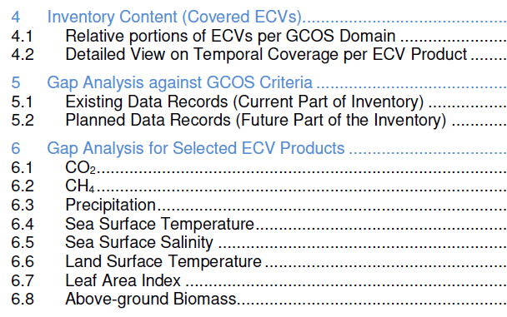
Gap Analysis 2019
  Automatic assessment
  Statistical analysis tools and graphical display
  Individual CDRs
  Assessment tools on the web interface (GA teams of experts) > “delta”
  Statistical analysis tools and graphical display
  Detailed analysis per ECV / ECV Product
    Will assess progress for 8 ECVs addressed last year;
    Selected 13 ECVs (5 atmosphere, 5 land, 3 ocean) not addressed before that are specifically part of GCOS-IP actions;
    Engaged WGClimate members to form Gap Analysis Teams for each selected ECV (VCs are invited where it matches the ECV);
    ECVs for which we cannot form Gap Analysis Team will not be analysed;
    May need MIM update.

Slide 12
Timeline
November
Q3.2019
Q4.2019
December
January
Q2.2019
February
March
Preparation (piecewise continuous)
Data collection and Verification (continuous)
Analysis and Reporting (annually)
Update of web interface, Questionnaire (GCOS-200)
Registration of new Responders and population of the database: update of pre-existing entries (contacts, URLs, deletion of obsolete/redundant content – e.g. new approach to ICDR-like data records, conversion planned > existing) + input of new entries
2019 Gap Analysis
2019 GA Report and Coordinated Action Plan
Verification of submitted contents for completeness and consistency, in preparation for publication and Gap Analysis
1st deadline for the cut-off of data collection for v3.0
Final cut-off date of data collection for v3.0 to be used in 2019 gap analysis
Intermediate results at the CGMS Plenary
Publication of ECV Inventory v3.0
Submission of Reports to CEOS Plenary
WGClimate #10

Slide 13
UNFCCC
Delivered CEOS/CGMS statement to SBSTA-49 in Katowice, Poland in December 2018, an extra report, and contributions to the SBSTA Chair report;
Provided a presentation to SBSTA-49 Systematic Observations Delegates;
SBSTA-49 could not agree on a text related to the IPCC 1.5° report. No agreed outcome for Systematic Observations from SBSTA-49 exists;
UNFCCC Secretariat targets to have an agreement at SBSTA-50 (17-27 June, 2019 in Bonn, Germany). UNFCCC Secretariat wants to help to achieve better recognition for space agency work in that text;
To support this an updated CEOS/CGMS statement for SBSTA-50 had been prepared and presented at CGMS-47, 19-24 May 2019 for endorsement; CEOS endorsed in written procedure shortly after;
SBSTA-51 at COP25 will be held 3-17 December 2019 in Santiago de Chile. Will prepare items as in 2018 including a statement to be endorsed at CEOS-33 Plenary (CMRS – 22).

Slide 14
Miscellaneous
Statement of Space Agency Contributions in Support of Each Article of the Paris Agreement (CEOS-32-02) was planned for WMO Congress early June 2019;
General status of implementation of actions from the coordinated action plan is mixed. Good progress on WGClimate internal, GHG, and SST actions. Land needs more attention. More detailed report at Plenary (CMRS-25,26,and 27);
SST VC analysed coordinated actions related to SST. Identified good reasons to try adding additional historical data to improve the SST ECV prior to 1991. We together ask agencies to enable some pilot projects to see what is achievable from such sensors;
WMO document for Congress on the Architecture for Climate Monitoring from Space has been commented by many agencies (see WMO presentation);
Status of CNES SCO has been presented and discussed by WGClimate;
SIT Chair letter expressed the overall CEOS view;
Formed small groups to address more case studies (WP CMRS-13) and WGClimate web presence – update on planned for CEOS-33 Plenary;
Work with WGISS on ECV data records and IDN registration (DATA-9 Action). Will consider this as gap from ECV Inventory.

Slide 15
Outlook
WGClimate # 11 in Anchorage, September 4-6, 2019, in parallel to LSI-VC/ SDCG / etc.
  Part 1: WGClimate “classical”: ECV inventory, Gap analysis
WGClimate # 13 in Fairbanks, September 10, 2019, as side-meeting to SIT TW
  Part 2: GHG task team meeting to finalize the roadmap paper and review status of tasks
WGClimate # 13 in March timeframe…..

Slide 16

Thanks!
Questions?
  Joerg.schulz@eumetsat.int
  dwyer@usgs.gov

