Slide 1
Progress on WGISS-WGCV Cooperation
M.Albani, A.Della Vecchia, I.Maggio, R.Woodcock
ESA/CSIRO
WGCV #45
Perth, AUSTRALIA
July 18, 2019

Slide 2
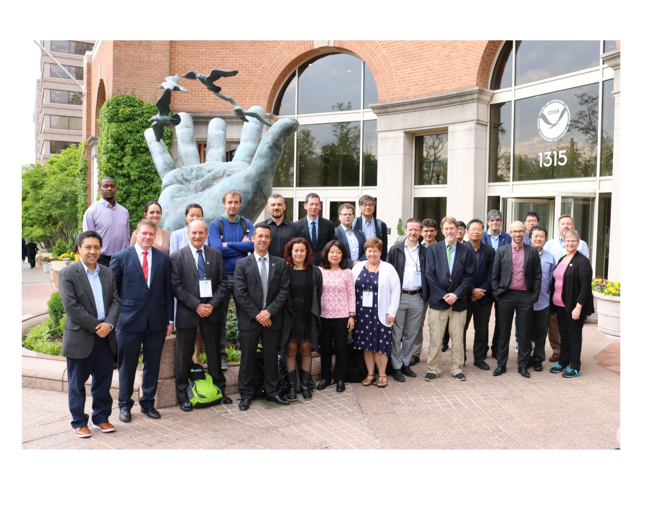
WGISS
WGISS-47, NOAA – Silver Spring,
29 April – 2 May 2019

Slide 3
WGISS Structure
WGISS
Chair, Mirko Albani, ESA
Vice-Chair, Robert Woodcock, CSIRO
WGISS Principals
CAS/AOE: Guangyu Liu
CAS/RADI: Lizhe Wang
CNES: Richard Moreno
CONAE: Homero Lozza
CSA: Paul Briand
CSIRO: Robert Woodcock
DLR: Katrin Molch
EC: Astrid Koch
ESA: Mirko Albani
EUMETSAT: Michael Schick
GA: Simon Oliver
INPE: Lubia Vinhas
ISRO: Nitant Dube
JAXA: Yousuke Ikehata
MFA/HSO: Gabor Remetey
NASA: Andrew Mitchell
NOAA: Kenneth Casey
NRSCC: Chuang Liu
ROSCOSMOS: Aleksandr Chunosov
UKSA: Esther Conway
USGS: Kristi Kline
WGISS Secretariat
Michelle Piepgrass, ESA
WGISS Infrastructure Services Project
NOAA – until end April 2019
Data Preservation and Stewardship Interest Group
(Mirko Albani, ESA)
Discovery and Access - WGISS Connected Data Assets System Level Team (Yonsook Enloe, NASA)
- IDN (Michael Morahan, NASA)
- FedEO (Andrea Della Vecchia, ESA ; Yves Coene, ESA)
- CWIC (Yonsook Enloe, NASA)
- OpenSearch II (Andrea Della Vecchia, ESA; Olivier Barois, ESA)
Interoperability and Use Interest Group
(Robert Woodcock, CSIRO; Richard Moreno, CNES)
- Future Data Architectures (Robert Woodcock, CSIRO; Richard Moreno, CNES; Kristi Kline, USGS)
- Carbon Portal (Kenneth Casey, NOAA; Liping Di, NOAA)
- Data Analytics Software and Tools (Iolanda Maggio, ESA)
Technology Exploration Interest Group
(Chris Lynnes, NASA; Yousuke Ikehata, JAXA)

Slide 4
Synergies Among Teams
CEOS Carbon Team - ongoing development of prototype Carbon Portal
WGClimate - ECV/CDRs registration in IDN in parallel with ECV inventory v3 update agreed during WGClimate-10 meeting
WGDisasters - possible cooperation on generic recovery observatory
WGCV - ongoing on four different tasks
Virtual Constellations - inventory of VC data to be updated to ensure discoverability/accessibility through WGISS infrastructure
WGCapD - joint organization of technology webinars and FDA events
SEO - COVE tool harvesting WGISS metadata, data cubes coordination
SDG AHT - SDGs platforms & data discovery through WGISS CDA under discussion

Slide 5
Joint WGISS/WGCV Activities
Four topics discussed in April 2018 with leads identified from WGISS and WGCV (updates at later stage)
Data Formats and Interoperability in the framework of FDA
Robert Woodcock (WGISS), Medhavy Thankappan (WGCV)
Quality Indicators in Discovery Metadata
Michael Morahan (WGISS), Nigel Fox (WGCV)
CEOS Data Cubes and CEOS Test Sites Data Access in support of WGCV Activities
Robert Woodcock, Andrea Della Vecchia (WGISS), Cindy Ong (WGCV)
Standardization and Best Practices (e.g. ISO 19159-3)
Iolanda Maggio (WGISS), Greg Stensaas, Philippe Goryl (WGCV)

Slide 6
1) Data Formats and Interoperability in the frame of FDA
Tasks - ARD uncertainty: Work to define a set of quality/uncertainty parameters to include within ARD and determine an initial method to incorporate these along with their provenance into the data stream, including education of the data community on how to provide provenance information
Analysis Ready Data (ARD) clear definition
Definition of quality/uncertainty parameters to be inserted into ARD
Determine a method to incorporate these along with their provenance into the data stream
Definition of a user manual for data community on how to provide provenance information
Approach (defined at June 2018 Telco):
WGCV concentrating on Surface Reflectance as ARD test case to be studied in more detail. L8 and S2 being investigated. Work should be completed in 2 months time.
Thermal and SAR ARD products work being started but will be completed at a later stage.
ARD team will also include a CAL/VAL function so the two teams will work closely together. Assessment framework will be defined by WGCV.

Slide 7
1) Data Formats and Interoperability in the frame of FDA
September 2018 and February 2019 updates:
WGCV was to provide an initial list of uncertainties in late September
Discussion with WGISS to define what uncertainty information to make available to users and how
WGISS to investigate how field sites data (e.g. for Surface Reflectance) can be made available through Data Cube technology
Workflow for this is in Digital Earth Australia - starts with field data, convolution to match satellite sensor surface reflectance, then comparison report mechanism
Reviewing USGS land product characterisation website for further use-case insight
Work with the WGISS Connected Data Assets team for an ARD data cube on demand
July 2019 updates:
Difficult to have necessary resources. WGCV work ongoing on measurements uncertainties; experimental design ongoing, uncertainties related to field based measurements; preliminary results can be shared with WGISS by end of August 2019.
Exchanged info with NPL.
Work on Surface Reflectance progressing (Rob). Replicate work on Data Cube on demand.
Further discussion will be held at WGCV-45.

Slide 8
2) Quality Indicators in Discovery Metadata
Tasks - QI Test case: Evaluate whether SST would provide a suitable test case for QI development that can act as an expressive case for QI access and implement this or another one as determined through this activity
Survey on QI currently used by different sensor families
Validation of SST as suitable test case for QI
Approach (defined at June 2018 Telco): Confirmed that SST is a suitable test case for QI development.
September 2018 and February 2019 updates:
WGCV (Nigel) and team of people working with GHRSST to survey SST QIs currently used by different sensor families at different agencies. G. Corlett of GHRSST has started to compile SST QIs
Review current reported metadata on SST and how QI information is made accessible/viewable
For individual sensors and from GHRSST product (if different)
Value/usefulness/adequacy for current users
Links to Validation data and preservation of information
SST Virtual Constellation team will collaborate in developing a case study on QI to be further implemented by WGCV.
WGISS (Michael) to start defining best approach for representing and including QIs for the selected test case in discovery metadata searchable by end users.
WGISS need one specific and one broader example of SST QI to start metadata analysis. Awaiting input from WGCV
WGISS (Michael) to start narrowing down 1) embedding measurement equation, 2) linking later stages to earlier stages and processing, 3) readability for end users
Dedicated small group teleconference (Task Team) to be held by end of July. Teleconference should be set-up by mid October.
Develop measurement Equation, traceability visualisation of process (from L1 data sets)

Slide 9
2) Quality Indicators in Discovery Metadata
July 2019 Updates:
Nigel will circulate more detailed slides.
Discussion is on-going with GHRSST team which has produced a specification for quality indicators for SST. Discussion focussed on how they have defined and included the indicators in the metadata and how potentially WGISS might be able to help take that forward.
QI are defined at two stages: first quite high level (Quality Level 1) saying whether the data is useful or not (pre-qualifiers) and second stage more detailed (Quality Level 2) with standard error statistics. These are derived by comparing satellite sensors results with the one derived from buoys. Standard deviations and biases computed between buoys (assumed as correct measurements) and satellites. This is delivered in the satellite data metadata but all the process is done manually now. Worth to know if WGISS can help in automating this. We should progress in two steps:
SST QI Activity Process description and definition including insertion in metadata (1st step)
Possible automation with Machine Learning (2nd step)
Teleconference to be organized between Nigel/Michael/Yonsook to further discuss way forward. Results will be shared with the WGISS-WGCV team.

Slide 10
3) CEOS Data Cubes and CEOS Test Sites Data Access in support to WGCV Activities
Tasks - LPV supersite data access test case: LPV supersites are a good test case related to validation with a broad user community. Objective is to provide an improved user access to the LPV supersite data sets coupled with analytics tools to provide improved results for the users
Definition of the status of the activity concerning the identification of the key supersites in the frame of CEOS Land Product Validation (LPV)
Definition of the analytics tools needed
Definition of how to improve the user access to the LPV supersites
Approach (defined at June 2018 Telco)
WGCV to document the cal/val test sites and provide information on Land calibration sites for optical sensors; WGCV to define list of validation sites for LPV.
WGCV to work with WGISS (Michael) to get these into the IDN with a link to the CEOS Cal/Val portal for site definition where available. A follow-on task would be for WGCV to update the test site catalog on CEOS Cal/Val portal and add links later for those not ready yet.
The focus for initial datacube/catalog population would be good to tie to the previous tasks on surface reflectance as a starting point.
The remaining step is to insure data is available from CEOS agencies. Starting with Landsat and Sentinel -2. Action to work with LSI-VC on data population.

Slide 11
3) CEOS Data Cubes and CEOS Test Sites Data Access in support to WGCV Activities
September 2018 and February 2019 Updates:
WGCV (Greg and Jamie) to update the test sites catalogue on the CAL/VAL Portal by August.
Metadata for sample test sites to be provided to Michael by end October
Ongoing collection of test sites, should be completed by end November
WGISS (Michael) to define how to get this info into the IDN for discover and possibly access by August.
Will be started after receiving initial input by WGCV, completed by end November
WGCV (Greg) to update info on USGS test data to allow access from WGISS Connected Data Infrastructure by October.
WGCV is updating catalogue. To be confirmed.
WGISS (Rob/Andrea) to investigate if/how test sites data (e.g. for Surface Reflectance) can be made available through Data Cubes technology.
Preliminary analysis being done in cooperation between Rob/Medhavy. Medhavy’s GA team has supplied some CV jupyter notebooks which can be used with the Data Cube technology. These operate over some Australian test sites and need to be ported to use the CEOS test site data. Information has been supplied by the WGISS CDA team regarding how to discover the test data. There are several challenges to overcome in the discovery, metadata and data access pipeline to load the necessary data into a DC and work on this is currently stalled in analysis and development due to competing work priorities. It is unclear when this will be addressed.
ESA PDGS Data Cube up and running with preliminary list of LPV sites

Slide 12
3) CEOS Data Cubes and CEOS Test Sites Data Access in support to WGCV Activities
July 2019 Updates:
List of validation sites for LPV:
Metadata for sample test sites to be provided to WGISS (Michael) by end July
Ongoing collection of test sites, should be completed by end July
WGISS (Michael) to define how to get this info into the IDN for discover and possibly access → will be started after receiving input by WGCV, completed by end August
WGCV (Greg) to update info on USGS test data to allow access from WGISS Connected Data Infrastructure by end July
Data Cubes
Cindy had a teleconference with CAL/VAL portal and DataCube people at ESA.
ESA PDGS Datacube (https://preops.eodatacube.eu/):
Hosts RadCalNet (In-Situ) and ACIX (In-situ and S-2/L-8) data (see HERE).
Provides Jupyter notebooks to reproduce ACIX use cases (http://calvalportal.ceos.org/results)
Effort ongoing in Australia to have the Digital Earth Africa programme up and running. Conference will be held in mid August. By end of September properly updated collection (Landsat data) will be available in the data cube. Report will be provided at WGCV-45.

Slide 13
3) CEOS Data Cubes and CEOS Test Sites Data Access in support to WGCV Activities
Document the cal/val test sites
Test site catalog list - Note using work being developed for Land Product Characterization Systems (LPCS)
Used LPV site list
CEOS test site list
NEON test sites
Need to get new sites added
New RadCalNet
New Australia sites
https://lta.cr.usgs.gov/Calibration_Validation_Test_Sites
Test site catalog
Cal/val portal – http://calvalportal.ceos.org/
USGS – test site catalog

Slide 14
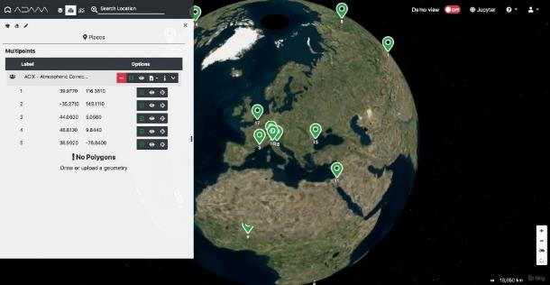
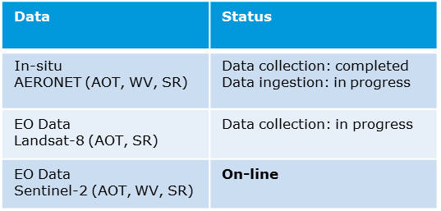
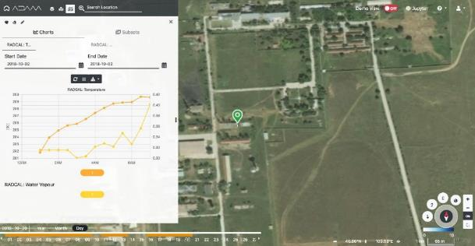
3) Joint WGISS/WGCV CEOS Data Cubes and CEOS Test Sites Data Access
ESA PDGS Data Cube - In-situ / EO Data Discovery, Visualization & Pixel Access
Atmospheric Correction Inter-Comparison Exercise (ACIX) (CV-14)
ACIX II-land, 115 sites were selected based on AERONET stations’ location and measurements availability for one-year period starting from October 2017. A total of around 7000 image scenes acquired by Sentinel-2A, -2B and Landsat-8;
ACIX-Aqua, the exercise is split into phases: Phase I, processors over coastal waters (20 AERONET-OC sites) and Phase II, processors over inland waters (15 sites with in-situ measurements)
Radiometric Calibration Network
(RadCalNet) (CV-09)
108 users since portal
opening
Pre-configured list of sites
Data Discovery
Direct access to the selected site
In-situ Data Visualization and pixel access;

Slide 15
4) Standardization and Best Practices
Tasks - Revisit and update WGISS-41/WGCV-40 actions: Define a point of contact within WGCV to work with WGISS to reinvigorate the actions of WGISS-41 in terms of more recent CEOS activities and move towards closure of these items to provide a good practice white paper for inclusion on the CEOS website
Definition of points of contact
Reviewing of Data Management and Stewardship Maturity Matrix
Collection of WGCV comments/feedbacks.
Issuing new version of the Data Management and Stewardship Maturity Matrix
Provision of new input to GEO Data Management Principles Implementation Guidelines (DMP IG)
Approach (defined at June Telco): WGISS point of contact: Iolanda. WGCV point of contact: Greg/Cindy
September 2018 and February 2019 Updates:
WGCV (Greg and Philippe) to provide comments on Maturity Matrix to WGISS (Iolanda) by end of July.
Awaiting inputs from Greg/Philippe.
Iolanda and Philippe/Greg to review actions from 2016 and reformulate as needed by end of July.
First draft with rewording prepared by Iolanda, waiting feedback from WGCV.
July 2019 Updates:
Feedback on maturity matrix awaited by Philippe and Greg. Further discussion will be held in Perth and feedback from WGCV-45 will be provided to WGISS.

Slide 16
4) Standardization and Best Practices
WGISS Maturity Matrix: Becomes more important as products/missions increase in number and comparison tools are needed
Maturity matrix concept can support the quality indicators topic
Current version of WGISS Maturity Matrix developed is very much data access and data preservation oriented
Efforts ongoing at ESA to reinforce data quality aspects: LPV work at the validation stage is being evaluated to possibly improve maturity matrix information
Need to align/merge activities related to maturity matrix recently carried out in parallel within WGISS and WGCV
Proposed Way Forward:
Collect feedback on WGISS Maturity Matrix by WGCV by August 2019.
Receive update of WMO Stewardship Maturity Matrix for Climate Data (SMM-CD) more focused on Quality Management and Uncertainty Analysis. Due date: October 2019
Improve the CEOS WGISS Data Management and Stewardship Maturity Matrix (DMSMM) for what concerns Data Management Principle (DMP) – 6: Data Quality. Due date: December 2019
Final review in WGISS/WGCV

