Slide 1

WGCV/WGISS: QI’s in discovery metadata
Fox - WGCV
Morahan –WGISS
WGCV 45
Committee on Earth Observation Satellites

Slide 2
2) Quality Indicators in Discovery Metadata
Objective: Ensure quality and uncertainty information availability (discovery and access) for users
Measurement equation must be embedded somehow
Per pixel uncertainty too large to handle
There exist a set of key quality metrics that are useful as indicators
QI should be tagged at all stages with a link to the earlier stages and is locked into the future
Discussion on where to go forward – QI is well defined but concrete cases will always have different levels and flags
Describing QI is not easy and more difficult to do it for the user readability
Keep in mind that quality is defined by end user – fitness for purpose is defined by end user

Slide 3
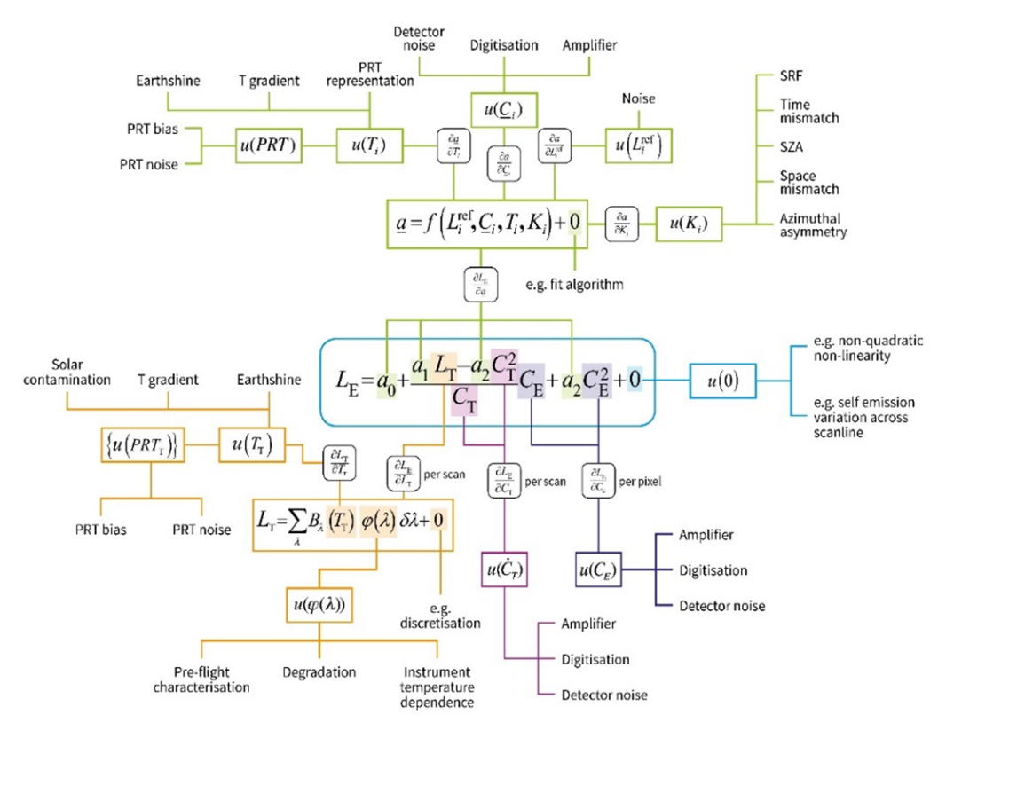
2) Quality Indicators in Discovery Metadata
Objective: Ensure quality and uncertainty information availability (discovery and access) for users
Or
Making things like this transparent to the non-calibration expert

Slide 4
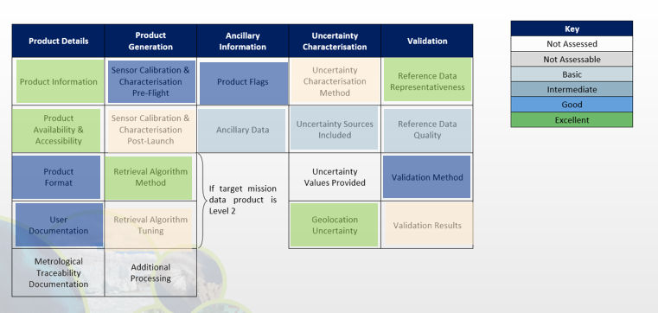
2) Quality Indicators in Discovery Metadata
Quality assessment matrix

Slide 5
2) Quality Indicators in Discovery Metadata
  Tasks - QI Test case: Evaluate whether SST would provide a suitable test case for QI development that can act as an expressive case for QI access and implement this or another one as determined through this activity
Survey on QI currently used by different sensor families
Rely on dedicated small group teleconferences (Task Team)
SST to be confirmed as a suitable test case for QI development
  WGCV to survey SST QIs currently used by different sensor families at different agencies.
  WGCV Vice-Chair to ask SST Virtual Constellation Chair to help develop a case study on QI
WGISS to define approach for representing and including QIs for the test case in discovery metadata searchable by end users
  Embedding measurement equation
  Link later stages to earlier stages and processing
  Readability for end users

Slide 6
Quality Indicators in global SST Products
Gary Corlett, Nigel Fox

Slide 7
GHRSST is a scientific project but integrated into CEOS SST-VC
All main SST capable sensors operated in the US, Europe & Japan (polar IR - AVHRR, MODIS, VIIRS, SLSTR, polar PMW - AMSR2, GMI, Windsat, geostationary IR - GOES, MSG, Himawari) are available in GHRSST format.
Data are produced by NOAA, NASA, EUMETSAT and JAXA. GHRSST
currently in discussion with CMA, ISRO & NSOAS about them distributing their data in GHRSST format.

Slide 8
Introduction
Global SST products contain quality indicators to facilitate users in their interpretation of the data. These indicators come in three forms:
  A quality indicator in terms of a numeric value
  A quality indicator in terms of a difference to a common reference
  A quality indicator in terms of a context sensitive uncertainty
The first two quality indicators have been included in the GHRSST Data Specification since its inception.
The quality indicators are provided as fields in the product itself, so are machine readable.
They are added by the original data provider
Note: GHRSST does not provide SST products. GHRSST is a Science Team, comprising operational practitioners, space agencies and SST researchers, who established a common framework for SST product data provision.

Slide 9
1. Quality Level (1)
Each Level 2 and Level 3 file in GHRSST format (as defined by the GHRSST Data Specification, GDS) contains a simple quality indicator.
  This is a numeric value from 0 to 5 where 0 = no data, 1 = cloudy, 2 = worst quality useable data and 5 = best quality useable data.
  Level 3 and 4 are optional and are left to the discretion of the data provider.
The values are sensor specific and are not meant to be comparable across datasets
  I.e. QL = 5 from one sensor does not mean it is comparable to QL = 5 from another – it simply means it is the best quality data from that sensor.
Data providers are encouraged to provide details in either a journal article or technical note on how the quality level indicator is derived.

Slide 10
1. Quality Level (2) - notes
Each data provider provides a summary of their decision making.
  The documentation is linked in the metadata in each product.
They are generated automatically based on heritage from analysis of historical data.
They are pixel level but may not be derived at pixel level.
  For example, one component may be due to the satellite zenith angle, so pixels with common angles will have a common contribution.
They are meant as a first level quality check as a very simple way of filtering the data.
Common sensors will use similar methods but they are not supposed to be comparable.
  It the highest – or lowest – quality data for that sensor.
They are provided in all data conforming to the GDS (current version is V2 revision 5)

Slide 11
2. SSES (1)
Sensor Specific Error Estimates (SSES) are provided in GHRSST format Level 2 and Level 3 SST products as a bias and standard deviation to a common reference.
Currently, the common reference used is drifting buoys.
The values provided are the bias (and not the correction term) and standard deviation.
Some basic rules are defined (such as preserving the depth of the SST) on how data providers should calculate their SSES.
Providing they follow these rules then SSES from different sensors are directly comparable between sensors.
Note: Error is used as the drifters are assumed to be truth

Slide 12
2. SSES (2) - notes
SSEs are provided at pixel level in each product, so they are machine readable. They may or may not have different levels of stratification to the quality indicator, i.e. all data of QL = 5 may have a range of SSES.
The reference field – drifters – is dynamic and linked to the SSES rules. Each provider generates their own set of match-ups in real time. No uncertainty is considered for the reference as they are treated as truth.
No other Quality Indicators are provided – they only deliver what is specified by GHRSST within the GDS.
The process is not automated. It requires evaluation of match-up results and knowledge of retrieval conditions to define how they are calculated. The scheme should be documented along with the quality level methodology.
The buoys network comprises mainly the GDP (Global Drifter program) operated by NOAA plus others (e.g. TRUSTED drifters from EUMETSAT)

Slide 13
Example – QL and SSES for SLSTR
Step 1
  Produce match-ups to drifters
Step 2
  Analyses match-ups looking for dependences
Step 3
  Define QL scheme
Step 4
  Calculate SSES bias and standard deviation

Slide 14
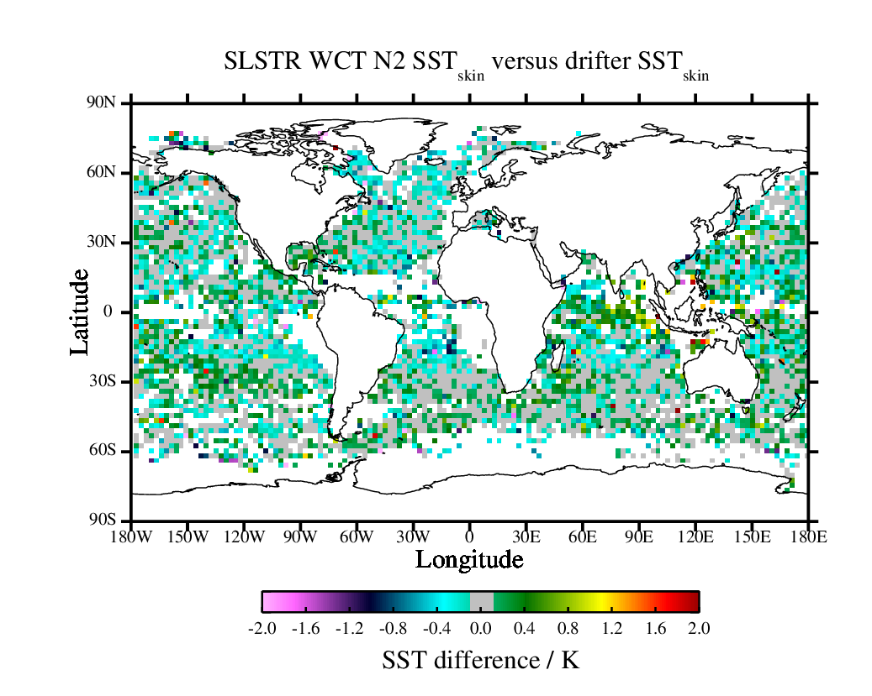
Step 1
Generate match-ups to drifters

Slide 15
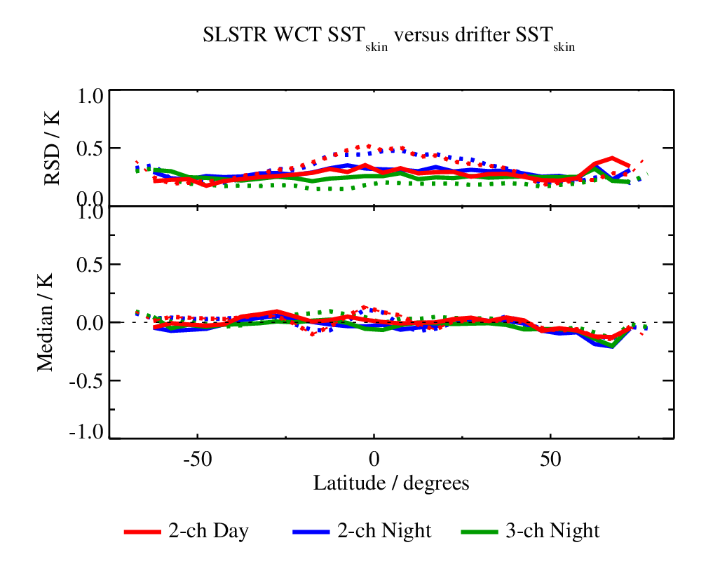
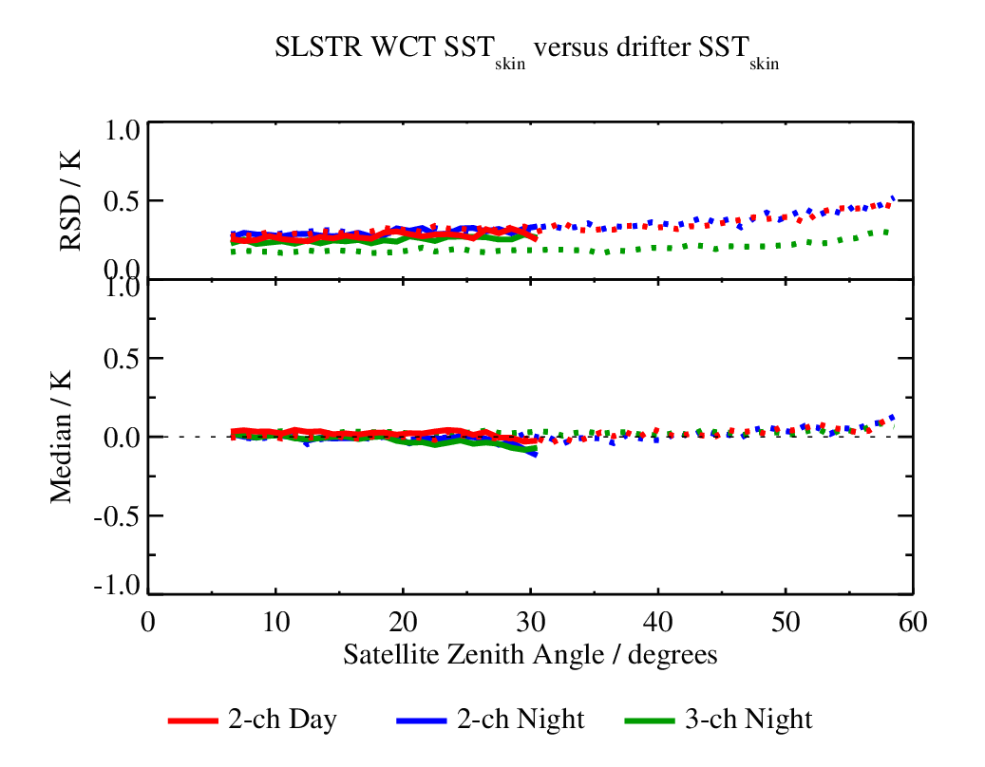
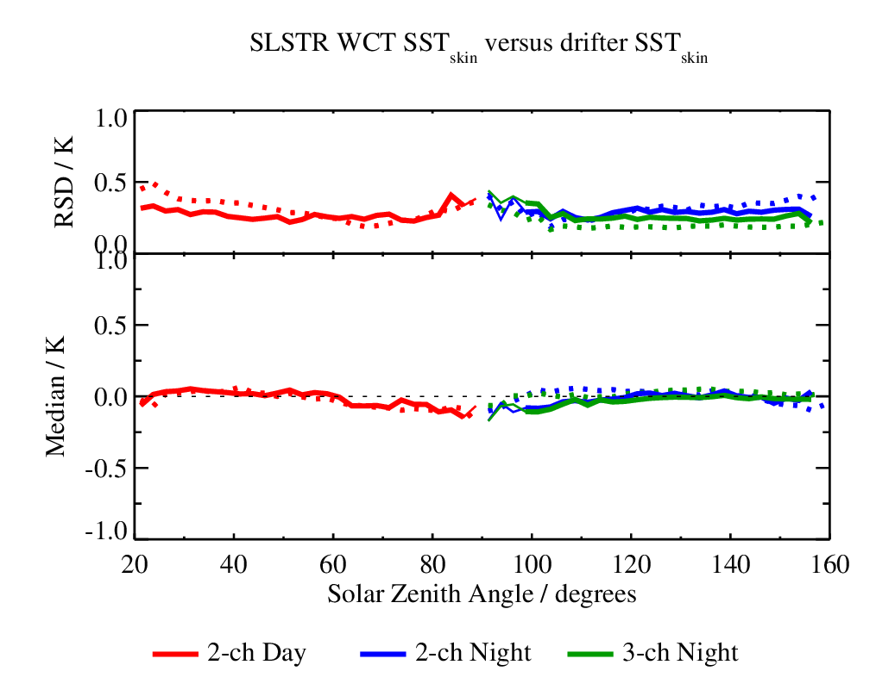
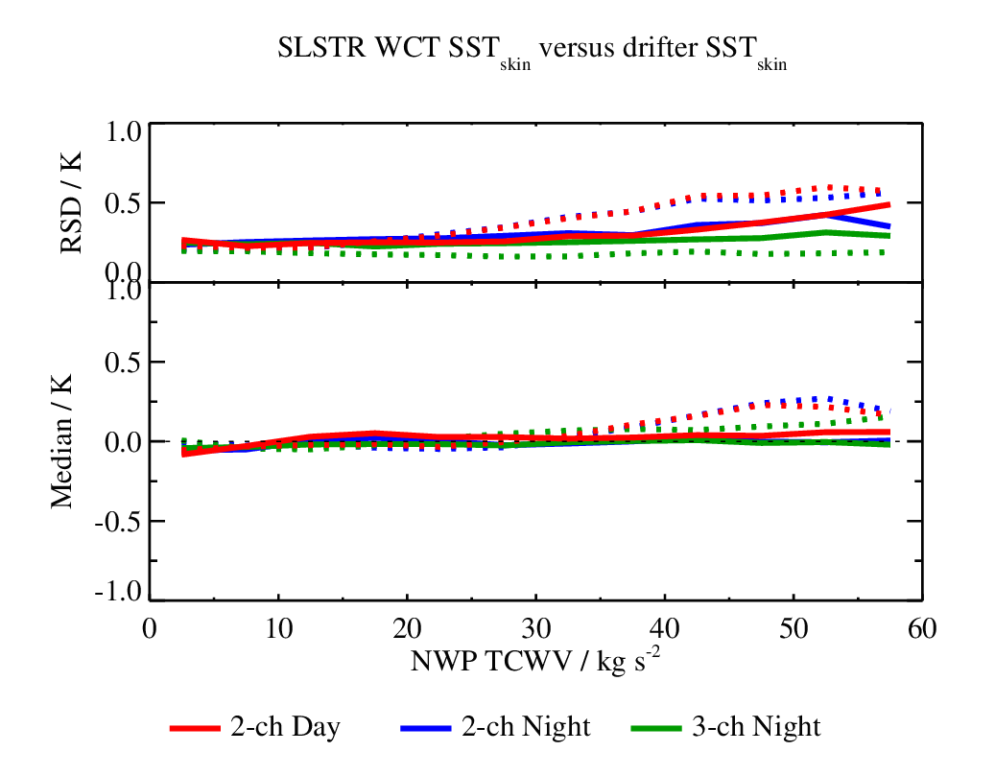
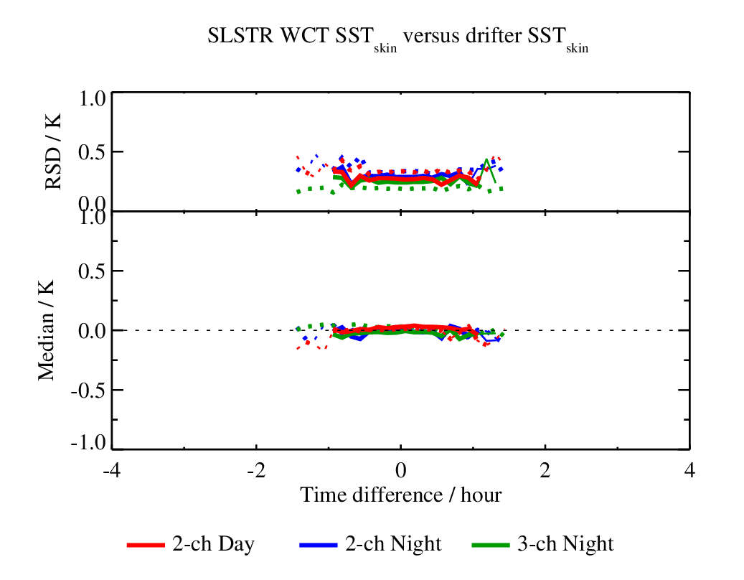
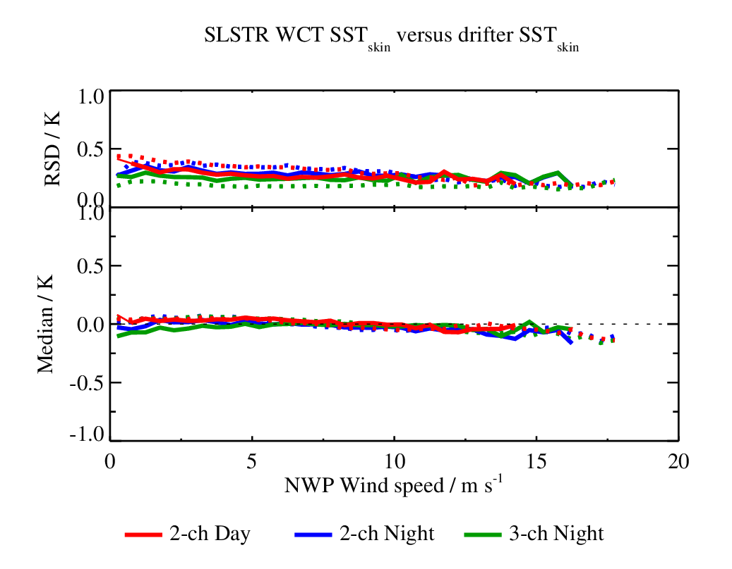
Step 2
Identify limitations/’anomalies’

Slide 16
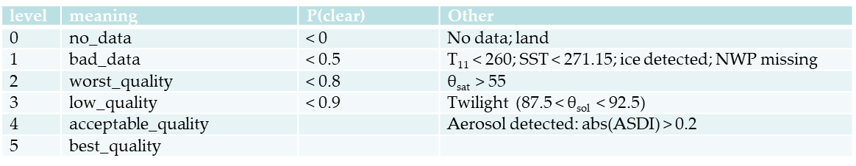
Step 3
Define Quality Level Scheme from limitations

Slide 17
Step 4
Calculate bias and SD for each QL
QL=2 (SatZA)
  Daytime
  N2: 1096 +0.12 (0.39)
  D2: - - -
  Night time
  N2: 34574 +0.01 (0.33)
  N3: 34574 +0.03 (0.19)
  D2: - - -
  D3: - - -
QL=3 (Twilight)
  Daytime
  N2: 1862 -0.20 (0.48)
  D2: 11 +0.01 (0.32)
  Night time
  N2: 365 -0.30 (0.67)
  N3: 18 +0.01 (0.19)
  D2: 9 +0.15 (0.12)
  D3: 9 +0.12 (0.27)
QL=4 (SDI)
  Daytime
  N2: 8776 +0.01 (0.34)
  D2: 257 -0.65 (1.89)
  Night time
  N2: 4688 +0.24 (0.44)
  N3: 917 +0.06 (0.28)
  D2: 151 -0.50 (0.94)
  D3: 151 -0.40 (0.71)
QL=5
  Daytime
  N2: 10834 +0.01 (0.33)
  D2: 9790 +0.02 (0.27)
  Night time
  N2: 13351 -0.01 (0.27)
  N3: 17471 +0.04 (0.18)
  D2: 8702 +0.02 (0.27)
  D3: 8703 -0.01 (0.22)
Values are them added to auxiliary data file and added to product

Slide 18
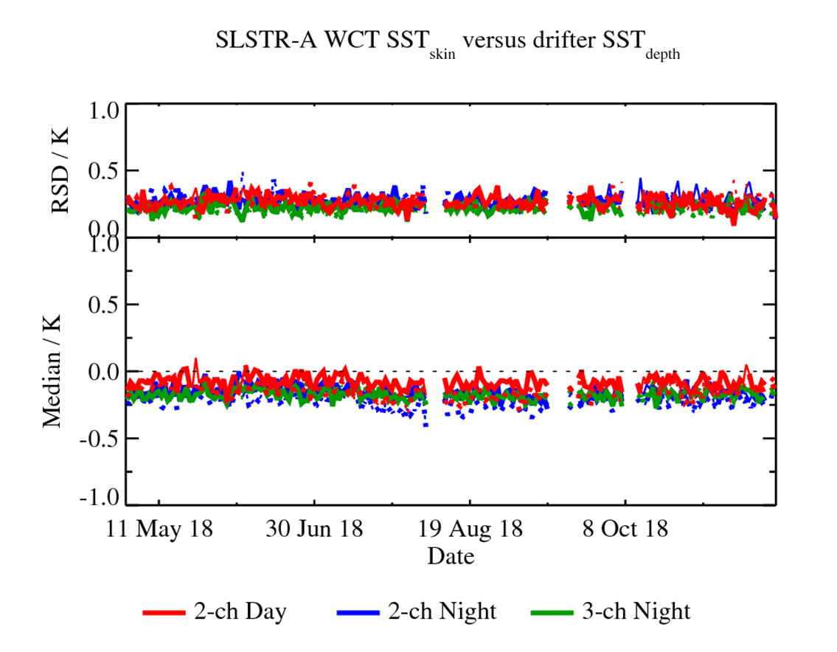
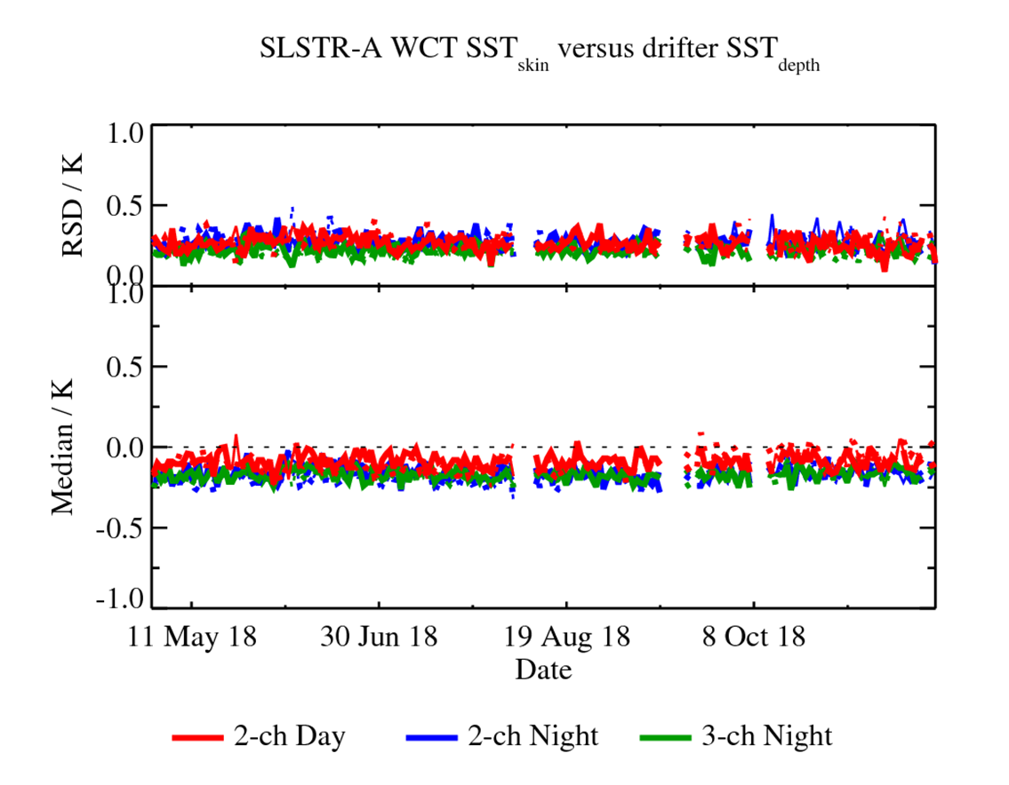
Note: SSES are continually evolved
Example: SLSTR-A cold finger temperature changed on board in July 2018
Before SSES
After SSES

Slide 19
WGISS support!!
Can we automate the calculation of the SSES
  Machine learning?
  Subtly different for each sensor but commonality

Slide 20
3. Pixel Level Uncertainties (1)
A quality indicator is being trialled by the ESA SST_CCI project team and is provided in addition to the first two indicators.
The standard uncertainty is estimated for each pixel from a theoretical basis.
  Components of uncertainty are also provided to provide some indication of their correlation for aggregation of products (e.g. from Level 2 to Level 3).
An advantage of this approach is that it does not reply on in situ data.
Also, methods have been developed that allow the in situ data to be used to validate not only the SST but the SST uncertainty estimate as well.

Slide 21
3. Pixel Level Uncertainties (2) - notes
They are provided per pixel as fields in the SST products and are machine readable.
The uncertainties are not differences to in situ but are calculated theoretically and then independently validated (see Bulgin et al, 2016).
  This has one major advantage in that it is not limited to just regions where you have matchups.
The QL is assigned based on simple criteria (e.g. clear sky, low water vapour, no aerosol, low view angle) as a result of the theoretical model.
We believe this is the correct way to provide both quality indicators and uncertainties but have a long way to go to convince the community!
The generation of the uncertainties is automated but the derivation of the schema (algorithm) is not.
Bulgin, C. E., Embury, O., Corlett, G. and Merchant, C. J. (2016) Independent uncertainty estimates for coefficient based sea surface temperature retrieval from the Along-Track Scanning Radiometer instruments. Remote Sensing of Environment, 178. pp. 213-222. ISSN 0034-4257 doi: https://doi.org/10.1016/j.rse.2016.02.022

Slide 22
Level 4
Quality Indicators in GHRSST format Level 4 products are not as advanced as those for Level 2 and Level 3.
  In fact, the products contain a misnamed field called the analysis error, which in reality is an estimate of the standard uncertainty.
  No correlation information is currently given as errors introduced in the analysis process are not well understood.
Level 4 are spatially complete analysis fields, which use some form of optimal interpolation or variational assimilation to fill data gaps. They are the main product that goes into NWP and operational oceanographic systems.
  The analysis error is included per pixel.
We can validate the analysis error using the usually methods and for reasons we don’t understand they validate very well.
We have not yet had much success using the real L2 or L3 errors within an L4 analysis system.

Slide 23
Summary
GHRSST compliant L2 and L3 SST products contain a simple quality indicator plus and error estimate
  Level 4 contain just the latter
They are generated based on knowledge of the sensor and SST algorithm
  They are automatically generated during processing and included in the SST products
  However, the schema for generation ‘cannot’ easily be automated
A new generation of pixel level uncertainties is being trialled
  This allows both the SST and it uncertainty to be independently validated

Slide 24
Next steps
Circulate link to GHRSST definitions
Arrange Telecon with GHRSST and WGISS to discuss what can be done
  Document QI process
  Automate method for establishing SSEs
Arrange Telecon with WGISS to discuss Measurement equn and how can be incorporated/in metadata

