Slide 1
ESA PDGS Data Cube for Cal/Val
Andrea Della Vecchia, Damiano Guerrucci, Mirko Albani (ESA)
Simone Mantovani, Antonio Vecoli (MEEO)
CEOS WGCV Meeting #45 18/07/2019

Slide 2
Outline
ESA PDGS Data Cube
  Use Cases
    EO Data Management
    In-Situ Data Management
    CEOS WGCV
  Demo
  Next Steps

Slide 3
Outline
ESA PDGS Data Cube
  Use Cases
    EO Data Management
    In-Situ Data Management
    CEOS WGCV
  Demo
  Next Steps

Slide 4
PDGS Data Cube Objectives
Brings the users to the data
Provides standardised and harmonised interfaces to manage EO and in-situ data
Innovative, and complementary, approach to access and visualize data
Permits on-the-fly pixel based processing and bulk asynchronous processing
Integration into ESA Collaborative Environment

Slide 5
Outline
ESA PDGS Data Cube
  Use Cases
    EO Data Management
    In-Situ Data Management
    CEOS WGCV
  Demo
  Next Steps

Slide 6
UC1: EO Data Discovery, Visualization and Pixel-based Access
UC2: EO Service Discovery and Processing

Slide 7
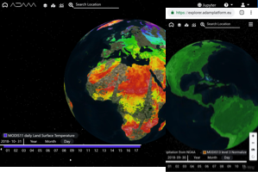





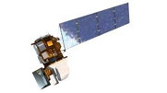
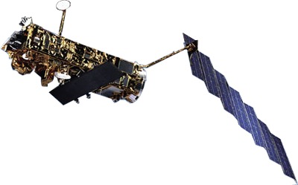
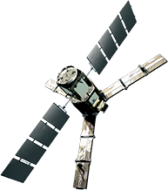
Functional View
Jupyter Notebook
Web based GUI
REST API
Visualization layer
Standardised data access interfaces allow connecting a wide range of user interfaces
Datacube Engine/API VMs
The deployment of DC-DAS in front of each data source enables effective pixel-based access services
DC-DAS
ESA
Third Party Missions
ESA
Heritage Missions
ESA
Earth Explorer
In-Situ: ACIX and
RadCalNet
Data layer
Data remain at their own location (multiple data centers) with the original data format

Slide 8
UC1: EO Data Discovery, Visualization and Pixel-based Access
The users:
connect to the GUI (https://eodatacube.eu/)
  select the collection(s)
  define AOI/TOI
connect to the central jupyter hub
  use/edit/create notebooks to manage the full data cycle (discover, access, process, visualize)
Open his/her own terminal
  use API / CLI to code and send the access / processing query
The GUI:
connects to datacube @ESA
sends the access / processing query to the DAS component
The DAS:
retrieves the data from the online storage
sends back the GUI

Slide 9
UC2: EO Service Discovery and Processing
The users:
connect to the GUI (https://eodatacube.eu/)
  select the collection(s)
  define AOI/TOI
connect to the central jupyter hub
  use/edit/create notebooks to manage the full data cycle (discover, access, process, visualize)
Open his/her own terminal
  use API / CLI to code and send the access / processing query
The jupyter hub provides (https://jupyter.eodataservice.org/user/demo/tree) :
notebooks with examples of access / processing query to the DAS component @ESA
interactive interface for live coding to discover, access, process, visualize the datacube(s)

Slide 10




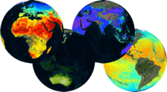
F E D E R A T I O N
Web based GUI
Jupyter Notebook
CLI / REST API
Visualization layer
Standardised data access interfaces allow connecting a wide range of user interfaces
Datacube Engine/API VMs
The deployment of DAS in front of each data source enables effective access services
DAS
DAS
DAS
DAS
DAS
DAS
DAS
Data layer
Data remain at their own location (multiple data centers) with the original data format
Mission-specific data
Thematic data
Other geospatial data

Slide 11
Outline
ESA PDGS Data Cube
  Use Cases
    EO Data Management
    In-Situ Data Management
    CEOS WGCV
  Demo
  Next Steps

Slide 12
UC2.1: In-situ / EO Data Discovery, Visualization and Pixel-based Access
  - Atmospheric Correction Inter-Comparison Exercise (ACIX)
  - Radiometric Calibration Network (RadCalNet)
UC3.1: In-situ / EO Service Discovery and Processing (on-going)
  - Atmospheric Correction Inter-Comparison Exercise (ACIX)
  - Customized UI to support AOT/WV/SR inter-comparison
  - Jupyter notebook to support live coding / sharing

Slide 13
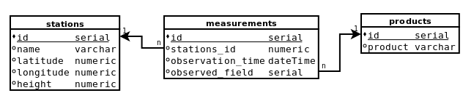
EO and In-situ Data Management
Preferred
Optional
ingestion
SQL
In-situ
rasterization
EO
WCS
Pre-processing (e.g., ARD):
Re-projection
Re-sampling
Format conversion
OpenSearch

Slide 14
Outline
ESA PDGS Data Cube
  Use Cases
    EO Data Management
    In-Situ Data Management
    CEOS WGCV
  Demo
  Next Steps

Slide 15
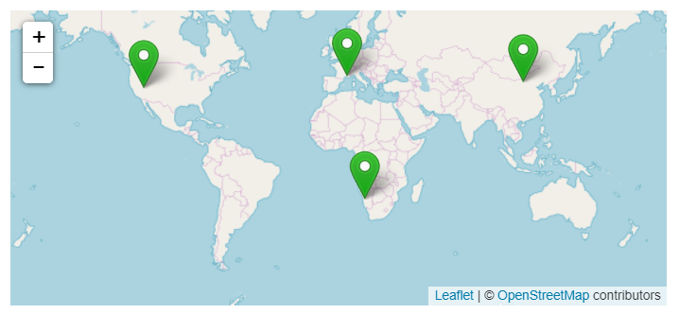
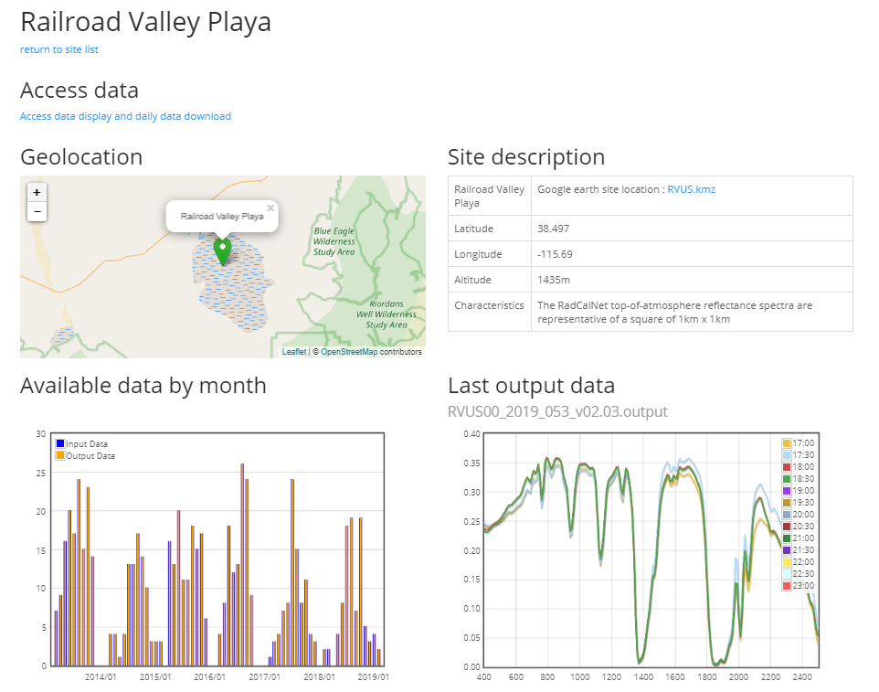
RadCalNet Exercise https://www.radcalnet.org/#!/
Support post-launch TOA radiometric calibration and validation of optical EO data
Ground nadir-view reflectance measurements (converted to TOA), and atmospheric measurements such as surface pressure, columnar water vapour, columnar ozone, aerosol optical depth and the Angstrom coefficient, over 4 sites
Nadir-view top-of-atmosphere reflectance at 30 minute intervals from 9am to 3pm local standard time at 10 nm intervals from 400 nm to 2500 nm

Slide 16
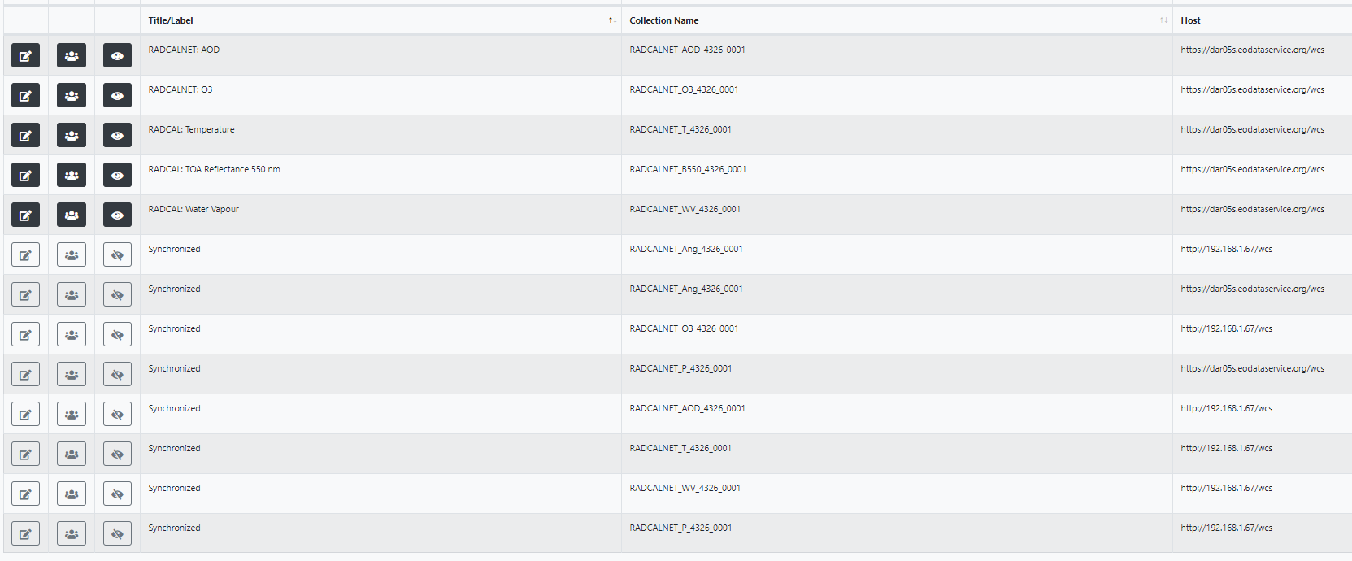
RadCalNet Indexed Data

Slide 17
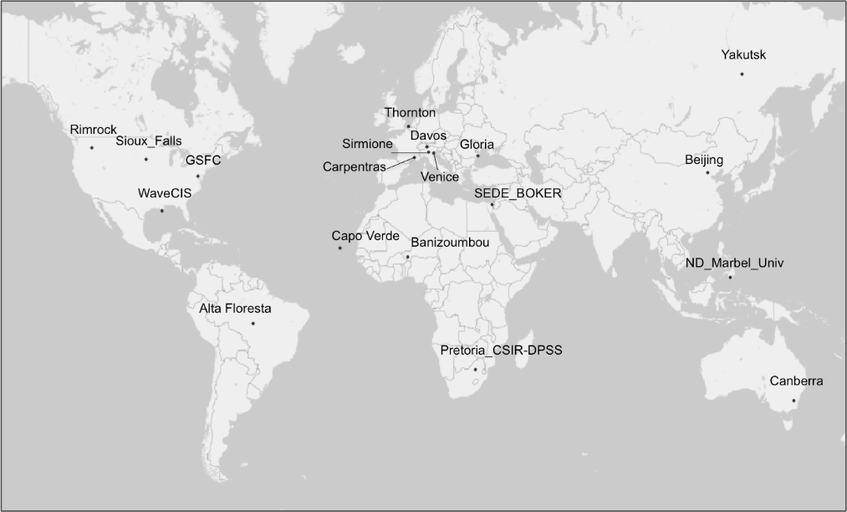
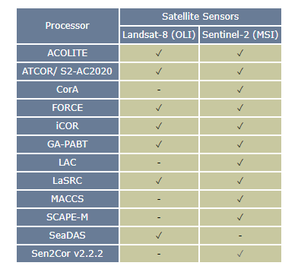
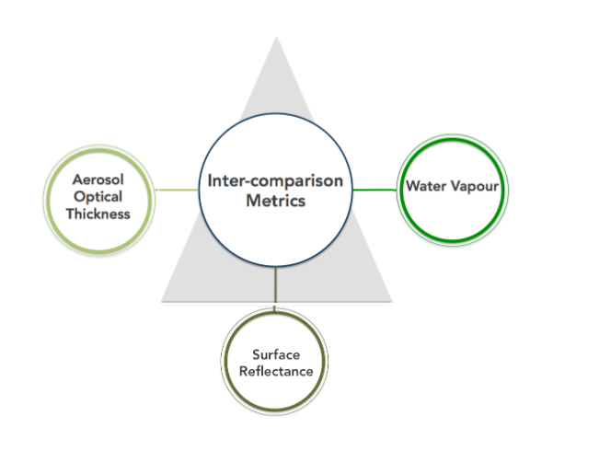
ACIX Inter-Comparison Exercise http://calvalportal.ceos.org/projects/acix
Inter-comparison of BOA radiometric calibration processors
AERONET stations over 19 sites to perform in-situ measurements of AOT, WV and SR
Landsat-8 and Sentinel-2 acquired over sites and converted to BOA with selected processors, to generate AOT, WV and SR
Inter-comparisons performed for all the products on image subset of 9km x 9km centred on every AERONET sites

Slide 18
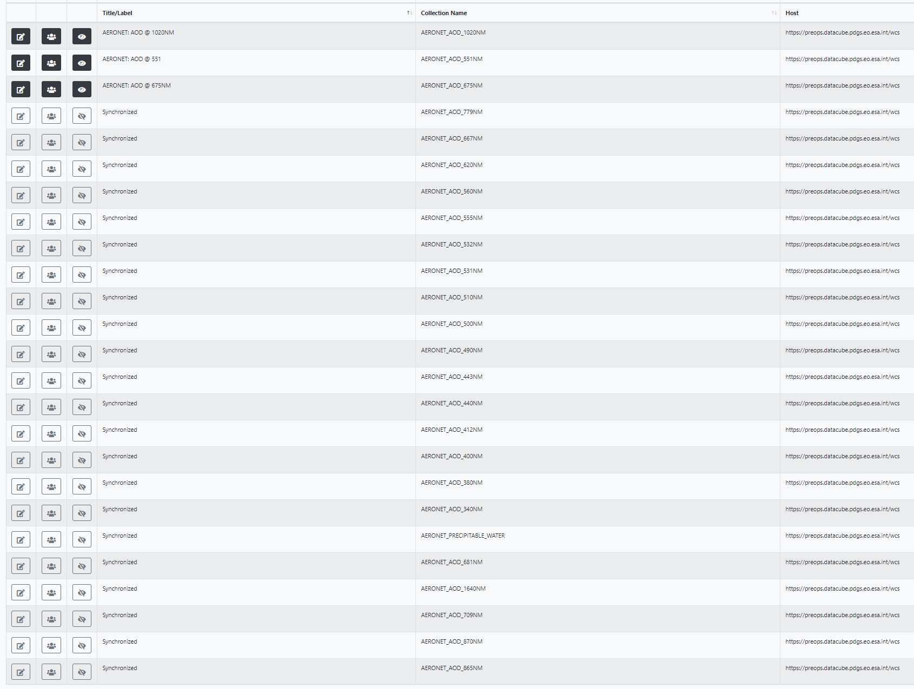
ACIX Indexed Data

Slide 19
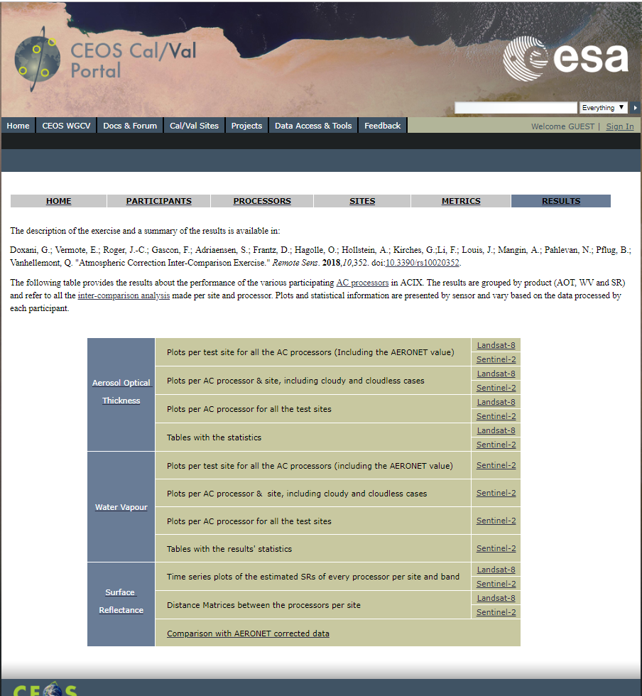
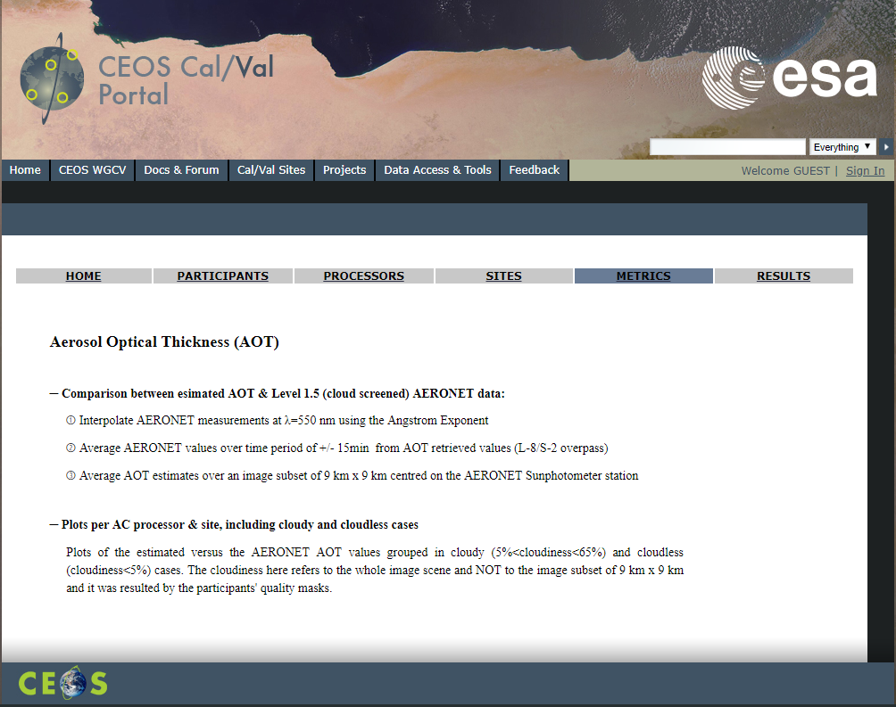
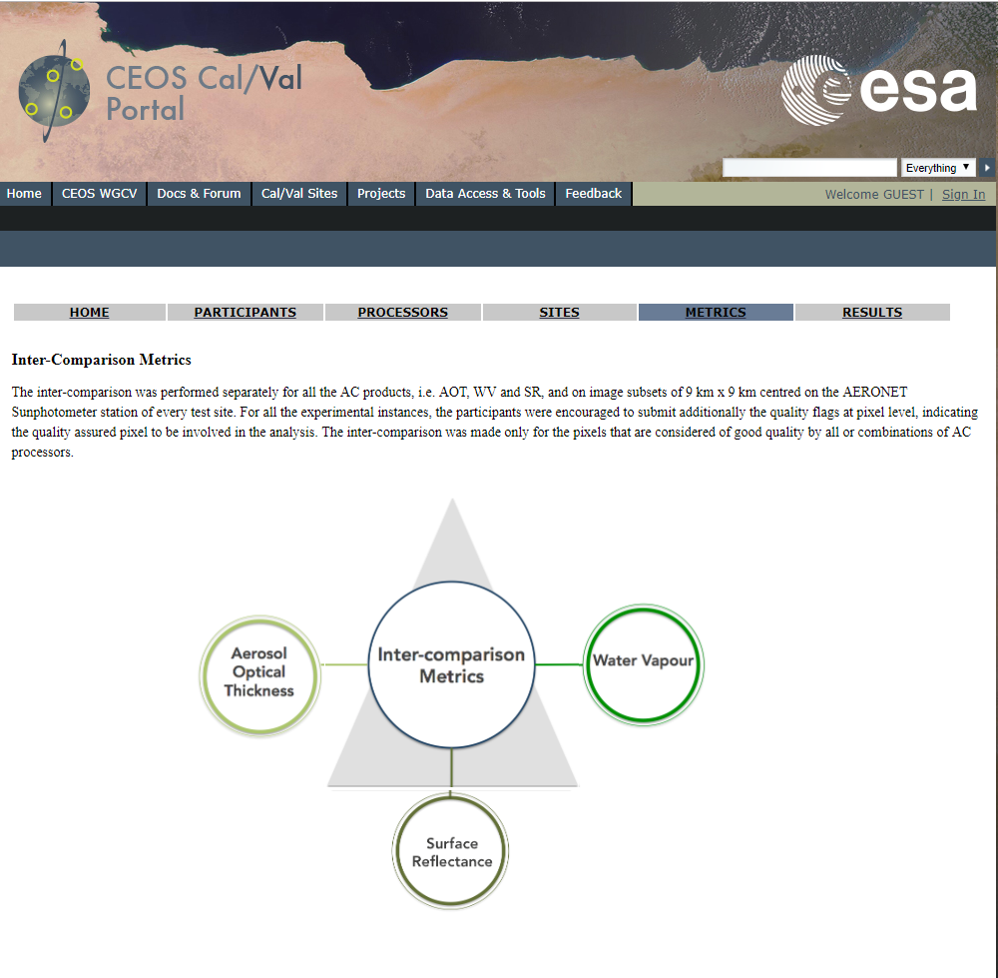
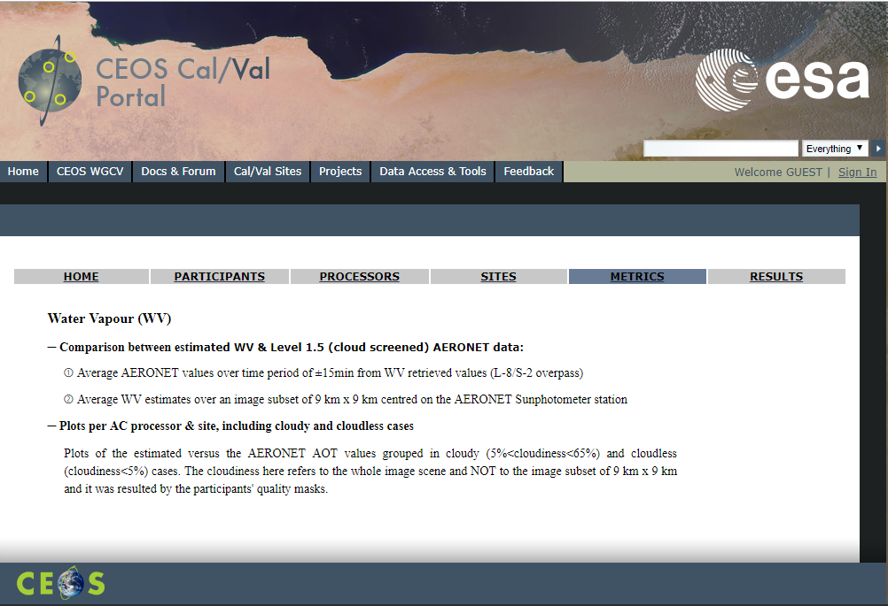
ACIX Processing

Slide 20
Outline
ESA PDGS Data Cube
  Use Cases
    EO Data Management
    In-Situ Data Management
    CEOS WGCV
  Demo
  Next Steps

Slide 21
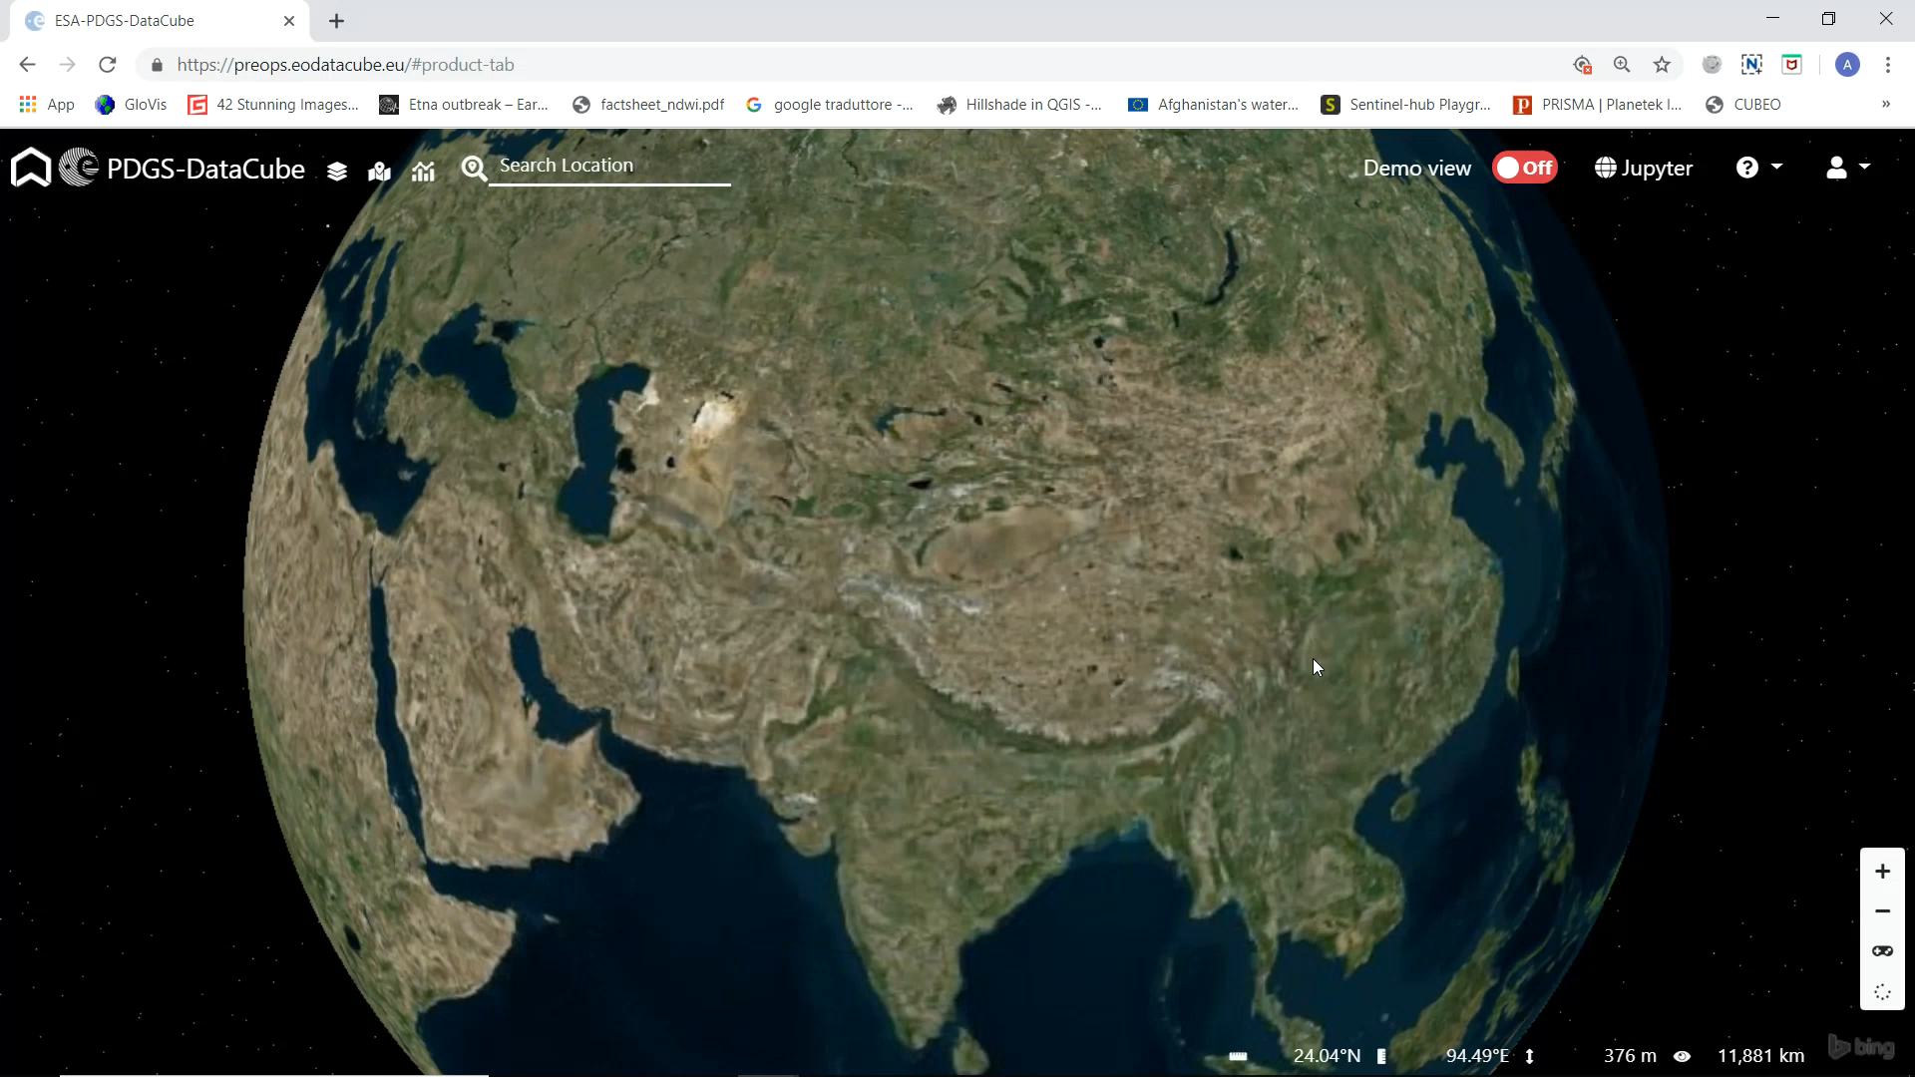

Slide 22
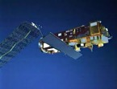
ACIX/RadCalNet Lesson Learnt
Web based GUI
Jupyter Notebook
Data Preparation: in-situ and EO Level 2 data are indexed and registered in the data cube, preserving both radiometric and geometric properties
Data Access: DAS shall offer access to both EO and In-situ data via unified interface (i.e. WCS)
Data Processing: Jupyter allows the users to perform inter-comparison scripts, sharing the code with authorise users, and accessing always the same data via WCS server.
PROs
Centralised data repository, replacing scattered ftp servers
Harmonised and standardised online data access interface, permitting data download
Reproducibility of inter-comparison exercises (via Jupyter notebook), restricted to authorised users
Easy sharing of algorithms and results
DAS
Landsat-8/Sentinel-2
Data
In-Situ: ACIX and
RadCalNet

Slide 23
Outline
ESA PDGS Data Cube
  Use Cases
    EO Data Management
    In-Situ Data Management
    CEOS WGCV
  Demo
  Next Steps

Slide 24
Next Step – 2019
  Cooperation with CEOS WGISS / FDA teams:
    Action WGISS-47-13: Andrea/Rob to define with SEO a roadmap and short term activities on interoperability between ODC / HMDC / DCFS Data Cubes (e.g. Jupyter notebooks with Xarray API and WCS / WPS).
    Action WGISS-47-15: Andrea/Rob to define coordinated roadmap and short term activities on WGISS-WGCV Data Cubes (ESA and ODC DEA) and possibly demo to be shown at SIT TW in September 2019.
  New ESA missions available
  Cooperation with WGCV team (TBD):
    ACIX II
    Land Product Validation Supersites

