Slide 1
45th WGCV Plenary Perth, July 2019
Working Group on Calibration and Validation
Land Product Validation Subgroup
Agency report: Australian Bureau of Meteorology
I. Grant
Notes:
LPV established as subgroup in 2000.

Slide 2
Working Group on Calibration and Validation
Australian Bureau of Meteorology
Australia's national weather, climate and water agency
Provide forecasts, warnings and long-term outlooks on environmental phenomena that affect the safety, prosperity and resilience of Australians.
Monitor and report on current environmental conditions.
Foster greater public understanding and use of environmental intelligence
24/7 service covering Australia and beyond
Head Office in Melbourne
Regional offices in state capitals
~1500 staff
Extensive observation networks over land and surrounding oceans
Notes:
SAOZ Instrument: A spectrometer of the Système D'Analyse par Observations Zénithales (SAOZ) design. It is a zenith sky UV-visible spectrometer which is used to retrieve mean values of total ozone and nitrogen dioxide both at sunrise and sunset on a daily basis. SAOZ should work year round at Davis which is at latitude 68.6 South.
MAX-DOAS (Multi-AXis Differential Optical Absorption Spectroscopy)

Slide 3
Working Group on Calibration and Validation
Australian Bureau of Meteorology
Satellite-based data products produced by ABoM
External use
Solar Radiation
Grassland Curing
NDVI
Sea Surface Temperature
Volcanic Ash
Fog / Low cloud
Aircraft Icing Potential
Public imagery
Internal use
Cloud properties
Precipitation
Sounder radiances
Atmospheric Motion Vectors
Forecaster imagery
Under development
Convective initiation
Storm tracking
Notes:
Formed in 2000 as part of NASA’s EOS validation program – validating MODIS land products
The mission of the CEOS Land Product Validation (LPV) subgroup is to coordinate the quantitative validation of satellite-derived products. The focus lies on standardized intercomparison and validation across products from different satellite, algorithms, and agency sources.

Slide 4
Atmospheric Composition
Working Group on Calibration and Validation
Ozone
The Bureau's Dobson, ozonesonde and MAX-DOAS ozone observations are now collected and available through the EVDC (ESA Validation Data Centre) and being used for TROPOMI validation
Dobson and MAX-DOAS observations submitted in Near Real Time HDF format to CAMS (Copernicus Atmospheric Monitoring Service)
Notes:
SAOZ Instrument: A spectrometer of the Système D'Analyse par Observations Zénithales (SAOZ) design. It is a zenith sky UV-visible spectrometer which is used to retrieve mean values of total ozone and nitrogen dioxide both at sunrise and sunset on a daily basis. SAOZ should work year round at Davis which is at latitude 68.6 South.
MAX-DOAS (Multi-AXis Differential Optical Absorption Spectroscopy)

Slide 5
Working Group on Calibration and Validation
Atmospheric Composition
ABoM supplies a large fraction of southern mid-latitude ozone observations
TROPOMI total ozone column - validation stations
Tropospheric ozone from assimilation of satellite profiles - validation stations
Garane et al.: TROPOMI/S5p total ozone column data: global ground-based validation & consistency with other satellite missions, Atmos. Meas. Tech. Discuss., https://doi.org/10.5194/amt-2019-147, in review, 2019
van Peet, J. C. A. and van der A, R. J.: Deriving tropospheric ozone from assimilated profiles, Atmos. Chem. Phys., 19, 8297-8309, https://doi.org/10.5194/acp-19-8297-2019, 2019.
Notes:
Formed in 2000 as part of NASA’s EOS validation program – validating MODIS land products
The mission of the CEOS Land Product Validation (LPV) subgroup is to coordinate the quantitative validation of satellite-derived products. The focus lies on standardized intercomparison and validation across products from different satellite, algorithms, and agency sources.

Slide 6
Atmospheric Composition
Working Group on Calibration and Validation
New instruments
Scientific lead is Matt Tully
MAX-DOAS (Multi-AXis Differential Optical Absorption Spectroscopy. O3)
Located in Melbourne
Ambition for a second one at Macquarie Island
SAOZ (Système D'Analyse par Observations Zénithales. O3, NO2)
Zenith sky UV-visible spectrometer
Instrument has been operational in Melbourne since July 2018
Plan to soon have two more for Macquarie Island and Davis
Pandora
Instrument is located in Melbourne and recently resumed operation
Tropospheric and total O3 and NO2, spectral AOD (SO2 and formaldehyde in future)
Intention is to join the Pandonia network
Notes:
SAOZ Instrument: A spectrometer of the Système D'Analyse par Observations Zénithales (SAOZ) design. It is a zenith sky UV-visible spectrometer which is used to retrieve mean values of total ozone and nitrogen dioxide both at sunrise and sunset on a daily basis. SAOZ should work year round at Davis which is at latitude 68.6 South.

Slide 7
Sea Surface Temperature
Working Group on Calibration and Validation
ABoM produces and validates SST datasets from AVHRR, VIIRS, Himawari-8 under the GHRSST (Global High Resolution SST) framework
A flexible generic validation system for comparing arbitrary point, line or spatial datasets
Notes:
Formed in 2000 as part of NASA’s EOS validation program – validating MODIS land products
The mission of the CEOS Land Product Validation (LPV) subgroup is to coordinate the quantitative validation of satellite-derived products. The focus lies on standardized intercomparison and validation across products from different satellite, algorithms, and agency sources.

Slide 8
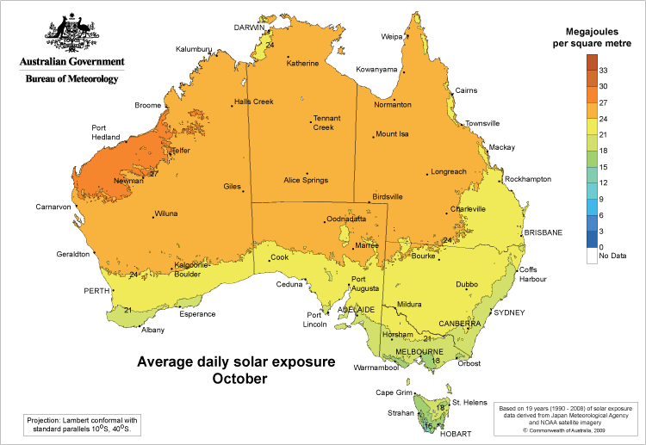
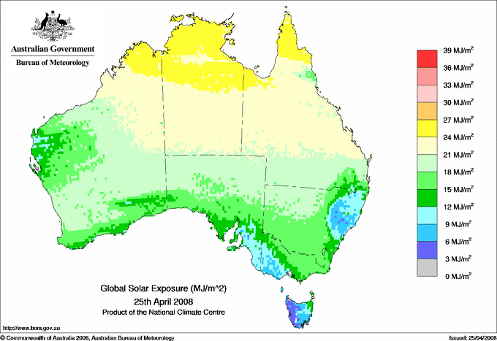
Working Group on Calibration and Validation
ABoM satellite solar data products
Gridded spatial data (0.05º resolution)
Based on GEO hourly data from 1990 to present
Time series
Hourly irradiance (global, direct)
Daily exposure (global)
Climatologies
Monthly mean hourly irradiance (global, direct)
Annual mean hourly irradiance (global, direct)
Annual mean daily global exposure
Notes:
Formed in 2000 as part of NASA’s EOS validation program – validating MODIS land products
The mission of the CEOS Land Product Validation (LPV) subgroup is to coordinate the quantitative validation of satellite-derived products. The focus lies on standardized intercomparison and validation across products from different satellite, algorithms, and agency sources.

Slide 9
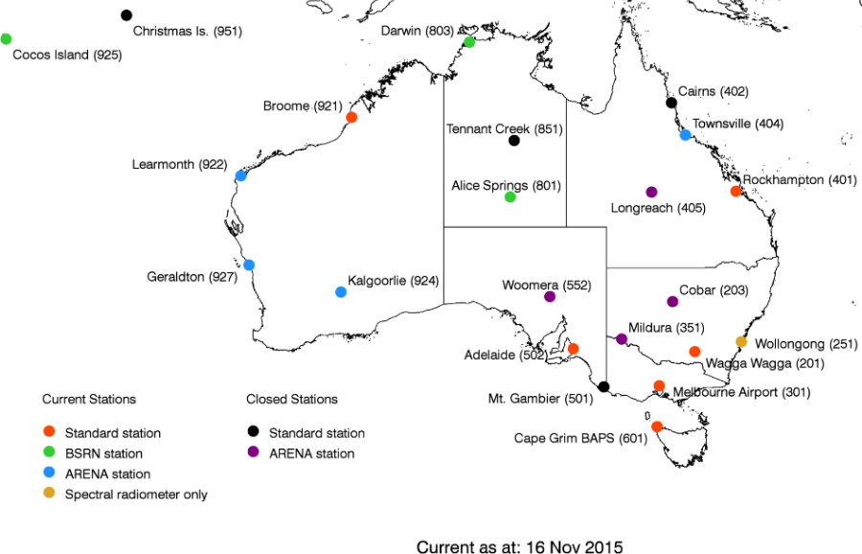
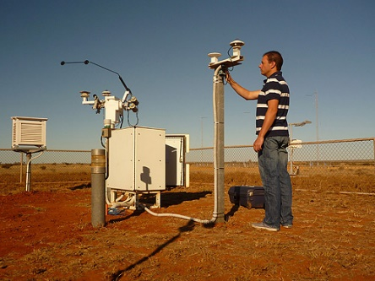
Working Group on Calibration and Validation
ABoM surface radiation network
Use surface data to bias correct and validate satellite solar data
>240 station-years of 1-minute statistics of 1-second samples
Global, diffuse and direct components
Traceable to World Radiometric Reference
Uncertainty accompanies every sample
Notes:
Formed in 2000 as part of NASA’s EOS validation program – validating MODIS land products
The mission of the CEOS Land Product Validation (LPV) subgroup is to coordinate the quantitative validation of satellite-derived products. The focus lies on standardized intercomparison and validation across products from different satellite, algorithms, and agency sources.

Slide 10
Extra slides
Working Group on Calibration and Validation
Notes:
Formed in 2000 as part of NASA’s EOS validation program – validating MODIS land products
The mission of the CEOS Land Product Validation (LPV) subgroup is to coordinate the quantitative validation of satellite-derived products. The focus lies on standardized intercomparison and validation across products from different satellite, algorithms, and agency sources.

Slide 11
Atmospheric Composition
Working Group on Calibration and Validation
Notes:
Formed in 2000 as part of NASA’s EOS validation program – validating MODIS land products
The mission of the CEOS Land Product Validation (LPV) subgroup is to coordinate the quantitative validation of satellite-derived products. The focus lies on standardized intercomparison and validation across products from different satellite, algorithms, and agency sources.

Slide 12
Atmospheric Composition
Working Group on Calibration and Validation
Notes:
Formed in 2000 as part of NASA’s EOS validation program – validating MODIS land products
The mission of the CEOS Land Product Validation (LPV) subgroup is to coordinate the quantitative validation of satellite-derived products. The focus lies on standardized intercomparison and validation across products from different satellite, algorithms, and agency sources.

Slide 13
LPV Subgroup Objectives
Working Group on Calibration and Validation
To foster and coordinate quantitative validation of global land products derived from remotely sensed data, in a traceable way, and to relay results to users.
To increase the quality and efficiency of global satellite product validation by developing and promoting international standards and protocols for:
Field sampling
Scaling techniques
Accuracy report and use
Data and information exchange
To improve quality of ground references used for product validation
Field campaigns for fiducial references
Identification of sites and supersites for validation
To provide feedback to international structures for:
Requirements on product accuracy and quality assurance
Terrestrial ECV measurement standards
Notes:
Formed in 2000 as part of NASA’s EOS validation program – validating MODIS land products
The mission of the CEOS Land Product Validation (LPV) subgroup is to coordinate the quantitative validation of satellite-derived products. The focus lies on standardized intercomparison and validation across products from different satellite, algorithms, and agency sources.

