Slide 1
Agency Report - Geoscience Australia
Medhavy Thankappan

Slide 2
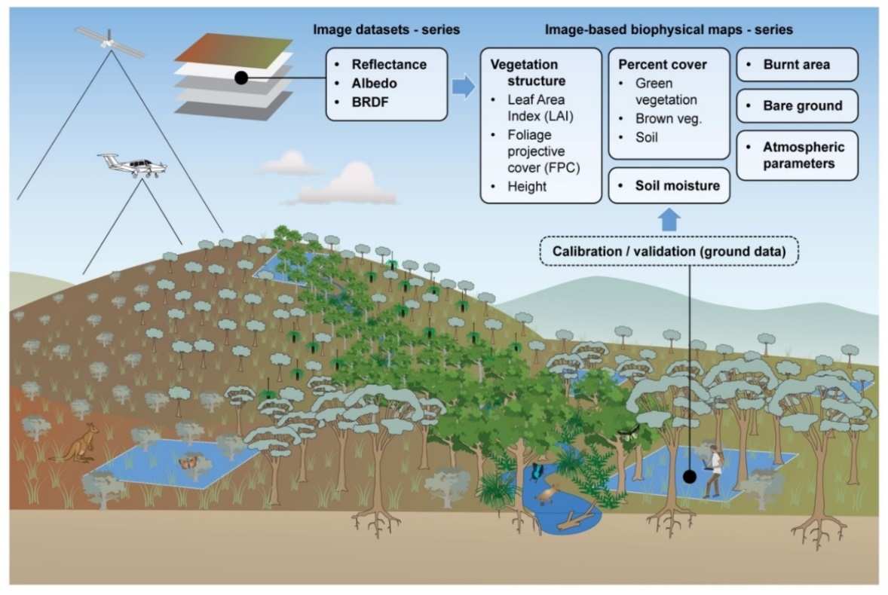

Surface Reflectance Validation Phase 1
Field data collection for continental scale validation of surface reflectance
Coordinated by CSIRO under a Project Agreement, funded through Digital Earth Australia (DEA)
Field data acquisition, near-coincident with satellite overpass (L8, S2a, S2b), from March 2018 to June 2019
Field based validation using best practice protocols seen as critical to ensure generation of consistent multi-sensor ARD products such as SR
Reliability, consistency of downstream products, user confidence and uptake

Slide 3
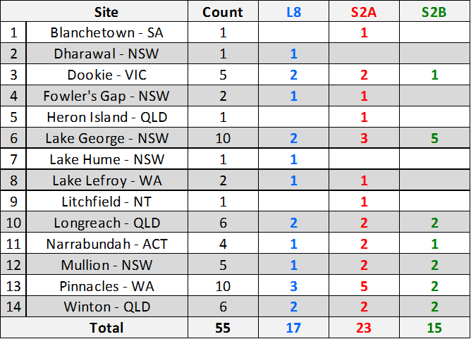
Phase 1 Field Data Collection
Total field data acquisitions at all sites

Slide 4
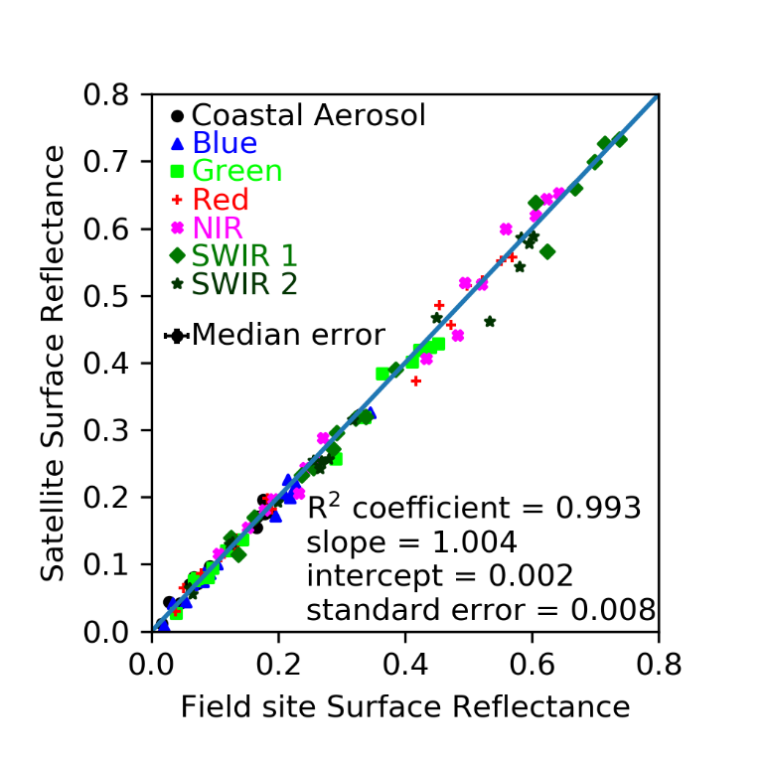
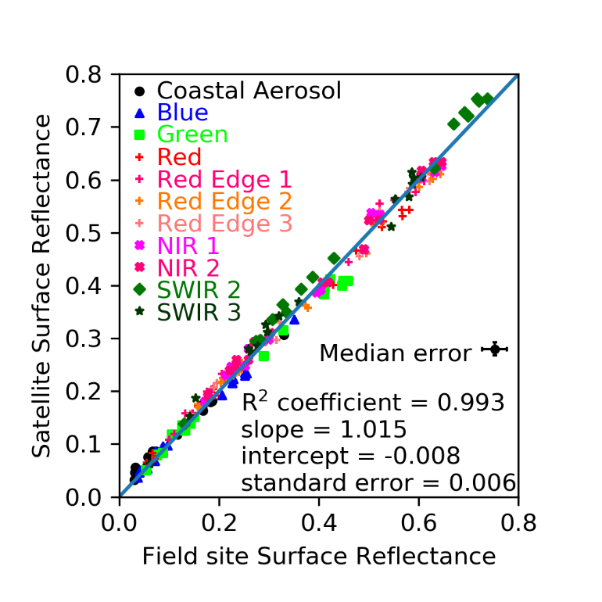
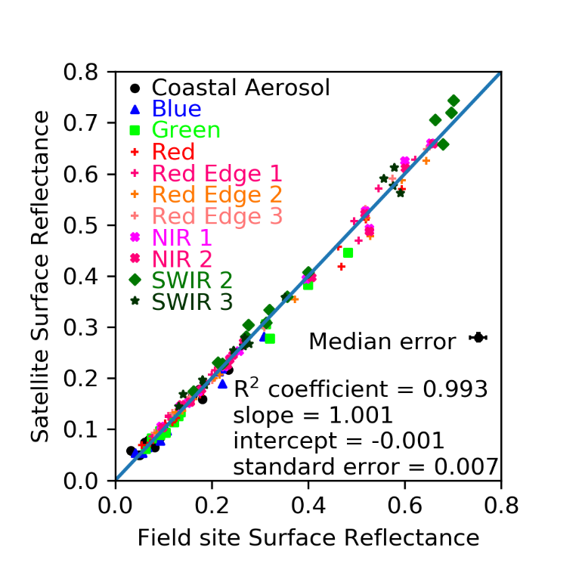
Field Validation Summary Results
Landsat-8
Sentinel-2A
Sentinel-2B

Slide 5
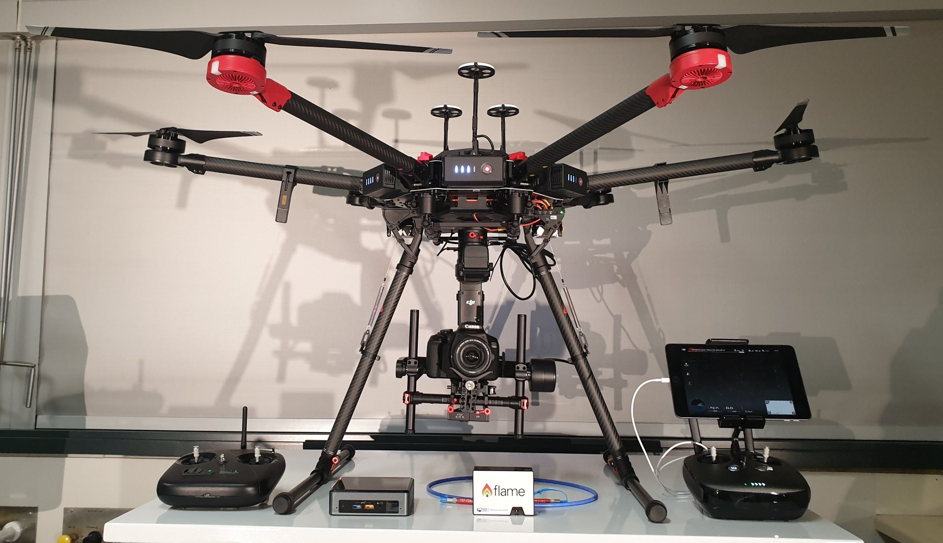
Validation of SR Phase 2
Scoping for Phase 2 has begun, use of instrumented sites and automation for data over complex sites; will explore cross-over with new LPV, IVOS initiatives
Staff training to fly UAS completed; UAS platform and payload acquired
Validation sites being determined

Slide 6
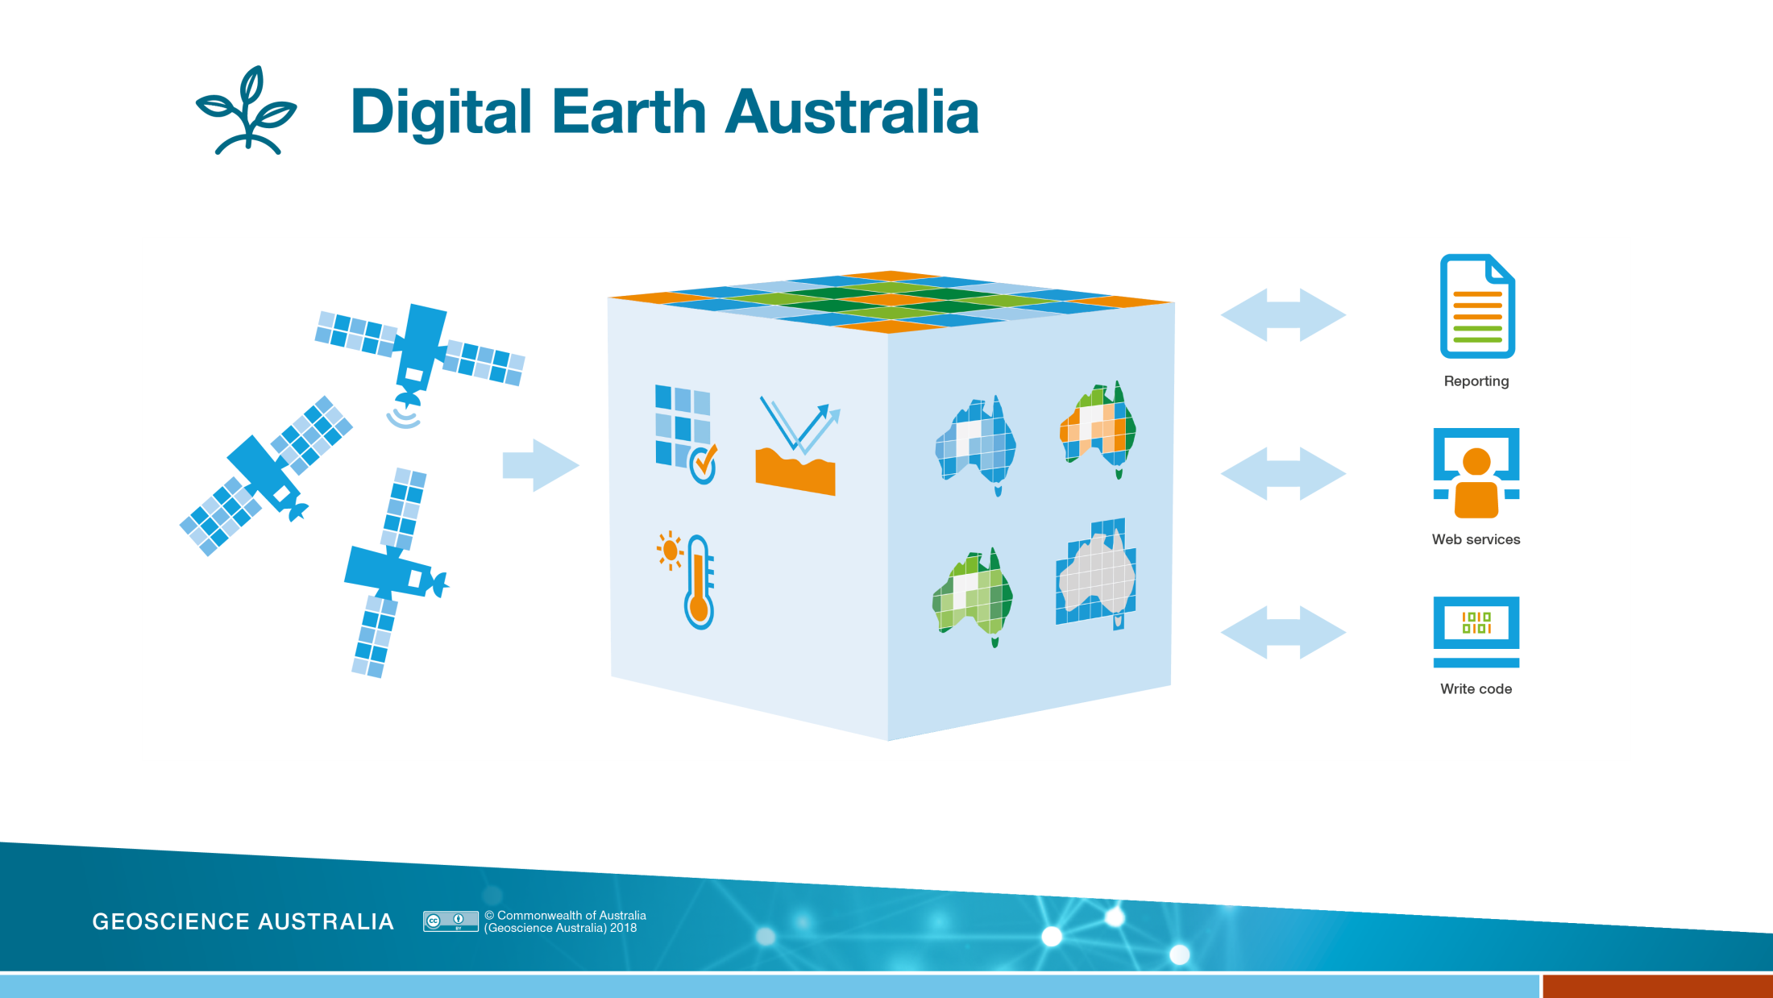

Structured time-series
Observations
Analysis
Ready Data
Information
for decisions
Products
GA Landsat Collection Upgrade

Slide 7
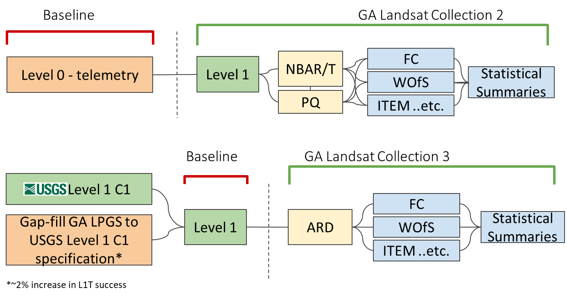
GA Landsat Collection Upgrade

Slide 8
Collection Upgrade Schedule
  Jul 2019 Sample ARD product available
  Sep 2019 Complete ARD production backlog
  Oct 2019 Derivatives production commenced
  Feb 2020 Derivatives production complete
  Jun 2020 GA Landsat Collection 2 decommissioned

Slide 9

Digital Earth Africa
US based Helmsley Charitable Trust and the Australian Government have funded the establishment of DE Africa
Digital Earth Australia will provide technical and operational guidance
DE Africa will eventually be a sovereign operational and analytical capability for Africa with in-country expertise in EO data analysis and management

Slide 10
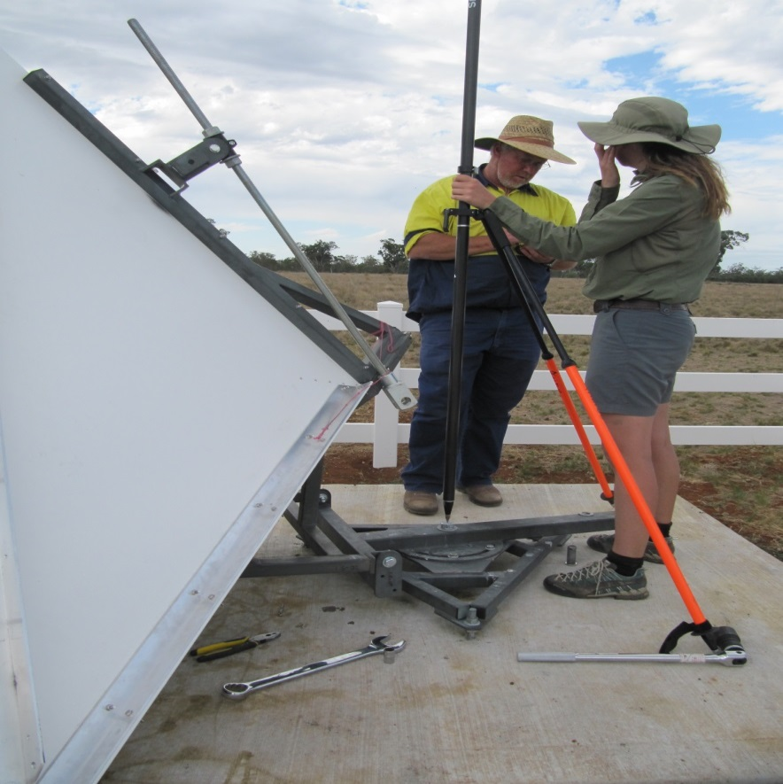
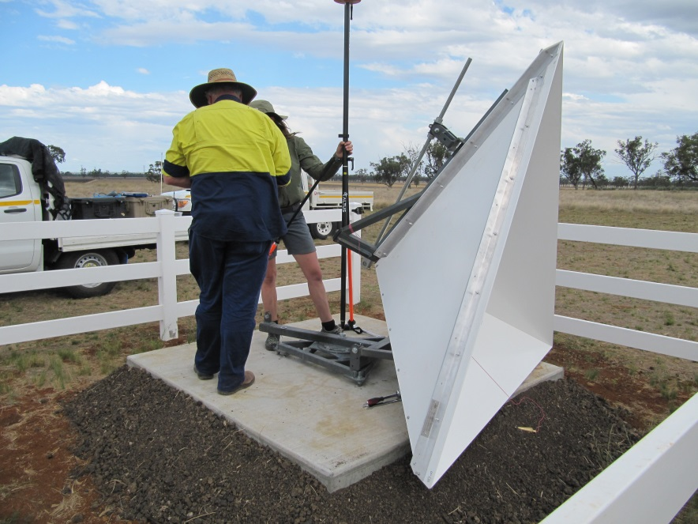
Updated Coordinates for AGOS CR Array
Original positions of all CRs obtained with RTK; mean 2σ uncertainty of 2 cm horizontal and 4 cm vertical (at pivot bolt)
Updated positions will be for CR vertex coordinates (survey completed in June 2018)
Updated
CR coordinate
Original CR coordinate
Notes:
All new CRs for final deployment were grey powder-coated. Prototype CRs were retrofitted with additional brace on the vertical panels. Fences are plastic – avoids strong double bounce

Slide 11
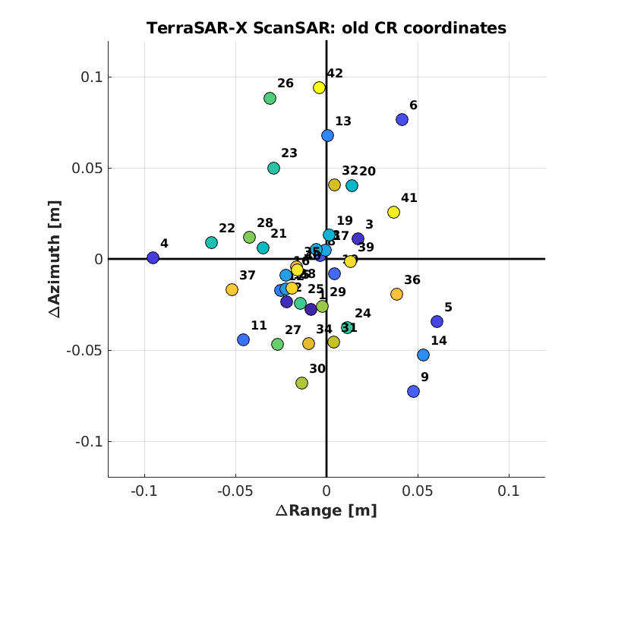
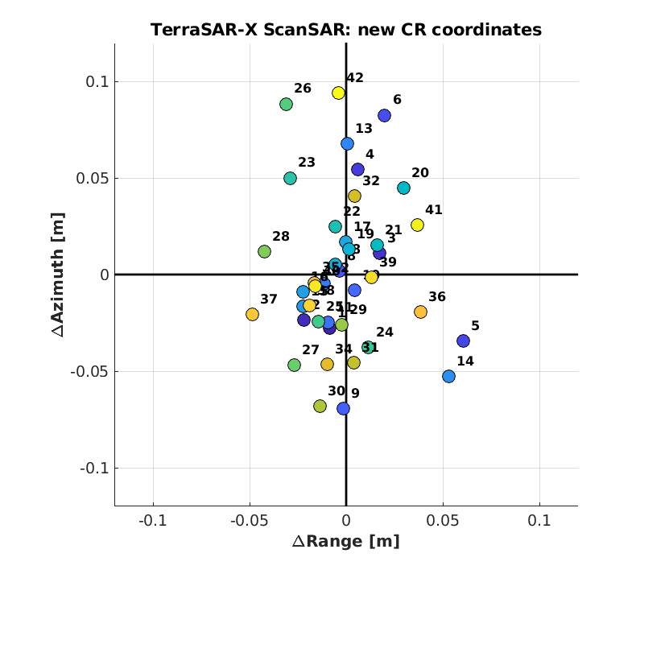
ALE results for TSX ScanSAR: old vs new coordinates
New coordinates shown for CRs 4, 6, 9, 11, 12, 17, 20, 21 and 22

Slide 12
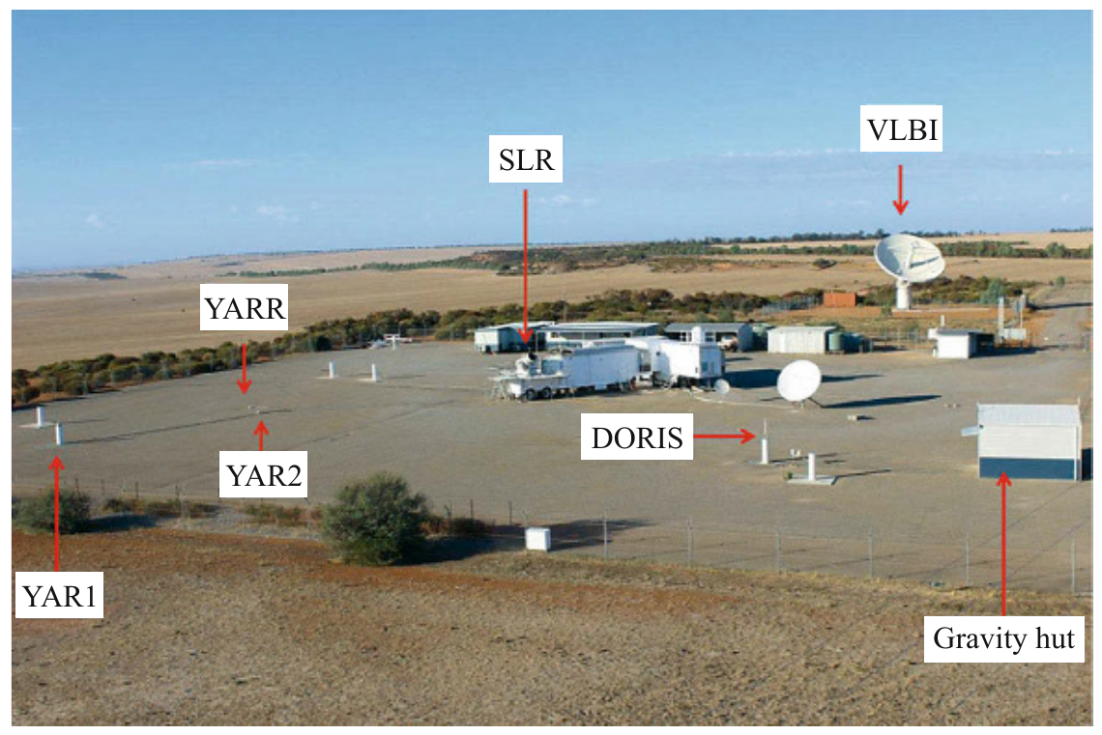

New Corner Reflectors at Yarragadee Geodetic Station
Yarragadee is one of the few fundamental geodetic stations that co-locates all four geodetic techniques (GNSS, VLBI, SLR, DORIS) . In August 2018 station equipped with two trihedral CRs (1.5m), mounted on deep concrete foundations, with one CR facing east and the other CR facing west to support both ascending and descending passes
The CR vertical boresight was aligned for 40° incidence angle to allow measurements from all radar beams between 25° and 55° incidence angle
Local ties have been measured with terrestrial geodetic survey and are now available in GDA2020 & ITRF2014
Both CRs have perfect visibility and the derived SCR values are in line with results obtained for the 1.5m CRs at Wettzell and Metsähovi (45 to 50 dB)
CR_{A}
CR_{D}
Yarragadee
modified from Teunissen & Montenbruck: Springer Handbook of GNSS, 2017

Slide 13
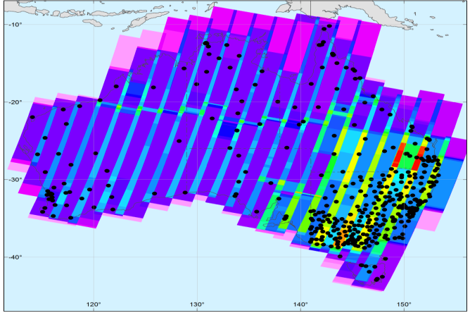
Operational ARD processing for SAR applications
Scaling up processing of Sentinel-1 SAR ARD data in Australia through the DEA InSAR Project
As part of the project GA is contributing to definitions for InSAR CARD4L products, working with LSI-VC:
  Interferogram
  Coherence
Workflow to be implemented for the Australian State of Victoria and validated for scaling up to a national product

Slide 14
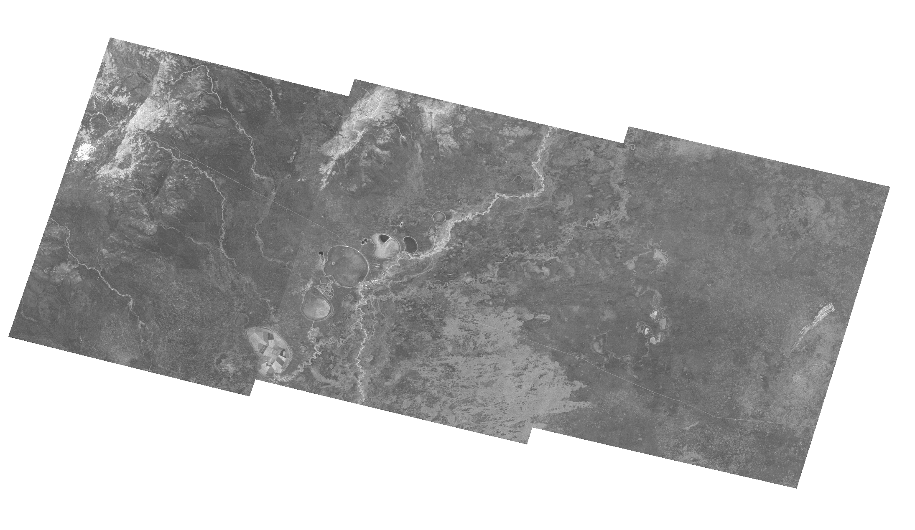
Example Backscatter Product - Menindee Lakes
Paper published in online journal - Data
Building a SAR-Enabled Data Cube Capability in Australia Using SAR Analysis Ready Data
Catherine Ticehurst, Zheng-Shu Zhou, Eric Lehmann, Fang Yuan, Medhavy Thankappan, Ake Rosenqvist, Ben Lewis and Matt Paget

Slide 15
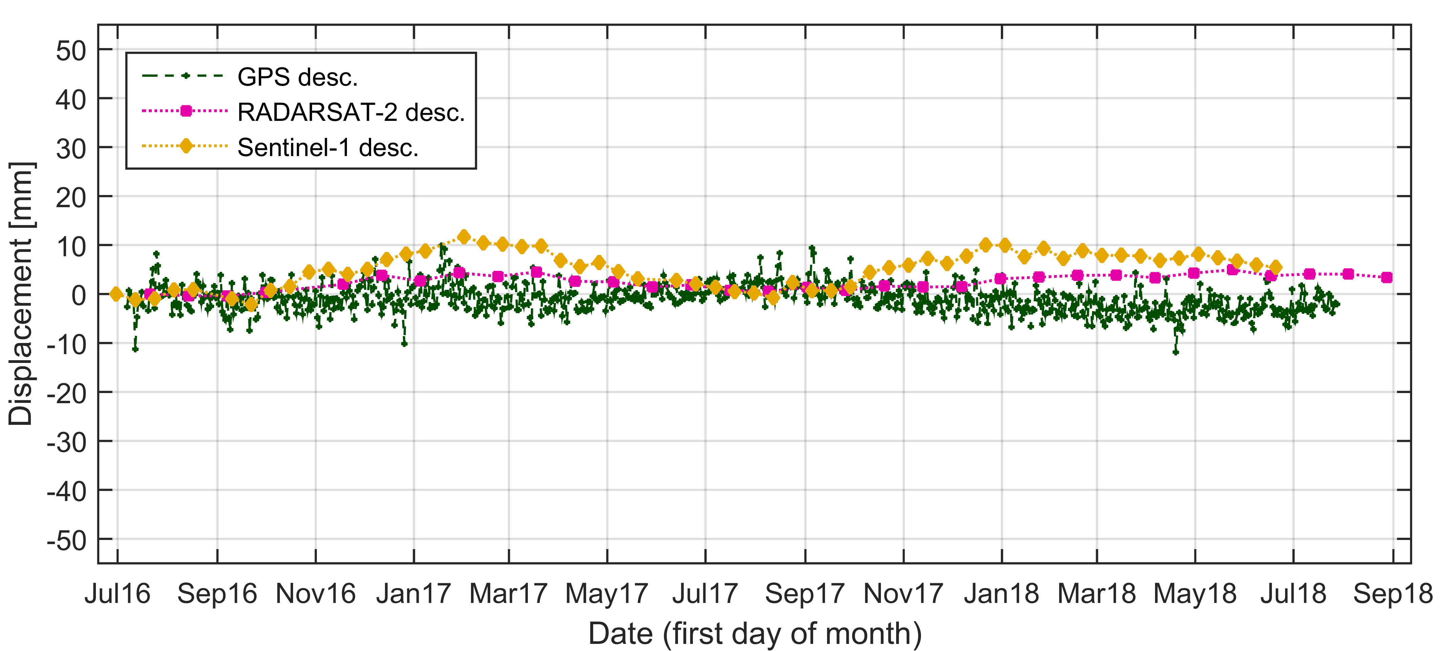
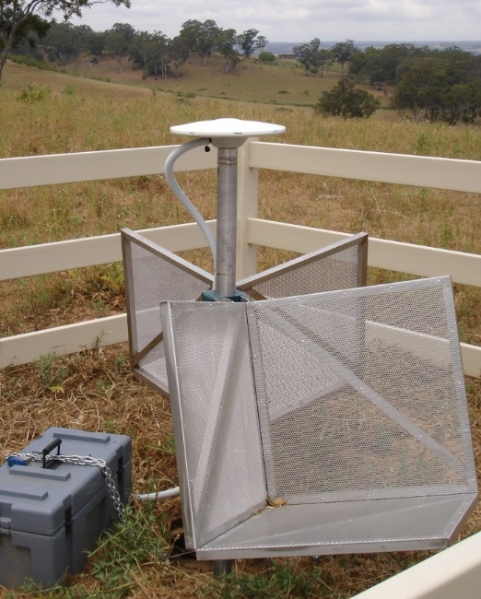
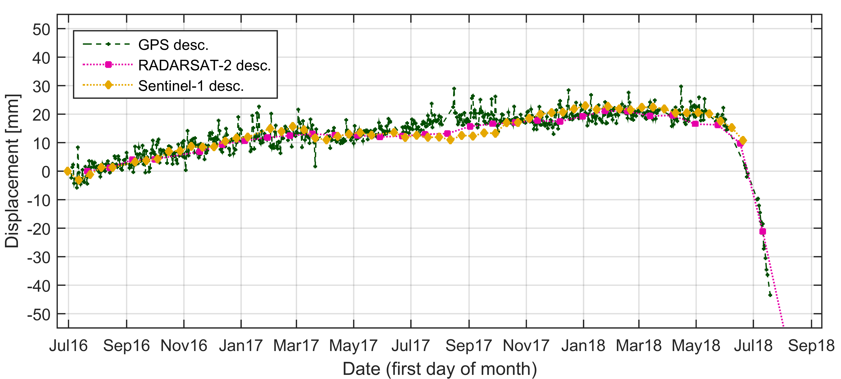
Sydney Basin: Validation of InSAR and GPS results
RADARSAT-2 & Sentinel-1
Displacement measured at GPS antenna
Stable site
GPS East, North and Up components transformed to asc and desc LOS
Moving site
Displacement measured at asc and desc corner reflectors
SAR CoP Workshop Canberra 13 June 2019
Notes:
Validation of InSAR-derived displacement with ground-based GPS measurements. 21 monitoring sites have been established in 2016 in the Sydney Basin consisting of two radar corner reflectors (ascending, descending) attached to a GPS antenna pole. RADARSAT-2 data is acquired in the area of the monitoring sites to obtain displacements from phase measurements at the corner reflectors. Only one of the 21 sites is located in an area which shows movements greater than 1 cm. We find that the differences between displacements measured by InSAR and GPS are generally within 1 cm. At the moving site the ascending corner reflector has slightly moved relative to the antenna pole which results in a discrepancy of both time series since mid-2017 adding up to a bit more than 1 cm by May 2018.

Slide 16
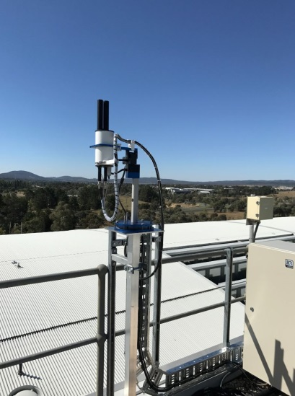
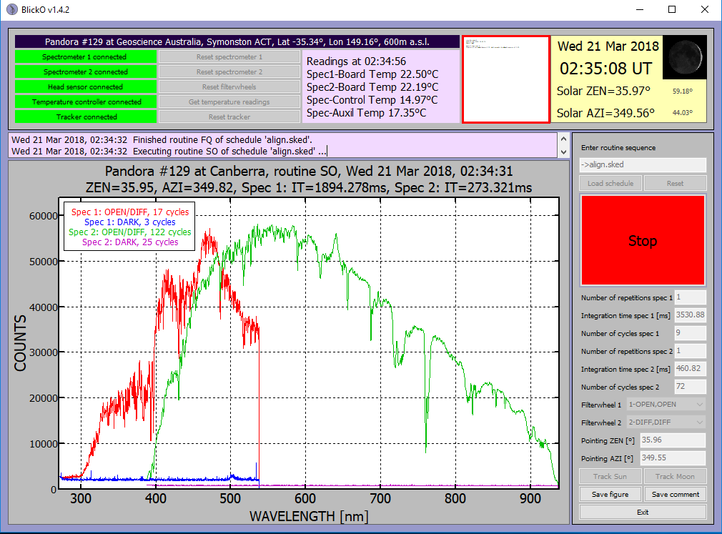
GA Hosting ESA Pandora Instruments
Pandora at Geoscience Australia, Canberra
Two Pandoras supporting ESA FRM4AC at Canberra and Alice Springs
First Pandonia Global Network workshop from 17-20 Sep, Innsbruck

Slide 17
Review of AeroSpan Network
AeroSpan is a network of automated instruments to characterise primary source of continental aerosols in Australia
GA participating in the review of the AeroSpan network to recommend a fit-for-purpose model for sustainable operations into the future

Slide 18
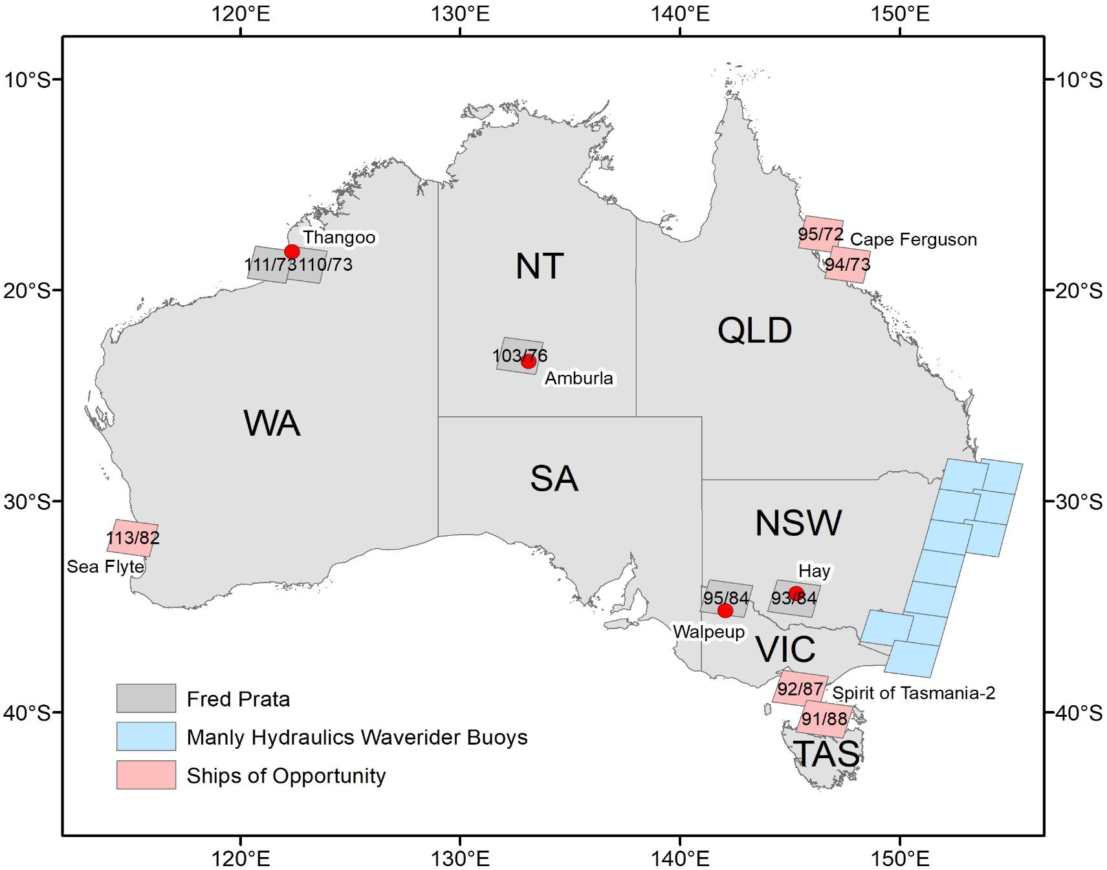
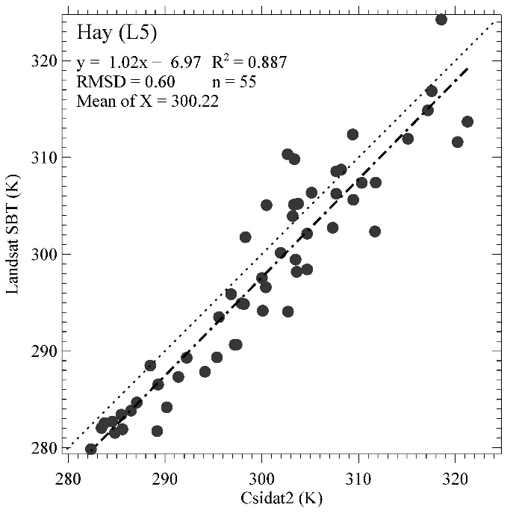
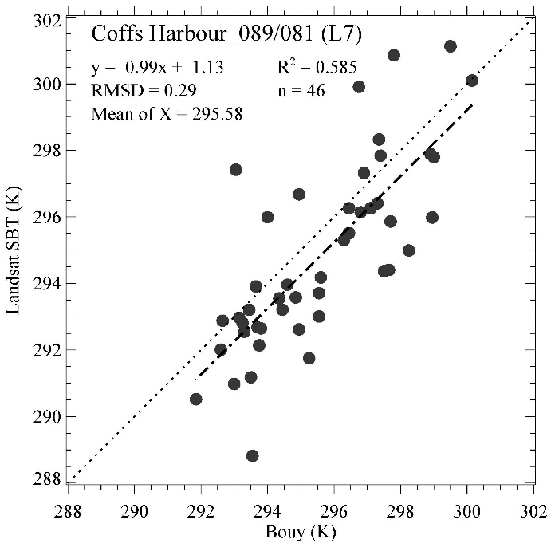
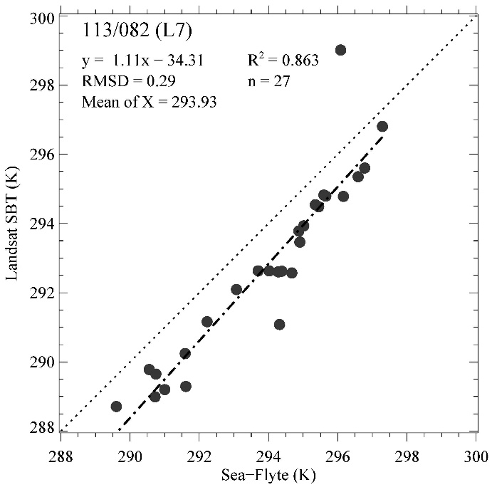
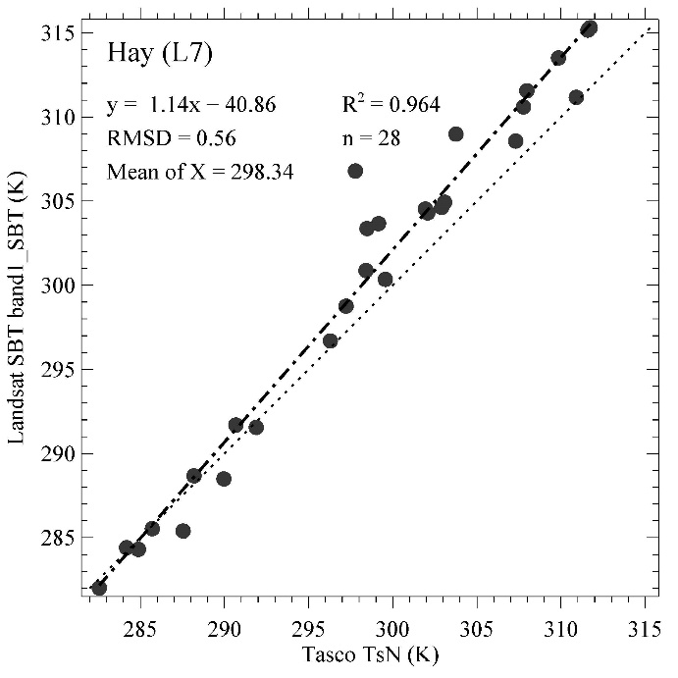
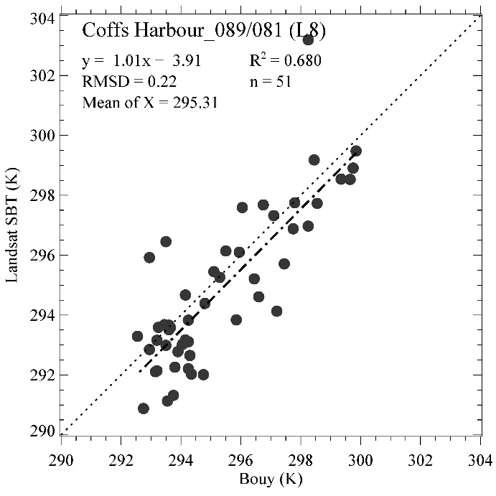
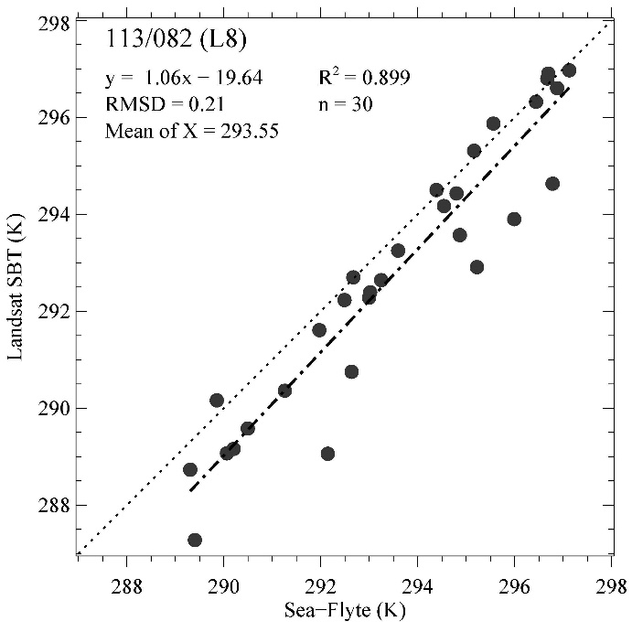
Landsat Surface Brightness Temperature Validation
Ground Based Radiometer
Waverider Buoys
Ships of Opportunity
Tim R. McVicar, Lingtao Li, Alfredo ‘Fred’ J. Prata and Helen M Beggs
Independent validation of GA’s Landsat SBT product using field data
Ground Based Radiometer
Waverider Buoys
Ships of Opportunity

Slide 19
National Coordination in EO
Inter-agency / inter-departmental committees and WGs, participation in Earth Observation Australia – an EO community based Org
Operation of the Copernicus Regional Data Hub with AU-NZ partners
New proposal for a national cal / val facility is under discussion

Slide 20
International Activities
GA-USGS collaboration on Data Cube, Product Generation and Cal / Val activities, annual face-to-face meetings and monthly tag-ups
Working with USGS, ESA to assess GRI processed datasets over Australia for geometric quality
Copernicus Regional Hub Partners (AU-NZ) to work with ESA to review Sentinel-2 surface reflectance for wider use / uptake in Australia – ToR being finalised
Ongoing discussions with NASA to support NISAR calibration through a new array of corner reflectors based in Australia

Slide 21



Upcoming
CSIRO / GA SIT Chair term from Oct 2019
IGARSS special session on ARD
GEO Week 2019 Nov 2019

