Slide 1
Copernicus Programme Implementation and Evolution

Slide 2
COPERNICUS PAST to PRESENT
    1998-2010:
    Space-related projects € 750 M
    Preparatory actions € 9,2 M
R&D activities
FP6-FP7
  2011-2013
  GMES –Initial Operations- € 107 M
EU-DEM
GMES-GIO
  2014-2020
  Dedicated satellites - Operational services
  Budget: € 4,3 Billion
Copernicus

Slide 3
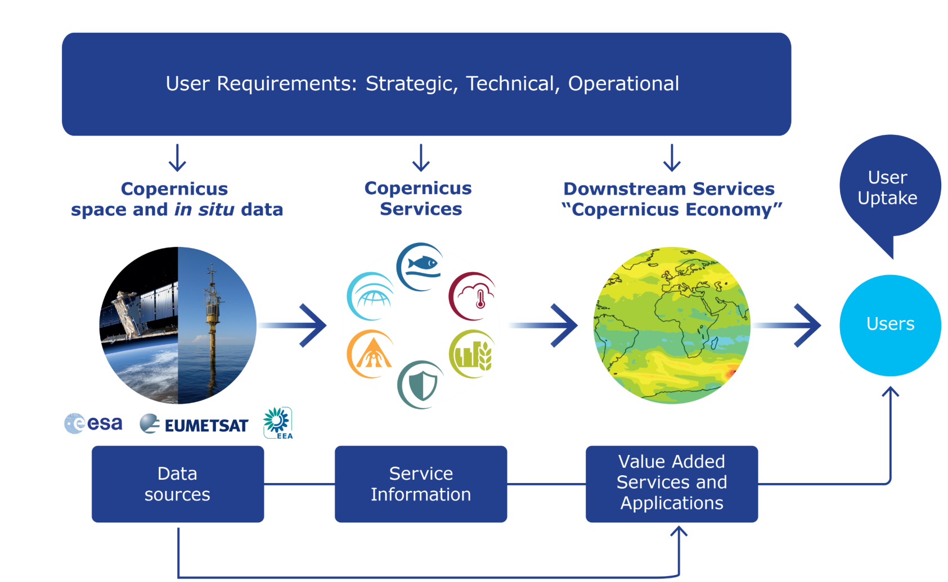
COPERNICUS IS DRIVEN BY THE USERS

Slide 4
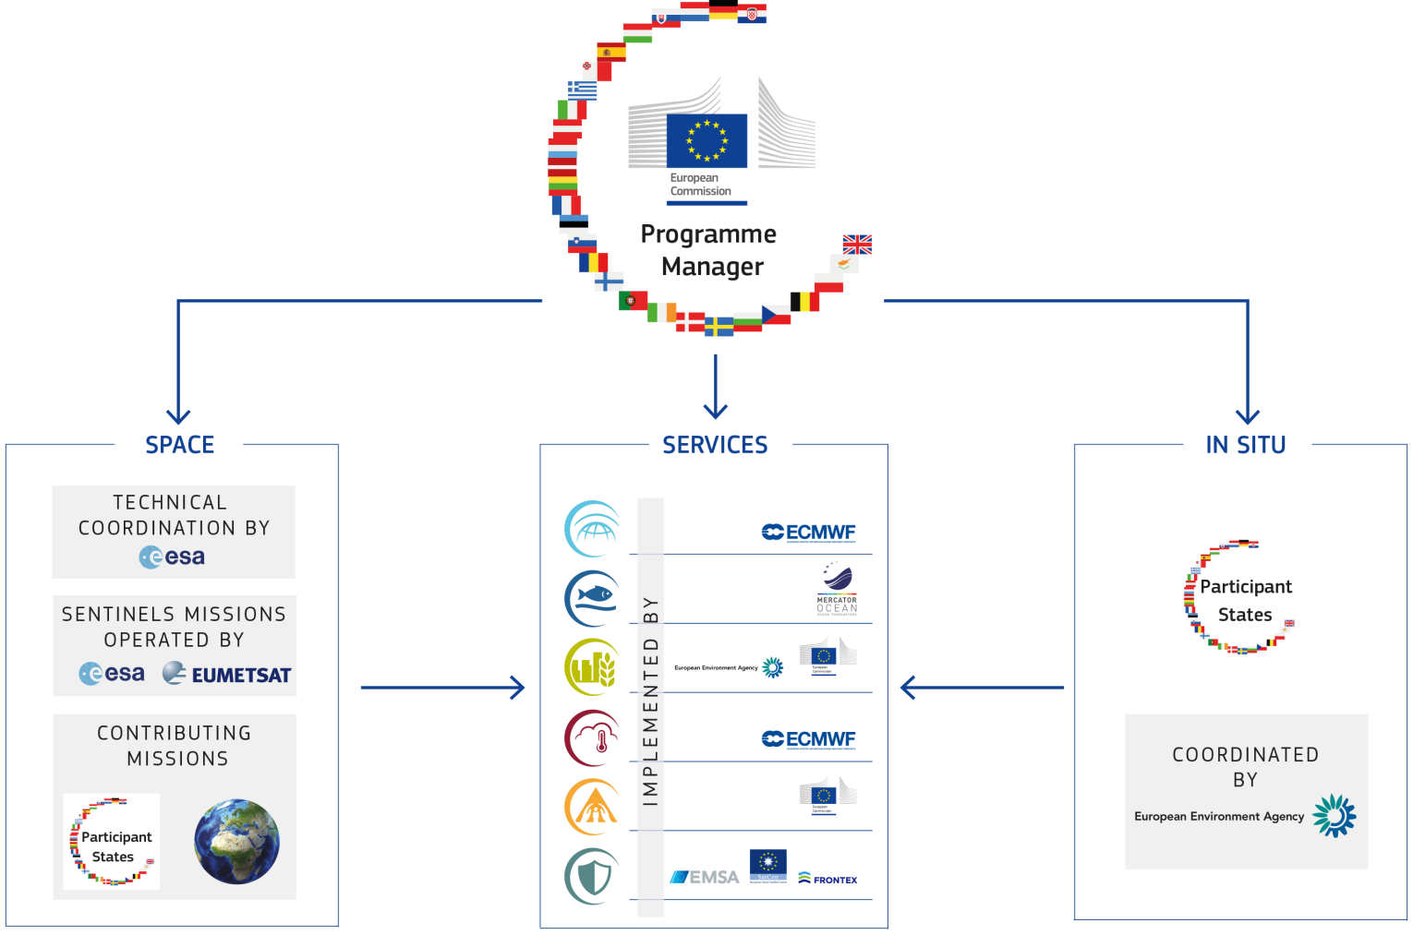
COPERNICUS GOVERNANCE
DIAS: Data and Information Access Services

Slide 5







THE SENTINELS
FULL, FREE AND OPEN
Sentinel Mission and Status
Key Features
SENTINEL-1:
4-40m resolution, 3 day revisit at equator
2 Sats in orbit
Polar-orbiting, all-weather, day-and-night radar imaging
SENTINEL-2:
10-60m resolution, 5 days revisit time
2 Sats in Orbit
Polar-orbiting, multispectral optical, high-res imaging
SENTINEL-3:
300-1200m resolution, <2 days revisit
2 Sat in Orbit
Optical and altimeter mission monitoring sea and land parameters
SENTINEL-4:
8km resolution, 60 min revisit time
1st Launch in 2020
Payload for atmosphere chemistry monitoring on MTG-S
SENTINEL-5p:
7-68km resolution, 1 day revisit
1 Sat in Orbit
Mission to reduce data gaps between Envisat, and S-5
SENTINEL-5:
7.5-50km resolution, 1 day revisit
1st Launch in 2021
Payload for atmosphere chemistry monitoring on MetOp 2ndGen
SENTINEL-6:
10 day revisit time
1st Launch in 2020
Radar altimeter to measure sea-surface height globally

Slide 6





Copernicus DIAS Providers
‘Creodias – http://www.creodias.eu’ : Creotech (PL) with cloud provider CloudFerro (PL)
‘ONDA – http://www.onda-dias.eu’ : Serco (IT) with cloud provider OVH (FR)
‘SOBLOO – http://www.sobloo.eu’ : Airbus (FR) with cloud provider Orange (FR)
‘Mundiwebservices – www.mundiwebservices.eu’ : ATOS (FR) with cloud provider T-Systems (DE)
‘WeKEO – http://wekeo.eu’ : EUMETSAT, with Mercator Ocean and ECMWF

Slide 7
Data Policy
FULL, FREE AND OPEN
Copernicus Data and Information Policy
  Sentinel data and service information are disseminated under a free, full and open data policy
  Free access is provided under pre-defined technical conditions through Copernicus dissemination platforms
Legal basis
  COMMISSION DELEGATED REGULATION (EU) of 12.7.2013 supplementing Regulation (EU) No 911/2010 of the European Parliament and of the Council on the European Earth monitoring programme (GMES)
Data and information
  Sentinel Data and Copernicus Service Information
  Satellite Data from Contributing Missions (national, commercial, ...) and In situ data
  Data available under specific license conditions set by, or negotiated with, the data providers
Rights of use
  The users are granted the rights to use, copy, modify, distribute, communicate to the public these data and information or the results of their processing
Attribution
  When redistributing, the user must indicate the source of the data or information.
  Redistribution of modified data or information must be correctly labelled.

Slide 8
Copernicus evolutioN:
Space Strategy for Europe
Stability of the programme and long term committment
  (Enhanced) continuity of current data and services
  Continuity of full, open and free data policy
Copernicus will continue to be a public service, driven by the needs of policy and public administrations and fostering economic development in Europe
  Support Public core Users at European, national, and sub-national level
  Help Europe to maintain a prominent role in the international context
  Strengthen Intermediate Users, downstream companies, value added service providers

Slide 9
Policy Needs and priorities
Additional services will be considered to meet emerging needs
  Climate change and sustainable development
  Monitoring CO2 and other greenhouse gas emissions
  Changes in the Arctic
  Land use and forestry
  Security and Defence: improving the EU's capacity (border controls and maritime surveillance)
Notes:
The private sector will only use and invest in space solutions if users and businesses are confident that services and data provided by Copernicus […] will continue in the future. The Commission therefore confirms its commitment to the stability of the EU space programmes. [Space Strategy, §1.2]
Additional services will be considered to meet emerging needs in specific priority areas, including (i) climate change and sustainable development, to monitor CO2 and other greenhouse gas emissions, land use and forestry, and changes in the Arctic9 with Copernicus; and (ii) security and defence to improve the EU's capacity to respond to evolving challenges related to border controls and maritime surveillance with Copernicus and Galileo/EGNOS. This expansion will take account of new technological developments in the sector, the need to ensure adequate level of security of the infrastructure and services, the availability of different data sources and the long-term capacity of the private sector to deliver appropriate solutions. [Space Strategy, §1.2]

Slide 10

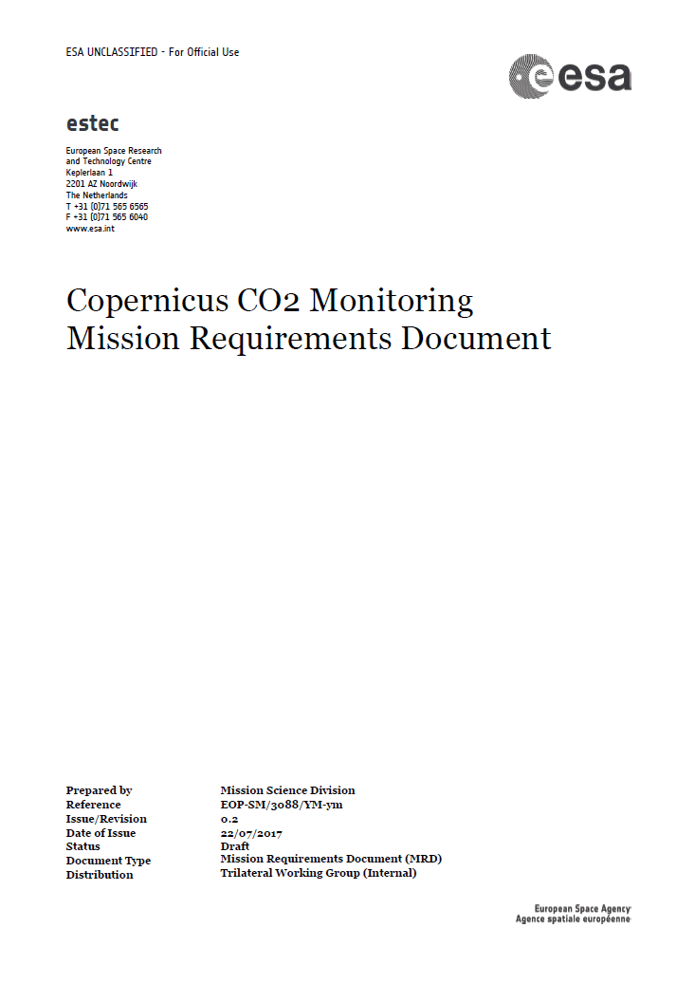
Towards an anthropogenic CO₂ Monitoring & Verification Support Capacity
Global Stock
Take 1
using inventories of 2026
CO₂ Task Force & ESA MAG
Global Stock
Take 2
2017
2019
2021
2023
2025
2027
2028
2029
system capacity built up
operation
MRD
#1
MRD
#2
MRD
#3
Launch target for
Copernicus S-7
constellation
ESA support studies
H2020 space call
H2020 Coordination & support Action: CHE
H2020: VERIFY

Slide 11
Copernicus Space Component Evolution
    2021-2027: new EU Space regulation*
    Continuity and evolution of Copernicus,
    new sectors of policies and economy, free and open data
    proposed Budget: 5.8 Bn€
current Sentinel Constellation
  ~ 2025
  Phasing in of Sentinel Expansion missions to address major gaps
Sentinel Expansion Missions
  ~ 2030/2032
  Both, current and expansion missions are replaced by NG missions
Sentinel
Next Generation
* http://europa.eu/rapid/press-release_IP-18-4022_en.htm

Slide 12
Resulting Observation Priorities
The (enhanced) continuity of existing observation capacity
is the overarching priority
Conclusions on major gaps :
  CO2 measurements to estimate anthropogenic emissions (top priority)
  High-Resolution Thermal observations
  SAR L-band observations
  Monitoring of sea ice and ice sheets in the polar region (PMR Imaging, Altimeter)
  Hyper-spectral measurements

Slide 13
Mission | Objective | Technical Concept
CO2 Mission | Paris agreement, anthropogenic CO₂ MRV support | VNIS/SWIR Spectrometer and multi-angle polarimeter, 4km2, 2-3 days revisit via a constellation
Thermal Mission | Addressing policies related to water and food security – EU Water Framework EU Directive, Common Agriculture Policy, UN SDGs, UNFCCC, UNCCD | 30-50 m, daily (goal) via a constellation, 3-5 TIR bands & minimum VNIR/SWIR
Polar Ice and Snow Topographic Mission | Monitoring of critical climate signals: ice sheet (sea ice and land ice elevation and thickness), ice cap melting and sea level; Support applications related to coastal and inland waters; contribute to the observation of ocean topography. | Ku-band and Ka-band interferometric radar altimeter, a laser retro-reflector array, a GNSS receiver
Passive Microwave Imaging Mission | Integrated EU Arctic Policy, sustainable development in and around the Arctic | Multifrequency microwave radiometer (CMIR) which sustains AMSR2 type capability and SMAP/SMOS capability
Hyperspectral Mission | management of natural resources. Supports services for food security, agriculture and raw materials. | 400-2500nm; 10nm;<30m, 10d via a constellation;
L-Band SAR Mission | vegetation cover, biomass and surface soil moisture. Enhanced monitoring polar regions (sea and land ice) and ground movement and deformation due to hazards. | L-band imaging SAR, full-pol, 5-30m, revisit TBD

Slide 14
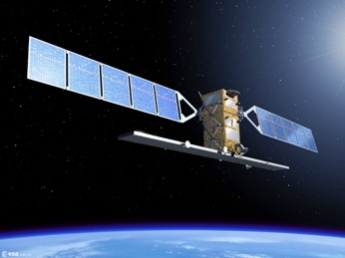
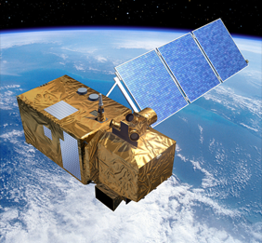
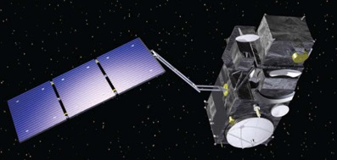
Copernicus Land Monitoring Service
Global Component
Systematic production of Biophysical Variables
Ground Based Observations for Validation
Hot-Spot Monitoring (land cover change)
Sentinel-2 Global Mosaics and thematic products

Slide 15
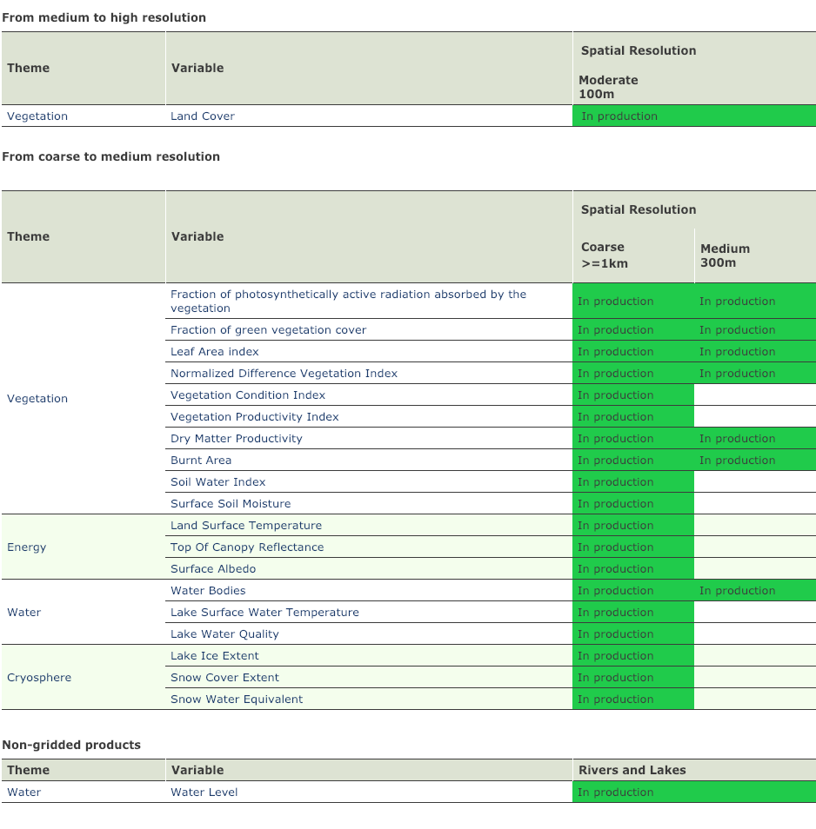
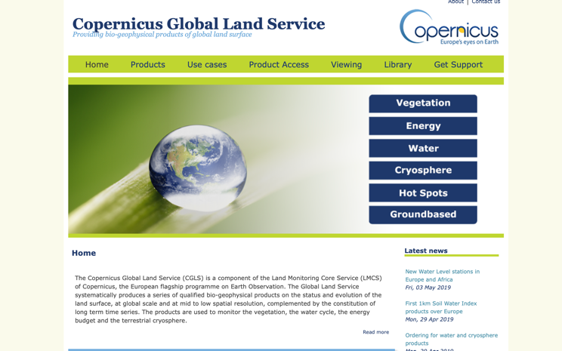
Biogeohysical Variable Systematic Monitoring
Routine Production
  21 type products
  3 resolutions
  80+ data collections
Products are being transferred to S3

Slide 16
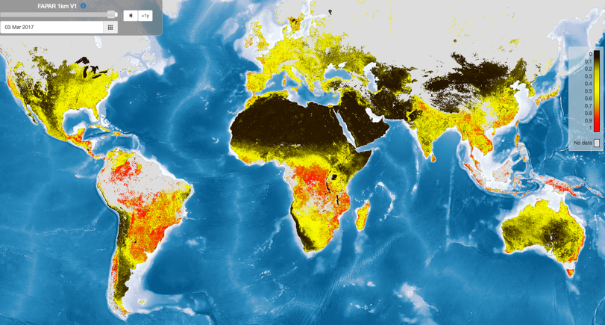
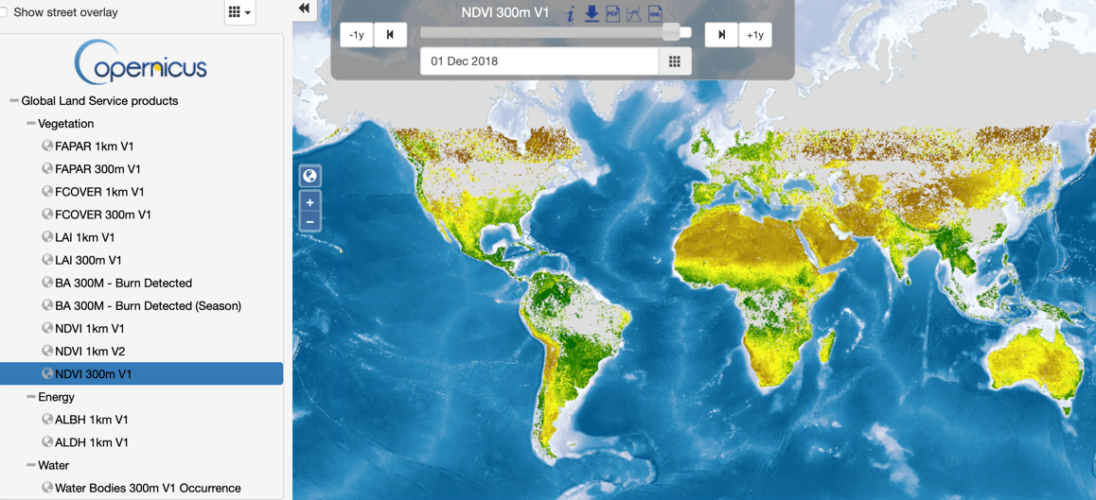
examples
Vegetation status (FAPAR)
< FAPAR, LAI, FCover
Global
Ten day (from 1999)
1km - 300m
Product viewer >
NEW!
NDVI BRDF corrected 300m version >

Slide 17

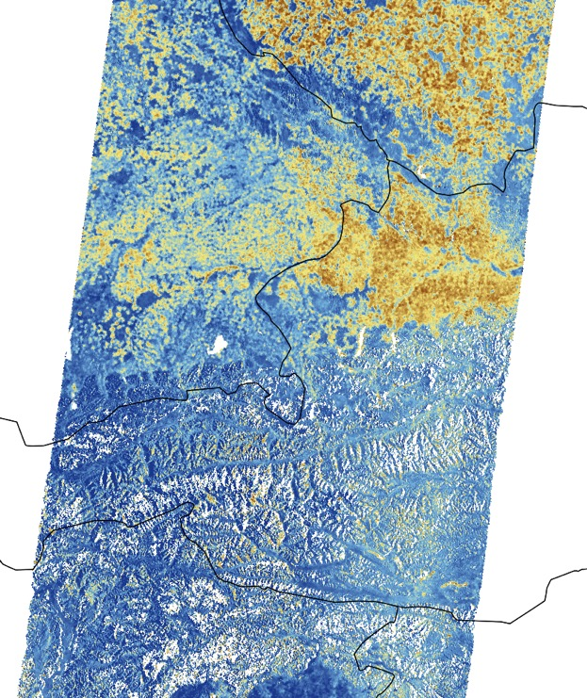
Examples ctd.
< Surface Soil Moisture
Europe, Global
Daily
1km
Sentinel-1 SSM – Detail Central Europe (EODC – TU Wien)
First years (2015-2017) of Surface Soil Moisture products and NRT
at 1km resolution (SSM1km) over continental Europe, based on the C-band SAR sensors of Sentinel-1 A and B
Radarsat Constellation could expend coverage and frequency

Slide 18
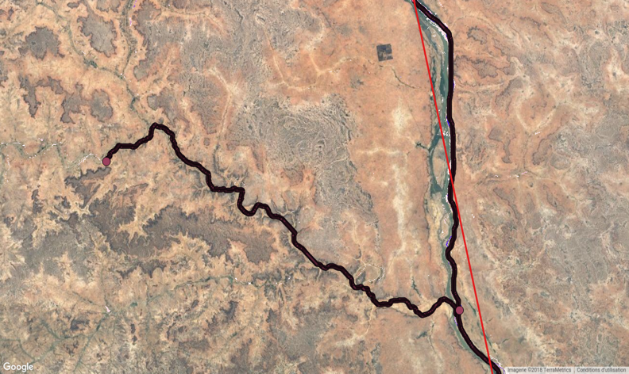
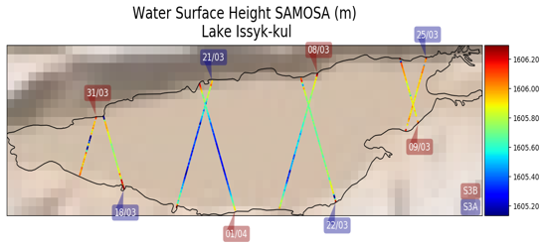
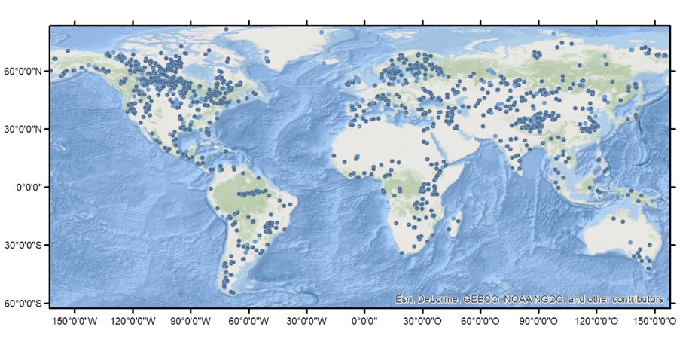
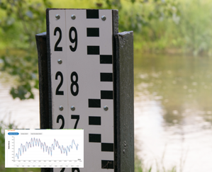
examples ctd.
< Lake and River Water Levels
set of high quality stations generated over Africa and Europe (respectively ~700
and 500 stations)
Now going to > 10 000 stations
Ten daily
Sentinel-3a ground-track
Lake Water Quality >
300m, 100m (in evolution)
Ten daily
2016-
Parameters:
Lake Surface Water Temperature (LSWT)
Turbidity (TUR)
Trophic State Index (TSI)
Lake Surface Reflectance (LSR)

Slide 19
Highlight 1
The Global Land Cover Layers:
more than a ‘map’, it is a systematic service providing dynamic, yearly, user-oriented global land cover maps from 2015
Notes:
The first version of the Copernicus Global Land Cover Layers at 100m at global scale for the year 2015 (2016-2018 to follow later this year).
The product is derived from the PROBA-V 100m Collection 1 dataset and a training dataset collected through the Geo-WIKI at 10m resolution.
The product consists of:
a discrete classification of 18 classes, including probabilities and a binary quality mask
four continuous vegetation cover fractions (0-100%) for bare, forest, grassland and shrub, …. See table on the left on the slide
one layer describing the water bodies occurence (0-100%) during the year
The overall accuracy is 80%

Slide 20
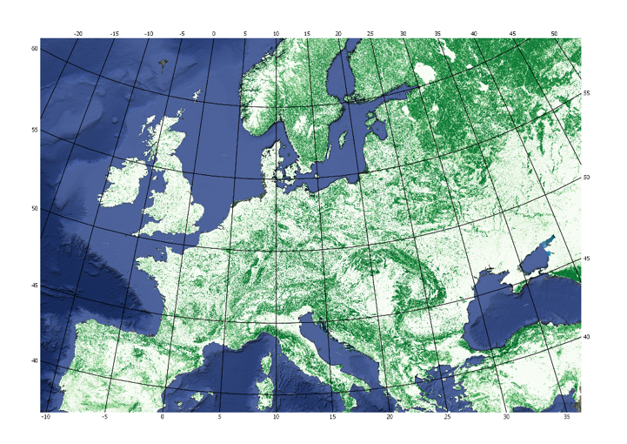
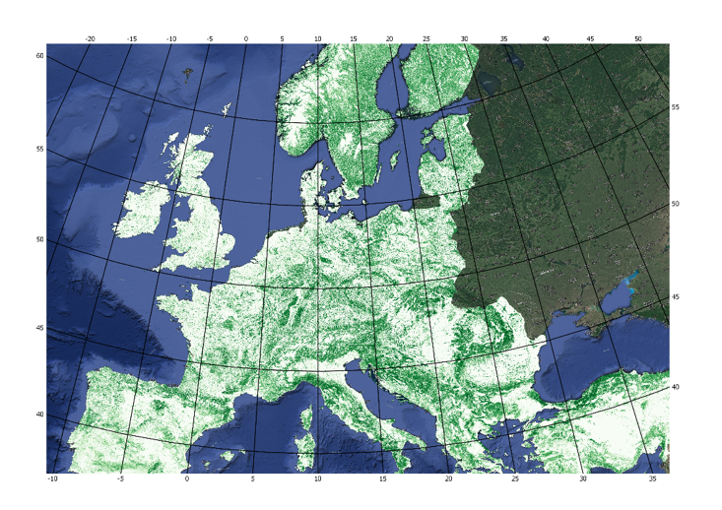

Highlight 1
It is complementary to the pan-European cover product
HRL2015 TCD + CGLS-LC100 Tree cover
HRL2015 TCD (20m - 100m)
“The LC100 cover fractions enable us to look outside Europe
using ‘known’ protocols but with less detail”
Notes:
The Global land Cover layers at 100m resolution follow know approaches and protocols to automatically derive the cover fraction layers. These are compatible with the Pan-European map layers insofar there are small variations due to the difference in resolution (20m EU –s 100m global). The hence, the Global map layers allow to extend the more detailed European view to outside Europe boundaries in a continuous and compatible way.

Slide 21
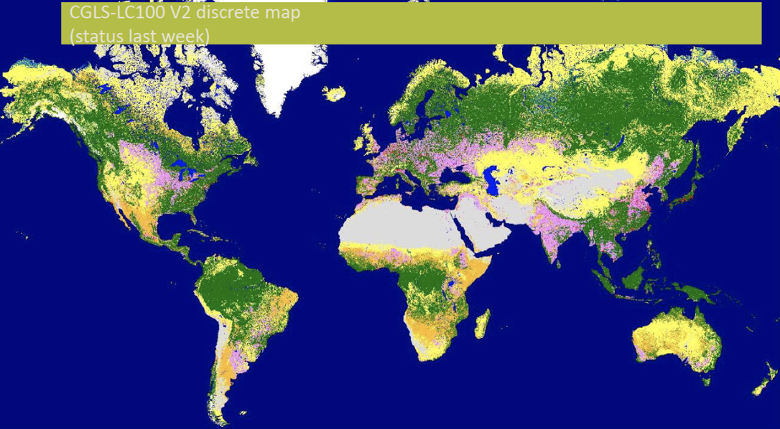
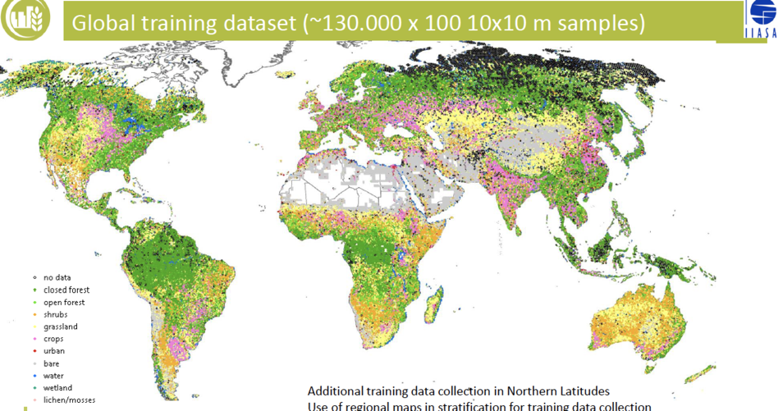
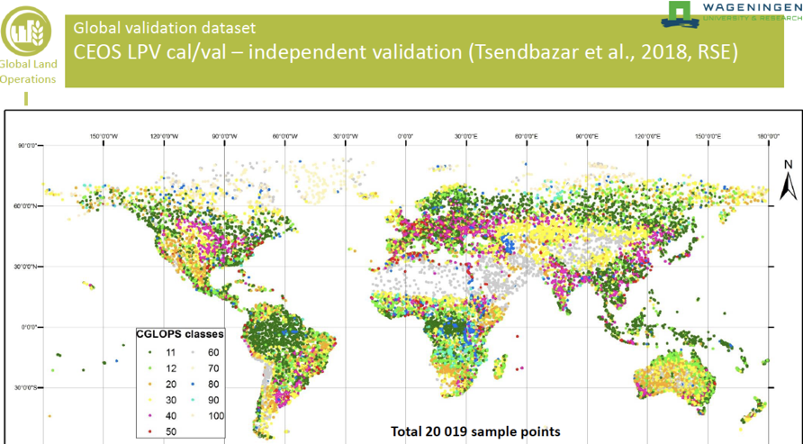
2015
Land Cover and Change >
Global
Yearly
100m
Accuracy: 80%
2015-2019 is
based on Proba-V
Then transition to
Sentinel 2 - 20m

Slide 22
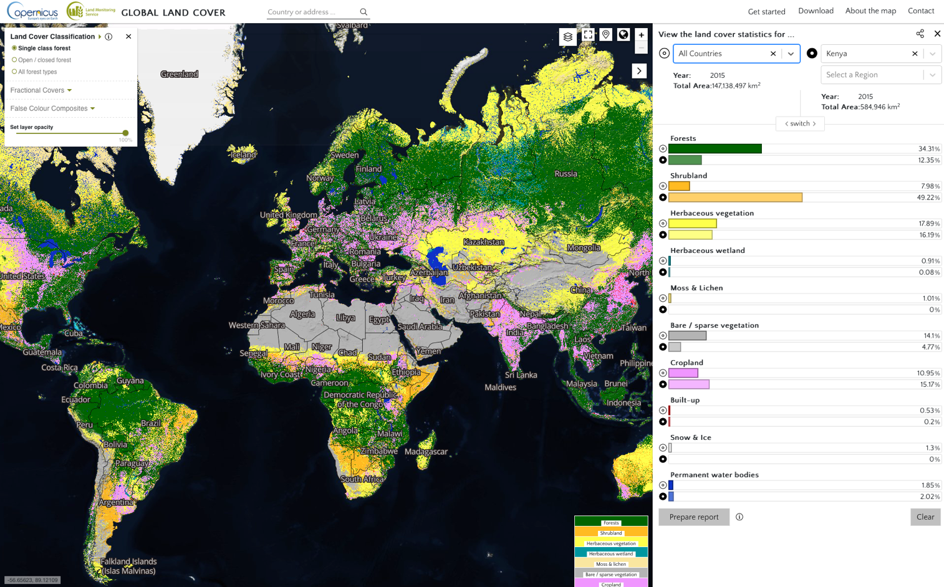
Highlight 1
Interactive viewer and statistics extraction
Notes:
Screenshot of the Global land cover layers viewer, allowing to view the discrete map layer, the separate cover layer, and extract/compare country and subnational statistics (based on the UN GAUL boundaries)

Slide 23
BIOPHYSICAL
Global Land Components
Systematic production of Biophysical Variables
Ground Based Observations for Validation
Hot-Spot Monitoring (land cover change)
Sentinel-2 Global Mosaics and thematic products

Slide 24
GROUND OBSERVATIONS - Hot Spot
< Ground-based Observations activity
Collection of ground-based observations;
a total of 53 sites covering the period 2013-2016.
now expanded to include 2017-18.
The GBOV is part and contributes to the CEOS ground observation network and Cal-Val activities.
No Canadian sites included as yet.
In support of validation of GL products

Slide 25
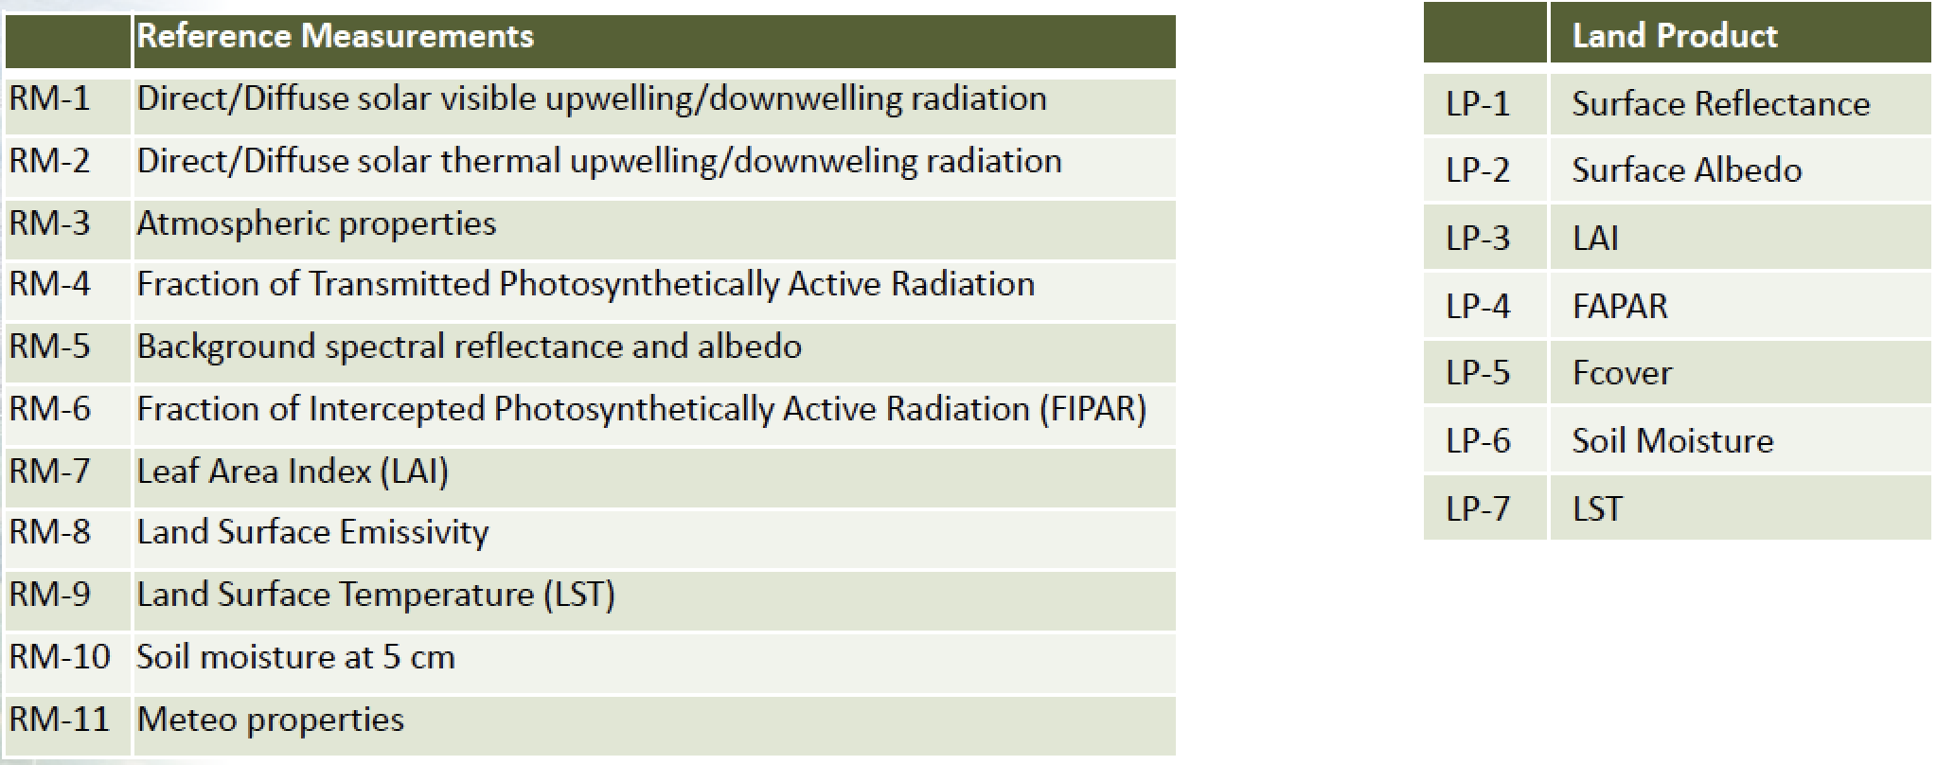
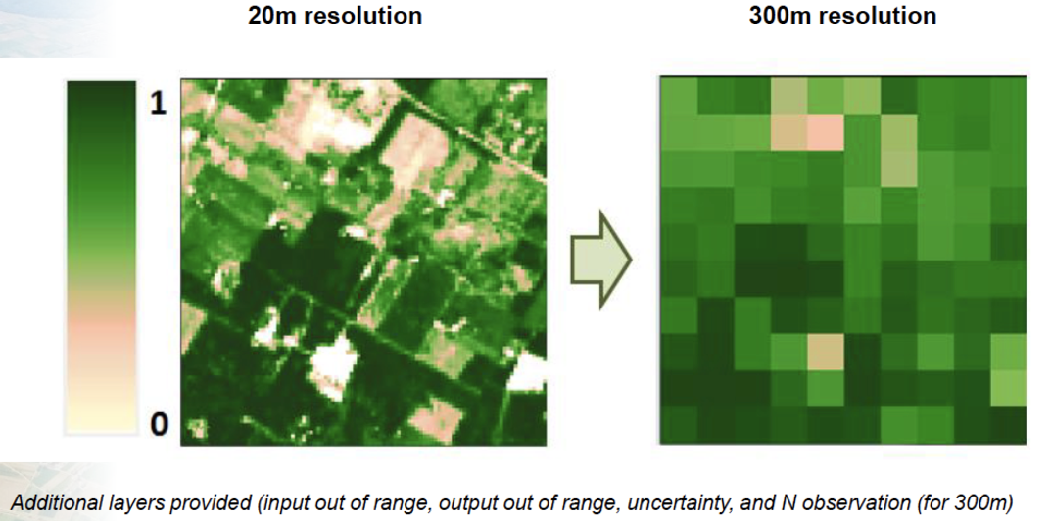
GBOV

Slide 26
BIOPHYSICAL
Global Land Components
Systematic production of Biophysical Variables
Ground Based Observations for Validation
Hot-Spot Monitoring (land cover change)
Sentinel-2 Global Mosaics and thematic products

Slide 27
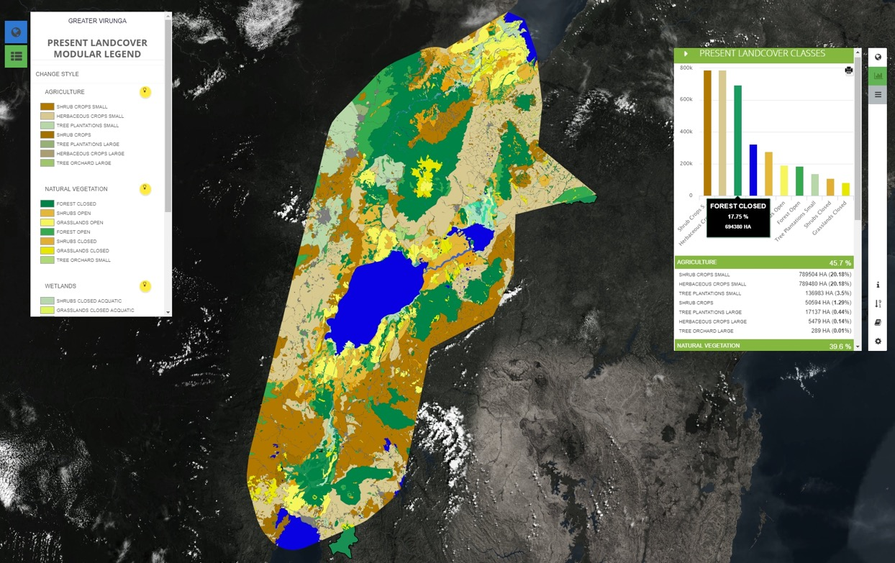
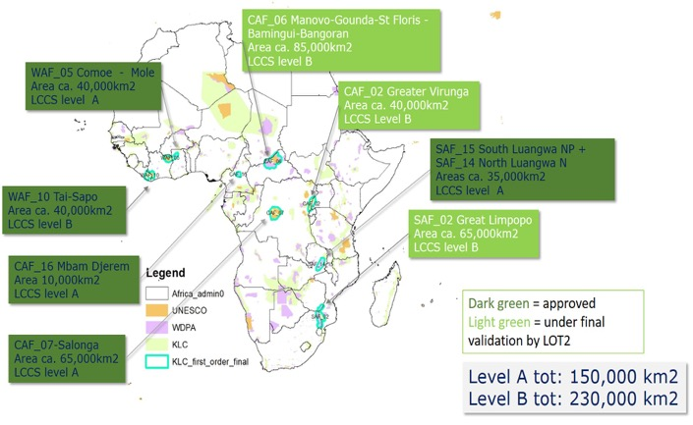
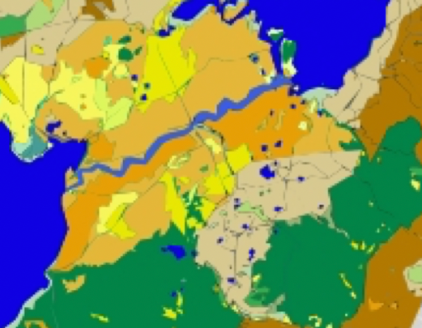
Hot Spot
< Hot Spot activity
Very High Res land cover/use and change mapping over AOIs per 5 year intervals since 1990 (if requested)
8 zones finalized
6 zones in validation
6 zones in production
20 Key Landscape zones
Total area: 1.273.350 km2

Slide 28
Global Land Components
Systematic production of Biophysical Variables
Ground Based Observations for Validation
Hot-Spot Monitoring (land cover change)
Sentinel-2 Global Mosaics and thematic products

Slide 29
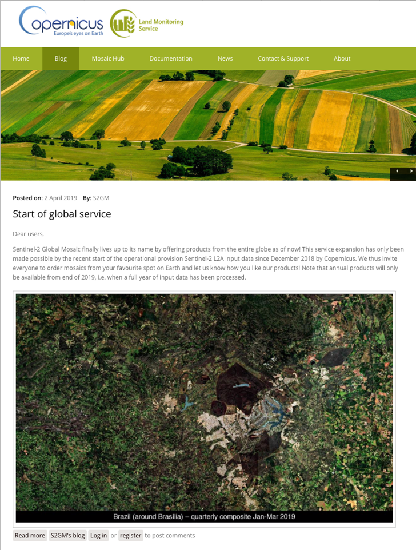
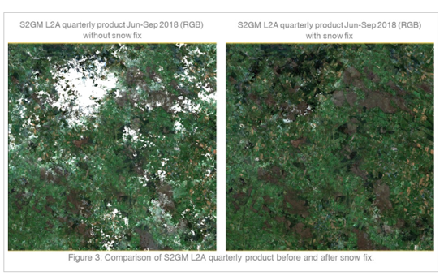
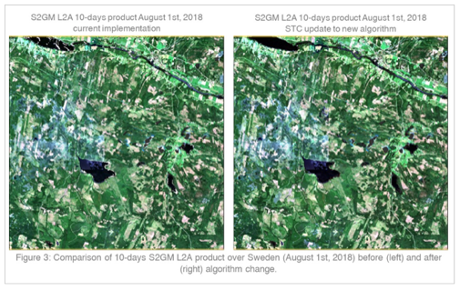
Sentinel 2 Global Mosaics activity
Provides a service for compilation of Sentinel2 - L2A spectral surface reflectance temporal composites;
It is an on-the-fly user defined production service !
Available since Q4 2018 for Europe, and now
Global coverage interactive service available since April 2019
>> New compositing approach introduced for better cloud screening, snow fix and spectral reflectance continuity

Slide 30
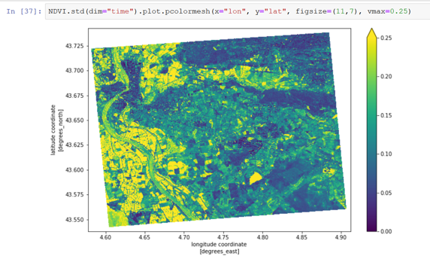
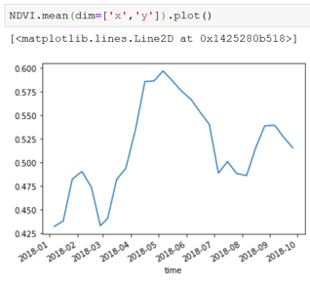
S2GM
AOI on-the-fly processing
daily, 10day, month, quarter, yearly
#resolution, #coordinate system, #file format, #bands, #ancillary

Slide 31
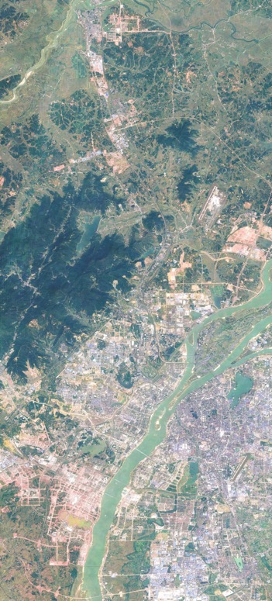
COPERNICUS SERVICE EVOLUTION
Main evolution objectives:
Increasing resolution of bio-geophysical variable products
Where relevant, adapting algorithms and processing chains to Sentinel-2 resolution
Optimize information generating efforts and product access
  More on-the-fly product delivery
  Operationalizing datacube/datagrids (covering input, processing, output and access and delivery)
Increase user-oriented core products
  Fusion products: Multi-product, multi-sensor, multi- temporal integration

Slide 32
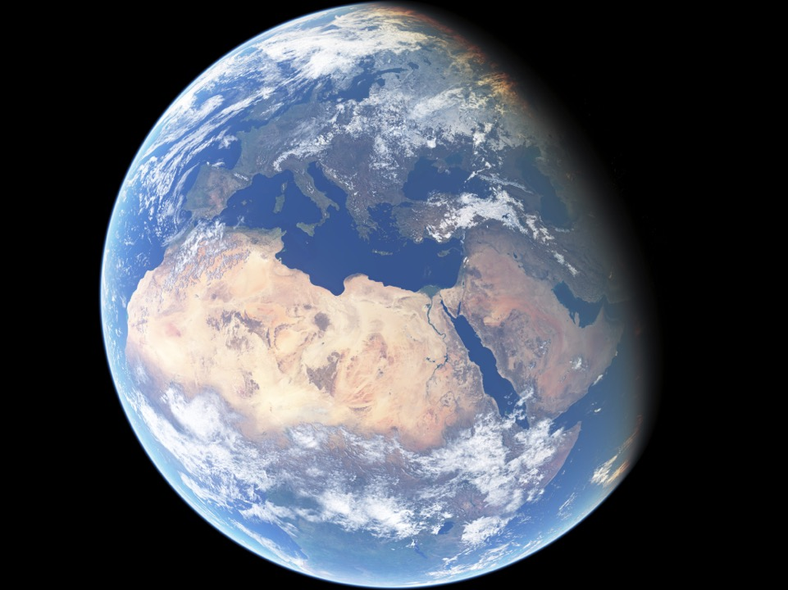
Thank you
Copernicus
Global Land Service
https://land.copernicus.eu/global/
Follow us on:
Copernicus EU CopernicusEU www.copernicus.eu

