Slide 1

WGCV Chair’s Report
C. Ong
CSIRO
WGCV Plenary # 45
CSIRO, Perth, Australia
15-19 July, 2019

Slide 2
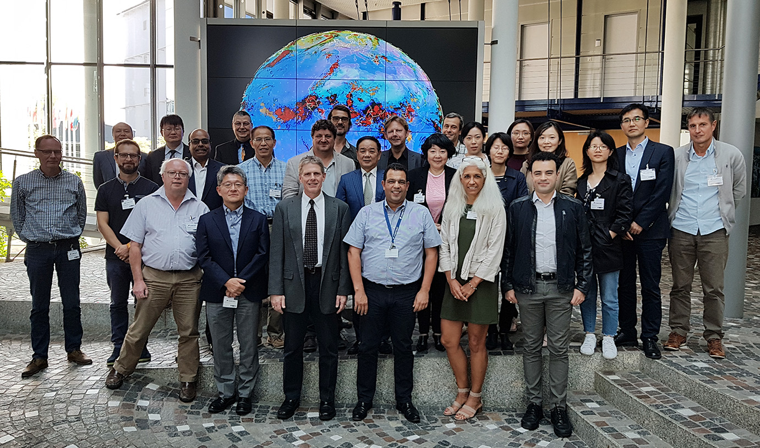
Timeline from WGCV-44
August 2018 WGCV plenary #44 in Darmstadt
October 2018 CEOS Plenary, Brussels, Belgium
April 2019 SIT-34, Miami, Florida, USA
Other activities
Inputs to monthly CEOS SEC meeting / telecon
March telecon with CEOS SIT
Joint WGISS/WGCV telecons

Slide 3
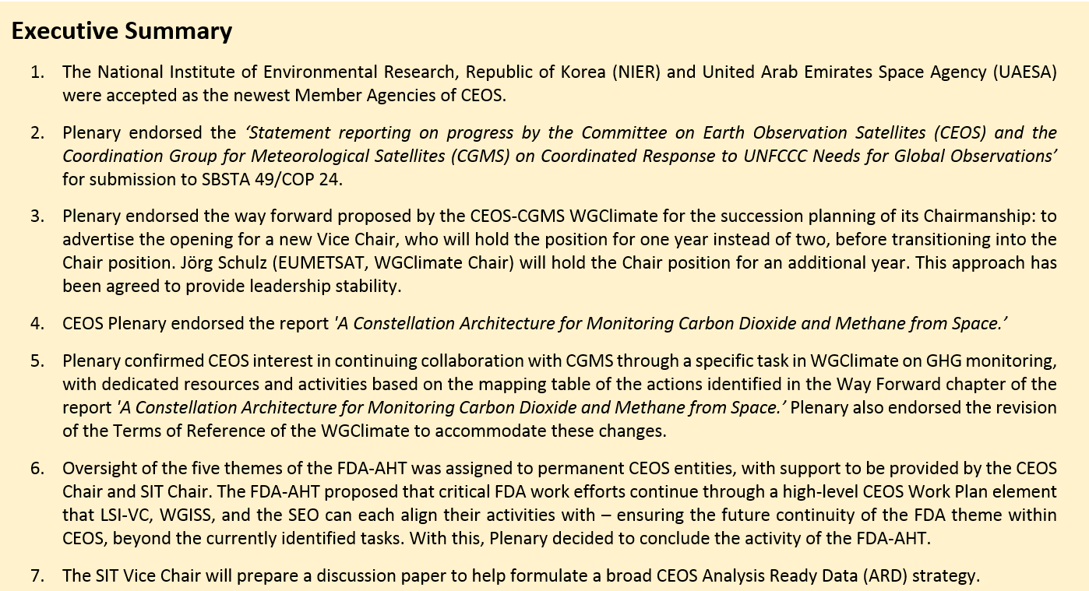
32nd CEOS Plenary, 16-18 October 2018, Brussels, Belgium

Slide 4
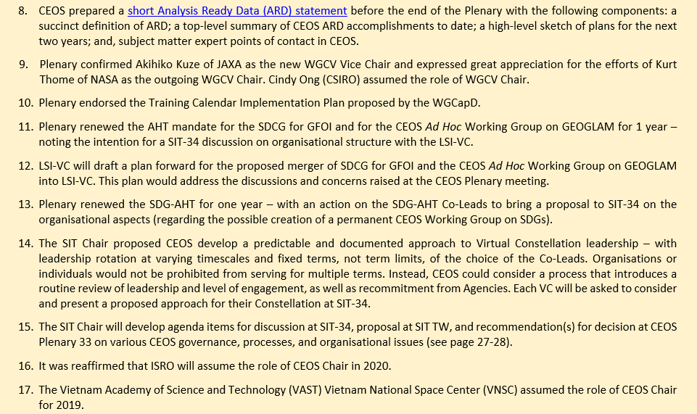

Slide 5
WGCV Report
Committee on Earth Observation Satellites
Kurt Thome (NASA)
Cindy Ong (CSIRO)
CEOS Plenary 2018
Agenda Item #6.1
Brussels, Belgium
17 – 18 October 2018

Slide 6
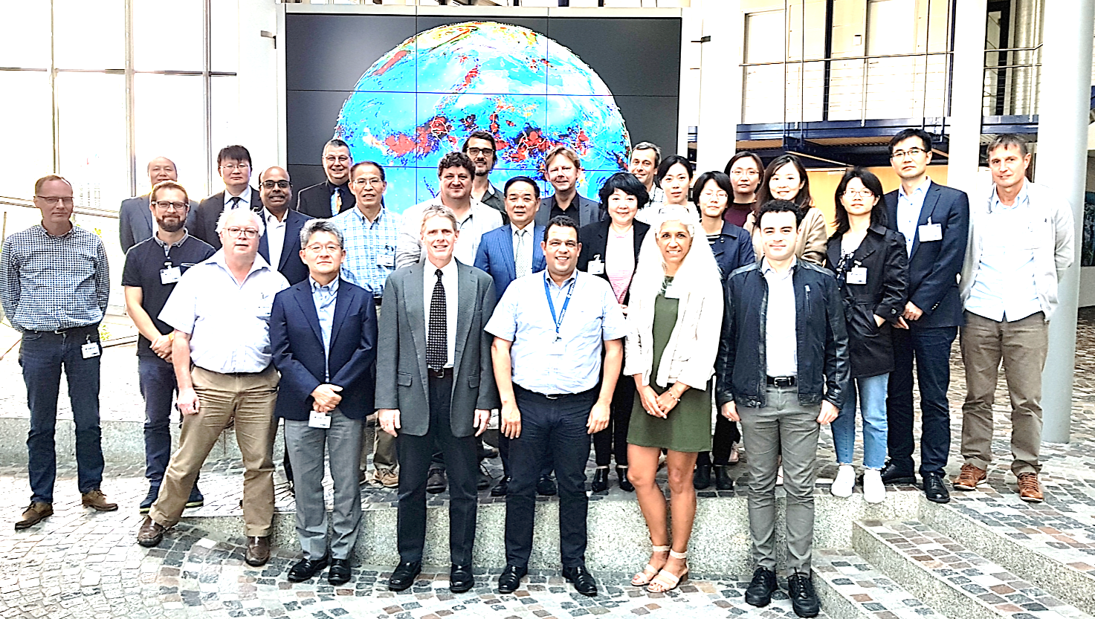
WGCV report
Key activities from 2018
  CEOS Work Plan Deliverables
  Highlighted with discussions related to ACIX, RADCALNET, Carbon, WGCV subgroups
  Interactions with other entities
Meetings / Workshops
Conclusion
WGCV-44 meeting hosted by EUMETSAT

Slide 7
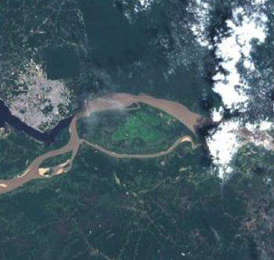
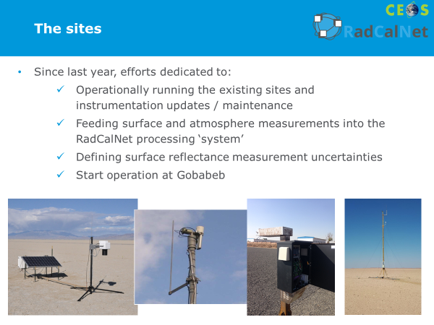
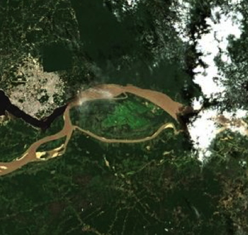
WGCV Achievements and Planned Outcomes
Recent major achievements
  ACIX (CV-13)
  RadCalNet (CV-9)
  Solar Irradiance Model (CV-16)
  LPV SuperSites (CV-12, CARB-19)
Improved reporting of achievements to ensure their utility to CEOS agencies
  CEOS WGCV website (completes CV-01)
  Other outreach methods
Near-term planned activities
  CARD4L assessment (CV-17)
  Joint WGISS activities
  GSICS Level 1 interoperability (CV-15)
  Carbon actions including GHGs (CV-18) and biomass (CV-19)

Slide 8
Conclusion
Work Plan progress is proceeding at a good pace
  All actions are proceeding
  Paths forward to completion are in place for all actions
WGCV interactions with other groups continues to provide challenges and progress
  Interactions with VCs and WGs are advancing WGCV activities
  Cross-cutting activities are creating new links between the subgroups
Attendance and participation by CEOS member agencies at the Working Group and Subgroup levels is strong

Slide 9
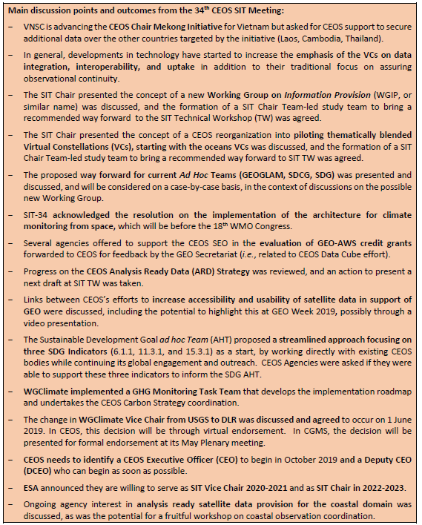
SIT-34, 2-4 April 2019, Miami, Florida, USA

Slide 10
SIT-34, 2-4 April 2019, Miami, Florida, USA

Slide 11

WG Calibration and Validation
WGCV Presentation to SIT-34
Committee on Earth Observation Satellites
Cindy Ong, CSIRO, Akihiko Kuze, JAXA
CEOS SIT-34
Session 5 and Agenda Item 5.3
Miami, FL, USA
3 – 4 April 2019

Slide 12
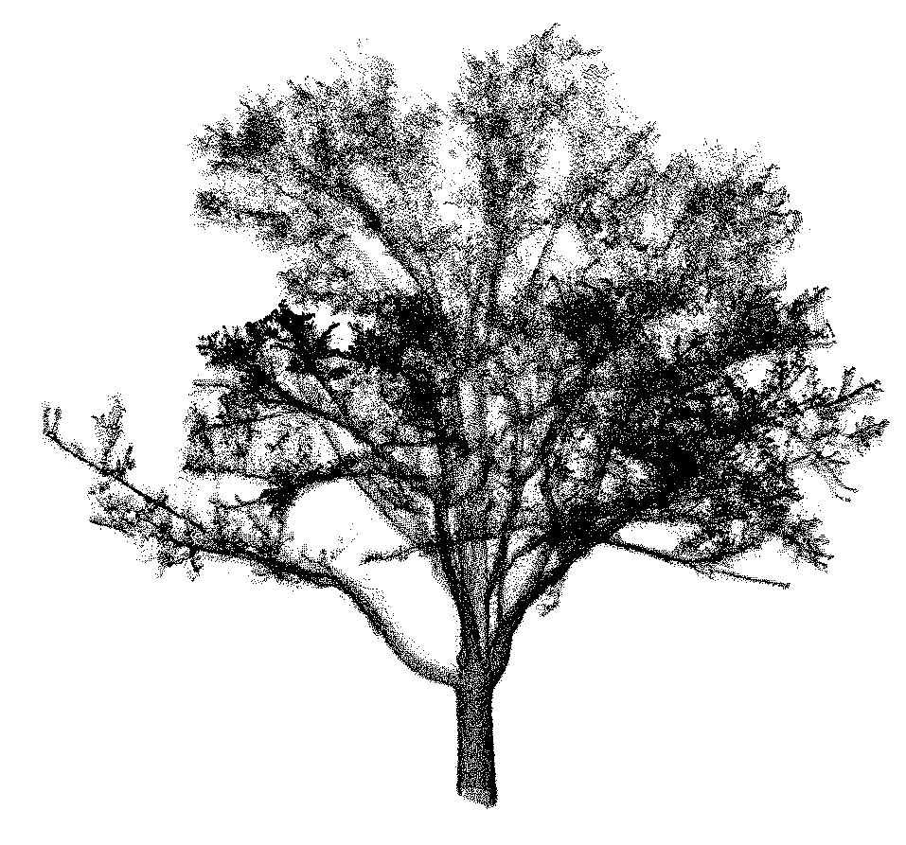
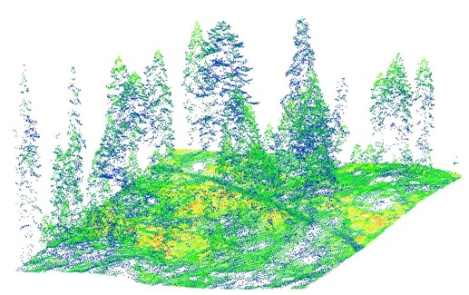
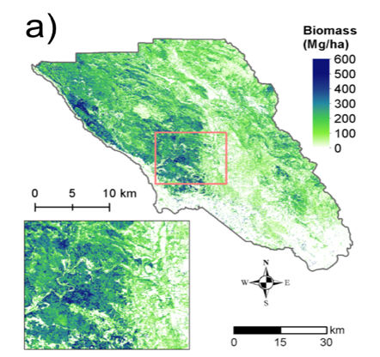
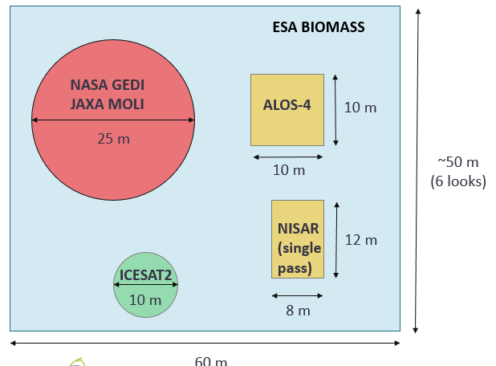
Biomass Validation Protocol
Achievement: Review paper on the Importance of Biomass Product Validation. Accepted in Surveys in Geophysics
Error Propagation
1. TLS and Field Data for plot biomass estimates
3. Generate local biomass maps at desired (spaceborne product) resolution
Calibrate Airborne lidar with
in situ data
4. Report accuracy over geographic domain of interest given available data
Expected outcome: A community-driven good practices guidebook for EO biomass product validation. External review expected in summer 2019
Chapters
Good practices for biomass estimation in the field
Linking remote sensing observations to field estimates
Error Propagation
Using existing in situ data for map validation
Independent Validation and Reporting
Utility of Protocol for Other Communities
Knowledge Gaps
CV19: contributing towards
CEOS Strategy for Carbon Observations from Space
CARB16: Cal/Val and production of biomass products from CEOS missions
CARB-23: Forest Biomass measurements for GFOI countries;
AGRI-13: Iteratively respond to GEOGLAM EO Data Coordination team’s definitions of “Applications Ready Data” (ARD+) and “Essential Agricultural Variables for GEOGLAM”

Slide 13

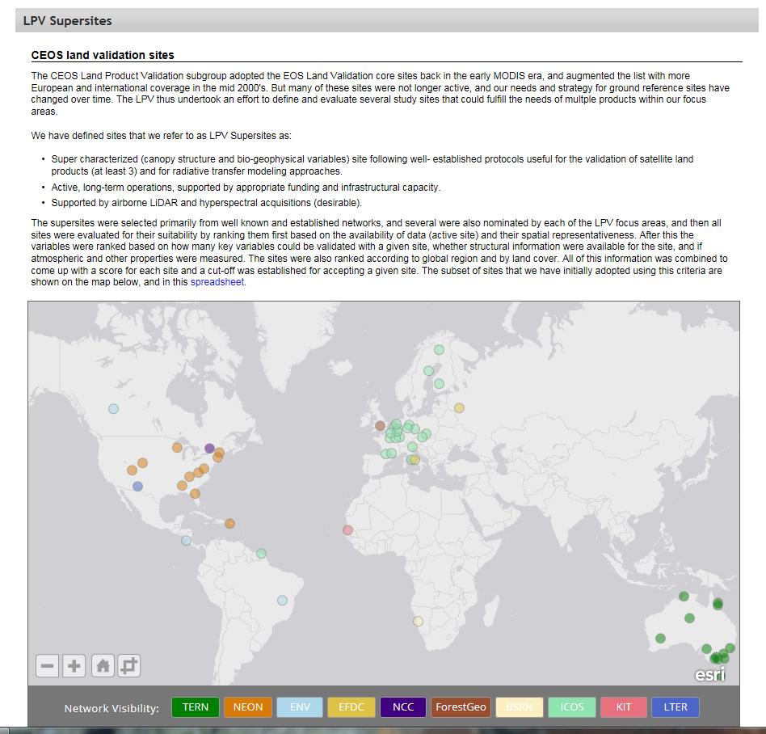
Surface Albedo Validation Protocol
Achievement: Global Surface Albedo Product Validation Best Practices Protocol completed, ready to be endorsed at the WGCV-45 in July in Perth, Australia; LPV Super Sites
Contributing to global products ECVs from a variety of satellite sensors per Action Items outlined in the 2010 GCOS Implementation Plan in Support of the UNFCCC (GCOS-138, 2010, aka IP-10) and the 2011 update [GCOS-154, 2011]
Notes:
International associates include intergovernmental groups like GCOS, GEO, UN systems
WGCV subgroups Terrain Mapping, IR Visible Optical Sensors, SAR, Microwave, Atmospheric Composition

Slide 14
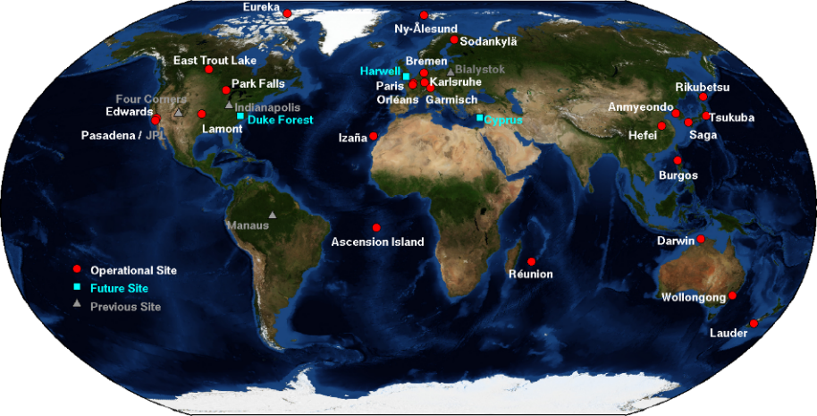

Greenhouse Gas Reference Standards
Expected Outcome: A list of reference standards for the validation of CO₂ and CH₄ (and CO, N₂O) products suitable for use in inter-comparison of multiple GHG missions
  Identify the current shortcomings/gaps/sustainability in GHG Cal/Val, and, formulate recommendations on the medium- to long-term way forward, that is, specific focus on GHG Fiducial Reference Measurement (FRM)
CV-18: Drivers/contributing to CEOS-32-05
CEOS AC-VC GHG Whitepaper “A Constellation Architecture For Monitoring Carbon Dioxide And Methane From Space”;
Past CEOS chair initiative on “an international coordinated Greenhouse Gases monitoring system”;

Slide 15
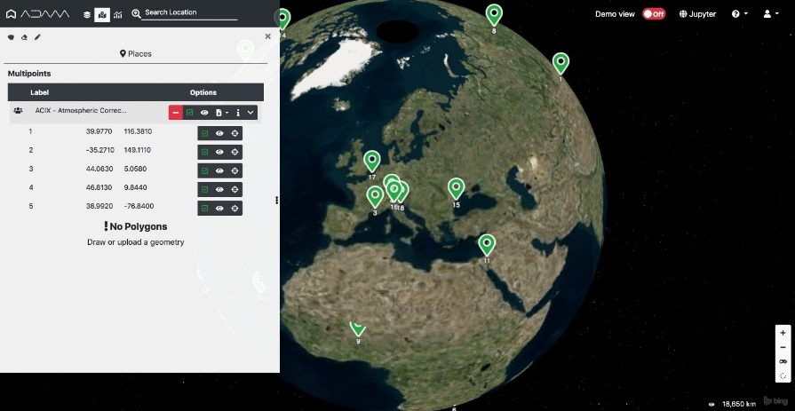
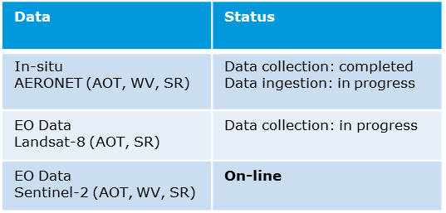
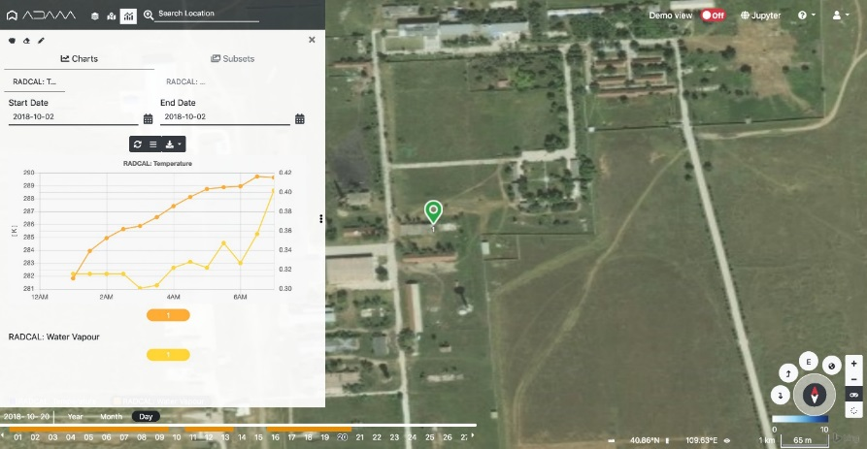
Joint WGISS/WGCV CEOS Data Cubes and CEOS Test Sites Data Access
In-situ / EO Data Discovery, Visualization and Pixel Access
  Atmospheric Correction Inter-Comparison Exercise (ACIX) (CV-14)
    ACIX II-land, 115 sites were selected based on AERONET stations’ location and measurements availability for one-year period starting from October 2017. A total of around 7000 image scenes acquired by Sentinel-2A, -2B and Landsat-8;
    ACIX-Aqua, the exercise is split into phases: Phase I, processors over coastal waters (20 AERONET-OC sites) and Phase II, processors over inland waters (15 sites with in-situ measurements)
  Radiometric Calibration Network
  (RadCalNet) (CV-09)
    108 users since portal
    opening
Pre-configured list of sites
Data Discovery
Direct access to the selected site
In-situ Data Visualization and pixel access;

Slide 16
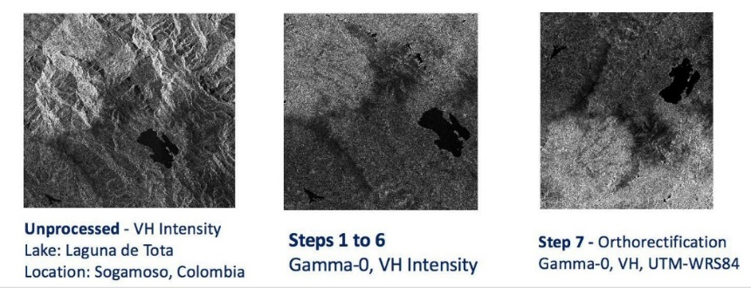
Analysis Ready Data
Support LSI-VC on the CARD4L Product Alignment Assessment Process through peer-review of products generated by data providers adopting these standards (VC-40);
Contributed paper “Role Of CEOS Working Group On Calibration And Validation In Analysis Ready Data Products”. IGARSS invited session organised by LSI-VC;
Support CARD4L SAR PFS Development and Product Assessment (VC-33).
  Support LSI-VC with the development of CARD4L SAR Product Family Specifications and support of the CARD4L Product Alignment Assessment Process through peer-review of products generated by data providers adopting these standards;
Future CV: SAR Radiometric Calibration and Geolocation Supersites.
  Update the calibration target and sites database and augment where needed;
  Produce a standards and requirements document for a multi-mission SAR image Cal/Val supersite including the characterization of targets and sites. This Cal/Val supersite may include a virtual array of active radar and passive calibration devices.
* SAR workshop at CONAE with 50 participants from JAXA, NASA/JPL, DLR, ESA, CSIRO, CCRS, INTA, KARI, GA, CONAE, University of Zurich , and companies Aresys, MDA, and SoloEO

