Slide 1
WGCV Work Plan
Committee on Earth Observation Satellites
Cindy Ong, CSIRO, Akihiko Kuze, JAXA
WGCV 45
Perth, Australia
16 July 2019

Slide 2
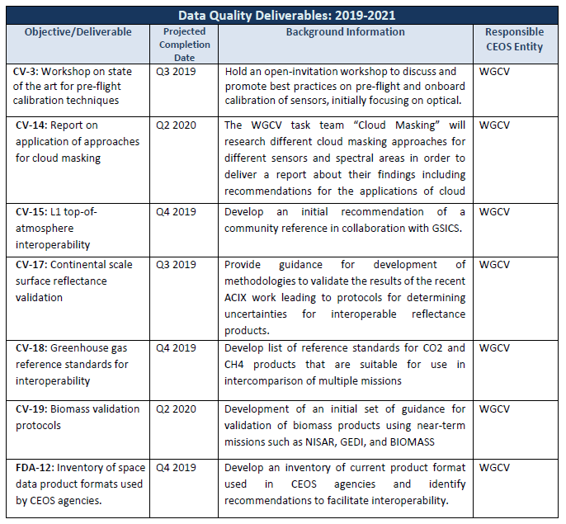
WGCV CEOS Work Plan

Slide 3
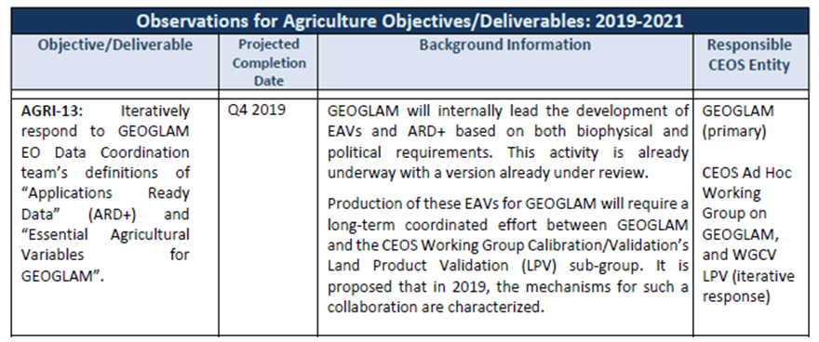
WGCV CEOS Work Plan

Slide 4
WGCV CEOS Work Plan

