Slide 1
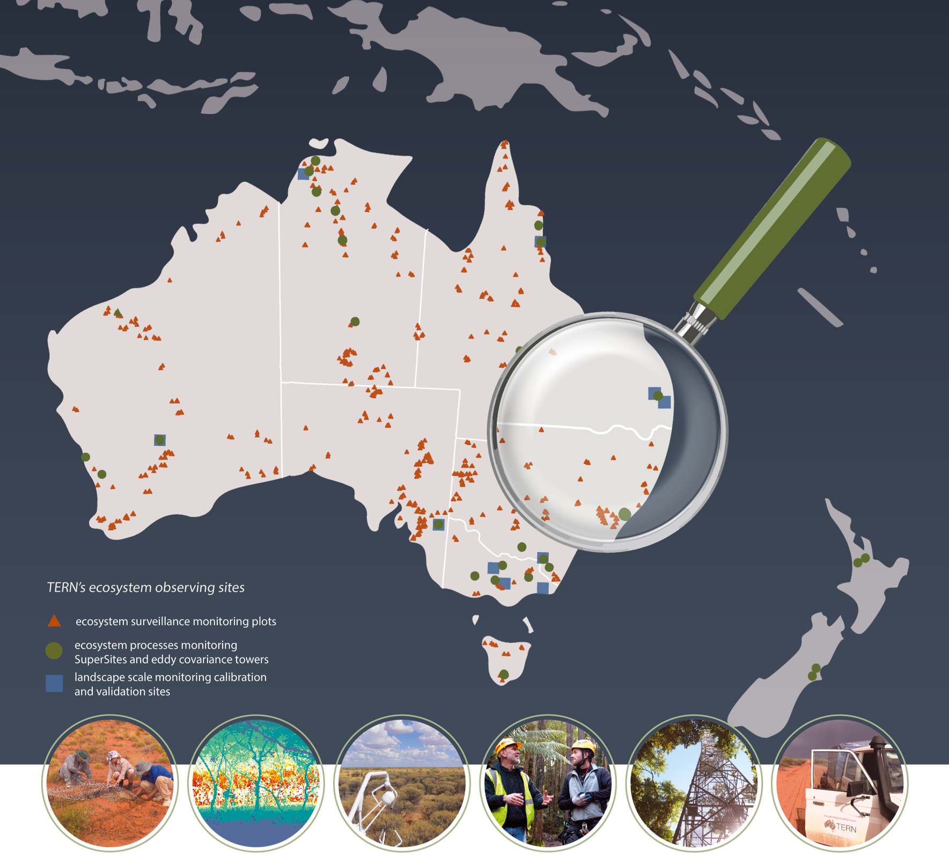

Australia’s
land ecosystem observatory
“SuperSites”
Mirko Karan
Notes:
TERN is Australia’s land ecosystem observatory.
We observe, record and measure critical terrestrial ecosystem parameters and conditions for Australia over time from continental scale to field sites at hundreds of representative locations. This information is standardised, integrated and transformed into model-ready data, enabling researchers to discern and interpret changes in land ecosystems.
Understanding ecosystem change, the rate of change, and underlying causes is essential for effectively protecting and managing Australia’s environment and the many services it provides.

Slide 2

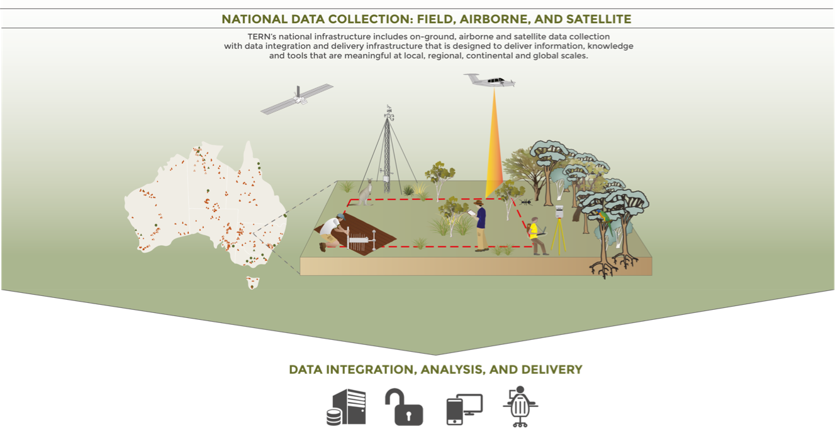
Notes:
TERN Delivers:
Data from TERN’s ecosystem field observatory, including plot data on soil and vegetation; gas, energy, and water exchange data; remote sensing data; and modelled data products about soil, climate, and landscape attributes;
Tools for the research community including nationally consistent field methods, vegetation and soil samples for physical analysis, data collection apps, and data publishing tools; and
Infrastructure that supports the discovery, access, and re-use of TERN data and other ecosystem data housed in our systems.
3 key themes of data collection

Slide 3
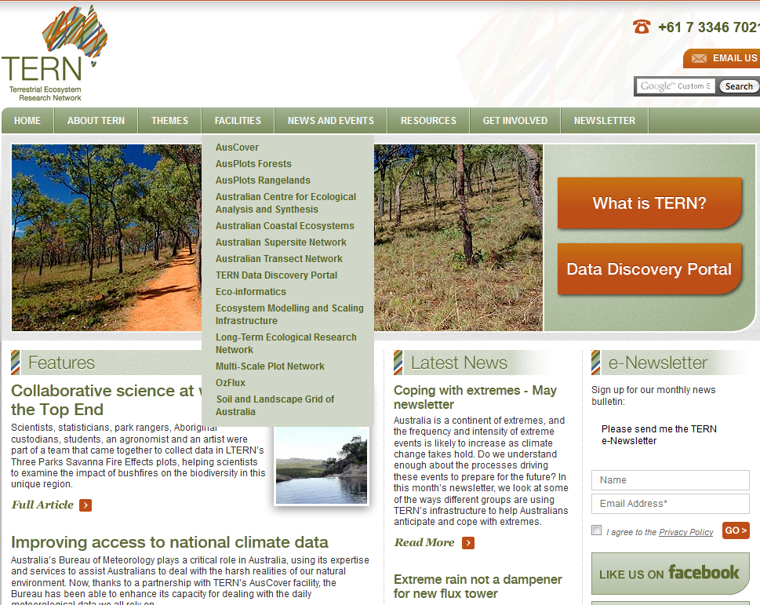
2009 NCRIS ~$10m/yr + Qld $4.1m
2011 EIF ~$10m
2013 - 15 Facilities
2019 – NCRIS $6m/yr + CAPEX
2019 – 3 Capabilities
Notes:
TERN was created in 2009 via a $20m funding program through the National Collaborative Research Infrastructure Strategy (NCRIS) and $4.1m from the Queensland State Government to set up 2 demonstrator SuperSites. An additional $25.63m was provided to TERN in 2011 under the Education Investment Fund (EIF) Super Science Initiative. Further funding and in-kind contributions have been received from numerous other partners.
In 2013 - There were 15 facilities within TERN. Some facilities will provide snapshot data or mapping data products, while others provide long term recurrent monitoring of biodiversity and/or biogeochemistry data products. The SuperSites network had expanded to 10 sites.

Slide 4
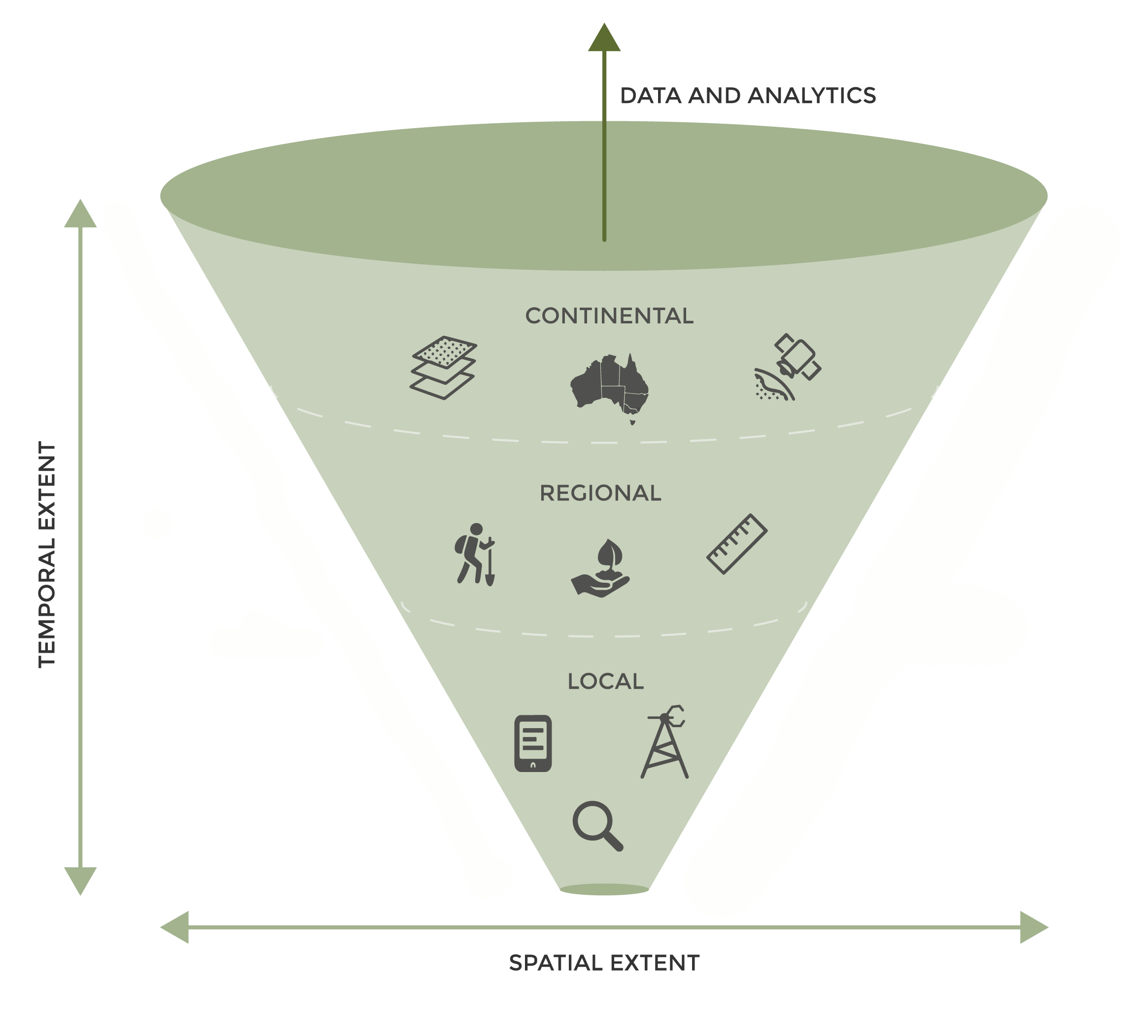
Landscape Monitoring
  Where and When is Change occurring?
Ecosystem Surveillance Monitoring
  What is changing?
  What direction is that change?
  What is the magnitude of this change?
Ecosystem Process Monitoring
  Why is change occurring?
  How do we mitigate unwanted change?
Notes:
TERN was established in 2009 as Australia’s first attempt at a national terrestrial ecosystem observatory.
It combines the ecosystem field observatory with its own data quality assurance, publication, and delivery platforms.
TERN was designed to monitor on three key environmental themes: Carbon and water, biodiversity, and landscapes and terrain
From the beginning, the TERN ecosystem observatory was structured around three key scales of observation:
targeted ecosystem process monitoring which gives a high level of detail at at a small number of sites. TERN has achieved this through our intensive field stations or ‘SuperSites’ which combine instrumented or sensor measurements – including Flux towers - with field measurement of biophysical and ecological parameters. TERN also negotiated with pre-existing LTER sites to publish data, enabling immediate access to long-term datastreams while we established our observatory;
ecosystem surveillance monitoring, which enables us to monitor and detect change in a wider spatial extent of environments. TERN uses a spatially extensive network of monitoring plots – over 500 – distributed through the country along environmental gradients and in key biomes; and
landscape monitoring mostly through remote sensing techniques based on satellite data, with increasing use of airborne data from UAVs. We also undertake modelling and synthesis activities to extrapolate and interpolate from observational data to produce modelled data products that are of use to the research community, such as fine scale gridded soil and terrain attributes, or fine scale meteorological data across the continent.
Combining these multi-scale activities enables us to use our very limited resources to get the best possible coverage of Australia’s environments, and collect meaningful observations about ecosystem process, function, and change.
Future (2017 onwards): focus more on achieving consistent and standard ecosystem measures across the continent, and in locating and aligning our sites to better achieve a representative cover of Australian ecosystems. Integrating across our scales of measurement, as well as with other data sources (NCRIS and PFRAs)

Slide 5


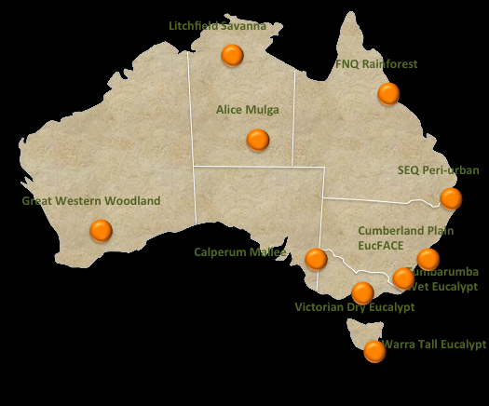
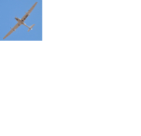
Notes:
The early aim was very ambitious, for SuperSites to become NEON-like in nature and cover a wide rage on environmental monitoring including bird surveys, invertebrates (ants), plant physiology, etc. using consistent methods, all around a core 1 ha vegetation plot within the footprint of an eddy covariance flux tower.
But the budget had a decreasing trend rather than increasing so the range of monitoring has reduced. Collection of field data was particularly difficult to do well at remote sites on inadequate budgets.

Slide 6

2018
Litchfield Savanna
Daintree Rainforest (Affiliate)
Robson Creek Rainforest
Alice Mulga
Mitchell Grass Rangeland
Samford Peri-Urban (Affiliate)
Gingin Banksia Woodland
Great Western Woodlands
Boyagin Wandoo Woodland
Calperum Mallee
Cumberland Plain
Tumbarumba Wet Eucalypt
Wombat Stringy Bark Eucalypt
Whroo Dry Eucalypt (Affiliate)
Warra Tall Eucalypt
TERN SuperSite
Affiliate TERN SuperSite
Notes:
In 2018 the SuperSite network had 12 fully funded SuperSites and 3 Affiliated SuperSites that have mostly been defunded, but are still actively collecting data.

Slide 7
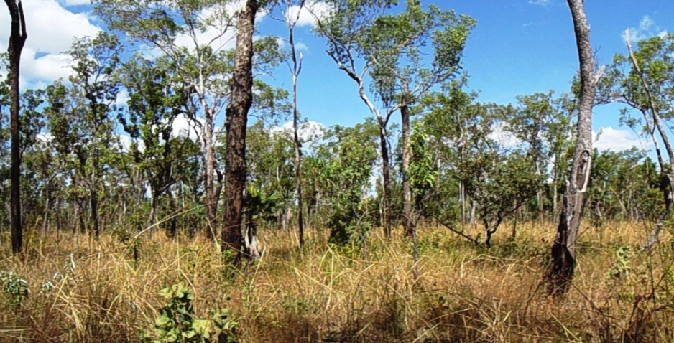
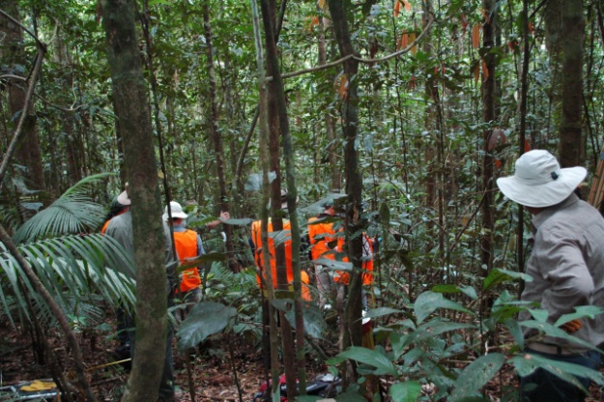
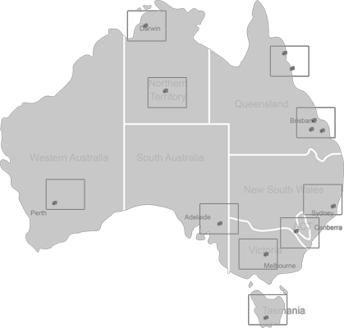
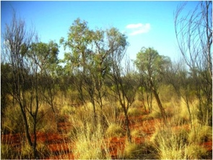
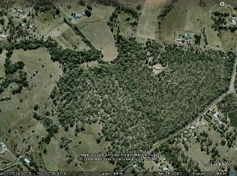
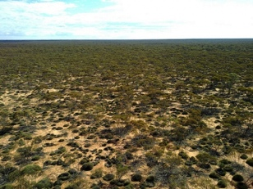
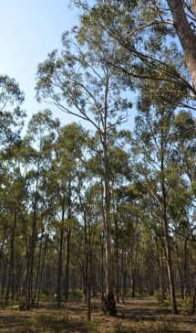
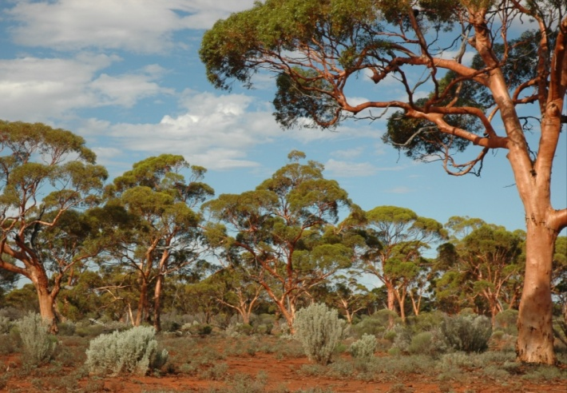
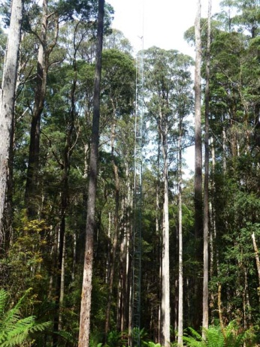
Notes:
ML Diverse biomes and vegetation types : rangelands, open and closed forests

Slide 8
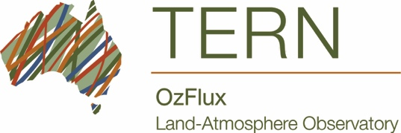
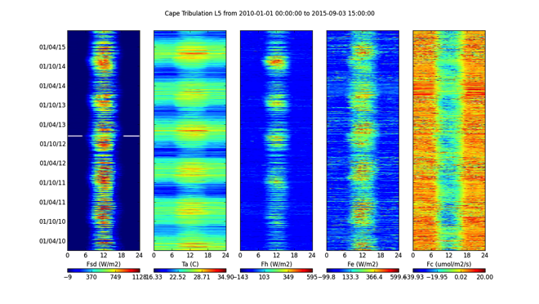
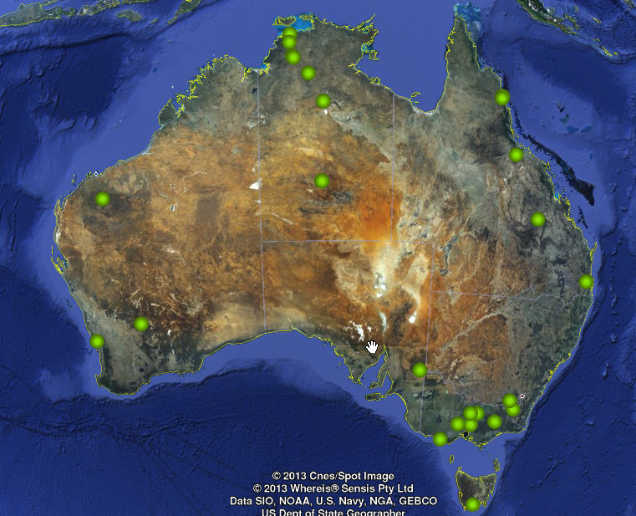
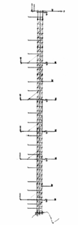
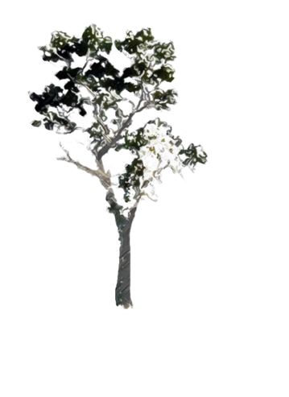
2018
ET
H
ET
Q
Q
NEE
G
Notes:
In 2018 the decision was made to merged TERN SuperSites with TERN OzFlux to form the Ecosystem Processes Capability. TERN OzFlux ran eddy covariance towers across the SuperSites and a number of other Sites around Australia. They produced standardised datasets on carbon turnover shared internationally with the FLUXNET database.

Slide 9
Ecosystems Processes July 2019
AU-HOW
Litchfield Savanna
AU-DAS
AU-DRY
AU-CTR, AU-COW
AU-STP
Daintree Rainforest (Affiliate)
Robson Rainforest
Alice Mulga
AU-TTE
Mitchell Grass Rangeland
AU-SAM
Samford Peri-Urban (Affiliate)
Great Western Woodlands
Gingin Banksia Woodland
Boyagin Wandoo Woodland
AU-RGF
Calperum Mallee
Cumberland Plain
AU-YNC
AU-WHR, AU-RIG
Tumbarumba Wet Eucalypt
Wombat Stringy Bark Eucalypt
Whroo Dry Eucalypt (Affiliate)
Warra Tall Eucalypt
Core TERN funded OzFlux site
Partial TERN funded OzFlux site
Notes:
TERN Ecosystem Processes began on Jul 1 2019 with sites located in significant Australian biomes, spanning a wide range of environmental conditions.

Slide 10
Litchfield Savanna
Daintree Rainforest (Affiliate)
Robson Creek Rainforest
Alice Mulga
Mitchell Grass Rangeland
Samford Peri-Urban (Affiliate)
Gingin Banksia Woodland
Great Western Woodlands
Boyagin Wandoo Woodland
Calperum Mallee
Cumberland Plain
Wombat Stringy Bark Eucalypt
Tumbarumba Wet Eucalypt
Whroo Dry Eucalypt (Affiliate)
Warra Tall Eucalypt
Notes:
The network is administered from JCU Cairns with each site run by a different institution with significant co-contributuions.

Slide 11
🌩
Litchfield Savanna
Daintree Rainforest (Affiliate)
Robson Creek Rainforest
Alice Mulga
Mitchell Grass Rangeland
Samford Peri-Urban (Affiliate)
Great Western Woodlands
🔥2013
Gingin Banksia Woodland
Boyagin Wandoo Woodland
Calperum Mallee
🌿
Cumberland Plain
Tumbarumba Wet Eucalypt
Wombat Stringy Bark Eucalypt
Whroo Dry Eucalypt (Affiliate)
🔥2019
🌿
Warra Tall Eucalypt

Slide 12
Ecosystems Processes
All sites host eddy covariance flux towers
  OzFlux
12 sites “SuperSites” combine flux data with classical field surveys and remote sensing activities centred on a core 1 ha vegetation plot
  Vegetation biomass (5 yearly), cover, phenology
  Biodiversity (acoustic soundscape monitoring)
  Physical infrastructure for research and education
  Historical research data
Assess drivers of change in ecosystems

Slide 13
COSMOS (Cosmic-ray Soil Moisture Observing System)
Litchfield Savanna
Daintree Rainforest (Affiliate)
COSMOS
Robson Creek Rainforest
COSMOS
Alice Mulga
COSMOS
Mitchell Grass Rangeland
COSMOS
Samford Peri-Urban (Affiliate)
COSMOS
Gingin Banksia Woodland
Great Western Woodlands
Boyagin Wandoo Woodland
Calperum Mallee
COSMOS
Cumberland Plain
Tumbarumba Wet Eucalypt
Wombat Stringy Bark Eucalypt
Whroo Dry Eucalypt (Affiliate)
COSMOS
Warra Tall Eucalypt

Slide 14
Airborne LiDAR campaigns
2013
Litchfield Savanna
2012
Daintree Rainforest (Affiliate)
Robson Creek Rainforest
Alice Mulga
Mitchell Grass Rangeland
“Credo”
2012
2013
Samford Peri-Urban (Affiliate)
“Chowilla”
Gingin Banksia Woodland
Great Western Woodlands
2012
UAV
Boyagin Wandoo Woodland
Calperum Mallee
2011
Cumberland Plain
Tumbarumba Wet Eucalypt
Wombat Stringy Bark Eucalypt
Whroo Dry Eucalypt (Affiliate)
2014
Warra Tall Eucalypt

Slide 15
Ecophysiology campaigns (ANU)
Leaf Traits
M_{a}
R_{dark}
V_{cmax}
△¹³C
WUE_{i}
Litchfield Savanna
🌿
🌿
Daintree Rainforest (Affiliate)
Robson Creek Rainforest
Alice Mulga
Mitchell Grass Rangeland
🌿
Samford Peri-Urban (Affiliate)
🌿
🌿
Gingin Banksia Woodland
Great Western Woodlands
Boyagin Wandoo Woodland
Calperum Mallee
Cumberland Plain
Tumbarumba Wet Eucalypt
Wombat Stringy Bark Eucalypt
Whroo Dry Eucalypt (Affiliate)
🌿
Warra Tall Eucalypt

Slide 16
Accessing site details and data
TERN Data Portal – redevelopment
SuperSites website
Site details
PI contacts
Ancillary data
  OzFlux
  Remote sensing
  AusPlots
  Historical data
Field data
BioImages Portal
  LAI images
  Phenocam images
  Photopoints
Acoustic Data Portal
  Recordings
  (Acoustic indices – TERN DB)
Institute Data Bases

Slide 17
Eddy covariance – OzFlux - FLUXNET
COSMOS (Cosmic-ray Soil Moisture Observing System)
LAI
Biomass (5 yearly)
Phenology – new infrastructure 2019
DroughtNet
Nutrient Network
ILTER TeaComposition
Global Woodblock Decomposition
Biomes of Australian Soils (soil microbial metagebomics)

Slide 18
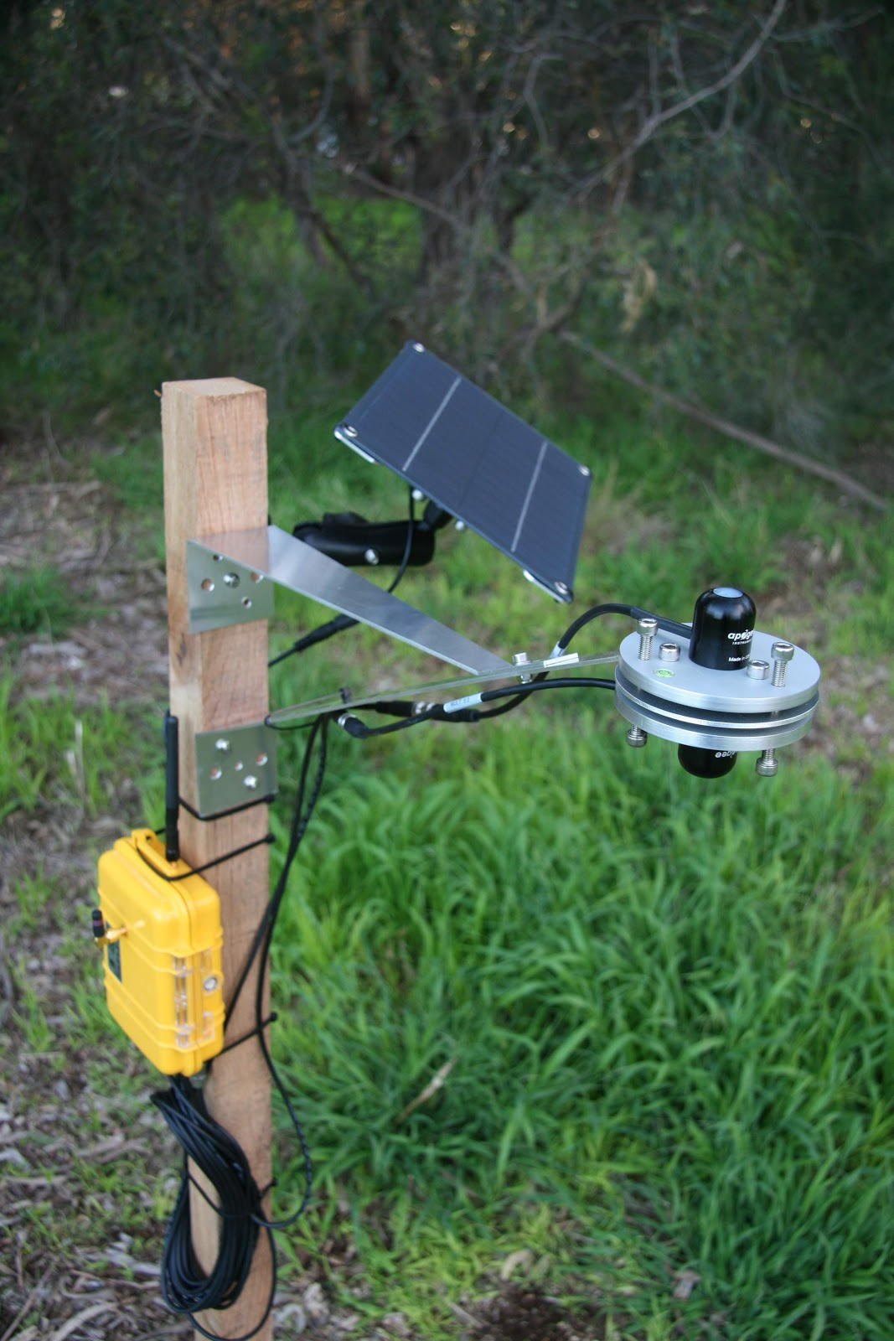
Tumbarumba
Copernicus’ Ground-Based Observations for Validation (GBOV) using Tumarumba to generate validation products
Surface Reflectance, Surface Albedo and Soil Moisture
LAI, FAPAR (Fraction of Absorbed Photosynthetically Active Radiation), FCOVER (Fraction of COVERed land);
LST (Land Surface Temperature).
PAR sensors
LAI – DHP
LAI2200
LAI – DCP
Laser Enabled Assessment of Forest (LEAF) Mk1 Automated TLS

Slide 19
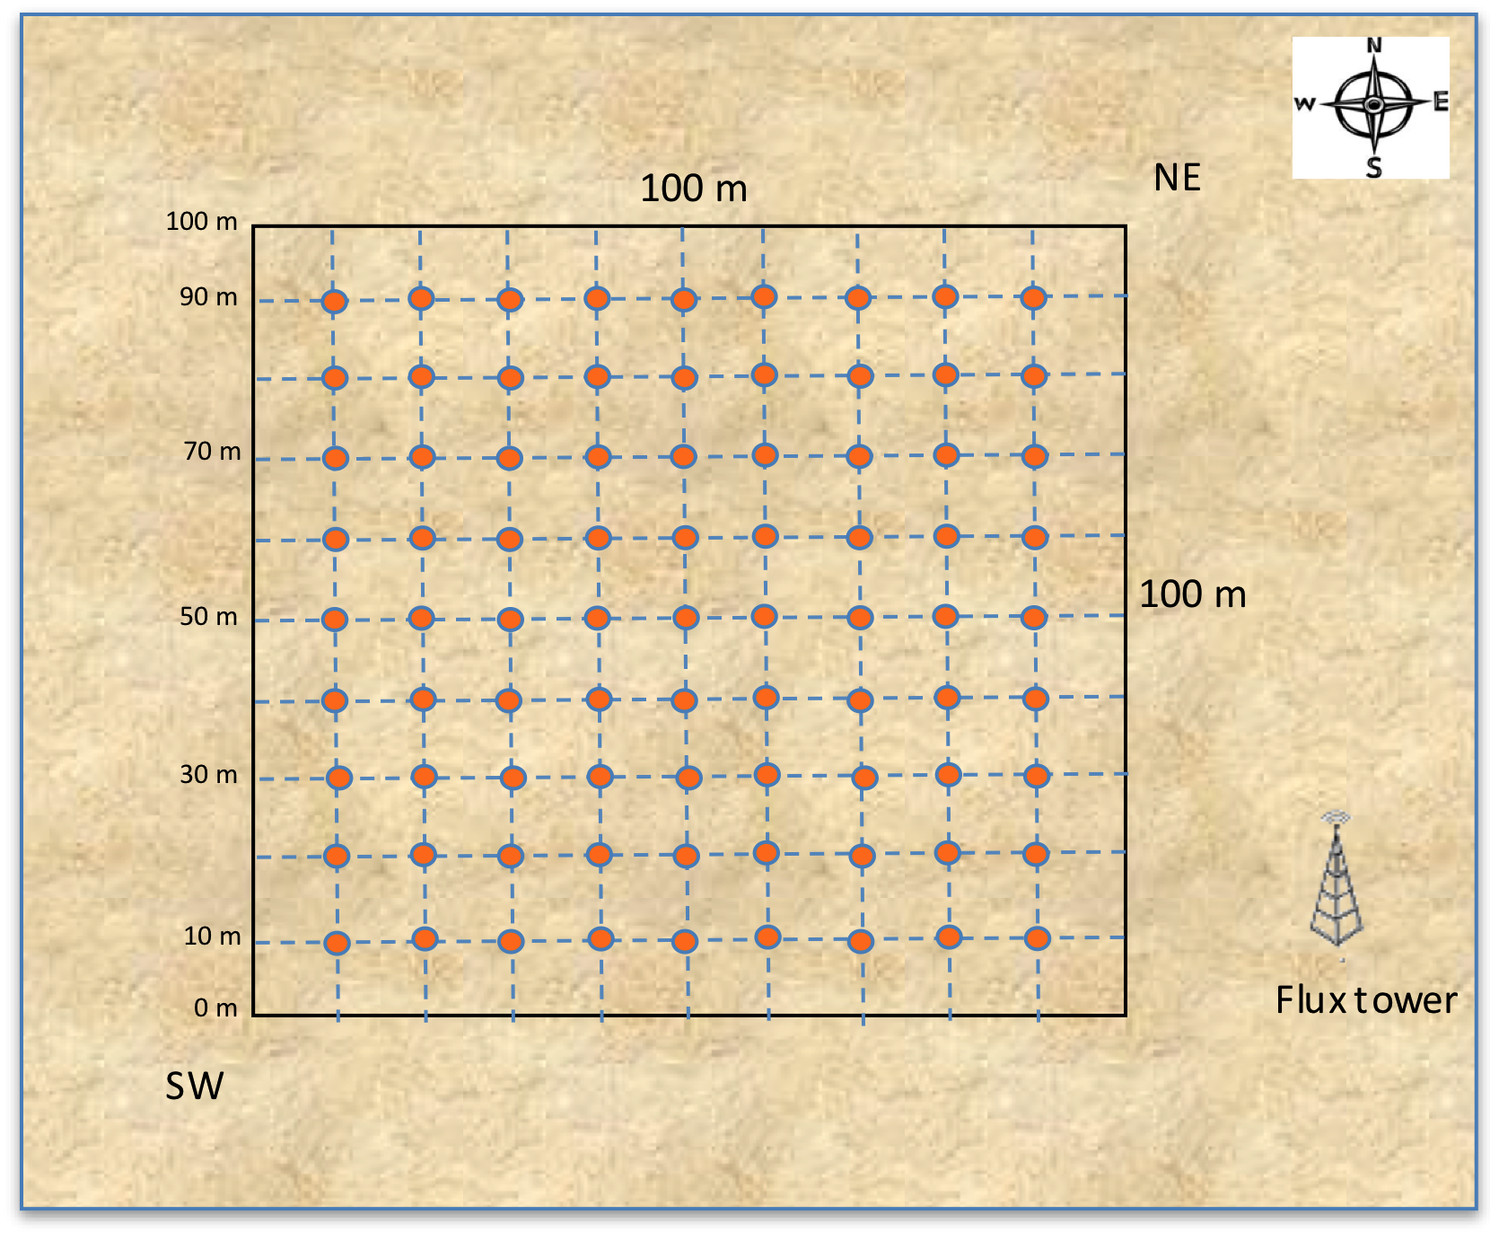
Leaf Area Index at SuperSites (under review)
Digital Hemispheric Photography
Digital Canopy Photography
Point Intercept 3 x 100m
LAI 2200 - AusPlots

Slide 20
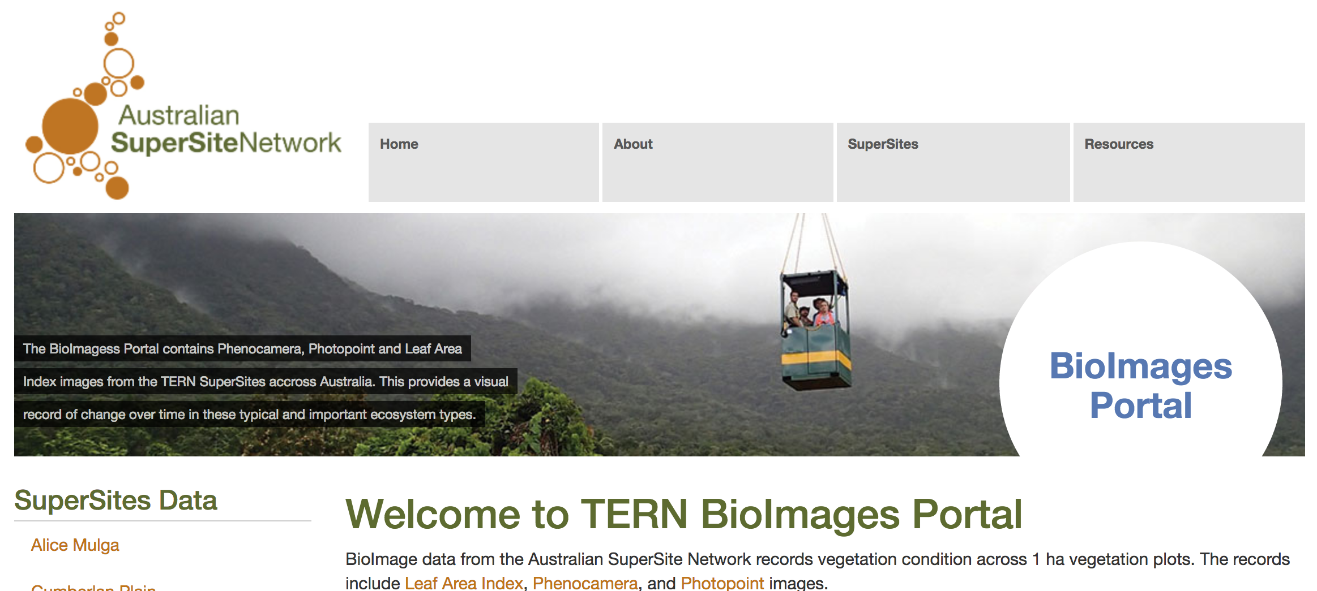
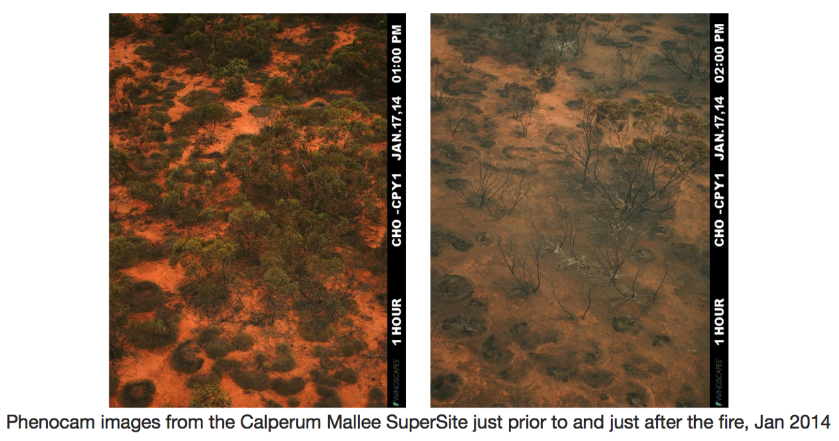
Notes:
Image data collected from each SuperSite is made available from the SuperSite BioImage data portal. Data includes Phenocam images, photopoints and Leaf Area Index images.

Slide 21
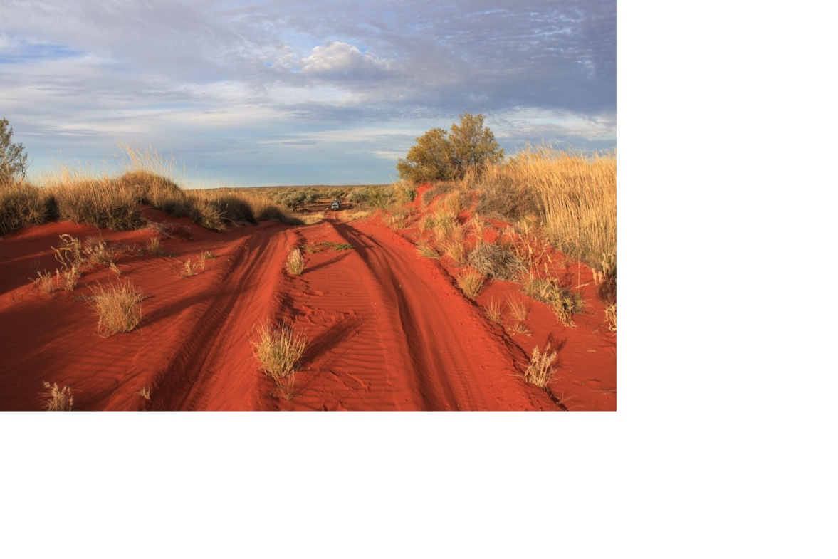

www.tern.org.au

Slide 22
Cal/Val
FullCAM model- DoEE
ECOsystem Spaceborne Thermal Radiometer Experiment on Space Station (ECOSTRESS)
SMAP

