Slide 1
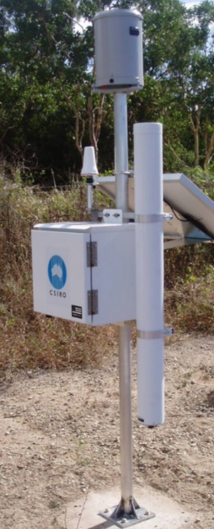
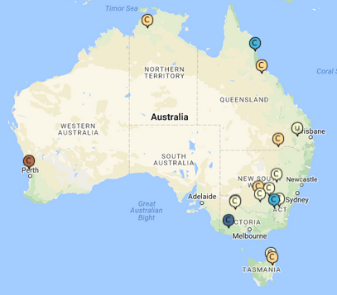
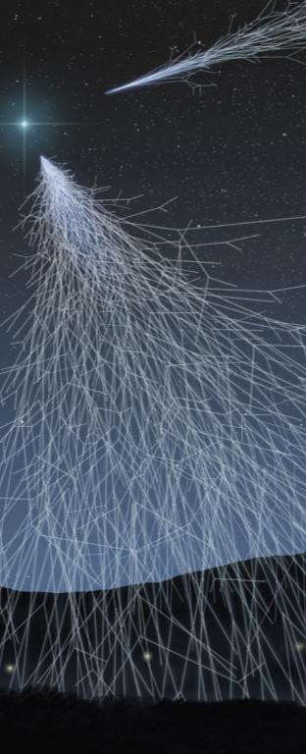
CosmOz: The Australian cosmic-ray soil moisture monitoring network
Cal/Val opportunities
CSIRO
Prepared by David McJannet, presented by Cindy Ong

Slide 2
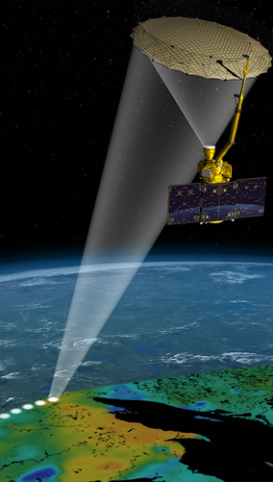
Introduction
What are cosmic-rays and where do they come from
The cosmic-ray soil moisture sensor?
  How does it work? What does it measure?
Why is a cosmic-ray soil moisture sensor good for cal/val
Introduction to the CosmOz network
  Current network & Future plans
Global cosmic-ray soil moisture sensing community
Mobile sensing for pixel scale cal/val
Notes:
Typical intro slide with the points to be covered in the talk

Slide 3
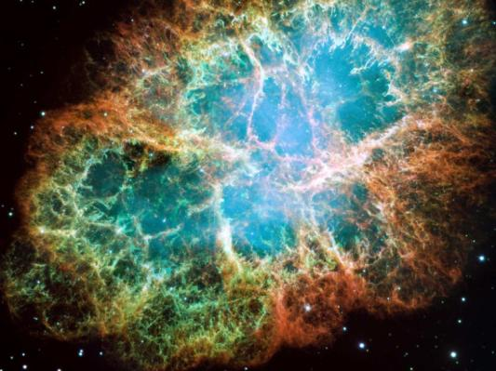

What are cosmic rays?
Cosmic rays are pieces of atoms that are accelerated and energised by the blast waves from exploding stars (super nova)
Cosmic rays penetrate the atmosphere and collisions with nuclei produce a cascade of secondary cosmic rays
Each collision in the atmosphere and at the soil surface reduces the energy of cosmic ray neutrons
Hydrogen (mainly as water in air and soil) causes the greatest reduction in cosmic ray energy
http://hubblesite.org
Key point for soil moisture measurement!
http://www.marsdaily.com
Notes:
Just trying to simplify what is quite a complex process.
We are continuously bombarded with these cosmic-rays which originate from exploding stars – they are everywhere
Water reduces there energy

Slide 4
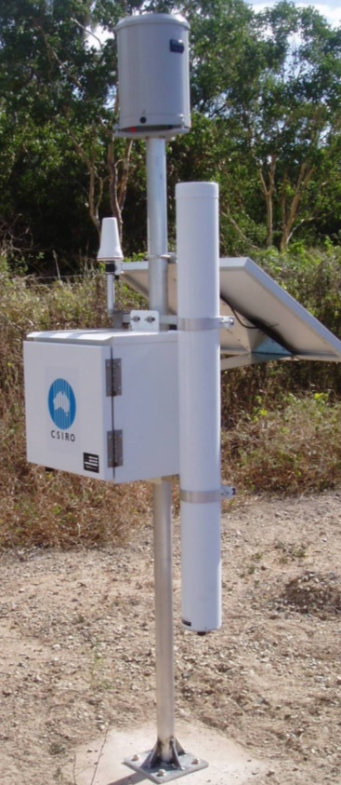
The cosmic-ray soil moisture sensor
Rain
gauge
The cosmic-ray sensor counts ‘fast’ neutrons above the soil surface
The variation in hydrogen in the soil moisture pool has the greatest impact on fast neutron counts
More soil moisture = Less fast neutrons
Satellite link
Solar
panel
Data logger and sensors
Neutron tube
Notes:
This is our typical installation – solar powered with remote telemetry
~$25k each – but cheaper if you add to existing stations

Slide 5
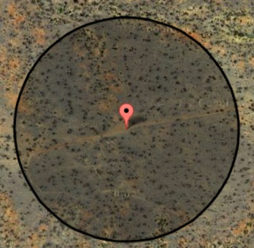
Cosmic-ray sensors for cal/val
400m (12.5ha)
Key benefit of cosmic-ray sensors for soil moisture cal/val is the measurement footprint - 12.5ha!
  Typical soil moisture sensor 10’s cm²
  Scale is greater than small scale variability that confounds point measurements
Large footprint from the large source area of cosmic-rays which can contribute to a sensor
Sensors are passive, robust, reliable
Depth of measurement 10-30cm BUT weighted to surface layers
20+
Football
fields
Notes:
Large footprint results from the statistics around the ‘random walk’ that cosmic rays can travel over after interacting with near surface hydrogen

Slide 6
CosmOz network
Currently 15 sensors installed across Australia
Calibrated to local conditions
Range of land uses - grazing, rain forest, temperate forest, crops, pasture
Range of climates – Tasmania to Darwin (temperate to tropical)
Hourly data from as far back as 2011
Open data access (cosmoz.csiro.au)
Plans for 10+ more sites in next 2 years
Notes:
Calibration involves at least one field sampling campaign where 72 spatially distributed samples are collected
Calibration just pulls a universal calibration curve to he correct location for a given site
New sites will be funded under TERN – terrestrial Ecosystems Research Network

Slide 7
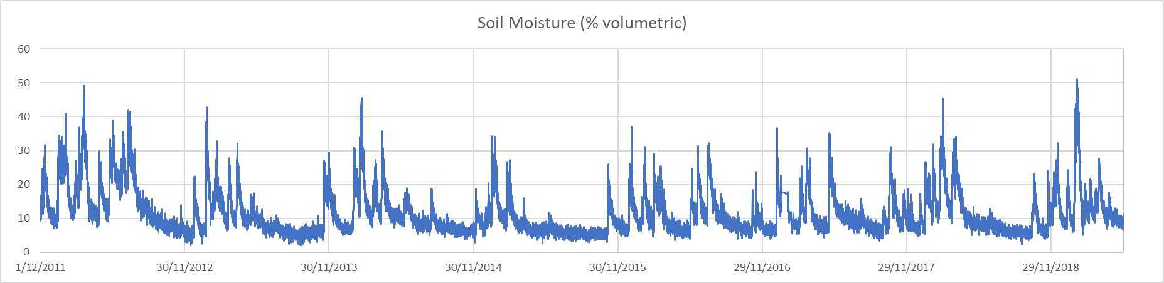
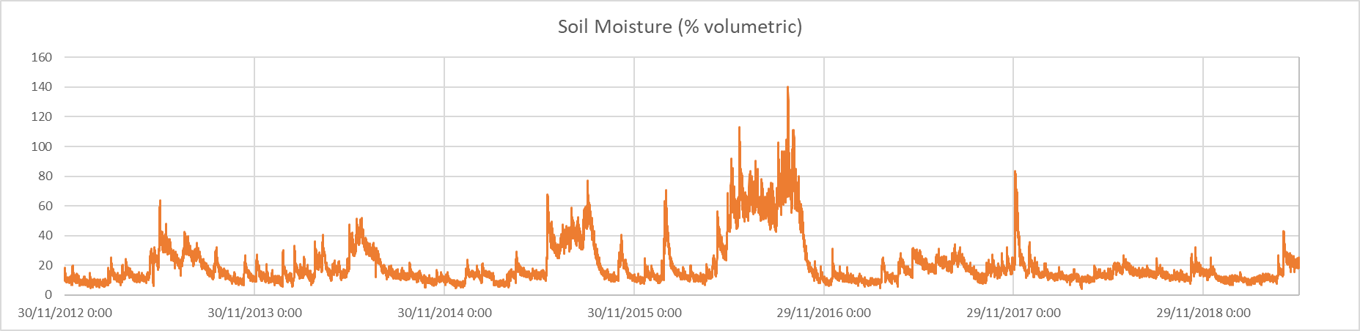
CosmOz network: data example
Savanah site north Queensland
Grazing site New South Wales
Flood
Notes:
Just a couple of demo sites to show how season effects are picked up over multiple years
Big peak on lower graph is a flood

Slide 8
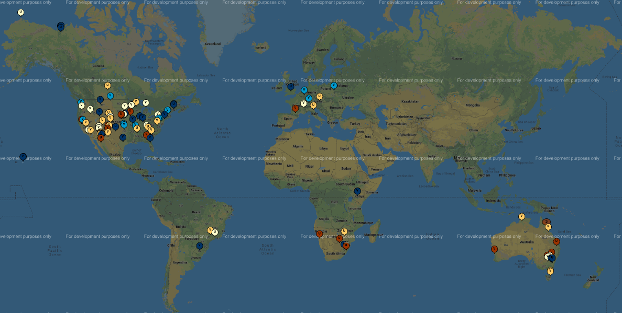
Global cosmic-ray soil moisture community
CosmOz part of a larger collaborative global network
  Networks in USA (planning for 600 sensors), UK, Europe, South Africa, China
  Aiming for consistency in processing and delivery
Notes:
Point of this slide is that Australia is not the only source of this data and that international standards are being applied

Slide 9
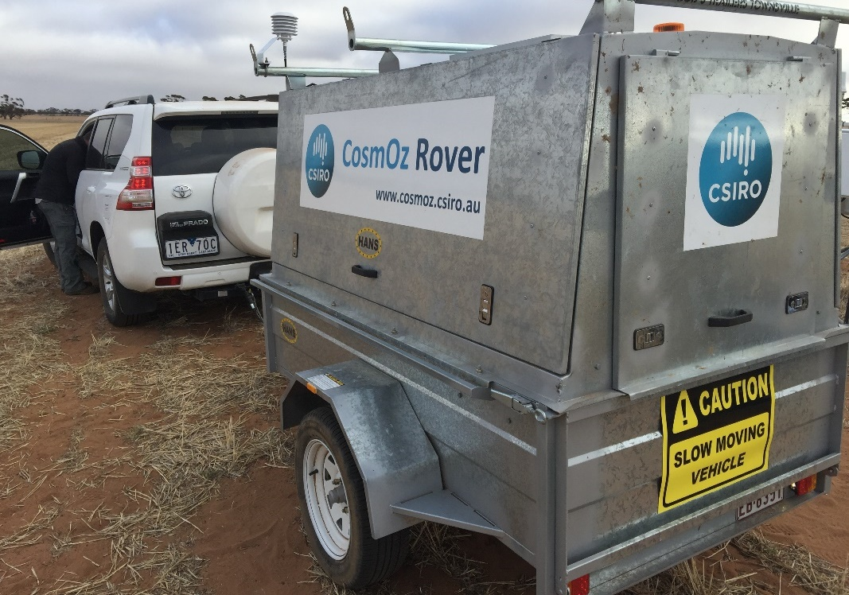
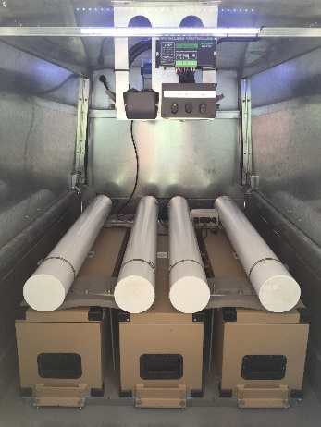
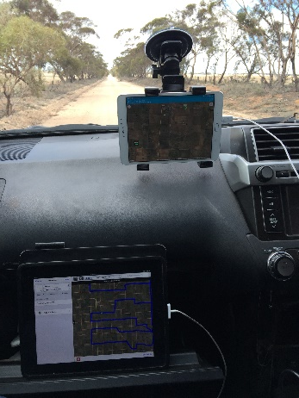
Mobile soil moisture monitoring: Rover
Trailer mounted cosmic-ray soil moisture monitoring
Equivalent of 18 standard sensors
GPS tracking and real-time monitoring in car
Measure at 1 min intervals
Speed controls local accuracy
Notes:
Mobile rover offers opportunity for detailed pixel scale analysis – good for upscaling and downscaling approaches

Slide 10
Survey Method Example: Birchip cropping area
Broad scale (SMAP pixel)
  ~500km, max travel speed 80 km/h, 10 hour survey, 9km resolution
Soil and landscape grid of Australia (90m res) provides elevation, clay content, bulk density and organic carbon values requires to convert neutron counts to soil moisture
Notes:
Some examples of a 40x40km SMAP pixel survey from Victoria
Left figure is track driven through pixel extent
Right figure is spatial distribution of values from the soil and landscape grid of Australia which has a resolution of 90m

Slide 11
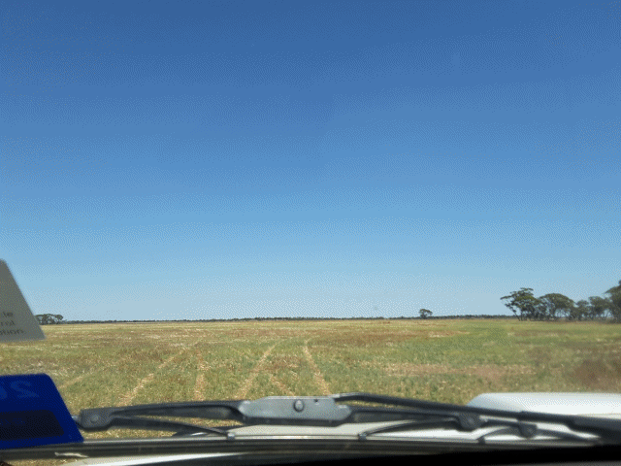
Survey results
Dash cam survey imagery provides good double check on land use and road type change
Notes:
Figure on left – spatial distribution of neutron counts is in left panels and spatial distribution in soil moisture is shown in the right panels
Figure on right shows dash cam footage from survey which is used to double check landuse and road type

Slide 12
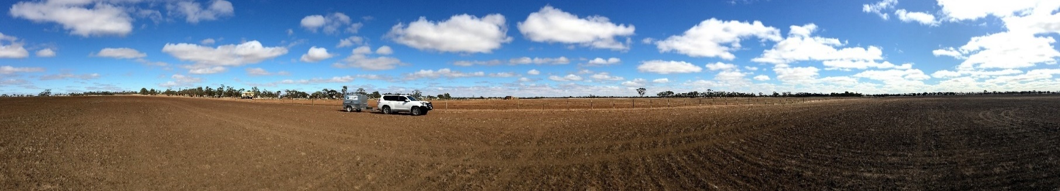
Summary
Spatial footprint of cosmic-ray soil moisture sensors makes data ideal for satellite cal/val
CosmOz established 2011
Open source data model
15 sensors currently with 10 new sensors in planning
Global community is growing and interactive
Mobile monitoring offers pixel and sub-pixel scale cal/val opportunities
Notes:
Just summarising key points relevant to audience

Slide 13
CSIRO Land and Water
  David McJannet
    t +61 7 38335584
    e david.mcjannet@csiro.au
Land and Water

