Slide 1
AEROSPAN
Australia’s contribution to AERONET
Dr Ian C Lau| Senior Experimental Scientist – Mineral Resources
16th July 2019
CSIRO Centre for earth observation

Slide 2
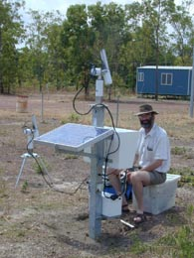
AEROSPAN (Aerosol characterisation via Sun Photometry: Australian Network)
Formerly Aerosol Ground Station Network (AGSNet), setup by Ross Mitchell and Susan Campbell.
Australia’s contribution to AERONET
First site: Tinga Tingana in April 1998
Recent site: Tumbarumba July 2019

Slide 3
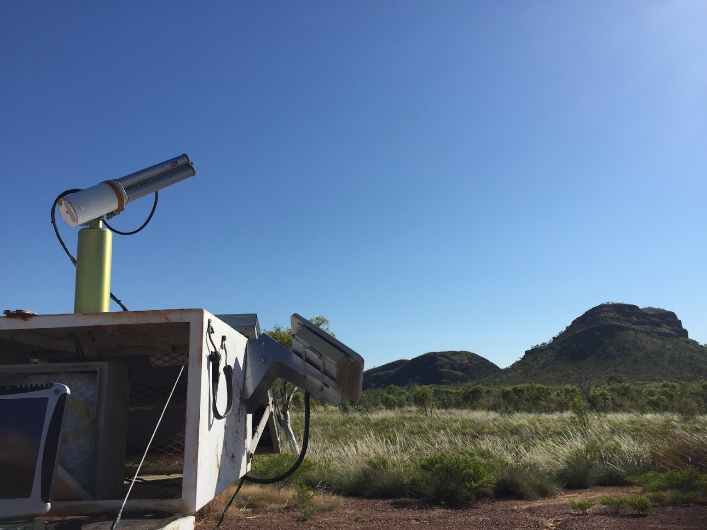
Current sites: 7+1+1
Jabiru, NT (2000- 14.2 years)
Lake Argyle, WA (2002- 13.99 years)
Birdsville, QLD (2005-)
Lucinda, QLD (2009-2010, 2013-)
Fowlers Gap, NSW (2013-
Lake Lefroy, WA (2012-
Learmonth, WA (2017-
Tumbarumba, NSW (2019-
Past sites:
Tinga Tingana (1998-2012)
Canberra, ACT (2003-2017)
Future sites:
Pinnacles, WA (12 band BRDF instrument, may not be on/suitable for AERONET)

Slide 4
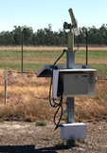
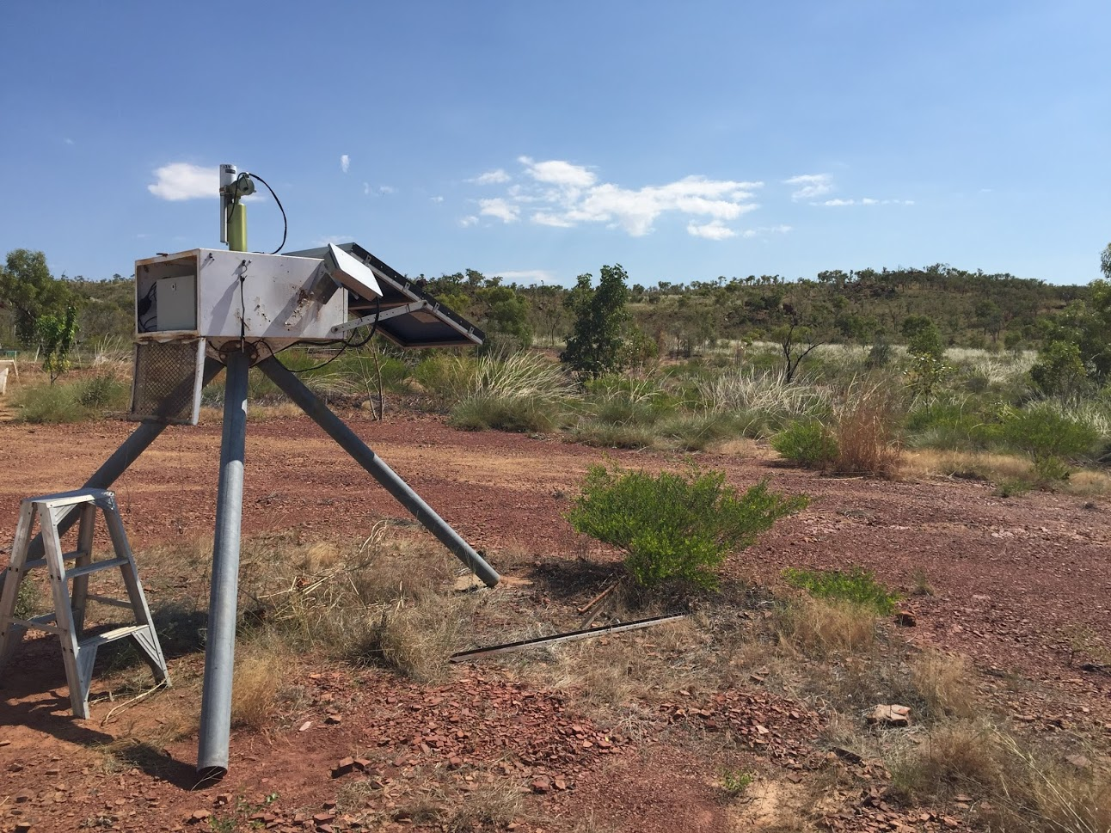
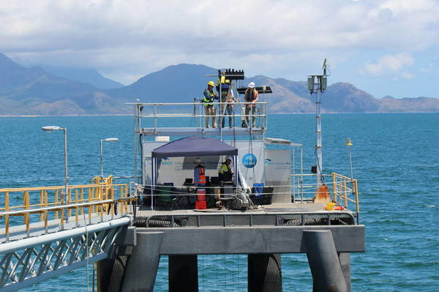
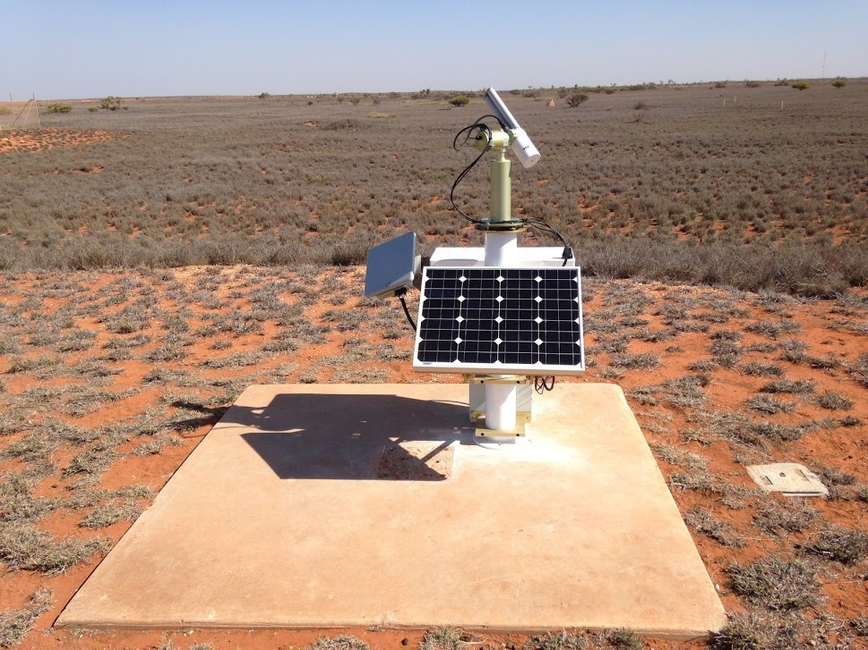
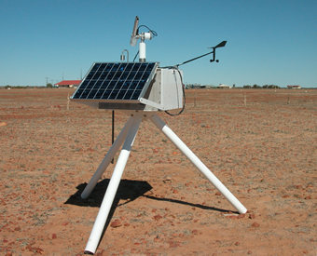
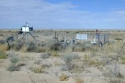
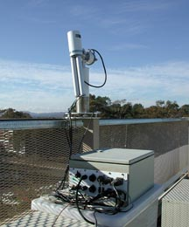
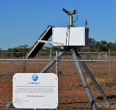
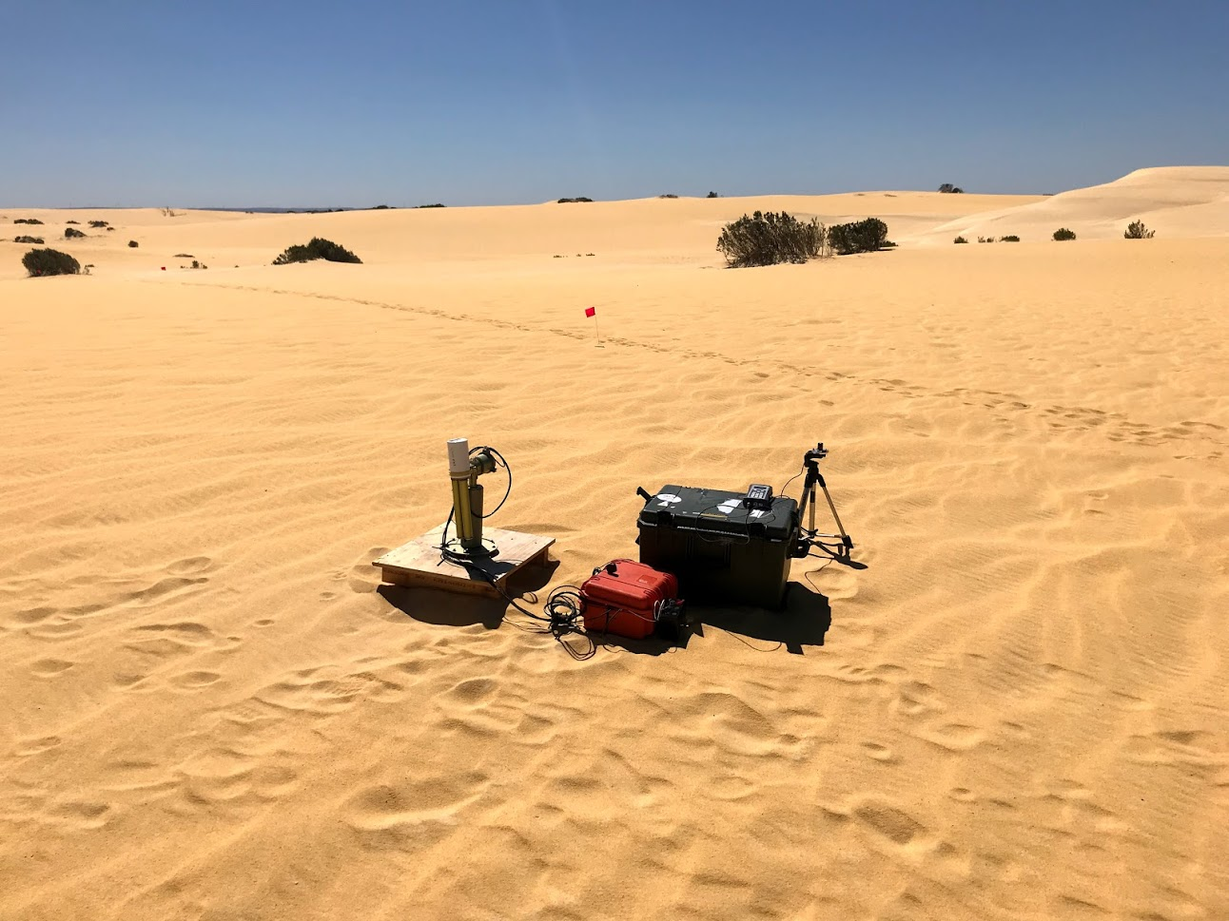
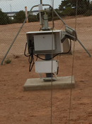
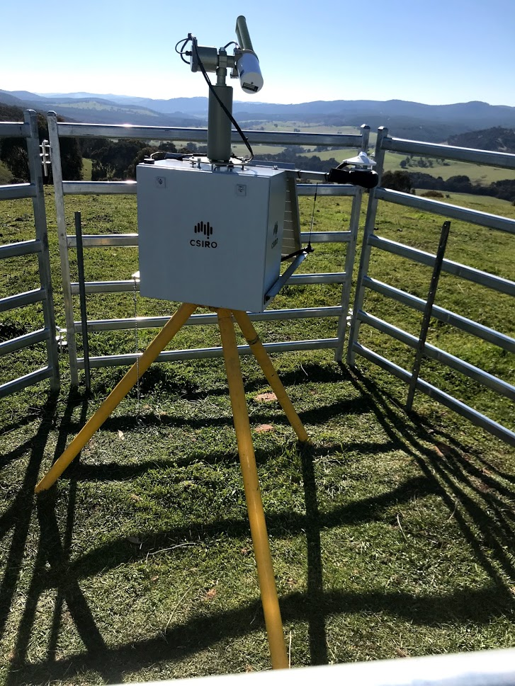
Site Locations
Jabiru
Lake Argyle
Lucinda
Learmonth
Birdsville
(Tinga Tingana)
Lake
Lefroy
(Pinnacles)
Fowlers Gap
(Canberra)
Aspendale
(testing)
Tumbarumba

Slide 5
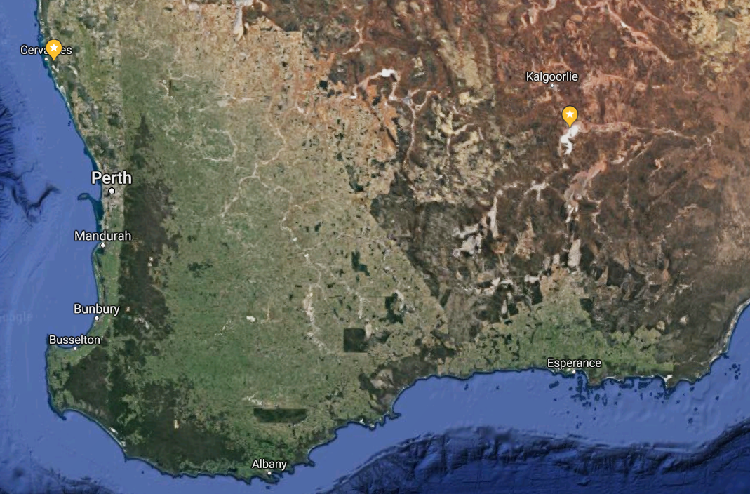
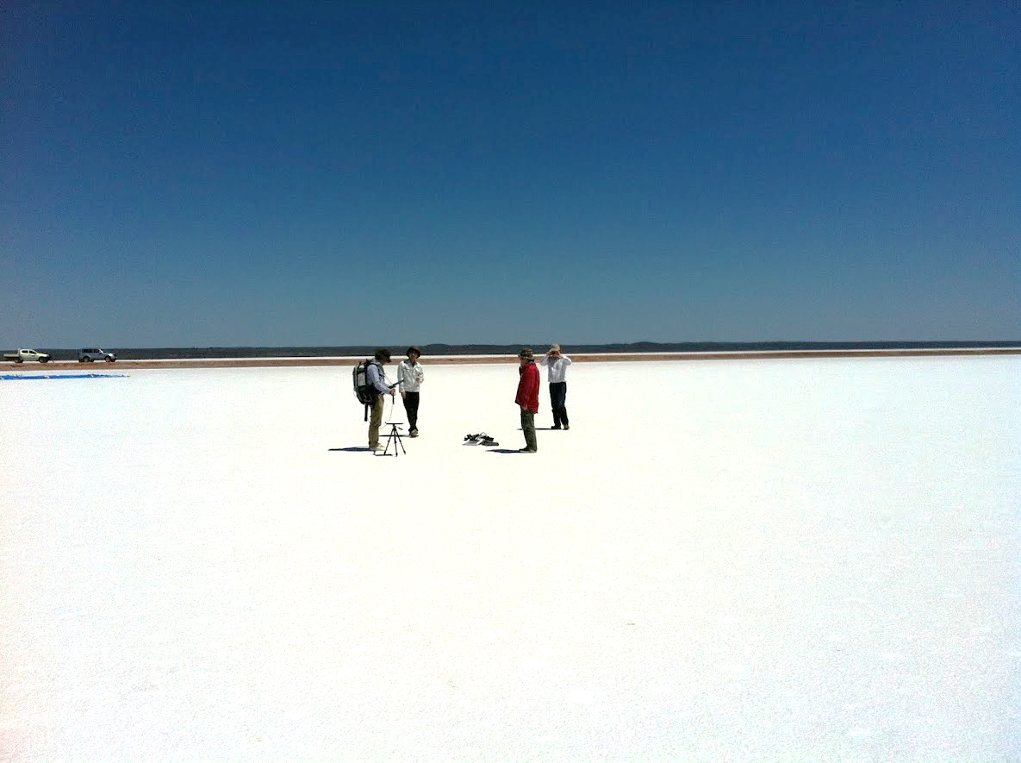
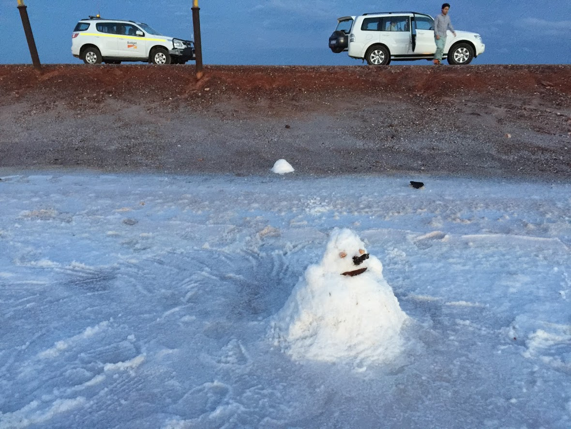
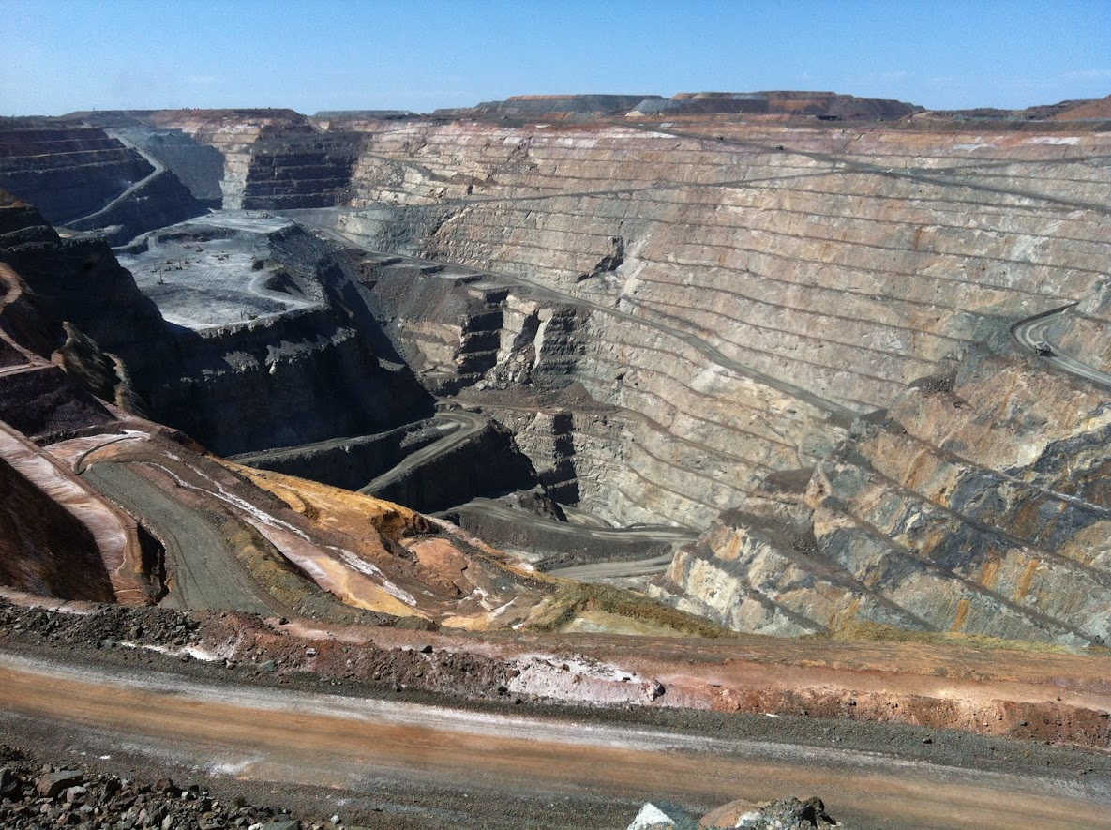
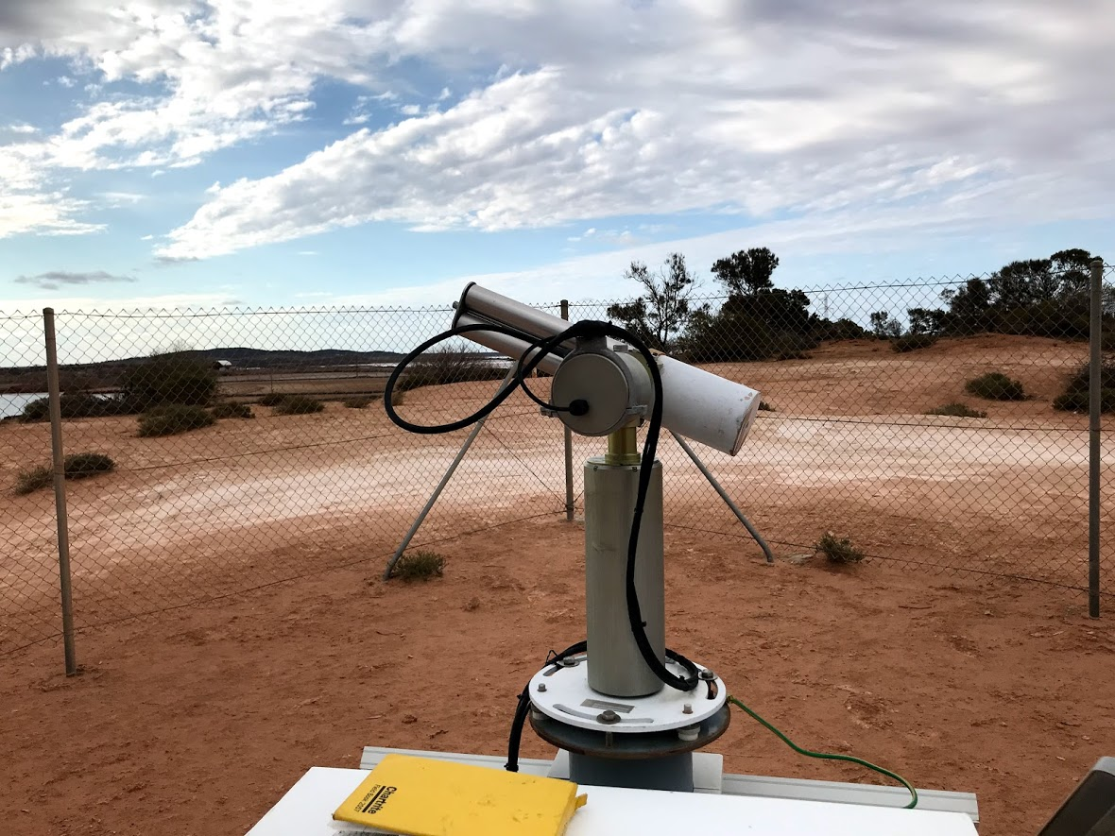
Lake Lefroy
Salt lake and clay pans
Mining operations (gold)
5km

Slide 6
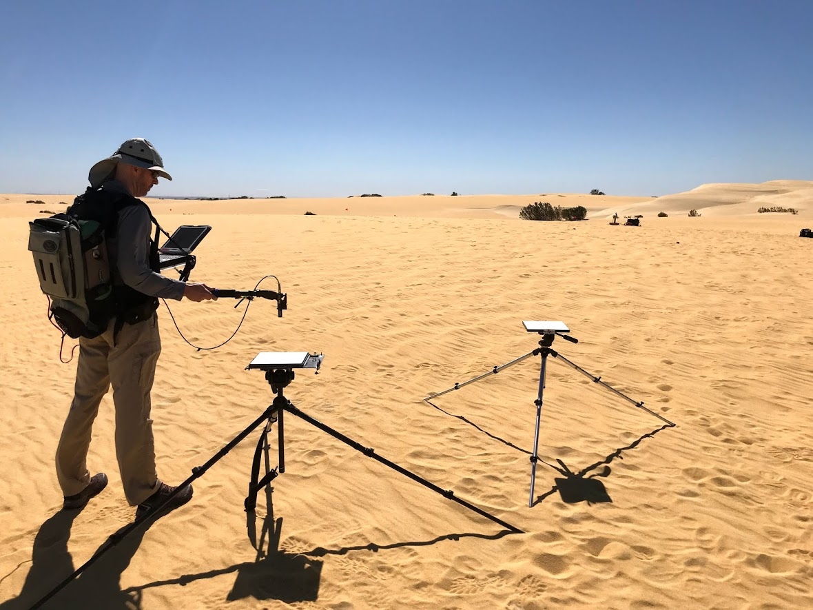
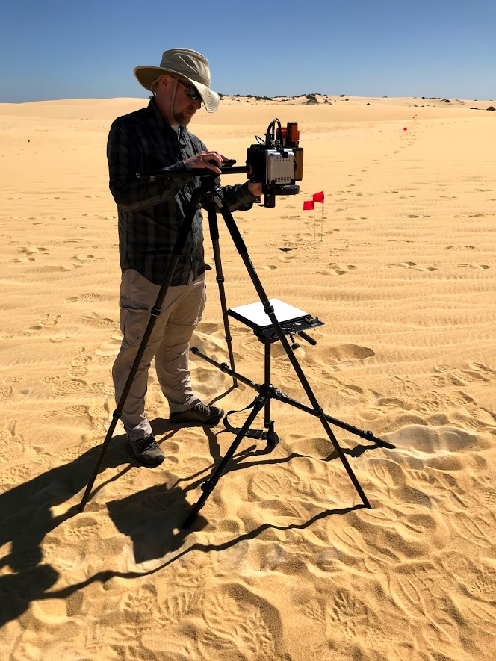
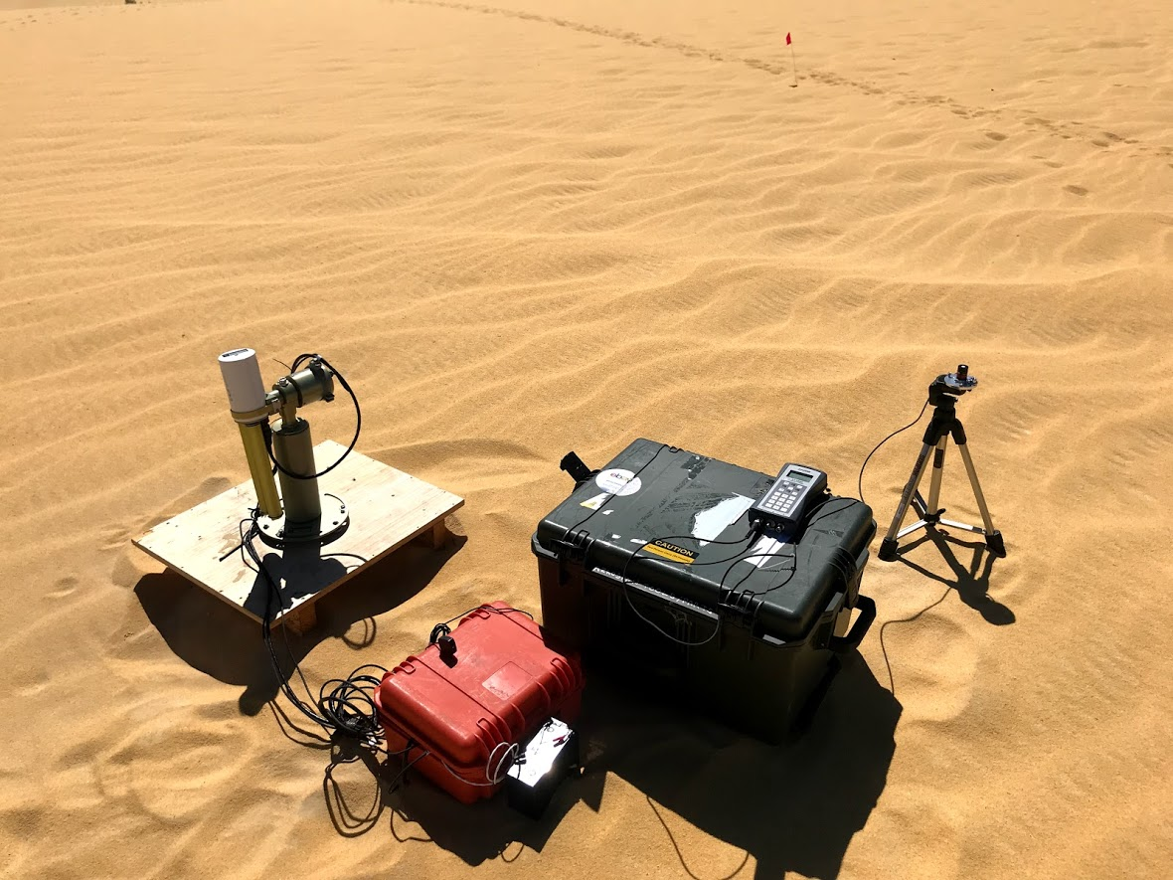
Pinnacles
200 km
Bare sand dunes surrounded by
coastal ‘kwongan’ vegetation
2km

Slide 7
Operations
Aspendale (VIC)
Equipment maintenance, testing and development
Central sites
Data download and data management
Townsville (QLD):
Lucinda site maintenance
Perth (WA):
Western Australian sites and Tumbarumba, NSW

Slide 8
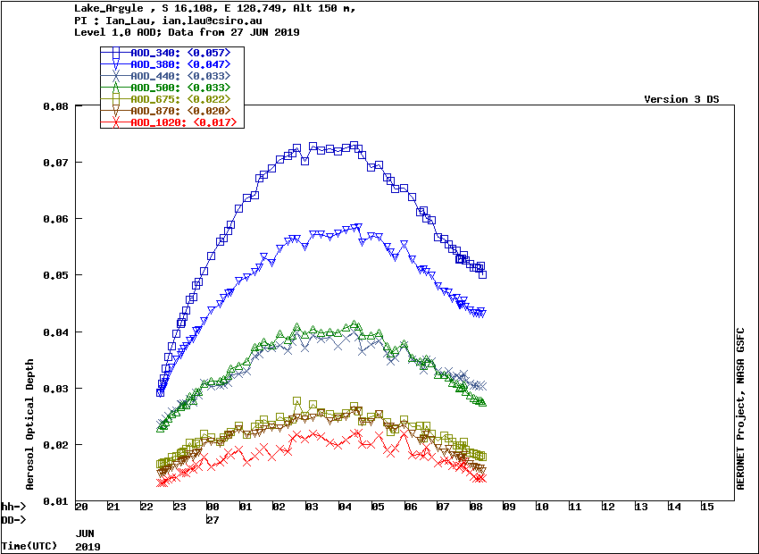
Aims
High level of instrument maintenance
Continuous measurement at all sites >360 days a year (yearly swap outs) providing high quality data
Uploads weekly (or fortnightly) to GSFC

Slide 9
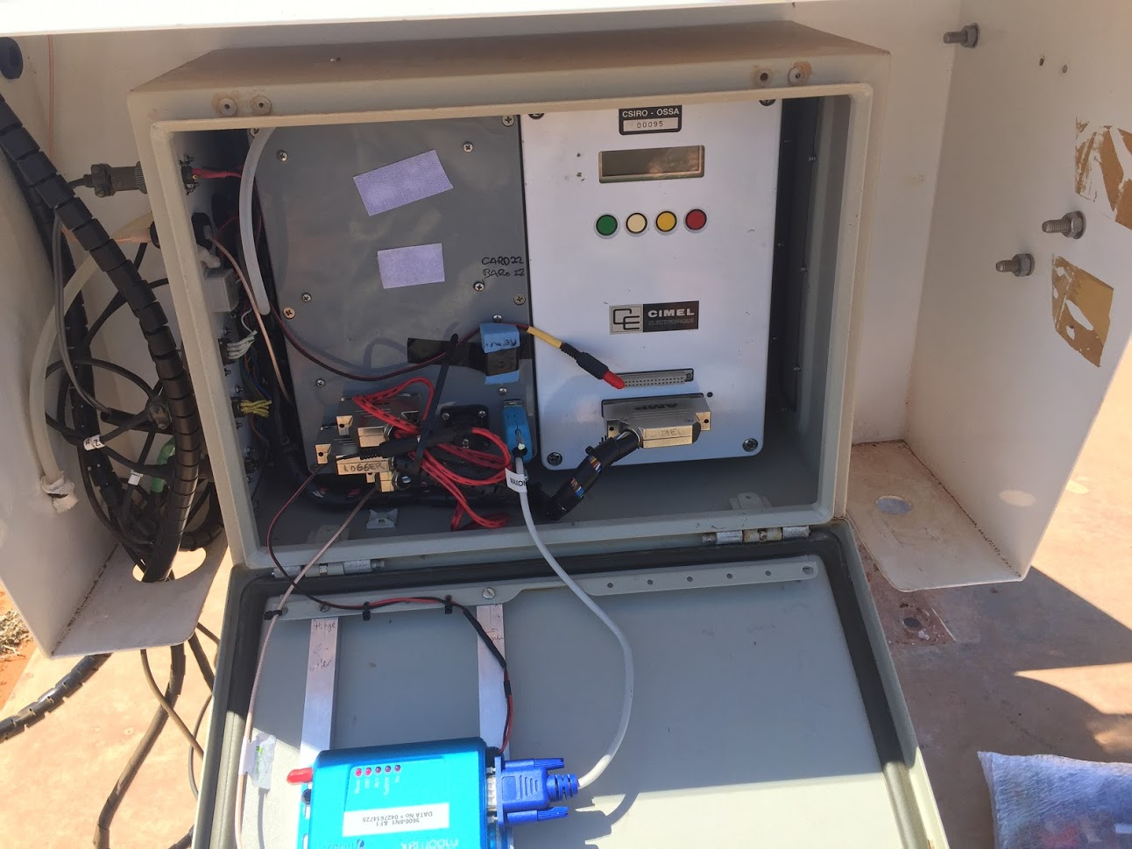
Legacy
CSIRO-built logger for acquiring extra instrumentation
Weekly downloads
Satellite modems at 4 sites, which could be reduced to 2 due to recent improvements in cellular coverage.
Sites located in areas of significance for research into continental aerosol monitoring
Older-style CIMEL
control box
Logger
Custom wiring
3G modem

Slide 10
Persistent obstacles
Aging instrument pool, need for renewal to replace older instruments.
CSIRO-loggers nearing retirement, no longer need extra measurements (nephelometers).
Small staffing %
Cost of ongoing maintenance, including fieldwork and development.
Cost of data downloads and multiple cellular connections
Science output and external revenue pressures

Slide 11
Future focus
Shift towards remote sensing and optical satellite cal/val after loss of aerosol scientist PI.
Rationalise sites to ones of significance for cal/val and easy access.
Lake Argyle – TIR/dark target
Lake Lefroy – Bright VNIR target
Tumbarumba – dark/veg target
Pinnacles – instrumented calibration site* (may not be suitable with BRDF instrument alone, may require second ‘standard’ CIMEL Sun photometer)
Replacement and/or upgrade of older CE-318-N photometer heads and control boxes to CE-318-T.
->Upgrade of communications.
->Automated daily uploads

Slide 12
CSIRO Mineral Resources
Ian C Lau Senior Technical Scientist
t +61 8 6436 8646
e Ian.Lau@csiro.au
w www.csiro.au/lorem
CSIRO Oceans and Atmosphere
David Barker Technician
t +61 2 9123 4567
e David.barker@csiro.au
w www.csiro.au/
CSIRO Centre for earth observation

