Slide 1
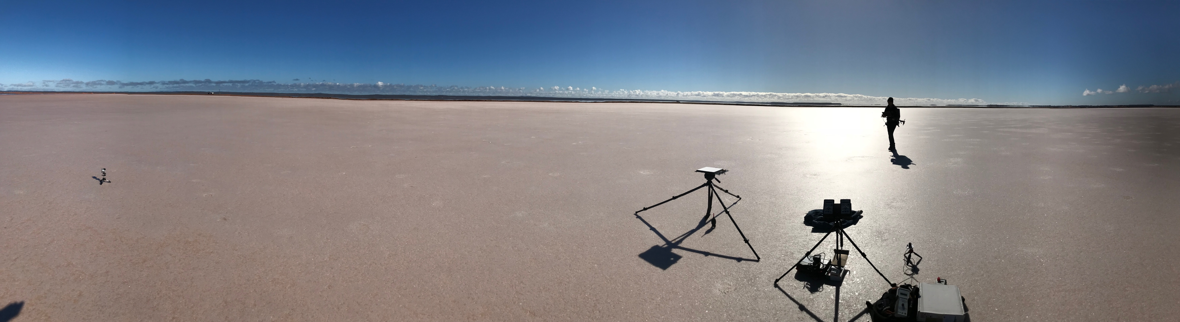

A Guideline For Ground Surface Reflectance Validation Measurements and Uncertainty Quantification
Tim Malthus, Cindy Ong, Peter Fearns, Ian Lau, Medhavy Thankappan, Guy Byrne, Andrew Walsh, Mark Broomhall
CSIRO Centre for Earth Observation, Geoscience australia
WGCV Perth, 16 July 2019

Slide 2
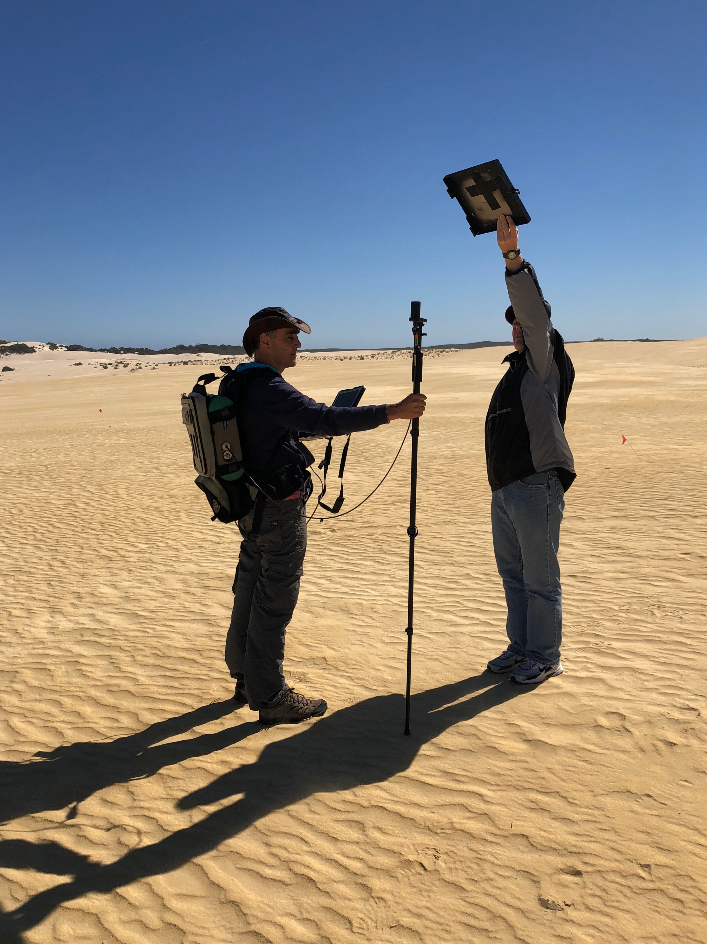
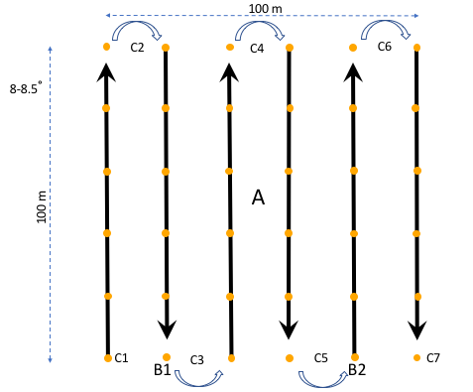
DEA surface reflectance validation project
Variety of surfaces measured in Phase 1
Spectroradiometric survey – 6 transects along a 100 x 100 m grid

Slide 3
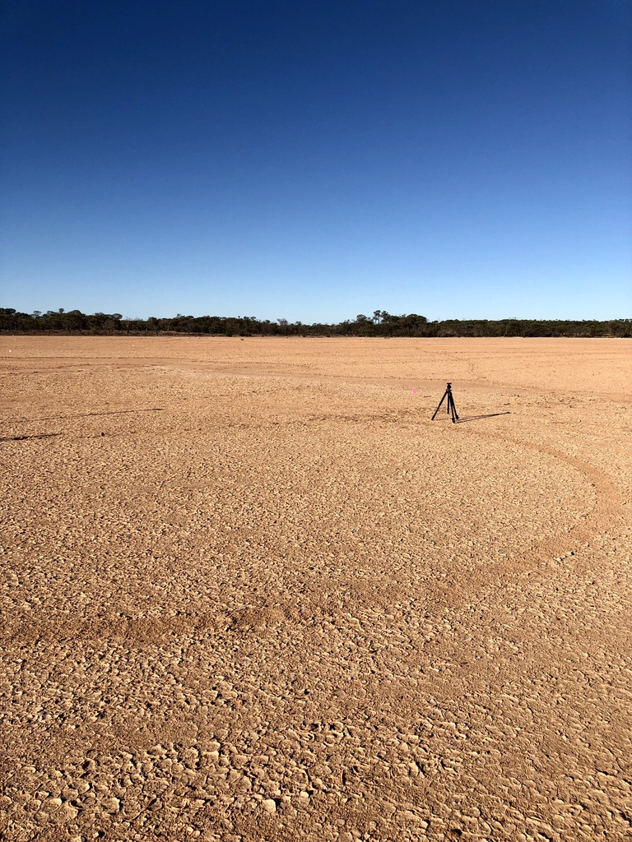
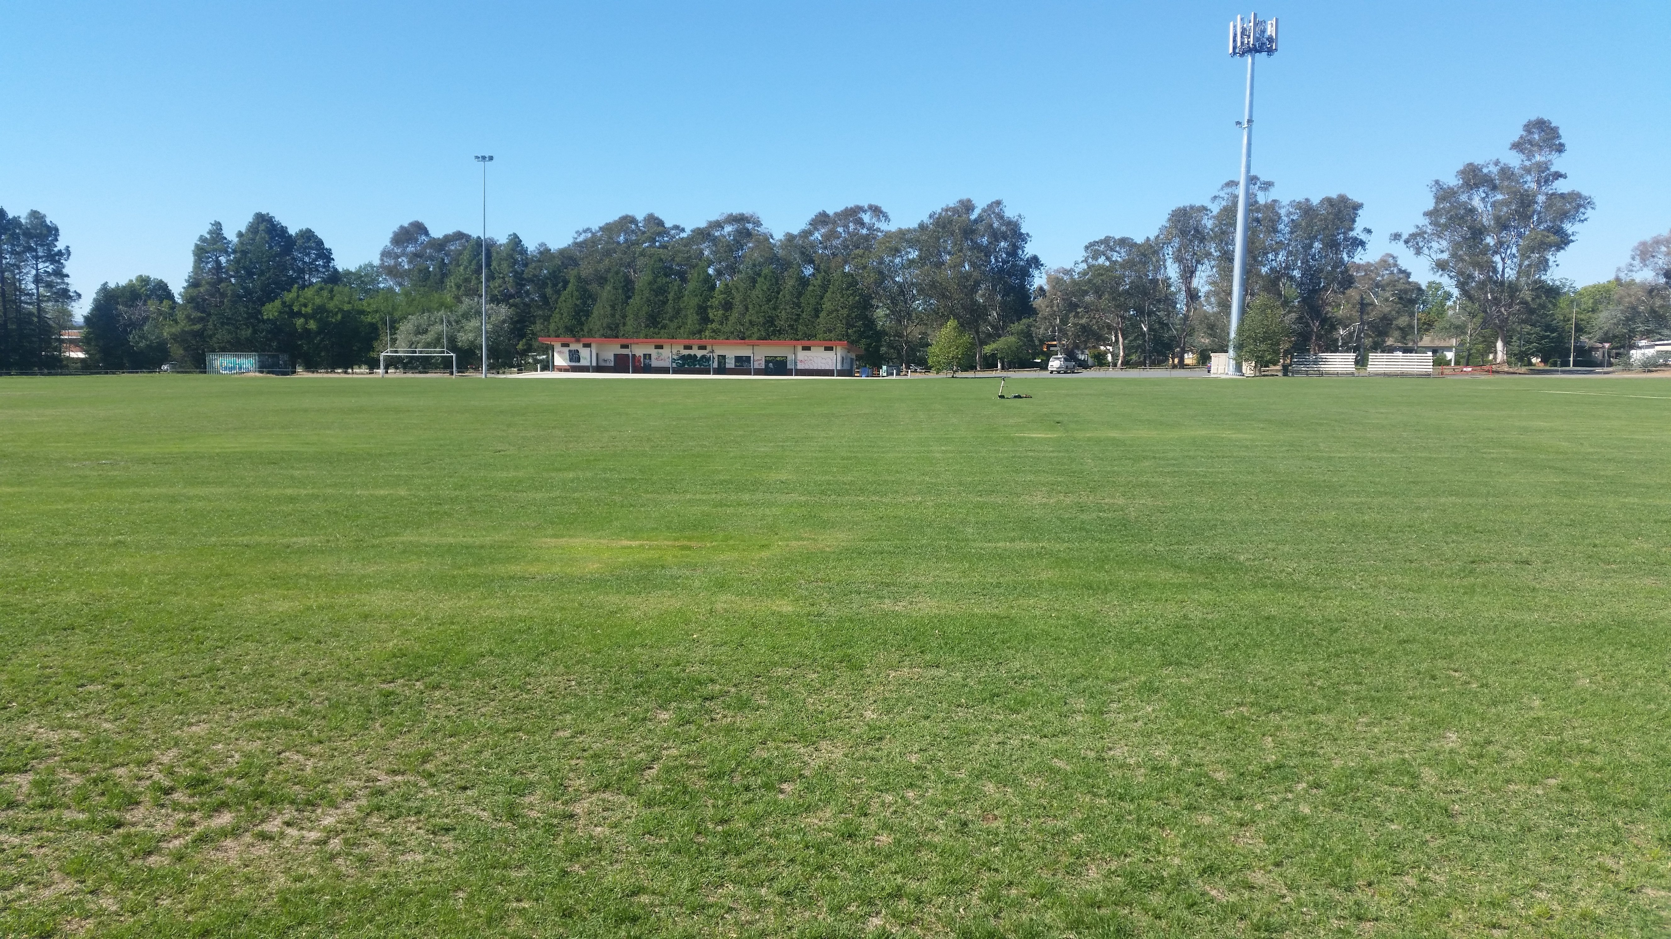
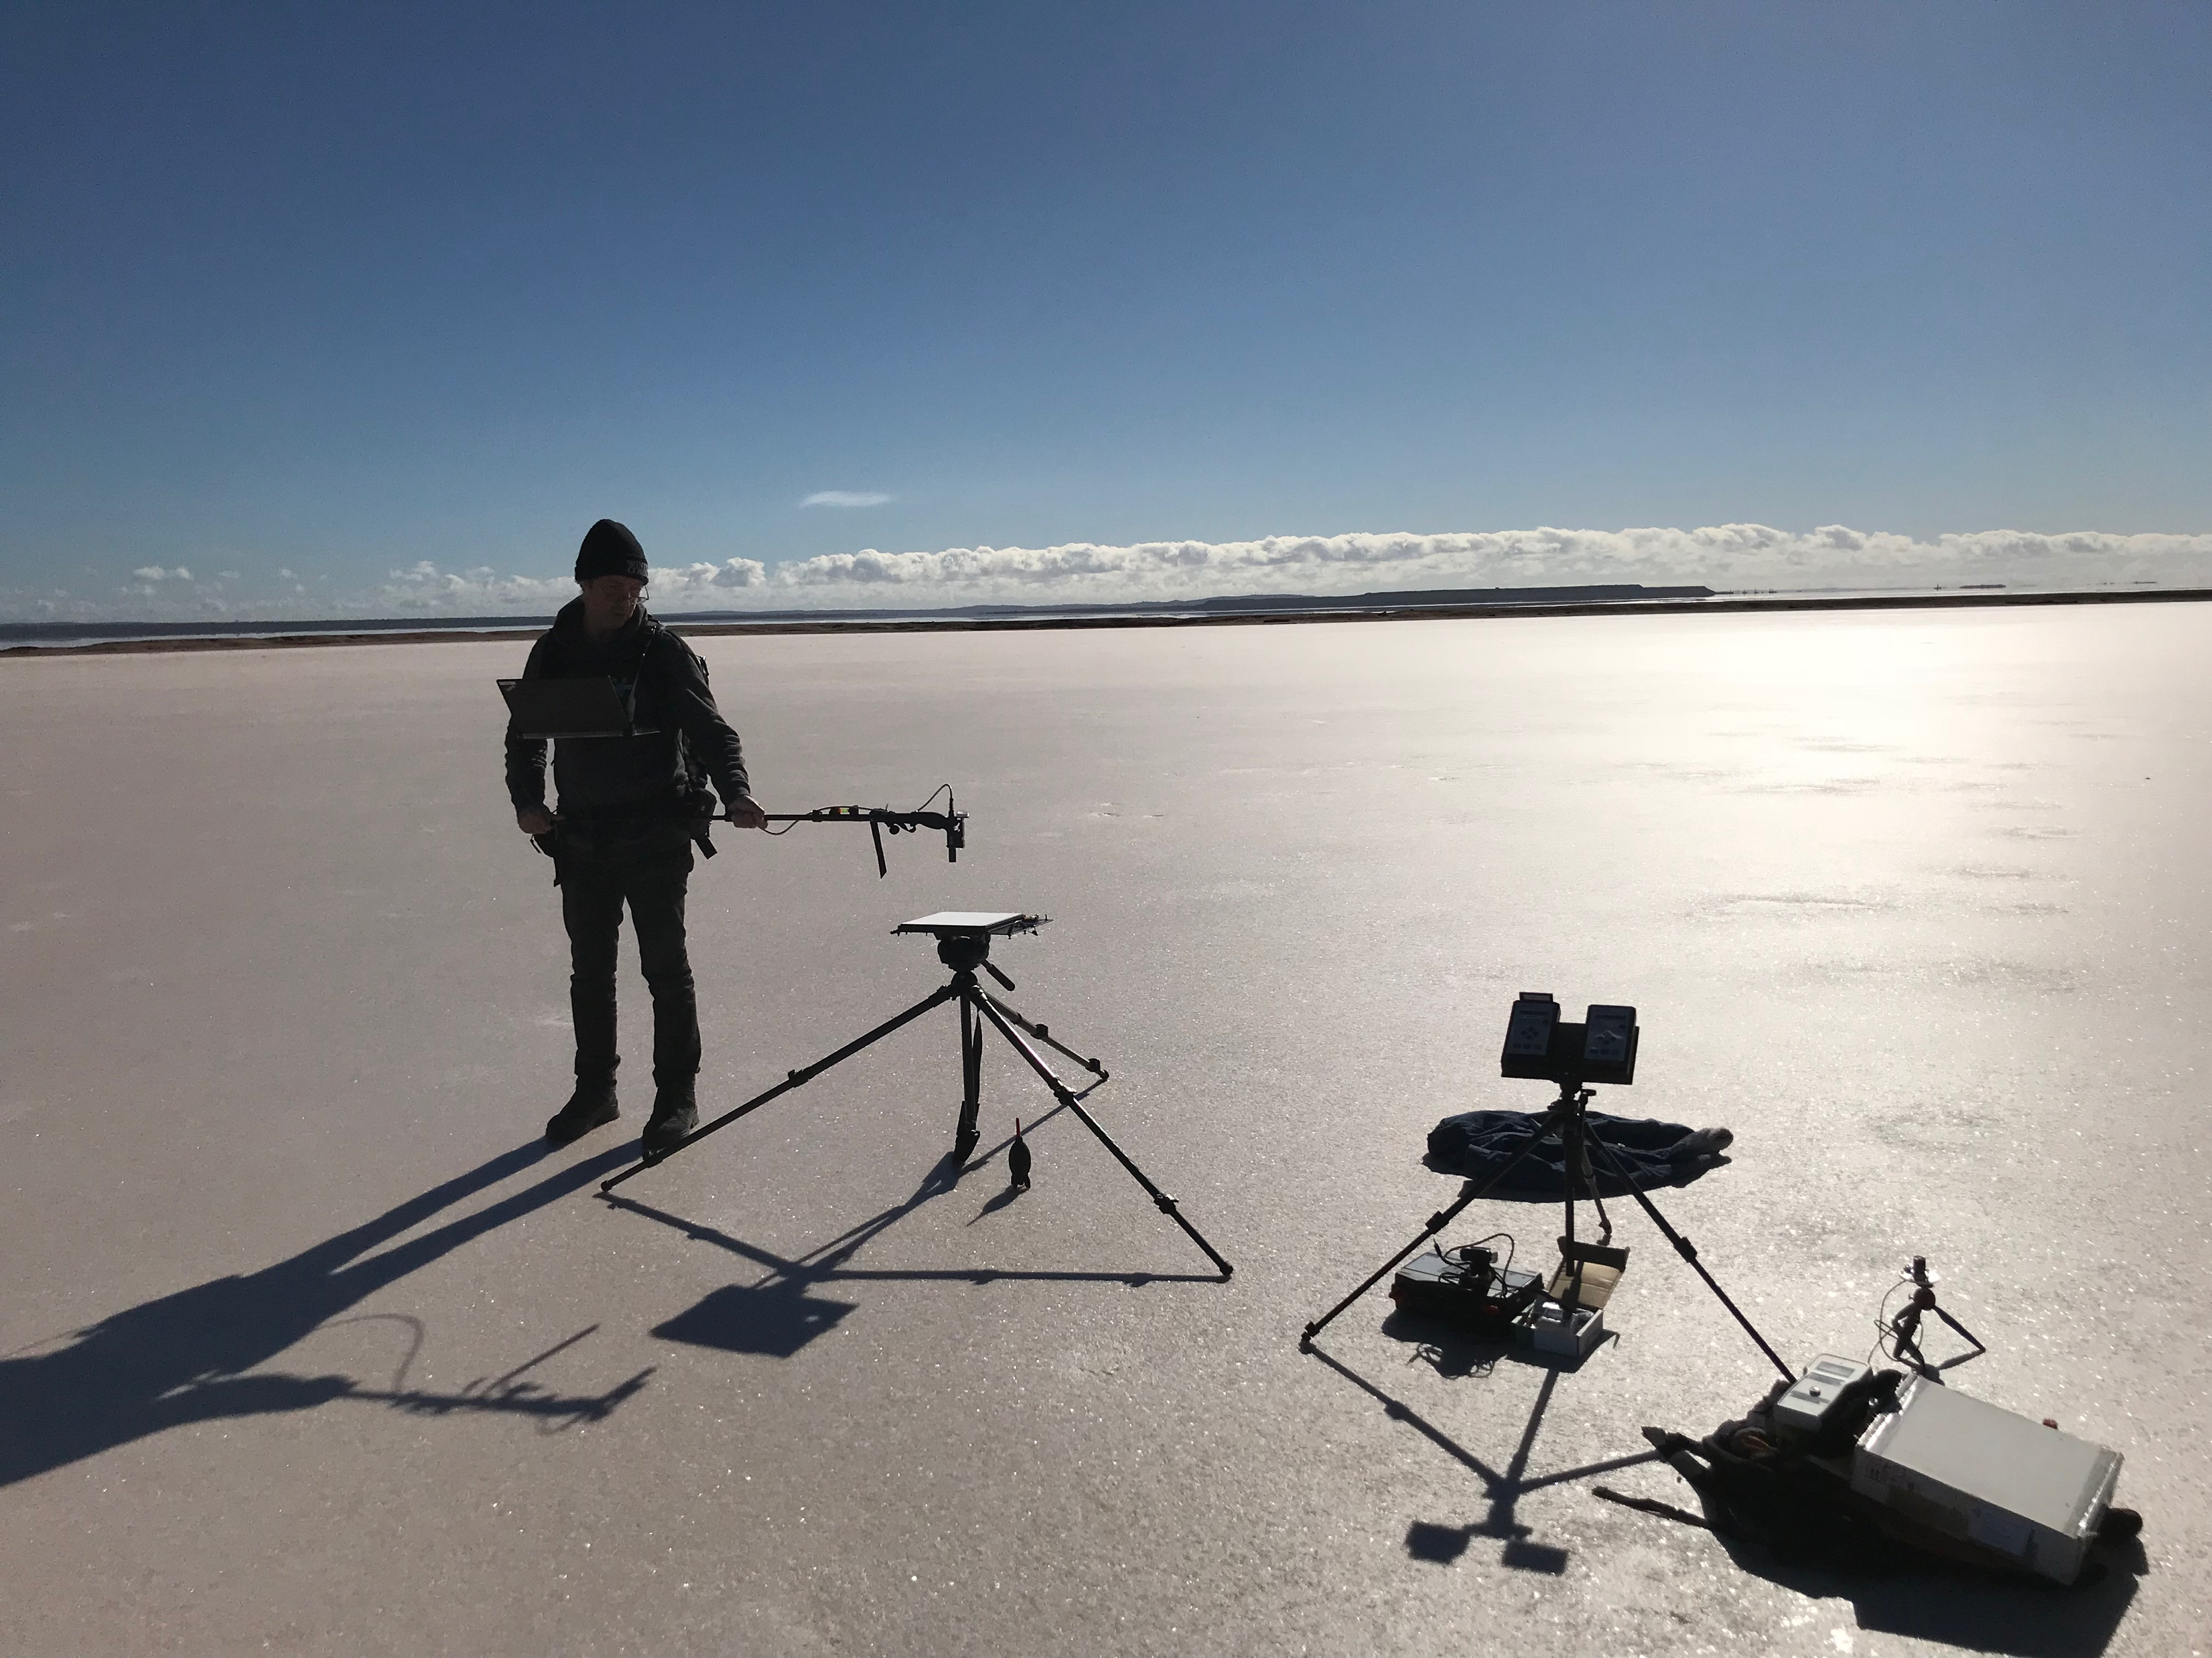
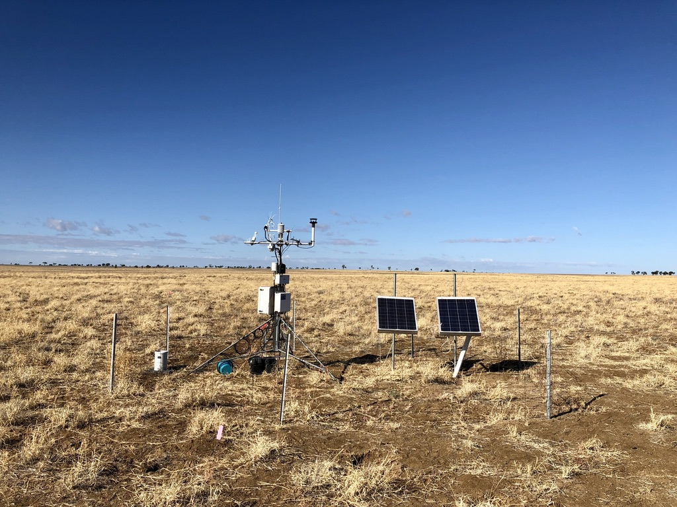
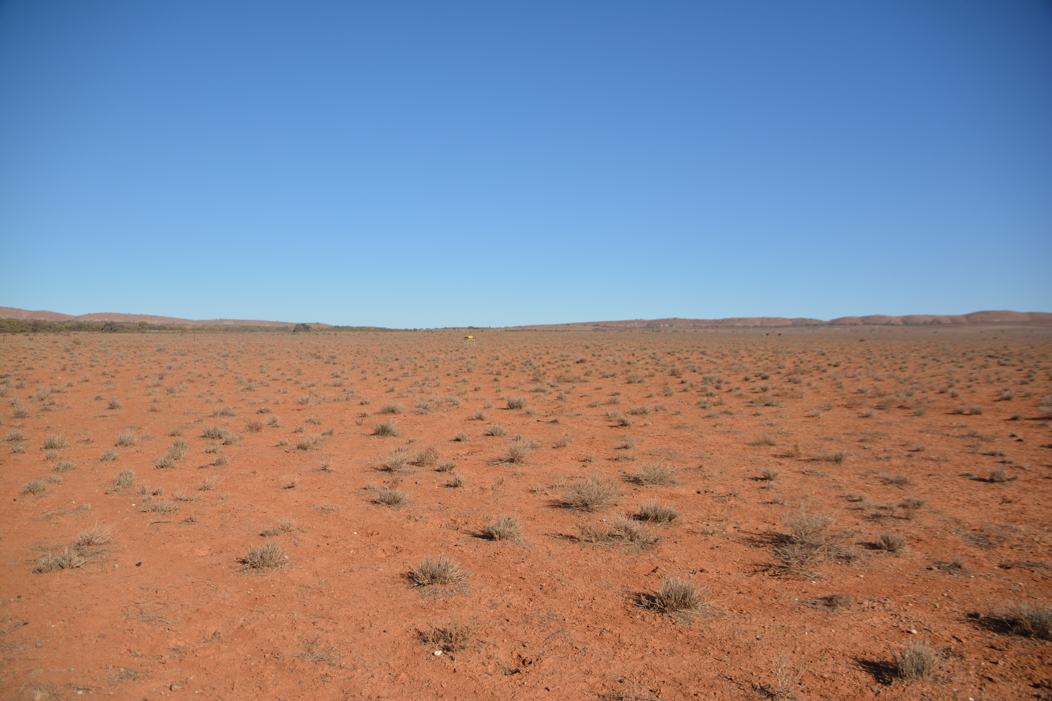
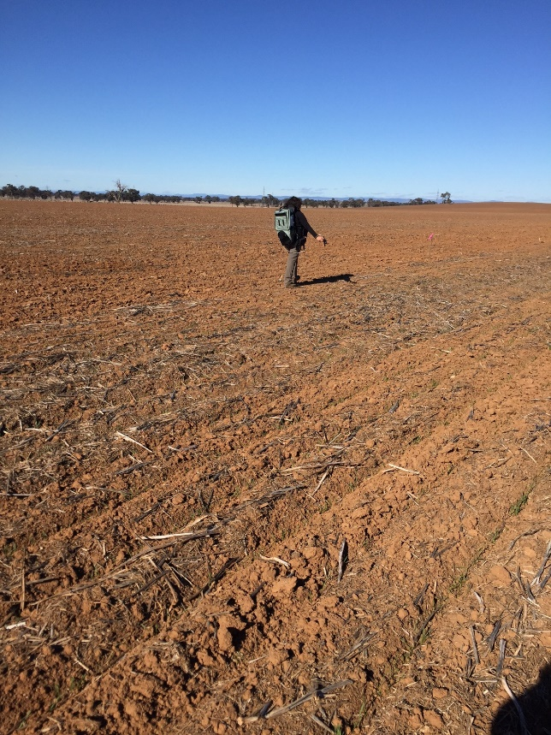
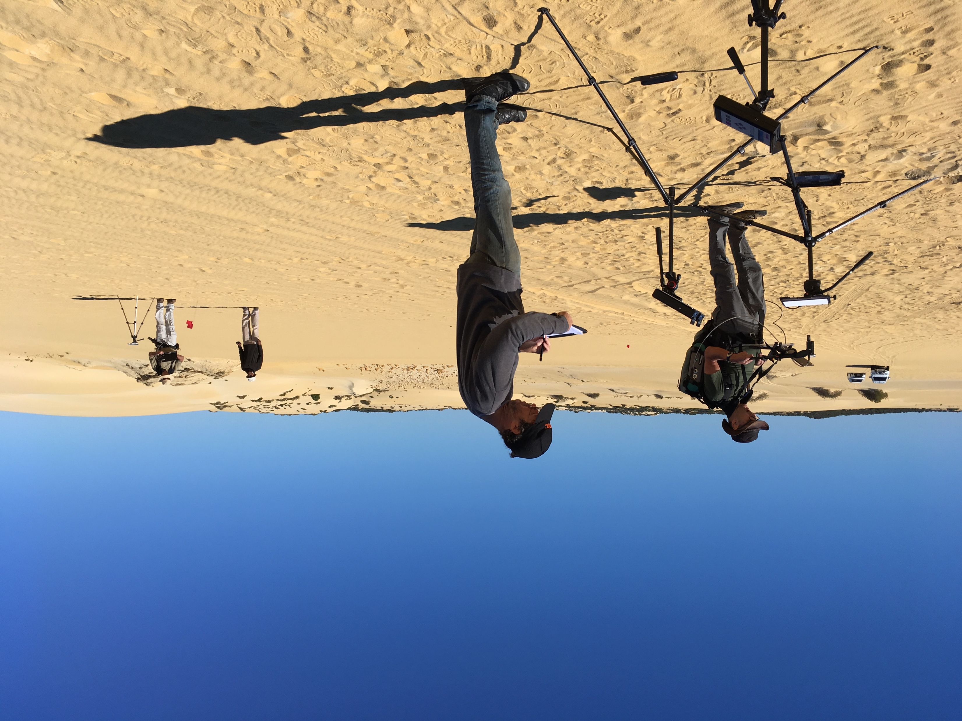
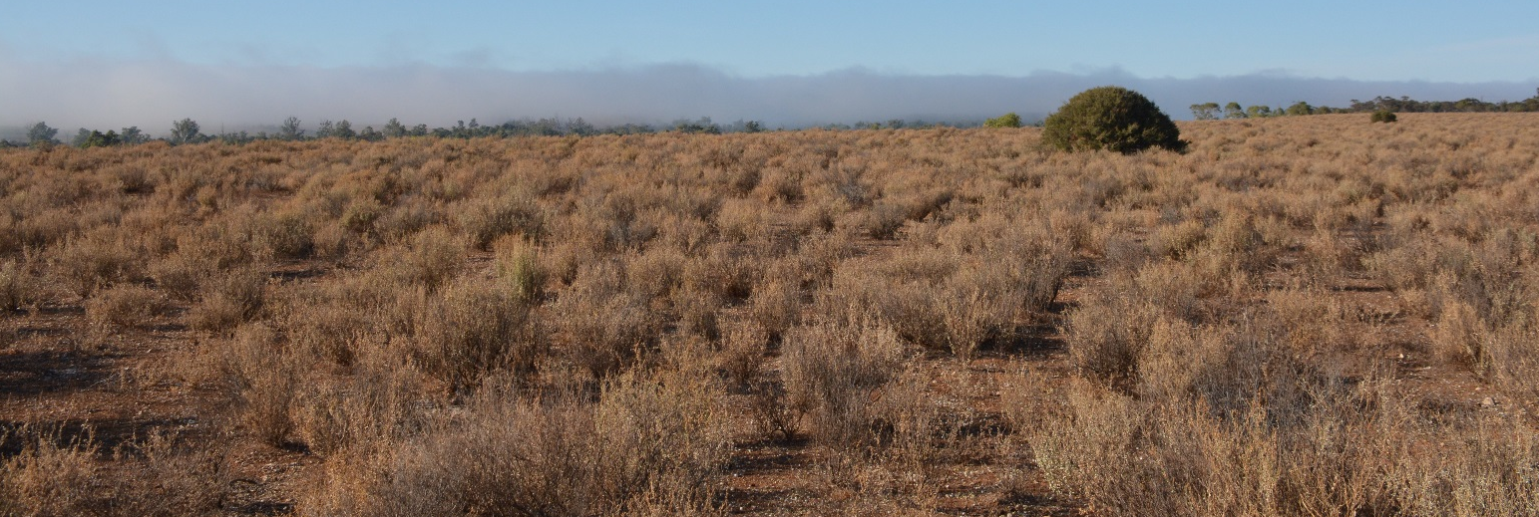
Variety of surfaces

Slide 4
Reflectances
Notes:
Overview of the range of reflectance data captured. From bright to dark over most of the spectrum.

Slide 5
Final project report
40 recommendations:
  Laboratory calibration protocols, instruments, wavelength calibration
  Field methods and field handbook
  Sites and site selection
  Uncertainty budgets
  Use of sunphotometer data
  Further phases
  Workshops & training
  Communications

Slide 6
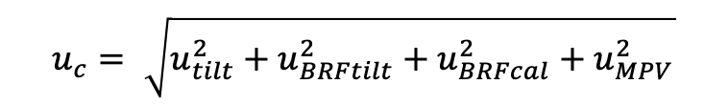
Uncertainties
Selected uncertainties are ultimately combined and reported as campaign wide values, both as spectral quantities and as a spectrally averaged Mean Total Uncertainty
where
  u_{tilt} is effect of panel tilt on total illumination flux
  u_{BRFtilt} is panel BRF uncertainty due to panel tilt
  u_{BRFcal} is panel BRF calibration uncertainties
  u_{MPV} is “Mean panel variability” - includes effects of spread in panel measurement data, misalignment of the panel throughout the campaign, changing atmospheric conditions
$$u_{c}= \sqrt{u_{tilt}^{2}+u_{BRFtilt}^{2}+u_{BRFcal}^{2}+u_{MPV}^{2}}$$
Notes:
All uncertainties are estimated as individual values.
The second story is about the reflectance uncertainty. I considered a lot of factors and played around with different calculations, but in the end I settled on
Selected uncertainties are ultimately combined and reported as campaign wide values, both as spectral quantities and as a spectrally averaged Mean Total Uncertainty
Panel Tilt (u_tilt and u_BRFtilt)
Panel BRF (BRFcal) the calibration of BRF
General variability in measurements due to local conditions. (u_MPV)
Look at the influence of these in turn

Slide 7
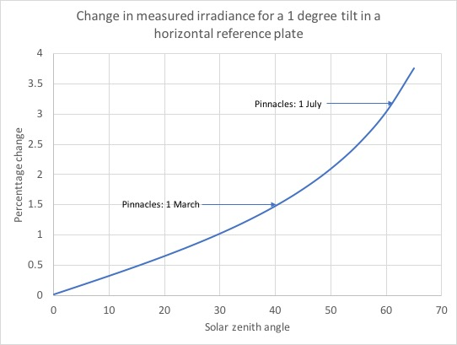
Tilt – Pinnacles (30.5∘ S)
Dependent on sun position
Tilt error in mid-winter - ~3%
Solution: automated levelling
Notes:
Tilt. We were not very good at measuring tilt, so I just guessed that we were at about 1 degree error. The plot shows the percentage change in irradiance for a 1 degree panel tilt. It depends on the position of the sun. For the Pinnacles, which is at about 30.5 South, has a sun zenith of about 45% in July, so a large effect due to tilt error. Up to 3%. Huge! We are looking to develop automated levelling and monitoring of panels. To reduce this at least by a factor of 10.

Slide 8
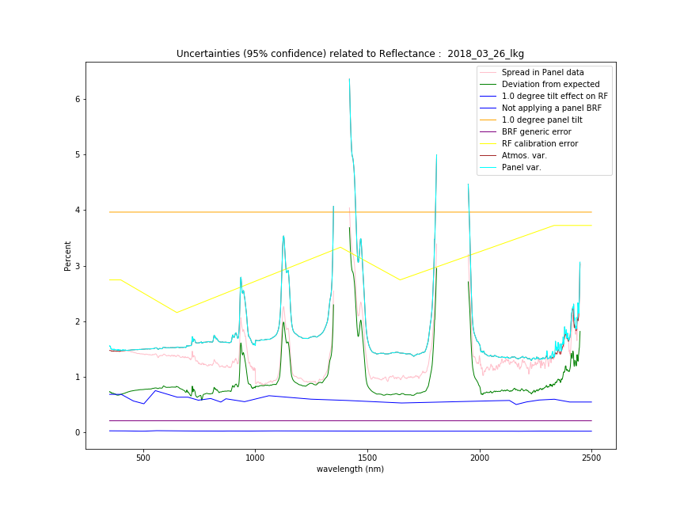
We end up with uncertainties expressed spectrally
Panel tilt
Panel RF calibration
Panel variability
Notes:
So at the end of all this I want to compare the contributions of all the parameters. Some curves are there just for comparison and edification: not included in the calculation.
Oh, and I also report uncertainties at both the k=1 and k=2 levels. The graph is at k~2 = 95% confidence. In this example the panel tilt of 1 degree leads to a 4% error at 95% confidence (brown line). The yellow zig-zag line is the reported k=2 uncertainty of the panel RF calibration. The pale blue line is the panel variability. All the other curves are bits and pieces, such as the effect of panel tilt on the uncertainty in the RF, or the change in BRF with panel tilt. All pretty small.

Slide 9
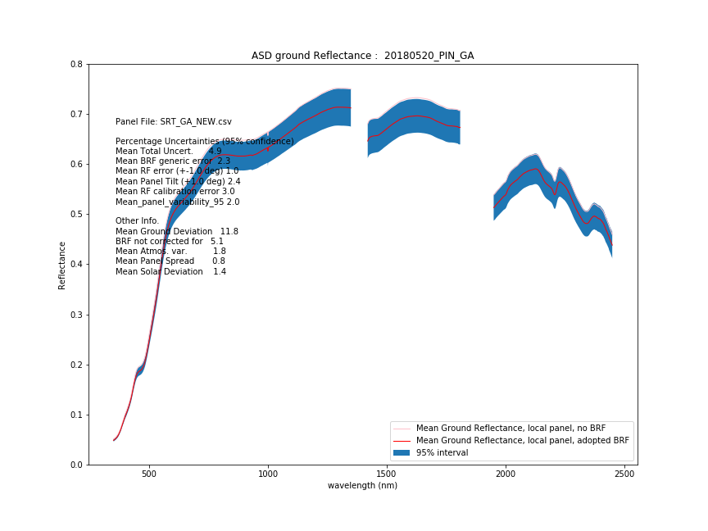
Campaign overview
Notes:
Finally we average the whole campaign, all 6 ground lines, to get an average ground reflectance (the red line). The bold blue region is the 95% coverage of the ground reflectance. It is hard to see, but there is a pink curve right at the top of the blue region. This is the mean ground reflectance, but without correcting for the panel BRF.
This data is from a campaign where they did not have a BRF for their panel. They would have gotten the pink curve. When we apply a ”generic” BRF from our CSIRO panel we get the red curve (a better result). There was a paper where someone showed that the shape of the panel BRF does not vary much, so I scale our BRF by the GA panel RF.

Slide 10
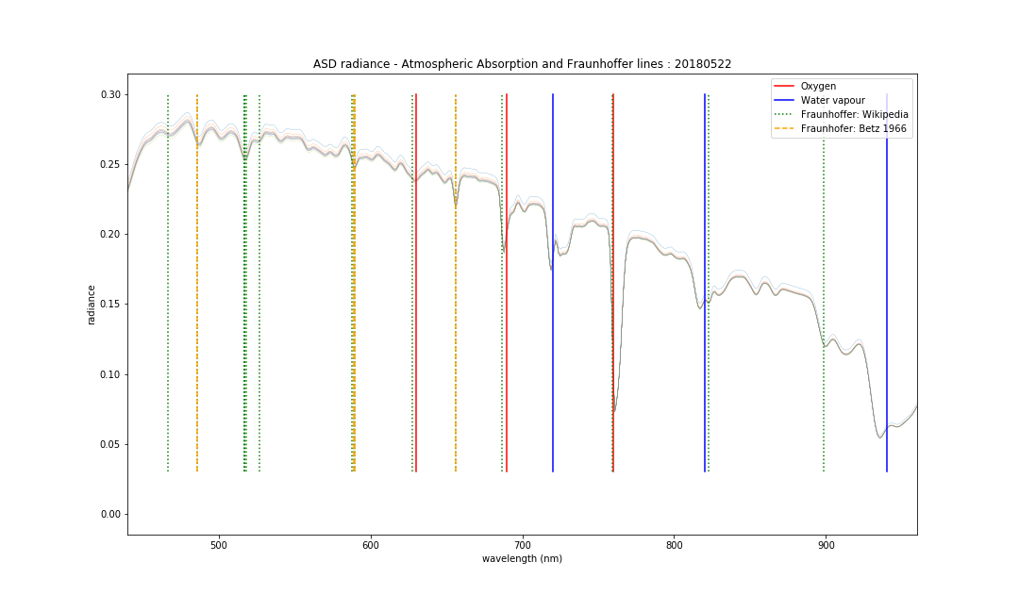
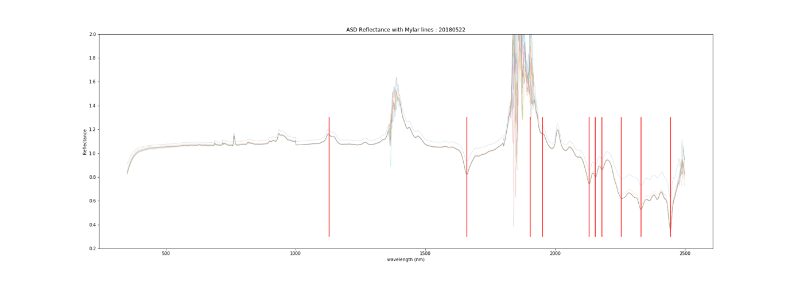
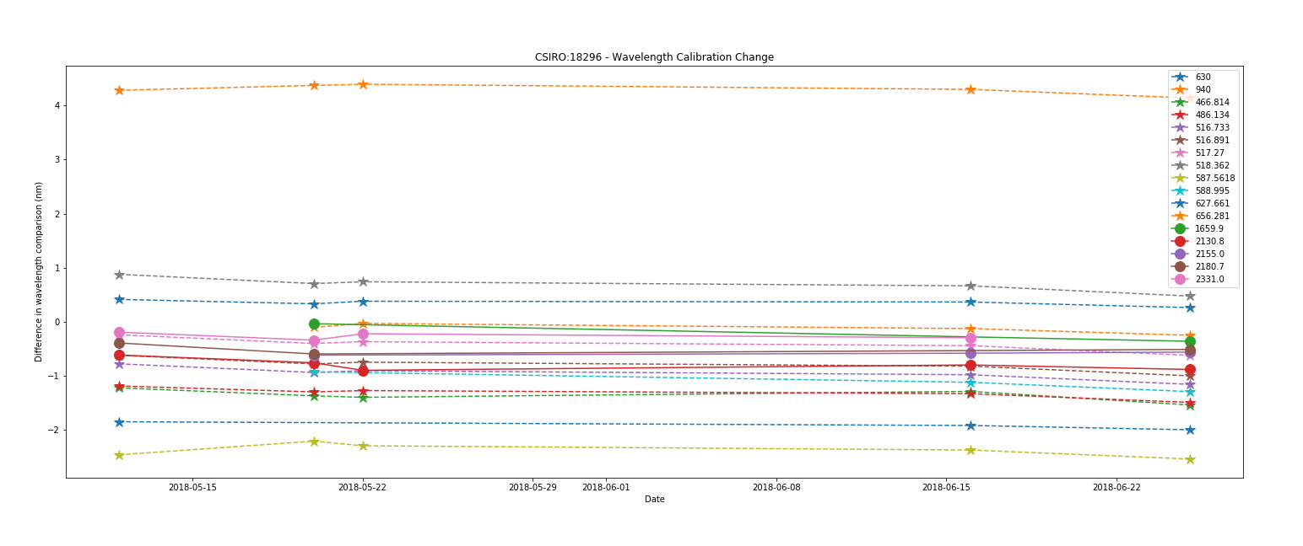
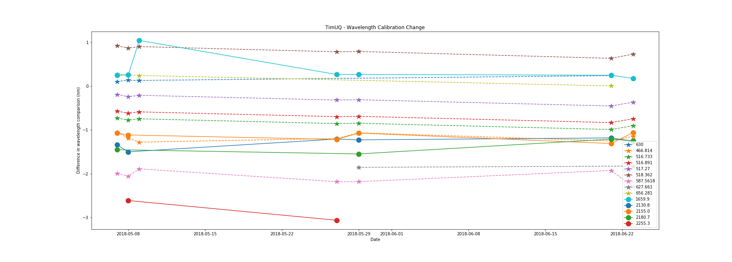
Wavelength stability
Field-measured reflectance through Mylar
Augmented with Fraunhofer line subset
Wavelength stability over time in two field spectroradiometers
Monitoring wavelength stability through time
Notes:
The idea with the Mylar is to take a measurement through the Mylar to add spectral features. The graph shows the locations of the features, matched to the reported wavelengths of the features (indiacted by red lines). They match pretty well!!!! But note the number. Not many. And they do not cover the full spectrum.
To extend the spectral coverage we considered using Fraunhoffer and atmospheric absorption features. I looked for published values and selected those that looked “strong”. Large line depths usually. The graph on the left shows the locations of all the lines I started with. I then compared them to the ASD data and ended up with a smaller set that looked as though there were coincident features in the ASD spectrum. The plot on the right shows these.
The two plots show the same data plotted through time. The graph shows the difference between the ASD spectral features and the expected feature positions. OK, there is one channel out by 4 nm, and that may be an error in choosing a good feature, or it may be real. But all other features show that they are within 1 to 2 nm. Of course we have not actually checked the wavelength calibration of the ASD for a while. The nice story is that the lines are pretty flat through time. This shows that the wavelength calibration is pretty stable through time.
When there is a jump, like the blue curve, this is probably a bit of noise in a spectrum rather than an instrument problem. It returns to a sensible curve, so no worries. We could go in by hand and check heaps more spectra, but havn’t.

Slide 11
Conclusions
Panels - the largest sources of error in field measurements
  Absolute calibration, BRF
  Tilt
Points to the improved methods for
  Laboratory calibration
  Leveling and orientation in the field
Paves the way for development of uncertainty budgets
Field handbook available

Slide 12
Some of the recommendations
Need for greater rigour in panel calibration / characterisation
Protocols for more frequent instrument oversight - QA checks and reporting on instrumentation in-field - Mylar/Fraunhofer lines
Protocols for mini spectrometers / UAVs
Improvements to the levelling of panels, , improved Sun tracking / fixed FOV frame
Extrapolation to non-simultaneous satellite overpasses
Suitability of sites for validation of coarser resolution sensors (e.g. MODIS, VIIRS, Sentinel-3)

Slide 13
Some of the recommendations…
Full uncertainty budget for key sites
Understanding uncertainty propagation into the DEA SR product
Realise the full value of sun photometer measurements
Complementarity of additional validation efforts (e.g. thermal and radar validation)
UAV acquisitions / cross comparisons
Utility of the handbook for CEOS WGCV (LPV, IVOS) as best practice to assist in the development of wider protocols

Slide 14











Thank you
tim.malthus@csiro.au
CSIRO Centre for Earth Observation, Geoscience Australia
Notes:
Sensor network:
Continuous monitoring, fixed
Above surface, reduced maintenance
Single spectrometer, no calibration
Overcomes spatial resolution issues, assists satellite validation
Hand held option

Slide 15
Back ups

Slide 16
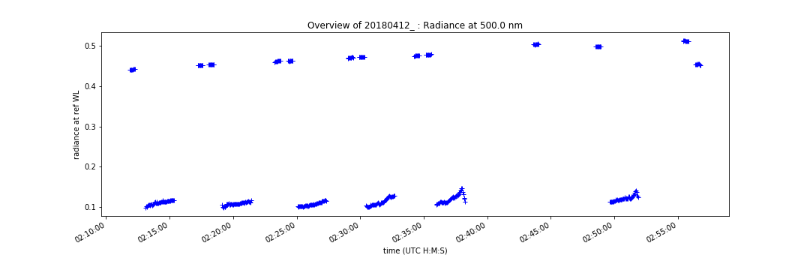
Campaign overview (radiance @500nm)
Pre-Panel line 1
Post-Panel line 1
Ground line 1
Ground line 6
Notes:
Here is an overview of a campaign. Radiance at 500 nm (just a reference for drawing a plot). Explain that we walk along a grid with six transects. Point out the 6 ground lines. Explain the reading of panels at the start and end of each ground line.
Show slight increase in panel reflectance as time progresses

Slide 17
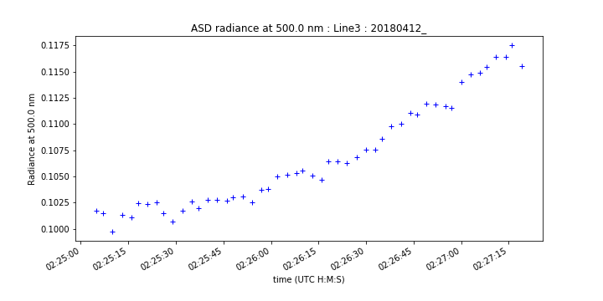
Ground line 3 (radiance @500nm)
2 min transect
Why is the curve not straight and flat?
Does the ground get brighter?
Is the sun rising slightly?
Is the atmospheric path length decreasing?
Is the atmosphere changing?
Notes:
Here is a sample of a set of ground measurements, just at 500 nm. Time span about 2 minutes. Why is it not flat? Does the ground get brighter? Maybe. The sun is rising slightly? Yes. The atmospheric path length is decreasing? Yes. Is the atmosphere changing? Maybe.
Now, we actually want reflectance, so we divide these ground data by the panel data.

Slide 18
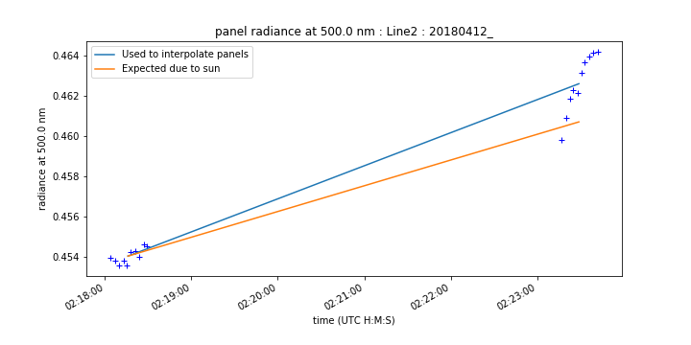
Interpolate panel data to calculate ground reflectance
Optical Depth
Path Length
Solar position
Notes:
If you remember, the panel data from a few slides earlier increased gradually throughout the campaign. For each ground line I interpolate the pre- and post panel data. The graph show the starting radiance ( = 1.0), then the final radiance ( = 1.06). I have tried to show that there may be contributions to the increase in the panel radiance due to change in solar position, decrease in path length, and a potential decrease in atmospheric optical depth.

Slide 19
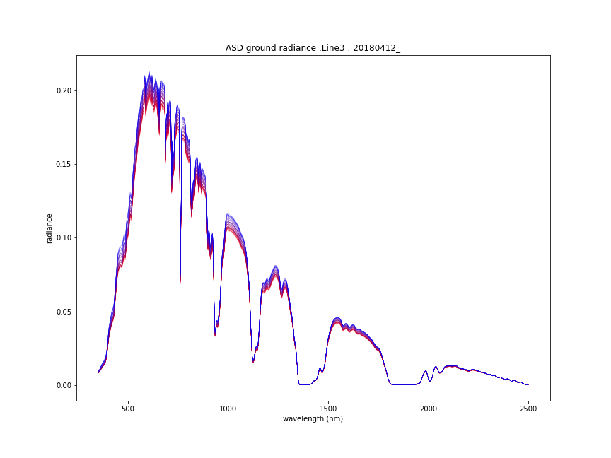
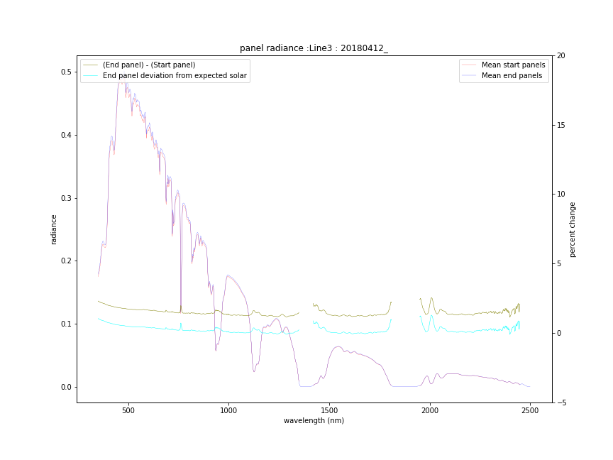
Overview of radiance change during a ground line
Notes:
The plot on the left just shows a set of ground radiance data for one transect, Plotted through time from red to blue. Not much change, but there is a slight change.
The plot on the right shows the panel start and end measurements (red and blue spectra). And the difference between the end and start panels (greeny coloured curve at about 2%). And the expected change in the panel only due to the change in solar position (the pale blue curve at less than 1%. The point here is that the actual change in panel radiance is bigger than simply the change in solar angle.

Slide 20
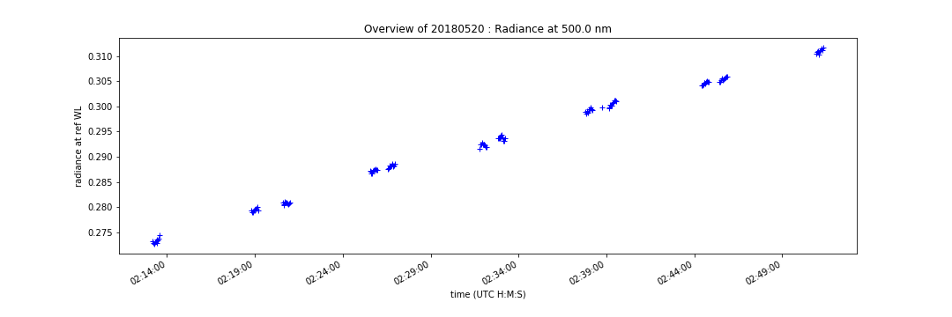
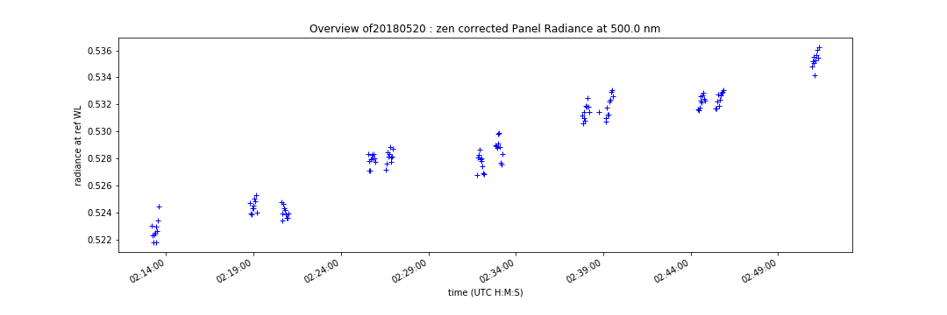
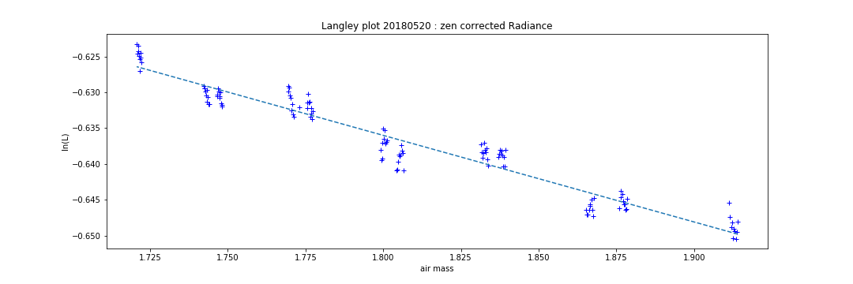
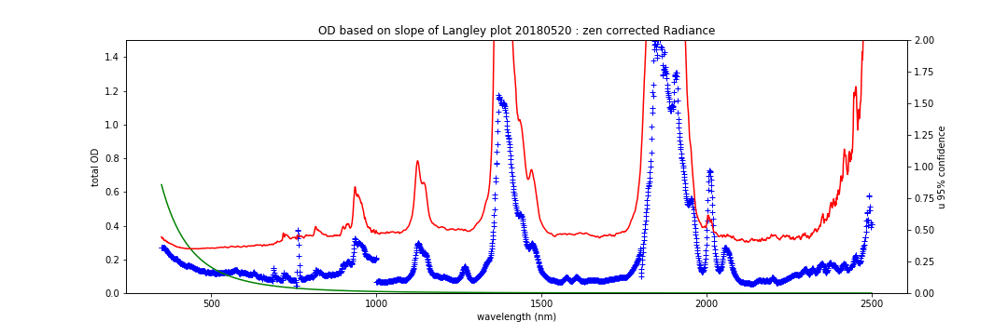
Estimating uncertainty in panel data due to “field conditions”
Panel data through time
Solar angle removed
Langley plot
Optical density
Notes:
Top left: Panel data through time, showing gradual increase. Pretty tight data.
Top right: Panel data with the effect of solar angle removed. The variability is accentuated because the vertical scale is over a much shorter range. It does show that the data are not constant. We do average the panel data for the pre-and post, which gives an uncertainty for the interpolation of each line.
The issue is, I also wanted to capture the fact that the data did not sit on a straight line throughout the whole campaign, which may be due to changing atmospheric conditions.
Lower left: log plot – Langley plot. In a perfect world the data would all sit on the line. I use the variability about the line as an estimate of the Mean Panel Variability.
Lower right: The slope of the Langley plot represents the Optical Depth. This plot shows OD in dark blue. The green curve is a first order estimate of Rayleigh optical depth (just to see how it looks). The red curve is the variability about the Langley plot – right hand axis as a percentage.
Yes, I do a Langley plot for every wavelength.
Later, I work out a sort of “average uncertainty across the spectrum”. Note that I mask out the atmospheric absorption regions where the red curve goes too high.

