Slide 1
Working Group on Calibration and Validation (WGCV): 45 Infrared Visible and Optical Sensors (IVOS) subgroup: report
Nigel Fox
NPL (with UKSA support)
WGCV 45

Slide 2
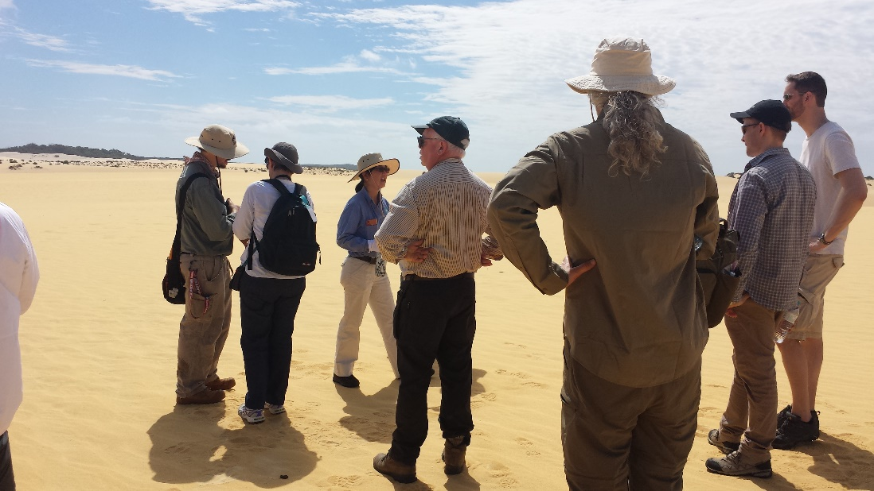
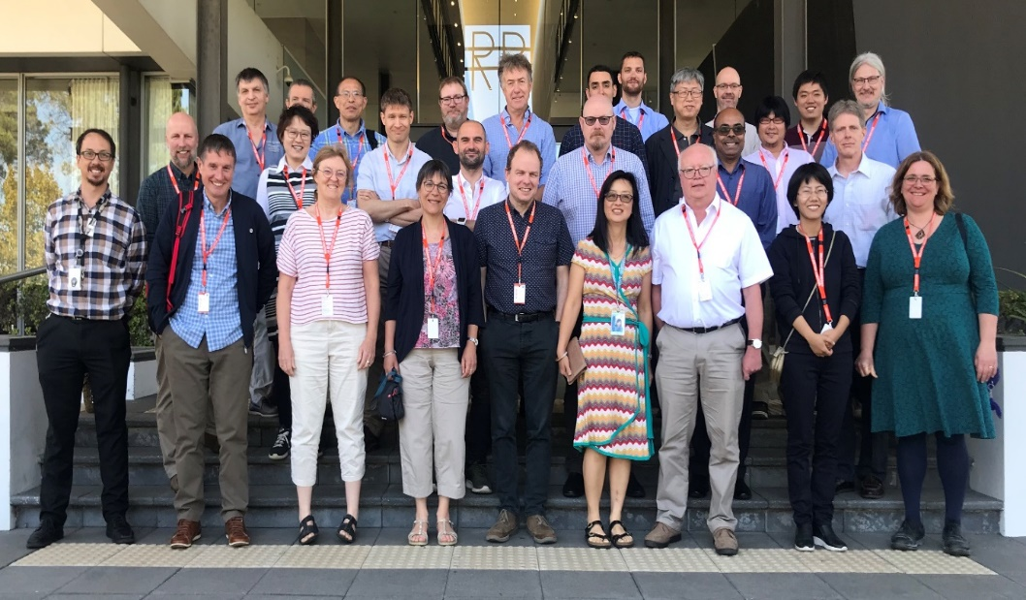
Summary of activities
IVOS 31 @ Perth, Australia.
hosted by CSIRO & GA Mar 2019
26 agency/orgs represented
28 attendees + 9 remote
Most themes and topics (work-plan discussed or summarised
5 th MTF ‘workshop’ (Mar 2019)
~ PICSCAR webex’s (Joint GSICS)
3rd Meeting (4th inc pre-cursors)
International SST validation workshop Jan 19)
mett
Special Projects:
RadCalNet team met Mar 2019 Various telecons
O-colour (FRM4SOC) international workshop (comparisons/strategy) Oct 2018)
Terminology task team established
Next Meeting to be hosted by USGS location/Date TBD)

Slide 3
Terms of Reference
Promote international and national collaboration in the calibration and
validation of all IVOS member sensors.
Address all sensors (ground based, airborne, and satellite) for which there
is a direct link to the calibration and validation of satellite sensors;
Identify and agree on calibration and validation requirements and
standard specifications for IVOS members;
Identify test sites and encourage continuing observations and
inter-comparison of data from these sites;
Encourage the preservation, unencumbered and timely release of data
relating to calibration and validation activities including details of pre-launch
and in flight parameters.
In the context of calibration and validation encourage the full consideration
of “traceability” in all activities involved in the end-to-end development of
an EO product including appropriate models and algorithms.
6.

Slide 4
IVOS: Vision
To facilitate the provision of ‘fit for purpose’ information through enabling data interoperability and performance assessment through an ‘operational’ CEOS coordinated & internationally harmonised Cal/Val infrastructure consistent with QA4EO principles.
Pre-flight characterisation & calibration
Test – sites
Comparisons
Agreed methodologies
Community Good Practises
Interchangeable/readable formats
Results/metadata - databases
Key Infrastructure to be established and maintained independent of sensor specific projects and/or agencies

Slide 5
Work plan
Structured into themes and led by ‘champions’ (effectively vice chairs for CEOS WGCV constitution) (Plus specific projects)
Look to develop good practises
Organise comparisons
Shared learning (research activities)
Shared infrastructure / tools / Methods
Recommendations as needed
Land surface reflectance - Czapler Myers (U of Arizona USA)
Ocean colour (link to IOCCG, VC-OCR etc) - Zibordi (JRC, EU) & Murakami (JAXA JPN)
Surface Temperature (link to VC-SST, GHRSST) - Corlett (U of Leicester, UK)
Geo spatial image quality - Helder (SDSU, USA) &
Viallefont (ONERA F)
Atmospheric Correction (Link to AC subgroup) - Thome (NASA, USA)
RT codes (context of IVOS use in calibration) - ?

Slide 6
Specific projects/cross-cutting
RadCalNet - Bouvet (ESA)
PICSCAR (with GSICS) - Henry (CNES, F)
Lunar (led by GSICS) - Wagener (Eumetsat)
SST/LST cross-comparison (+ VC-SST & LPV - Fox (NPL, UK)
(instrument Cal for LST)
O-Colour Vicarious Cal comparisons - Fox (NPL, UK)
Vocabulary - Wooliams (NPL, UK)
Others in progress/development/related
Establishing a CEOS Reference and method of use for L1 radiometric interoperability (with GSICS) (including potential tools/databases)
Good practise for convolving spectral data sets (solar/surface/sensor bandwidth) Selection of Reference Solar irradiance spectrum(CEOS WGCV (sub-groups) & GSICS) – Partly complete
Comparison of Rayleigh and Sun-Glint methods

Slide 7
IVOS 31 Discussion Topics
Summary of workshops/task groups, MTF, RadCalNet, PICSCAR
Terminology
Issues on Solar Irradiance spectrum
Sensor Pre-flight Cal (climate quality)
New Sensors (Hyperspectral
Lunar calibrations
Collaborations/interactions – WGCV, GSICS, VCs, Climate, Carbon ….
Potential support to AC-VC GHG constellation
Metrology and Uc evaluation….
ARD
Comparison results (land/Ocean)
CalVal Portal
Minutes/Actions and presentations available at: CEOS CalVal Portal

Slide 8
MTF activities & comparison
Task group created in 2015 and very active- small but increasing community (particularly commercial sensors) report on Thursday

Slide 9
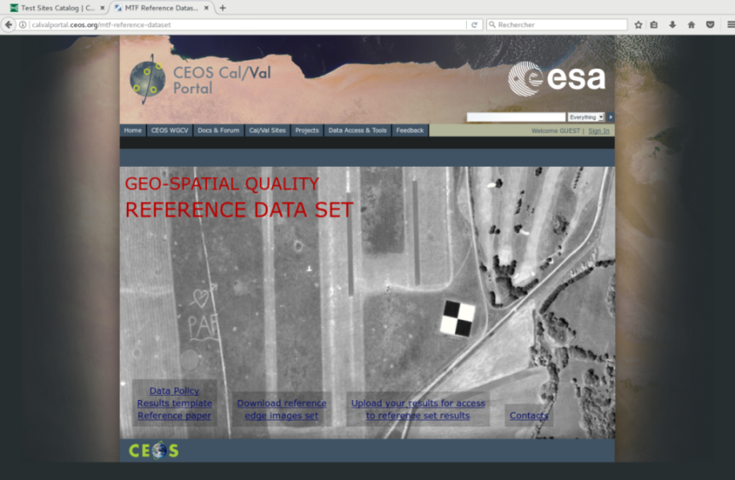
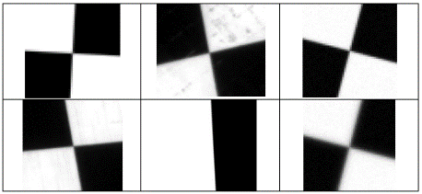
IVOS MTF TASK GROUP: 2018 ACHIVEMENTS
Goal: to enable agencies and commercial operators to develop and/or validate their MTF assessment method in a consistent manner
Achieved: Reference dataset created and published on CalVal portal with associated paper (7 organizations, 4 countries) describing methods
Comparison of MTF measurements using the edge method: towards a reference dataset
Françoise Viallefont-Robinet, Dennis Helder, Renaud Fraisse, Amy Newbury, Frans van den Bergh, DongHan Lee, and
Sébastien Saunier
Optics Express Vol 26, Issue 26, 33625-33648, 2018
https://doi.org/10.1364/OE.26.033625

Slide 10
PICSCAR Joint with GSICS lead P Henry CNES
Pseuodo invariant sites used for Rad L1 Cal/comparison/monitoring
Work-plan
Bi-monthly community Telecons/webex to discuss methods and how to establish/compare (BRDF, Atmosphere, surface spectral reflectance)
Organise comparison exercises to assess community state of the art
CNES established draft web ‘portal’
Hosted on/via CalVal portal
Good practises on how to use
Repository of observations
Repository of comparison results
Characteristics of PICS and tools for users
NPL & CNES to consider how to evaluate Uc
Goal to establish a TOA ‘Radiance simulator’

Slide 11
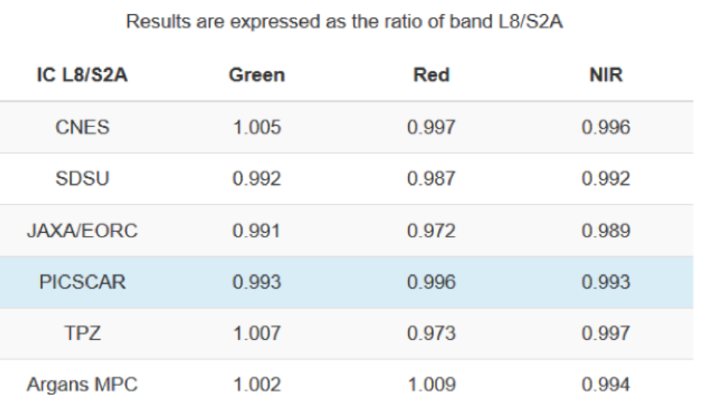
Comparisons
Evaluate consistency of data extraction/data sets for Landsat 8 and Sentinel 2 (Libya 4) (initially some variances)
Define and supply a common set of data to participants for independent processing
Exercise 1: Intercompare L8 against S2A as Reference
Exercise 2: Intercompare MODIS Aqua against MERIS
Exercise 3: Assess the BRDF of the site (own model) to normalise MERIS TOA reflectance to a specific geometry.
results for Exercise 1)

Slide 12
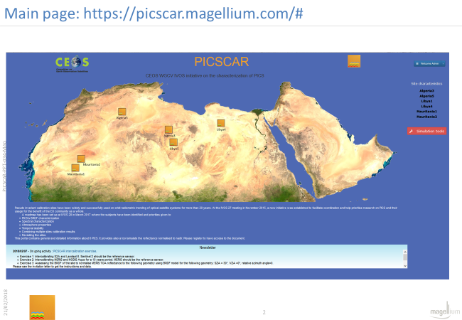
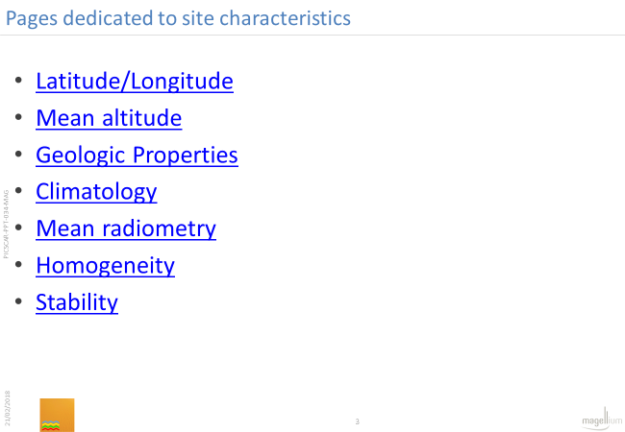
PICSCAR portal to be linked from Cal/Val portal

Slide 13
Picscar current status/action

Slide 14
Next steps

Slide 15
Sand database

Slide 16
Laser based Cal facility for imaging spectrometers

Slide 17
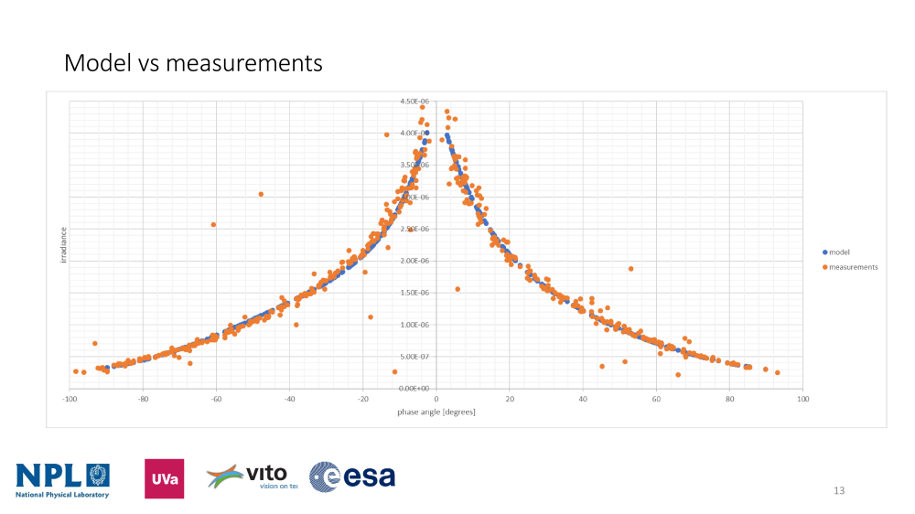
ESA project to measure lunar irradiance as a Cal reference
Define a strategy to derive the model regression coefficients (ROLO based) from the lunar measurements
Derive regression coefficients from database of measurements
Measurements uncertainty propagation in to the model parameters / regression coefficients

Slide 18
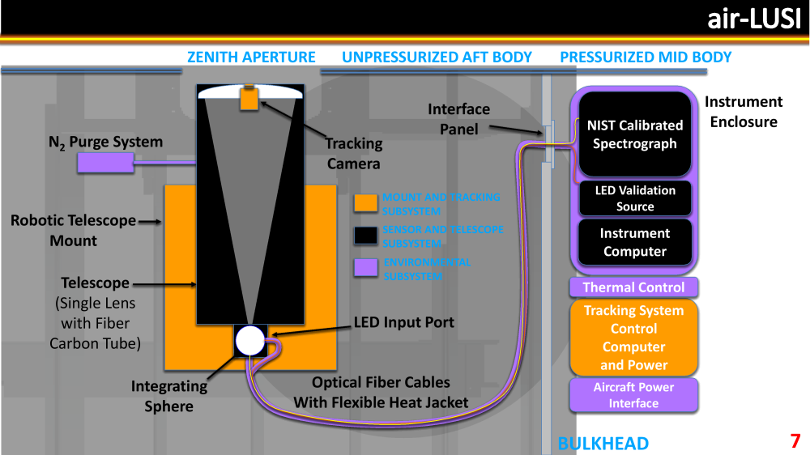
Absolute Lunar radiance Cal from High altitude aircraft

Slide 19
Solar Spectral Irradiance SWIR anomaly
New analysis provides debate in SWIR (same data nature of correction for
instrument drift!!. Organising joint GSICS/WGCV and solar community webex

Slide 20
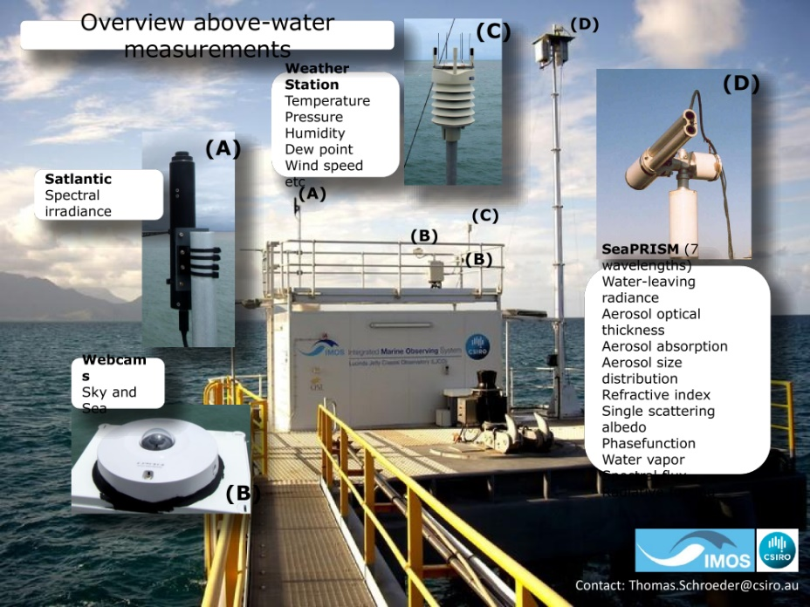
Australia: Examples

Slide 21
Hyperspectral imagers

Slide 22
Metrological approach to present & assess uncertainties

Slide 23
Ocean Colour workshop conclusions
Community actions/requests
Space agencies should encourage
development of FRM quality data and move
towards only using such data for Cal/Val
Compare instruments and develop consensus protocols including Uc analysis
Establish specifications for next generation hyperspectral validation systems to meet future satellite needs
~ 40 attendees
4 continents
Industry and agencies
Established consensus view/strategy
Proceedings in special issue of
remote sensing
Regular global (interlinked regional)
comparisons including training (lab and field
Agencies to ensure fully operational
(redundant) SVC systems (ideally at least 3)

Slide 24
European Metrology Network for Climate and Ocean observation
Single focal point for whole European metrology community (All Major NMIs members)
Building collaborative partnerships with those making and using observations
Strategic coordination of European metrology research to respond to real community needs
(one theme Earth Observation and associated FRM/in-situ validation activities
Seeks input to define work program
European delivery at present but anticipate creating a global network with America and Asia
For more information, see: www.euramet.org/climate-ocean email: ClimOcNet@euramet.org

Slide 25
IVOS Key actions/conclusions
ARD – consensus of IVOS was to accept the Card4L ‘threshold’ specs with the hope that these will evolve with time and are prepared to help assess compliance
Cal/Val portal and testsite naming convention: IVOS keen to make use of portal and to encourage its use with links made to it (assuming content there) via presentations/papers etc - Broadly happy with testsite naming convention proposed
Further review Solar spectral irradiance: Initiate webex with GSICS
Encourage agencies (particularly with hyperspectral sensors) to collect and provide data over CEOS radiometric sites (PICS)

Slide 26
Key actions/conclusions
Support to ACVC- GHG: If helpful could look at:
how to collate info to optimise pre-flight cal of sensors
requirements and methods (pre-flight cal workshop)
How to collate sites suitable for vicarious radiometric post-launch Cal/Val.
Thermal IR: consider holding workshop on thermal IR domain at next IVOS & potential prep for next comparison?

Slide 27
Summary
IVOS active team expanding (good global coverage- agency and industry)
Thematic projects working effectively with motivated champions: Number sometimes make logistics for meetings an issue but are working well between IVOS plenaries via webex etc
Looking for good examples of ‘impact’
Many collaborations with GSICS and supporting VCs
Keen to revitalise and use Cal/Val portal as the community interface
Plan to have session on Thermal Sensors at next IVOS.
Still need to engage and bring on-board some agencies

