Slide 1
Working Group on Calibration and Validation Land Product Validation (LPV) Subgroup Report
Chair: Fernando Camacho (EOLAB / U. Valencia)
Secretariat: Jaime Nickeson (SSAI/NASA Goddard)
& Focus Area leads

Slide 2
Land Product Validation (LPV) Our Mission: Coordinate quantitative validation of satellite-derived land products in a traceable way and increase the quality and efficiency of global satellite product validation Our Vision: Land products algorithms are iteratively improved based on validation results Reliable uncertainty information is only determined through community agreed good practices for validation using fiducial measurements or other suitable references

Slide 3
LPV Focus Areas and Co-leaders
Snow Cover*, Sea Ice | Thomas Nagler (ENVEO, Austria) |  | Vacant | Vacant
Surface Radiation (Reflectance, BRDF, Albedo*) | Zhuosen Wang (NASA GSFC) |  | Dominique Carrer (Meteo-France) | Dominique Carrer (Meteo-France) |  |  | Ian Grant (Australia)
Land Cover and Land Use Change* | Pontus Olofsson (Boston University) |  | Sophie Bontemps (University of Louvain) | Sophie Bontemps (University of Louvain)
Biophysical variables (FAPAR*, Leaf Area Index* ) | Sylvain Leblanc (Natural Resources Canada) | Marie Weiss (INRA) |  |  | Hongliang Fang (Chinese Academy of Science) | Hongliang Fang (Chinese Academy of Science)
Fire* (Active Fire, Burned Area) | Luigi Boschetti (University of Idaho) | Gareth Roberts (U. Southampton, UK) |  |  | Andrew Edwards (Charles Darwin U.) | Andrew Edwards (Charles Darwin U.)
Land Surface Temperature* (LST and Emissivity) | Glynn Hulley (NASA JPL) |  |  | Frank Goettsche (KIT, Germany)
Soil Moisture* | Michael Cosh (USDA ARS) |  |  | Carsten Montzka (Jülich Research Centre)
Land Surface Phenology | Joshua Gray (University of Montana) |  |  | Victor Rodriguez-Galiano (Universidad de Sevilla)
Vegetation Index | Tomoaki Miura (University of Hawaii) |  |  | Else Swinnen (VITO)
Above Ground Biomass* | Laura Duncanson (GSFC) | John Armston (UMD/UQ, Australia) |  |  |  | Mat Disney (U. College London, UK)
Vice-Chair position is currently vacant !
If you know a suitable candidate from a non-European Agency, please let us know.
FAPAR and LAI were recently merged into Biophysical variables (similar ground data collection, product algorithms and validation)
*Essential Climate Variable (ECV) as defined by GCOS
Co-lead: sitting, recent, vacant, ex-officio

Slide 4
CEOS LPV Subgroup Composition
11 (44%) Gov’t : 11
9 (36%) Academia: 14
3 (12%) Male: 20 (80%)
1 ( 4%) Female: 5 (20%)
1 ( 4%)
25 members
3-year appointments (10 new openings in Dec 2016) + one possible extension
LPV Chair & Vice-Chair Goals: To ensure geographic, thematic, and gender diversity.

Slide 5
LPV Subgroup Objectives
To foster and coordinate quantitative validation of global land products derived from remotely sensed data, in a traceable way, and to relay results to users.
To increase the quality and efficiency of global satellite product validation by developing and promoting international standards and protocols for:
Field sampling
Scaling techniques
Accuracy report and use
Data and information exchange
To improve quality of ground references used for product validation
Field campaigns for fiducial references
Identification of supersites for validation
To provide feedback to international structures for:
Requirements on product accuracy and quality assurance
Terrestrial ECV/EBV measurement standards

Slide 6
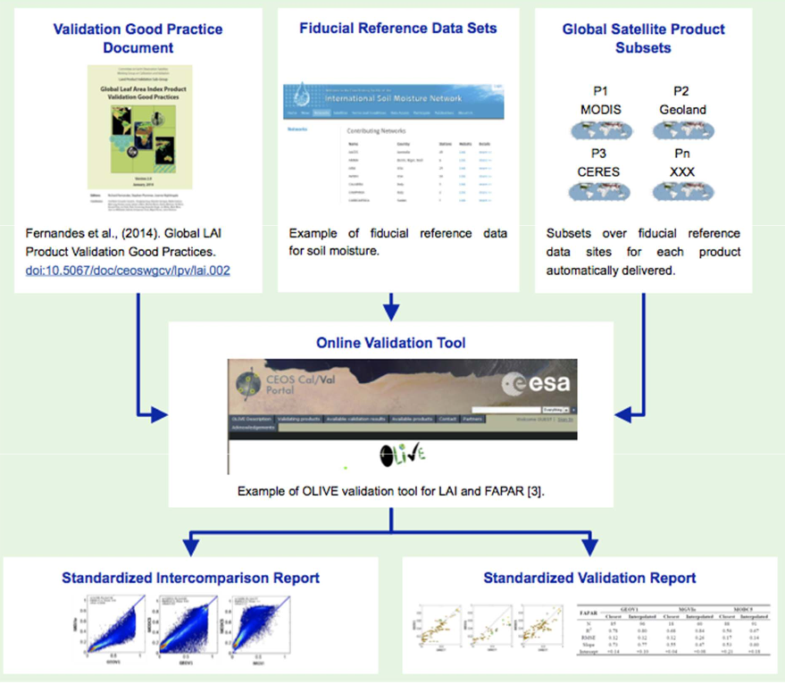
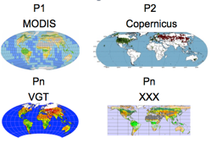
LPV Validation Framework
Lead Agency: NASA
Lead Agencies: Various
Lead Agencies: USGS/NOAA
VALIDATION STAGES
Lead Agencies:
ESA/NASA/USGS
Lead Agency: ESA/NASA/USGS

Slide 7
Recent Achievements
CARB Actions – Biomass Validaiton white paper published, Biomass protocol – in internal review, identification of supersites ongoing
Surface Albedo validation protocol – to be endorsed at this meeting
CEOS LPV Supersite network – Working towards a European network of land product supersites
GCOS surface reference network (GSRN)
LST – MODIS, VIIRS, and ECOSTRESS stage 1 validation complete
WP AGRI-13 action : GEOGLAM-ARD+
LPV VI Focus Area Meeting, Washington, DC - December 2018
Outreach – Contributions to LPS workshop on Biomass, VI, Albedo, LPV overall
LPV Plenary – Set up the Strategy and Action Plan for the Chair term (Q2 2019 -Q1 2022)

Slide 8
CARB-16: Cal/Val and production of biomass products from CEOS missions
CARB-16-2018-2 : Review paper on the Importance of Biomass Product Validation.
Background paper on the biomass validation protocol
Published in Surveys in Geophysics
https://rdcu.be/bFdVw

Slide 9
CARB-16:Cal/Val and production of biomass products from CEOS missions
CARB-16-2018-3 : CEOS WGCV LPV Biomass Product Validation protocol
CV- 19: Biomass validation protocol

Slide 10
CARB-16:Cal/Val and production of biomass products from CEOS missions
CARB-16-2018-5 : Establishment of biomass validation supersites
Proposed biomass super sites (under review)
A subset of data rich Multi-Mission Sites that have been identified as serving all missions

Slide 11
Surface Albedo Product validation protocol
Following the LAI and LST validation protocol, the Radiation group has finished in 2019 the Global Surface Albedo Validation good practices protocol.
METRICS O FOTO BONITA
Authors: Wang, Z., Schaaf, C., Lattanzio, A., Carrer, D., Grant, I., Román, M., Camacho, F., Yu, Y., Sánchez-Zapero, J. & Nickeson, J.
https://doi.org/10.5067/doc/ceoswgcv/lpv/albedo.001

Slide 12
CEOS LPV Supersite network Towards an European network of land product supersites
Super characterized (canopy structure and bio-geophysical variables) site following well-established protocols useful for the validation of (at least 3) satellite land products and for radiative transfer modeling approaches.
Active, long-term operations, supported by appropriate funding and infrastructural capacity.
Supported by airborne LiDAR and hyperspectral acquisitions (desirable).
https://lpvs.gsfc.nasa.gov/LPV_Supersites/LPVsites.html
Notes:
Teleco to coordinate FLEX, FRM4VEG, EC GBOV, DATE
ESA FRM4Veg to set up 2 permanent site based on CEOS LPV supersites
GBOV instrumenting new supersites (Valencia AS)
LIST OF POTENTIAL SITES
MAXIMIZE THE INTEREST OF AGENCIES
NEED FOR INCREASING COVERAGE

Slide 13
GSRN – GCOS Surface Reference Network
Contribution to the GCOS Surface Reference Network (GSRN) (GCOS-226), a proposal for the establishment of a GCOS Surface Reference Network, with the support of the GCOS programme
Terrestrial ECVs (LAI, FAPAR, Albedo..) considered (in addition to mandatory atm. ECVs)
https://library.wmo.int/index.php?lvl=notice_display&id=21404#.XR4ENOgzZPY

Slide 14
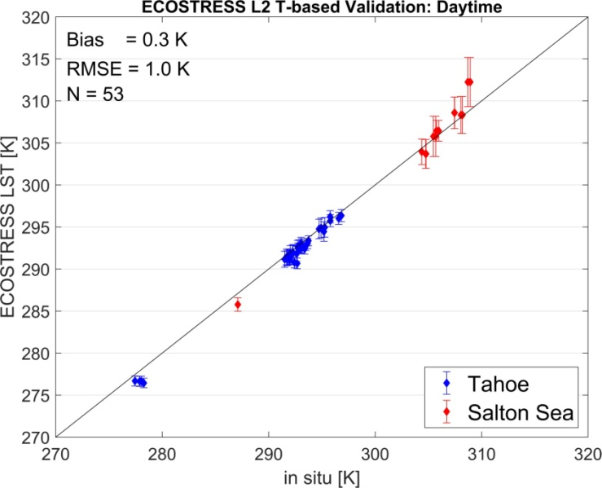
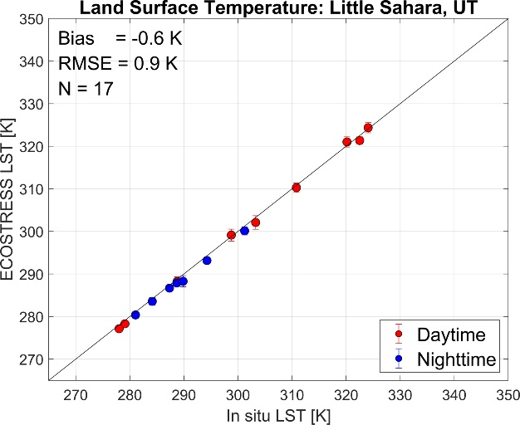
MODIS,VIIRS and ECOSTRESS LST validation
ECOSTRESS LST validation following LPV protocols:
Temperature-based
Radiance-based
Sensor inter-comparison
First validation results for ECOSTRESS LST product indicate an RMSE of about 1.0 K
Validation results of MODIS and VIIRS LST (MOD21/VNP21) were also reported.
Notes:
Other activities to be conducted in ESA CCI , FRM4ST

Slide 15
AGRI-13: GEOGLAM – ARD+
GEOGLAM initiative to propose Essential Agriculture Variables (EAVs)
Dedicated workshop
23-24 October 2019 (Belgium)
Sophie Bontemps, UCL, LPV Land Cover co-lead, to act as coordinator between CEOS GEOGLAM initiative and CEOS LPV in response to CEOS WP AGRI-13 action
EAVs to be produced by CEOS Agencies in GEOGLAM
Land Cover validation protocol
Starting with cropland validation (one-class product)
Already some effort through the JECAM community
Generalize to LC product
Due in Q4 2020
Notes:
Other activities to be conducted in ESA CCI

Slide 16
LPV VI Focus Area Meeting
https://lpvs.gsfc.nasa.gov/LPV_Meetings/VI_FA_meeting_2018.html
December, 12, 2018. Washington, 22 attendees
The workshop participants agreed to the statement
CEOS LPV recommends that the validation document of a VI product include: 1) product QA information, 2) uncertainty information obtained via validation (NIST-traceability), and 3) product inter-comparison results
The workshop participants agreed to adopt the “time series validation” approach as a standard VI validation methodology where it focuses on how well VI products capture the seasonal evolution of vegetation. Recommended time series data for this approach includes: FLUXNET (GPP), NPN, Phenocam, and PEN data sets.

Slide 17
Outreach
LPV presentation at the Living Planet Symposium, Milan 2019:
CEOS LPV good practices, F.Camacho et al
LPV Albedo protocol, Z.Wang et al
Biomass protocol, L. Duncanson et al
LPV VI intercomparison methods, E. Swinnen et al.
IGARSS 19 Japan Session on:
Biophysical variables
2019 Fall AGU Sessions on:
Surface Temprearture
Surface Albedo

Slide 18
LPV Plenary Meeting
https://lpvs.gsfc.nasa.gov/LPV_Meetings/LPV_plenary2019.html
Date: May 15, 2019
Side event to the ESA Living Planet Symposium, Milan (Italy)
Objectives:
Discuss the LPV overall strategy and priorities for the Chair’s term: Define the LPV Action plan ( Q2 2019- Q1 2022)
Exchange information with ESA and Copernicus services to foster collaboration for validation of satellite products
Data and information exchange
Outcome:
LPV Action Plan 2019-2022 :
28 Actions identified
5 LPV Recommendations
Action Plan and all presentations are available at the LPV web site

Slide 19
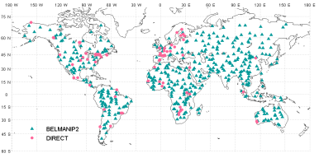
LPV Strategy
Lead Agency: NASA
Lead Agencies: Various
Lead Agencies: USGS/NOAA
Global sampling
Increase the quality and efficiency of global satellite product validation
Operational Services
Lead Agency: Various

Slide 20
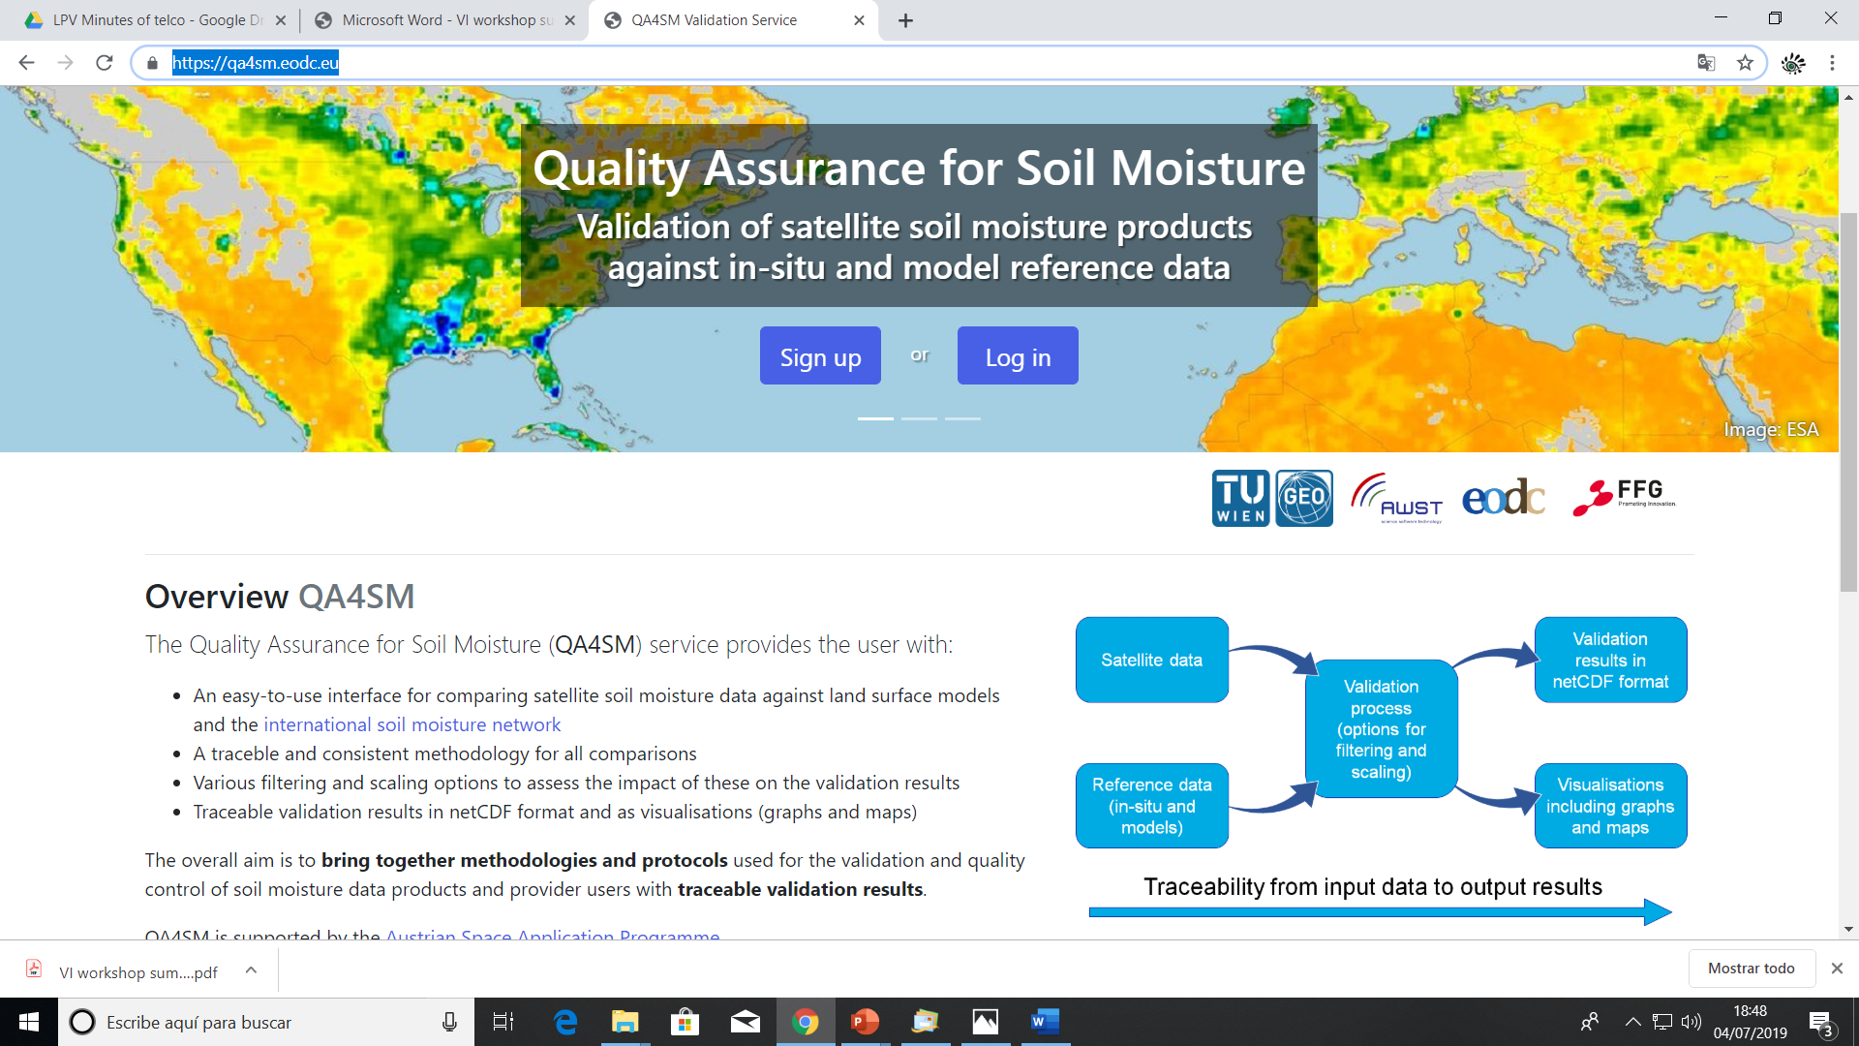
Validation tools

Slide 21
LPV Strategy (Q2 2019- Q1 2022)
As Chair, my primary goal is to increase the efficiency and quality of global satellite Land Product Validation (achieving higher validation stages) while assuring a well-functioning LPV Subgroup.
Strategy based on 4 main components:
Continuous Development of Good Practices for global satellite land product validation
Biomass protocol almost ready
Soil Moisture, Vegetation Indices, Land Cover, Active Fire and Phenology validation protocols are beginning development now. The objective is to have them ready for community review in about two years from now.
Surface Reflectance validation protocols need to be written. Strategic action within LPV (SR input for most variables).
Coordination with ESA FRM4VEG, CEOS IVOS, ACIX, WGCV, Australian government, initiative required. (LPV-R-2019-1) (LPV-R-2019-2).
8 Actions identified ( Biomass, SM, VI, LC, AF, BA, LSP, BIO) , 2 Recommendations
Notes:
Current focus area leads are responsible for producing a validation protocol for their respective variables describing current methods and good practices within their respective communities. Some of these documents have been produced, and the following are in the pipeline:
Biomass protocol (contribution to CEOS CARBON strategy, CARB-16 and WGCV-19) under internal evaluation. Expected in Q4 2019.
Soil Moisture, Vegetation Indices, Land Cover, Active Fire and Phenology validation protocols are beginning development now. The objective is to have them ready for community review in about two years from now.
LAI protocol needs to be updated to cover new in-situ tools and good practices for high resolution products. The protocol document can also be updated to incorporate FAPAR as well. Expected for Q4 2021.
Surface Reflectance protocols need to be written. ESA is developing protocols for fiducial references and product validation under the FRM4Veg project. Similar exercises are being conducted by the Australian government. Moreover, the WGCV IVOS subgroup proposed that validation of surface reflectance to be subject of a new task force or extension of ACIX (IVOS R-2018-1). This is of strategic need also for LPV subgroup as surface reflectance is the input for most of our land products.

Slide 22
LPV Strategy (2019-2022)
Improving ground references to achieve higher validation stage by improving uncertainty characterization and spatio/temporal coverage
Support the collection of Fiducial Reference Measurement contributing to field campaigns and data collection. LPV members are actively involved in ESA FRM4Veg and FRM4LST projects among others.
Seek collaborations with nationally funded terrestrial ecosystem networks (e.g. TERN Australia, NEON USA, ICOS in EU) and other networks to help with the expansion of validation supersites.
Expand land product validation supersites network. A key objective is to support the establishment of a European Network of validation supersites where current activities conducted by ESA (FRMVeg, FLEX) and EC (CLMS) could converge
Complete the list of Biomass supersites for the validation of biomass products (CARB-16 action, ESA/NASA). Expected for Q4 2019.
Analyze the scientific quality of reference datasets before promoting them for validation (e.g. GBOV , ICOS datasets).
Contribute to databases for gathering ground references for validating high resolution products.
5 Actions, LPV Recommendations R-2019-2 , R-2019-3
Notes:
Current focus area leads are responsible for producing a validation protocol for their respective variables describing current methods and good practices within their respective communities. Some of these documents have been produced, and the following are in the pipeline:
Biomass protocol (contribution to CEOS CARBON strategy, CARB-16 and WGCV-19) under internal evaluation. Expected in Q4 2019.
Soil Moisture, Vegetation Indices, Land Cover, Active Fire and Phenology validation protocols are beginning development now. The objective is to have them ready for community review in about two years from now.
LAI protocol needs to be updated to cover new in-situ tools and good practices for high resolution products. The protocol document can also be updated to incorporate FAPAR as well. Expected for Q4 2021.
Surface Reflectance protocols need to be written. ESA is developing protocols for fiducial references and product validation under the FRM4Veg project. Similar exercises are being conducted by the Australian government. Moreover, the WGCV IVOS subgroup proposed that validation of surface reflectance to be subject of a new task force or extension of ACIX (IVOS R-2018-1). This is of strategic need also for LPV subgroup as surface reflectance is the input for most of our land products.

Slide 23
LPV Strategy (2019-2022)
Promote validation and intercomparison exercises (products and algorithms) with CEOS main agencies in collaboration with operational services (e.g., EC Copernicus Services).
Identify opportunities for international coordination and collaboration in validation and intercomparison of satellite land products.
Eg., Albedo and VI focus areas will conduct intercomparison and validation exercises in collaboration with Copernicus Services.
Eg., ECOSTRESS LST Validation
Contribute to Biomass intercomparison exercise-2 (BRIX-2) (MAAP platform)
Promote a surface reflectance validation and intercomparison exercise (TBD, WGCV-45).
5 Actions, LPV Recommendation R-2019-4
Improve LPV communication with stakeholders ( web page, newsletter, symposiums, thematic workshops)
Notes:
Focus area leads are responsible to promote intercomparison and validation exercises and relay results to users in the form of publications. This should be done in collaboration with the international community and using good practices for validation when available.

Slide 24
LPV Strategy (2019-2022)
Improve LPV focus area communication with stakeholders ( web page, newsletter, symposiums, thematic workshops)
Promote special sessions in symposiums and conferences. The Chair and secretariat to organize sessions at AGU and EGU conferences.
Each focus area will organize Topical workshops (at least 1 during this three-year period) to address specific land product validation issues, inter-comparison activities and review of CEOS endorsed, community consensus protocol documents.
Keep the LPV Subgroup website updated (at least annually).
The LPV Subgroup distributes an annual community newsletter each Fall. To add new young scientists to each focus area listserv is highly encouraged.
The LPV focus area leads will distribute newsletter to their own listserv, approximately 6 months from the distribution of LPV-wide newsletter, keeping their community apprised of focus area activities.
7 Actions, including 3 already planned workshops (Bio, VIs, LC)
Notes:
We want our listserv to feel like they are a part of LPV, and this is done in part by keeping them informed of LPV activities.

Slide 25
LPV Action Plan (Q2 2019- Q1 2022)
https://lpvs.gsfc.nasa.gov/LPV_Meetings/LPV_plenary2019.html
LPV Strategy for this period based on 4 components:
Continuous Development of Good Practices for global satellite land product validation
Improving ground references to achieve higher validation stage by improving uncertainty characterization and spatio-temporal coverage
Promote validation and intercomparison exercises
Improve LPV communication with stakeholders
28 Actions Identified (to be updated annually):
CEOS WP 2019-2022 (CARB-16, AGRI-13): 4 actions
Good practices protocols writing : 8 actions
Supersites and in-situ references: 4 actions
New Inter-comparison exercises: 2 Actions – BRIX-2, SR round-robin
Validation and inter-comparison of satellite products: 3 actions (Albedo and VIs)
Outreach and communication: 7 Actions

Slide 26
LPV Recommendations
LPV R-2019-1: To promote FRMVeg protocols under CEOS WGCV, to involve other agencies to achieve the necessary international consensus on Surface Reflectance and FAPAR validation protocols.
LPV R-2019-2: To adopt Fiducial Reference Measurement concept in the CEOS LPV and modify the validation hierarchy table accordingly
LPV R-2019-3: To endorse biomass supersites as CEOS WGCV cal/val sites (contribution to CARB-16).
LPV R-2019-4: In collaboration with IVOS, propose a new CEOS WGCV surface reflectance validation and intercomparison exercise lead by ESA and NPL (UK) in the framework of FRM4Veg.
Additional
LPV R-2019-5: That the EC Copernicus Land Monitoring Service perform an independent quality assessment of EC GBOV procedures and database. The LPV community stresses that this evaluation is mandatory to qualify the GBOV database as CEOS reference datasets for validation activities. The LPV focus area experts propose to act as external evaluators in this independent review process.

Slide 27
CEOS LPV 5-Year Roadmap
< 2018 2019 2020 2021 2022
Operational Validation Framework (Lead : USGS/NOAA)
Operational Validation in Services (Lead : EC Copernicus)
LST & Albedo protocols
Burned Area, VI, Soil Moisture LC, Phenology, FAPAR, AF Protocols
Vision
Mission
CEOS Carbon Actions
Biomass Protocol (Lead : NASA)
Land products algorithms are iteratively improved based on validation results. Reliable uncertainty information is only determined through community agreed good practices for validation using fiducial measurements or other suitable references
Coordinate quantitative validation of satellite-derived land products in a traceable way
Increase the quality and efficiency of global satellite product validation by developing good practices and standards
protocols for Snow (Lead : ESA)
2
WGCV ACIX (Lead: ESA)
Biomass validation & Intercomparison (Lead: ESA/NASA)
WGCV ACIX- 2 , Cloud Masking IX (Lead: ESA/NASA)
SR RR intercomparison & Validation
Field Data
Definition of LPV Supersites , carbon supersites, supporting FRM campaigns, new supersites
New Missions
Biomass
Sustained Missions
a/b
b
Morning
c
EPS-SG
Afternoon
Landsat 9
Terra/Aqua/S-NPP
JPSS-1
JPSS-2

Slide 28
Thank you for your attention ! https://lpvs.gsfc.nasa.gov/

