Slide 1
Microwave Sensors Subgroup (MSSG) Report
Xiaolong DONG, MWSG Chair
National Space Science Center, Chinese Academy of Sciences
&
National Remote Sensing Center of China
(NSSC/CAS, NRSCC)
Email: dongxiaolong@mirslab.cn
CEOS WGCV-45 July 16-19, Perth, Australia

Slide 2
OUTLINE
Missions and objectives
Focuses
Update from WGCV-43
Recommendations

Slide 3
Missions & Objectives of MSSG
Missions:
The mission of the Microwave Sensors subgroup is to foster high quality calibration and validation of microwave sensors for remote sensing purposes. These include both active and passive types, airborne and spaceborne sensors.
Objectives
Facilitate international cooperation and co-ordination in microwave sensor calibration / validation activities by sharing information on sensor development and field campaigns.
Promote accurate calibration and validation of microwave sensors, through standardization of terminology and measurement practices.
Provide a forum for discussion of current issues and for exchange of technical information on evolving technologies related to microwave sensor calibration / validation.
Provide calibration/validation support to CEOS virtual constellations and data application groups/communities by coordination of reference sites for both passive and active microwave sensors, and standardization of quality assurance of microwave remote sensing data.

Slide 4
MSSG covers passive and active…
All EO sensors operated in microwave spectrum, except SAR
Works currently focuses on: MWR, SCAT, ALT
Microwave Radiometers (sounders, imagers) (MWR)
Radar Scatterometers (surface and volume) (SCAT)
Radar Altimeters (ALT)
GNSS-RO and reflectrometry
With current emphasis on
Radar Scatterometers (Ocean and land surface)
Microwave Radiometers (Passive Microwave)

Slide 5
Subgroup current focuses
Objectives
Support CDR from microwave;
Support CEOS VCs;
Benefit member agencies and communities;
Priorities and focuses
SCAT Level 1 data calibration
Backscattering coefficient for radar scatterometer
MWR calibration standards
MWR Onboard calibrator (noise source, RAM blackbody)
Prelaunch measurement and characterization
Models and algorithms supporting CDR

Slide 6
Updates from WGCV-44
Confirmation of calibration/cross-calibration requirements for radar scatterometers for ocean surface wind vector
Standard/guideline for calibration of passive microwave sensors
Interaction with GSICS-Microwave Subgroup and joint work for Cal/val of passive microwave sensors

Slide 7
Focus group for calibration/validation of scatterometry for OSVW
Participants
No. | Name | Organization | Country
1 | Xiaolong Dong | National Space Science Center (NSSC), CAS | China
2 | Di Zhu | National Space Science Center (NSSC), CAS | China
3 | Risheng Yun | National Space Science Center (NSSC), CAS | China
4 | Honggang Yin | National Satellite Meteorological Center (NSMC), CMA | China
5 | Juhong Zou | National Satellite Oceanic Application Service (NSOAS) | China
6 | Bo Mu | National Satellite Oceanic Application Service (NSOAS) | China
7 | Wenming Lin | Nanjing University of Information Science and Technology | China
8 | Stefanie Linow | EUMETSAT
9 | Ad Stoffellen | Koninklijk Nederlands Meteorologisch Instituut (KNMI) | Netherlands
10 | Marcos Portabella | Institut de Ciències del Mar (ICM-CSIC) | Spain
11 | Raj Kumar | Indian Space Research Organisition (ISRO) & CEOS OSVW VC | India
12 | Paul Chang | NOAA/NESDIS/STAR & CEOS OSVW VC | USA

Slide 8
Focus group for calibration/validation of scatterometry for OSVW
Objectives
Develop guideline/standard for calibration of radar scatterometer for ocean surface winds;
Develop and validate algorithm and method for radar scatterometer calibration with global ocean NWP data;
Identify and organize data for calibration and cross-calibration of radar scatterometer for ocean surface vetor wind

Slide 9
Focus group for calibration/validation of scatterometry for OSVW
Progresses after WGCV-44
Organize focus group for calibration/validation of scatterometer for OSVW
Discussion and confirmation with OSVW-VC (Paul Chang) about the requirements
Practices of NWP Ocean calibration of CFOSAT scatterometer

Slide 10
CFOSAT SCAT Calibration
CFOSAT: launched on Oct 29, 2018
Rotating fan-beam scatterometer
Calibration requirements:
Antenna pattern related L1B data processing for sigma 0
A joint work by NSSC, NSOAS, KNMI and ICM

Slide 11
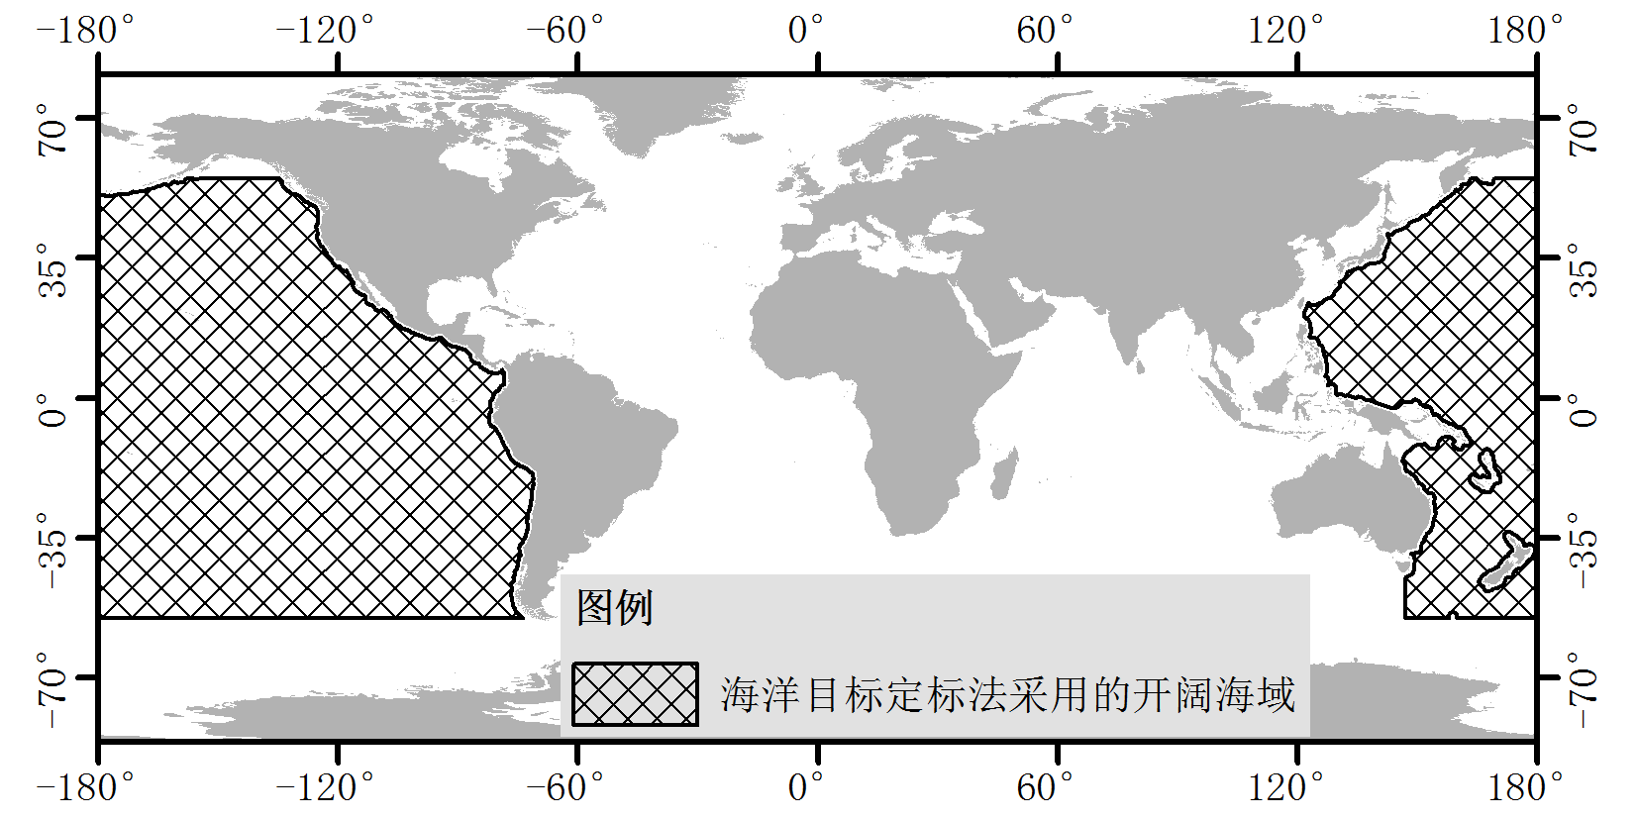
CFOSAT SCAT Sigma0 Calibration on L1B Data
The ocean calibration method utilizes the simulated sigma0 by GMF and the CFOSAT SCAT wind data in open ocean.
GMF: NSCAT-4 model. This was correspondingly chozen for the L2B wind inversion.

Slide 12
Ku-band NOC method per WVC
—
Binning in NWP speed i and direction j
QC switch (rain)
GMF
Integrate direction j uniformly
Scatterometer
product
NWP winds
Integrate over speed PDF

Slide 13
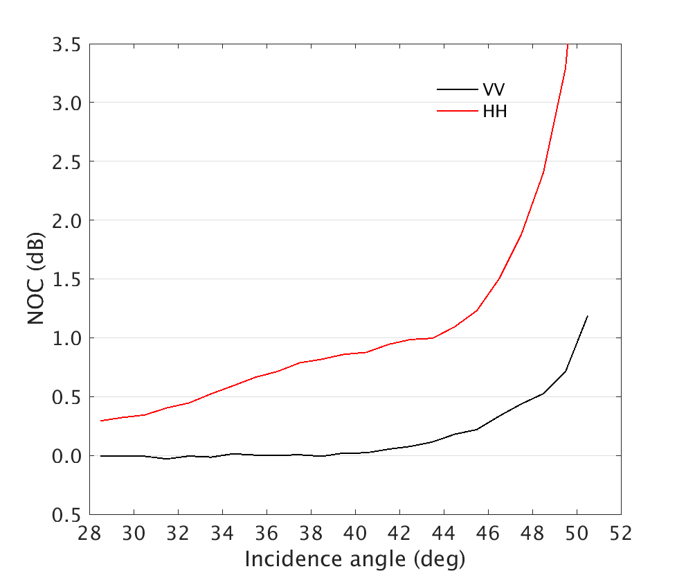
CFOSAT SCAT Sigma0 Calibration on L2A Data
CFOSCAT NOC coefficients based on the L2A products

Slide 14
Focus group for calibration/validation of scatterometry for OSVW
Next step plan
Further confirmation with OSVW-VC about the requirements
Organize group workplan
1) draft guideline/standard objectives;
2) summary and review of past and current practices;
3) identify requirements and availability of data for calibration
4) organize group for future collaborated calibration/validation

Slide 15
Standard/guideline for calibration of passive microwave sensors
Progresses after WGCV-44
Standard of calibration/validation of spaceborne microwave radiometer promotion by SAC (Standardization Administration of China) to ISO TC-211 WG6
ISO/NP TS 19159-4, Geographic information -- Calibration and validation of remote sensing imagery sensors -- Part 4: Space-borne passive microwave radiometers was accept for development in June, 2019
Call for experts and participation
Spain/UPC, Russia/VNIIFTRI confirmed

Slide 16
Interaction with GSICS-Microwave Subgroup and joint work for Cal/val of passive microwave sensors
Organize a research group in collaboration with GSICS MW group, to identify and confirm the requirement for pre-launch calibration;
Development of techniques for re-calibration/re-processing of historical data.

Slide 17
Requirement for GSICS Microwave: At CGMS-46
Draft list of plenary actions resulting from CGMS-46 discussions (11 June 2018): https://www.cgms-info.org/Agendas/WP/CGMS-46-CGMS-WP-29
WGI actions open from previous plenary sessions (at CGMS-46)
Actionee | AGN item | Action # | Description | Action feedback/ closing document | Deadline | Status | HLPP ref
GSICS | F | A46.xx | On passive microwave observations: GSICS is requested to organise an expert meeting on the intercalibration of operational PMW sensors to meet the WIGOS 2040 targets for a coordinated effort to share information on current and future PMW instruments and report to CGMS-47 (CGMS-46-EUM-WP-14) |  | CGMS-47 | OPEN
Future Joint Meeting between the CEOS/WGCV and GSICS microwave groups:
CEOS/WGCV develop better instrument design strategy and pre-launch calibration algorithms by learning the knowledge of data quality issues and inter-calibration algorithms from GSICS group.
GSICS develop better re-calibration and inter-calibration algorithms by learning the instrument design and pre-launch calibration issues from the CEOS/WGCV group

Slide 18
Next step workplan
Summary and development of calibration/validation of passive microwave sensors
Radiometric standard target for MW
Prelaunch calibration requirements and implementation
In-orbit calibration/cross-calibration/validation
Call for more paticipating agency/focus group members (ISO TC211 WG6 expects collaborated work with WGCV on passive microwave)

Slide 19
GSICS MW group focuses and WGCV MSSG focuses
GSICS-MW group focuses
Inter-calibration
Data standards
WGCV MWSG focuses supporting GSICS requirements:
Priorities of specific activity areas for interaction with GSICS
Prelaunch calibration for characterization of sensors
Guidelines/standards for prelaunch calibration: specifications, procedures and processing
Postlaunch CAL/VAL for monitoring of calibration parameters, by collaborating with GSICS MW group
Standards toward SI traceability of MW radiometric reference (passive/active noise standards)

Slide 20
Recommendations to WGCV-45
Calibration/cross-calibration of scatterometer for OSVW
Propose a joint task between WGCV and OSVW-VC development of guideline/standard for calibration/cross-calibration of radar scatterometer for ocean surface wind vector.
Calibration/validation of passive microwave sensors
Call for agency participation for development of guideline/standards for calibration/validation of space passive microwave sensors

