Slide 1

CSIRO Centre for Earth Observation
Alex Held

Slide 2
CSIRO - Australia’s Government Science Agency
New
ecosystems, industries and utilities
Universities (domestic and international)
Industry, SMEs,
Governments,
NGOs
Applied
Pure
Basic
CSIRO
Tech Development
Production

Slide 3
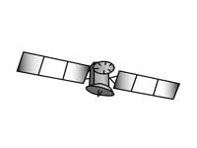
CSIRO Business Units and Facilities
Agriculture and Food
Astronomy and Space Science
Energy
Health and Biosecurity
Land and Water
Manufacturing
Mineral Resources
Oceans and Atmosphere
National Telescope Facility
Animal Health Laboratory
Data61
Marine Facility
National Computational Infrastructure
National Collections
NovaSAR

Slide 4

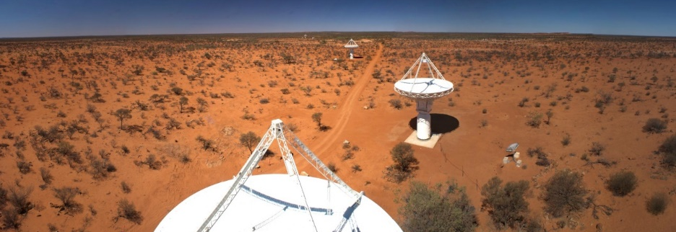
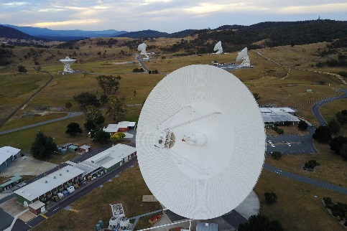
CSIRO Astronomy and Space Science
Home to three of Australia’s national space facilities
    Australia Telescope National Facility
    Canberra Deep Space Communication Complex (NASA DSN) + New Norcia (ESA)
    NovaSAR Research Facility
Home to CSIRO’s Space Program (Sarah Pearce):
  CSIRO Centre for Earth Observation (Alex Held)
  Space Technologies Future Science Platform (Kimberley Clayfield)
  DMTC HAAS Program
  CSIROSat-1 CubeSat, etc.
Image credits: CSIRO

Slide 5
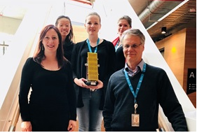
CSIRO Centre for Earth Observation (CCEO)
Since June 2018
CSIRO has been working in the space sector for 75 years, looking into outer space and EO
The ‘Centre’ w. staff in Canberra, Adelaide, Sydney, Perth and Hobart, connects ~80 CSIRO EO scientists across the country housed in 6 Business Units, running projects worth about ~$50m projects p.a.
Core CCEO mission:
  Support of EO science and data analytics across CSIRO
  Build partnerships with the EO industry and government agencies
  Manage Australia’s access to the NovaSAR-1 research facility, including satellite tasking, data downlink and distribution
  Conduct research into new satellite sensors and on-board processing technologies
  Fund ongoing vicarious satellite calibration and validation activities
  Establish an operational DataCube capability to underpin CSIRO earth observation science and commercialisation opportunities
  Represent CSIRO’s EO community internationally (mainly GEO & CEOS)
Notes:
for now the CCEO keeps acting as a primary point of contact, Bringing a long-standing technical EO expertise to provide an effective representation without duplicating efforts from other agencies - communication between CSIRO BU and CEO, but also with other Australian agencies will be critical

Slide 6
CSIRO Astronomy & Space Science –STRUCTURE
Space Technologies
FSP
Kimberley Clayfield
SPECIAL PROJECTS
Future Sensors and Platforms
EO TECHNOLOGIES
EO Data Hub & Applications
Satellite Calibration/ Validation
EO Data Analytics
Satellite Data Operations Manager
GROUND SEGMENT
National Coordination & Communications
International Coordination & Cooperation
CSIRO Centre for Earth Observation
Alex Held
CASS Space Program
Sarah Pearce

Slide 7
Domestic Coordination, Research and Outreach Functions

Slide 8




Linking CSIRO to Australian Government and wider EO Sector
Technical ‘Communities of Practice’
  SAR
  LiDAR
  Hyperspectral
Annual EO Science Symposium
Australian Government Earth Observation from Space Working Group (AGEOSWG)
Earth Observation Australia (EOA)

Slide 9
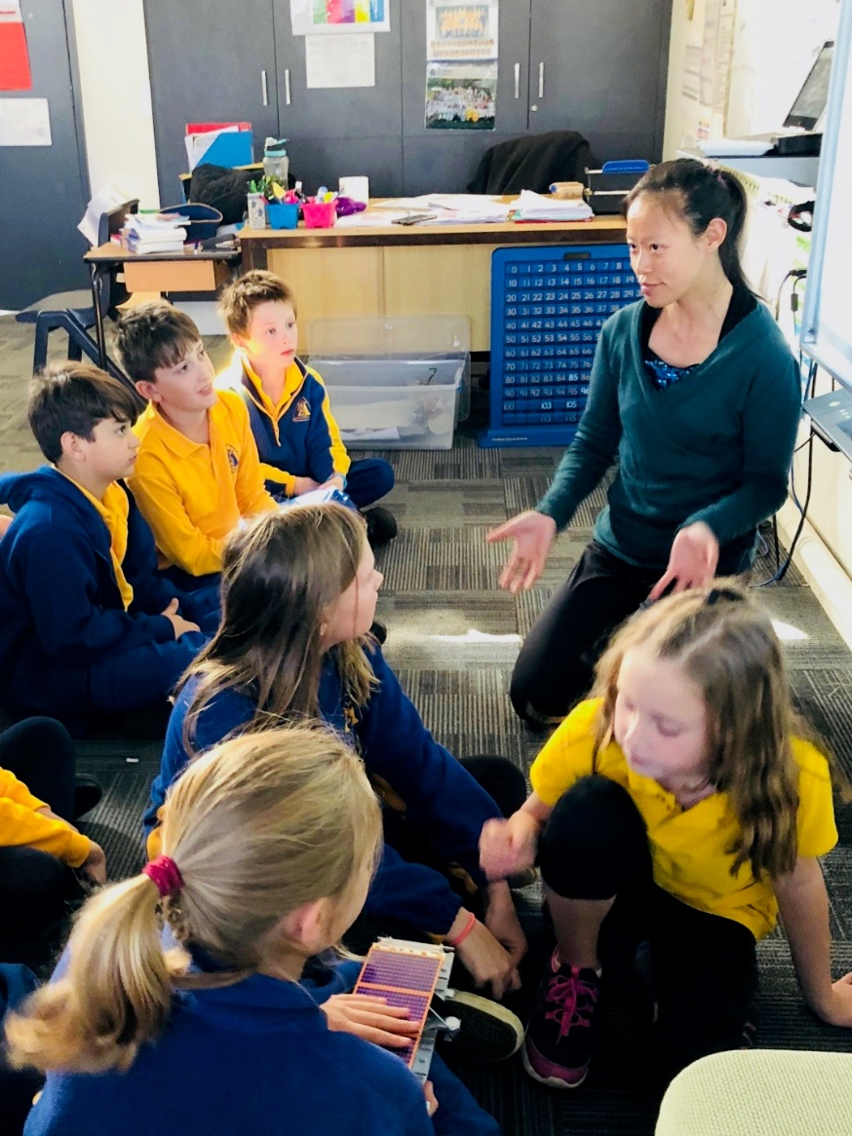
Education and Outreach

Slide 10
Bilateral, Regional and International Engagement

Slide 11
International Representation
CEOS: concrete support to tackling global challenges
GEO: key forum to realise benefits of EO globally

Slide 12

Key CEOS Publications
“The integration of statistics, geospatial information, Earth observations, and other sources of Big Data, combined with new emerging technologies, analytics and processes, are becoming a fundamental requirement for countries to measure and monitor local to global sustainable development policies and programs”
UN-GGIM co-chairs

Slide 13
CEOS SIT 2020-2021
Committee on Earth Observation Satellites
CSIRO and GA will take on Chairmanship of the CEOS Strategic Implementation Team (SIT) at CEOS Plenary in October 2019 for a 2-year term
SIT “..provides strategic guidance on the direction, progress, and status of implementation activities in relation to the established priorities, commitments, and partnerships of the CEOS organization”.

Slide 14


Slide 15
NovaSAR-1

Slide 16
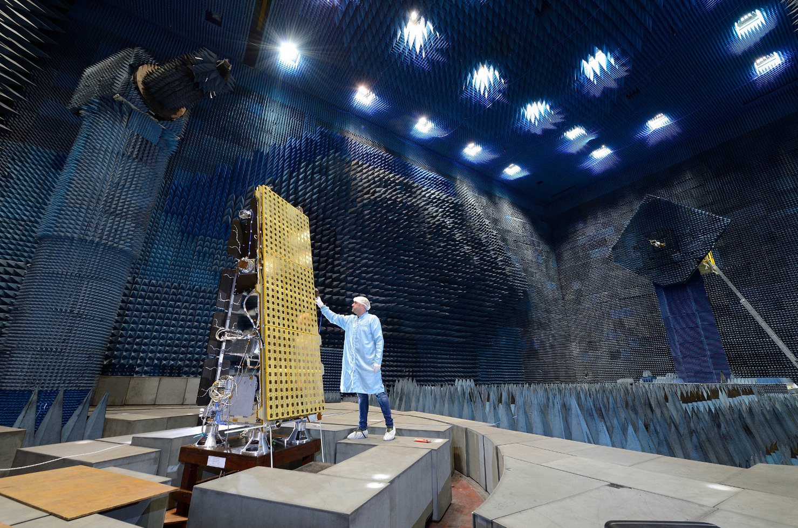
NovaSAR
Special wide swath Maritime Mode (400 x 800km)
Estimated Launch – June 2018; 7 years lifetime
Automatic Identification of Ships (AIS) on-board
6m, 20 x 1000+km StripMap Mode
S-band, 3GHz
Operated from UK, but payloads available to partners

Slide 17
NovaSAR-1 Australia:
A new space research facility operated by CSIRO
Partnership w. UK, India and Phillipines
CSIRO has access to 10% satellite’s tasking and acquisition worldwide, with priority over Australian region.
Launch September 17, 2018; Operations August 2019
NovaSAR Specs:
  S-Band, polarimertic Synthetic Aperture Radar imager + AIS ship locator
  Spatial resolution 6 m (Stripmap mode ) – ScanSAR (30 m)
  Swath width: 100 km (ScanSAR) – 20 km (Stripmap)
  Revisit: 3-4 days (sun synchronous)
  Duty cycle: at least 2 min per orbit
CSIRO will operate NovaSAR as R&D facility, with tasking and data requests on merit or national need basis (eg disasters)

Slide 18
CSIROSat-1

Slide 19
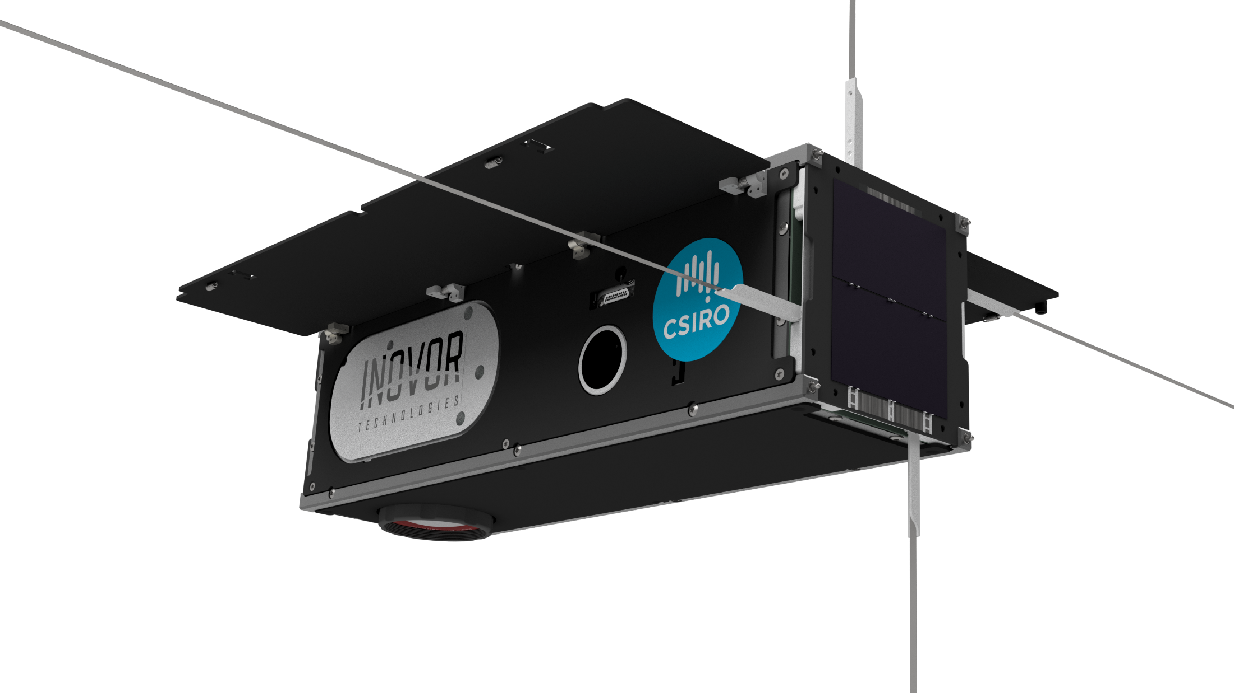

Slide 20
CSIRO SWIR IMAGER CubeSat – Design
3U
Shortwave infrared sensor
On-board data processing and in-flight reprogrammable
This CubeSat will be built and integrated by Australian company Inovor Technologies. Most components will be purchased off-the-shelf.
This CubeSat will be a starting point for CSIRO to design, procure and operate future satellites/constellations that would host advanced imaging technologies for use in Earth- or planetary monitoring applications.

Slide 21
Open Data Cube

Slide 22

Open Data Cube community
ODC vision
Increase the impact and value of satellite data
Provide a free and open EO data analysis architecture and tools
Foster a community to grow the technology and applications
www.opendatacube.org
Growing list of Partners and Associates
NASA (CEOS SEO), GA, CSIRO, USGS, IDEAM, VNSC, UK Catapult, RHEA, Swiss Met., NSPO, RADI, NZ Space, …
..and Initiatives
CEOS DC, AfricaDataCube, Digital Earth Aust., CSIRO Earth Analytics Hub, Colombia DC, Vietnam DC, Swiss DC, …

Slide 23


Global Open Data Cube Network
3
6
31
Operational
Under Development
Under Review or Expressed Interest

Slide 24
Calibration / Validation Activities
CSIRO CENTRE FOR EARTH OBSERVATION

Slide 25

Radiometric Calibration and Product Validation Sites
3 x SuperSites become Affiliate SuperSites
3 x New SuperSite Locations from 2018
Litchfield Savanna
Daintree Rainforest (Affiliate)
Robson Rainforest
Alice Mulga
Lucinda Jetty
Mitchell Grass Rangeland
Samford Peri-Urban (Affiliate)
Gingin Banksia Woodland
Great Western Woodlands
Lake Frome
SAR Corner Reflectors)
Boyagin Wandoo Woodland
Calperum Mallee
Cumberland Plain
Cotter
Pinnacles
Tumbarumba Wet Eucalypt
Wombat Stringy Bark Eucalypt
Whroo Dry Eucalypt (Affiliate)
Radiometric Cal/Val Site
TERN SuperSite
Warra Tall Eucalypt
Affiliate TERN SuperSite
Notes:
From 2018 there are three new SuperSite locations chosen to increase the representation of biomes across Australia. Three existing SuperSites are now Affiliate SuperSites that maintain flux tower data streams and will deliver other (non-TERN funded) data where possible.

Slide 26
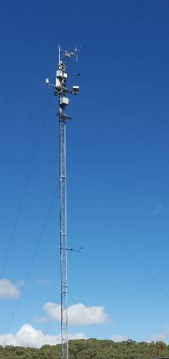
Tumbarumba Flux tower and SuperSite
Additional instrumentation
CIMEL sun photometer
SWIR hyperspectral
Fluorescence sensor
Flux tower
Open path CO2, H2O
Sonic anemometer
Air temperature profile (Thermocouple)
Air H2O and CO2 profiles
Net Radiometer
Pyranometer
Atmospheric Pressure
Rh+T
Rainfall
Wind Vane
Soil Heat Flux (2 replicates)
Soil Temperature
Soil moisture (Time Domain Reflectometry)
Direct and diffuse proportion (PAR)
SuperSite
Faunal monitoring
Soil and hydrology
Biophysical (biodiversity, structure, recruitment, composition etc.)
+ Sapflow & dendrometers
+ wireless PAR network
Landscape (topography, drainage, land-use)
Notes:
Flux tower – nationally and internationally consistent measurements of radiation, water, and CO2 ++
SuperSite – support long-term monitoring using harmonised protocols

Slide 27
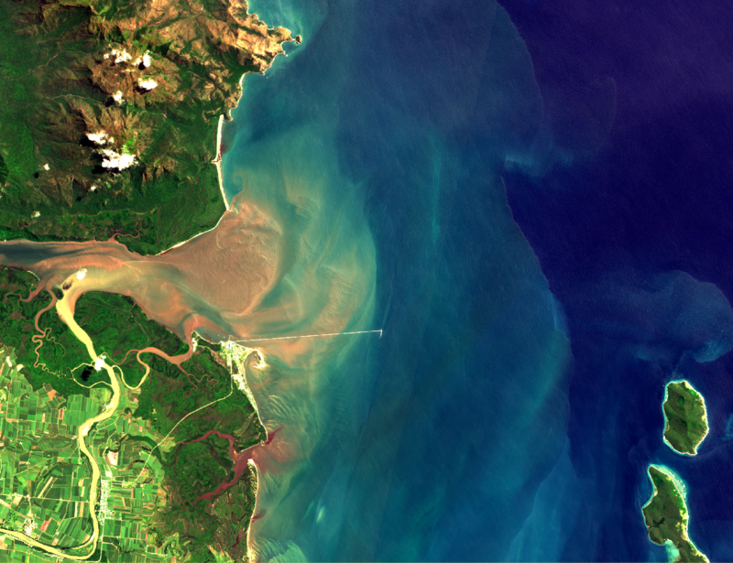
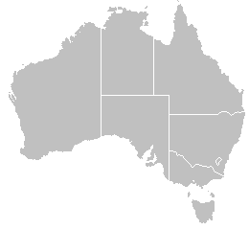
Sentinel-2A MSI
Ongoing Sentinel 3-A validation over Lucinda
Acquisition of continuous above-water radiometry + in-water optics
Only southern-hemisphere AERONET-OC site
Validation results presented at March 2018 S3VT meeting
Hyper-spectral radiometry added to match S3-A morning passes
Calibration inputs to CSIRO Biogeochemical Model
Consistency of radiometric measurements analysed IMOS Radiometry Task Team
Lucinda Jetty
6 km

Slide 28
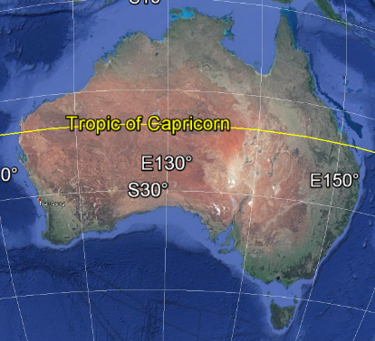
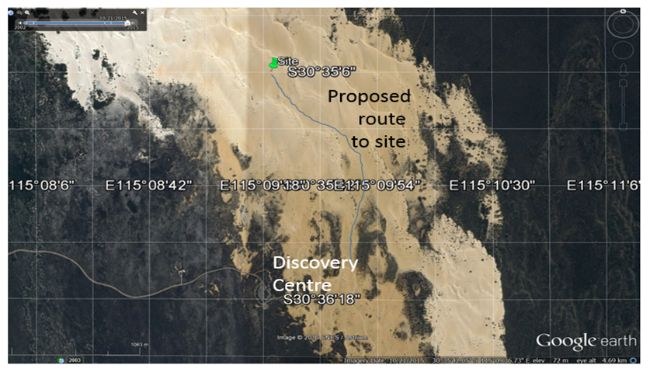
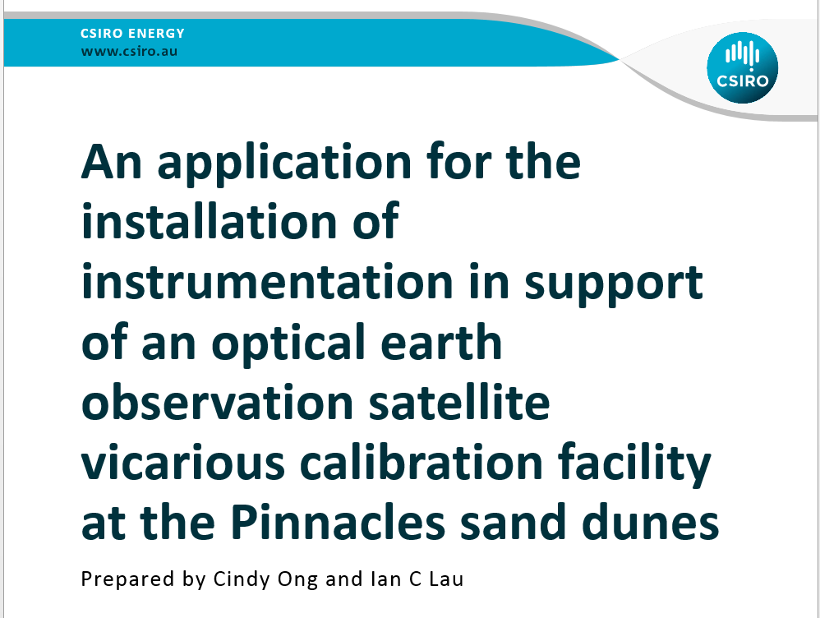
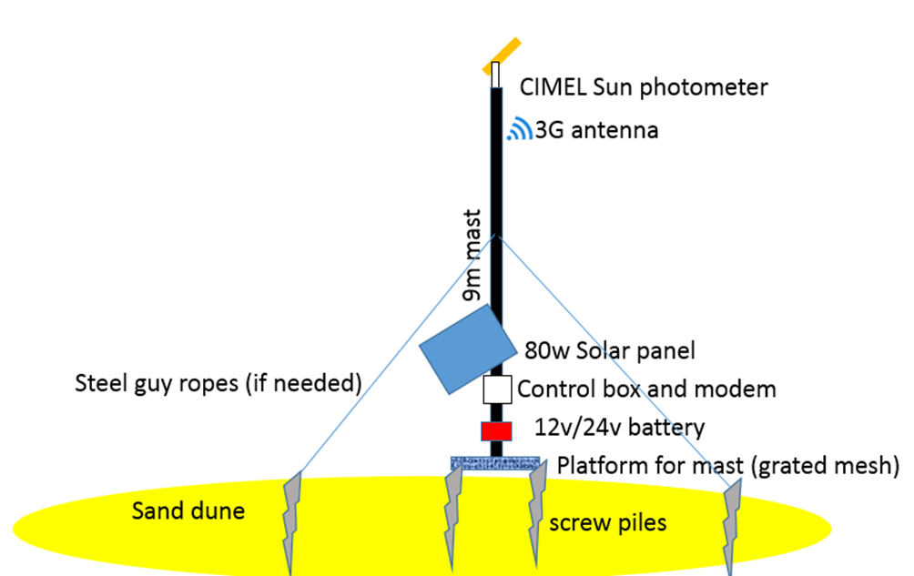
Optical Vicarious Calibration Site at Pinnacles Desert
To be upgraded in the future to DFOV VNIR-SWIR spectrometer
Concept sketch of mast, foundations and instrumentation installed on the sand dune

Slide 30
Earth Observation Data Supply

Slide 31

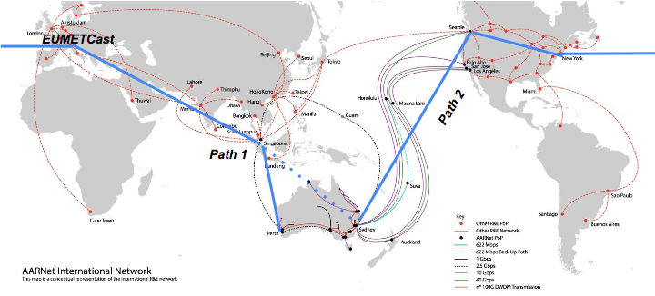




EO Data Access
CCEO Provides funding for the Regional Copernicus Data Hub that distributes and promote data from all European Sentinel satellite missions
www.copernicus.gov.au

Slide 32
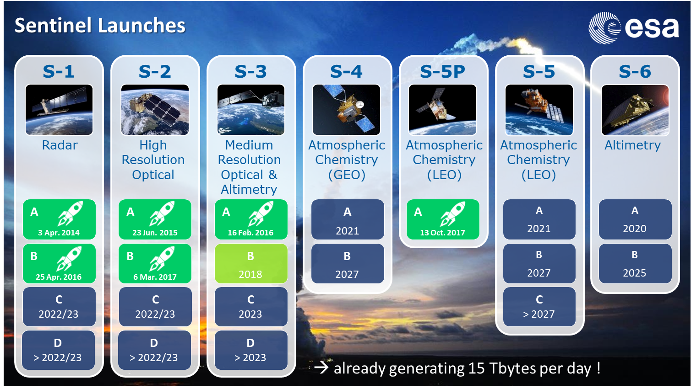
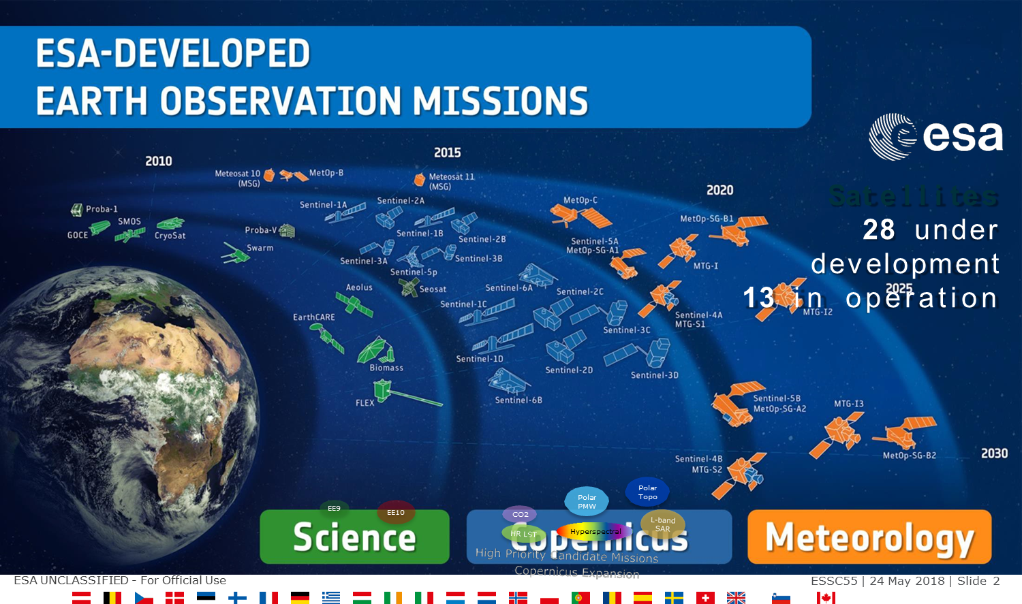
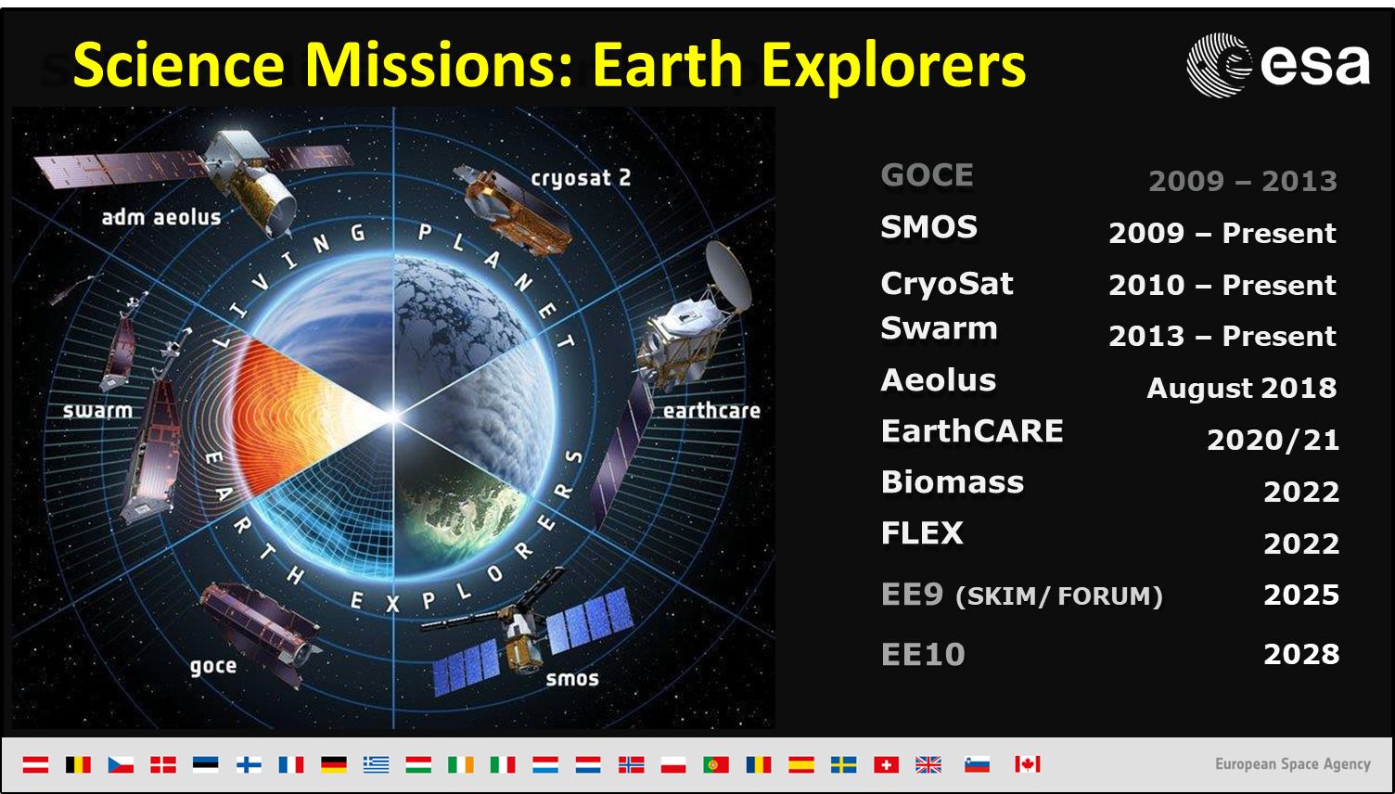
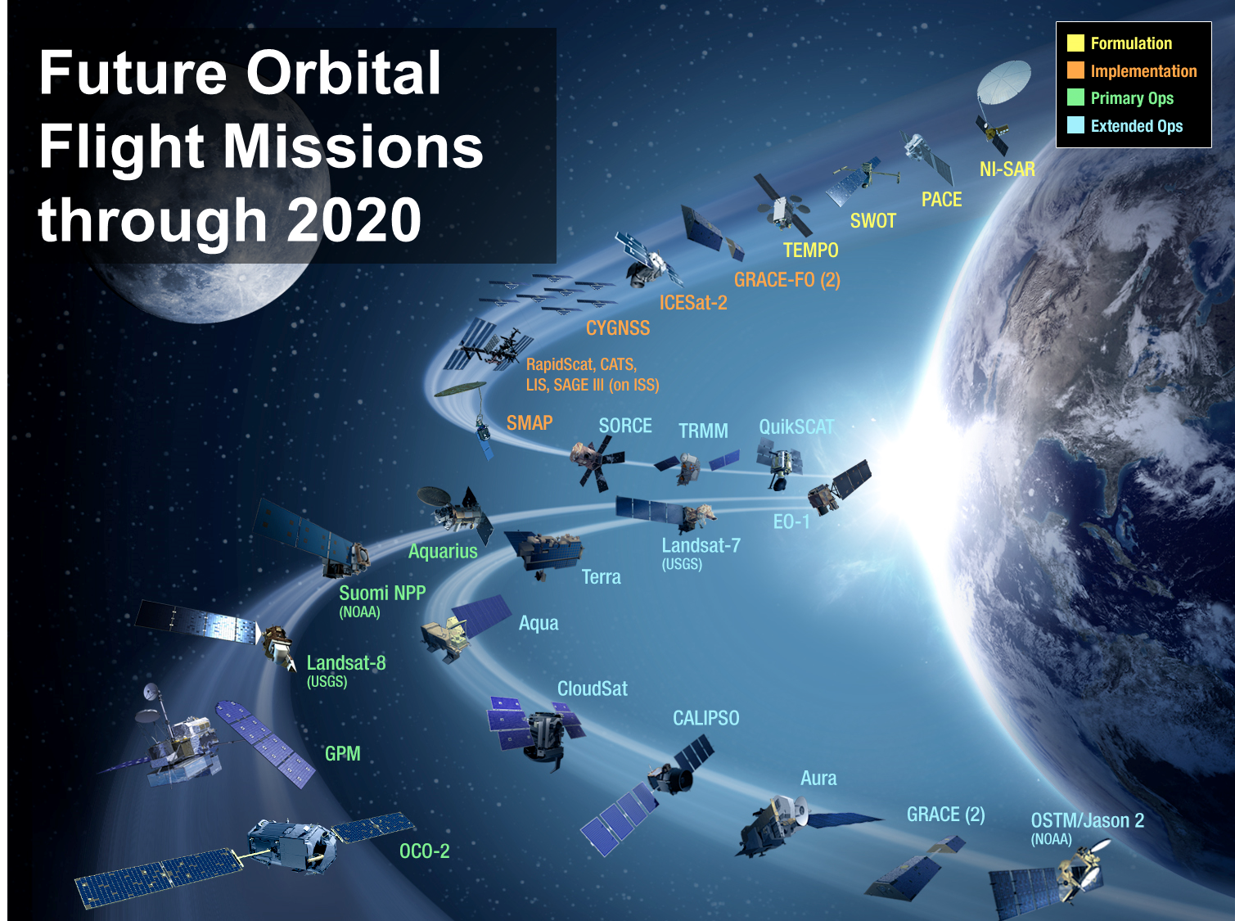
Access to EO Science Missions

Slide 33
Future Sensors and Platforms

Slide 34
Satellite Instrument Design
“For Australia, the minimum economic impact of EO from space-borne sensors alone is approximately A$5.3 billion each year.”
FSP Project:
  Investigate the global marketplace for satellite-based Earth Observation Imagers
  Investigate the potential for CSIRO to play a role in supply of satellite-based Earth Observation Imagers
What satellite instruments should Australia aspire to build and launch in the next 10 years?
How much data do we want, and how many satellites should we launch if we can get a constellation up?
And when we do, what could possibly go wrong?

Slide 35
Thank you

