Slide 1
45th WGCV Plenary Perth, July 2019
Working Group on Calibration and Validation
Land Product Validation Subgroup
Solar radiation validation protocol
I. Grant
Notes:
LPV established as subgroup in 2000.

Slide 2
Why a solar radiation protocol?
Working Group on Calibration and Validation
Downwelling surface solar radiation (DSSR) is a key environmental variable. It drives weather, climate, evapotranspiration, plant growth, solar energy,
DSSR is a GCOS ECV
Under: Atmosphere – Surface – Radiation budget
GCOS has proposed the GCOS Surface Reference Network (GSRN) with DSSR a core variable as one of the four components of surface radiation budget.
DSSR is produced by CEOS agencies
WGClimate inventory of satellite ECV datasets:
EUMETSAT (CM SAF): CLARA (AVHRR), CLAAS (SEVIRI), SARAH (SEVIRI by Heliosat)
NASA (CERES)
Others include
NOAA: NSRDB (US coverage)
NASA: POWER (global coverage, from GEWEX/SRB)
EC: CAMS radiation service (Meteosat coverage)
ABoM (Australia coverage)
JAXA (Himawari coverage)
DSSR is the fuel for solar energy generation
UN Sustainable Development Goal (SDG) 7 "Affordable and Clean Energy"
Notes:
Formed in 2000 as part of NASA’s EOS validation program – validating MODIS land products
The mission of the CEOS Land Product Validation (LPV) subgroup is to coordinate the quantitative validation of satellite-derived products. The focus lies on standardized intercomparison and validation across products from different satellite, algorithms, and agency sources.

Slide 3
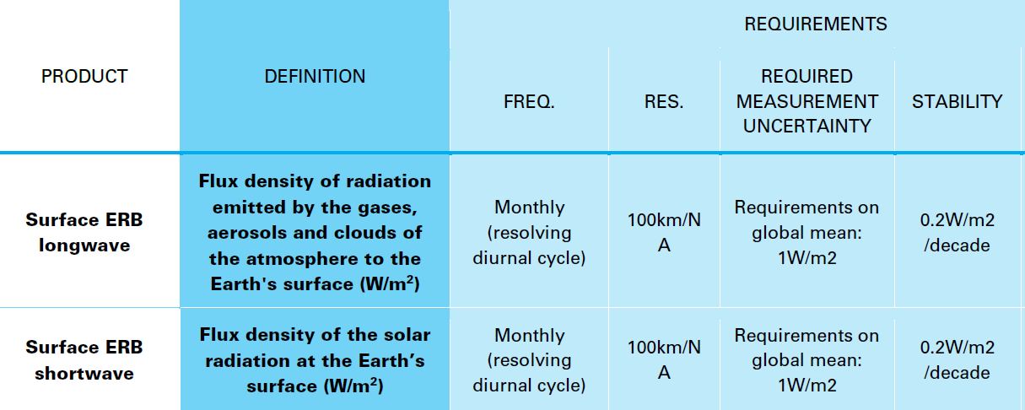
GCOS ECV
Working Group on Calibration and Validation
Atmosphere – Surface – Radiation budget
Notes:
Formed in 2000 as part of NASA’s EOS validation program – validating MODIS land products
The mission of the CEOS Land Product Validation (LPV) subgroup is to coordinate the quantitative validation of satellite-derived products. The focus lies on standardized intercomparison and validation across products from different satellite, algorithms, and agency sources.

Slide 4
Spatiotemporal characteristics
Working Group on Calibration and Validation
DSSR has the spatiotemporal variability of clouds
Ground observation sampling is at 1 minute or even 1 second
E.g. ABoM network is 1-minute statistics of 1-second samples
GEO satellite data has hourly or recently 10/15 minute sampling
Satellite solar products are typically at 10/15 minutes, hour, day, month, year
Significant spatial variation within a satellite IFOV or grid cell
Thus
Temporal "smoothness" metric of Albedo, FAPAR, etc. is not appropriate
Errors of dataset intercomparison depend on spatial and temporal resolution
Point ground observations have more temporal variability than spatially averaged satellite observations
Notes:
Formed in 2000 as part of NASA’s EOS validation program – validating MODIS land products
The mission of the CEOS Land Product Validation (LPV) subgroup is to coordinate the quantitative validation of satellite-derived products. The focus lies on standardized intercomparison and validation across products from different satellite, algorithms, and agency sources.

Slide 5
IEA/PVPS Task 16
Working Group on Calibration and Validation
International Energy Agency (IEA) – Photovoltaic Power Systems (PVPS) – Task16: "Solar resource for high penetration and large scale applications”
International group of self-funded technical experts: ~20 nations, ~100 people
Focus on improving solar resource assessment and forecasting for solar energy sector
Duration 2017–2020 (extension to 2023 under development)
Continues IEA/SHC Task 4 (1977–), …, Task 46 (2011–2016)
Produced Best Practices Handbook
Task 16 broad goals include
Lowering uncertainty of satellite retrievals
Contribute to or setup international benchmark for data sets
Task 16 members are broadly supportive of a CEOS protocol to formalise solar radiation validation
Notes:
Formed in 2000 as part of NASA’s EOS validation program – validating MODIS land products
The mission of the CEOS Land Product Validation (LPV) subgroup is to coordinate the quantitative validation of satellite-derived products. The focus lies on standardized intercomparison and validation across products from different satellite, algorithms, and agency sources.

Slide 6
Previous solar validation efforts
Working Group on Calibration and Validation
IEA/SHC Task 36 "Report on Benchmarking of Radiation Products" (2009)
Point comparisons at ground stations
Map-based relative intercomparison of satellite datasets
Metrics include MBE, RMSE, measures of difference between probability distributions
IEA/SHC Task 46 "Best Practices Handbook" (2015): "There is no standardized method for accuracy assessment [of satellite datasets]"
Notes:
Formed in 2000 as part of NASA’s EOS validation program – validating MODIS land products
The mission of the CEOS Land Product Validation (LPV) subgroup is to coordinate the quantitative validation of satellite-derived products. The focus lies on standardized intercomparison and validation across products from different satellite, algorithms, and agency sources.

Slide 7
A Solar validation protocol
Working Group on Calibration and Validation
Model on Albedo (and LST, FAPAR, …) protocol
Adapt to existing solar validation work and necessary future work
Metrics adapted from albedo or FAPAR protocols
Delete smoothness
Add measures of PDF difference, temporal variability?, ramps?
Identify future work needed (e.g. How necessary is ground site homogeneity?)
Split of DSSR into direct beam & diffuse components
Critical for solar energy
Direct/diffuse split is also used by e.g. weather models, ecosystem models
Expand solar protocol from initial DSSR to include direct component?
Notes:
Formed in 2000 as part of NASA’s EOS validation program – validating MODIS land products
The mission of the CEOS Land Product Validation (LPV) subgroup is to coordinate the quantitative validation of satellite-derived products. The focus lies on standardized intercomparison and validation across products from different satellite, algorithms, and agency sources.

Slide 8
Issues / Questions
Working Group on Calibration and Validation
Is DSSR "land" enough to come under LPV?
Protocol to cover direct and diffuse?
Some CEOS agency datasets include direct (e.g. NOAA/NSRDB, ABoM, JAXA, EC/CAMS, CM-SAF/MVIRI)
Protocol to list areas requiring research, including
What is adequate global distribution of sites?
What is the need for spatial homogeneity of ground sites?
Need for QC of ground data
Dealing with gaps in ground or satellite data to be compared as temporal aggregates (e.g. daily totals, monthly averages)
Lack of globally coordinated dataset production and distribution
What to call it?
Downwelling surface solar radiation
GCOS: Surface ERB shortwave
Solar energy community: Global horizontal irradiance, Direct normal irradiance
Notes:
Formed in 2000 as part of NASA’s EOS validation program – validating MODIS land products
The mission of the CEOS Land Product Validation (LPV) subgroup is to coordinate the quantitative validation of satellite-derived products. The focus lies on standardized intercomparison and validation across products from different satellite, algorithms, and agency sources.

Slide 9
Extra slides
Working Group on Calibration and Validation
Notes:
Formed in 2000 as part of NASA’s EOS validation program – validating MODIS land products
The mission of the CEOS Land Product Validation (LPV) subgroup is to coordinate the quantitative validation of satellite-derived products. The focus lies on standardized intercomparison and validation across products from different satellite, algorithms, and agency sources.

Slide 10
IEA/PVPS Task 16 – Broad goals
Working Group on Calibration and Validation
Lowering uncertainty of satellite retrievals and Numerical Weather Prediction (NWP) models for solar resource assessments and nowcasting.
Define best practices for data fusion of ground, satellite and NWP data (re-analysis) to produce improved datasets, e.g. time series or Typical Meteorological Year (TMY).
Develop enhanced analysis of long-term inter-annual variability and trends in the solar resource.
Develop and compare methods for
Estimating the spectral and angular distributions of solar radiation (clear and all-sky conditions)
Describing the spatial and temporal variabilities of the solar resource
Modelling point to area forecasts
Probabilistic and variability forecasting
Contribute to or setup international benchmark for data sets and for forecast evaluation.
Notes:
Formed in 2000 as part of NASA’s EOS validation program – validating MODIS land products
The mission of the CEOS Land Product Validation (LPV) subgroup is to coordinate the quantitative validation of satellite-derived products. The focus lies on standardized intercomparison and validation across products from different satellite, algorithms, and agency sources.

Slide 11
IEA/PVPS Task 16
Solar resource for high penetration and large scale applications, 2017-2020
Main goal is to lower uncertainty of resources and forecasts and therefore lower the costs of financing costs as well operation and grid integration costs
Subtask 1: Evaluation of current and emerging resource assessment methodologies:
Ground based methods
Numerical weather models (NWP)
Satellite-based methods
Benchmarking framework
Subtask 2: Enhanced data & bankable products:
Data quality & format
Merging of satellite, NWP & ground data
Spatio-temporal high variability
Long-term inter-annual variability
Products for the end-users
Subtask 3: Evaluation of current and emerging solar forecasting techniques:
Value of solar power forecasts
Regional solar power forecasting
Variability forecasting and probabilistic forecasting
Subtask 4: Dissemination and Outreach:
Develop a Task Brochure
Create a 6-month Task Newsletter
Conduct periodic (annual) Subtask-level webinars and/or conference presentations
Update of the solar resource handbook

Slide 12
LPV Subgroup Objectives
Working Group on Calibration and Validation
To foster and coordinate quantitative validation of global land products derived from remotely sensed data, in a traceable way, and to relay results to users.
To increase the quality and efficiency of global satellite product validation by developing and promoting international standards and protocols for:
Field sampling
Scaling techniques
Accuracy report and use
Data and information exchange
To improve quality of ground references used for product validation
Field campaigns for fiducial references
Identification of sites and supersites for validation
To provide feedback to international structures for:
Requirements on product accuracy and quality assurance
Terrestrial ECV measurement standards
Notes:
Formed in 2000 as part of NASA’s EOS validation program – validating MODIS land products
The mission of the CEOS Land Product Validation (LPV) subgroup is to coordinate the quantitative validation of satellite-derived products. The focus lies on standardized intercomparison and validation across products from different satellite, algorithms, and agency sources.

