Slide 1

CNES Activity Report
Patrice HENRY - CNES
WGCV Plenary # 45
Perth, Australia
July 16-19, 2019

Slide 2

CNES
Report on Cal/Val Activities
WGCV Plenary # 45
SUMMARY
Overview of CNES Cal/Val Activities
The CO3D Project
Atmospheric Correction using MAJA

Slide 3
CNES
Report on Cal/Val Activities
WGCV Plenary # 45
Main Events at CNES since last WGCV Meeting
Launch of CFOSAT – 2018 Oct. 29
Launch of IASI-C on-board METOP-C – 2018 Nov. 7
Launch of CSO (Defence satellite) – 2018 Dec. 20
Contract signature with Airbus for the development of the CO3D system – 2019 July 8
SPOT World Heritage agreed (and partially funded ☺) as a CNES project - 2018 Sept. 17

Slide 4
CNES
Report on Cal/Val Activities
WGCV Plenary # 45
Calibration and Performance Monitoring
of CNES (cooperation) in-Flight Missions
PLEIADES 1A & 1B (Very High Resolution Imagers) - Airbus
IASI A, B & C (IR Atmospheric Sounders) - Eumetsat
Megha-Tropiques: Saphir (MW Sounder), Scarab (Optical Scanning Radiometer) - ISRO
Calipso-IIR (IR Radiometer) - NASA
          SMOS (Passive MW – L Band) - ESA
          VENμS (Optical multispectral Imager) - ISA
          Jason 2 & 3 (Altimeters) – NASA, Eumetsat, NOAA
          CFOSAT-SWIM (Ku Band Radar) - CNSA

Slide 5
CNES
Report on Cal/Val Activities
WGCV Plenary # 45
Participation in other Missions Calibration Monitoring
Airbus SPOT-6&7 satellites
Support to ESA for Sentinel-2 and Sentinel-3 (optical sensors and altimeter) calibration and performance monitoring
Support to GISTDA for THEOS calibration
Exchanges with NASA for Landsat-8 and MODIS calibration
Support to Eumetsat for 3MI ground characterization and future in-flight calibration monitoring
Intercalibration of IASI with AIRS and CRIS (GSICS)
Performance monitoring of Cryosat (ESA) and HY2 (CNSA)

Slide 6
CNES
Report on Cal/Val Activities
WGCV Plenary # 45
Missions in Development Phase
at CNES (cooperation)
IASI NG (IR Atmospheric Sounders) – Eumetsat + UKSA
        MicroCarb (SWIR spectrometer) – Eumetsat, UKSA
MERLIN (LIDAR) - DLR
          SWOT (Wide-Swath Ka-Band Radar Interferometer, Nadir Radar Altimeter,
          Microwave Radiometer) - NASA + CSA & UKSA
          TRISHNA (TIR Imager) - ISRO

Slide 7
CNES
Report on Cal/Val Activities
WGCV Plenary # 45
SUMMARY
Overview of CNES Cal/Val Activities
The CO3D Project
Atmospheric Correction using MAJA

Slide 8
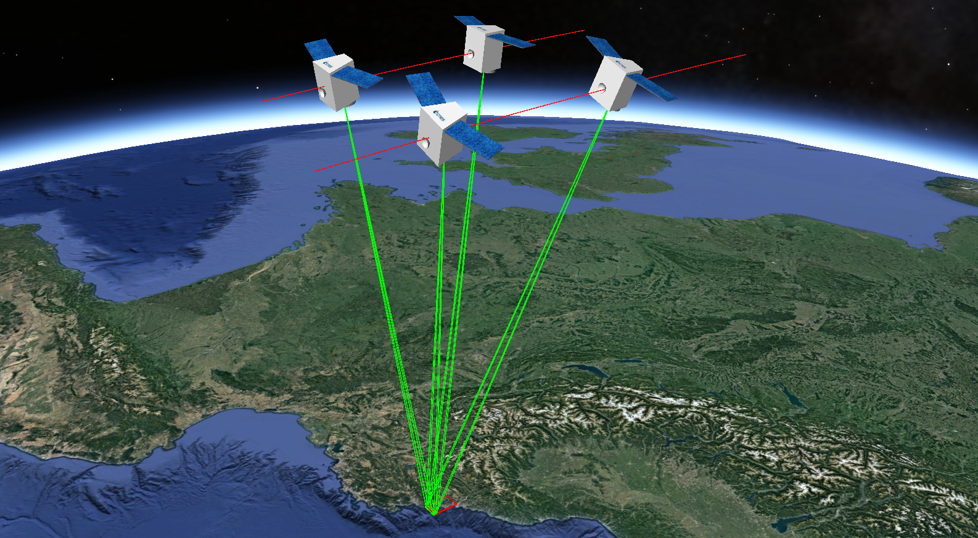
CNES
Report on Cal/Val Activities
WGCV Plenary # 45
CO3D System
Launch 2022/2023
4 satellites constellation
Altitude: 500 km
Resolution: 50 cm
Bands B,G,R,NIR
Local time: 11 h
3D global coverage in 5 years
Relative altimetric accuracy: 1 m (B/H~0,3)
Synchronous acquisition per satellites pair
Capacity for urban quadri-stereo every 2 days
Programming optimisation using meteo
Massive 3D production based on cloud facilities

Slide 9
CNES
Report on Cal/Val Activities
WGCV Plenary # 45
CO3D Main Figures
Government/Industry co-funded program
        CNES budget ≈100 M€
New technology small satellites
. Mass≈ 300 kg
. All electric propulsion (based on Astrobus platform)
. High agility
          Massive automatic processing capability
          . High DEM reactualization capacity
          . Global DEM at 1m resolution in less than 5 years
          Processing chains will be provided by CNES (ortho & DEM) and calibration/performance monitoring will be performed by CNES

Slide 10
CNES
Report on Cal/Val Activities
WGCV Plenary # 45
CO3D Main Objectives
For CNES, demonstrator for the production of large scale accurate DEM at low cost and with high resilience
        For industry, capacity to offer to customers high revisit capabilities for 1m DEM (DTM?) and possibility to extend the constellation and the capacities in orbit (sell low cost satellites? or system co-investors?)
CNES involved in the development phase up to the end of the in flight assessment phase + 1 year of a probative exploitation phase
. Accuracy of DEM demonstrated through the complete coverage of France (500 000 km²)
. Operationality of the system demonstrated through the coverage of large areas interesting French Defence (25 Mkm²)
          After 1 year, possibility for CNES to access at production cost to 15 Mkm² per year and after 5 years to a degraded accuracy global DEM (10m ?)

Slide 11
CNES
Report on Cal/Val Activities
WGCV Plenary # 45
SUMMARY
Overview of CNES Cal/Val Activities
The CO3D Project
Atmospheric Correction using MAJA

Slide 12
CNES
Report on Cal/Val Activities
WGCV Plenary # 45
What is MAJA
. MAJA = MACS (CNES) + ATCOR (DLR) Joint Algorithm
. Atmospheric correction processor for high revisit sensors
. MAJA combines multispectral and multitemporal criteria
. to detect clouds, water, shadows and snow
. to estimate Aerosol Optical Thickness (AOT) and Water Vapour (WV)
. MAJA corrects for atmospheric eects (absorption and scattering), including:
. adjacency effect (blurring effects from atmosphere)
. terrain effect
Documentation on method
. search for "MAJA ATBD“ (https://doi.org/10.5281/zenodo.1209633)
Who is developing MAJA
. Methods: CESBIO, CNES, DLR
. Processor: CS-SI
. Validation support: Cap Gemini
. Funding: CNES (since 2006), CNRS (2011-2015), ESA (2017)

Slide 13
CNES
Report on Cal/Val Activities
WGCV Plenary # 45
Example of
MAJA’s ouput
over
Tanger/Gibraltar
08/11/2017

Slide 14
CNES
Report on Cal/Val Activities
WGCV Plenary # 45
Example of
MAJA’s ouput
over
Tanger/Gibraltar
13/11/2017

Slide 15
CNES
Report on Cal/Val Activities
WGCV Plenary # 45
Example of
MAJA’s ouput
over
Tanger/Gibraltar
23/11/2017

Slide 16
CNES
Report on Cal/Val Activities
WGCV Plenary # 45
Example of
MAJA’s ouput
over
Tanger/Gibraltar
08/12/2017

Slide 17
CNES
Report on Cal/Val Activities
WGCV Plenary # 45
Example of
MAJA’s ouput
over
Tanger/Gibraltar
13/12/2017

Slide 18
CNES
Report on Cal/Val Activities
WGCV Plenary # 45
Example of
MAJA’s ouput
over
Tanger/Gibraltar
18/12/2017

Slide 19
CNES
Report on Cal/Val Activities
WGCV Plenary # 45
Example of
MAJA’s ouput
over
Tanger/Gibraltar
23/12/2017

Slide 20
CNES
Report on Cal/Val Activities
WGCV Plenary # 45
Example of
MAJA’s ouput
over
Tanger/Gibraltar
02/01/2018

Slide 21
CNES
Report on Cal/Val Activities
WGCV Plenary # 45
Example of
MAJA’s ouput
over
Tanger/Gibraltar
12/01/2018

Slide 22
CNES
Report on Cal/Val Activities
WGCV Plenary # 45
Example of
MAJA’s ouput
over
Tanger/Gibraltar
17/01/2018

Slide 23
CNES
Report on Cal/Val Activities
WGCV Plenary # 45
Example of
MAJA’s ouput
over
Tanger/Gibraltar
11/02/2018

Slide 24
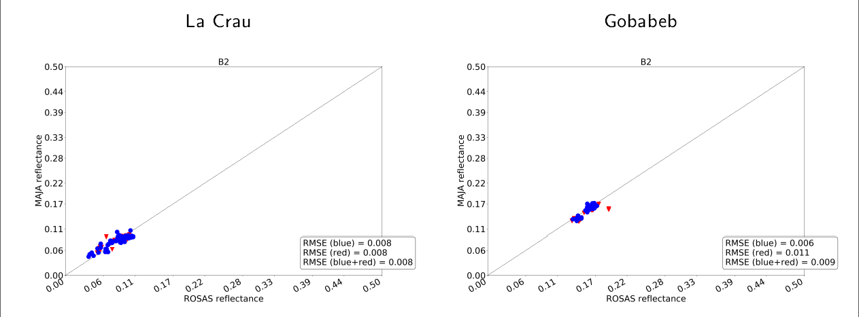
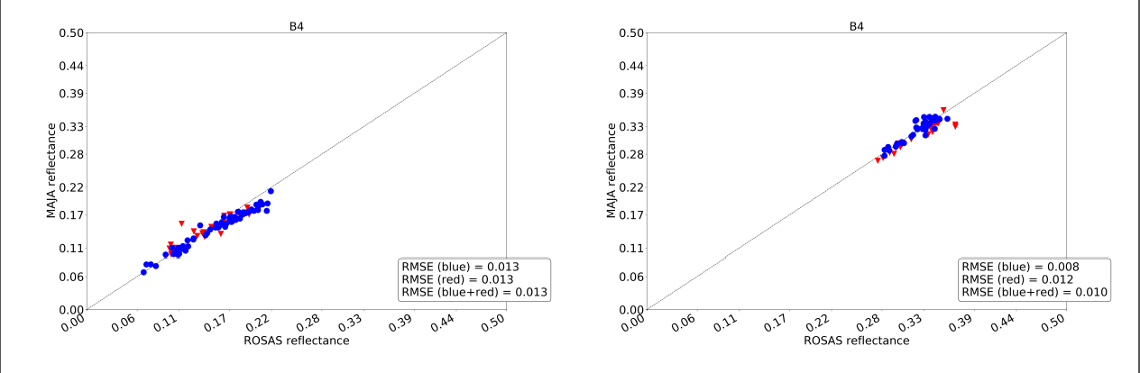
CNES
Report on Cal/Val Activities
WGCV Plenary # 45
Validation of Sentinel-2 MAJA products

Slide 25
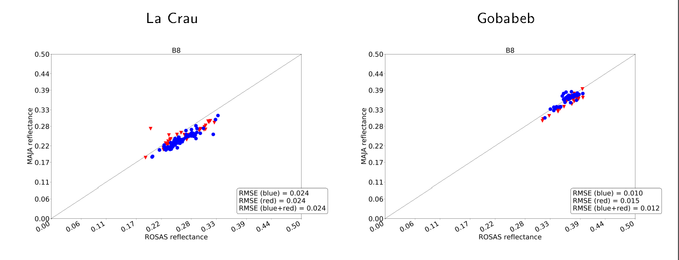
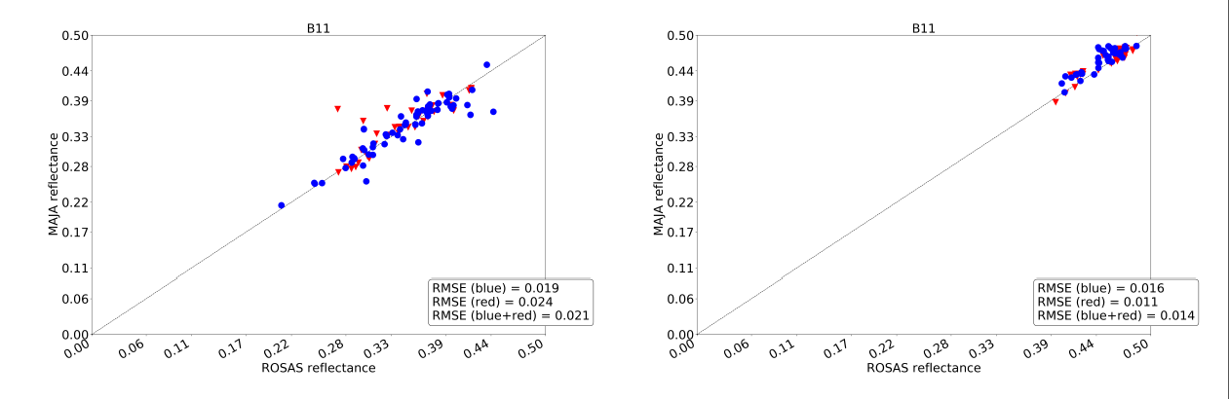
CNES
Report on Cal/Val Activities
WGCV Plenary # 45
Validation of Sentinel-2 MAJA products

Slide 26
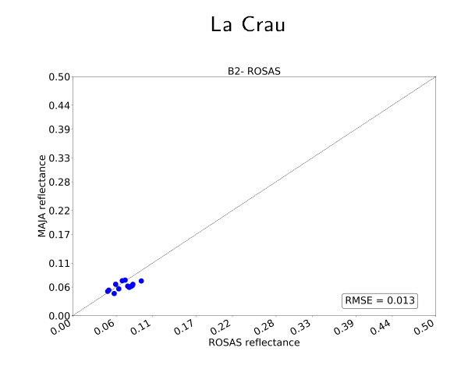
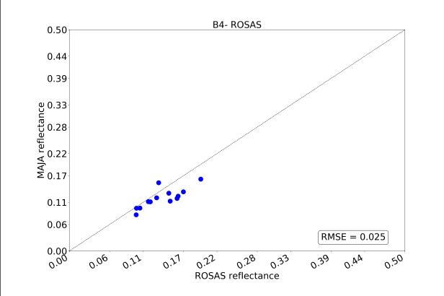
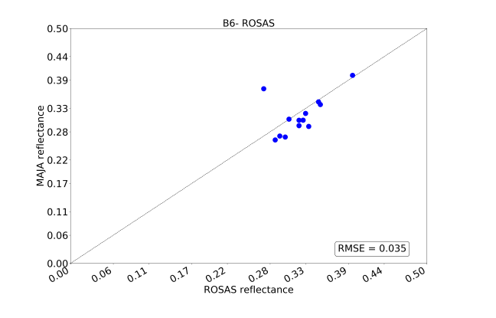
CNES
Report on Cal/Val Activities
WGCV Plenary # 45
Validation of Landsat-8 MAJA products
Gobabeb area is not processed in Theia

Slide 27
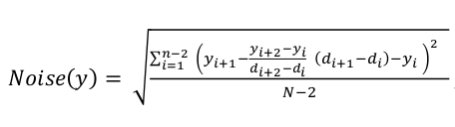
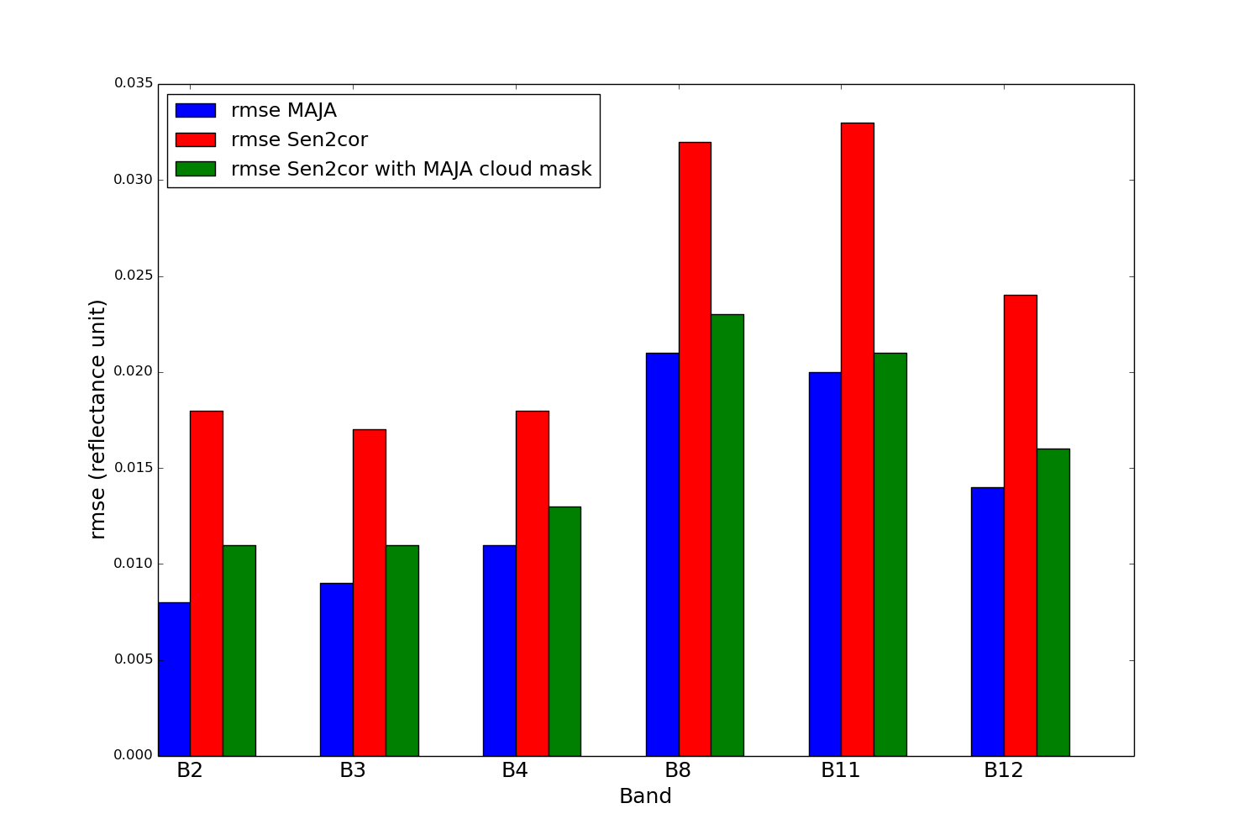
CNES
Report on Cal/Val Activities
WGCV Plenary # 45
Temporal Noise of MAJA products

Slide 28
CNES
Report on Cal/Val Activities
WGCV Plenary # 45
MAJA Now
Operationally used within Theia Data Center in CNES (MUSCATE) with the production and the distribution of:
. 750 tiles of Sentinel-2 data in near real time
. Landsat 8 products over France (Sentinel-2 tiles format)
. Venµs Level 2A products (≈120 sites)
DLR is about producing the coverage of Germany on a regular basis
Installed within Sentinel-2 for Agriculture framework (ESA)
. Operational coverage of Ukraine and other areas
          Downloaded as a stand alone version (https://logiciels.cnes.fr)
          Installed as a processing service on PEPS, the CNES Copernicus Collaborative Ground Segment
          . Stand alone version to process 1 tile/1 date
          . Multitemporel version to provide up to 1 year over 1 tile

Slide 29
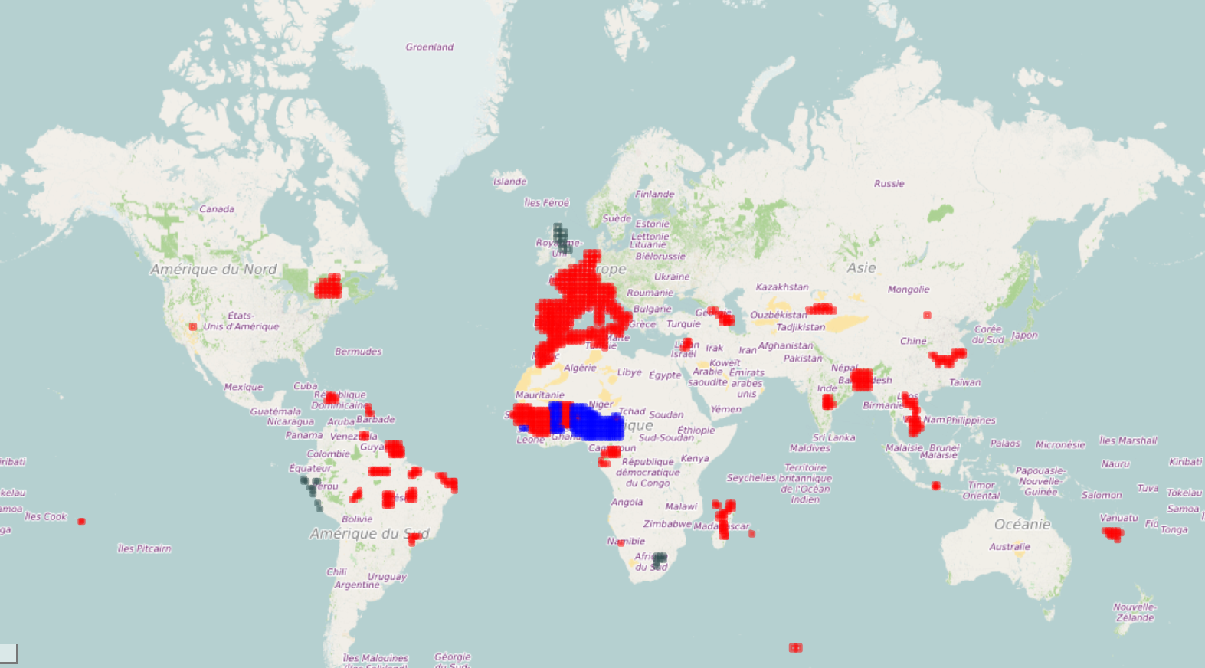
CNES
Report on Cal/Val Activities
WGCV Plenary # 45
Coverage of Sentinel-2 MAJA products at Theia

Slide 30
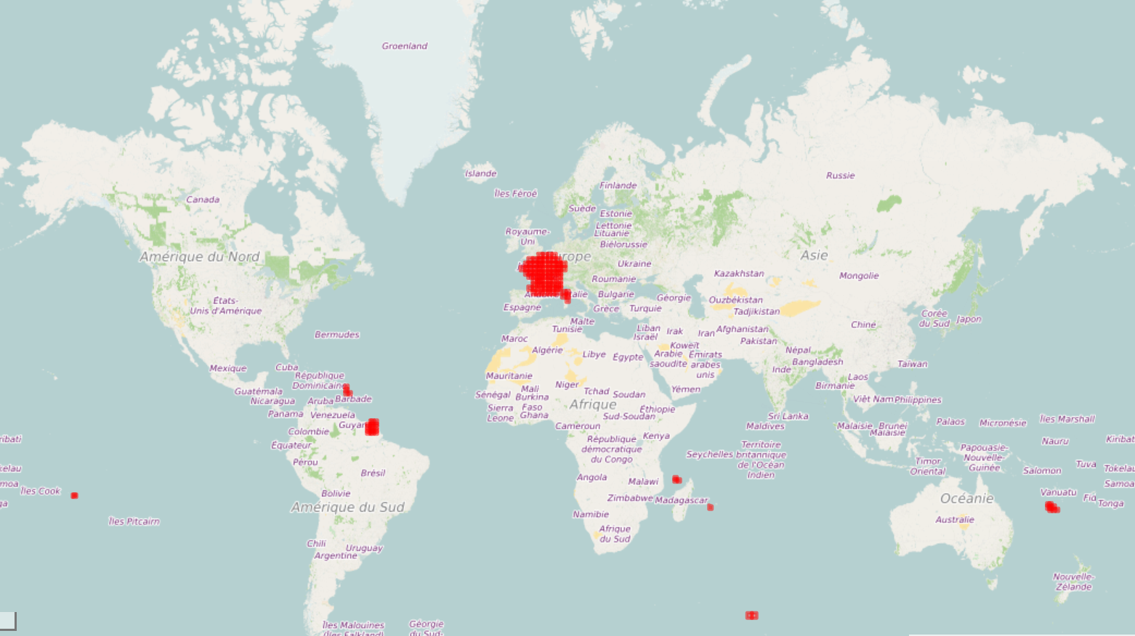
CNES
Report on Cal/Val Activities
WGCV Plenary # 45
Coverage of Landsat-8 MAJA products at Theia

Slide 31
CNES
Report on Cal/Val Activities
WGCV Plenary # 45
MAJA Processing using PEPS
Complete coverage of the Victoria state (Australia) using PEPS on demand processing (http://francois-petitjean.com/Research/MonashVic10/)
. Period: July 15 2017 → August 14 2018
. 4,349 images against 37 tiles of Sentinel-2 data (100km x 100km)
. Final product: land cover of Victoria state
New ‘multitemporal’ MAJA tool available in July 2019 – ‘Full MAJA’
          Other on-demand processors on PEPS
          . S1 tiling – Orthorectification of Sentinel-1 images against Sentinel-2 geometry
          . Fine registration of Sentinel-2 time series (soon available)
          . Correlation between Sentinel-2 images (soon available)
          . Interferometry using Sentinel-1 images (soon available)
          . Atmospheric correction for coastal Sentinel-2 images (soon available)

Slide 32
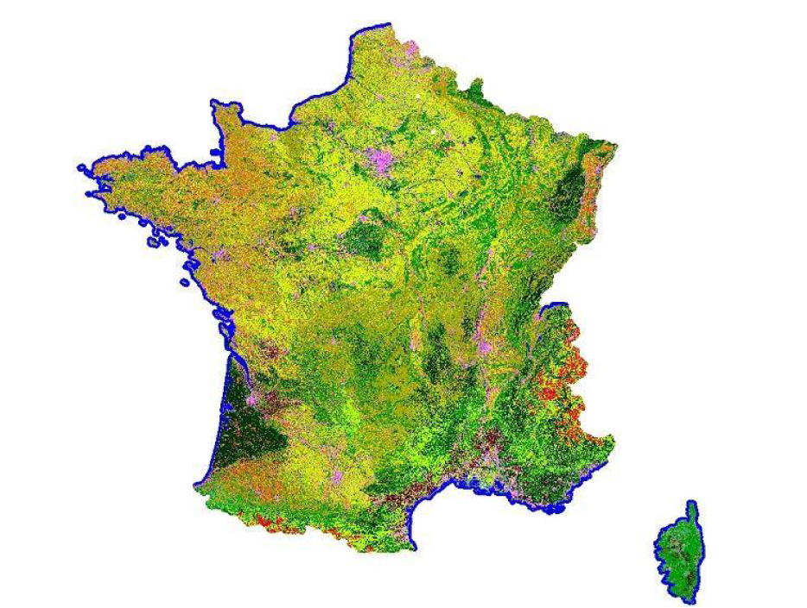
CNES
Report on Cal/Val Activities
WGCV Plenary # 45
Other processings in Theia
WASP Level 3A product:
. Monthly synthesis of cloud free Sentinel-2 MAJA reflectances
. WASP = Weighted Average Synthesis Processor
. Processed and distributed at tile format
Snow Product
. Processed from MAJA reflectance
. Selected to be the High Resolution Snow & Ice Monitoring Product of the
Copernicus Land Monitoring Service
OSO Land Cover Product
. Processed from MAJA reflectance
. Annual product (over France and soon over Sahel)
          And soon detection of water bodies using both
          Sentinel-1 & 2 data

Slide 33
CNES
Report on Cal/Val Activities
WGCV Plenary # 45
Example of
MAJA/WASP
Level 3A products
July to Oct. 2018
http://www.cesbio.upstlse.fr/multitemp/?p=14593

Slide 34
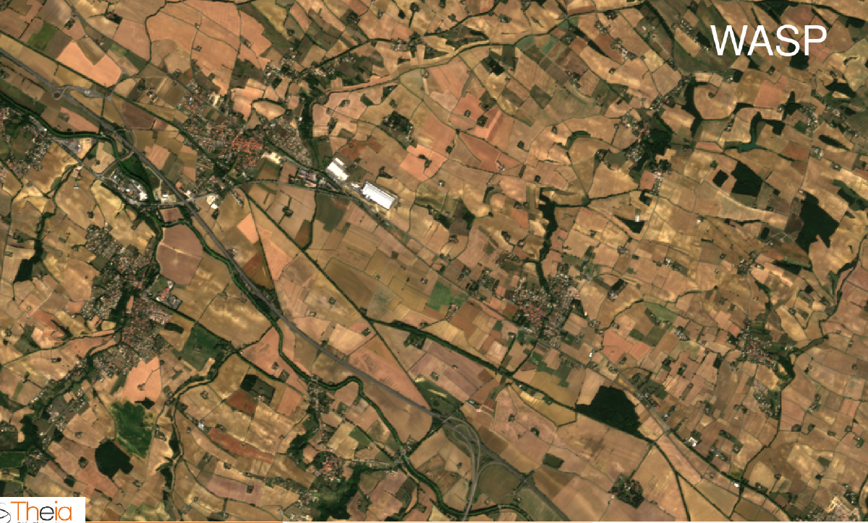
CNES
Report on Cal/Val Activities
WGCV Plenary # 45
Comparison MAJA/WASP

Slide 35
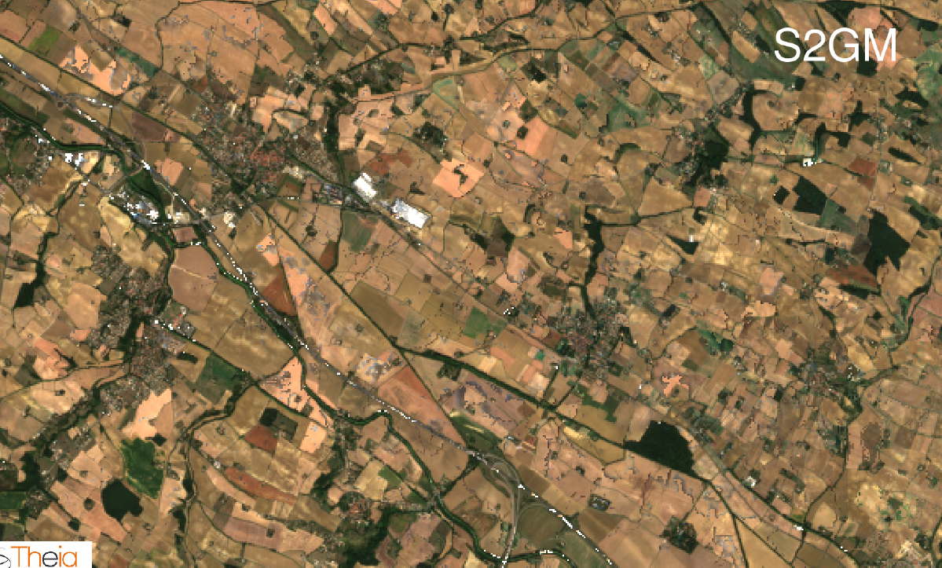
CNES
Report on Cal/Val Activities
WGCV Plenary # 45
Comparison vs S2GM

Slide 36
Thank you for your attention

