Slide 1
ESA Agency Report
Philippe Goryl, ESA / ESRIN
Philippe.Goryl@esa.int
CEOS WGCV #45, Perth, Australia, Hosted by CSIRO
July 16-19, 2019

Slide 2
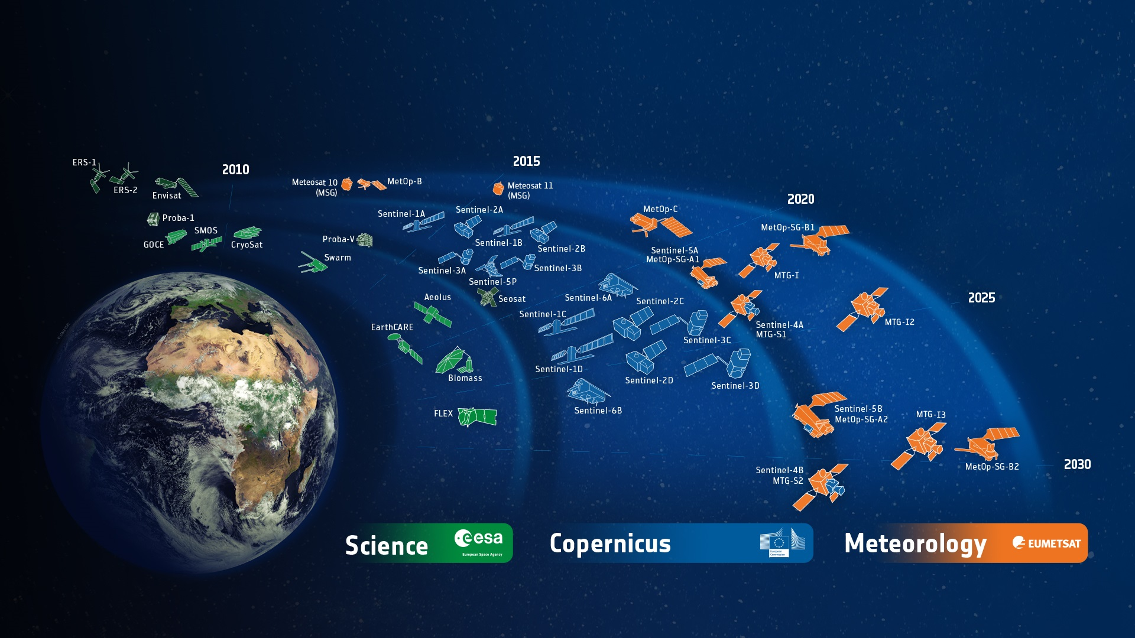
ESA Developed Earth Observation Missions
Satellites
25 under development
15 in operation
Notes:
D/EOP has three main lines of activities: Earth Science, Copernicus and Meteorology
Since the latest launch of Aeolus on 22 Aug. 2018, we have 25 satellites in development and 15 satellites in operation.

Slide 3
A long term vision along 4 axis
FutureEO
Operational EO
In partnership
with European Commission
and with EUMETSAT
New name
for ESA EO R&D programme
Customised EO
Earthnet (International cooperation, Third Party Missions, Charter)
Heritage Data
Basic Activities
Proba-V Altius InCubed
Climate Change Initiative (CCI)
Global Development Assistance
Notes:
In coherence with DG’s overall strategy and programmatic approach
Taking stock of the EOP CM19 workshop on 23 May, the EOP HoD workshop on 12 June and CWG#1 on 14 June
Commensurate with ESA LTP 2018-2027

Slide 4
A diverse fleet of satellites
FutureEO
Operational EO
In partnership
with European Commission
and with EUMETSAT
New name
for ESA EO R&D programme
Sentinels
Earth Explorers
Copernicus Contributing Missions
Customised EO
Earthnet (International cooperation, Third Party Missions, Charter)
Heritage Data
Basic Activities
Proba-V Altius InCubed
Climate Change Initiative (CCI)
Global Development Assistance
Third Party Missions
Proba-V
Altius
ERS, Envisat
TRUTHS
Notes:
In coherence with DG’s overall strategy and programmatic approach
Taking stock of the EOP CM19 workshop on 23 May, the EOP HoD workshop on 12 June and CWG#1 on 14 June
Commensurate with ESA LTP 2018-2027

Slide 5
FutureEO – Earth Explorers as S&T flagships
Flying Missions
Science & Innovation
4.700+ Reg. Users
300+ Publ. per Year
GOCE | SMOS | Cryosat | Swarm | Aeolus
2009-2013 | 2009 | 2010 | 2013 | 2018
H₂O
NaCl
Future Missions
EarthCare | Biomass | FLEX | EE-9 | EE-10
2021 | 2022 | 2022 | 2025 | 2027
2 Cand.
3 Cand.
High Risks for Great Rewards
Notes:
There is a huge diversity in data & products, as well as the heterogeneous user communities that the EE Mission serve
The number of publications refers to peer reviewed journals – and rises every year!

Slide 6
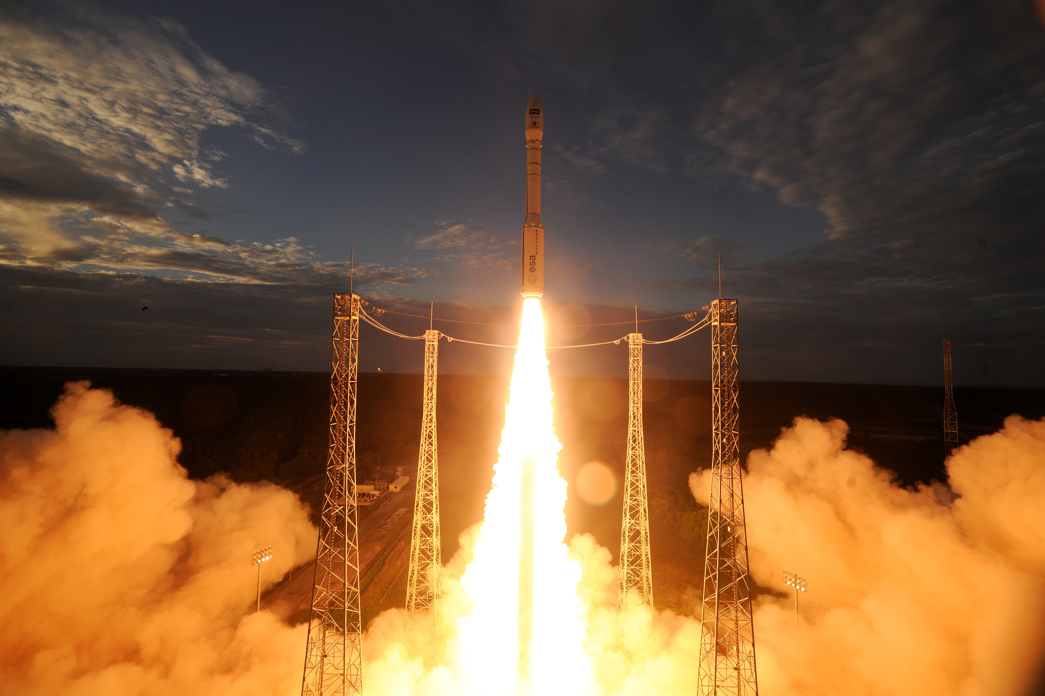
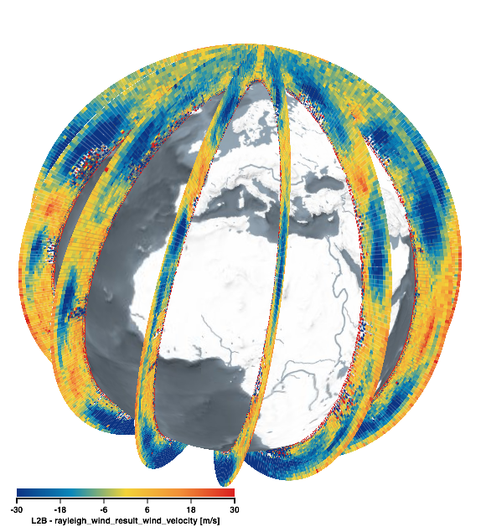
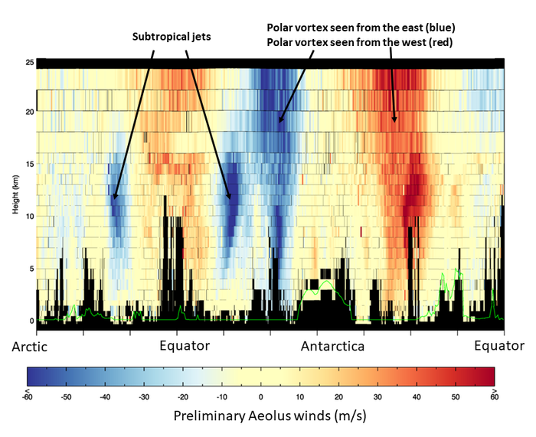
Aeolus
Mission Status
Aeolus successfully launched on 22 August 2018
Data release to Cal/Val teams on 18 December 2018
First Cal/Val workshop after the launch in March 2019 in Frascati
More than 26 accepted Cal/Val teams
First validation results very promising
First NWP impact assessment experiments clearly show positive impact
→ 2nd press release
12 Sep

Slide 7
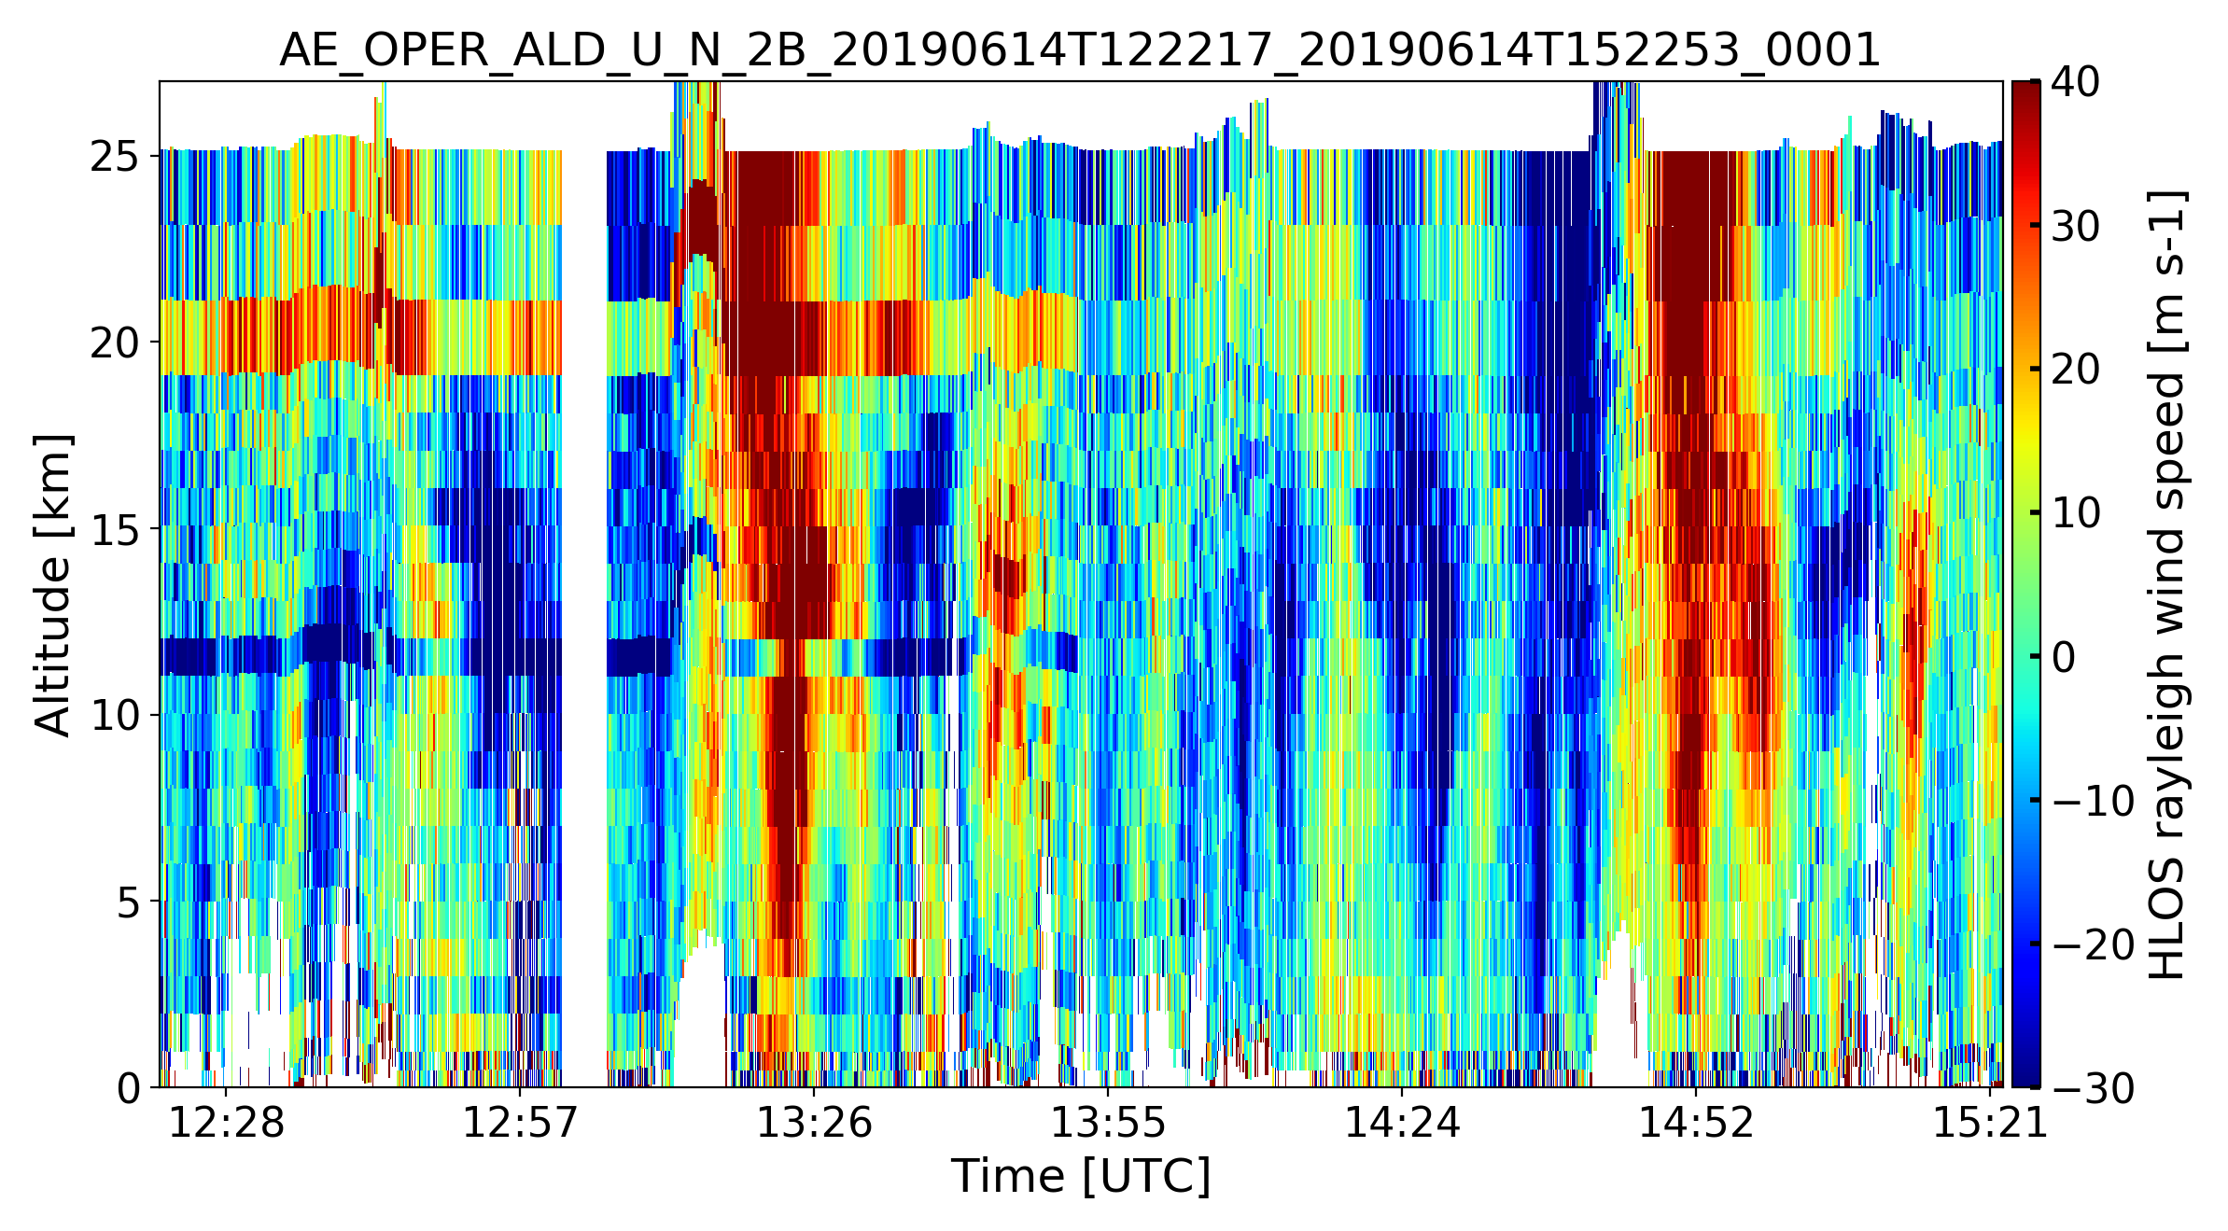
Aeolus
Mission Status – Data Quality
Advanced correction scheme implemented on 14 June 2019
correct for biases introduced by increased dark currents in the detection unit (warm pixels)
Correction scheme operationally implemented
Example of L2B Rayleigh HLOS wind, courtesy by S. Bley

Slide 8
Aeolus
Mission Status – Switch from Laser A to Laser B
Highest UV emit energy in the mission (~68 mJ)
First sensitivity tests indicate very good instrument performance
→ Timeline of the laser emit energy including the switch to laser B, Courtesy by F. Weiler, DLR

Slide 9
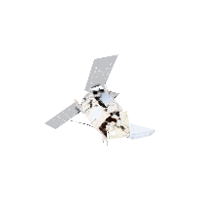
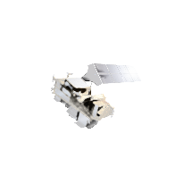
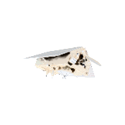
Copernicus – continue global leadership in EO
> 225.000
6 operational services
registered users
= tip of the iceberg
Land
Atmosphere
Ocean
Climate
Disaster
Security
7 satellites flying
250 TB satellite data distributed per day
S1 | S2 | S3 | S4 | S5P | S5 | S6
●● | ●● | ●● |  | ●
full, free & open data policy
preparing Copernicus 4.0
Notes:
This infographic captures the key elements of the Copernicus EO system ➔ explain a few.
Copernicus is the Reference Backbone for an integrated EO observing system and, it is an excellent example of European global leadership in space.
Copernicus enables us to provide a routine health check of our planet.

Slide 10
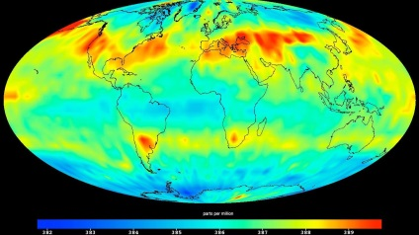
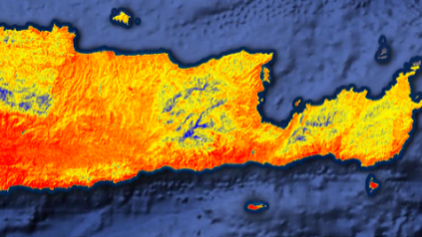
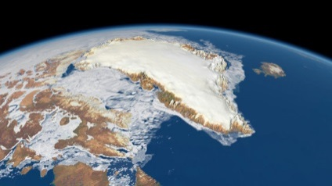
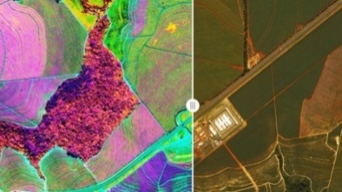
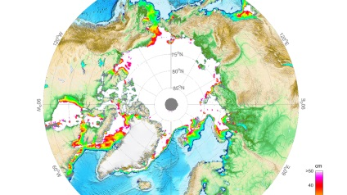
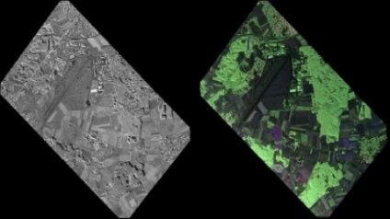
Copernicus 2.0 – 6 High Priority Candidate Missions
 | Monitor causes of Climate Change ➔ CO₂ Imaging Spectrometer |  | Agriculture & Water Productivity ➔ High Res. Surface Temperature
 | Monitor effects of Climate Change ➔ Polar Ice & Snow Topography |  | Food Security, Soil & Minerals, Biodiversity ➔ Hyperspectral Imaging
 | Sea Ice Conc. & SST ➔ Passive Microwave Imaging |  | Vegetation & Ground Motion & Moisture ➔ L-band SAR
Notes:
Kick-Off & Progress
Potential Sentinel expansion system study activities initiated
End-to-end performance simulation campaigns
Scientific studies in support of mission requirements definition
Pre-developments of most critical technologies.
Copernicus Long Term Scenario
20 new spacecraft
6 new mission domains: CO₂ imaging spectrometry, thermal / hyperspectral / microwave imaging, etc.
Integration of NewSpace and national mission data
Sophisticated, operational data access
Cost Estimate for Space: 8 Bn Euro (EU MFF + ESA CM)
CM19 proposal: 1,4 bn Euro (+0,6 bn at CM22/25)

Slide 11
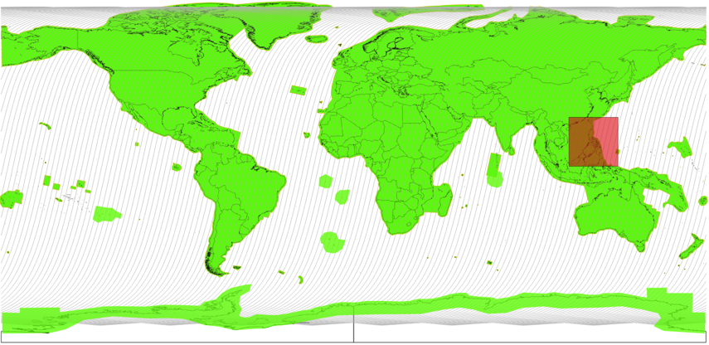
S2 Observation Requests / East of Philippines
East of Philippines / NASA / [August 1, 2019 – October 15, 2019].
Rationale:
The Cloud, Aerosol, and Monsoon Process Philippines Experiment (CAMP2Ex: https://espo.nasa.gov/camp2ex/content/CAMP2Ex) seeks to better understand how aerosols affect the properties of shallow cumulus and congestus clouds in a tropical meteorological environment.
The campaign further seeks to improve knowledge on how spatially inhomogeneous aerosol and cloud fields affect atmospheric heating rates and fluxes. An additional goal is to better understand how satellite remote sensing retrievals perform under complex cloud and aerosol conditions.
High resolution satellite images of clouds and aerosols will play a central role with addressing the CAMP2Ex mission objectives and Sentinel-2 MSI images are requested to support their science interpretation.
Implementation foreseen for a two months campaign starting from August 2019.
Example of Level-2A surface reflectance versus Level-1C (top-of-atmosphere)
Copyright: Contains modified Copernicus Sentinel data (2018)

Slide 12
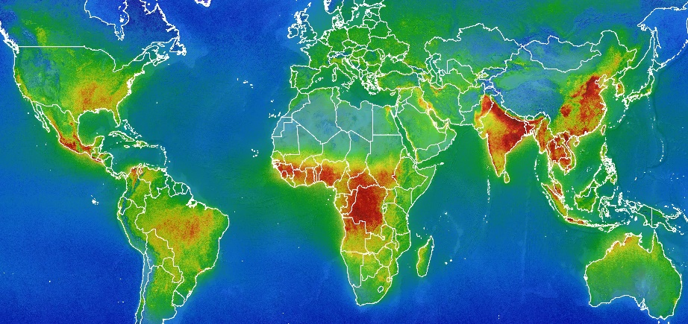
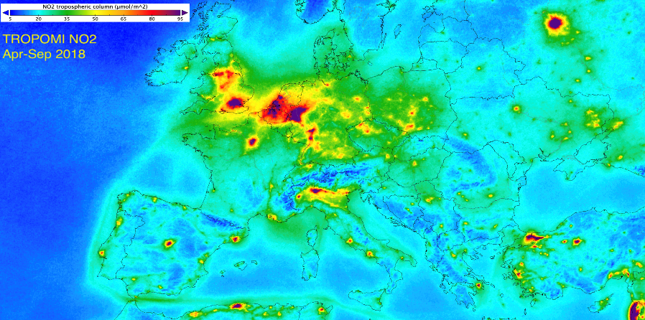
Sentinel-5 Precursor mission status
HCHO
Launched: 13th October 2017
Routine operations: since March 2018
Products Quality: all within requirements
Main user Copernicus Atmosphere Monitoring Service (CAMS) operated by ECMWF:
Assimilation: O₃ since 4th Dec. 2018
Assimilation tests: Tropospheric NO₂; CO; volcanic SO₂
Planned TROPOMI resolution improvement: along track resolution from 7 to 5.5 Km on 6th Aug. 2019
Data release status:
TROPOMI HCHO:
Nov 2017 – Oct. 2018
Product | NRTI | OFFL
Level 1B | N/A
Ozone - O₃
Tropospheric O₃ | N/A
Vertical profile O₃
Nitrogen Dioxide – NO₂
Sulphur Dioxide - SO₂
Carbon Monoxide - CO
Methane – CH₄ | N/A
Formaldehyde - HCHO
Cloud Parameters
Aerosol Index
Aerosol Layer Height
Credits – BIRA
Released to Users
✓
Validated - To be released end August 2019
Pending L1B UV radiometric calibration – 1st Quarter 2020
Credits – KNMI
✓
✓

Slide 13
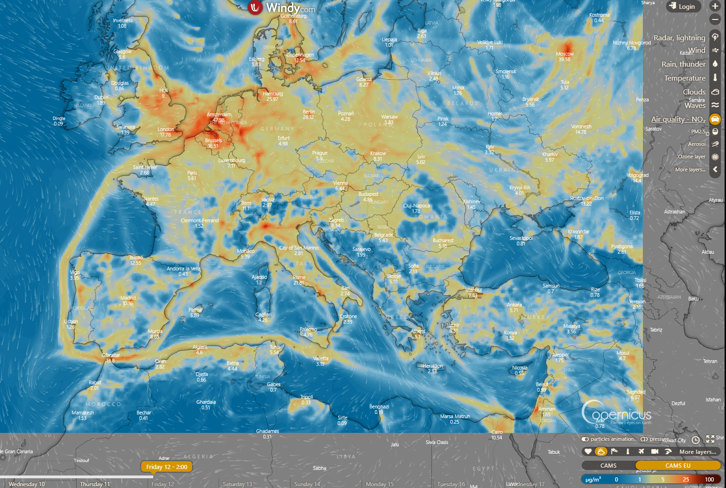
Sentinel-5P
NO2
CAMS – EU
https://www.windy.com

Slide 14
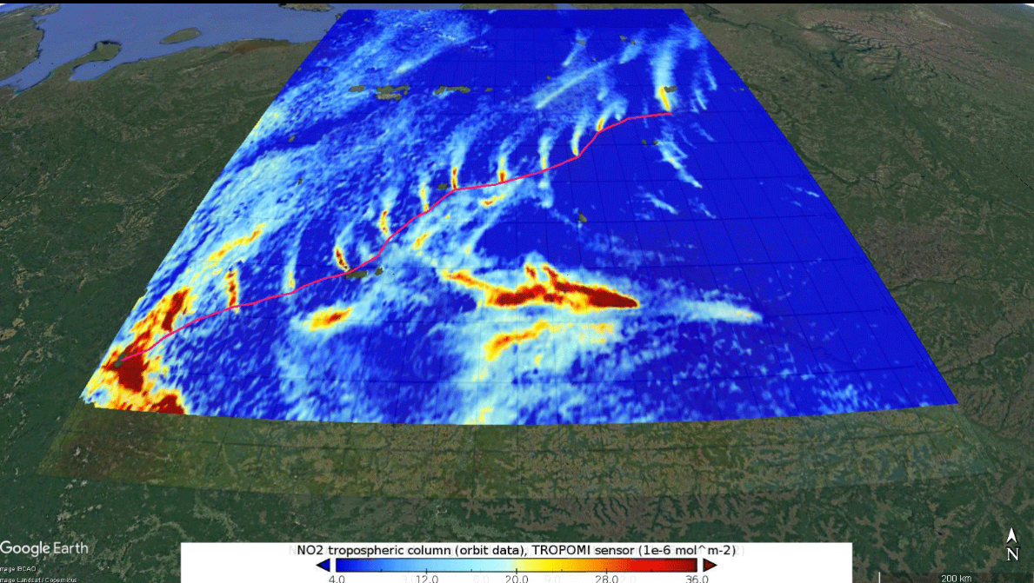
The Urengoy–Pomary–Uzhhorod pipeline is one of Russia’s main natural gas export pipelines. In order to maintain the pressure and flow over long distances, a series of compressor stations are strategically placed to help push the gas along.

Slide 15
EDAP : New ESA data assessment pilot launched
In line with the Earthnet Programme objectives, ESA aims to foster cooperation and collaboration with not only other national space agencies, but also commercial mission providers.
These NewSpace players are now playing an important role in the EO international strategy. Some of these new missions are potential candidates for Earthnet TPMs.
ESA has set up a project to assess the quality of their data and also to establish dialogues with the various mission providers in order to improve the overall coherence of the EO system.
This project called Earthnet Data Assessment Pilot (EDAP) was kicked-off on 23 November 2018 for a total duration of 2 years.
The EDAP consortium, headed by Telespazio VEGA UK is aimed at the provision of various clusters of expertise to perform an early data quality assessment of existing or future EO missions from national or commercial providers, which may potentially become TPMs within ESA's Earthnet Programme.
The performed tasks are identified in close dialogue with the mission's owners given the sensitive and potentially confidential information related to data quality.
→ CEOS WGCV context (best practises, methods…etc…) is a key element of the project

Slide 16
EDAP – Maturity Matrix
Quality Assessment Guidelines. Sam Hunt et al., NPL

Slide 17
VHR-RODA – CEOS WGCV SAR workshop
The Very High-resolution Radar & Optical Data Assessment (VH-RODA) workshop will be held in Frascati, Italy from 18-22 November 2019. The Workshop, hosted by ESA/ESRIN, will provide an open forum for the presentation and discussion of current status and future developments related to the calibration and validation of space borne very high-resolution SAR and optical sensors and data products.
https://earth.esa.int/web/sppa/meetings-workshops/hosted-and-co-sponsored-meetings/vh-roda
The VH-RODA workshop will be in conjunction with the CEOS SAR 2019 workshop (http://sarcv.ceos.org/workshop2019) and organised consecutively to the Committee on Earth Observation Satellites (CEOS) Working Group on Calibration and Validation (WGCV) SAR Subgroup. The CEOS SAR 2019 workshop will focus on current and future issues related to the calibration and validation of space borne SAR sensors and data products.

Slide 18
Lunar irradiance measurement and modelling for absolute radiometric calibration of EO sensors
Define a strategy for the measurement of the lunar spectral irradiance variation from the ground
Demonstrate the feasibility of such measurements
Compile a database of such measurements and on that basis improve the modelling of the lunar disk irradiance variations through its cycles (targeting sub-2 % absolute radiometric accuracy)
Compare the improved lunar disk irradiance model to various independent sources of lunar observations from space

Slide 19
Lunar irradiance measurement and modelling for absolute radiometric calibration of EO sensors
M. Bouvet (ESA), Emma Woolliams (NPL), Claire Greenwell (NPL), Maria Garcia Miranda(NPL), Carlos Toledano (Univ. Valladolid), Alberto Berjón (Univ. Valladolid), África Baretto (Univ. Valladolid), Stefan Adriaensen (VITO)
KO of activity in Sept. 2017
KO+2 months: definition and procurement of lunar photometer
KO+6 months (19th of March 2018): Review of instrument characterisation (spectral, geometric and radiometric), calibration and derivation of measurement uncertainties.
KO+6 months (19th of March 2018) to end:
Lunar data collection at Pico Teide / Izana (Spain)
Development of a model of lunar irradiance
KO+12 month to end: comparison of the model of lunar irradiance to:
lunar observations: from Proba-V, PLEIADES and a subset of the GLOD
Other lunar model(s): GIRO
Final meeting: Sept. 2019

Slide 20
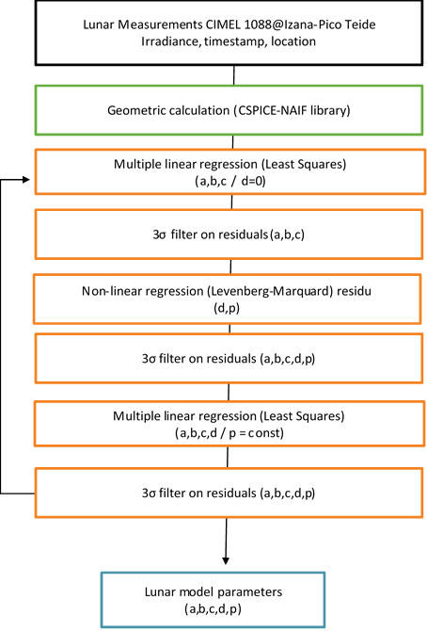
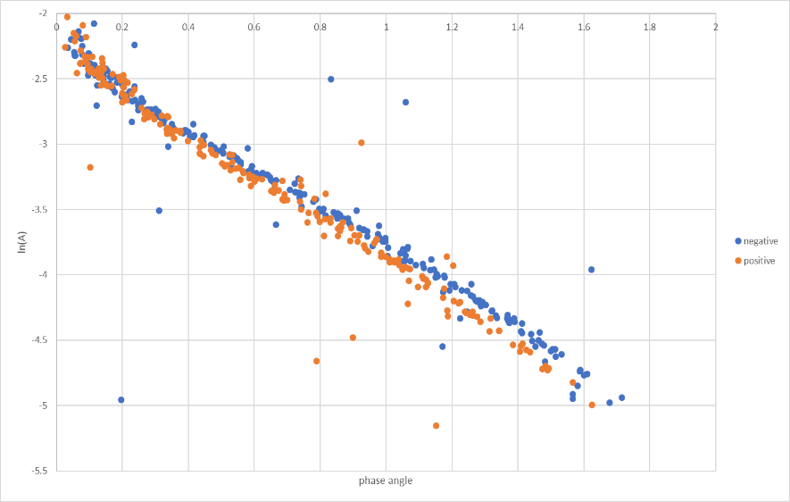
WP 4000: Lunar spectral irradiance model development
WP 4000: Lunar spectral irradiance model development
Define a strategy to derive the model regression coefficients (ROLO based) from the lunar measurements
Derive regression coefficients from database of measurements
Measurements uncertainty propagation in to the model parameters / regression coefficients
Logarithm reflectance

Slide 21
Eradiate Community Workshop 2019
Object: First announcement of the Eradiate 2019 workshop
Dear colleagues,
As announced on the eradiate.eu web page, the 2019 Eradiate workshop will be held on November 26th-27th 2019 at the Joint Research Center facilities in Ispra (Italy). Eradiate is an open-source 3D radiative transfer model based on a state-of-the-art Monte Carlo ray tracing method. The first phase of the development of the code has started last May. A first beta version the code will be released in late 2020. Several additional beta releases are scheduled over the course of 2021. The first public release, open for contribution, is scheduled for early 2022.
A major originality of Eradiate is to offer a common 3D radiative transfer simulation framework to Earth observation subcommunities (atmosphere, land, ocean, etc.) to allow painless integration of scientific advances. Eradiate is intended to be a place to aggregate state-of-the-art techniques, proven by research and widely accepted by the community as a standard.
Contribution can take several forms, some of which require programming, but not only. Contributing to a community project can mean:
reporting bugs or problems;
suggesting features;
writing documentation;
fixing bugs;
implementing new features;
developing new 1D and 3D scenes.
The main goals of this year’s workshop are therefore to assess which tools and processes should be put in place for contribution including Eradiate benchmarking procedures, as well as to start discussions on potential community contributions. The latter will be oriented to meet RTM needs to support Copernicus-related CalVal activities.

Slide 22
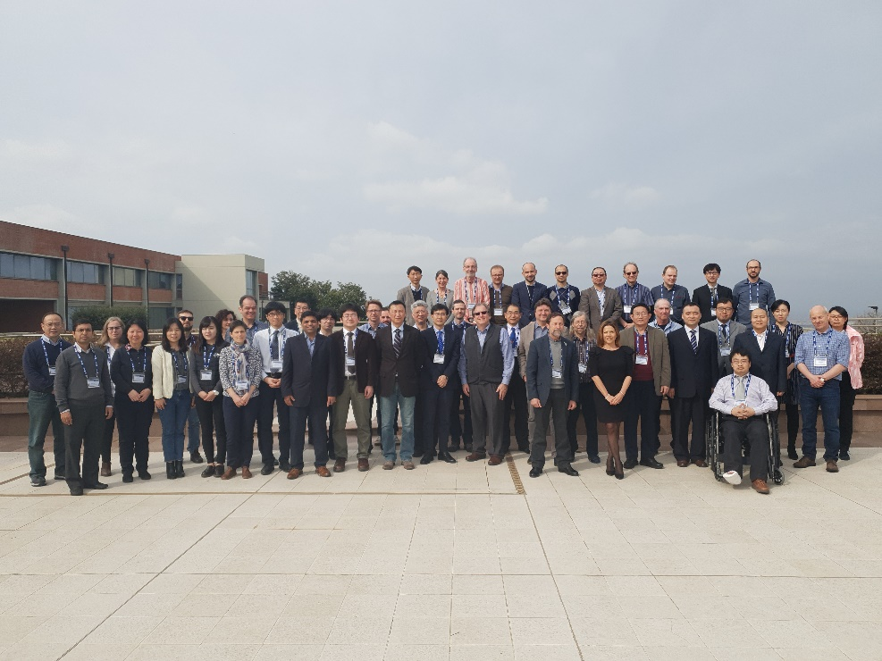
ESA full Member of GSICS
The GSICS POC for ESA are:
Philippe Goryl
Philippe.Goryl@esa.int
Mark Drinkwater
Mark.Drinkwater@esa.int
2019 GSICS Data and Research Working Groups Annual meeting held at ESA Frascati in March 2019.

