Slide 1

NASA
Report on Cal/Val Activities
K. Thome
NASA
WGCV Plenary # 45
CSIRO, Perth
July 16-19, 2019

Slide 2





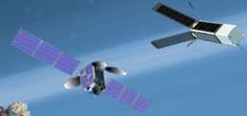
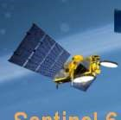



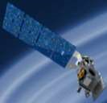
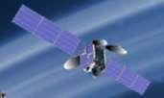
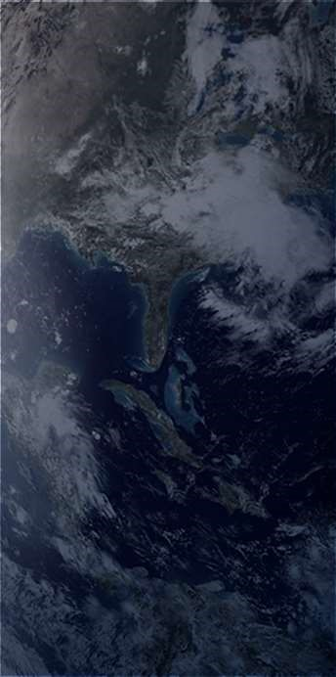

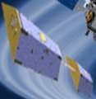
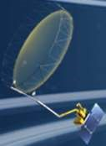


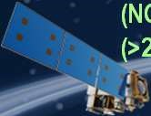



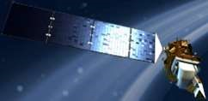

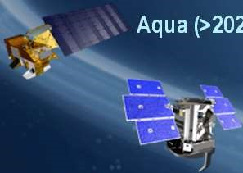
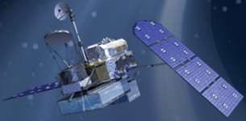
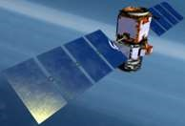
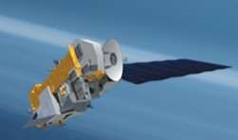
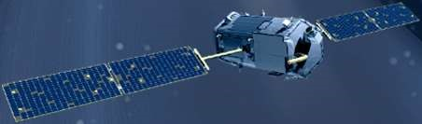
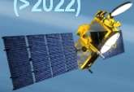
NASA Earth Science
PREFIRE (2) (TBD)
(
Pre)Formulation
PACE (2022)
Implementation
Missions: Present through 2023
GeoCARB (~2021)
Primary Ops
TROPICS (12) (~2021)
Extended Ops
MAIA (~2021)
Landsat 9 (2020)
Sentinel-6A/B (2020, 2025)
ISS Instruments
NI-SAR (2021)
SWOT (2021)
LIS (2020), SAGE III (2020)
TEMPO (2018)
InVEST/CubeSats
TSIS-1 (2018),
OCO-3 (2019),
ICESat-2 (2021)
RAVAN (2016)
ECOSTRESS (2019),
GEDI (2020)
GRACE-FO (2) (2023)
NISTAR, EPIC
CLARREO-PF (2020), EMIT (TBD)
(
DSCOVR / NOAA)
RainCube (2018)
CYGNSS (8) (2019)
TEMPEST-D (2018)
(2019)
CubeRRT (2018)
JPSS-2 Instruments
Suomi NPP
SMAP
CSIM (2018)
NOAA)
(>2022
OMPS-Limb (2019)
(
)
CIRiS (2019)
(>2022)
HARP (2019)
Landsat 7
SORCE,
SNoOPI*
Terra (>2021)
(USGS)
TCTE (NOAA)
HyTI*
Landsat 8
(~2022)
(2017)
(
USGS)
CTIM*
(>2022)
Aqua (>2022)
TACOS*
CloudSat (~2018)
*
Launch date TBD
GPM (>2022)
CALIPSO (>2022)
Aura (>2022)
OSTM/Jason-2 (NOAA)
(>2022)
OCO-2 (>2022)
(>2022)

Slide 3
NASA ESD Flight Portfolio through 2023
Extended
  Terra (2022), Aqua (2022), Aura (2022), GPM (2022), CloudSat (20119), CALIPSO (2022), OSTM/Jason-2 (2022), SORCE (2019)
On-orbit
  CYGNSS (2019), DSCOVR (2019), ECOSTRESS (2020), GRACE-FO (2023), ICESat-2, OCO-2 (2022), SMAP (2022), S-NPP (2022), TSIS-1 (2019), SAGE-III (2020)
Development
  CLARREO Pathfinder, EMIT, GRACE-FO, LIS, MIAI, NISAR , OMPS-Limb, PACE, Jason CS/Sentinel 6A and –B, SWOT, TSIS-2
  Earth System Science Pathfinder (ESSP) - TEMPO, EVS-2 and -3
  Venture Technology selections (GrAOWL, Tempest), EVM-2 & 3, EVI-3, 4, 5, and 6
Preformulation
  TROPICS, GeoCARB, PREFIRE
In-Space Validation of Earth Science Technologies (InVEST):
  CubeSats

Slide 4
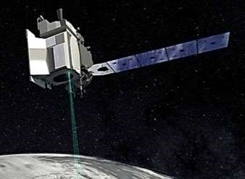
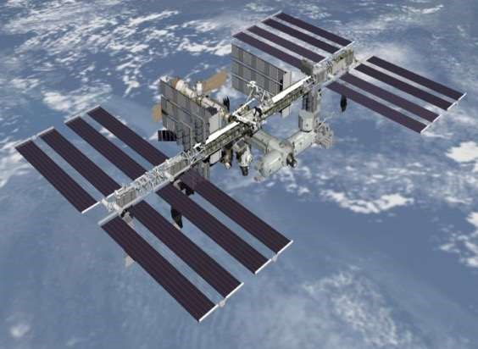
Recent Launches: ICESat-2; GEDI; OCO-3
ICESat-2: Quantify polar ice sheet contributions to sea-level change and measure vegetation canopy height as a basis for estimating large-scale biomass and biomass change
GEDI: Characterize the effects of changing climate and land use on ecosystem structure and dynamics providing the first global, high resolution observations of forest vertical structure
OCO-3: Investigate important questions about the distribution of carbon dioxide on Earth as it relates to growing urban poplulations and changing patterns of fossil fuel contribution

Slide 5
Compact Spectral Irradiance Monitor CubeSat Launched December 2018 as part of Spaceflight SmallSat Express rideshare
Developed through a 2013 IIP grant at LASP/UC-Boulder
Ultra- compact, solar spectral irradiance (SSI) monitor covering 200-2400 nm
SI-traceable accuracy and stability to meet solar input measurement requirements for benchmark climate records
Will validate performance against SSI measurements being made by SORCE and TSIS SIM

Slide 7
2017 Earth Venture Suborbital-3 (EVS-3) solicitation - Five 5-year investigations selected
DCOTTS - Dynamics and Chemistry of the Summer Stratosphere – Kenneth Bowman, Texas A&M University: Understand how dynamical and chemical processes interact to determine composition of extratropical stratosphere
S-MODE (Submesoscale Ocean Dynamics and Vertical Transport) – Thomas Farrar, Woods Hole Oceanographic Institute: Test hypothesis that submesoscale ocean dynamics make important contributions to vertical exchange of climate and biological variables in the upper ocean.
IMPACTS (Investigation of Microphysics and Precipitation for Atlantic Coast-Threatening Snowstorms) – Lynn McMurdie, University of Washington: High-altitude ER-2 observations to understand snow band formation and evolution
ACTIVATE (Aerosol Cloud Meteorology Interactions Over the Western Atlantic Experiment) – Armin Sorooshian, University of Arizona: Study interactions of aerosol particles and clouds
Delta-X: Enabling Deltas to Thrive in a Century of Rising Seas - Marc Simard, Jet Propulsion Laboratory: Calibrate sediment transport and plant productivity models of the Mississippi delta floodplain to understand impacts of sea-level rise

Slide 8

Private Sector Small-Satellite Constellation Pilot
Buy existing data products related to ECVs derived from private sector-funded small-satellite constellations (3-satellite minimum constellation, full longitude coverage) for evaluation by NASA researchers to determine value for advancing NASA research
  Planet – three satellite constellations including 200+ satellites supplying imagery and derived products
  DigitalGlobe – five satellite constellations supplying high-resolution(31-50-cm) images
  Spire – constellation of 48satellites collecting Radio Occultation soundings and ship reports
Evaluations by broad set of funded researchers chosen from existing funding for a 1 year evaluation period to assess quality of geophysical information; sata availability (latency) and subdistribution rights vs. cost; vendor plans for constellation maintenance/evolution

Slide 9
Designated observables summary as described in recent Decadal Survey

Slide 10
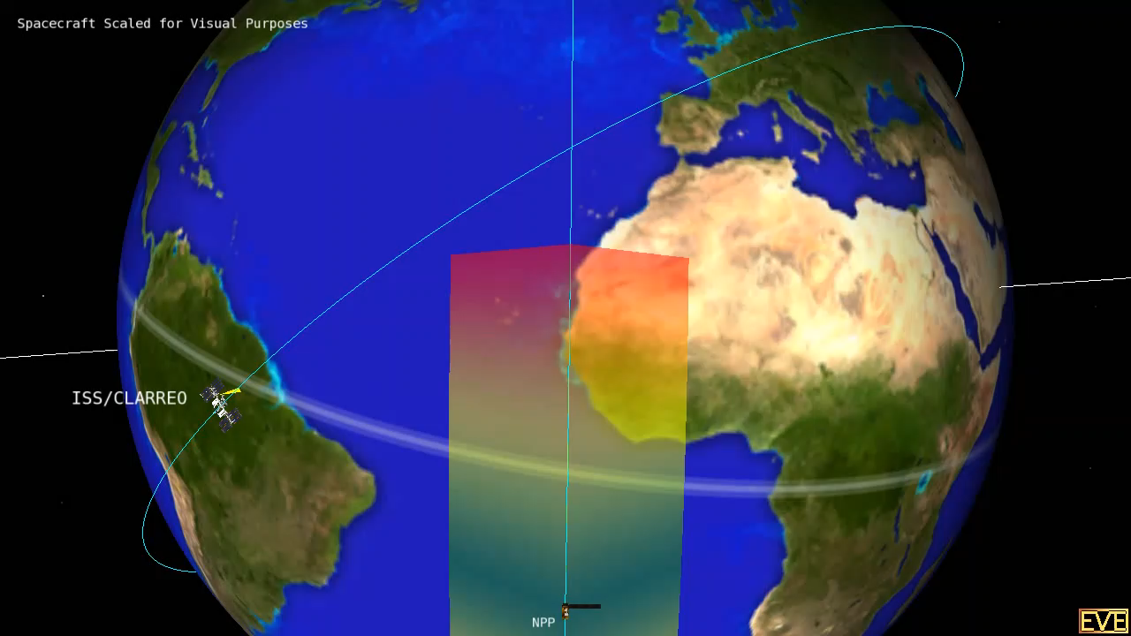
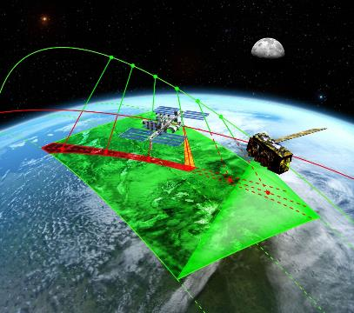
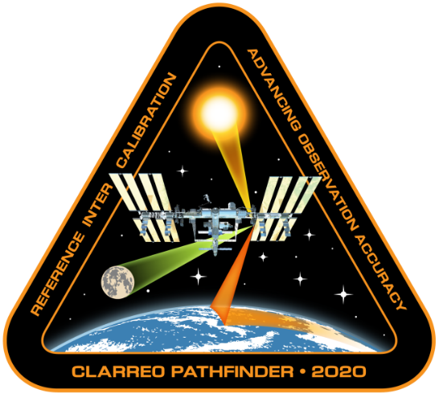
CLARREO Pathfinder is in Phase B
Demonstrate
  Essential measurement technologies for the Reflected Solar portion of the full Tier 1 Decadal Survey-recommended CLARREO mission
  On-orbit, high accuracy, SI-Traceable calibration
  Ability to transfer calibration to operational sensors
Formulation, implementation, launch to ISS, and operation of a Reflected Solar (RS) Spectrometer
Class D Mission with late 2022/early 2023 launch for nominal 1-year mission life
Additional 1 year science data analysis

Slide 11
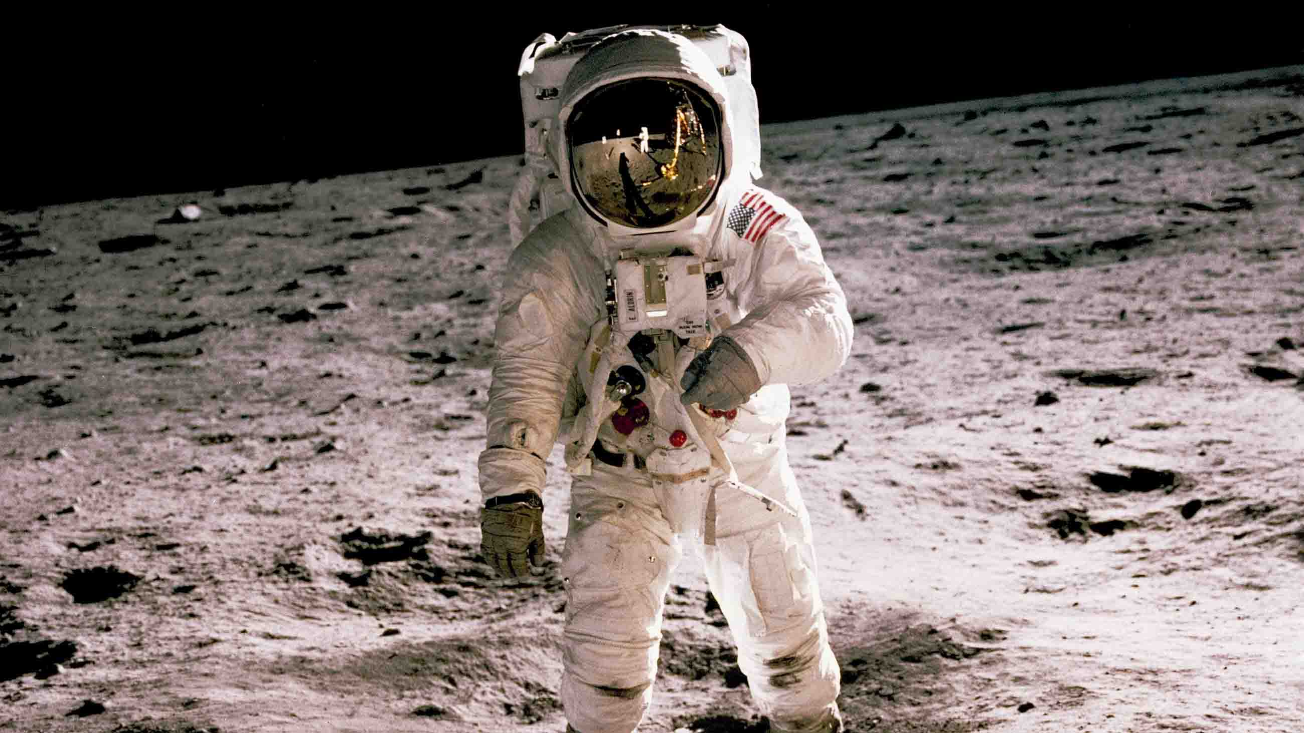
Recognize the first Lunar Calibration Workshop held July 20, 1969
Two attendees participated in the productive 2 hour and 32 minute workshop
Topics included evaluations of
  Trajectory of lunar soil when kicked
  Visibility in lunar sunlight
  Thermal effects of sun and shadow inside the suit
  Surface shadows and colors

