Slide 1
USGS Agency Report
to CEOS WGCV, CSIRO Perth, AU, July 2019
Greg Stensaas, stensaas@usgs.gov, +01 (605) 594-2569

Slide 2
Outline
Introduction
EROS Cal/Val
Landsat 8 Calibration Update
Landsat 7 Calibration Update
Geometric/DEM Improvements
Collection 2
Lunar Cal
L2 Validation
Landsat 9 & 10
Summary

Slide 3
Introduction
USGS/EROS is responsible for the production and distribution of Landsat data (L1 – L5 MSS, L4 – L5 TM, L7 ETM+, and L8 OLI/TIRS).
EROS is also involved in the development of Landsat 9.
EROS Cal/Val Center of Excellence (ECCOE) has incorporated all cal/val components into a larger calibration group, partnerships included NASA/GSFC, NASA/JPL, Rochester Institute of Technology, South Dakota State University, and University of Arizona, and other partners

Slide 4
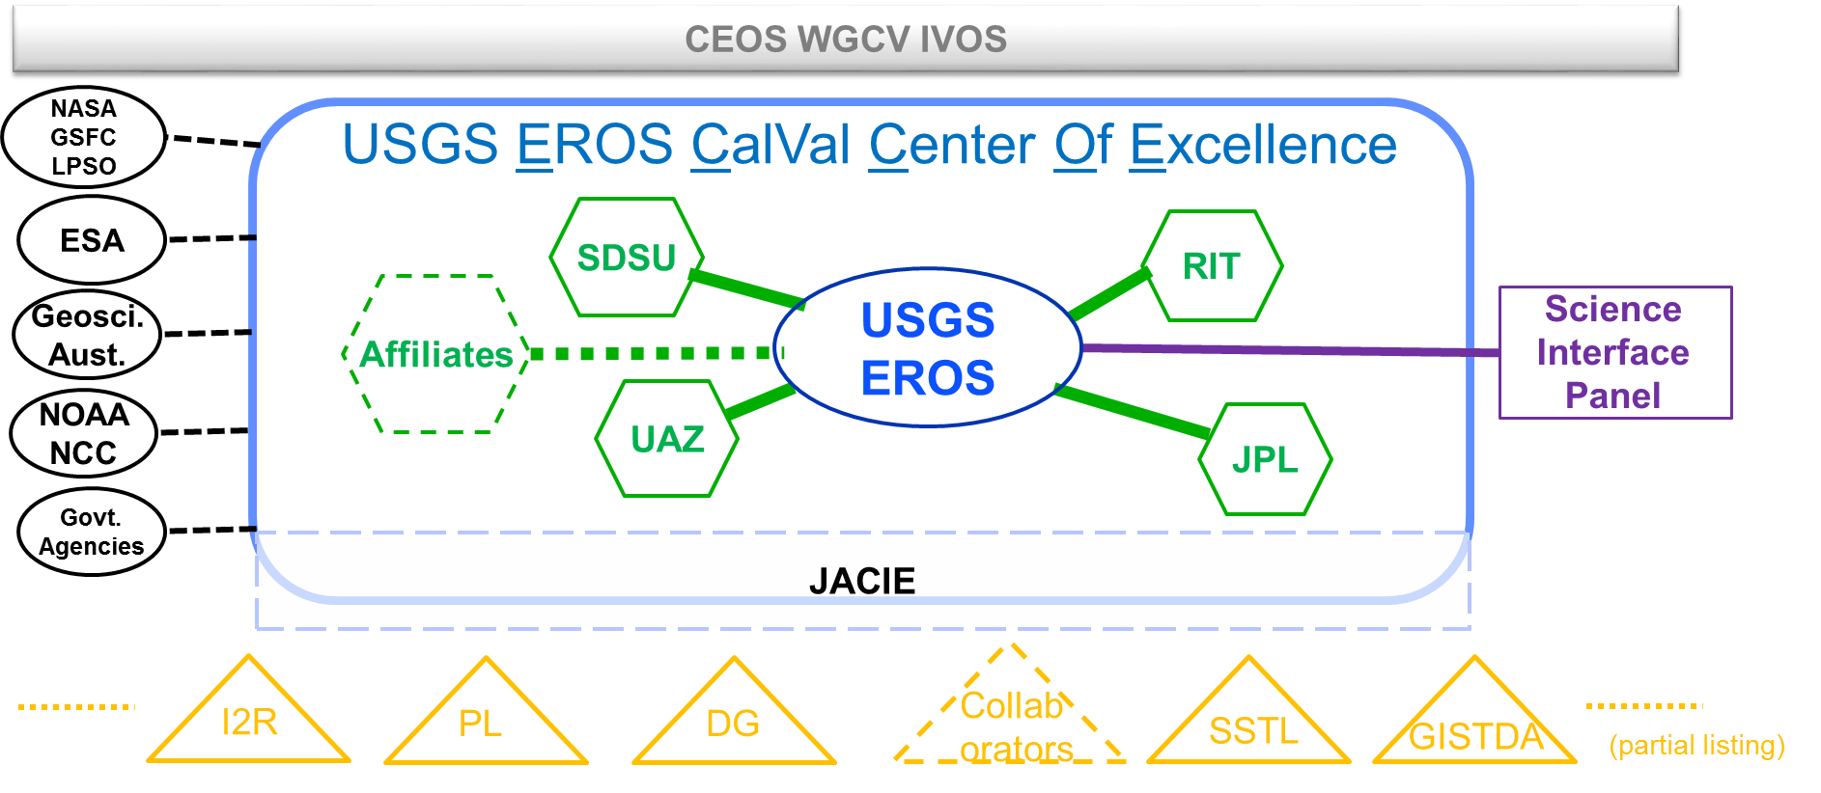
EROS Calibration/Validation Center of Excellence (ECCOE)
established 2017 for: “improving the accuracy, precision, and efficiency of radiometric, geometric, and spatial characterization, calibration, and cross-calibration of optical remote sensing systems to achieve the highest degree of interoperability of remote sensing data products.”
Scope Enhanced - Increasing Staff by 7-10 FTE’s ~26 people at USGS EROS, and other partnership personnel from NASA, NOAA, agreements, grants, …, (many additional FTE)
  Collaborate/Integrate International Surface Reflectance and Temperature Measurements
  Maintain Operational Surface Reflectance and Temperature Monitoring
  Support/Influence External Data Interoperability
  Operationalize USGS UAS Calibration Capability
  Expand/Improve Landsat/ Sentinel 2 Harmonization and Interoperability
  Establish Best Practices in conjunction with CEOS IVOS and GSICS
2nd annual workshop: Sept. 2018 at NOAA in College Park, MD
  focus theme: compare calibration and data quality between satellites (commercial versus Govt.)
3rd annual workshop: Sept 23, 2019 at USGS in Reston, VA
  focus theme: GEO-LEO Simultaneous NADIR Overpass Cross-Calibration and joint usability
Register to attend here:
https://www.eventbrite.com/e/eros-calval-center-of-excellence-eccoe-workshop-tickets-58572955286

Slide 5
.
Click to expand

Slide 6
USGS ECCOE
Greg Stensaas - ECCOE Project Manager - stensaas@usgs.gov
Cody Anderson – Cal/Val Lead - chanderson@usgs.gov
Michael Choate – Geometric Cal/Val Scientist - choate@usgs.gov
Tom Stone - Lunar Calibration Project Scientist - tstone@usgs.gov
  co-developer of the ROLO model and Lunar Cal Lead
Jeff Irwin – Field Survey and Data assessment – jrirwin@usgs.gov
Jeff Danielson – Bathy, CoNED, Elevation Assessment - daniels@usgs.gov
Hiring additional Government staff for ECCOE
  Radiometric and Photogrammetric experts

Slide 7
Joint Agency Commercial Imagery Evaluation (JACIE) program
Co-sponsored by USGS, NASA, NOAA and the U.S. Dept. of Agriculture
Performs product analysis of commercial and other remote sensing data and information products
  Provides independent characterizations of image and image-derived end products
  Provides independent verification of commercial imagery data quality
Provides Earth scientists with awareness of commercial imagery
  Annual workshops, 2019 workshop #18 (Sept. 24-26)
  Register to attend here: http://jacieworkshop2019.eventbrite.com?s=84508608
  ECCOE workshops held in conjunction with JACIE (Sept. 23)
JACIE Information:
  https://www.usgs.gov/land-resources/eros/calval/jacie

Slide 8
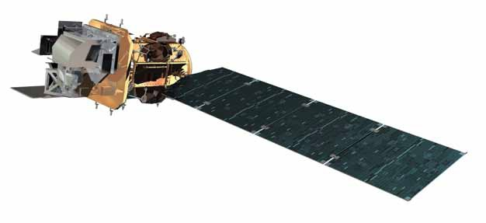
Landsat 8 Observatory Status
  Launched 11 February 2013
  705 km, Sun sync 10:12 AM
Operational Land Imager
Propulsion Subsystem
- Service Line/Valve Temp Instability
Thermal Control System
- May 2016 Rwheel-4 thermostat instability began
- PDM out of family temperature increase under
watch/discussion
Attitude Control System
- July 2015 CSS-9 &12 current instabilities began
- Oct 18-21 2017 CSS-10 current instabilities seen
(reappeared in late Mar 27 2018)
- Mar 22-23 2018 CSS-11 current instabilities seen
RF Communications
Thermal Infrared Sensor
- Mar 2015 - Side-A SSM Encoder degraded, switched to B side
- Aug 2015 - Side-B Encoder degradation, powered off 29 Oct 2015
(now only used for bi-monthly cals ALT CON OPS)
Command & Data Handling System
- May 2015 SSR Ghost file errors began accumulating
- Sept 2015 Toggled SSR low power, Ghost files ceased
- Mar 2017 SSR HKDB CEC Error Count Trend Increase
Electrical Power System
- Average Battery Pressure under watch conditions

Slide 9
Landsat 8 On-board Calibrators
OLI
Shutter
Two Diffusers
  Working – weekly
  Pristine – twice/year
Three Lamp Pairs
  Working – daily
  Backup – every two weeks
  Pristine – twice/year
Lunar
  Once/lunar cycle, near Full Moon
  All 14 focal plane arrays
TIRS
Blackbody
Deep Space

Slide 10
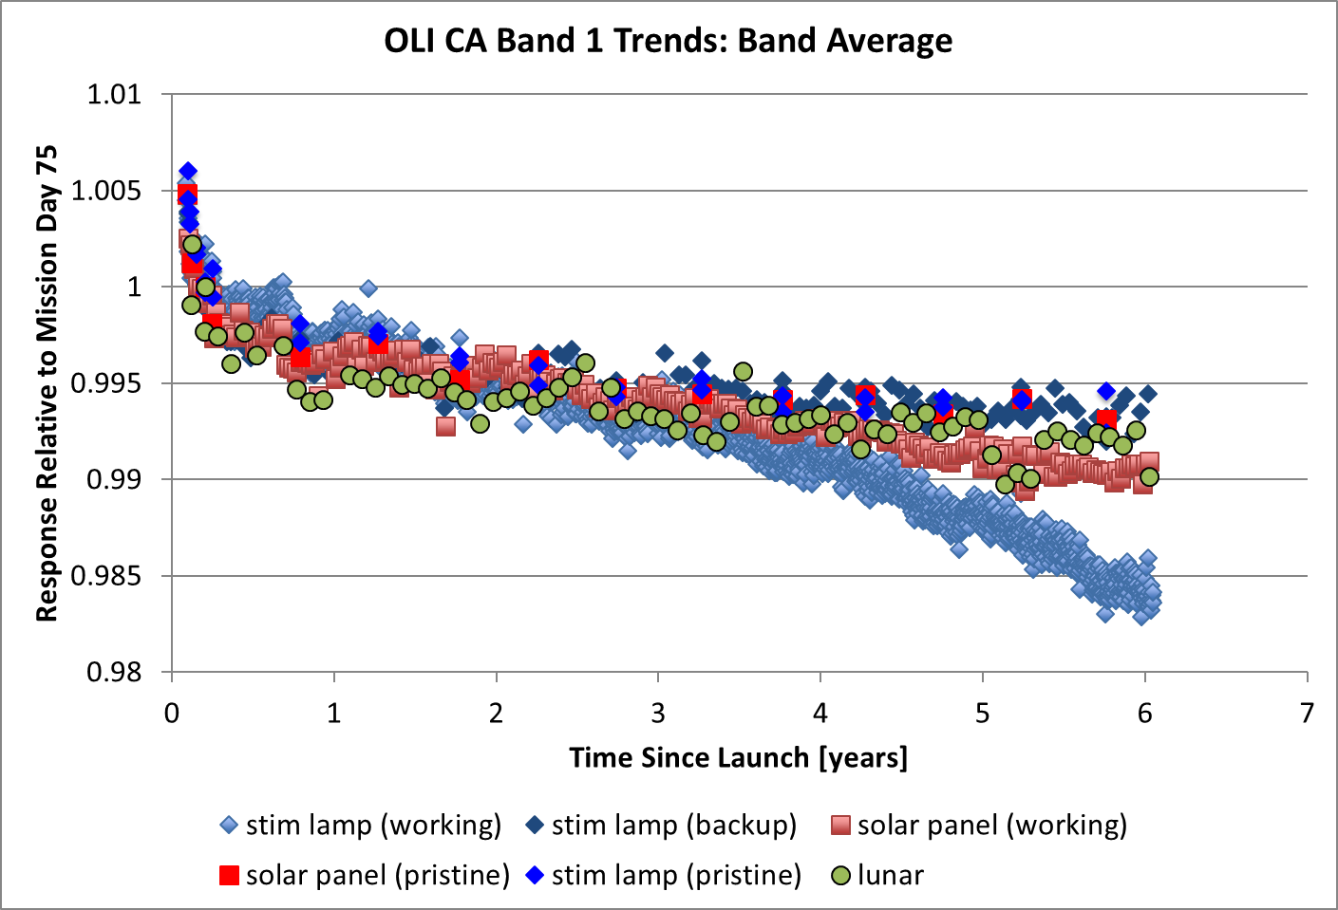
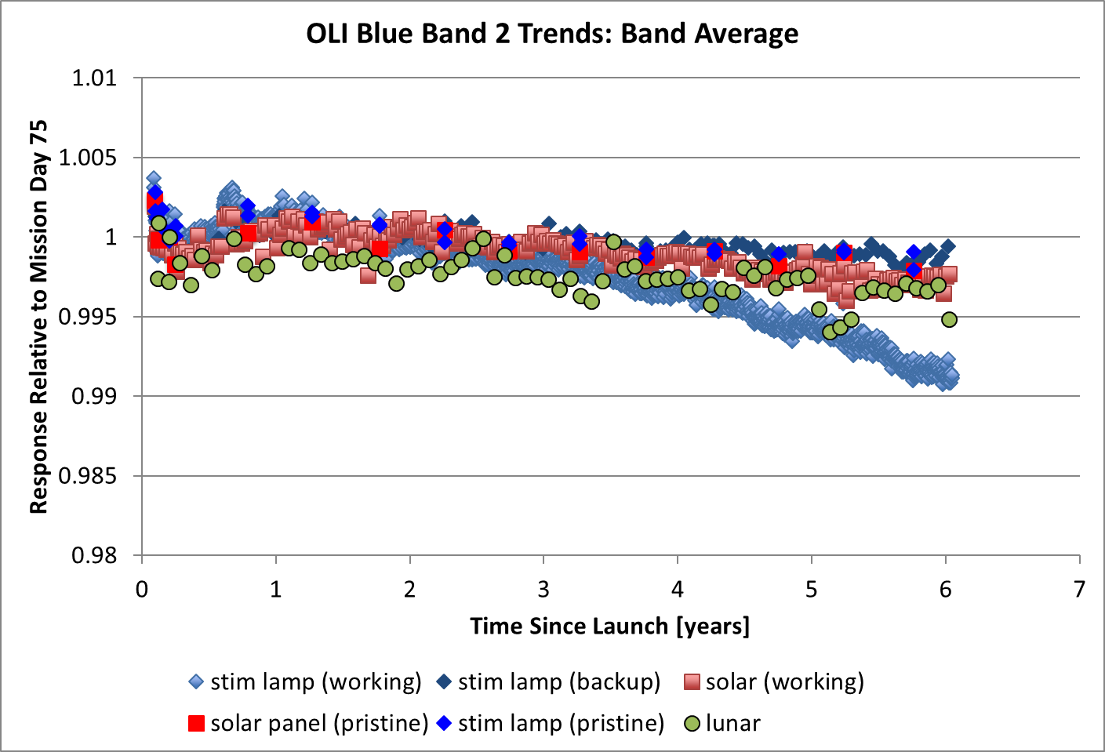
L8 OLI Radiometric Stability
Overall radiometric response models are a weighted average of the responses from 2 stim lamps, 2 solar diffusers, and lunar collects
  Working stim lamp (light blue) has been removed from the weighted model
  Possible degradation in working diffuser trend in CA band
Decay in sensor responsivity over the lifetime indicated by all calibrators
  CA band ~1.3%; Blue band ~0.25%

Slide 11
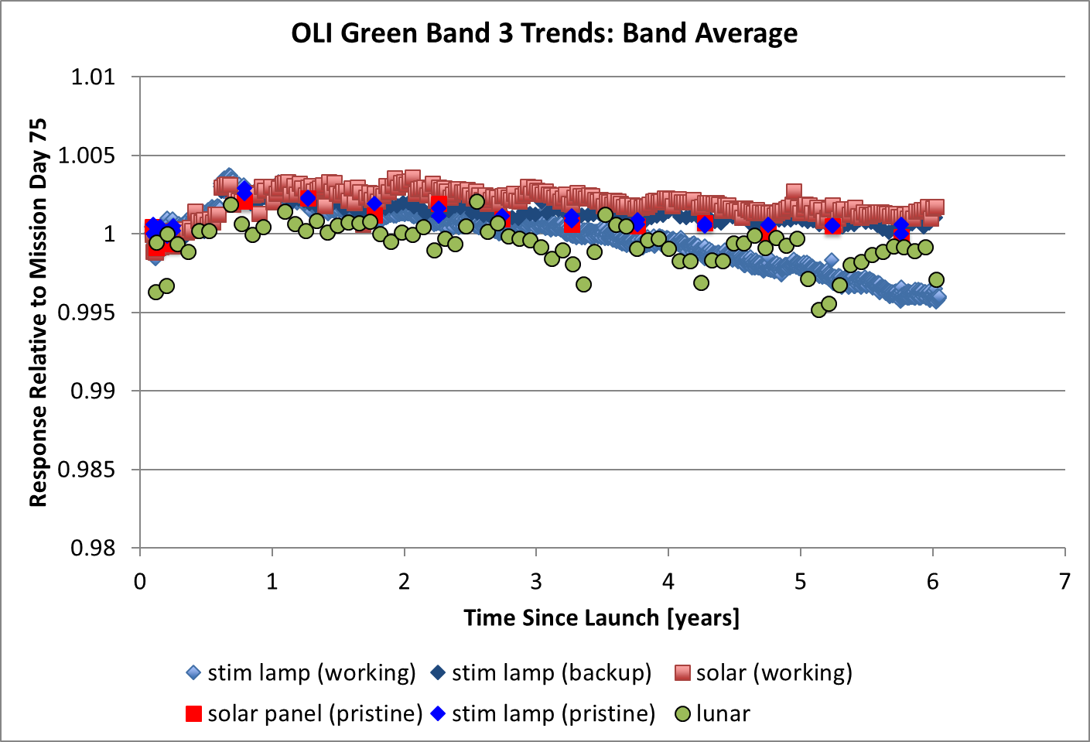
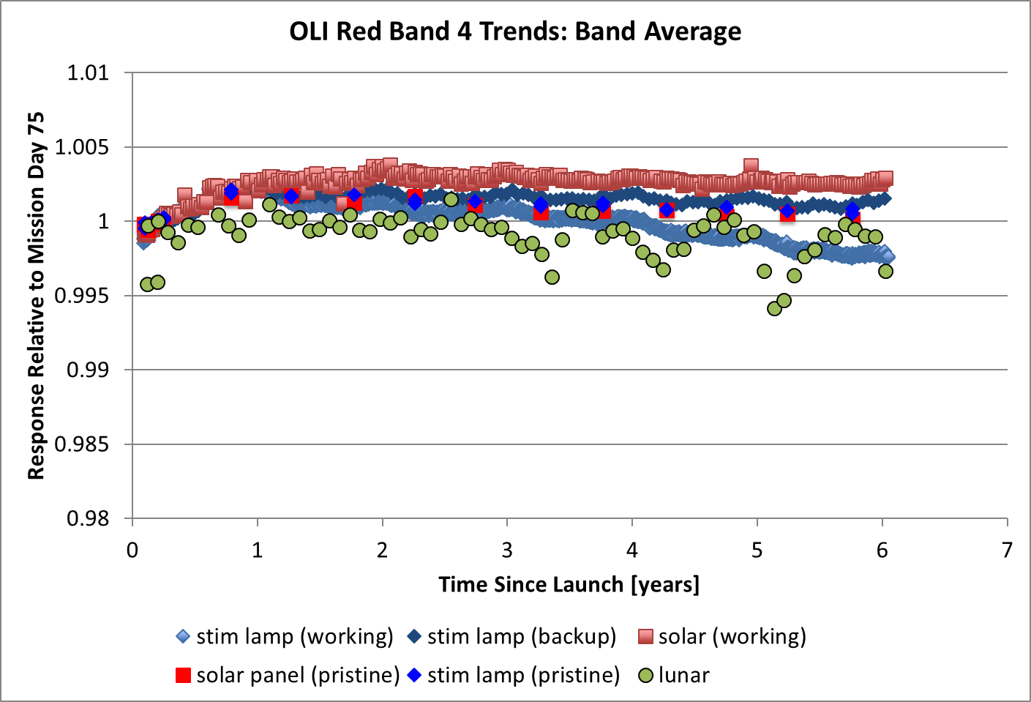
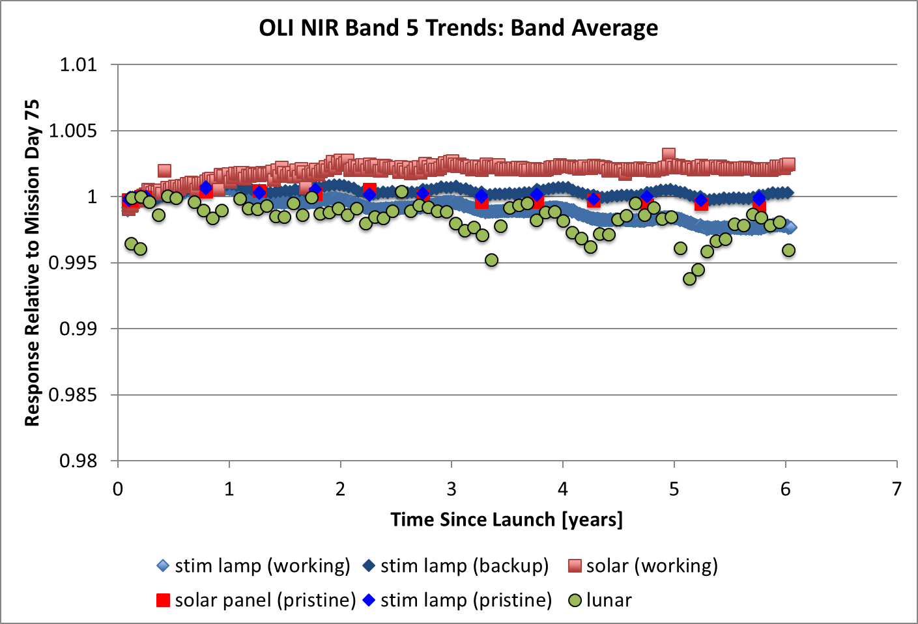
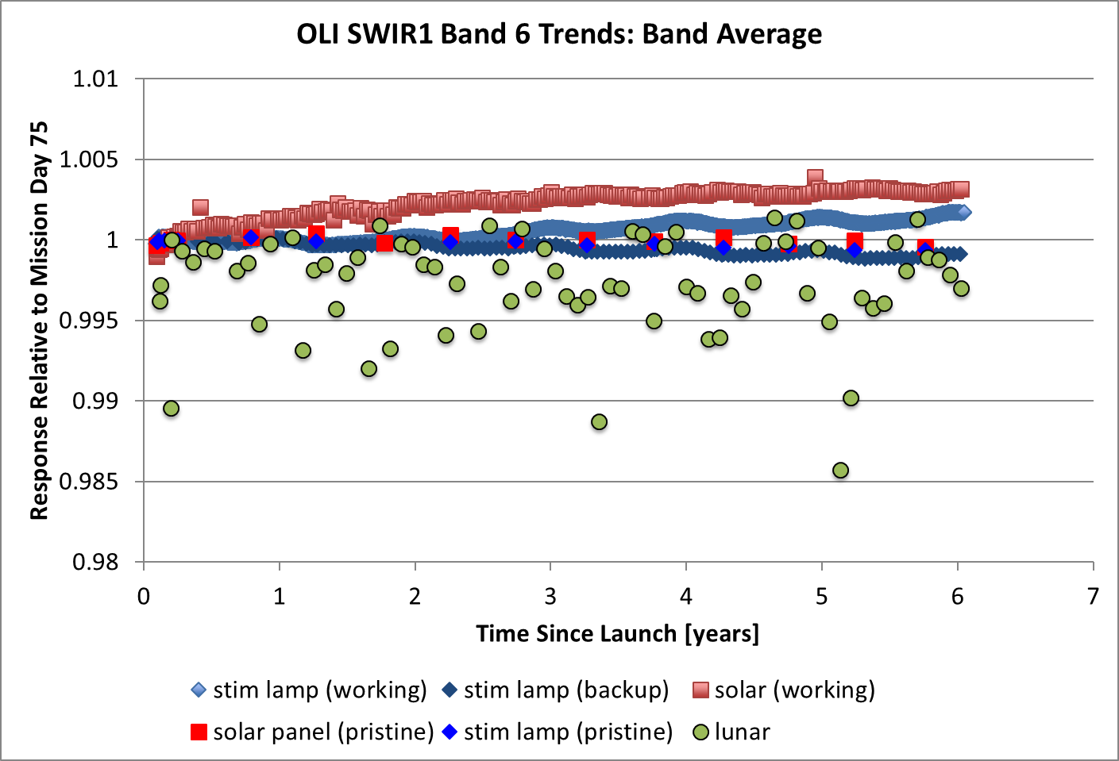
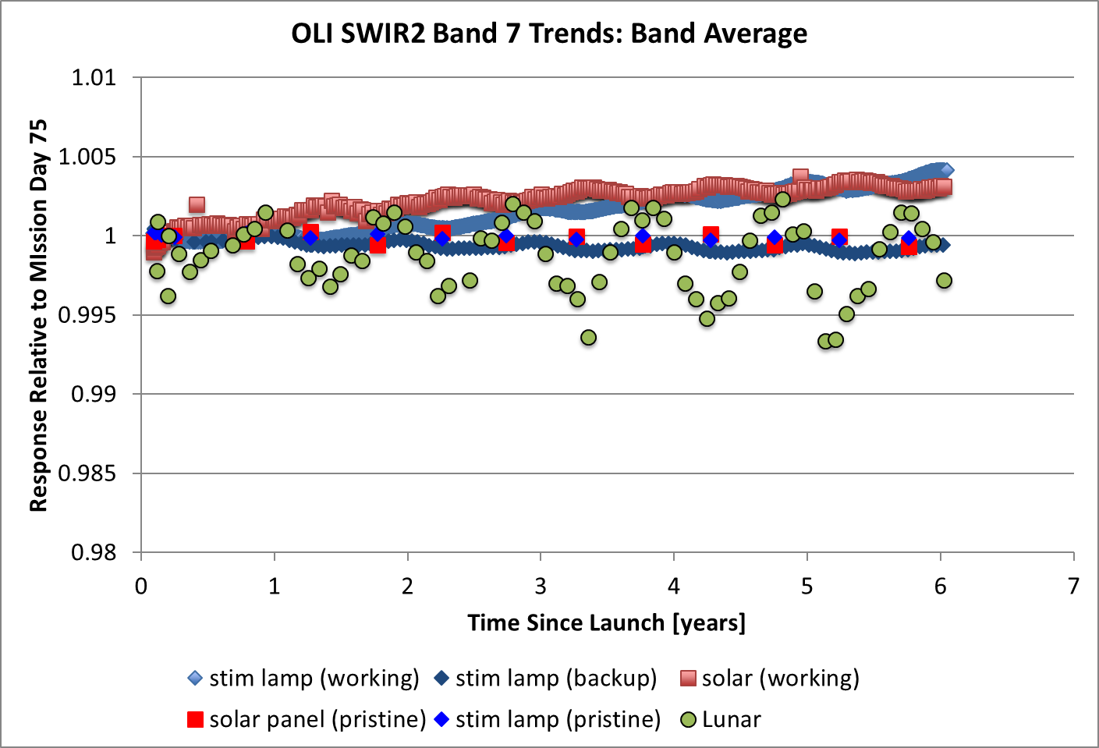
L8 OLI Radiometric Stability (Cont.)
Lunar collects show more variability at longer wavelengths
No modeled decay for these bands

Slide 12
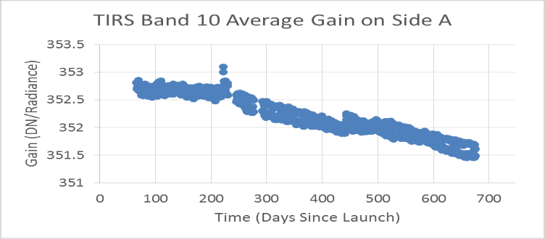
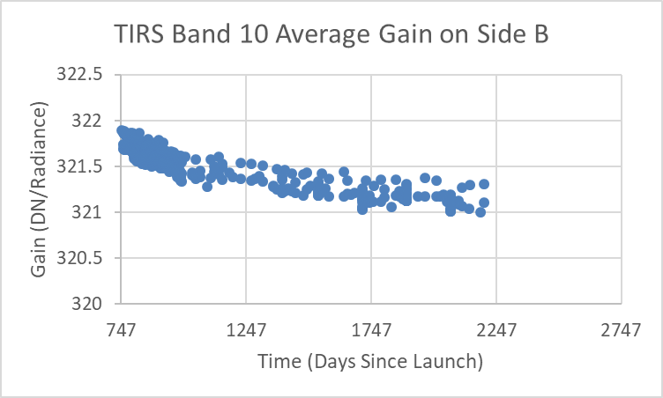
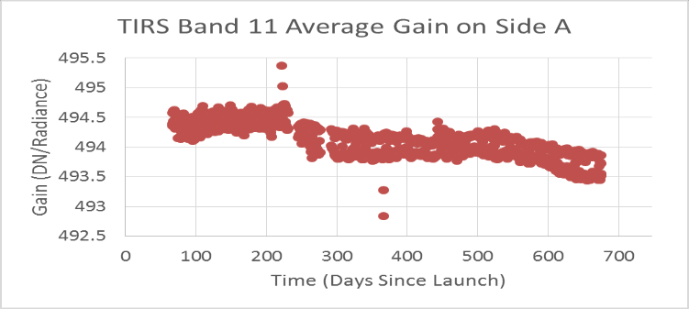
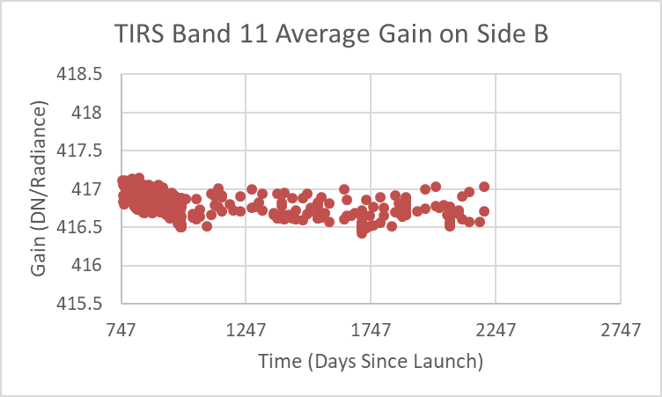
L8 TIRS Radiometric Stability
Switch from side A to side B electronics due to scene select mirror current draw
Side B shows better stability than side A
Different ops con caused the different sampling rate seen in the side B plots.

Slide 13
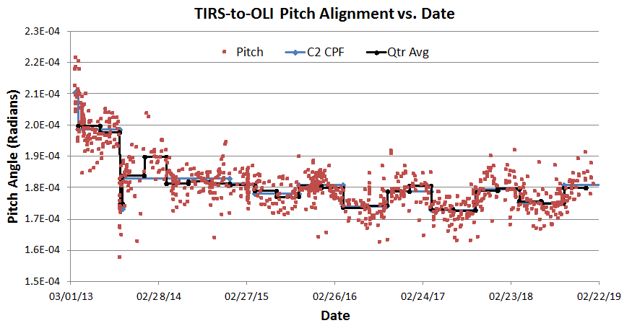
L8 TIRS-to-OLI Pitch Alignment vs. Date
Measure TIRS-to-OLI alignment using TIRS 10.8 μm and OLI SWIR1 bands
  TIRS alignment changed as L8 maneuvered into the final orbit
  A spacecraft anomaly in September 2013 caused a step change
  A safe-hold event in April 2014 had a smaller impact
A seasonal pitch variation in mode 0 data of ~8 μrad will be corrected in the Collection-2 CPFs.
A.1
A.2
A.3
B

Slide 14
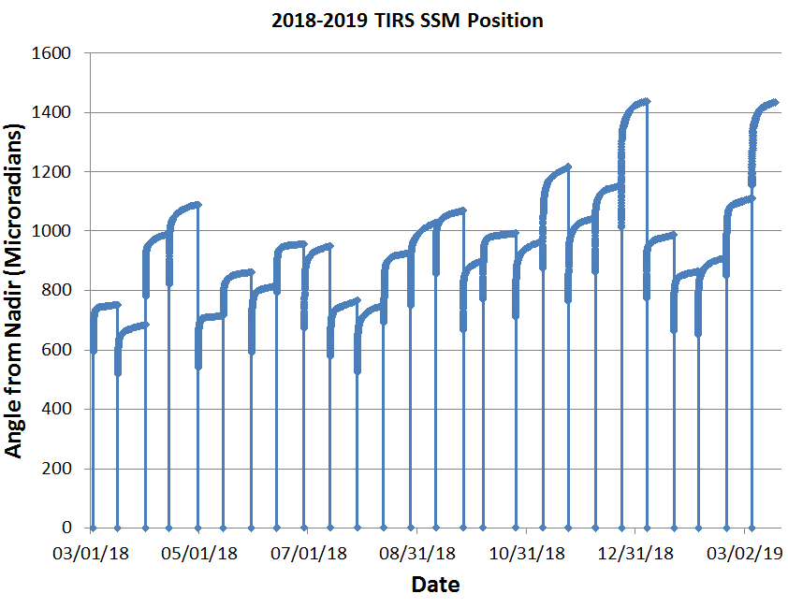
L8 TIRS SSM Position Variation
TIRS cal events reset the SSM position model every ~14 days
  SSM exhibits considerable variation in the magnitude of initial motion, so the initial motion is measured by leaving the encoder on for ~40 minutes
Subsequent motion is monitored using image measurements from cal scenes
  Fit a model of SSM position to encoder and scene data
  SSM position angles vs. time are used in ground processing
Note event-to-event variability
655m
More extreme
events since mid-2018
Each return to zero is a calibration event
Notes:
The thermal infrared sensor (TIRS) Scene Select Mirror (SSM) encoder …
On March 6, 2015 the Landsat 8 Thermal Infrared Sensor (TIRS) switched from A side to B side electronics to resolve a problem with the A side ...

Slide 15
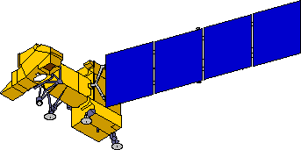
Landsat 7 Observatory Status
On orbit since April 1999
Final orbit maneuver February 2017
Continue science mission until mid 2021 (915)
Electrical System
Attitude Control System
•10/18/2014 Clock Generator Circuit failure
•Battery performance nominal
Solar Array
•05/05/2004 Gyro 3 Shut Off
•1-gyro control system in development
5/14/2002 Circuit #14 Failure
5/16/2005 Circuit # 6 Failure
8/13/2008 Circuit #14 recovery
14 circuits remain operating
no impact to ops
Enhanced Thematic Mapper +
•5/31/2003 SLC Failure
•4/01/2007 Bumper mode
Reaction Control System
1/07/04 Fuel line #4 thermostat #1a failure
2/24/05 Fuel line #4 thermostat failure;
Primary heater circuit disabled
4/25/13 Fuel line #2 thermostat failure;
Redundant heater circuit disabled
Remote Tlm Cmd (RTC) Box
Solid State Recorder
•09/27/2014 RTC A Failover
11/15/1999 SSR PWA #23 Loss
02/11/2001 SSR PWA #12 Loss
12/07/2005 SSR PWA #02 Loss
08/02/2006 SSR PWA #13 Loss
03/28/2008 SSR PWA #22 Loss
09/03/2008 SSR PWA #23 Recovered
10/12/2013 SSR PWA #11 Loss
Each PWA is 4% loss of launch capacity
Boards are likely recoverable
X-band System
Performance nominal
S-band System
Performance nominal

Slide 16
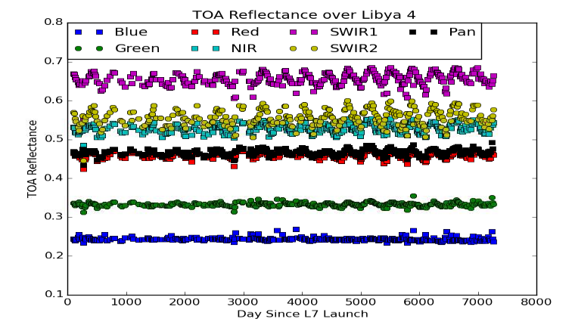
L7 ETM+ Radiometric Stability
ETM+ radiometric stability is monitored over PICS (here Libya 4)
Longer wavelength bands show some seasonal variation
The data don’t show any significant trends, so the current radiometric model is performing well

Slide 17
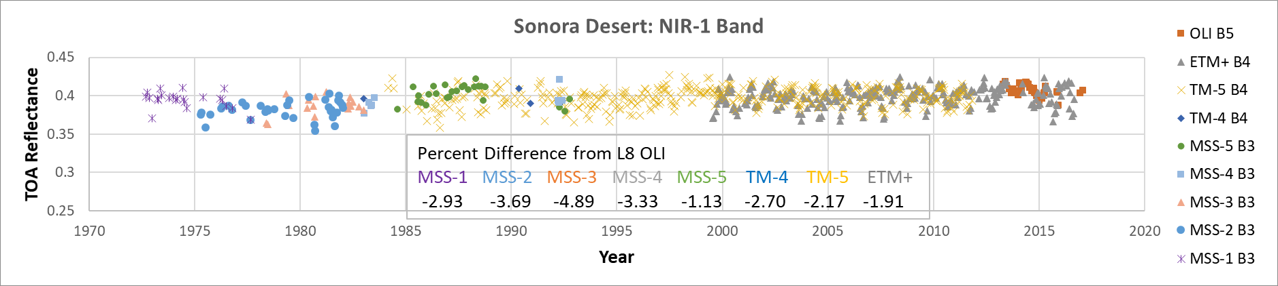
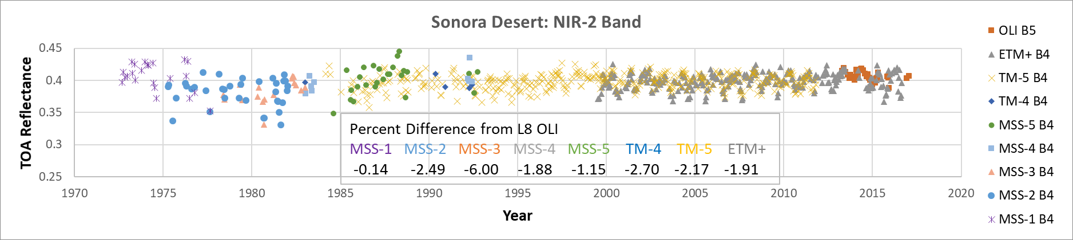
Landsat MSS Validation from L8 OLI using PICS
Attribution: USGS EROS

Slide 18
Landsat Collection 2
Currently scheduled for Fall 2019 –
  https://www.usgs.gov/land-resources/nli/landsat/landsat-collection-2
Level 2 Surface Reflectance and Surface Temperature
  Caveat: Discussions still underway for producing Level 2 products in Collection 1
Improved Geometric Accuracy/Sentinel 2 Alignment
L8 TIRS Absolute Radiometric Adjustment
L8 OLI Retroactive Absolute Radiometric Adjustment (CA and Blue)
L8 OLI to TIRS Seasonal Alignment
L7 ETM+ Sensor/Band Alignment
TM Thermal Absolute Radiometric Adjustment

Slide 19
Lunar Calibration
GIRO validation against ROLO
  GSICS Implementation of the ROLO (GIRO) model and the GSICS Lunar. Observation Dataset (GLOD)
  identified code modifications needed for both GIRO and ROLO
  modifications to GIRO code requires rebuilding the benchmark
  ROLO revision requires reprocessing all instruments’ lunar data
  Planning for 3rd Lunar Calibration Workshop
  Every 2 years
  Late 2019
USGS POC: Tom Stone, USGS, Flagstaff, AZ

Slide 20
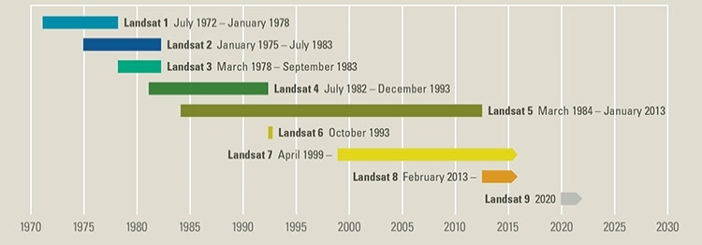
Landsat 9 and Beyond
Nearly identical copy of Landsat 8, part of Sustainable Land Imaging (SLI) Program - Operational Land Imager (OLI-2) and Thermal Infrared Sensor (TIRS-2)
Fast-tracked for December 2020 launch; on schedule
  Sun-sync orbit, phased 8 days from L8 for better temporal coverage
  OLI-2 - Finished all qualitative testing, Bounded to baseplate, Pre-Ship Review early Fall 2019
  TIRS-2 – Finished qualitative testing, Pre-Ship Review early Fall 2019
SLI Architecture Study Team
  USGS-NASA team
  Define architecture for 2027-2040
  Open slate, looking at multiple solutions against user requirements
Notes:
OLI-2 - Finished all qualitative testing, Bounded to baseplate, Pre-Ship Review early Fall 2019
TIRS-2 – Finished qualitative testing, Pre-Ship Review early Fall 2019

Slide 21
Landsat/S2 Registration Improvement Plan
Perform global readjustment of the GLS control using L8 data with sparse ties to the Sentinel-2 Global Reference Image (GRI).
  Six triangulation blocks are being used to perform this global readjustment.
L8-only triangulations are complete for all blocks.
  New OLI GCPs were also extracted for all blocks.
  The adjusted control is available for testing but is not yet being used for product generation.
When the S2 GRI L1C data become available (April 2019), we will re-run the triangulation solution with MSI control added to a subset of scenes.
  Some MSI control will be withheld to test the triangulation.
  Validate using OLI-MSI image registration measurements.

Slide 22
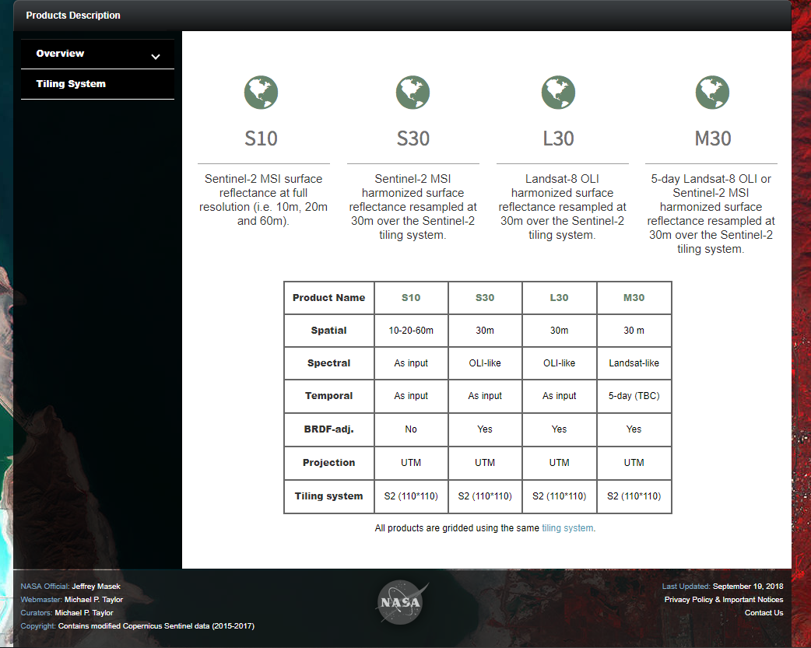
Landsat and Sentinel-2 Harmonization
NASA (Jeff Masek) developed Harmonized Landsat and Sentinel-2 Surface Reflectance Data
  Citation for HLS data set: Claverie, M., Ju, J., Masek, J. G., Dungan, J. L., Vermote, E. F., Roger, J.-C., Skakun, S. V., & Justice, C. (2018). The Harmonized Landsat and Sentinel-2 surface reflectance data set. Remote Sensing of Environment, 219, 145-161.
EROS in discussions to take ownership

Slide 23
Digital Elevation Model Improvements
ESA is procuring a global DEM.
  Recent information is that the 90-m/3-arcsec version will be publicly releasable but the 30-m/1-arcsec version will be restricted distribution based upon licensing.
Other DEM sources.
  National datasets in Scandinavia.
  Newer data in Canada (CDEM), and Alaska (NED).
  New reprocessed SRTM (NASADEM).
  WorldView-derived ArcticDEM for high latitude islands.
WGCV DEM team support from USGS – Mike Choate, Jeff Danielson, and Dean Gesch

Slide 24
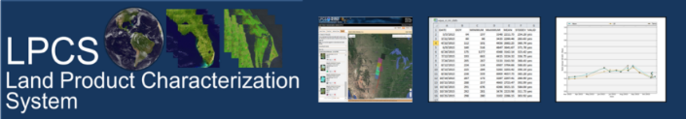
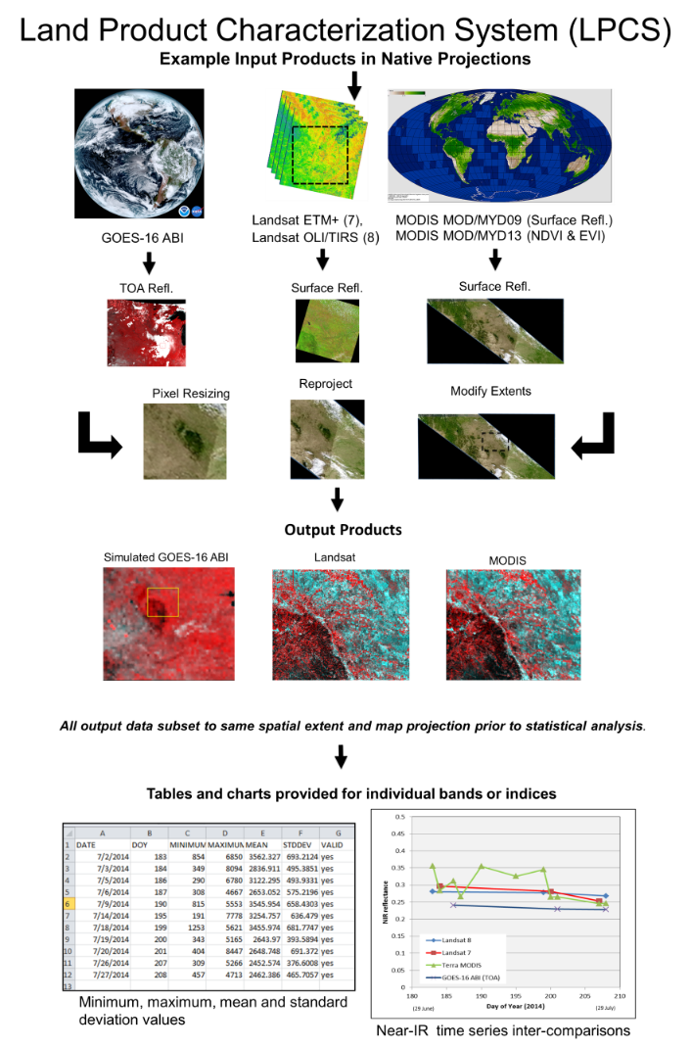
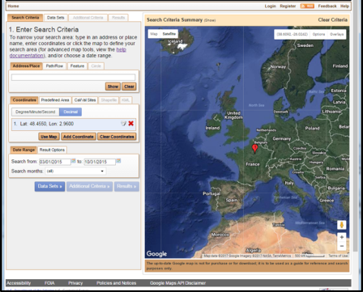
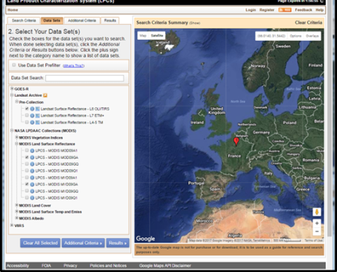
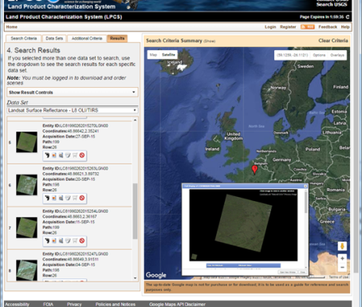
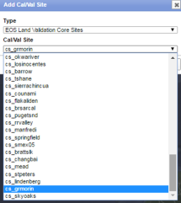
LPCS joint effort – NOAA and USGS https://landsat.cr.usgs.gov/lpcs
The Land Product Characterization System (LPCS) is a web-based system designed to facilitate characterization and validation of higher-level scientific data products including land products from ASTER, VIIRS, MODIS, Landsat, and in the future, Sentinel-2 and-3, GOES-16 ABI, and comparable in situ products.
The LPCS includes:
data inventory,
access, processing options, and
analysis functions,
that will permit selection of data to be easily identified, retrieved, co-registered, and compared statistically through a single interface. Data inventory and selection includes numerous pre-defined cal/val locations as well as options for user-defined selection of locations.
New funding from NOAA and USGS this year

Slide 25
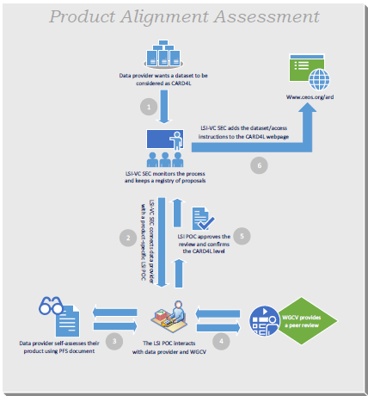
CEOS Analysis Ready Data for Land (CARD4L)
CARD4L - Satellite data that have been processed to a minimum set of requirements and organized into a form that allows immediate analysis with a minimum of additional user effort and interoperability both through time and with other datasets.
CEOS LSI-VC led - includes the overarching Definition, the individual Product Family Specifications, as well as the Assessment Process and outreach, advocacy, and promotion.
CEOS Analysis-Ready Data website
Working alignment to CARD4L
  Areas to improve rigidity, Traceability (SI-traceability and uncertainty), Radiometric Accuracy (absolute radiometric uncertainty relative to known standard), Measurement (SI-traceability), Measurement Uncertainty (SI-traceability)
  USGS contract whitepaper on definition related to interoperability

Slide 26
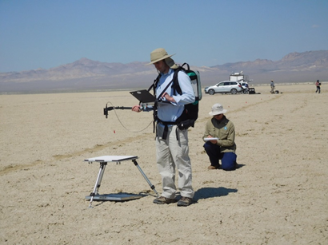
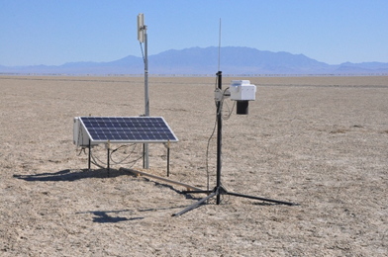
L2 Validation at USGS
CEOS WGCV, 10–13 Apr 2018
Surface reflectance is determined during vicarious calibration
Can be used to validate higher-order data products
In situ surface reflectance measurement techniques
  Typical technique: reference panel and spectroradiometer
  Panel calibration should be linked to metrology standard for SI traceability
  Current uncertainty estimate: ~2%
Automated systems (e.g. RadCaTS/RadCalNet)
  Use different techniques to measure surface reflectance
  Relies on solar model to determine surface reflectance
  Current uncertainty estimate: ~3.5–5.0% (U of AZ RadCaTS)
Developing L2 Validation Plan and Infrastructure

Slide 27
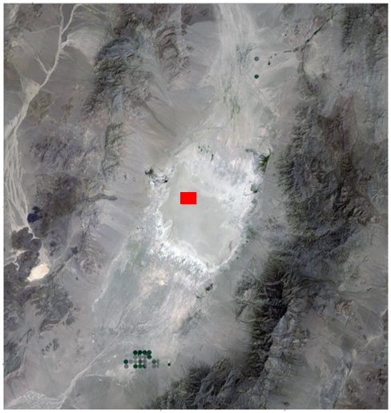
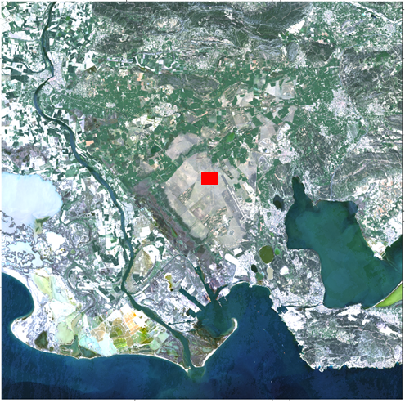
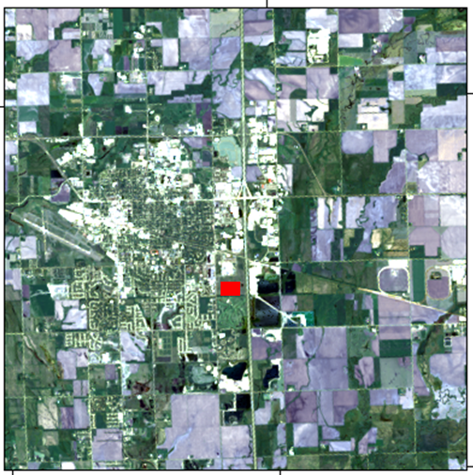
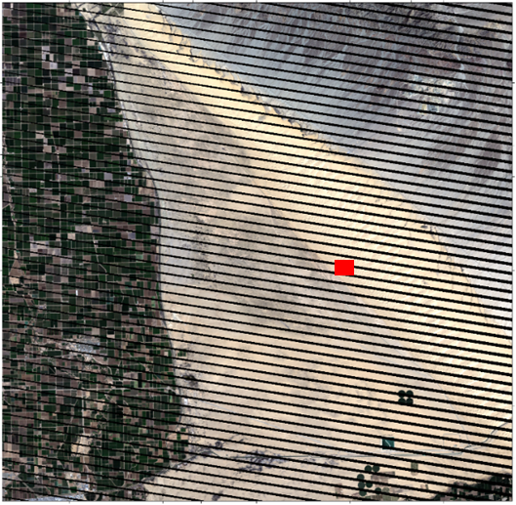
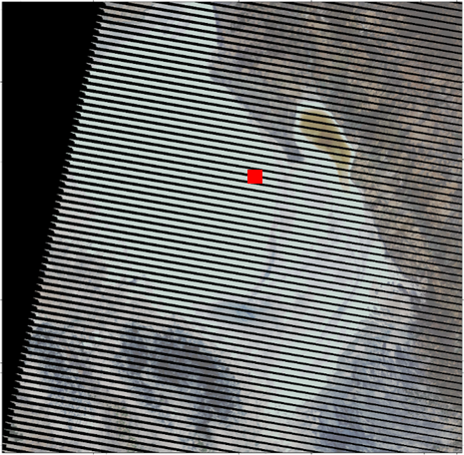
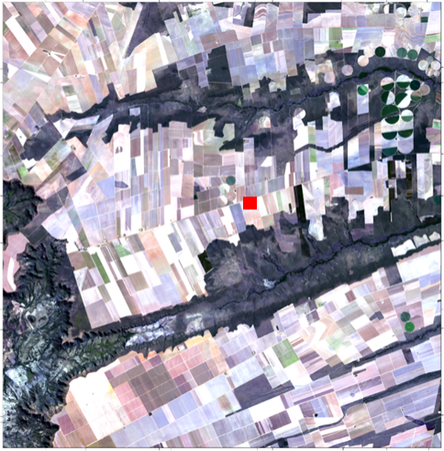
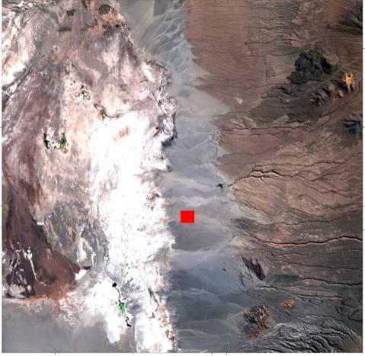
L2 Product Validation (Existing)
Surface Reflectance
  University of Arizona
    Railroad Valley, Ivanpah, Algodones
  South Dakota State University
    Brookings, Algodones, Tuz Golu, Brazil, Chile, PICS
Surface Temperature
  JPL
    Lake Tahoe, Salton Sea
  NOAA Buoys
  SURFRAD, CRN, LSA SAF,
  JPL, Fluxnet, GCU
Railroad Valley
La Crau
Brookings
Algodones Dunes
Tuz Golu
Brazil
Chile

Slide 28
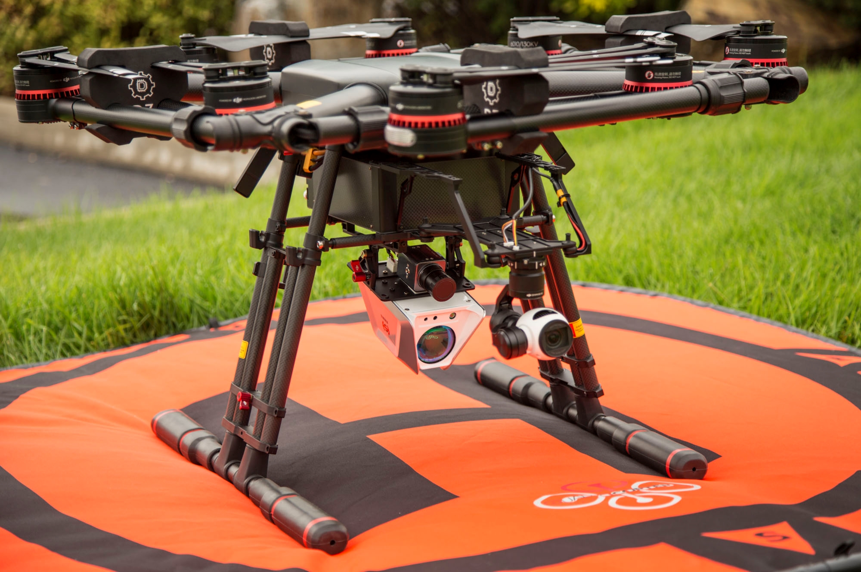
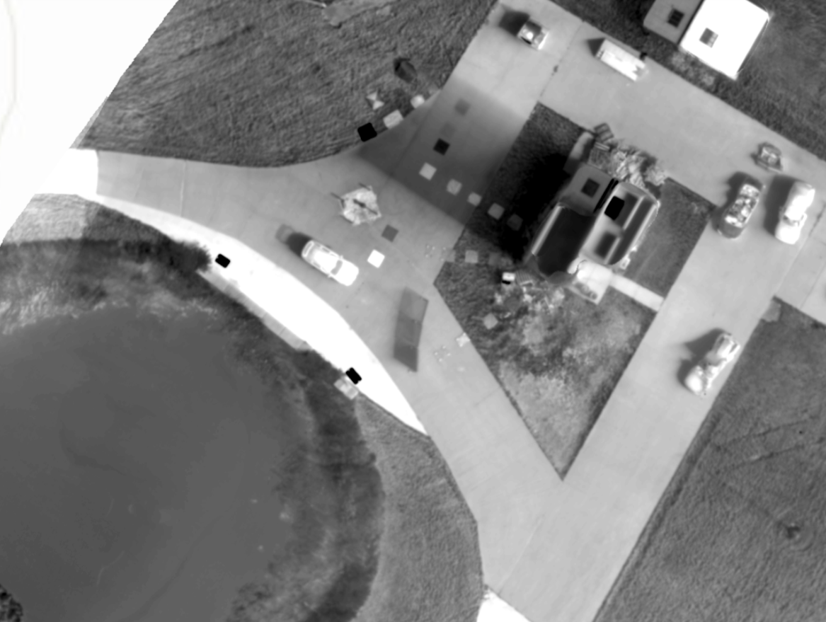


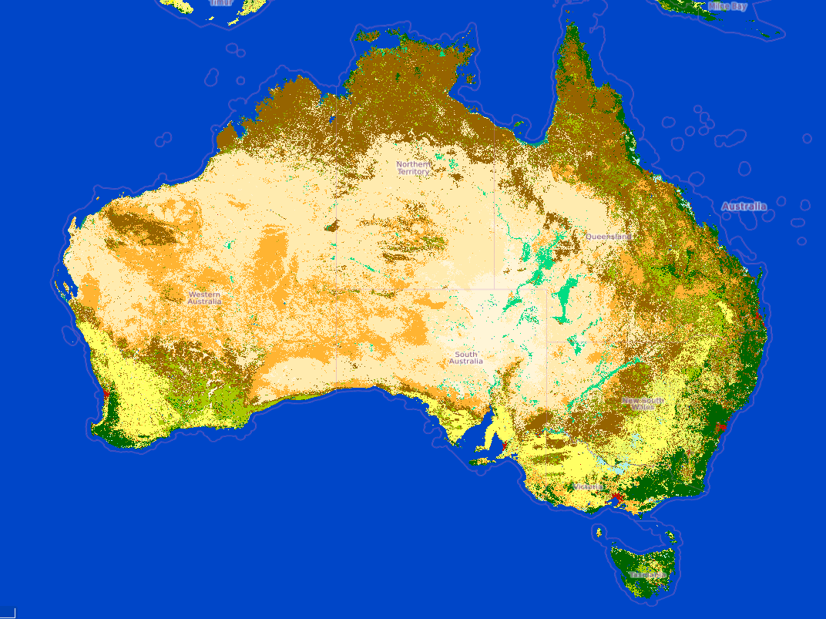
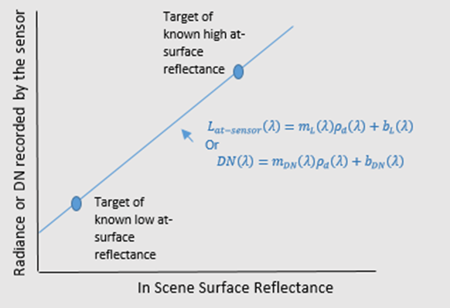
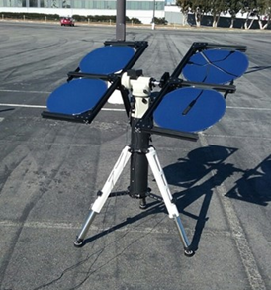
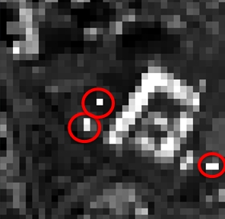
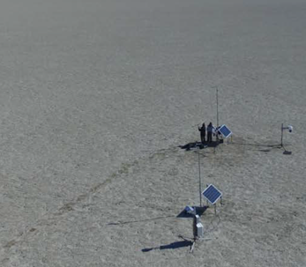



L2 Validation Support - Academia and Partners
Rochester Institute of Technology
  Surface Temperature Thermopiles
  Pole Mounted
  UAS Deployment
University of Arizona
  Surface Reflectance
  Radiometers
  RadCalNet
  Transfer Radiometers
South Dakota State University
  Surface Reflectance Mirror Method
  Empirical Line Method
Geoscience Australia
  Multiple Validation Sites
  Landat-8 and Sentinel-2 validation
Initial Activities
  GSA/CSIRO field campaigns
  ESA Hypernets
  USGS/NASA - initial discussions
GSA Field Campaigns

Slide 29
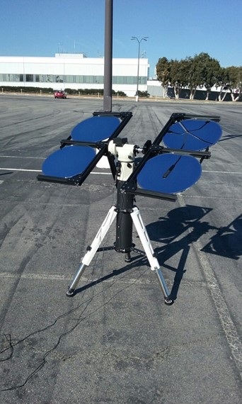
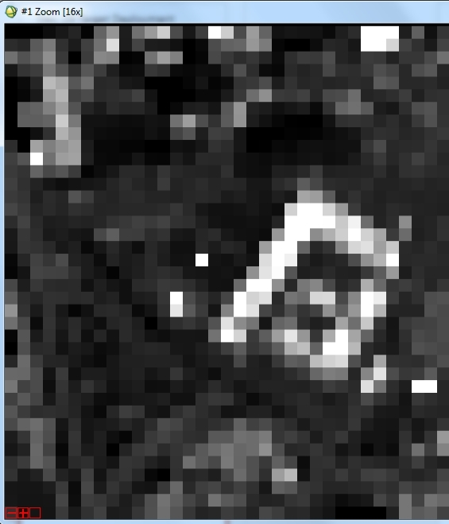
L2 Product Validation (Mirror Based Approach)

Slide 30
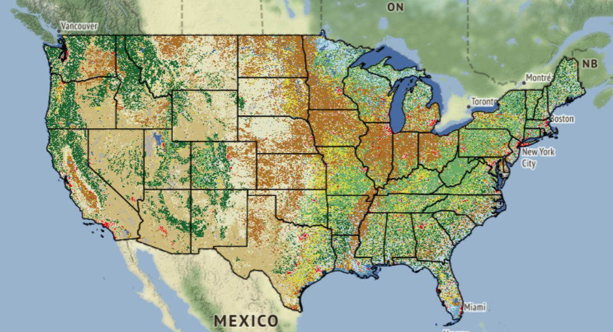
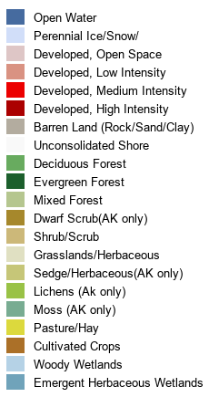
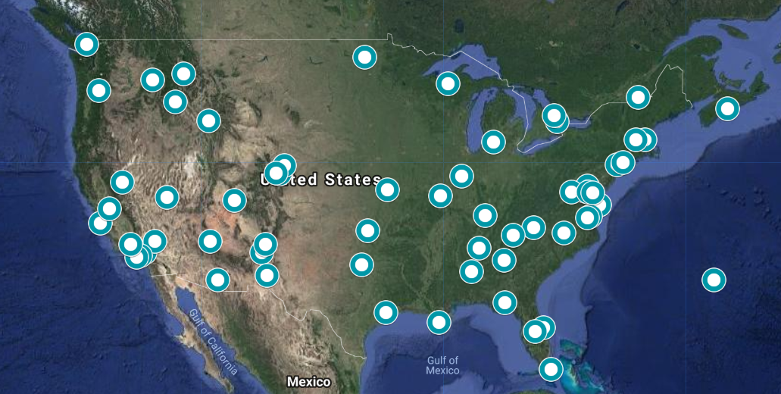
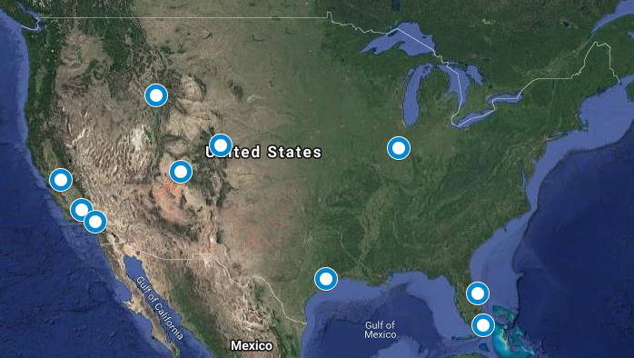
AERONET
L2 Product Validation (EROS Research Areas)
Use of USGS Landcover Database
Op
t
ima
l

Slide 31
Surface Reflectance Validation Thoughts
Develop instrumentation to appropriately monitor sites
  Field campaigns
  Automated instrumentation
  UAV
Partner with other organizations producing surface reflectance data sets
  Ensure traceability of measurements
  Measurement uncertainty required
Use stable PICS to monitor long term trends
  Use well known Sahara sites
  Consider using globally distributed sites
    Range of surface reflectance values
    Range of atmospheric parameters
  Understand uncertainties

Slide 32
Surface Reflectance Validation Thoughts (2)
An approach based on Landsat Surface Reflectance Product Validation
  Use only sites/targets with surface reflectance directly measured
    Develop standard for acceptable surface reflectance measurement approach
    Show traceability to National Standards
    Develop uncertainty model
  Identify sites that span a broad range of atmospheric types
    Tropical Atmosphere
    Mid latitude Summer
    Mid latitude Winter
    Subarctic Summer
    Subarctic Winter
    Standard US Atmosphere
  Identify sites that span a broad range of land (water?) cover types
    Agriculture—crops/hay
    Forest—deciduous/coniferous
    Developed (cities)
    Shrubland
    Grassland
    Wetland
    Coastal
    Open Water
    Snow/Ice
Notes:
Cody—here’s an alternative to the Range of Atmospheric types Bullet:
Aerosols – type and quantity
Water Vapor -- quantity
Ozone – quantity
Temperature/Pressure/Altitude

Slide 33

Infrastructure
ASD Field Spec 4 Dual Mount
  Rapidly changing atmospheric conditions, Illumination conditions that are inconsistent with the associated reference measurement, and limited to weather conditions of test
2 - Trimble GPS base stations, Rovers, and Total Stations
Terrestrial Lidar Scanners
Traps and panels
4 - UAS systems – DJI Matrice 600Pro
  2- MicaSense Altums
  2 –MicaSense RedEdge MX
  1 – integrated Hyperspectral Headwall visible through 2500 microns, Velodyne Lidar, high precision GPS/IMU
Smaller Parrots UAS with video, and DJI Solos with Ricoh mapping cameras
Portable sun photometers
Notes:
to: Intercalibrate wavelength scale using the wavelength intercalibration reference puck, and Intercalibrate the reflectance scale using the white reference panel

Slide 34


Deliverables
Guide to Digital Imagery Spatial Resolution
  https://www.usgs.gov/media/files/guide-digital-imagery-spatial-resolution
  MTF tool and simulations coming
2019 Joint Agency Commercial Imagery Evaluation— Land Remote Sensing Satellite Compendium
  https://pubs.er.usgs.gov/publication/cir1455
Interoperability white paper
Best Practices for JACIE
Total Propagated Uncertainty due to Atmospheric Correction of Landsat 8 OLI Imagery (Calcon)
L2 SR comparison and effects of Atmospheric correction (Planet workshop and JACIE)
TPU tool and simulator developed for both lidar and satellite imagery

Slide 35

USGS hosted Planet STAC/ Interoperability workshop
Ignacio’s on-line preliminary agenda (https://www.ard.zone/ard19) is not yet very specific, but these are the current areas that we plan to cover in our CEOS presentation:
CEOS Engagement Areas:
• Definitions
• CARD4L PFSs
• CARD4L Self-Assessment Process
• CARD4L WGCV Peer Review Process
• Preview Broader CEOS ARD Strategy – SIT Chair Team (CSIRO/GA – Adam Lewis attending)
• Pilot Examples – ESA, USGS, GEO/LEO
• Add a couple of slides that include images and measurements
• Add a slide at the end promoting GEO and the GEO ARD side meeting
And here are the USGS-specific areas:
USGS Areas:
• ARD / Interoperability / Standards – All / Renee
• Interoperability Uncertainty – Jon
• COG / STAC – Kristi / Renee
• ODC / GA Collaboration – Tony
• LPDAAC / AppEEARS – Aaron
https://docs.google.com/forms/d/e/1FAIpQLSdEGozIBcIt7-5PAqjTD1D6qcJEEzD2oalRgXlkzaubTVQwbQ/viewform

Slide 36
CEOS L2 SR Product Validation Plan
Where is the CEOS home for this: LPV or IVOS?
How do we begin? One possible approach…
  Identify interested organizations
  Define acceptable approaches
  Develop standard/best practices
  Mechanism for identifying and accepting high quality data
  Develop mechanism for sharing data
  Develop sustainability plan
What does CARD4L provide in terms of harmonization and interoperable data use in the future?
  Need for common terminology and associated metadata
  Geometric, spatial, spectral, and radiometric measurands and uncertainty documentation
  Common test sites and comparison methods
    RadCalNet good example – however, impact of vegetation, biomass, BRDF,….

Slide 37
Summary
Opportunities with ECCOE
Committed to Level 2 Surface Reflectance validation
Many partnership opportunities – always open to working with others
USGS continued support for IVOS, LPV, and DEM, as well as WGCV specific tasks

Slide 38
Thank You!

Slide 39
Back up Slides

Slide 40
ECCOE High Level Scope
Maintain Landsat and Requirements Capabilities and Analysis for Earth Observation (RCA-EO)
Support Landsat and Land Imaging Development
  Landsat 9
  Instrument Development and support for cal/val/characterization/testing
  Maintain and develop cal / val / interoperability tools
Perform NLIP New Missions Assessment
  Develop and utilize RCA prioritized list of new missions and standardized measurements
  Perform prioritization analysis and characterization, mission and usability assessments (JACIE)
  Field instrumentation and associated cal/val equipment
Operationalize L2 Product Validation and Sentinel 2 Interoperability
  Research and establish EROS validation plan/team in conjunction with University partners
  Understand and document interoperability parameters of land imagery sensors
Engage/lead global Cal/Val community
  Document and support common sensor Cal/Val characterization baseline (pre- and post-Launch)
  Enhanced Science and CEOS interfaces
  Electronic Interface and publication

Slide 41
ARD
US ARD (currently offered)
  Surface Reflectance and Temperature
  Albers Equal Area (AEA) Conic map projection
  Modified Web-Enabled Landsat Data (WELD) tiling scheme
Collection 2
  Surface Reflectance and Temperature
  Universal Transverse Mercator / Polar Stereographic map projection
  Scene Based
CEOS ARD for Land Compliance

Slide 42
Integrated Approach
Surface Reflectance
  ASDs with reflectance panels and UofA radiometers (SI Traceability)
  Mirror based empirical line and hyperspectral UAS (Expanded Area)
Surface Temperature
  Pole mounted thermopile sensors (SI Traceability)
  UAS deployed thermopile sensors (Expanded Area)
Operationalization
  Working with external entities to establish best practices and standards for Level-2 validation collections
  Best practices to include field collects, stationary/continuous collects, data archiving and access, etc.

Slide 43
L2 Discussion
Level 2 algorithms have a strong peer-reviewed theoretical basis
Publication history of L2 validation has highlighted the lack of direct in-situ surface reflectance and temperature measurements
Three university partners have extensive experience in surface reflectance and temperature measurements
Development of new/expanded methods for measurements is already underway
New methods will greatly increase the geographical and temporal extent of in-situ measurements and will provide SI traceability to USGS Level-2 products.
USGS will/is working with external entities to establish best practices and standards for Level-2 validation collections.

