Slide 1

JAXA Agency Report
Committee on Earth Observation Satellites
Akihiko KUZE
(Earth Observation Research Center, Japan Aerospace Exploration Agency)
CEOS WGCV
CSIRO Perth
July 17, 2019

Slide 2



JAXA’s Earth Observation Schedule
Japanese Fiscal Year
2016 | 2017 | 2018 | 2019 | 2020 | 2021 | 2022 | 2023 | 2024 | 2025 | 2026 | 2027 | 2028 | 2029 | 2030
National Security
Disaster
ALOS-2/PALSAR-2
ALOS-4 (SAR)
Land Monitoring
ALOS-4 Follow-on
ALOS-3
(Optical)
ALOS-3 Follow-on
Climate
Change
GCOM-W/AMSR-2
AMSR-2’s Successor Sensor onboard GOSAT-3
Water Cycle
Precipitation
GPM/DPR
Vegetation,
Aerosol
GCOM-C/SGLI
EarthCARE/CPR
Clouds
GOSAT/FTS
Greenhouse
Gases
GOSAT-2/FTS-2
GOSAT-3 (tentative name)

Slide 3
Essential Climate Variables measured
by GCOM-C & W, GPM/DPR, GOSAT
Climate Change
Measured by GCOM-C
Measured by GCOM-W
Measured by GPM/DPR
Measured by GOSAT
Atmospheric
Terrestrial
Oceanic
Surface | Upper-air | Composition
Air temperature | Temperature | Carbon dioxide
Wind speed & direction | Wind speed & direction | Methane
Water vapour | Water vapour | & other long-lived GHGs *
Pressure | Cloud properties | Ozone & Aerosol
Precipitation | Earth radiation budget (including solar irradiance) | supported by their precursors **
Surface radiation budget
Surface | Sub-surface
Sea-surface temperature | Temperature
Sea-surface salinity | Salinity
Sea level | Current
Sea state | Nutrients
Sea ice
Surface current
Ocean colour
CO2 partial pressure | CO2 partial pressure
Ocean acidity | Ocean acidity
Phytoplankton
 | Oxygen
 | Tracers
River discharge
Water use
Groundwater
Lakes
Snow cover
Glaciers and ice caps
Ice sheets
Permafrost
Albedo
Land cover (including vegetation type
Fraction of absorbed photosynthetically active radiation (FAPR)
Leaf area index (LAI)
Above-ground biomass
Soil carbon
Fire disturbance
Soil moisture
* including N2O, CFCs, HCFCs, SF6, PFCs
** in particular NO2, SO2, HCHO, CO
Total Essential Climate Variables (ECVs) (ECVs largely dependent on satellite observations identified by CEOS and GCOS are shown in bold.) | 50
ECVs measured by GCOM-C&W, GPM/DPR and GOSAT | 23
3

Slide 4
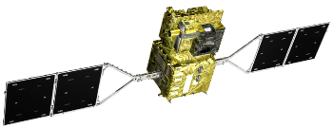
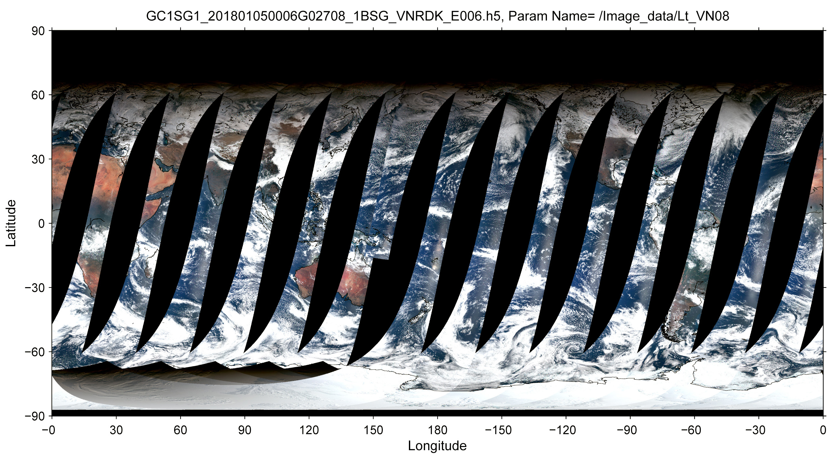
GCOM-C/SGLI
Global Change Observation Mission – Climate (GCOM-C),
Second-generation Global Imager (SGLI)
InfraRed Scanner (IRS)
GCOM-C SGLI characteristics
Launch Date | 23 Dec. 2017
Weight | 2,000kg
Orbit | Sun-synchronous (descending local time: 10:30), Altitude: 798km, Inclination: 98.6deg
Mission Life | 5 years (3 satellites; total 13 years)
Scan | Push-broom electric scan (VNR) Wisk-broom mechanical scan (IRS)
Scan width | 1150km cross track (VNR: NP & POL) 1400km cross track (IRS: SWIR & TIR)
Spatial resolution | 250m (land and coast), 500m (TIR), 1km
Polarization | 3 polarization angles for POL
Along track tilt | Nadir for VN, SW and TIR, & +/-45 deg for POL
Visible and Near-infrared Radiometer (VNR)
All standard products (Level-1, 2, and 3) have been open to the public via JAXA data portal, “G-Portal” (GUI data search and direct FTP are available; https://gportal.jaxa.jp/gpr/)
An example of SGLI/VNR daily coverage (5 Jan2018)
4

Slide 5
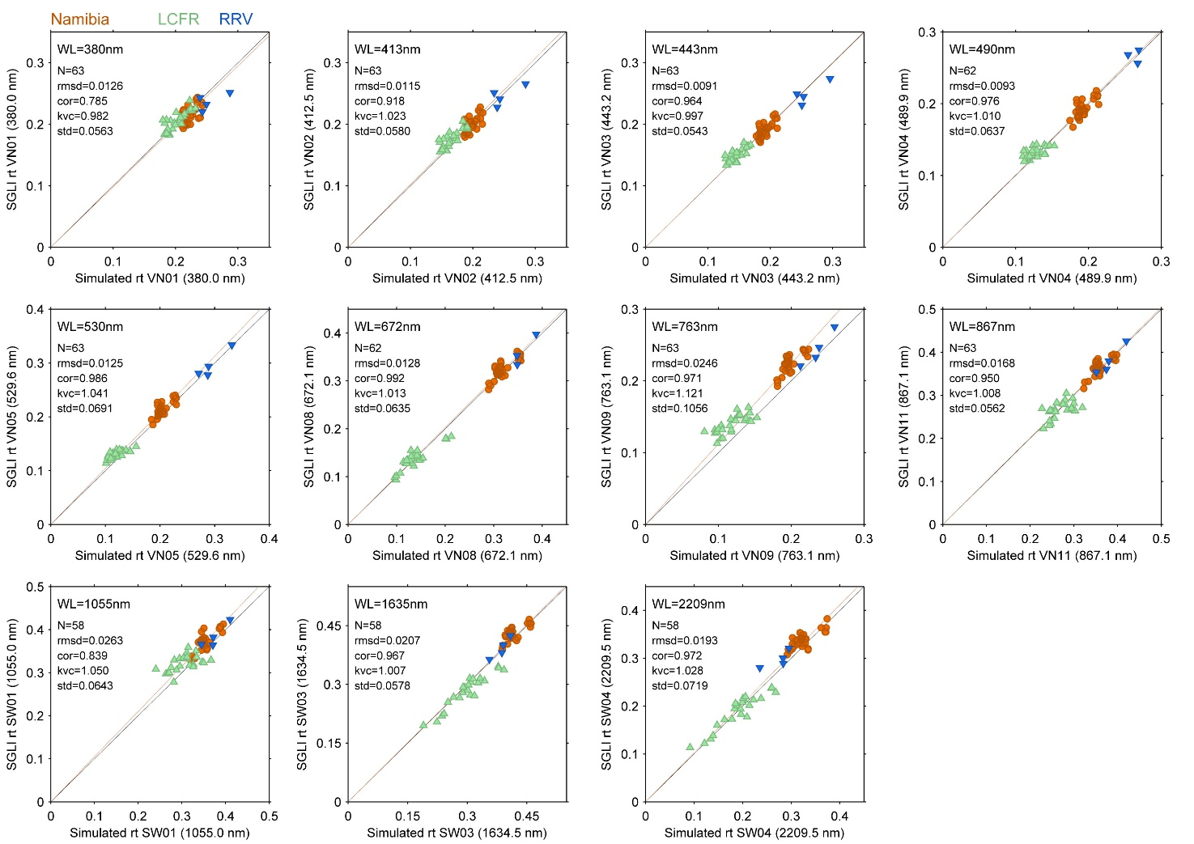
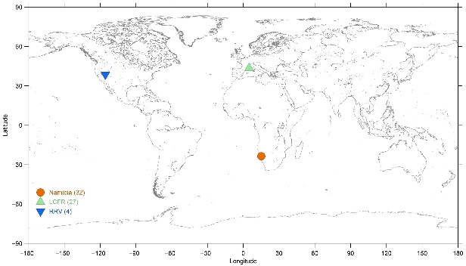
SGLI vical by RadCalNet
(Gobabeb, LCFR, RRV)
SGLI TOA reflectance
comparison
Simulated TOA reflectance
Radiative transfer
(Pstar4)
In-situ
AOT, α
RadCalNet
In-situ surface reflectance
Wavelength nm | 380 | 412 | 443 | 490 | 530 | 670 | 763 | 865 | 1050 | 1630 | 2200
RadCalNet(in)+Pstar4 | 0.982 | 1.023 | 0.997 | 1.010 | 1.041 | 1.000 | NA | 1.008 | 1.050 | 1.007 | 1.028
Samples from Jan 2018 to May 2019
Gobabeb, RRV, LCFR* (* can be influenced by the small structures)
5

Slide 6
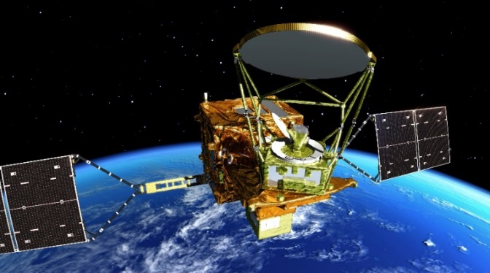
Global Change Observation Mission - Water "SHIZUKU" (GCOM-W)
Successor of Aqua/AMSR-E (launched in May 2002), providing continuous data for climate studies and operational applications
Joining A-train constellation and also GPM constellation
Carrying AMSR2, a multi-polarization and multi-frequency microwave imager
Observing various water-related ECVs over atmosphere, land, ocean and cryosphere in high spatial resolution
Improving on-board calibration target has resulted reduction of annual TB variation due to calibration and improvement of TB stability
Achieved designed mission life (5-year) on May 18, 2017, and continues observation.
AMSR2 follow-on (AMSR3) has been in Pre-project phase (Phase A) since Sep. 2018.
AMSR2 Products
STD | Brightness Temperature
 | Total Precipitable Water (over Ocean)
 | Total Cloud Liquid Water Content
 | Precipitation
 | Sea Surface Temperature
 | Sea Surface Wind Speed
 | Sea Ice Concentration
 | Snow Depth
 | Soil Moisture Content
RES | All-weather Sea Surface Wind Speed
 | 10-GHz Sea Surface Temperature
 | Land Surface Temperature
 | Thin Ice Detection
 | Total Precipitable Water over Land
6

Slide 7
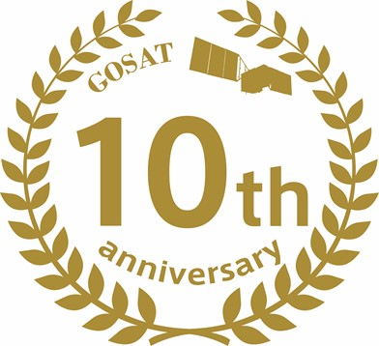
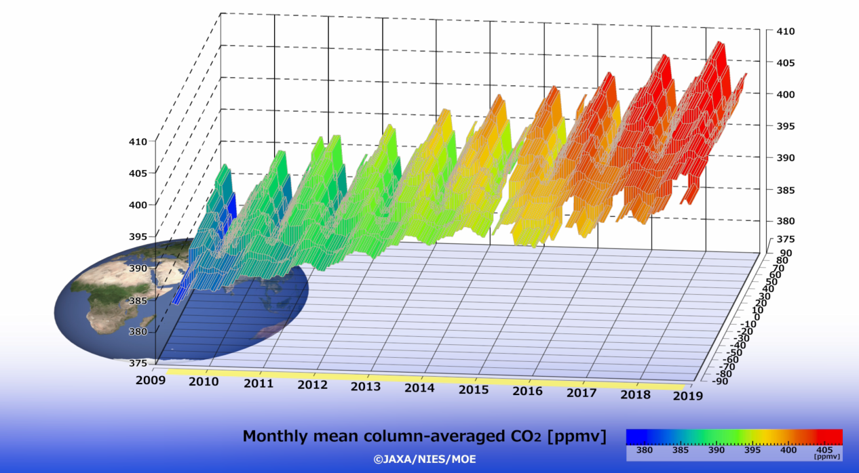
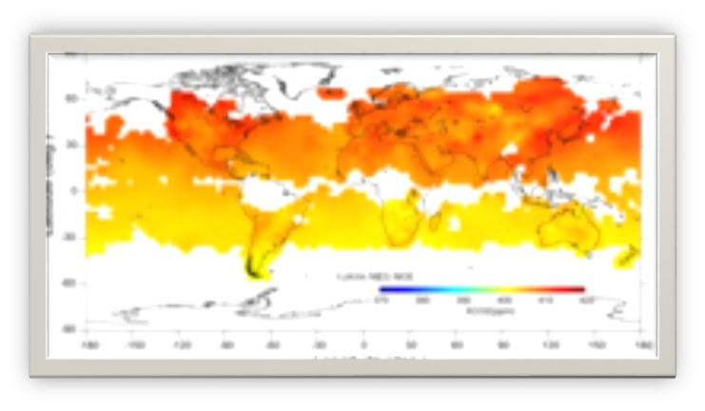
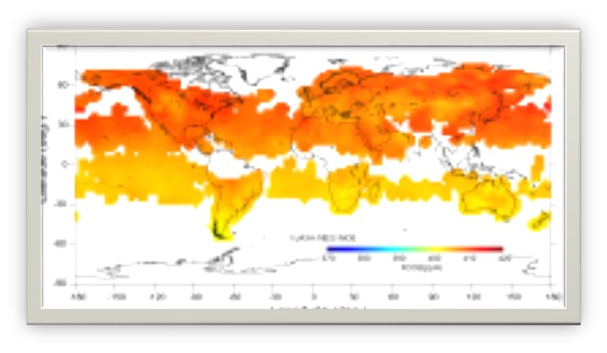
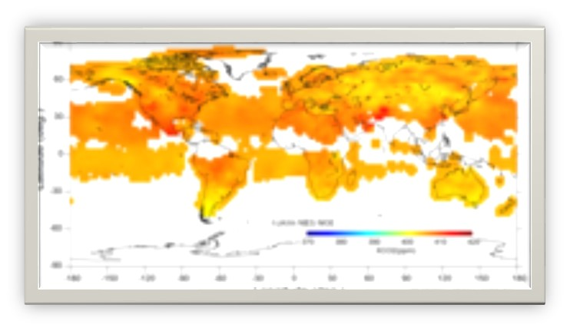
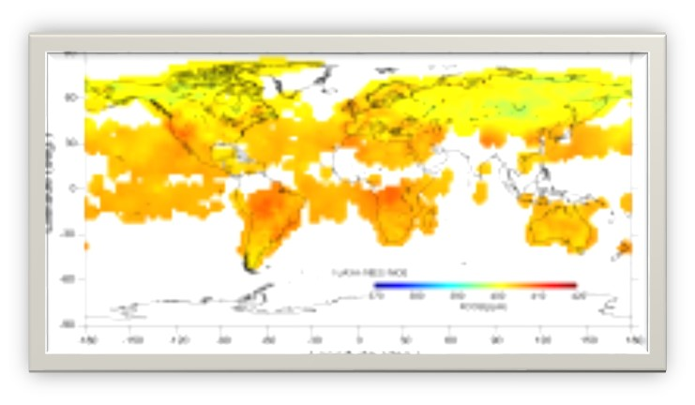
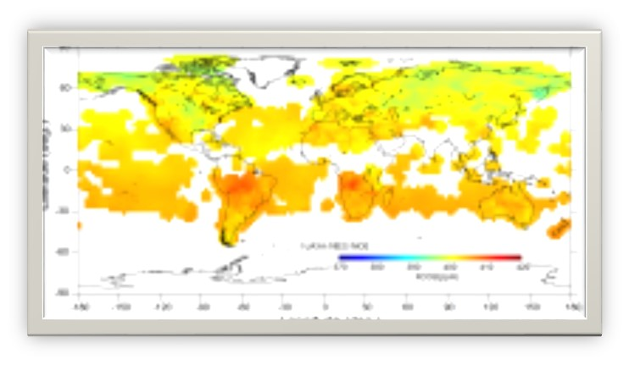
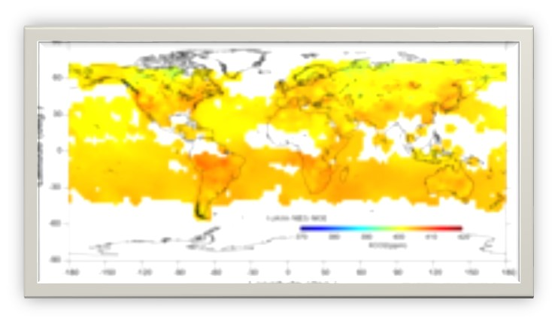
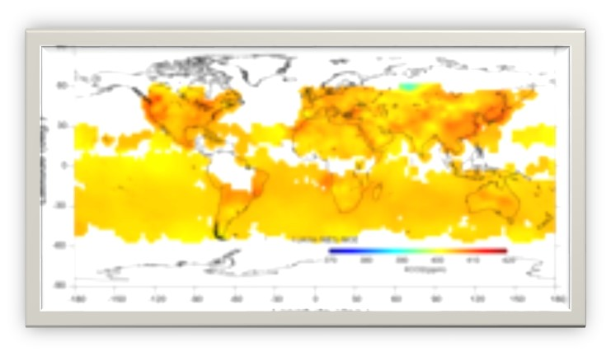
Decade-long Observation by GOSAT
10th anniversary on Jan. 23, 2018
Global CO₂ density
https://data2.gosat.nies.go.jp/gallery/fts_l3_swir_co2_gallery_en.html
Toward 20-year operation
enough fuel for another decade operation
no significant degradation in classic four NiCd batteries.
Radiance degradation and TIR non-linearity correction tables for 20-year operation are ready in new Level V220. (assuming very slow degradation in 0.76 µm and no degradation in 1.6 and 2.0 µm.
7

Slide 8
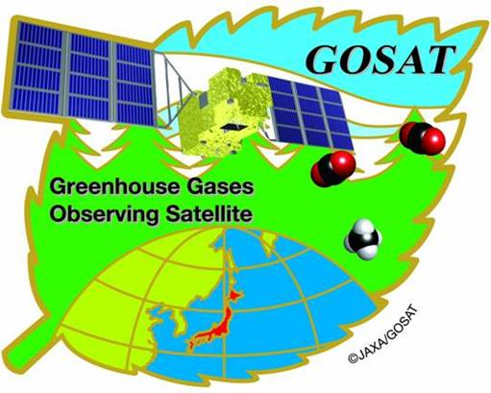
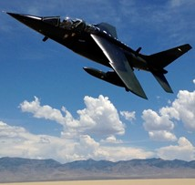
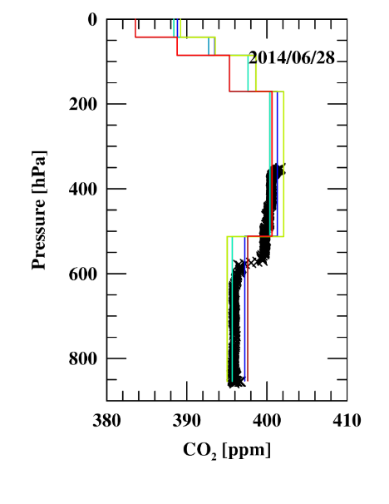


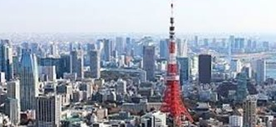
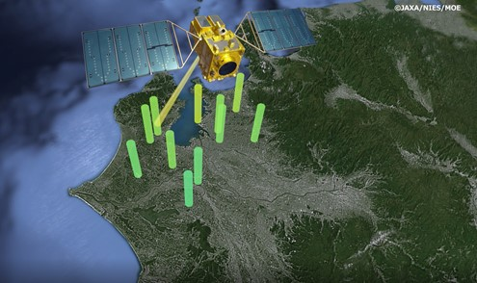
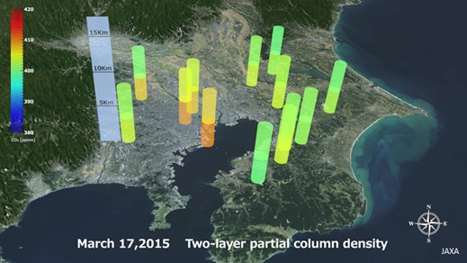
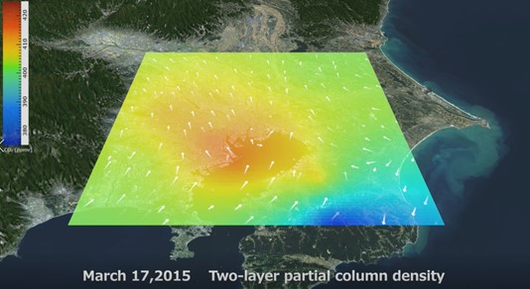
GOSAT (2009-) new products
Partial column density using both SWIR and TIR
GOSAT measures both solar reflected light from the Earth’s surface (SWIR) and thermal emission from the Earth’s atmosphere (TIR) providing CO₂ partial-column densities of UT and LT.
Upper Troposphere (UT)
http://www.eorc.jaxa.jp/GOSAT/CO2_moitor/index.html
AJAXA vertical profile vs. 4 GOSAT retrieval at RRV, NV
Lower Troposphere (LT)
Coutesy of R. Kawa
Needs more validation data of vertical CO₂ and CH₄
Local Emission
8

Slide 9
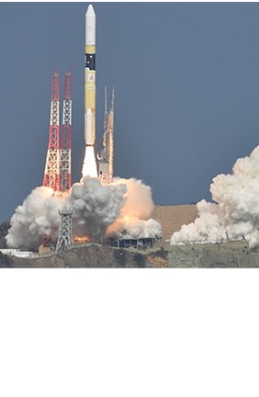
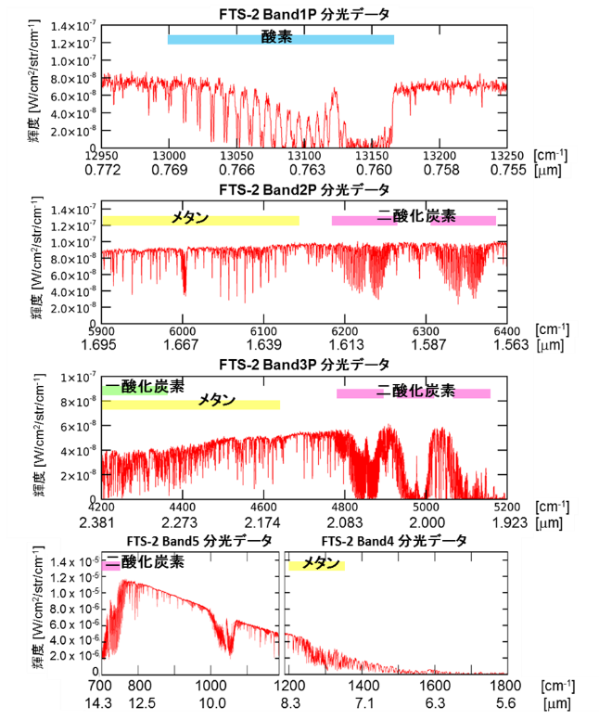
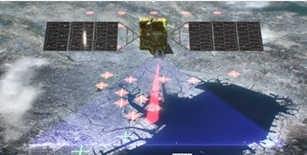
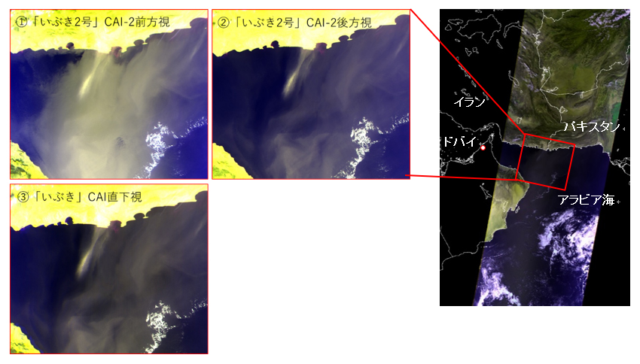
Greenhouse gases Observing SATellite-2
“IBUKI-2” (GOSAT-2) (2018-)
GOSA-2 launch on Oct. 29, 2018
TANSO-FTS-2
Adding Carbon Monoxide (CO) measurement to identify CO₂ enhancement by combustion
Wider pointing angles
Fully customized observation pattern
Cloud avoiding pointing
TANSO-FTS-2 first spectra Dec. 13, 2018 Nagoya
O₂
TANSO-CAI-2 (1) 10 bands
(2) Multi-viewing capability improved aerosol detection
CH₄
CO₂
GOSAT-2 CAI-2-forward
GOSAT-2 CAI-2-Backward
CO
CO₂
CH₄
Iran
Dubai
Pakistan
GOSAT CAI Nadir
TANSO-CAI-2 first light
(Nov. 5)
Arabian Sea
CO₂
CH₄
9
Dec. 13, Nagoya

Slide 10
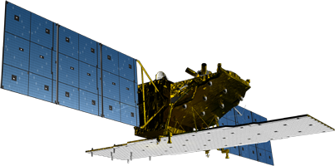
ALOS-2 “Daichi-2”
Mission sensor | PALSAR-2 (Phased Array type L-band Synthetic Aperture Radar 2)
Launch | May 24, 2014 H-IIA launch vehicle FY24
Mass | 2.1 tons
Lifetime | 5 years (target: 7 years)
Orbit | Sun-synchronous, 628 km altitude, 14 days revisit, Orbit control: ≦ +/- 500 m
Local sun time | 12:00±15 min (descending) 24:00±15 min (ascending)
Mission data transmission | X-band: 800 Mbps (16 QAM), 200/400 Mbps (QPSK)
Mission objectives:
Disaster monitoring (Earthquake, Volcano, Landslide, Flooding, …)
Environmental monitoring (Forest, Ice sheet, …)
Agriculture, natural resources, and ocean
Technology development
Y
X
Z
Solar Arrays
PALSAR-2
(Phased Array type L-band Synthetic Aperture Radar 2)
PALSAR-2 antenna
X-band downlink antenna
The compact infrared camera (CIRC) and SPAISE2 for detecting ships are carried as a technology demonstration payload.
10

Slide 11

ALOS-2 Mission Operation
JFY2014 | 2015 | 2016 | 2017 | 2018 | 2019 | 2020 | 2021
ALOS-2
(L-SAR)
May 24, 2014
Launch
Initial C/O
Nominal Operation Review Meeting
Initial Cal-Val
Product release
Mission operation (5 years)
Post-mission operation
ALOS-3
(Optical)
Development
ALOS-4
(L-SAR)
Development
11

Slide 12
PALSAR-2 Calibration Summary
On-board internal calibration is performed every 3 months.
Product quality of major observation modes is evaluating regularly using SAR data over calibration sites.
The standard product processing software was updated on June 2018 (radiometric calibration) and on Nov. 2018 (correction of range offset).
> PALSAR-2 keeps good conditions and performances.
Calibration summary as of August 2018.
Items | Results
Geometry (RMSE) | [Stripmap and Spotlight] 6.38 m (L1.1) / 6.73 m (L2.1) [ScanSAR] 60.77 m (L1.1) / 29.33 m (L2.1)
Radiometry | RCS accuracy (1σ) | 0.57 dB (corner reflectors) 0.41 dB (Amazonian forests)
Polarimetry | VV-HH amplitude ratio | 1.000 (σ=0.012)
 | VV-HH phase difference | 0.137 deg (σ=4.42)
 | Cross talk | [HV/HH] -41.90 dB (σ=5.264) [VH/VV] -41.56 dB (σ=4.953)
12

Slide 13
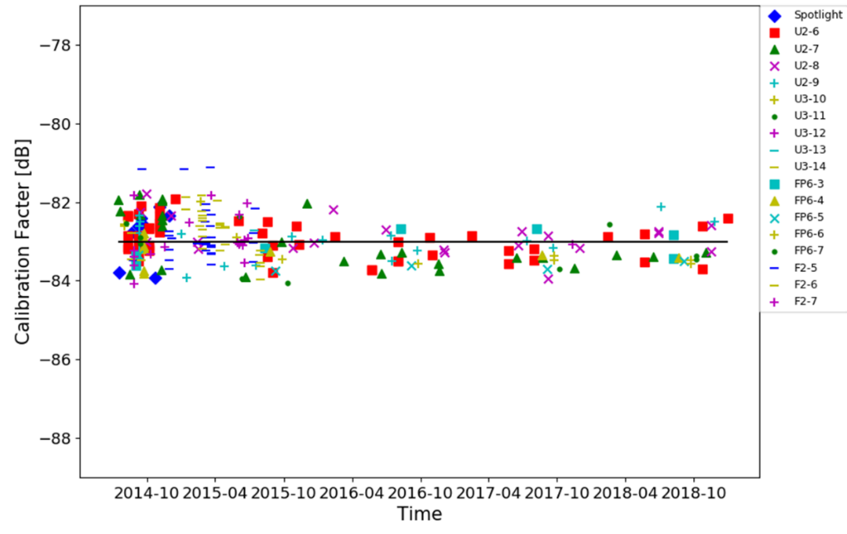
PALSAR-2 Radiometric Calibration
Digital number of PALSAR-2 product can be converted to sigma-zero value by using the following equation.
The Calibration Factor (CF) in the equation is evaluated by measuring CRs.
DN: digital number
CF = -83 dB
A = 32 dB
Corner Cube reflector in Gotenba-city
Time trend of radiometric accuracy.
Ave.= -82.96 dB, RMSE = 0.57 dB
No. = 248 CRs
13
13

Slide 14
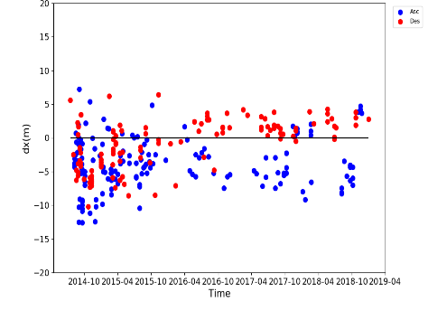
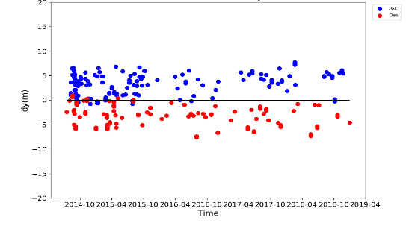
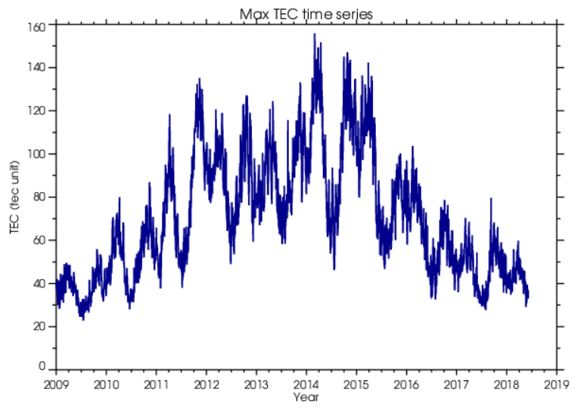
PALSAR-2 Geometric Calibration
Geometric accuracy is evaluated at the point targets i.e. CRs, ARCs, GCs.
(b) Geometric error
in NS direction
● Asc.
● Desc.
Geometric error
in EW direction.
Time trend of geometric accuracy (SM mode).
Mode | Beam | dx (EW direction) |  |  | dy (NS direction) |  |  | No.
 |  | Ave. (m) | STDEV (m) | RMSE (m) | Ave. (m) | STDEV (m) | RMSE (m)
Spotlight | - | -5.423 | 4.278 | 7.140 | 2.540 | 2.439 | 3.622 | 10
SM 3m | U2-6～U3-14 | -0.546 | 3.636 | 3.677 | -0.926 | 4.053 | 4.159 | 141
SM 6m | FP6-3～7 | -4.310 | 3.495 | 5.569 | 3.667 | 1.743 | 4.080 | 83
SM 10m | F2-5～7 | -4.201 | 3.151 | 5.279 | -0.995 | 2.793 | 2.968 | 60
ScanSAR | W2 | -7.977 | 7.864 | 10.987 | 4.838 | 4.757 | 6.656 | 13
PALSAR
PALSAR-2
Range difference estimated by TEC (m)
N=180
Time series in global average TEC.
Geometric error in slant range (m).
Ionosphere effects on geometric accuracy.
14

Slide 15
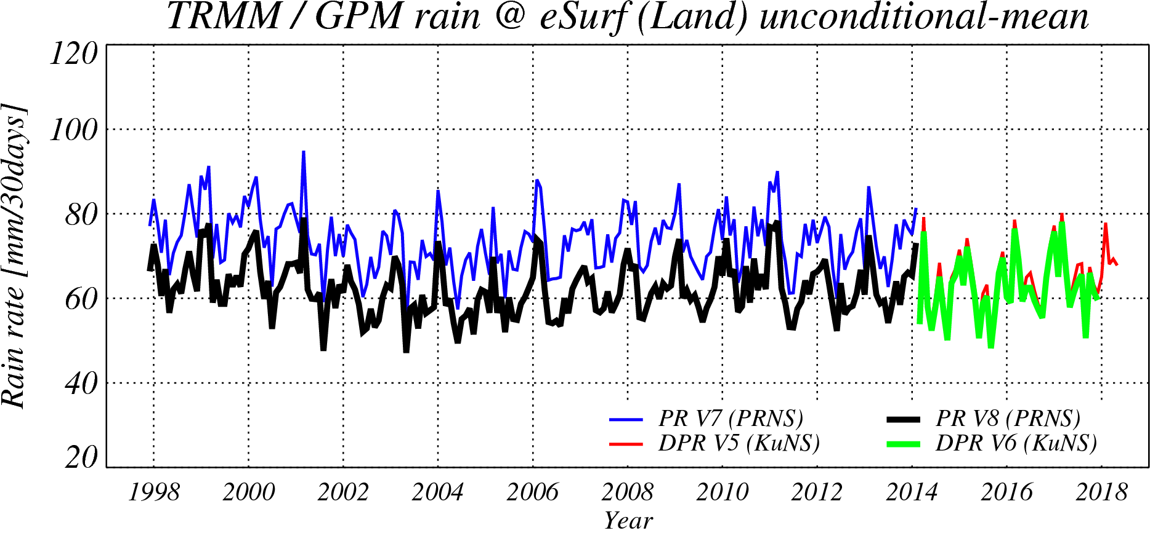
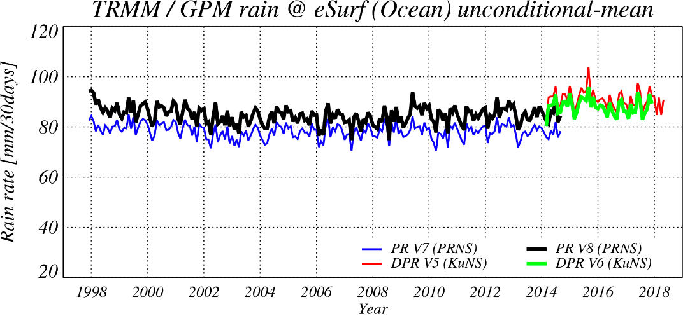
Continuity of the GPM/DPR
and the TRMM/PR
Both GPM/DPR’s calibration factors and TRMM/PR’s calibration factors were changed in 2017.
After the algorithm update in Oct. 2018, the GPM/KuPR V06 and the TRMM/PR V8(GPM TRMM V06) show better continuity on surface precipitation rate.
Over-land surface precipitation rates averaged in 35S-35N.
Over-ocean surface precipitation rates averaged in 35S-35N.
PR V7
KuPR V5
KuPR V5
PR V8
PR V7
KuPR V6
PR V8
KuPR V6
15

Slide 16
Future JAXA Earth Observation Satellites
AMSR3 additional higher frequency channels of 166 & 183 GHz for snowfall retrievals)
New products: TPW over land, high-resolution SST, all-weather sea surface wind speed & high-resolution sea ice concentration
GOSAT-3: GHG + NO₂, Global coverage and targeting anthropogenic emission sauces with high spatial resolution imaging capability
16

Slide 17
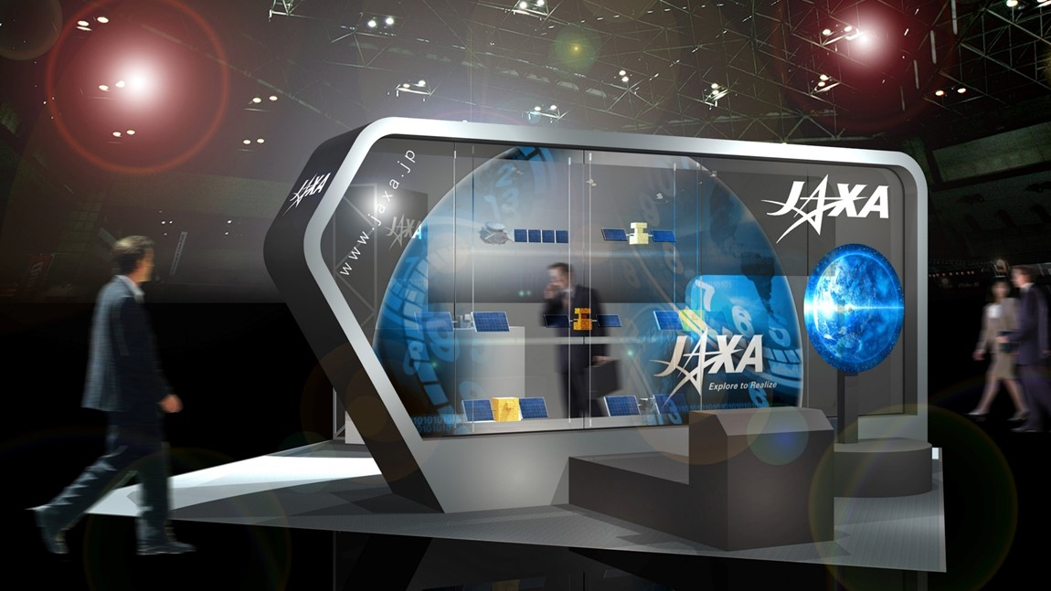
IGARSS 2019 Yokohama
See you again in 10 days!
17

